Slide 1

Exploring Employee Absenteeism

Slide 2

Introduction
Project Significance:
Addressing HR Challenges: Tackling employee absenteeism, a critical HR concern.
Data-Driven Solutions: Leveraging data science for evidence-based strategies.
Organizational Impact: Enhancing employee well-being and productivity.
Project Overview:
Multifaceted Exploration: Data analysis, visualization, and predictive modeling.
Uncovering Insights: Identifying factors influencing absenteeism patterns.
HR Strategy Enhancement: Providing a solid foundation for informed decision-making.

Slide 3

Data Preprocessing
Handling missing values: Mean for numerical, mode for categorical
One-hot encoding for categorical variables
Ensure data readiness for analysis
Feature Engineering
Creating "TotalExperience": Sum of age and length of service
Capturing complex interactions between variables
Enhanced understanding of non-linear relationships
Exploratory Data Analysis (EDA)
Positive correlation: Age and absentee hours
Gender-based differences in absenteeism rates
Divisional variations and impact of tenure/experience

Slide 4

Machine Learning Models:
- Linear Regression, Random Forest Regression, Hyperparameter Tuning
- Best-performing model: Random Forest Regressor
- Metrics: Mean Absolute Error, Mean Squared Error
Feature Importance Analysis:
- Identify key drivers of absenteeism
- Significant contributors: Age, total experience, length of service
- Insights for targeted HR interventions
Visualizations:
- Scatter plots, bar plots, and heat maps
- Visual aid for uncovering patterns and relationships
- Enhanced understanding of data trends

Slide 5
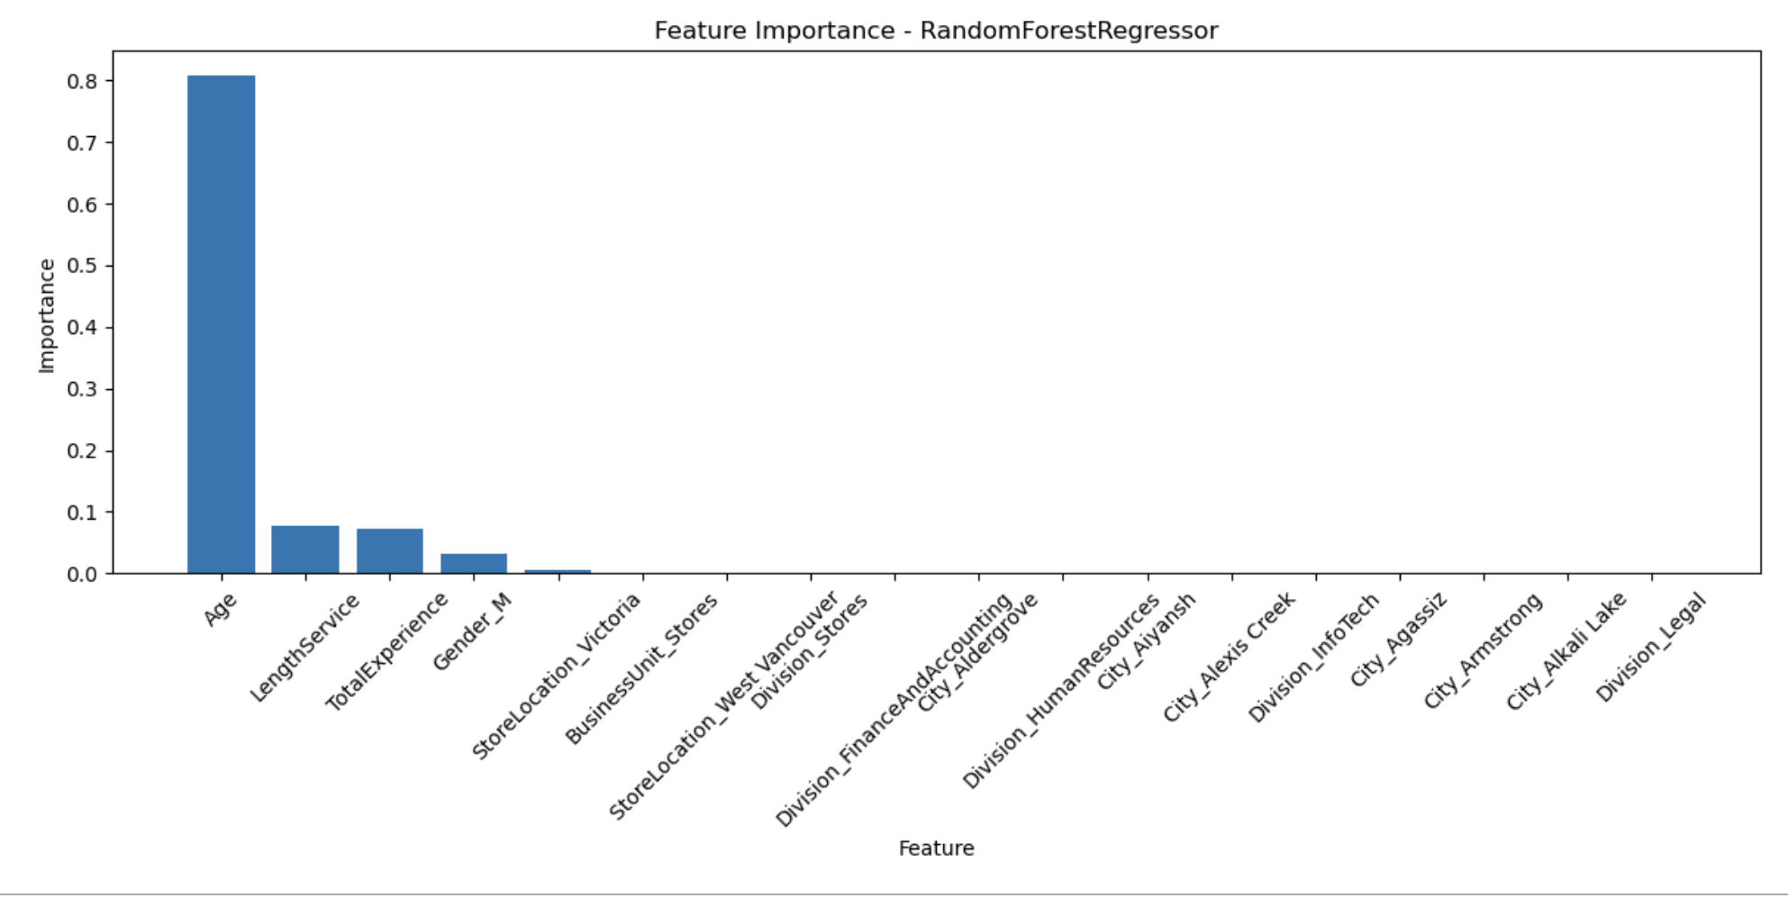
Feature Importance Analysis

Slide 6
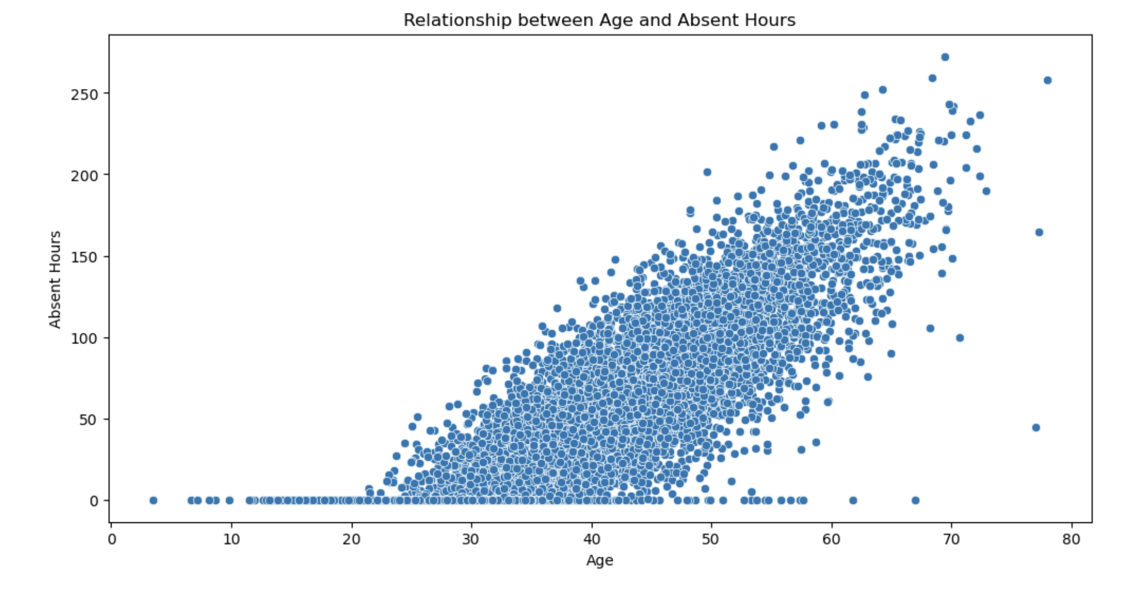
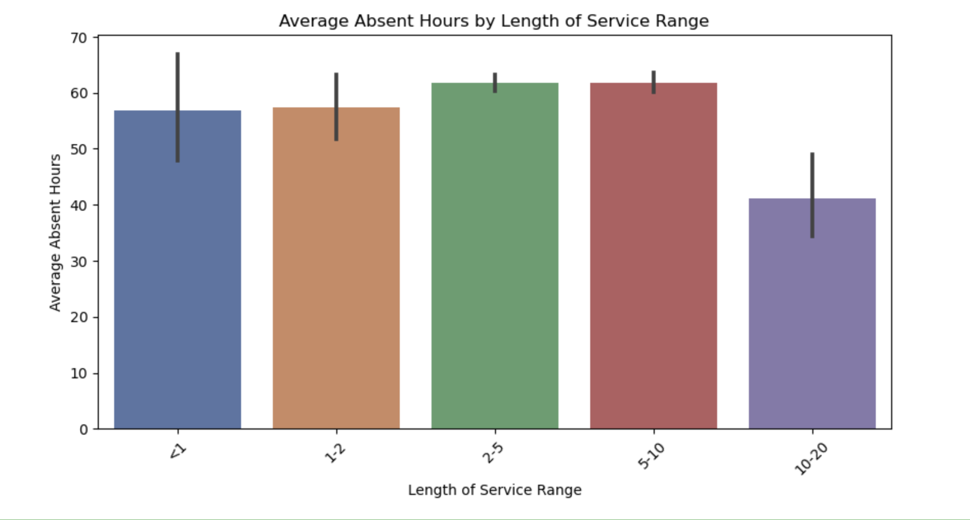
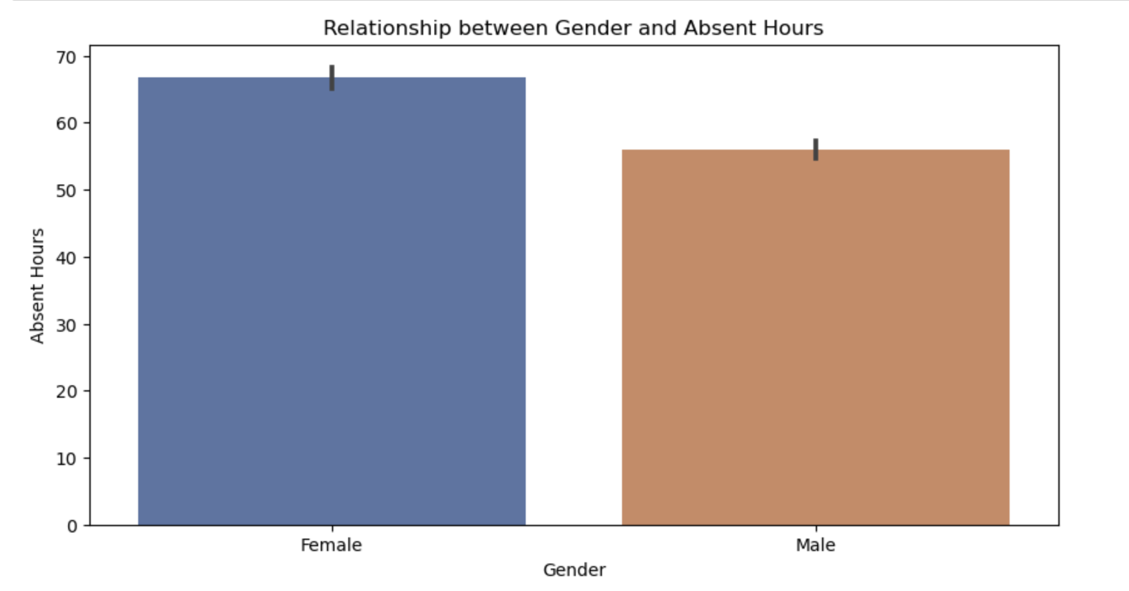
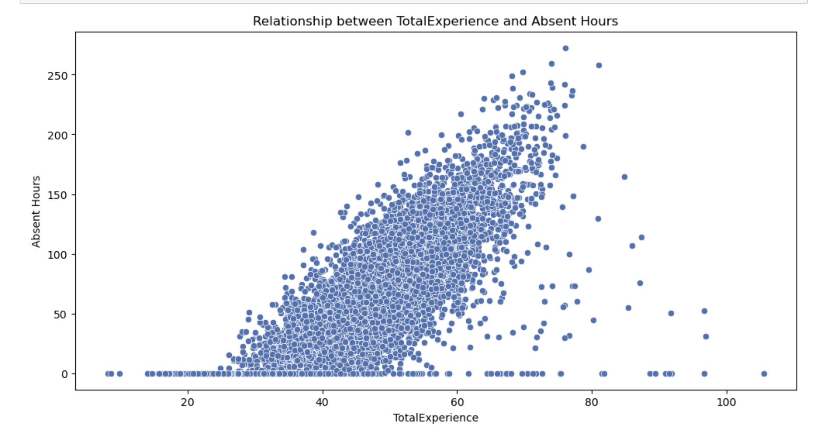

Slide 7
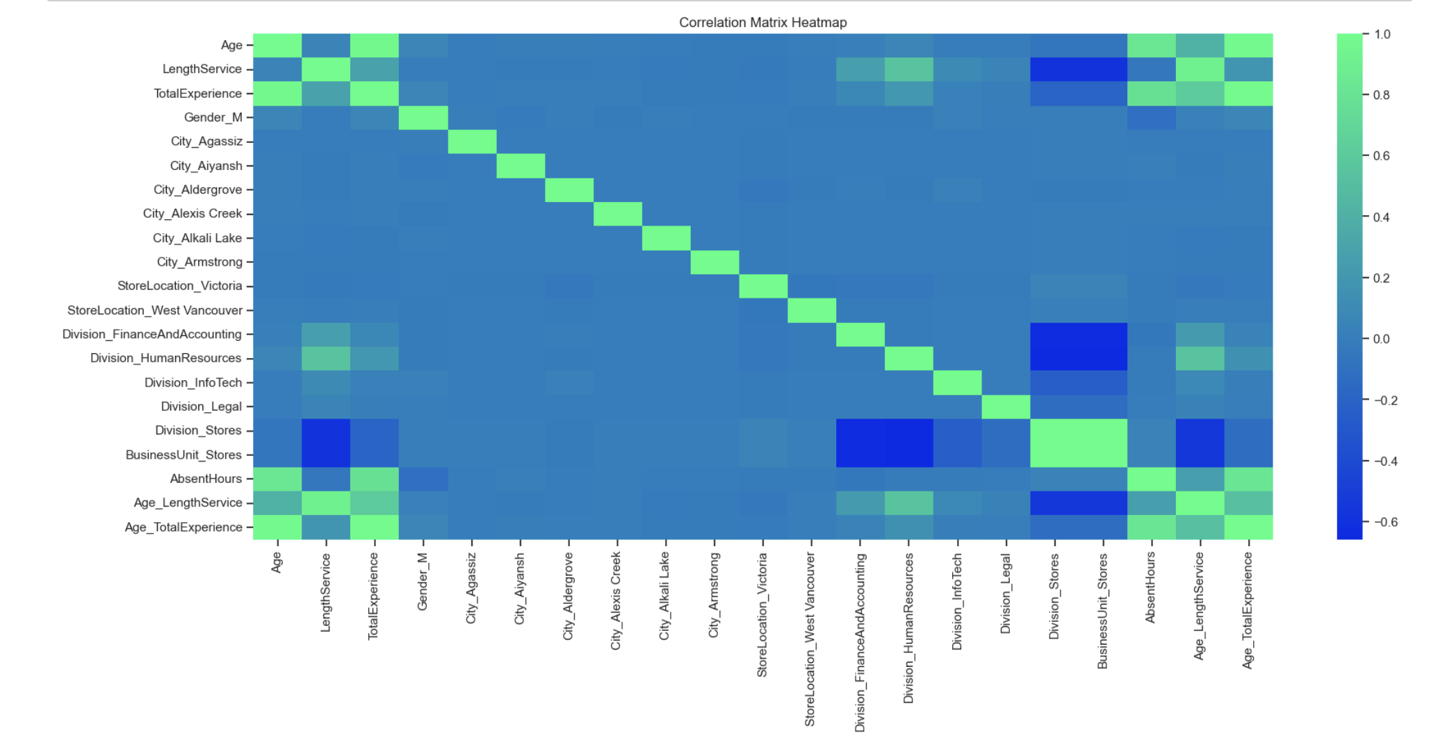
Heatmap

Slide 8
Conclusions
Positive correlation: Age and absenteeism
Divisional variations: "Finance and Accounting" division
Gender disparities: Higher absenteeism among females
Influence of tenure and experience on absenteeism
Significance and Future Implications
Power of data science in HR decision-making
Optimizing workforce management and engagement
Future implications: Designing targeted interventions

Slide 9

Thank you!!!

