Slide 1

Introduction To Python

Slide 2

Objective
At the end of this module, we will able to :
Understand Python- an object oriented Programming Language.
List the user of python for Data Analytics.
Defining Identifiers and Indentation.
List operations on Number.
Run a python script
Basic of Python(Variable, Data Types)
Python Input / Output
Understand Flow Control

Slide 3
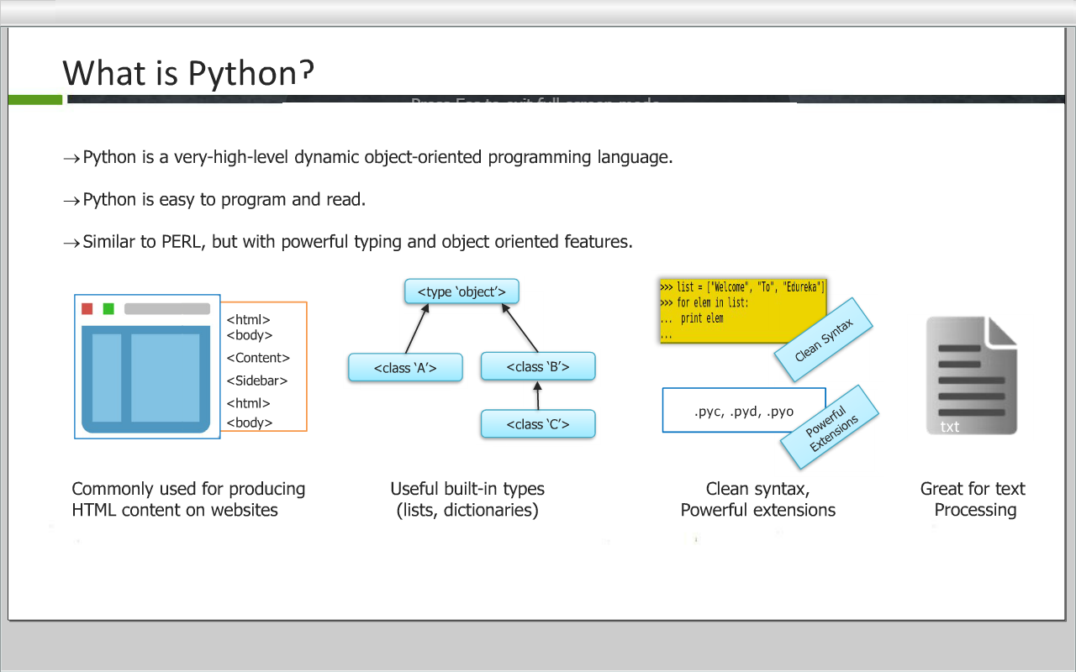
Why Python
Python is a very-high-level dynamic object-oriented programming language.
Python is easy to program and read.
Similar to PERL, but with powerful typing and object oriented features.

Slide 4

Why Python
Software Quality
Developer Productivity
Program Portability
Support Library
Component Integration
Enjoyment
Pyhton programs run unchanged on all major computer platforms. (Windows, linux, Mac OS etc)
Python comes with a large collection of prebuilt and portable functionalty known as Standard Library.
Python is ease of use and built-in toolset, it makes the programming more pleasurable.
Python code is typically one-third or one-fifth the size of equivalent C++ or Java code. That means there is less to type, less to debug and less to maintain.
Python focuses on readability , coherence and software quality in general which sets it apart from other languages in the scripting world.
Python scripts can easily communicate with other parts of an application, using a variety of integration mechanism.

Slide 5
About Python
Python was developed by Guido Van Rossum in 1991.
Language was named after “Monty Python”
Open Source and Interpreted Language.
Also considered as scripting language.
Functional and Object Oriented.
Used by Google and Increasingly popular.
Job trend of Python is remarkable as per indeed.com

Slide 6
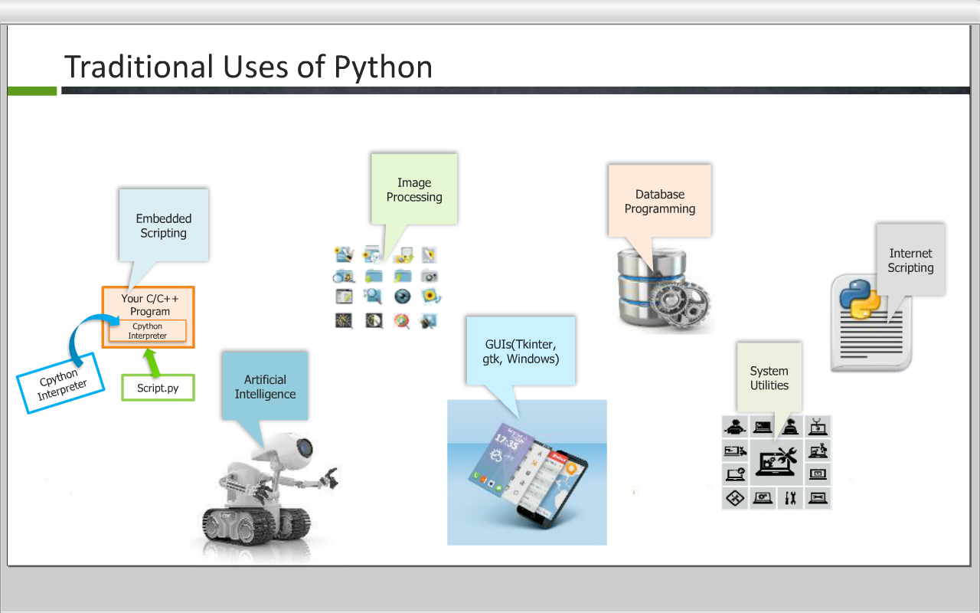


Slide 7
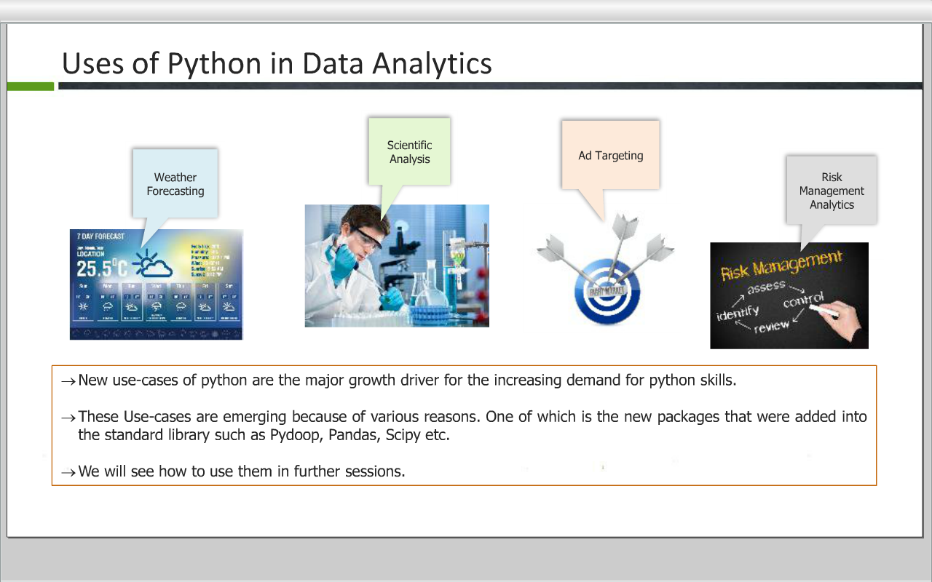

Slide 8
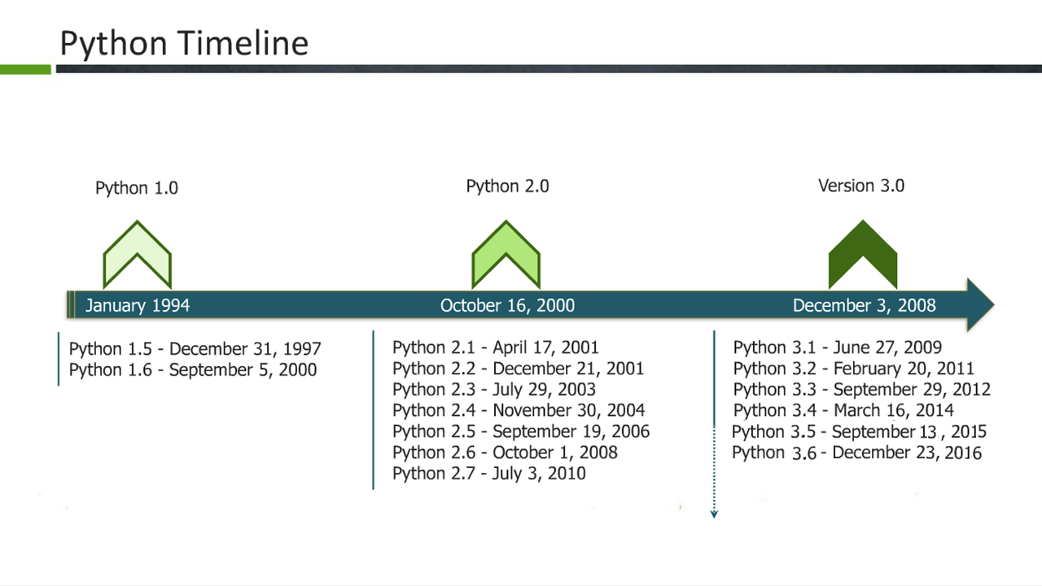

Slide 9
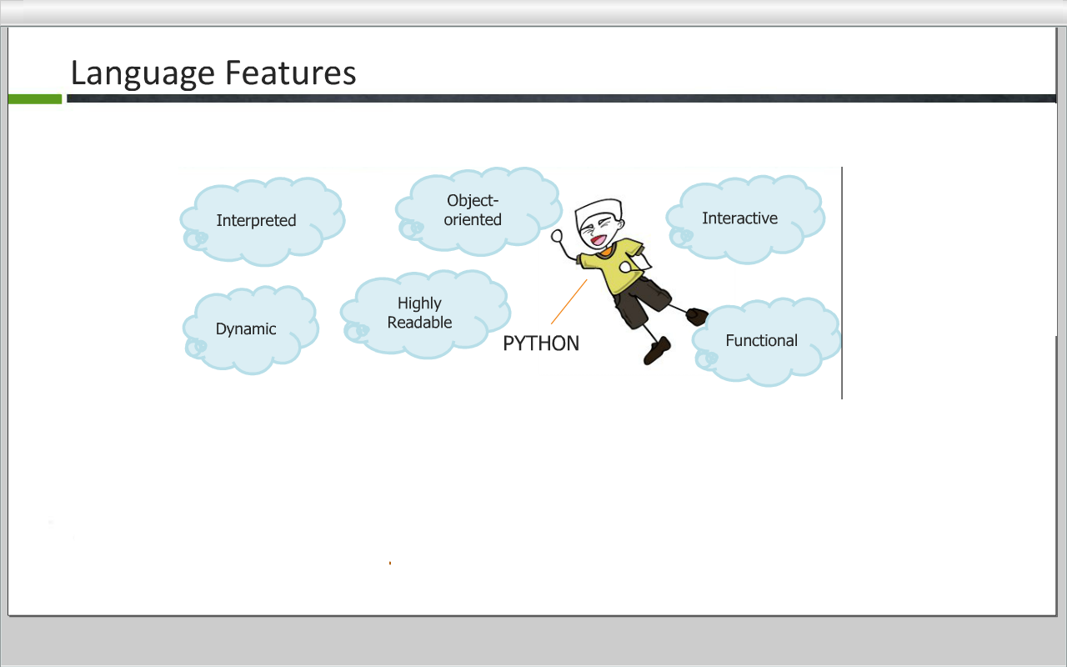

Slide 10
Installing Python
Python is pre-installed on most Unix systems, including Linux and MAC OS X
But for in Windows Operating Systems , user can download from the
https://www.python.org/downloads/

Slide 11
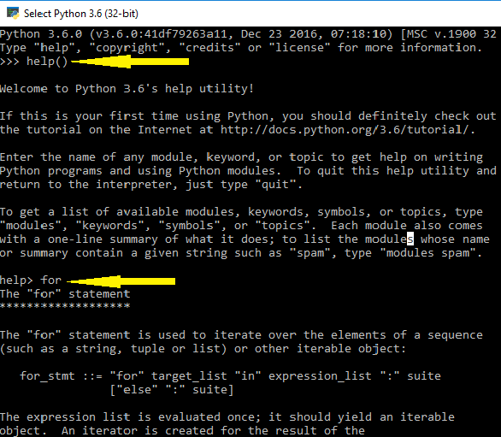
Getting Help in Python
Python interpreter has a built-in function called help(‘Object’). This function is intended for interactive use which invokes the help system.
To use this function, type – help() or help(‘Object’)
To exit the help press ‘q’
For Example:
Run help(‘for’) – This displays the help for the for function.

Slide 12
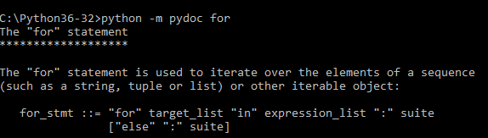
Getting Help in Python(Contd…)
Pydoc
Pydoc is a documentation module for python which gets installed with any python distribution.
Pydoc allow programmers to access python’s documentation, generate HTML pages with documentation specifies, and find the appropriate module for a particular job.
Pydoc can be accessed from a module-specific GUI from within the Python Interpreter, or from a command line shell.

Slide 13
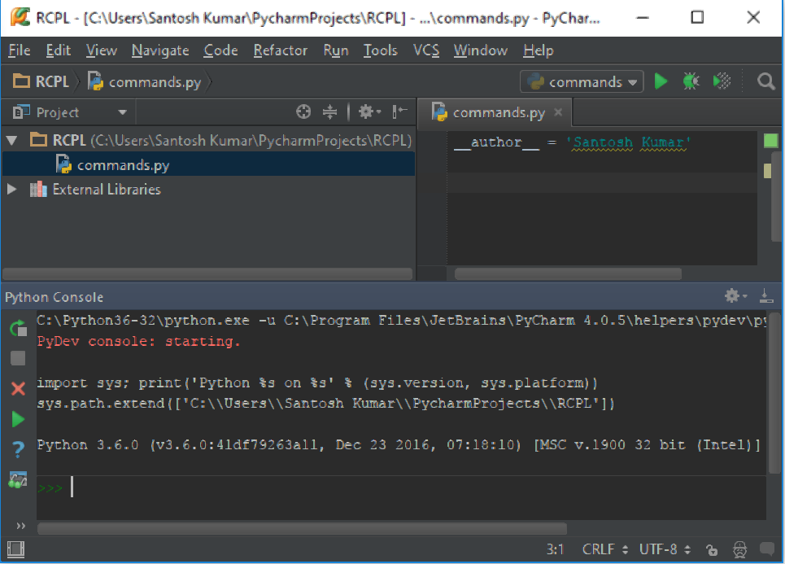
Python IDE
IDE is “Integrated Development Environment” which is used as the code editor, including a series of peripheral components and attachments.
The most important feature of the Python IDE is beyond ordinary text editor, it offers a variety of language-specific shortcut editing functions which make it fast and comfortable for programmers while coding.
The IDE that we will be using is Pycharm.

Slide 14
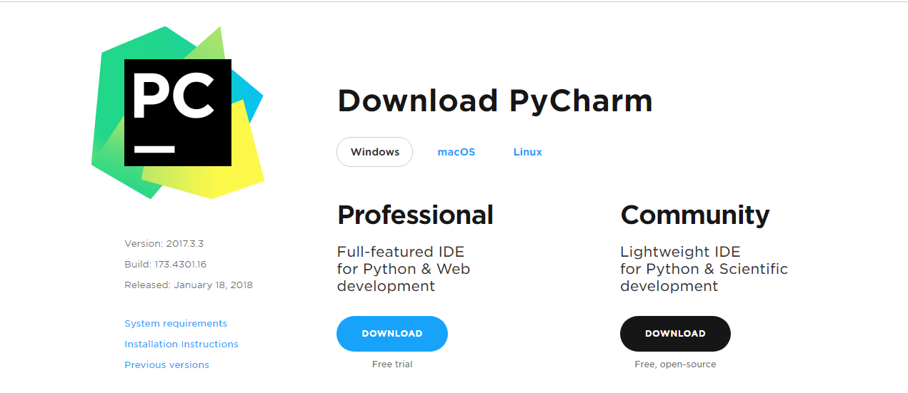
Python IDE
You can download Pycharm from below link :
http://www.jetbrains.com/pycharm/download/

Slide 15
Starting Python
There are two modes for using the Python interpreter:
Interactive Mode
Script Mode

Slide 16
Basic of Python

Slide 17
Keywords
Keywords are reserved words in Python and used to perform an internal operation. All the keywords of Python contain lower-case letters only.
List of Keywords:
and assert in del else
raise from if continue not
pass finally while yield is
as break return elif except
def global import foror print
lambda with class try exec

Slide 18
Identifier
Python Identiﬁers: Rules for Variable names
A Python Identifier is a name used to identify a variable, function, class, module or other object.
An identifier starts with a letter A to Z or a to z or an underscore (_) followed by zero or more letters, underscores and digits (0 to 9).
Python is a case sensitive programming language.
Python does not allow special characters such as @, $ and 0/o within identifiers.
Variables are used by just assigning them a value. No declaration or data type definition is needed/used.
Identifier naming convention for Python
Class names start with an uppercase letter and all other identifiers with a lowercase letter.
Starting an identifier with a single leading underscore indicates by convention that the identifier is meant to be private.
Starting an identifier with two leading underscores indicates a strongly private identifier.
If the identifier also ends with two trailing underscores, the identifier is a language-defined special name.

Slide 19
Variables
Python is completely object oriented, and not "statically typed". You do not need to declare variables before using them, or declare their type. Every variable in Python is an object.
Variable assignment:
We use the assignment operator (=) to assign values to a variable. Any type of value can be assigned to any valid variable.
For Example :
a = 5
b = 10.5
c = “Hello”

Slide 20
Data Types
Everything in Python programming is an object, and each object has its own unique identity(a type and a value).
There are many built-in data types available in Python.
Some important Data Types are:
Numbers
Boolean (bool)
Strings
Tuples
Lists
Sets
Dictionaries

Slide 21
Types of Numbers
Python supports following numeric types:
Integer
Decimal
Example : 0,1,124,-56,999999999999999
Binary
Start with 0b
Example: 0b1001
Octal
Start with 0o
Example: 0o86
Hex
Start with 0x
Example: 0x9fff

Slide 22
Type of Number (Cont…)
Floating Point Number:
Example : 1.0, 1e10,3.14e-2,6.99E4
Complex Number:
Example : 2+3j, 2j, 2.0+3.0j

Slide 23
Type Conversion
Sometimes it is necessary to convert values from one type to another. Python provides a few simple functions that will allow us to do that.
Function | Description
int(x [,base]) | Converts x to an integer. base specifies the base if x is a string.
float(x) | Converts x to a floating-point number.
complex(real [,imag]) | Creates a complex number.
str(x) | Converts object x to a string representation.
eval(str) | Evaluates a string and returns an object.
tuple(s) | Converts s to a tuple.
list(s) | Converts s to a list.
set(s) | Converts s to a set.
dict(d) | Creates a dictionary. d must be a sequence of (key,value) tuples.

Slide 24
Comment and Literals
Comments are little texts that can be added in code. They are created for programmers to read, not computers. A comment is simply one or more lines of text that is not executed by the computer.
There are two ways of comment in python
Single-line comments : A single line comment starts with the number sign (#) character
Multi-line comments : For multiple lines is to use the (”’) symbol.
Literal Constants: The number or string that represent itself.
Example: The number 2 always represent itself and nothing else – it is a constant because its value cannot be changed.

Slide 25
Operators

Slide 26
Operators
Operators are symbol that is used to perform mathematical or logical manipulations.
Python programming language is rich with built-in operators.
Types of operator:
Arithmetic Operators
Assignment Operators
Comparison (Relational) Operators
Logical Operators
Identity Operators
Bitwise Operators
Membership Operators

Slide 27
Arithmetic Operator
+ Addition
- Subtraction
* Multiplication
/ Division
% Modules
** Exponent
// Floor Division

Slide 28
Assignment Operator
Assignment operators are used in Python to assign values to variables.
Operator | Example | Equivalent to
= | x = 5 | x = 5
+= | x += 5 | x = x + 5
-= | x -= 5 | x = x - 5
*= | x *= 5 | x = x * 5
/= | x /= 5 | x = x / 5
%= | x %= 5 | x = x % 5
//= | x //= 5 | x = x // 5
**= | x **= 5 | x = x ** 5

Slide 29
Comparison Operator
Comparison operators are used to compare values. It either returns True or False according to the condition.
Symbol | Operator Name | Description
== | Double Equal | If the two value of its operands are equal, then the condition becomes true, otherwise false
!= or <> | Not Equal To | If two operands values are not equal, then condition becomes true. Both the operators defines the same meaning and function
> | Greater Than | If the value of left hand operand is greater than the value of right hand operand, condition becomes true.
< | Less Than | If the value of left hand operand is less than the value of right operand, then condition becomes true.
<= | Less Than Equal To | If the value of left hand operand is less than or equal to the value of right hand operand, condition becomes true.
>= | Greater Than Equal To | If the value of left hand operand is greater than or equal to the value of right hand operand, condition becomes true.

Slide 30
Logical Operator
Symbol | Operator Name
and | Logical AND
or | Logical OR
not | Logical NOT

Slide 31
Identity Operator
Symbol | Operator Name | Description
is | is | The result becomes true, if values on either side of the operator points to the same object & False otherwise.
is not | is not | The result becomes False if the variables on either side of the operator points to the same object

Slide 32
Bitwise Operator
Operator | Meaning
& | Bitwise AND
| | Bitwise OR
~ | Bitwise NOT
^ | Bitwise XOR
>> | Bitwise right shift
<< | Bitwise left shift

Slide 33
Membership Operators
Operator | Meaning
in | True if value/variable is found in the sequence
not in | True if value/variable is not found in the sequence

Slide 34
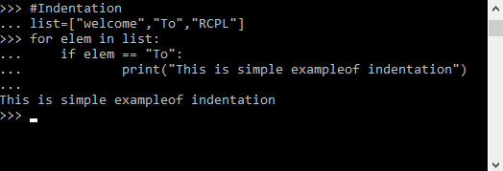
Indentation
Indentation
Leading whitespace (spaces and tabs) at the beginning of a logical line is used to compute the indentation level of the line, which is turn is used to determine the grouping of statements.
Indentation is MUST in Python
There are no braces to indicate blocks of code for class and function definitions or flow control.
The number of spaces in the indentation is variable, but all statements within the block must be indented the same amount.
Standard is to use 4 whitespaces as per official recommendation.
Some editors automatically takes care of the indentation.

Slide 35
Python Input / Output
Python provide built-in function for I/O.
For Input : In Python, we have input() function to take a input from user.
The syntax for input() is :
input([prompt])
For Output : We use the print() function to output data to the standard output device (screen).
For Example :
num=input(“Enter Number : “)
print(“Value of num is”,num)

Slide 36
Flow Control

Slide 37
Flow Control
Python provide various tools for flow control.
Some of them are :
if statement
if-else statement
if .. elif … else statement
while
for
pass
break
continue etc.

Slide 38
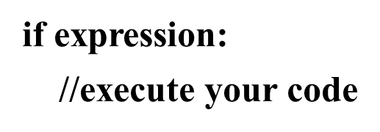
if statement
An if statement in python takes an expression with it. If the expression amounts to True, then the block of statements under it is executed. If it amounts to False, then the block is skipped and control transfers to the statements after the block.
Syntax:
But remember to indent the statements in a block equally. This is because we don’t use curly braces to delimit blocks. Also, use a colon(:) after the condition.

Slide 39
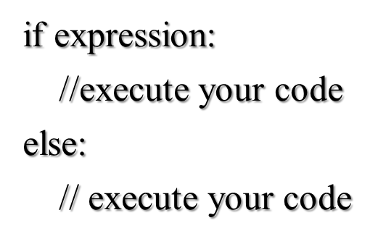
if-else statement
When we want to execute some block of code if a condition is true and another block when the condition is false, In such case we use if-else statement.
Syntax:

Slide 40
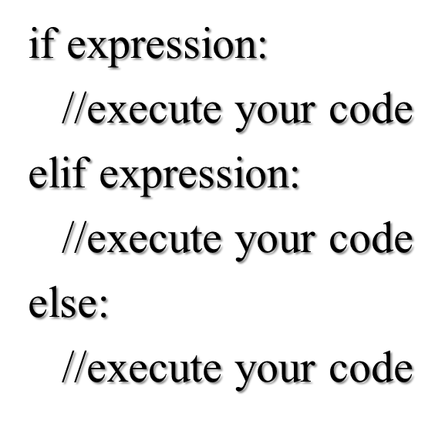
if….elif…else statement
There is no switch statement in Python. You can use an if…elif…else statement to do the same thing.
The elif statement allows you to check multiple expressions for truth value and execute a block of code as soon as one of the conditions evaluate to true
Syntax :

Slide 41
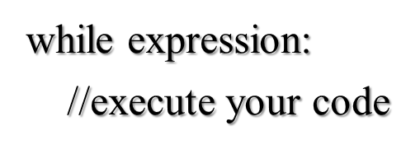
while Loop
The while statement allows you to repeatedly execute a block of statements as long as a condition is true.
Indentation and colon should be respected
Syntax:

Slide 42
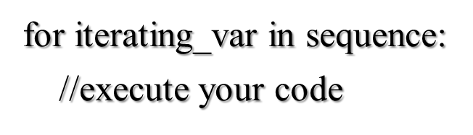
for Loop
The for…in statement is another looping statement which iterates over a sequence of objects i.e. go through each item in a sequence.
Syntax:

Slide 43
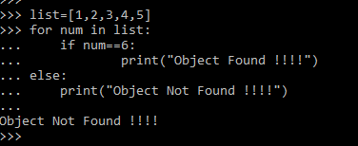
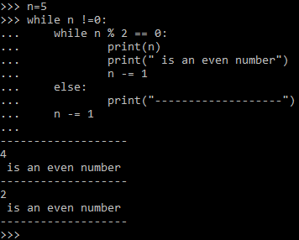
Loops With else Clause
Python supports to have an else statement associated with a loop statement.
If the else statement is used with a for loop, the else statement is executed when the loop has exhausted iterating the list.
If the else statement is used with a while loop, the else statement is executed when the condition became false.

Slide 44
Range Function
range() generates lists containing arithmetic progression
3 variation of range() function :
range(stop) – Starts from 0 till (stop -1)
range(start,stop) – Ends at (stop -1)
range(start,stop,step) – Step can not be 0, default is 1

Slide 45
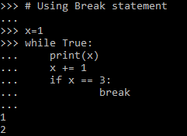
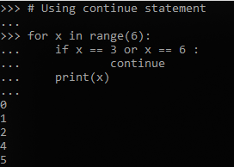
Break and Continue Statement
Break and continue statements are used to exit from the loop.
The break statement is used to break out of a loop statement i.e. stop the execution of a looping statement, even if the loop condition has not become false or the sequence of items has not been completely iterated over.
The continue statement is used to tell Python to skip the rest of the statements in the current loop block and to continue to the next iteration of the loop.

Slide 46
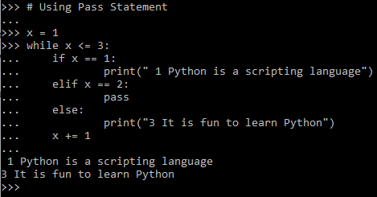
Pass Statement
The pass statement does noting. It can be used when a statement is required syntactically but the program required no action
In simpler words, you cannot leave a statement empty in python. In this situation you can place pass statement there
Used commonly while creating minimal classes.
Syntax:
While True:
pass
Class MyEmptyClass:
pass

Slide 47
THANK YOU!!
visit : www.rcplindia.in
santosh@rcplindia.in

