Slide 1

Matplotlib

Slide 2
Matplotlib
Matplotlib is a plotting library in Python, which produces 2D graphics in different interactive environments.
In Matplotlib, you can draw different types of graphs, like line, scattered, bar, etc. It is mostly used in Python and R for drawing graphs and enabling exploration of data.
Following are the features of Matplotlib:
It has a large community.
It comprises of tons of plot types.
It is well integrated into ipython.
It is the de-facto standard for ‘command line’ plotting from ipython.
It enables day-to-day data exploration.

Slide 3
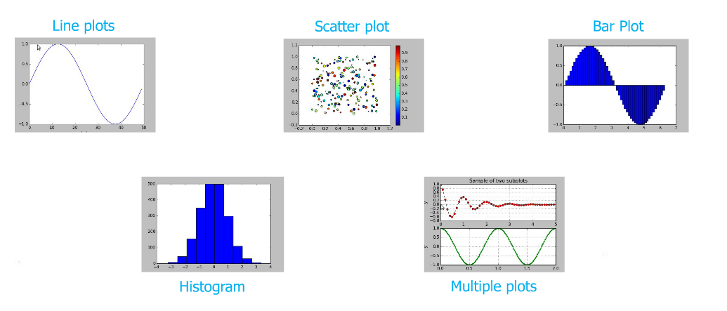
Different Types of Plots:

Slide 4
Pandas

Slide 5
Pandas
Pandas is an open-source, BSD-licensed Python library providing high-performance, easy-to-use data structures and data analysis tools for the Python programming language.
It is built on top of NumPy, SciPy, to some extent matplotlib.
Pandas is well suited for many different kinds of data:
Tabular data with heterogeneously-typed columns, as in an SQL table or Excel spreadsheet
Ordered and unordered (not necessarily fixed-frequency) time series data.
Arbitrary matrix data (homogeneously typed or heterogeneous) with row and column labels
Any other form of observational / statistical data sets. The data actually need not be labeled at all to be placed into a pandas data structure

Slide 6
Primary data structures of pandas
The two primary data structures of pandas are :
Series (1-dimensional) and
DataFrame (2-dimensional)
They are used to handle the vast majority of typical use cases in finance, statistics, social science, and many areas of engineering.
For R users, DataFrame provides everything that R’s data.frame provides and much more.
pandas is built on top of NumPy and is intended to integrate well within a scientific computing environment with many other 3rd party libraries.

Slide 7
Things that pandas does well
Easy handling of missing data (represented as NaN) in floating point as well as non-floating point data
Size mutability: columns can be inserted and deleted from DataFrame and higher dimensional objects
Automatic and explicit data alignment: objects can be explicitly aligned to a set of labels, or the user can simply ignore the labels and let Series, DataFrame, etc. automatically align the data for you in computations
Powerful, flexible group by functionality to perform split-apply-combine operations on data sets
Intelligent label-based slicing, fancy indexing, and subsetting of large data sets
Intuitive merging and joining data sets
Flexible reshaping and pivoting of data sets
Hierarchical labeling of axes (possible to have multiple labels per tick)
Robust IO tools for loading data from flat files (CSV and delimited), Excel files, databases, and saving / loading data from the ultrafast HDF5 format

Slide 8
pandas - Data Structure Types
Series :
Series is a one-dimensional labeled array capable of holding any data type (integers, strings, floating point numbers, Python objects, etc.). The axis labels are collectively referred to as the index.
The basic method to create a Series is to call:
Here, data can be many different things:
a Python dict
an ndarray
a scalar value (like 5)
>>> s = pd.Series(data = d, index=index)

Slide 9
pandas - Data Structure Types
DataFrame :
It is a 2-dimensional labeled data structure with columns of potentially different types. You can think of it like a spreadsheet or SQL table, or a dict of Series objects.
DataFrame accepts many different kinds of input:
Dict of 1D ndarrays, lists, dicts, or Series
2-D numpy.ndarray
Structured or record ndarray
A Series
Another DataFrame
>>> s = pd.DataFrame(data = d , index=index)

Slide 10
pandas - Series
Series
One-dimensional array like object containing data and labels (or index)
>>> import pandas as pd
>>> series = pd.Series(list('98765'))
>>> series
0 9
1 8
2 7
3 6
4 5
dtype: object
>>> import pandas as pd
>>> series = pd.Series(tuple('abcdef'))
>>> series
0 a
1 b
2 c
3 d
4 e
5 f
dtype: object

Slide 11
pandas - Traversing Series
Working with Index :
Index in a series can be specified and using the index we can fetch its corresponding value.
Multiple values can be fetched with multiple indexes
>>> import pandas as pd
>>> series = pd.Series([9,8,7,6],index = ['*','**','***','****'])
>>> series
* 9
** 8
*** 7
**** 6
dtype: int64
>>> series[ ['*','***'] ]
* 9
*** 7
dtype: int64

Slide 12
pandas - Traversing Series (Contd….)
Series is like a fixed-length, order dictionary.
Unlike dictionary, index items don't have to be unique
>>> import pandas as pd
>>> series = pd.Series(range(5),index =list('xyzxy'))
>>> series
x 0
y 1
z 2
x 3
y 4
dtype: int64
>>> # Fetching the values with index x
>>> series['x']
x 0
x 3
dtype: int64

Slide 13
pandas - Incomplete Data in Series
Data can be filtered using conditions.
pandas can accommodate incomplete data. Incomplete data is replaced with "NaN" and "NaN" value is not an issue in arithmetic operations. Unlike in Numpy ndarray, data is automatically aligned
We can use numpy-operations on data for filtering
>>> import pandas as pd
>>> series = pd.Series({1:10,2:20,3:30},index = [1,2,3,4])
>>> series
1 10.0
2 20.0
3 30.0
4 NaN
dtype: float64
>>> series * 4
1 40.0
2 80.0
3 120.0
4 NaN
dtype: float64

Slide 14
pandas - DataFrame
Data Frame
Spreadsheet-like data structure containing an ordered collection of columns
Has both row and column index
DataFrame Creation
Creation with dictionary of equal-length list
>>> data={'country':['INDIA','USA','INDIA','USA'],
'Year':[2010,2011,2012,2013],
'Population':[20,28,32,38]}
>>> dataFrame=pd.DataFrame(data)
>>> dataFrame
Population Year country
0 20 2010 INDIA
1 28 2011 USA
2 32 2012 INDIA
3 38 2013 USA

Slide 15
pandas - DataFrame
New Columns can be added by computation or direction assignment
>>> dataFrame
Population Year country
0 20 2010 INDIA
1 28 2011 USA
2 32 2012 INDIA
3 38 2013 USA
>>> # Adding new column
>>> dataFrame[ 'GDP‘ ] = { 6.3, 5.7, 7.8, 5.5 }
>>> dataFrame
Population Year country GDP
0 20 2010 INDIA 6.3
1 28 2011 USA 5.5
2 32 2012 INDIA 7.8
3 38 2013 USA 5.7

Slide 16
pandas - DataFrame
Function on DataFrame
We can apply functions like sum(), means(), max(), head(), count(), tail() etc on dataFrame
>>> dataFrame
Population Year country
0 20 2010 INDIA
1 28 2011 USA
2 32 2012 INDIA
3 38 2013 USA
>>> dataFrame['GDP'].sum()
25.3
>>> dataFrame['Population'].mean()
29.5

Slide 17
pandas - DataFrame
describe() functions will give the summary of DataFrame
>>> dataFrame.describe()
Population Year GDP
count 4.000000 4.000000 4.000000
mean 29.500000 2011.500000 6.325000
std 7.549834 1.290994 1.040433
min 20.000000 2010.000000 5.500000
25% 26.000000 2010.750000 5.650000
50% 30.000000 2011.500000 6.000000
75% 33.500000 2012.250000 6.675000
max 38.000000 2013.000000 7.800000

Slide 18
pandas - Data Loading
pandas support several ways to handle data loading
Text file data
read_csv
read_table
Structured data (JSON, XMLm HTML)
It works fine with existing libraries
Excel (depends upon xlrd and openpyxl packages)
Database
pandas.io.sql module (read_frame)

Slide 19
pandas – Loading CSV data
pandas.read_csv will load the csv data
>>>data = pd.read_csv('employee.csv')
>>> data
Emp_ID EMP_Name Gender Age Join_year
0 5001 Purnima Pandey Female 56 1971
1 5002 Chandramohan Doss S Male 45 1972
2 5003 Zaheer Begum M Male 36 1979
3 5004 Sreenath A N Male 38 1987
4 5005 Sivaramakrishnan R Male 57 1994
5 5006 Gita N Murthy Female 48 1988

Slide 20
pandas – Loading CSV data
Using len on DataFrame will give you the number of rows
We can get the column name using columns property
>>> len(data)
19
>>> data.columns
Index(['Emp_ID', 'EMP_Name', 'Gender', 'Age', 'Join_year'], dtype='object')

Slide 21
pandas – Loading CSV data
Columns can be accessed in two ways
The first is using the DataFrame like a dictionary with string keys. Multiple columns can be accessed by passing multiple column names
>>> data[‘Open’]
The second way to access columns is using the dot syntax. This only works if your column name could also be a Python variable name (i.e., no spaces), and if it doesn't collide with another DataFrame property or function name (e.g., count, sum)
>>> data.Open
>>> data['Emp_ID']
0 5001
1 5002
2 5003
3 5004
4 5005
5 5006
Name: Emp_ID, dtype: int64

Slide 22
pandas – Loading CSV data
head() function lists the first 5 rows as default. If we want to display first n rows. Use head(n)
head() function can be applied on columns also
We can use other functions like tail(), max(), min(), std(), means() etc
>>> data.head(2)
Emp_ID EMP_Name Gender Age Join_year
0 5001 Purnima Pandey Female 56 1971
1 5002 Chandramohan Doss S Male 45 1972
>>> data.Emp_ID.head(2)
0 5001
1 5002
>>> data.Emp_ID.max()
5006

Slide 23
THANK YOU!!
visit : www.rcplindia.in
santosh@rcplindia.in

