Slide 1

Python Data structure

Slide 2
String
Python does not support a character type, these are treated as a string of length one.
String are immutable.
Strings are ordered blocks of text
Strings are enclosed in single or double quotation marks.
Double quotation marks allow the user to extend strings over multiple lines without backslashes.
Example : ‘abc’ , “ABC”
Concatenation and repetition
Strings are concatenated with the + sing :
Strings are repeated with the * sign:
>>>’abc’+’def’
‘abcdef’
>>>’abc’*3
‘abcabcabc’

Slide 3
Operation on String
Indexing and Slicing Operation
Python start indexing at 0.
A string s will have indexing running from 0 to len(s)-1
Example :
s=‘Python’
print(len(s))
print(s[2])
Output :
6
t

Slide 4
Operation on String
Slicing Operation
A subset of string is called "Slice"
You can get a subset of a string and other data structure, called a "slice", by specifying two indices
Slicing works if one or both of the slice indices is negative
Syntax : string [ first_pos : last_pos : step ]
When slicing in Python, note that:
The slice begins with the character at first_pos and includes all the characters up to but not including the character at last_pos.
If first_pos is left out, then it is assumed to be 0.
If last_pos is left out, then it is assumed to be the length of the string, or in other words, one more than the last position of the string.

Slide 5
Example :
s=‘PYTHON’
print(s[ 0 : 3 ] )
print(s[ 1 : -1]
Output :
PYT
YTHO

Slide 6
Operation on String
Membership checking
in – Return true if the character exists in the given string.
Example:
not in - Return true if the character not exists in the given string.
Example:
String Formatting Operator %
This function is unique to strings and makes up for the pack of having functions from C’s printf() family
>>> ‘P’ in ‘PYTHON’
True
>>> ‘P’ not in ‘PYTHON’
False
>>>”My name is %s and age is %d years!!! ” % (‘Santosh’,33)
My name is Santosh and age is 33 years!!!

Slide 7
Built-in String Methods
len(str) //global function
max(str) //Global Function
min(str) //Global
capitalize()
count(str, beg=0, end = len(str)) : counts how many times str occurs in string.
encode(encoding=‘utf-16’) : Return encoded string version of string.
decode(encoding=‘utf-16’) : Decode the string using the codec registered for encoding.
index(str, beg=0, end=len(str))
replace(old, new)
upper()
lower()
title()
split(‘delimeter’)

Slide 8
List
Lists are the most versatile of Python's compound data types. A list contains items separated by commas and enclosed within square brackets [ ].
Example :
list = [ 'abcd', 123 , 23.4, ‘python', 34.5 ]
print list # Prints complete list
print list[0] # Prints first element of the list
print list[1:3] # Prints elements starting from 2nd till 3rd
print list[2:] # Prints elements starting from 3rd element

Slide 9
Built-in List Methods
append( object )
count( object )
index( object )
insert(index , object)
pop()
remove( object )
reverse()

Slide 10
Tuple
A tuple is a immutable list. A tuple can not be changed in any way once it is created.
A Tuple is defined in the same way as a list except that the whole set of elements are enclosed in parentheses instead of square brackets.
>>> tu = ( 'python‘ , 'Hadoop‘ , 'R‘ , 'C‘ )
>>> tu[0]
'python'
>>> tu[-1]
'c'
>>> tu[1:3]
( 'Hadoop‘ , 'R‘ )

Slide 11
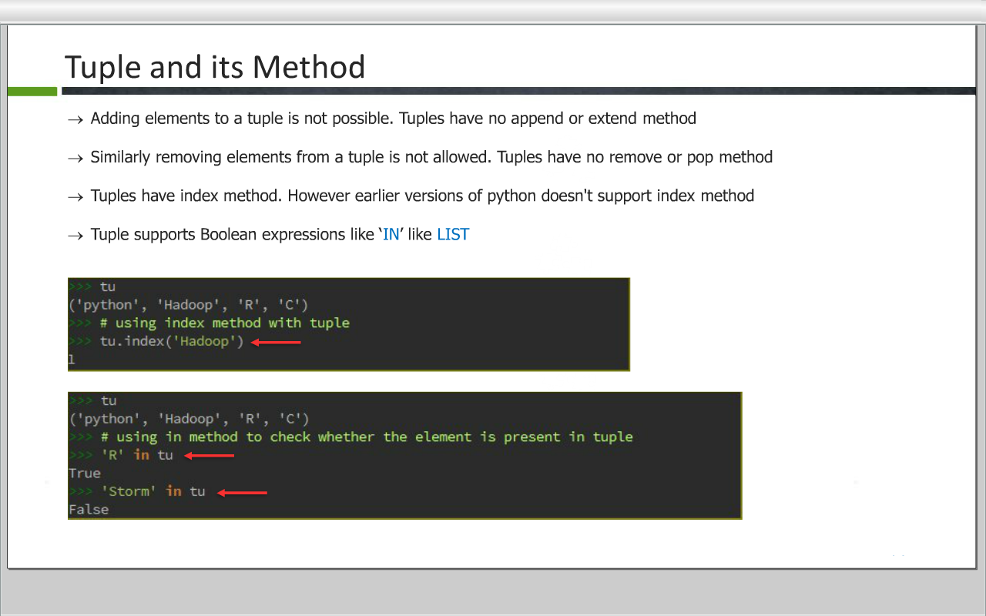
Tuple and its Method
Adding elements to the tuple is not possible. Tuples have no append or extend method
Similarly removing elements from a tuple is not allowed. Tuple have no remove or pop method
Tuple have index method. However earlier versions of python doesn't support index method
Tuple supports Boolean expression like 'IN' like LIST

Slide 12
Tuple Methods
Index( object , [ start , stop ] )
count( object)

Slide 13
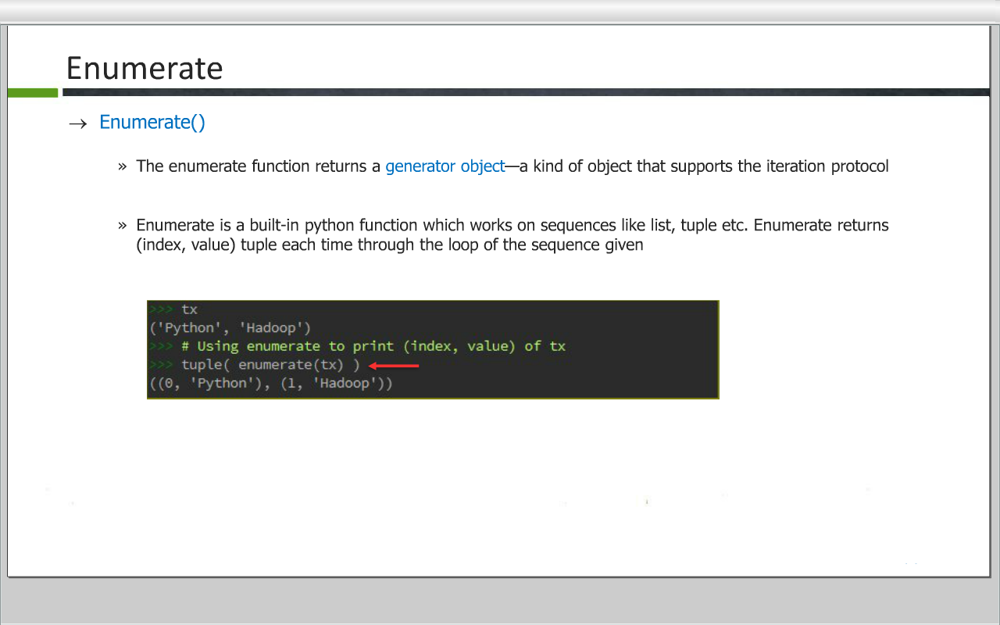
Enumerate Function
Enumerate()
The enumerate function returns a generator object - a kind of object that supports the iteration protocol
Enumerate is a built-in python function which works on sequences like list, tuple etc. Enumerate returns ( index, value ) tuple each time through the loop of the sequence given

Slide 14
Dictionaries
Dictionaries
Dictionaries are perhaps the most flexible built-in data type in Python
The chief distinction is that in dictionaries, items are stored and fetched by key, instead of by positional offset
List Ordered collection of Objects
Dictionaries Un-ordered collection of Objects

Slide 15
Dictionaries
Properties
Accessed by key, not offset
Unordered collections of arbitrary object
Variable-length, heterogeneous, and arbitrarily nestable
Mutable mapping

Slide 16
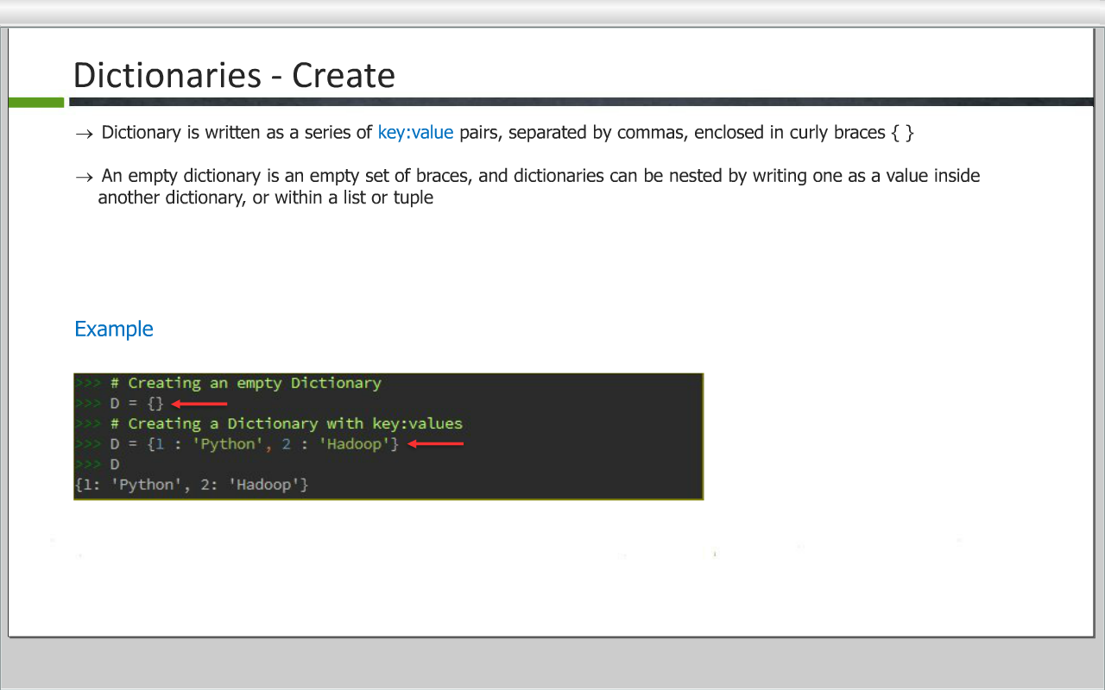
Dictionaries - Create
Dictionary is written as a series of key: value pairs, separated by commas, enclosed in curly braces {}
An empty dictionary is an empty set od braces, and dictionaries can be nested by writing one as a value inside another dictionary, or within a list or tuple

Slide 17
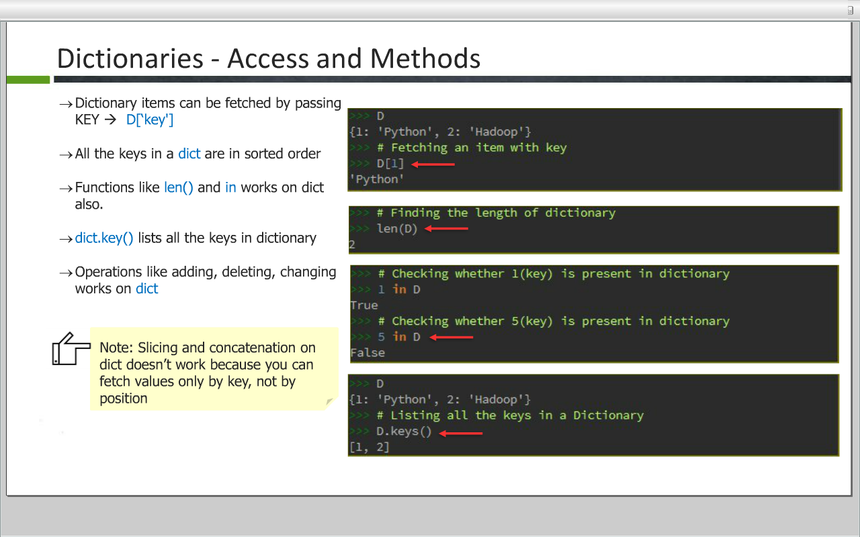
Dictionaries – Access and Methods
Dictionary items can be fetched by passing
KEY => D[‘key’]
All the keys in a dict are in sorted order
Functions like len() and in works on dict also.
dict.key() lists all the keys in dictionary
Operations like adding, deleting, changing works on dict
Note : Slicing and concatenation on dict doesn’t works because you can fetch values only by key, not by position.

Slide 18
Dictionaries – Methods
clear() Removes all elements of dictionary
copy() Returns a shallow copy of dictionary
fromkeys() Create a new dictionary with keys from seq and values set to value.
get(key) For key key, returns value or default if key not in dictionary
pop() Remove specified key and return the corresponding value. If key is not found, d is returned if given, otherwise KeyError is raised
popitem() Returns and removes an arbitrary element (key, value) pair from the dictionary.
update(dict2) Adds dictionary dict2's key-values pairs to dictionary

Slide 19
Dictionaries – Methods
Dictionary contains iterator functions which handles iteration on dictionary items.
items() Returns a list of dict's (key, value) tuple pairs
keys() Returns list of dictionary dict's keys
values() Returns list of dictionary dict's values

Slide 20
Sets
Sets are neither mapping or sequences;
A set is an unordered collection of items. Every element is unique (no duplicates) and must be immutable (which cannot be changed).
However, the set itself is mutable. We can add or remove items from it.
Sets can be used to perform mathematical set operations like union, intersection, symmetric difference etc.

Slide 21
Sets - Creating
Curly braces or the set() function can be used to create sets.
Sets creation using set()
Sets creation using { }
>>> set1=set('try')
>>> set1
{'t', 'r', 'y'}
>>> set2={"Python","Java","Hadoop"}
>>> set2
{'Hadoop', 'Python', 'Java'}

Slide 22
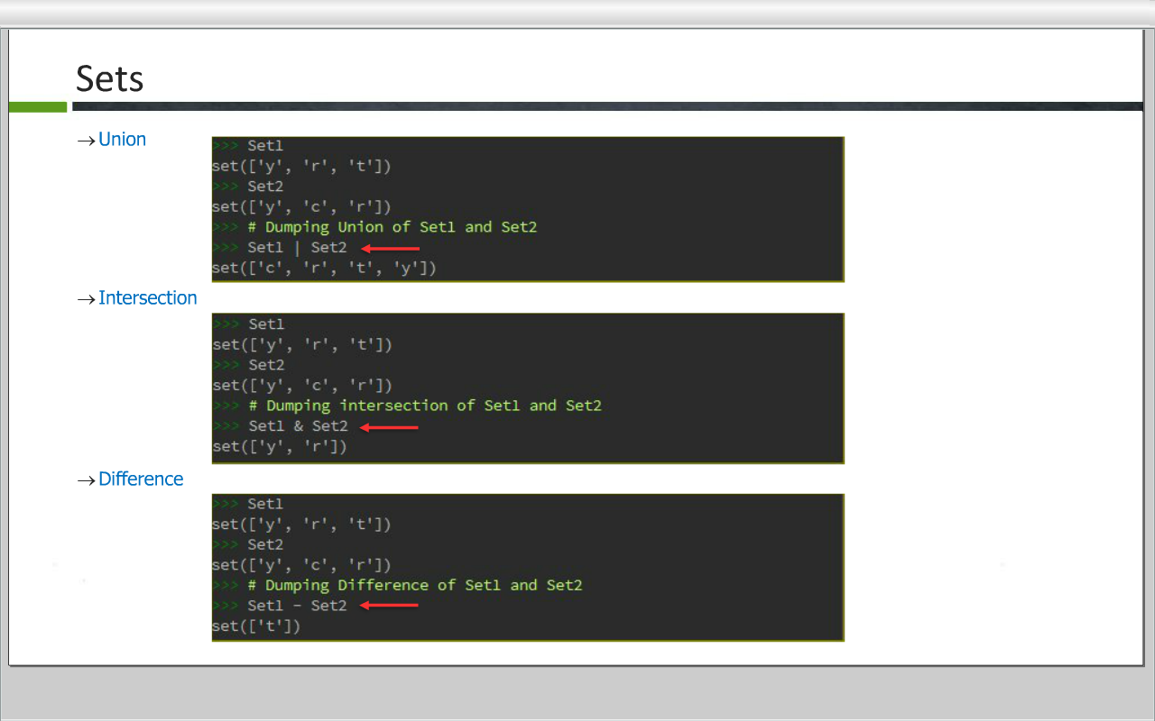
Sets

Slide 23
Methods
add() Add an element to a set
clear() Remove all elements form a set
copy() Return a shallow copy of a set
difference() Return the difference of two or more sets as a new set
discard() Remove an element from set if it is a member.
(Do nothing if the element is not in set)
intersection() Return the intersection of two sets as a new set
isdisjoint() Return True if two sets have a null intersection
issubset() Return True if another set contains this set
issuperset() Return True if this set contains another set
pop() Remove and return an arbitary set element. Raise KeyError if the set is empty
remove() Remove an element from a set. If the element is not a member, raise a KeyError
union() Return the union of sets in a new set
update() Update a set with the union of itself and others

Slide 24
Command Line Arguments
The Python sys module provides access to any command-line arguments via the sys.argv
sys.argv is the list of command line arguments
len(sys.argv) is the number o command line arguments
sys.argv[0] is the program ie. script name
Example:
$ python commands.py inp1,inp2,inp3
Inside Commands.py:
import sys
print("Number of arguments : ",len(sys.argv),"arguments")
print("Argument List : ",str(sys.argv))
It will produce the following o/p:
Number of arguments : 4 arguments.
Argument List : ['sample.py','inp1','inp2','inp3']

Slide 25
THANK YOU!!
visit : www.rcplindia.in
santosh@rcplindia.in

