Slide 1

Functions

Slide 2

Objective
At the end of this module, we will able to :
Understand function and various forms of function Arguments
Explain Standard Library
Define Module
Describe Zip Archives and Packages

Slide 3
Functions
A Function is a set of instructions that is used to perform a single related operation
Function are :
Organized
Re-usable
Modularized
Python has many built-in functions like print(), input(), int(), len(). Etc but you can also create your own functions.
These function are called User-defined Function
Syntax :
def <function_name>( parameter1, parameter2, ……., parameter ):
Statement1
Statement 2
return [ expression ]

Slide 4
Defining and Calling a Function
Defining a Function
Start of the function
def myFunc(str):
Body of the function print(str)
return
End of the function
Calling of Function
myFunc(str) Calling of Function

Slide 5
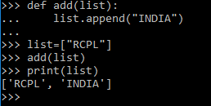
Pass by Object Reference
Python supports call by value (Where the value is always an object reference, not the value of the object)
Hence many professionals term it as Pass by Object reference
Example 1:
In this example, we are appending value to an existing list. Hence the change is reflected in the list whose reference has been passed to the function.

Slide 6
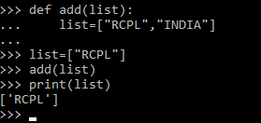
Pass by Object Reference
Example 2:
In this example we have assigned a new list. Hence the change is not reflected in the list whose reference has been passed to the function

Slide 7
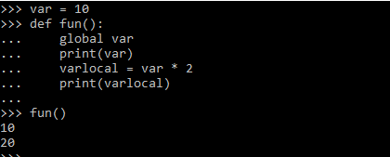
Function (Local and Global Variables)
Local Variables
The variable defined within the function has a local scope and hence they are called local Variable.
Local scope means they can be accessed within the function only
They appear when the function is called and disappear when the function exits.
Global Variable
The variable define outside the function has a global scope and hence they are called global variable
Global scope means they can be accessed within the function as well as outside the function.
The value of a global variable can be used by referring the variable as global inside a function.
Global Variable
Local Variable

Slide 8
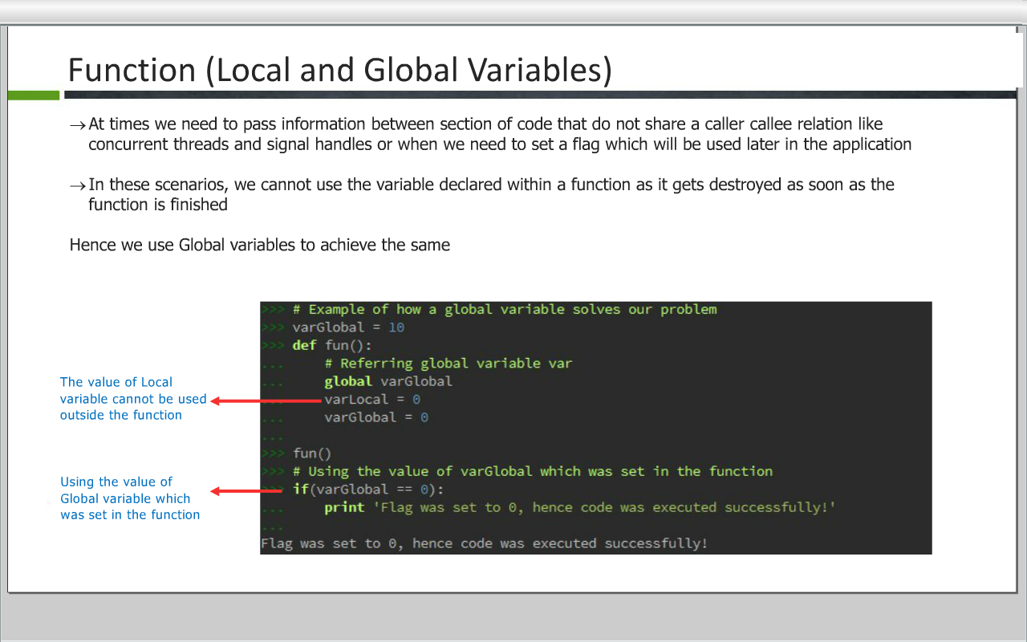
Function (Local and Global Variables)
At times we need to pass information between section of code that do not share a caller callee relation like concurrent threads and signal handles or when we need to set a flag which will be used later in the application
In these scenarios, we cannot use the variable declared within a function as it gets destroyed as soon as the function is finished.
Hence we use global variables to achieves the same.

Slide 9
Various Forms of Function Arguments)
It is possible to define functions with a variable number of arguments
You can call a function by using the following arguments
Positional Argument : Arguments passed should match the function parameter from left to right
Default Arguments : We can assign default value for arguments to receive if the call passes too few values
>>> # Postional Arguments
>>> def fun(a,b,c):
print(a,b,c)
>>> # Calling of function
>>> fun(1,2,3)
1 2 3
>>> # Default Argument
>>> def fun(a,b=3,c=3):
print(a,b,c)
>>> fun(1)
1 3 3

Slide 10
Various Forms of Function Arguments)
Keyword Arguments : We can call a function by specifying the keyword argument in the form argument name = value
>>> # Keyword Arguments
>>> def fun(a,b,c):
print(a,b,c)
>>> fun( b=2, c=3, a=1)
1 2 3

Slide 11
Various Forms of Function Arguments)
Arbitrary Argument Lists : You may need to process a function for more arguments than you specified while defining the function
These arguments are not named in the function definition. They are used when you need to pass more arguments that you have specified while defining the function. To add an arbitrary argument in the function definition, start the variable name with * an **
>>> def fun( *arr ):
>>> def fun( **arr ):
>>> # Arbitrary Arguments
>>> def funNew(**arr):
for k in arr.keys():
print(k,",",arr[k])
>>> # Calling the function
>>> funNew(a='RCPL',b='INDIA')
a , RCPL
b , INDIA
>>> # Arbitrary Arguments
>>> def fun(*arr):
for val in arr:
print(val,)
>>> # Calling the function
>>> fun(1,2,3,4)
1 2 3 4

Slide 12
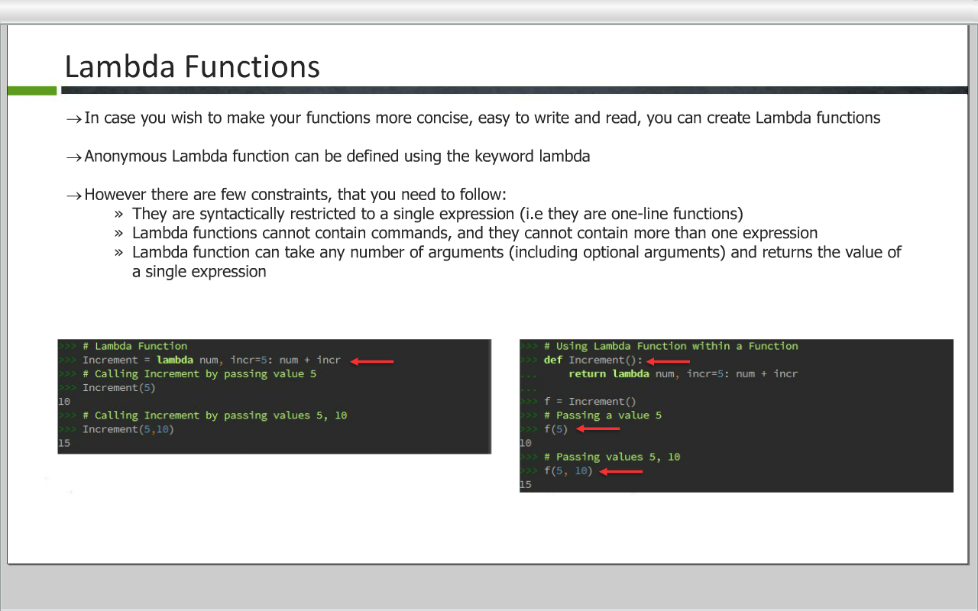
Lambda Functions
In case you wish to make your functions more concise, easy to write and read, you can create Lambda functions
Anonymous Lambda function can be defined using the keyword lambda
However there are few constraints, that you need to follow:
They are syntactically restricted to a single expression (i.e they are one-line functions)
Lambda functions cannot contain commands, and they cannot contain more than one expression
Lambda function can take any number of arguments (including optional arguments) and returns the value of a single expression

Slide 13
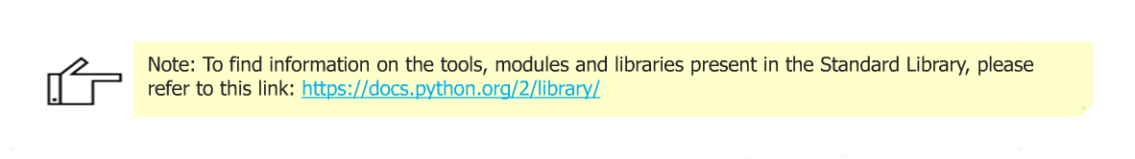
Standard Library
Standard Library is a collection of tools that come with Python. The standard library includes the following:
Built-in Functions
Modules
Packages
There are many tools available in Python's Libraries which are developed and donated by hundreds of programmers
Python's tools are packaged in modules. Hence to use them, you have to import the module it is stored in
The recommended way to import modules is by typing: import <modulename>
Example: import sys

Slide 14
Built-in Functions
Built-in functions are the functions which are built into(already available) Python and can be access by end-users.
Some common built-in functions:
sorted()
abs()
all()
any()
bin()
enumerate()
eval()
input()
int()
len()
open()
Now, lets have a look at some popular built-in functions

Slide 15
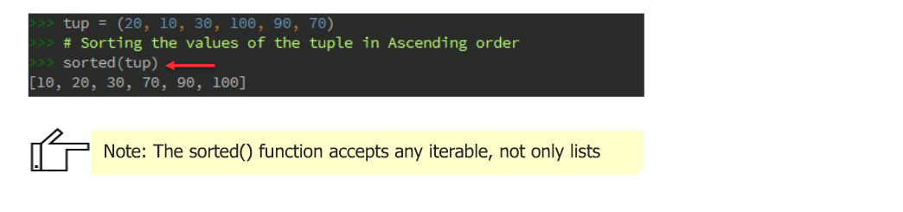
Sorting
Python has a sorted() built-in function that builds a new sorted list fom an iterable
Example: list, tuple etc.
Ascending sort -> Call the sorted(iterable) function. It returns a new sorted list in ascending order.
Example

Slide 16
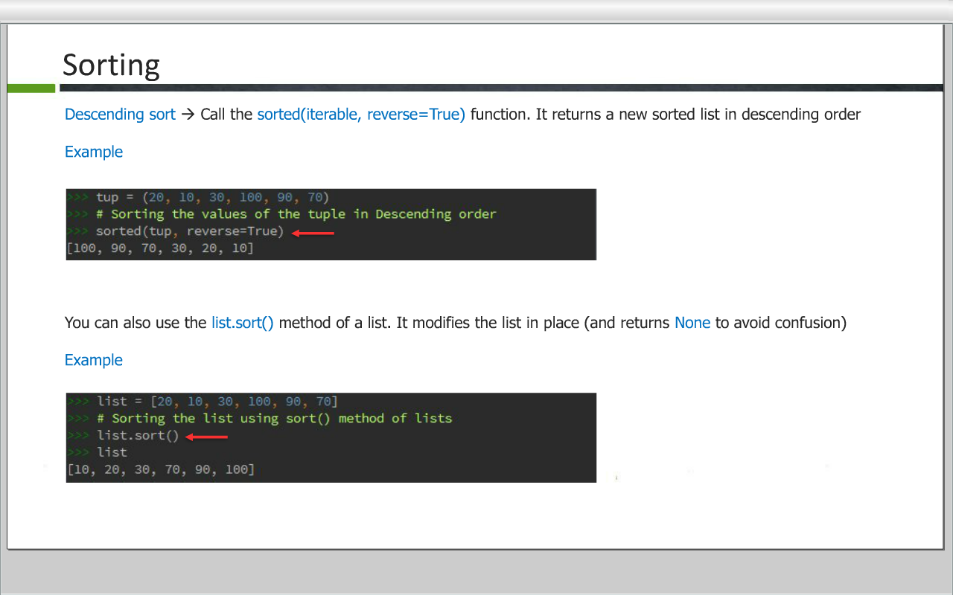
Sorting
Descending sort : Call the sorted(iterable,reverse=True) function. It returns a new sorted list in descending order
Example
You can also use the list.sort() method of a list. It modifies the list in place (and return None to avoid confusion)
Example

Slide 17
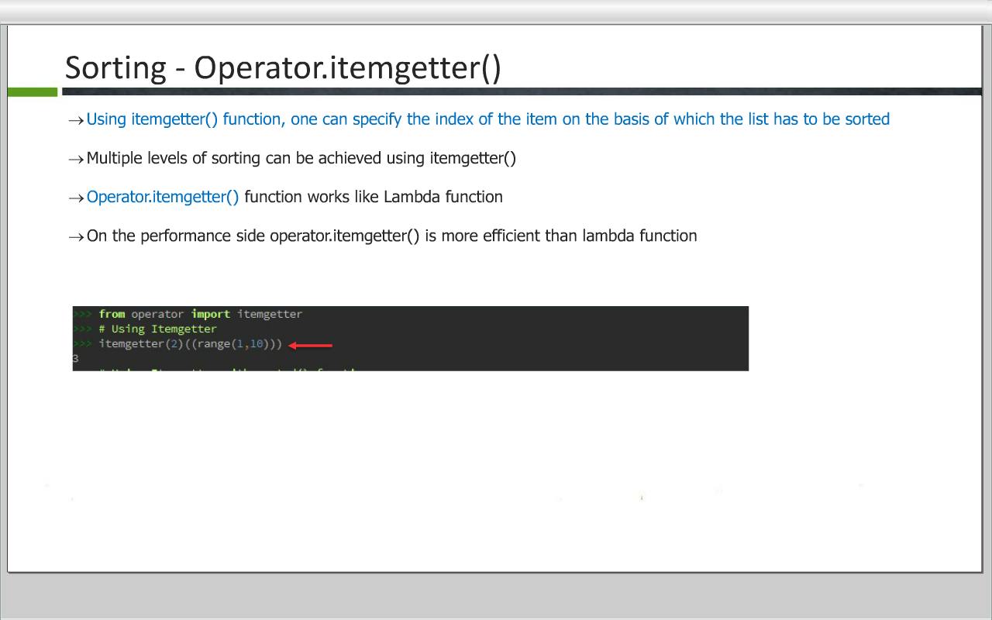
Sorting - Operator.itemgetter()
Using itemgetter() function, one can specify the index of the item on the basis of which the list has to be sorted
Multiple levels of sorting can be achieved using itemgetter()
Operator.itemgetter() function works like Lambda function
On the performance side operator. itemgetter() is more efficient than lambda function

Slide 18
dir()
The dir() function returns an alphabetized list of an object's attributes, such as functions or methods, constants, and the name of the object
To see the names in the current namespace, type dir()
Example :
>>> dir ( )
To see all the attributes (named items) belonging to an object, type dir(name of object)
Example :
>>> dir( sys )

Slide 19
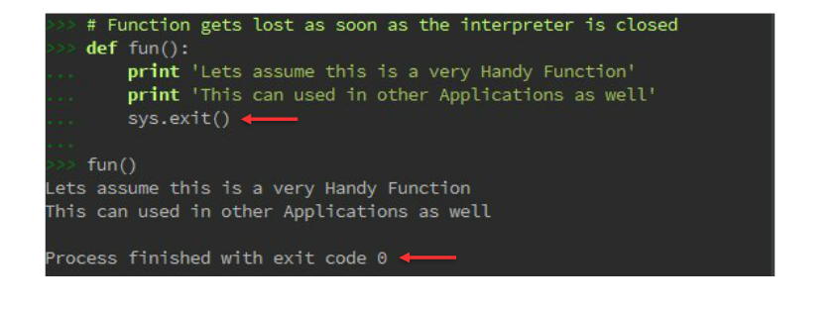
Why Modules?
The code written in interpreter gets lost as soon as the interpreter is closed.

Slide 20
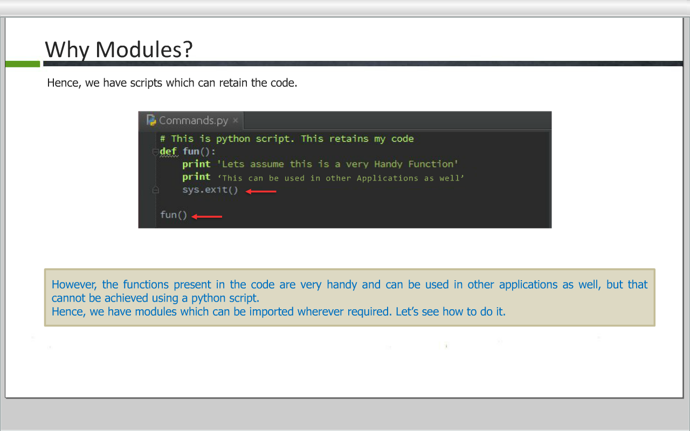
Why Modules?
Hence, we have scripts which can retain the code.

Slide 21
Modules
A module is a python file that (generally) has only definitions of variables, function, and classes.
Some Python modules are written in languages other than Python, most commonly C or C++. Such a module is called an Extension Module
Importing a module
To import a module in interactive mode, or in another Python program, type import followed by the name of the module without the .py suffix, like : import modulename
Initializing a module
Importing a module for the first time in a particular program, or in interactive mode, causes Python to perform a series of action initializing the module.
Python creates a module namespace that stores the names defined in the module
Python runs the code in the module
Python stores the name of the module in the local namespace

Slide 22
Modules (Cont…)
Accessing functions and other items inside a module
mymodule.myfunction(x)
Other ways of accessing module attributes are
To import a specific item, type from, the module name, import, and the item name
Example:
from mymodule import myfunction
To import all of a module's functions, type from, the module name, import, and an asterisk(*), a wildcard character that stands for all
Example:
from mymodule import *
Importing a module using a different name
To import a module (but not a function) using a different name, type import, the module name, as, and the name you want to use
Example:
import tinymodule as mymod

Slide 23
Packages
Packages are namespaces which contain multiple packages and modules themselves. They are simply directories, but with a twist.
Each package in Python is a directory which MUST contain a special file called __init__.py. This file can be empty, and it indicates that the directory it contains is a Python package, so it can be imported the same way a module can be imported.

Slide 24
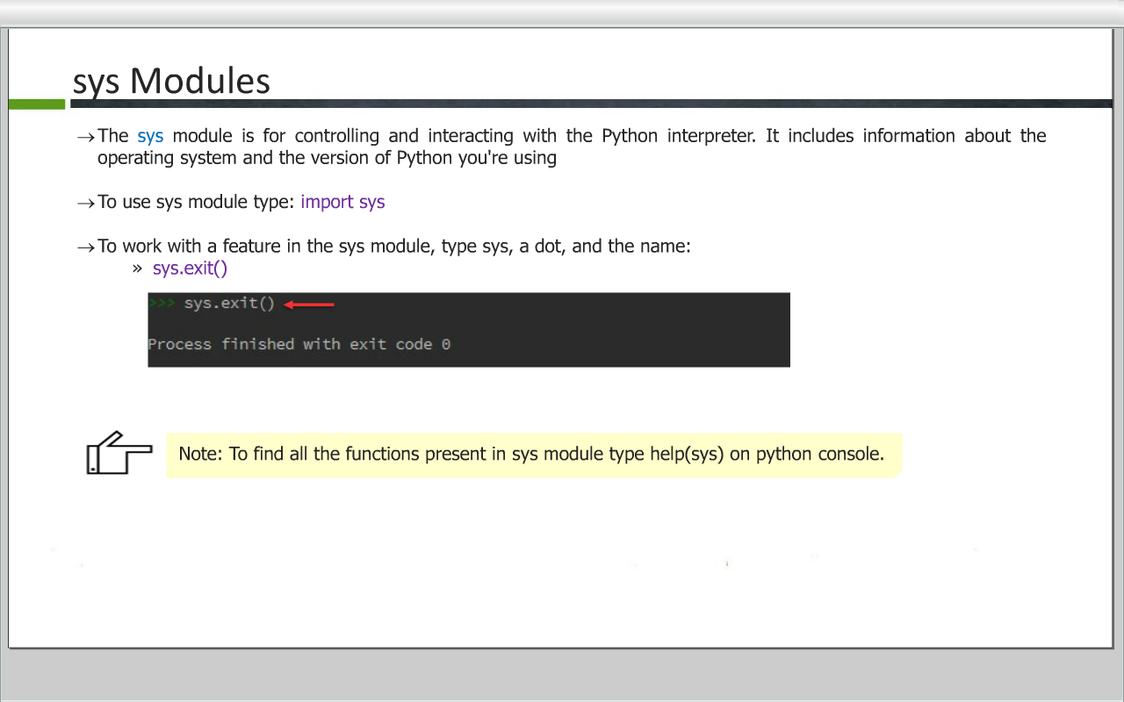
sys Modules
The sys module is for controlling and interacting with the Python interpreater. It includes information about the operating system and the version of Python you're using
To use sys module type : import sys
To work with a feature in the sys module, type sys, a dot, and the name:
sys.exit()

Slide 25
sys Modules
Common Data, Functions present in sys mod
sys.exit() function : Tells the python interpreter to quit. It's the most direct way to end a Python script while it's running
sys.argv list : Stores any command line arguments passed when you started Python. Also includes the name of the program you're running
stdin: Used by the input() function; accept input from user
stdio: Used by the print(); In interactive mode, prints to the screen
stderr: Stores error messages

Slide 26
os and subprocess Modules
The os and subprocess modules include code that lets Python work with your operating system - they even run operating system command
The os module is best for the following tasks:
Working with paths and permissions (test for access to a path, changing directories, changing access permissions and user/group IDs)
Working with files (open, close, write, truncate, create links)
The subprocess module, lets you safely interac with the operating system to run commands and get information out of them.

Slide 27
Function of OS module
os.system() : Executing a shell command
os.environ : Get the users environment
os.getcwd() : #Returns the current working directory.
os.getpid() : Returns the real process ID of the current process.
os.name : Return information identifying the current operating system.
os.listdir(path) : Return a list of the entries in the directory given by path.
os.mkdir(path) : Create a directory named path with numeric mode.
os.remove(path) : Remove (delete) the file path.
os.removedirs(path) : Remove directories recursively.
os.rename(src, dst) : Rename the file or directory src to dst.
os.rmdir(path) : Remove (delete) the directory path.

Slide 28
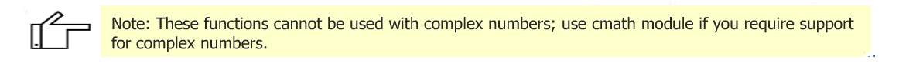
Math Module
In order to achieve the final result, you have to code many computational logics using mathematical functions
To ease this task various mathematical functions are predefined and can be used using math module
Math functions are broadly classified into:
Number-theoretic
Power and Logarithmic Functions
Trigonometric Functions
Angular Conversion
Hyperbolic Function
Special Functions
Constants

Slide 29
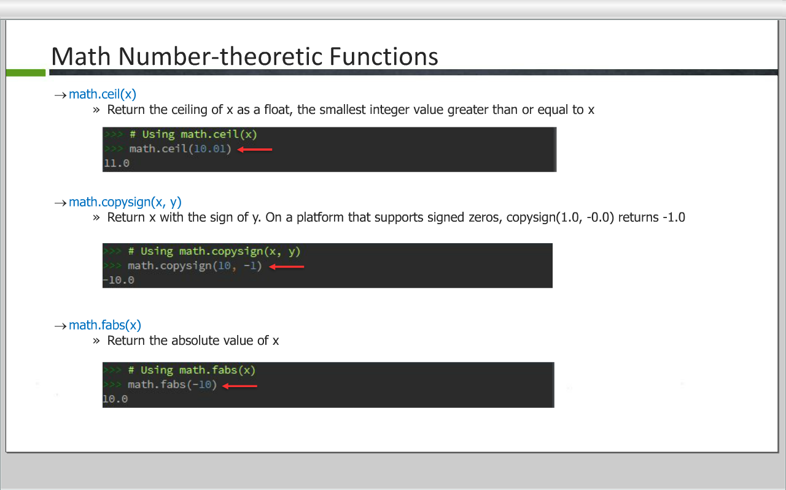
Math Number-theoretic Function

Slide 30
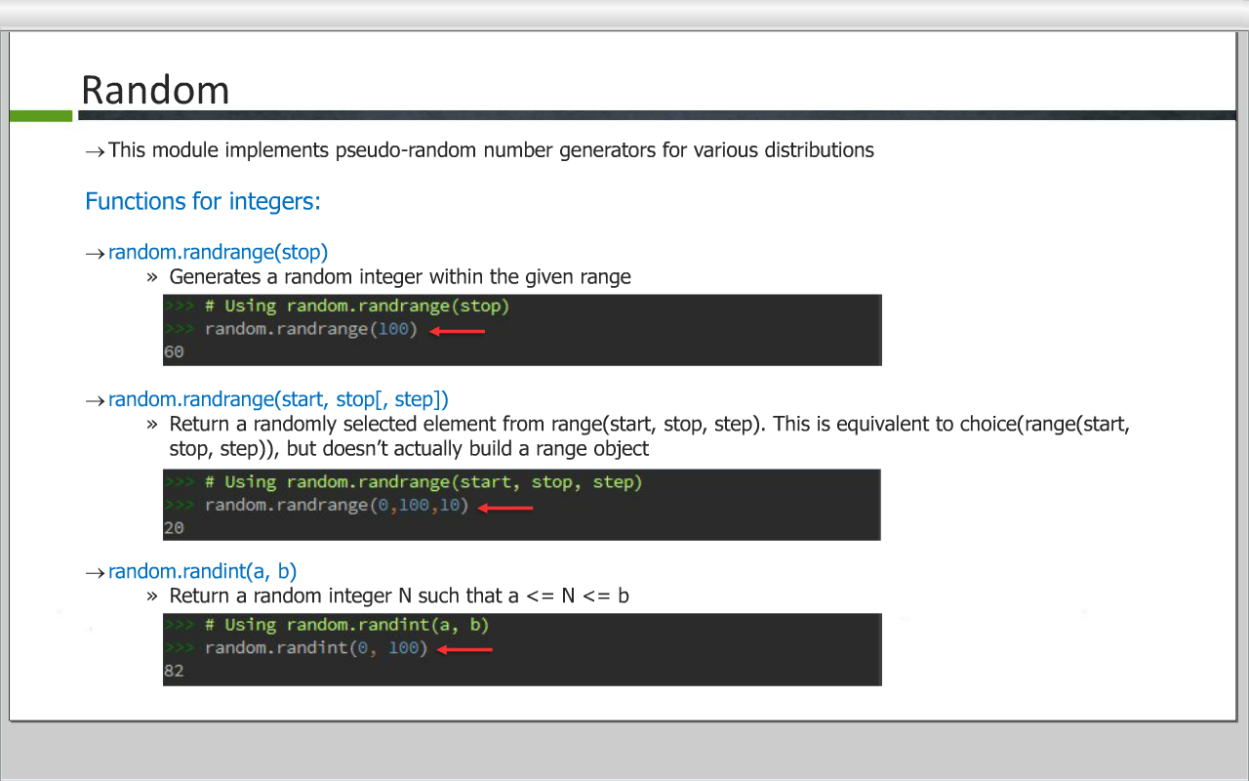
Random

Slide 31
Date Time Module
In Python, date, time and datetime classes provides a number of function to deal with dates, times and time intervals.
Date and datetime are an object in Python, so when you manipulate them, you are actually manipulating objects and not string or timestamps. Whenever you manipulate dates or time, you need to import datetime function.
The datetime classes in Python are categorized into main 5 classes:
date – Manipulate just date ( Month, day, year)
time – Time independent of the day (Hour, minute, second, microsecond)
datetime – Combination of time and date (Month, day, year, hour, second, microsecond)
timedelta— A duration of time used for manipulating dates
tzinfo— An abstract class for dealing with time zones

Slide 32
Date Time Module
An object that stores date and time information looks like this: datetime.datetime(1969, 7, 20, 22, 56)
datetime.datetime is the type of object
The arguments are integers, separated by commas, in this order:
year, month, and day of month
Optional arguments (which default to 0): hours, minutes, seconds, microseconds. Another optional argument is time zone information, which defaults to None
Example:
>>> import datetime
>>> # Datetime object
>>> str(datetime.datetime(1997,7,20,22,56))
'1997-07-20 22:56:00‘

Slide 33
Date Time Module
Calculating Time Difference
When you perform arithmetic on datetime() objects, you get the result in a timedelta() object. Its attributes are days, seconds, and microseconds
Example:
>>> # Using datetime.datetime.today()
>>> print(datetime.datetime.today())
2018-05-31 14:05:11.367469
>>> # Adding time
>>> now = datetime.datetime.today()
>>> other=datetime.datetime(1997,7,20,22,56)
>>> now-other
datetime.timedelta(7619, 54579, 919102)
>>> print(now-other)
7619 days, 15:09:39.919102

Slide 34
THANK YOU!!
visit : www.rcplindia.in
santosh@rcplindia.in

