Slide 1

File Handling

Slide 2


Stream
A stream is simply a sequence of bytes that flows into or out of our program.
It’s an abstract representation of an input or output device.
Data
Data
Program
Input Stream
Output Stream

Slide 3
Input & Output Streams
Input Stream : Any stream, the data can be read from.
Output stream : Any stream, the data can be written to.
Types of Streams :
Binary or Byte Streams: While writing data to a Binary Stream, the data is written as a series of bytes, exactly as it appears in the memory. No data transformation takes place.
Character Streams: With character streams, program reads and writes Unicode characters, but the stream will contain characters in the equivalent character encoding used by the local computer.

Slide 4
Working with File
Files are storage compartments on your computer that are managed by operating system
Python built-in open() function creates a Python file object, which serves as a link to a file residing on your machine
file object = open(file_name, access_mode])
>>> # Creating a new file and opening it in writing mode
>>> newFile = open("test.txt" , "w")
>>> # Opening a file in a read mode
>>> newFile = open("test.txt","r")

Slide 5
Mode of Opening a File in Binary
Mode | Meaning
rb | Open a binary file for reading.
rb+ | Open a binary file for read/write.
wb | Create a binary file for writing.
wb+ | Create a binary file for read/write.
ab | Append to a binary file.
ab+ | Append or create a binary file for read/write.

Slide 6
Mode of Opening a File in character
Mode | Meaning
r | Open for reading only. Start at beginning of file.
r+ | Open for reading and writing. Start at beginning of file.
w | Open for writing only. Remove all previous content, if file doesn’t exist, create it.
w+ | Open for writing mode. Truncates the file (effectively overwriting it). If the file doesn't exist, it will attempt to create the file. it deletes all information in the file when the file is opened.
a | Open writing, but start at END of current content.
a+ | Open for reading and writing, start at END and create file if necessary.

Slide 7
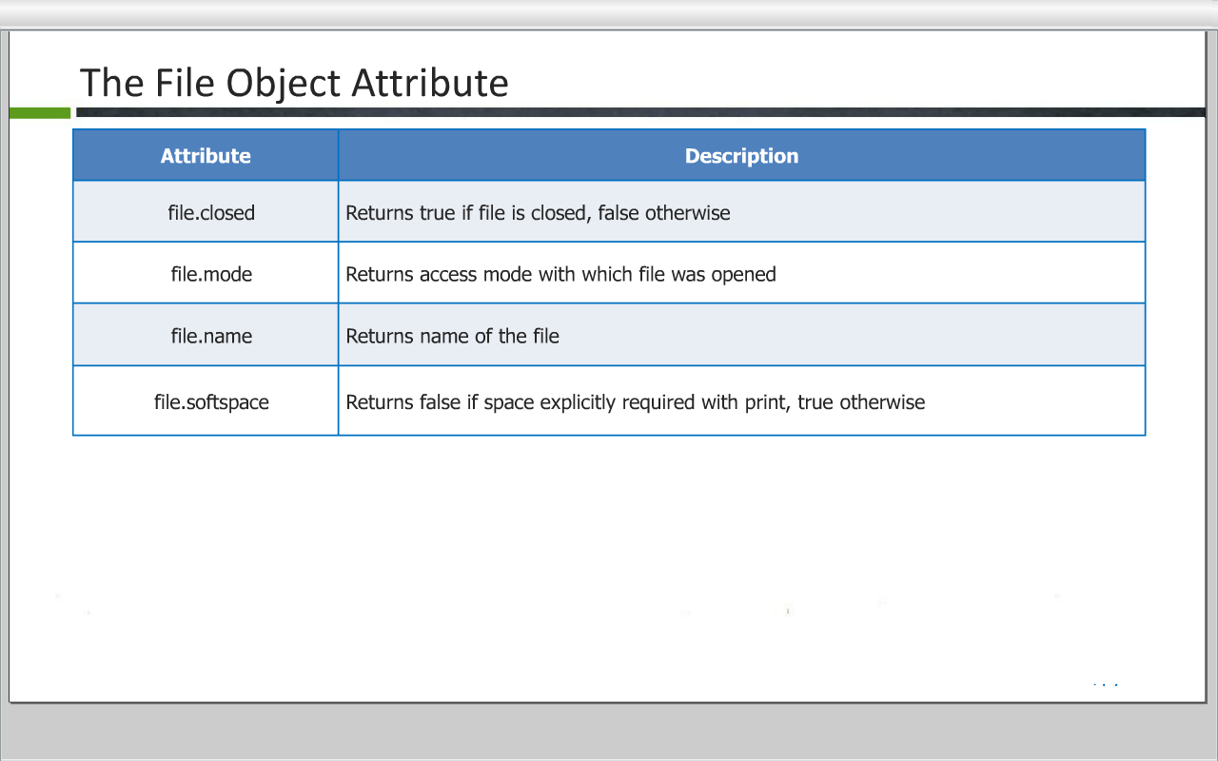
File Handling

Slide 8
Common File Methods
write()
The write() method writes any string to an open file. It is important to note that Python strings can have binary data and not just text.
Syntax: fileObject.write(string);
read()
The read() method reads a string from an open file. It is important to note that Python strings can have binary data and not just text.
Syntax: fileObject.read([count]);
close()
The close() method of a file object flushes any unwritten information and closes the file object, after which no more writing can be done.
Python automatically closes a file when the reference object of a file is reassigned to another file. It is a good practice to use the close() method to close a file.
Syntax: fileObject.close();

Slide 9
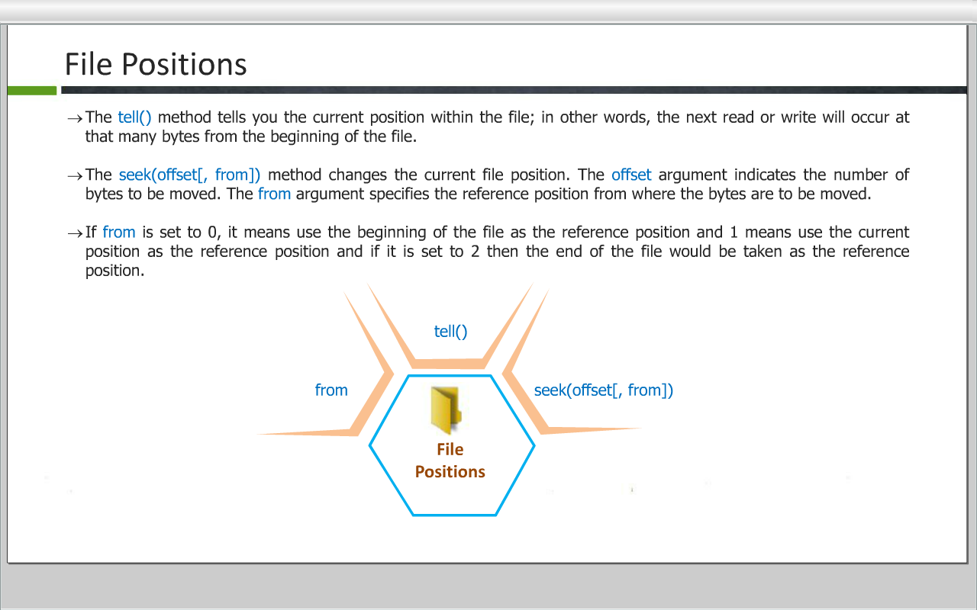
File Positions
The tell() method tells you the current position within the file; in other words, the next read or write will occur at that many bytes from the beginning of the file.
The seek(offset[, from]) method changes the current file position. The offset argument indicates the number of bytes to be moved. The from argument specifies the reference position from where the bytes are to be moved.
If from is set to O, it means use the beginning of the file as the reference position and I means use the current position as the reference position and if it is set to 2 then the end of the file would be taken as the reference position.

Slide 10
Python pickle Package
Pickle is used to serialize and deserialize a python object structure. Any object on python can be pickled so that it can be saved on disk.
Pickle first serialize the object and then converts the object into a character stream so that this character stream contains all the information necessary to reconstruct(deserialize) the object in another python script.
Use pickle.dump(object,file,protocol) function to store the object data to the file.
Use pickle.load(file) to retrieve pickled data.

Slide 11
Python pickle Example(pickling)
import pickle
data = { 'a': [1, 2.5, 3, 4 + 6j], 'b': ("character string"), 'c': {None, True, False} }
file=open('data.pickle', ‘wb')
pickle.dump(data, file, pickle.HIGHEST_PROTOCOL)
file.close()
print("data written")

Slide 12
Python pickle Example(unpickling)
import pickle
file=open('data.pickle', 'rb')
print("data from file:")
data = pickle.load(file)
file.close()
print(data)

Slide 13
THANK YOU!!
visit : www.rcplindia.in
santosh@rcplindia.in

