Slide 1

Object Oriented Programming

Slide 2
Object-Oriented Programming
Object-Oriented Programming(OOP) is an approach of looking at a problem using models which are organized around the real-world concepts.
The fundamental construct of Object-Oriented Programming (OOP) is object which combines both data structure and behavior as a single entity.
Features of object-oriented programming are:-
Abstraction
Encapsulation
Inheritance
Polymorphism

Slide 3
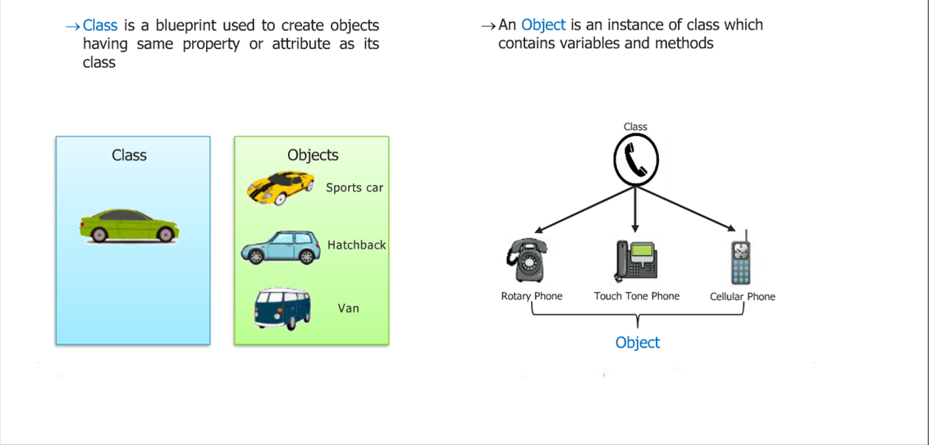
Classes an Objects

Slide 4
Classes an Objects
Class is a template definition of methods and variables in a particular kind of object.
A class describes the abstract characteristics of a real life thing
There can be instances of classes ,an instance is an object of a class created at runtime.
The set of values of the attributes of a particular object is called its states.
The set of methods of particular object is called its behaviors.

Slide 5
Classes and Objects in Python
Compared with other programming languages, Python’s class mechanism adds classes with a minimum of new syntax and semantics. It is a mixture of the class mechanisms found in C++ and Modula-3.
All Classes in python are derived from object class
A class can consists of class and instance variables, methods, constructors etc.
Syntax:-
class <class-name>:
“docstring”
<class suite>
Defining Empty Class:
class Student(object):
“Empty Student Class”
pass
Creating Object:
obj=Student( )
print( obj )

Slide 6
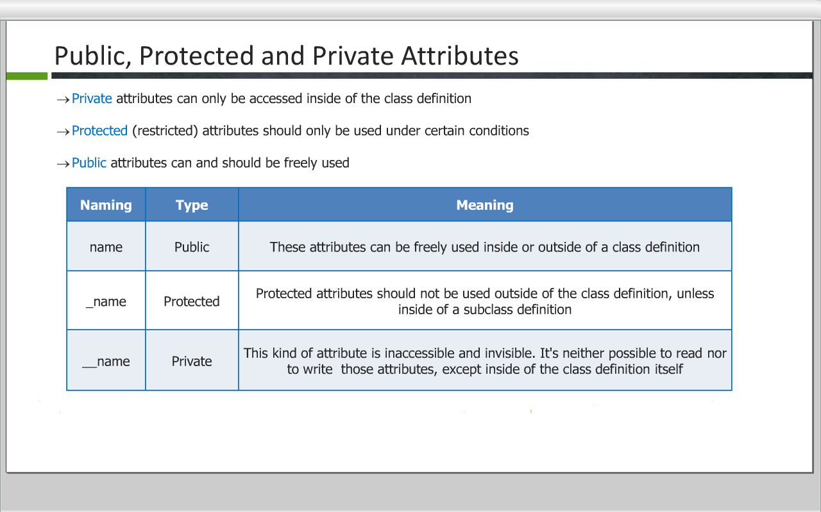

Slide 7
Classes and Objects in Python
# Defining Constructor:
def __init__(self):
print("constructor called")
# Defining Methods:
def show(self):
print("Hello from Show")
# Defining Static Methods:
@staticmethod def display(): print(" This is static in python ")
# Destructor def __del__(self): class_name = self.__class__.__name__ print(class_name, "destroyed")

Slide 8
Classes and Objects in Python
def fmin(self, x, y): return min(x, x+y) class Test: fn = fmin
def message(self): return 'hello world‘
varf = message

Slide 9
Inheritance in Python

Slide 10
Inheritance
Inheritance is the mechanism of acquiring some attributes of any existing class type into a new class type.
One of the key concepts of OOP’s.
Establishes a hierarchical relationship among classes.
Establishes a superclass/subclass relationship.
Establishes “is a” relationships.
Benefits:
Reusability of code.
Put code in one class, use it in all the subclasses.
Write general purpose code designed for a supertype that works for all subtypes.
A superclass defines a general set of functionality, whereas subclasses define functionalities specific to them.

Slide 11
Inheritance in Python
Syntax:
class DerivedClassName(BaseClassName):
<statement-1>
. . .
<statement-N>
The name BaseClassName must be defined in a scope containing the derived class definition.
In place of a base class name, other arbitrary expressions are also allowed. This can be useful, for example, when the base class is defined in another module.
Example:
class DerivedClassName(modulename.BaseClassName):
pass

Slide 12
Inheritance in Python
Python has two built-in functions that work with inheritance
Use isinstance() to check an instance’s type: isinstance(obj, Test) will be True only if obj.__class__ is Test or some class derived from Test.
Use issubclass() to check class inheritance: issubclass(Derive, Base) is True if Derive is a subclass of Base else False.

Slide 13
Constructor in Inheritance
Constructor Calling from Subclass:
def __init__(self): Base.__init__(self) # super(Derive,self).__init__() super().__init__() print("constructor derive")

Slide 14
Abstract classes in Python
For making a class abstract first you have to import abc package for Abstract base Class in Python.
Example:
from abc import ABC, ABCMeta, abstractmethod
class MyBase(ABC):
__metaclass__ = ABCMeta
@abstractmethod
def show(self):
pass
class Derive(MyBase):
def show(self):
print("Show from derive….")
derive=Derive()
derive.show()
#base=MyBase() #error can’t instantiate

Slide 15
Operator Overloading in Python
class Point:
def __init__(self, x = 0, y = 0):
self.x = x
self.y = y
def __str__(self):
return "({0},{1})".format(self.x,self.y)
def __add__(self,other):
x = self.x + other.x
y = self.y + other.y
return Point(x,y)
p1=Point(2,3)
p2=Point(2,3)
print(p1+p2)
# (4,6)

Slide 16
THANK YOU!!
visit : www.rcplindia.in
santosh@rcplindia.in

