Slide 1

Numpy

Slide 2
What is NumPy
NumPy is an extension to the Python programming language, adding support for large, multi-dimensional arrays and matrix's, along with a large library of high-level mathematical functions to operate on these arrays.
NumPy is the fundamental library needed for scientific computing with Python.
This contains:
N-dimensional array object
Array slicing methods
Array reshaping methods
Numerical routines in numpy:
Linear algebra functions
Fourier transform
Random number capabilities

Slide 3
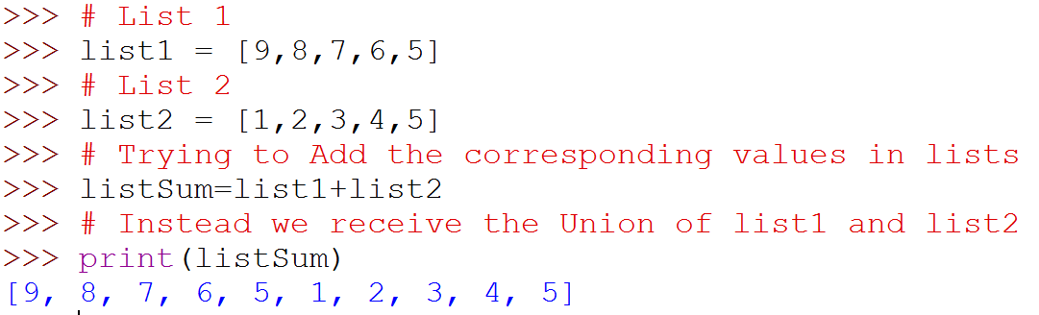
Why NumPy
Arithmetic Operation can not applied directly on lists
Example:
Hence we need efficient arrays with arithmetic and better multidimensional tools
NumPy package provide arrays which are similar to lists, but much more capable, except fixed size

Slide 4
NumPy - ndarray
NumPy’s main object is ndarray (homogeneous multidimensional array).
It is a table of elements (usually numbers), all of the same type, indexed by a tuple of positive integers.
Dimensions → usually called axes.
Rank → number of axes.
Examples of multidimensional arrays include vectors, matrices, images and spreadsheets
[9, 1, -1] → An array of rank 1 i.e. A matrix with 1 row and columns
[ [ 10, 0.21, -30], → An array of rank 2 ( A matrix with 2 rows and 3 columns)
[ 1.9, 7.4, 1.9] ]

Slide 5
Numpy – ndarray Attributes
ndarray.ndim
Gives dimensiona (ran of axes) of the array
ndarray.shape
For a matrix with n rows and m columns, shape will be tuple (n,m). The length of the shape tuple is therefore the rank, or number of dimensions, ndim.
ndarray.size
the total number of elements of the array. This is equal to the product of the elements of shape.
ndarray.dtype
an object describing the type of the elements in the array. One can create or specify dtype’s using standard Python types. Additionally NumPy provides types of its own. numpy.int32, numpy.int16, and numpy.float64 are some examples.
ndarray.itemsize
the size in bytes of each element of the array. For example, an array of elements of type float64 has itemsize 8 (=64/8), while one of type complex32 has itemsize 4 (=32/8). It is equivalent to ndarray.dtype.itemsize.
ndarray.data
the buffer containing the actual elements of the array. Normally, we won’t need to use this attribute because we will access the elements in an array using indexing facilities.

Slide 6
Numpy - Array Creation
There are a couple of mechanisms for creating arrays in NumPy:
A Python list or tuples
Using functions that are dedicated to generating numpy arrays, such as arange, ones, zeros linspace, etc.
reading data from files

Slide 7
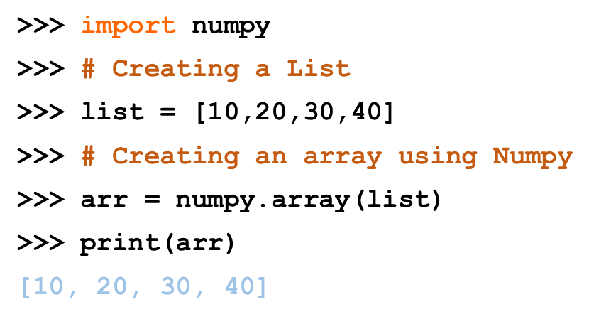
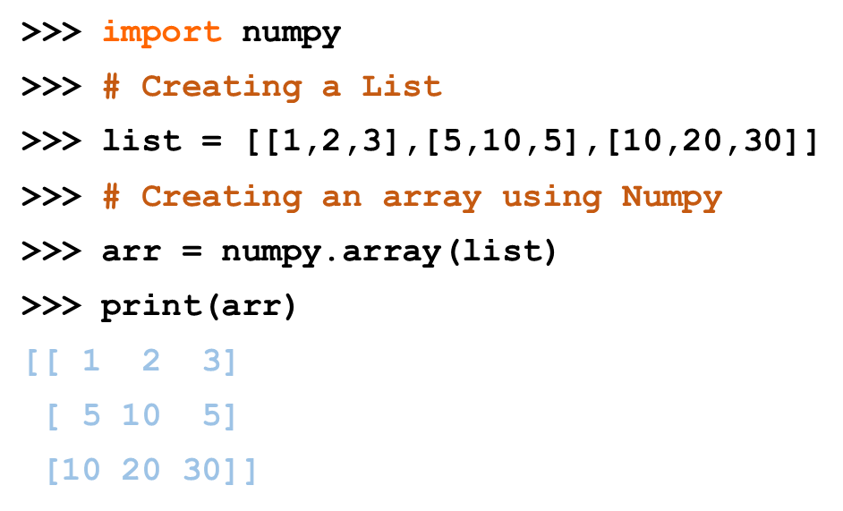
Numpy - Creating Array using list
In general, any numerical data that is stored in an array-like container can be converted to an ndarray through use of the array() function. The most obvious examples are sequence types like lists and tuples.
Creating 1-D Array | Creating 2-D Array

Slide 8
Numpy - Creating Array using built-in function
There are a couple of built-in NumPy functions which will create arrays from scratch.
zeros(shape) -- creates an array filled with 0 values with the specified shape. The default dtype is float64.
ones(shape) -- creates an array filled with 1 values.
arange() -- creates arrays with regularly incrementing values.
linspace() -- creates arrays with a specified number of elements, and spaced equally between the specified beginning and end values.
random.random(shape) – creates arrays with random floats over the interval [0,1).
eye(): Return a 2-D array with ones on the diagonal and zeros elsewhere.

Slide 9
Numpy Methods
sort()
argsort()
transpose()
invert()
dot()
var()
std()

Slide 10
THANK YOU!!
visit : www.rcplindia.in
santosh@rcplindia.in

