Slide 1

MACHINE LEARNING

Slide 2
Example Problem
A credit card company receives thousands of applications for new cards. Each application contains information about an applicant,
age
Marital status
annual salary
outstanding debts
credit rating
etc.
Problem: to decide whether an application should approved, or to classify applications into two categories, approved and not approved

Slide 3
Our Focus for Machine learning
Like human learning from past experiences.
A computer does not have “experiences”.
A computer system learns from data, which represent some “past experiences” of an application domain.
Our focus: learn a target function that can be used to predict the values of a discrete class attribute, e.g., approve or not-approved, and high-risk or low risk.
The task is commonly called: Supervised learning, classification, or inductive learning.

Slide 4
DATA and the GOAL
Data: A set of data records (also called examples, instances or cases) described by
k attributes: A₁, A₂, … A_{k}.
a class: Each example is labelled with a pre-defined class.
Goal: To learn a classification model from the data that can be used to predict the classes of new (future, or test) cases/instances.

Slide 5
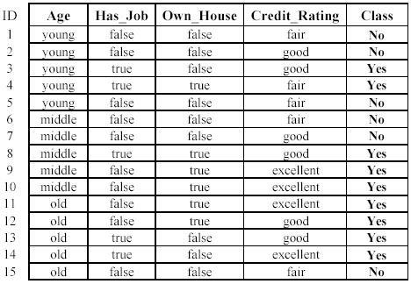
LoaN application data example

Slide 6
An example: the learning task
Learn a classification model from the data
Use the model to classify future loan applications into
Yes (approved) and
No (not approved)
What is the class for following case/instance?

Slide 7
Supervised vs unsupervised
Supervised learning: classification is seen as supervised learning from examples.
Supervision: The data (observations, measurements, etc.) are labeled with pre-defined classes. It is like that a “teacher” gives the classes (supervision).
Test data are classified into these classes too.
Unsupervised learning (clustering)
Class labels of the data are unknown
Given a set of data, the task is to establish the existence of classes or clusters in the data

Slide 8
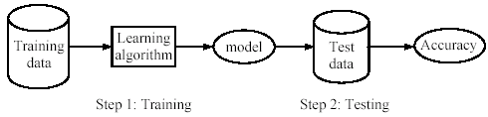
Supervised learning process: two steps
Learning (training): Learn a model using the training data
Testing: Test the model using unseen test data to assess the model accuracy

Slide 9
What do we mean by learning?
Given
a data set D,
a task T, and
a performance measure M,
a computer system is said to learn from D to perform the task T if after learning the system’s performance on T improves as measured by M.
In other words, the learned model helps the system to perform T better as compared to no learning.

Slide 10
Fundamental assumption of learning
Assumption: The distribution of training examples is identical to the distribution of test examples (including future unseen examples).
In practice, this assumption is often violated to certain degree.
Strong violations will clearly result in poor classification accuracy.
To achieve good accuracy on the test data, training examples must be sufficiently representative of the test data.

Slide 11
SVM
Support vector machines (SVMs) are a set of supervised learning methods used for classification and regression
The advantages of support vector machines are:
Effective in high dimensional spaces.
Still effective in cases where number of dimensions is greater than the number of samples.
Uses a subset of training points in the decision function (called support vectors), so it is also memory efficient.
Versatile: different Kernel functions can be specified for the decision function. Common kernels are provided, but it is also possible to specify custom kernels.

Slide 12
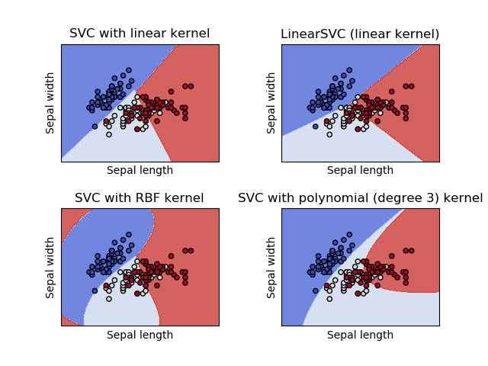
CLASSIFICATION

Slide 13
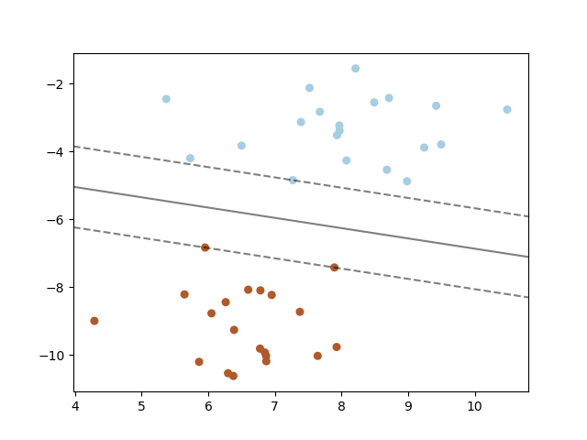
Hyperplane
A support vector machine constructs a hyper-plane or set of hyper-planes in a high or infinite dimensional space, which can be used for classification, regression
a good separation is achieved by the hyper-plane that has the largest distance to the nearest training data points of any class
In general the larger the margin the lower the generalization error of the classifier.

Slide 14
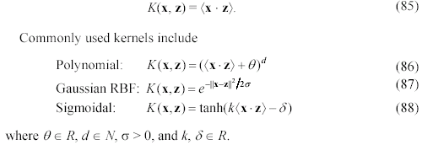
Kernel function
The kernel function can be any of the following:

Slide 15

Evaluating classification methods
Predictive accuracy
Efficiency
time to construct the model
time to use the model
Robustness: handling noise and missing values
Scalability: efficiency in disk-resident databases
Interpretability:
understandable and insight provided by the model
Compactness of the model: size of the tree, or the number of rules.

Slide 16
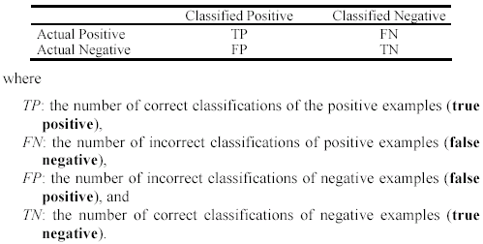
Precision and recall measures
Used in information retrieval and text classification.
We use a confusion matrix to introduce them.

Slide 17

Precision and recall measures
Precision p is the number of correctly classified positive examples divided by the total number of examples that are classified as positive.
Recall r is the number of correctly classified positive examples divided by the total number of actual positive examples in the test set.

Slide 18
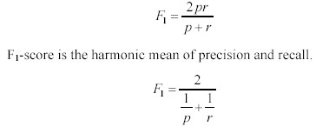
F₁-value (also called F₁-score)
It is hard to compare two classifiers using two measures. F₁ score combines precision and recall into one measure
The harmonic mean of two numbers tends to be closer to the smaller of the two.
For F₁-value to be large, both p and r much be large.

Slide 19
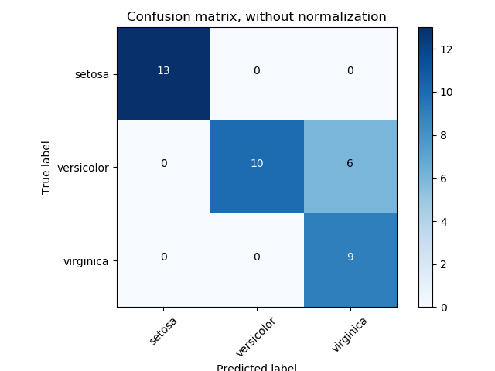
Confusion MAtrix

Slide 20
Sklearn module
from sklearn import svm
* Contains the methods for the svm classification
from sklearn import datasets
*Contains the methods to retrieve the datasets
from sklearn import metrics
* Contains the methods to calculate the evaluating parameters

Slide 21
Pickle module
We use pickle module the use the trained models and load them for the testing script within the current workspace
import pickle
S=pickle.dumps(model)
Here S variable will be there in the workspace of the current shell and can be loaded in any other script for the testing
model2= pickle.loads(S)
Loads method will load the saved model in the variable model2 and its now ready to predict

Slide 22
Saving model in file
from sklearn.externals import joblib
joblib.dump(model, ‘train_model.pkl')
To save the trained model in the folder as train_model.pkl
model= joblib.load(‘train_model.pkl')

Slide 23
Downloading datasets from external source
from sklearn.datasets import fetch_mldata
mnist = fetch_mldata('MNIST original', data_home=‘./’)
This command will fetch the original MNIST complete dataset from the ml library online available and save it in the root directory of the python

Slide 24
SVC method
Classifier = svm.SVC()
SVC(C=1.0, kernel=’rbf’, degree=3, gamma=’auto’, coef0=0.0, shrinking=True, probability=False, tol=0.001, cache_size=200, class_weight=None, verbose=False, max_iter=-1, decision_function_shape=’ovr’, random_state=None)
C : float, optional (default=1.0)Penalty parameter C of the error term.
kernel : string, optional (default=’rbf’)
degree : int, optional (default=3) for poly kernel only
gamma : float, optional (default=’auto’) for rbf, sig and poly its generally 1/n features or auto
coef0 : float, optional (default=0.0) only for poly and sig kernel
probability : boolean, optional (default=False) Whether to enable probability estimates.
tol : float, optional (default=1e-3) stopping criteria

Slide 25
sVC METHOD
decision_function_shape : ‘ovo’, ‘ovr’, default=’ovr’ used for multiclass processing
max_iter : int, optional (default=-1)
random_state : int, RandomState instance or None, optional (default=None)
Attributes of the trained models:
support_ - array-like, shape = [n_SV] Indices of support vectors
support_vectors_ : array-like, shape = [n_SV, n_features] Support vectors.
n_support_ : array-like, dtype=int32, shape = [n_class] Number of support vectors for each class.

Slide 26
Aedifico Tech Pvt. Ltd
Office:
C-16,Aruna Park, LAXMI NAGAR, DELHI - 110092
Contact: 011- 65025584, 9910025548, 9910025524,
26
26
Notes:
26

