Slide 1
Support Vector Machine(SVM)

Slide 2
What is Support Vector Machine(SVM)?
Data classification is a very important task in machine learning. Support Vector Machines (SVMs) are widely applied in the field of pattern classifications and nonlinear regressions
A Support Vector Machine is a supervised machine learning algorithm which can be used for both classification and regression problems. It follows a technique called the kernel trick to transform the data and based on these transformations, it finds an optimal boundary between the possible outputs.

Slide 3
How does it work?
The main idea is to identify the optimal separating hyperplane which maximizes the margin of the training data.

Slide 4
Hyperplane??
For instance, we can draw a line in which all the points above the line are green and the ones below the line are red. Such a line is said to be a separating hyperplane.
The support vector machine can work for a general n-dimensional dataset too. And in the case of higher dimensions, the hyperplane is the generalization of a plane.
More formally, it is an n-1 dimensional subspace of an n-dimensional Euclidean space. So for a
1D dataset, a single point represents the hyperplane.
2D dataset, a line is a hyperplane.
3D dataset, a plane is a hyperplane.
And in the higher dimension, it is called a hyperplane.

Slide 5
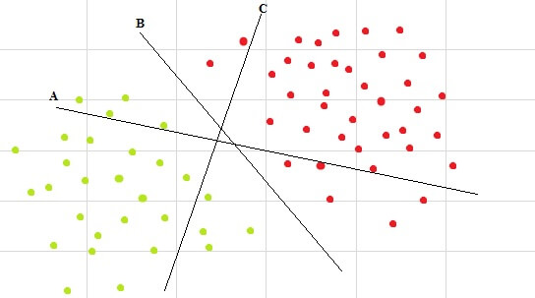
Multiple hyperplanes
There are multiple hyperplanes, but which one of them is a separating hyperplane? It can be easily seen that line B is the one which best separates the two classes.

Slide 6
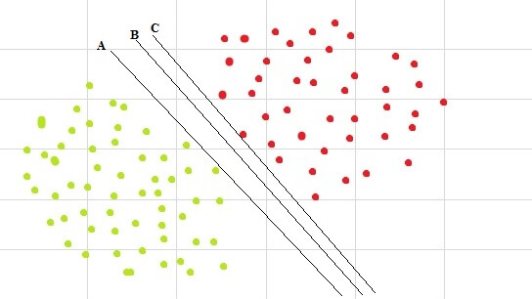
Multiple separating hyperplanes
So the aim is to choose the hyperplane which is as far as possible from the data points of each category.

Slide 7
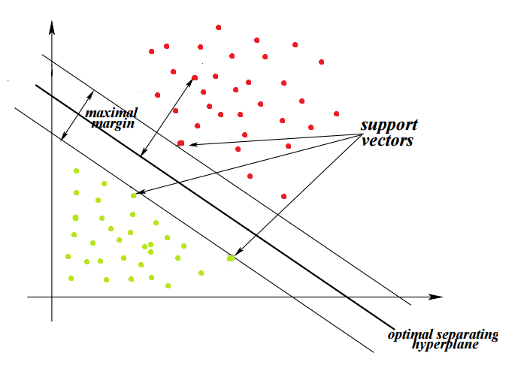
Choose Optimal HyperPlane
Maximizing the distance between the nearest points of each class and the hyperplane would result in an optimal separating hyperplane. This distance is called the margin.
The goal of SVMs is to find the optimal hyperplane because it not only classifies the existing dataset but also helps predict the class of the unseen data. And the optimal hyperplane is the one which has the biggest margin.

Slide 8
Regularization parameter
C is the regularization parameter that controls the trade-off between the slack variable penalty (misclassifications) and width of the margin.
Small C makes the constraints easy to ignore which leads to a large margin.
Large C allows the constraints hard to be ignored which leads to a small margin.
For C=inf, all the constraints are enforced.

Slide 9
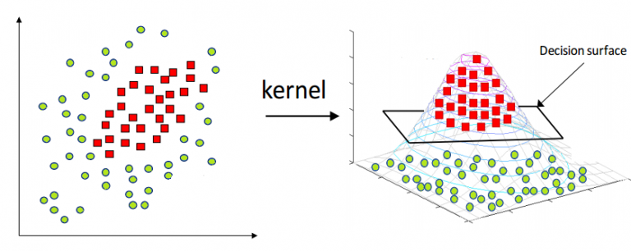
Kernel trick
kernel trick where the kernel function transforms the data into the higher dimensional feature space so that a linear separation is possible.

Slide 10
Parameters
C: It is the regularization parameter, C, of the error term.
kernel: It specifies the kernel type to be used in the algorithm. It can be ‘linear’, ‘poly’, ‘rbf’, ‘sigmoid’, ‘precomputed’, or a callable. The default value is ‘rbf’.
degree: It is the degree of the polynomial kernel function (‘poly’) and is ignored by all other kernels. The default value is 3.
gamma: It is the kernel coefficient for ‘rbf’, ‘poly’, and ‘sigmoid’. If gamma is ‘auto’, then 1/n_features will be used instead.

Slide 11
Pro’s Of SVM
The very nature of the Convex Optimization method ensures guaranteed optimality. The solution is guaranteed to be a global minimum and not a local minimum.
SVM is an algorithm which is suitable for both linearly and nonlinearly separable data (using kernel trick). The only thing to do is to come up with the regularization term, C.
SVMs work well on small as well as high dimensional data spaces. It works effectively for high-dimensional datasets because of the fact that the complexity of the training dataset in SVM is generally characterized by the number of support vectors rather than the dimensionality. Even if all other training examples are removed and the training is repeated, we will get the same optimal separating hyperplane.
SVMs can work effectively on smaller training datasets as they don’t rely on the entire data.

Slide 12
Con’s Of SVM
They are not suitable for larger datasets because the training time with SVMs can be high and much more computationally intensive.
They are less effective on noisier datasets that have overlapping classes.

