Slide 1

Car Parking System
Team Name: Path Hackers
Jyoti Thakral 800952063
Pawan Araballi 800935601
Asasuddin Syed 800936339
Nikita Mehta 800935482
Akanksha Avhad 800936330
Gaurav Pant 800935199

Slide 2
Project Definition
The objective is to build an application that makes it easier for people to book parking spaces online in a faster and convenient way.

Slide 3
Scope of Work
Car Parking System is designed to make it easier for people to book parking spaces online.
The system in real time will enhance the website by enabling customers to pre-book parking spaces both online and at the entry point.
Car Parking System administrator can add as many car space types as they need for different locations, set availability periods and prices.
The web application dashboard allows the user to determine the vacant parking slots at different locations which in turn helps save time.
Additionally, users have the capability to view the past booking history via reports/graphs.

Slide 4
EERD

Slide 5
Entities
Users
UserRoles
Vehicles
Bookings
Locations
BookingHistory
ParkingSpaces
Tarrifs
Payments

Slide 6
Business Rules
User can only have one login account and can have only one role (student, faculty, guest) and a role can have multiple users (one to many).
A location can have multiple vehicles and a vehicle can be parked at multiple locations (many to many)
User can make multiple bookings with a single login account and a booking always belongs to a single user.

Slide 7
Business Rules contd..
A user can have multiple vehicles (one to many) and each vehicle belongs to a single user.
A user can have multiple records for booking history and a single user exists for each booking.
The default duration for reserving a slot is two hours.

Slide 8
Constraints
The start and end time should be in date format.
It doesn’t show the times in any other zones except UTC-5:00 time zones.
Start time should be lesser than the end time.
The application does not support background check.
The application is not keeping track of any kind of physical damage to the vehicle.

Slide 9
Constraints contd..
The system does not prioritize users on the basis of their roles.
The application does not give recommendation for the nearest parking slot available in case of non-availability of requested slot.
The application is restricted to UNC Charlotte campus which can further be scaled, if needed.

Slide 10
Constraints contd..
The system does not prioritize users on the basis of their roles.
The application does not give recommendation for the nearest parking slot available in case of non-availability of requested slot.
The application is restricted to UNC Charlotte campus which can further be scaled, if needed.

Slide 11
User Interface Requirements (UML Use Case Diagram)

Slide 12
List of Users and User Privileges
Administrator
Super User
Can view, create, modify and delete bookings
Guest
Can view the available parking slots for a location
Student & Faculty
Can view the available parking slots
Can request for a new booking for a parking slot

Slide 13
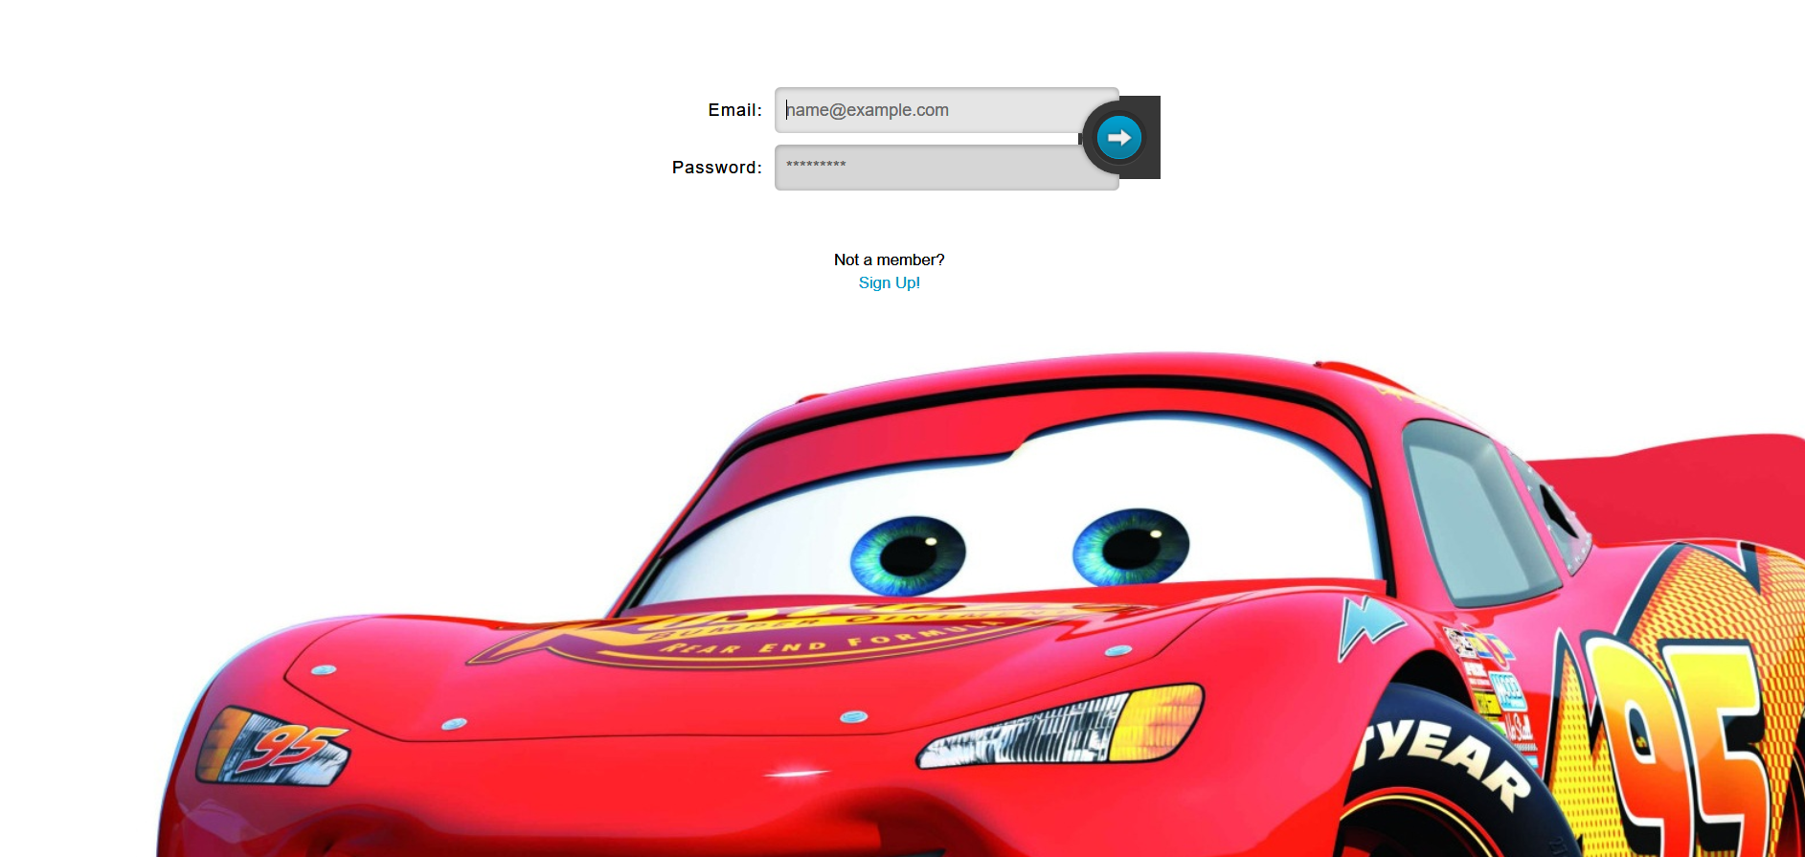
User Login Page

Slide 14
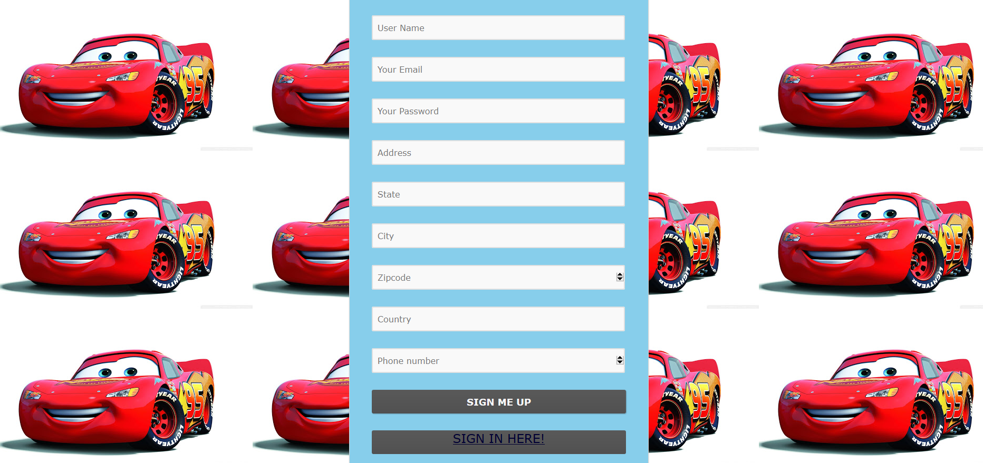
User Registration Page

Slide 15
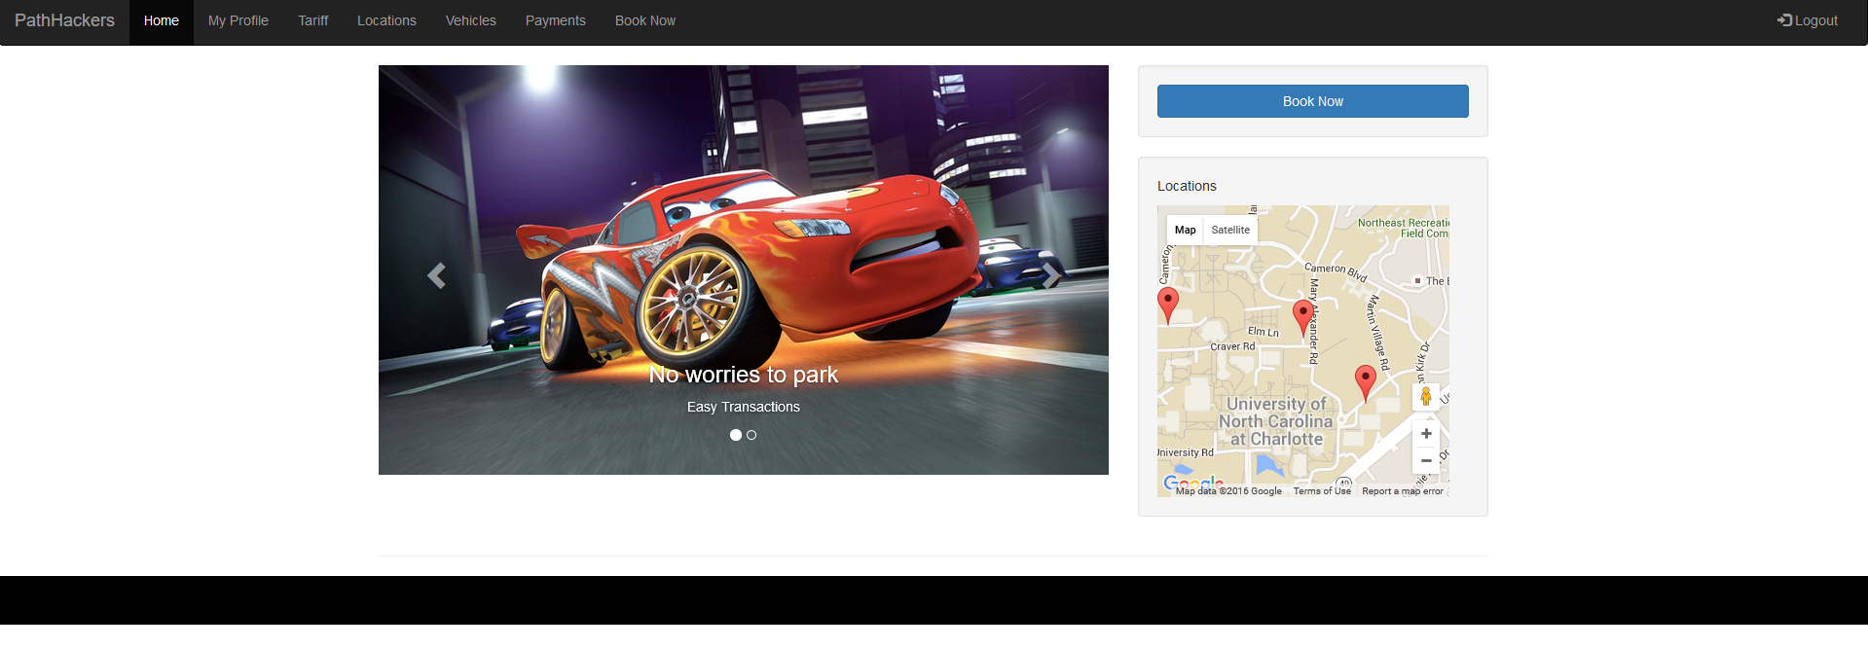
Home Page

Slide 16
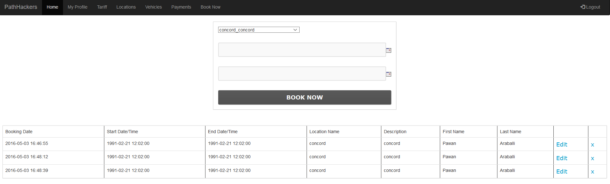
Booking Page

Slide 17
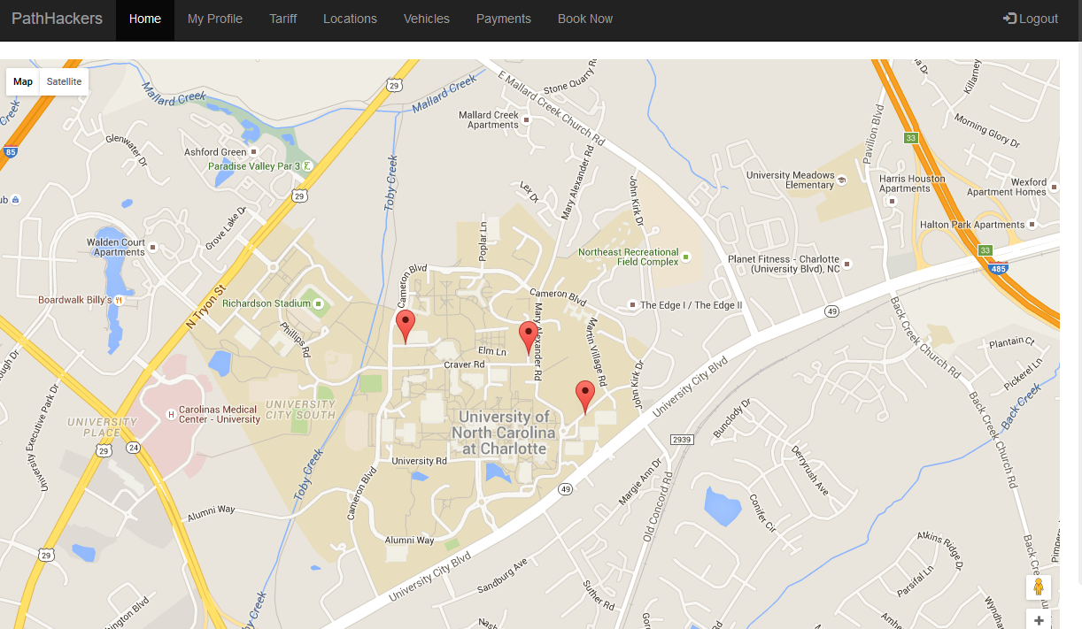
Location Page

Slide 18
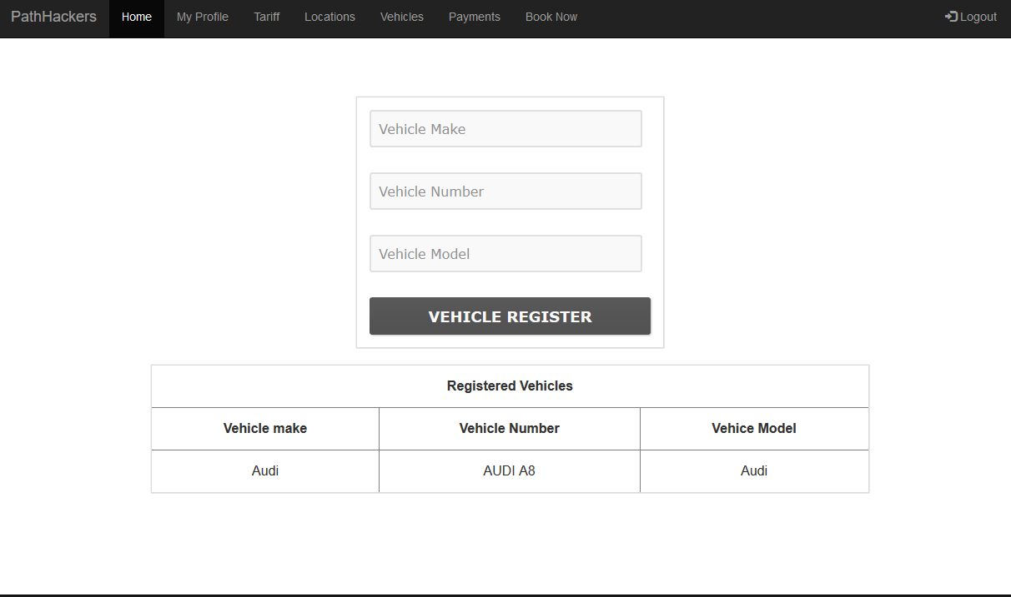
Vehicles Page

Slide 19
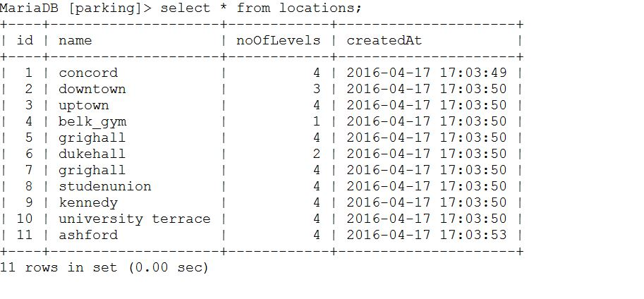
Data

Slide 20
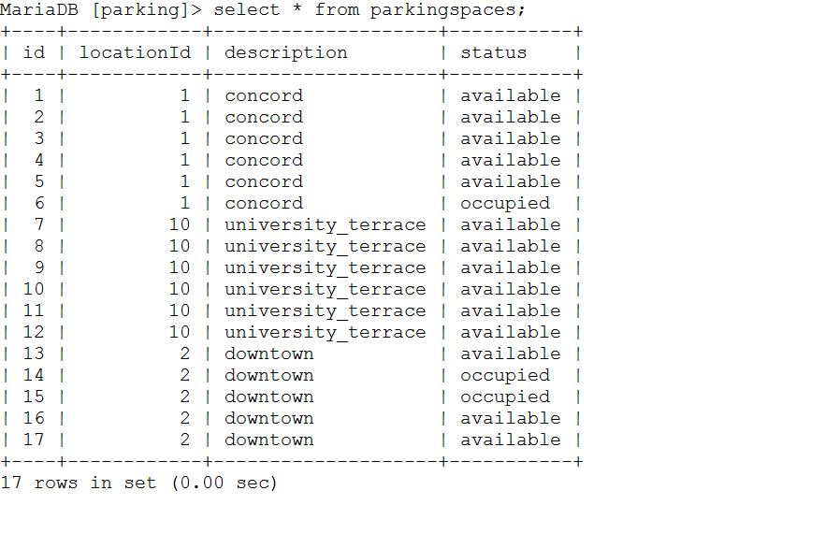
Data Contd..

Slide 21
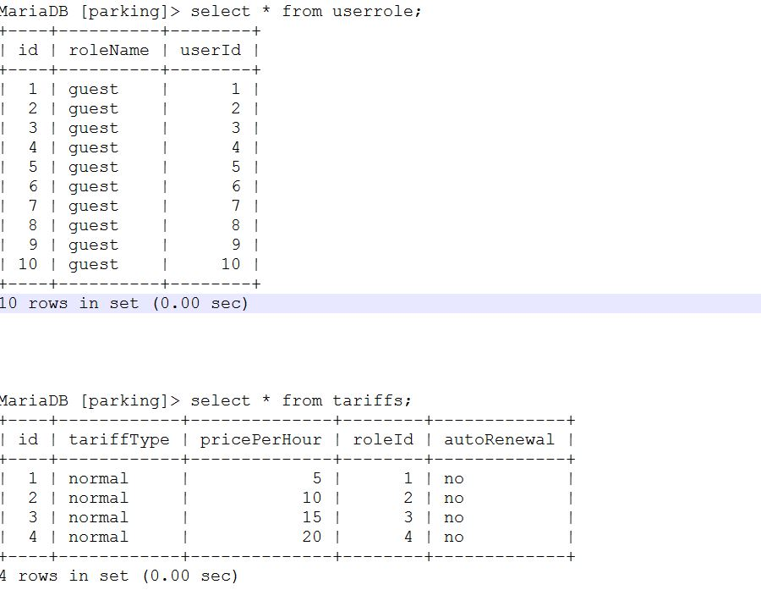
Data Contd..

Slide 22
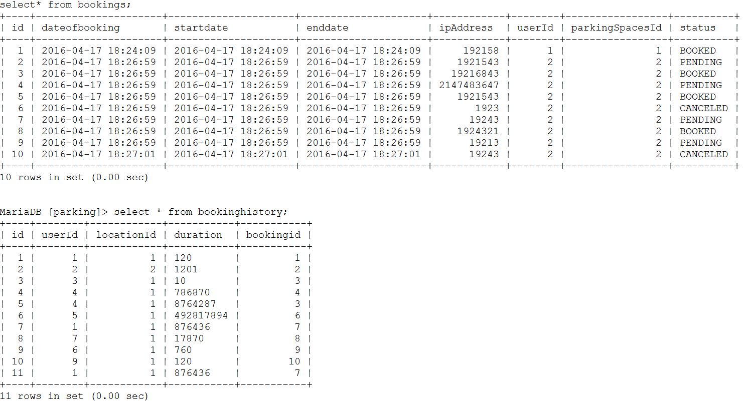
Data Contd..

Slide 23
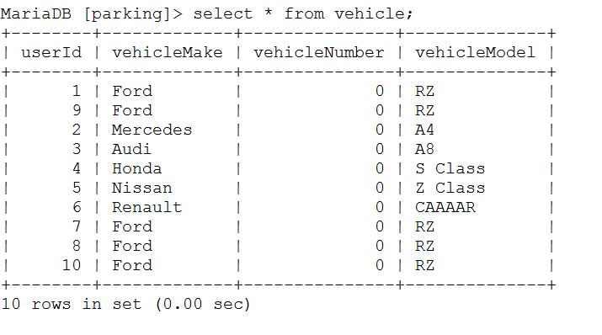
Data Contd...

Slide 24
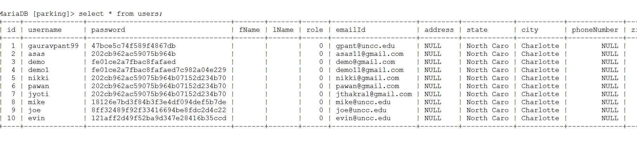
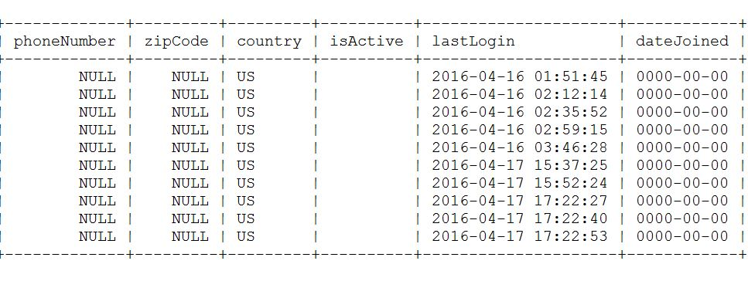
Data Contd..

Slide 25
Future Enhancements
We are thinking big about this project to make it get implemented with the official University website so that we would minimize the problem of students, professors in searching a place to park their vehicle.
As we are very well versed with mobile application development, we are actually thinking of developing an application to make it easier for students.

Slide 26
Thank You …

