Slide 1
Foodelicious
Growth Analysis Report
Submitted by: Akanksha Bajpai

Slide 2
Analysis
The study we have conducted revolves around the critical business problem of optimizing revenue generation by analysing the impact of market campaigns.

Slide 3
We have divided the problem statement into following sub tasks/questions to support our research analysis.
What are the top 10 product categories that exhibited the highest revenue generation following the completion of our marketing campaigns?
How can we describe the monthly revenue trends derived from all households?
Which are the top 5 product categories favoured by households in each income bracket after marketing campaigns?
Can we identify any disparities between the top 5 product categories before and after our marketing campaigns?
Which product categories, despite the implementation of our marketing campaigns, continue to show negligible or no income generation?

Slide 4
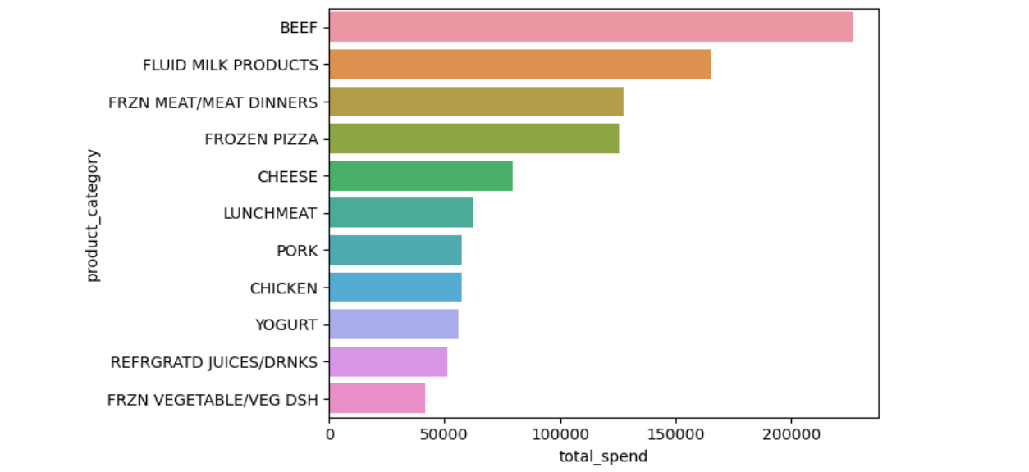
Top 10 products where customers spends more money
"BEEF" generated the Highest Revenue to the store from only the transactions occurred after the campaigns.
"Fluid milk products," "Frozen meat," "Frozen pizza," "Cheese," "Lunchmeat," "Pork," "Chicken," "Yogurt," "Refrigerated juices," and "Frozen vegetables" which also contributed significantly to the store's revenue post-campaign

Slide 5
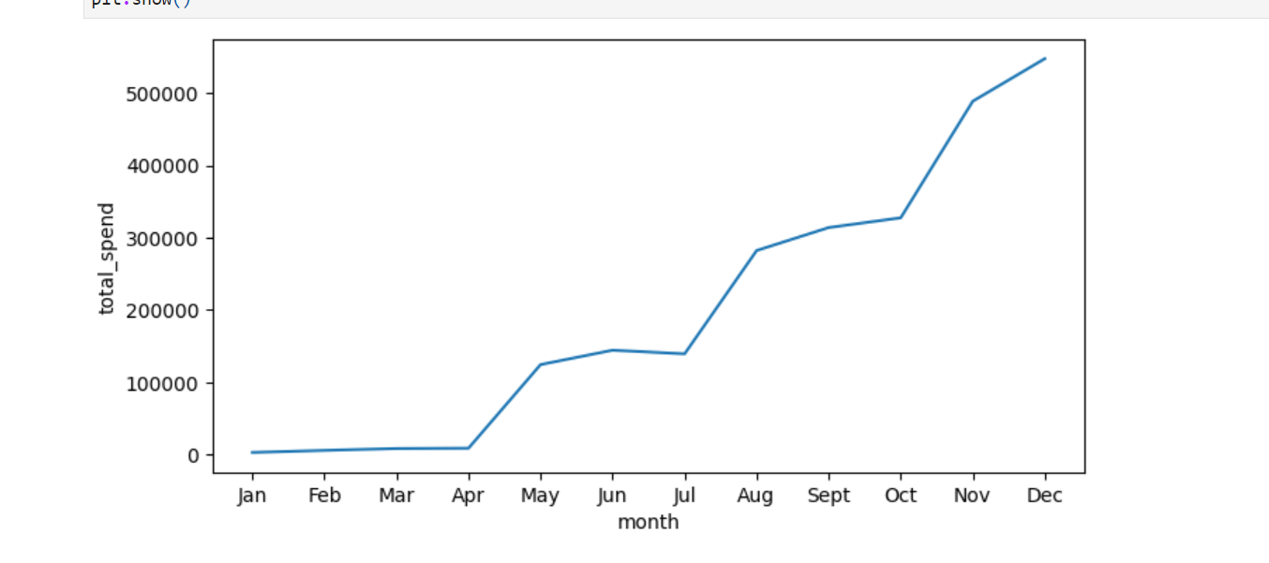
Monthly revenue trends derived from all households
There is a spike in revenue in "May" and in "Aug" months. And the total revenue gradually increased over period from January to December. This shows the impact of campaigns on total revenue generation.

Slide 6
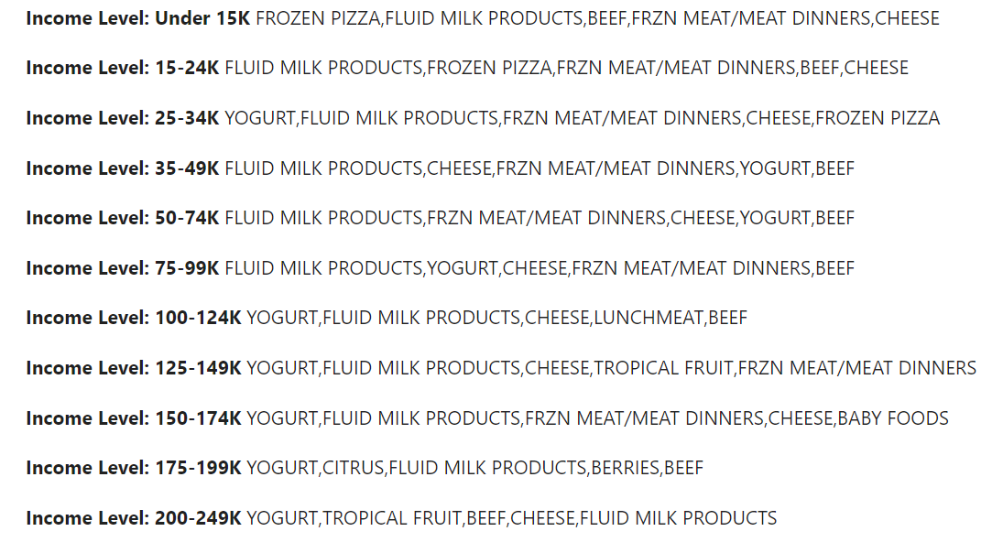
Top 5 product categories favoured by households in each income bracket before marketing campaigns
Here is a summary of the top 5 product categories before campaigns are conducted for each income level households. YOGURT and FLUID MILK PRODUCTS are consistently popular across various income levels. BEEF also appears in the top 5 for several income levels, indicating its general popularity. Different income levels show varying preferences, such as BABY FOODS in the 150-174K bracket and CITRUS in the 175-199K bracket. Lower-income levels (Under 15K and 15-24K) tend to prefer FROZEN PIZZA, while higher-income levels (250K+ and 200-249K) show diverse preferences.

Slide 7
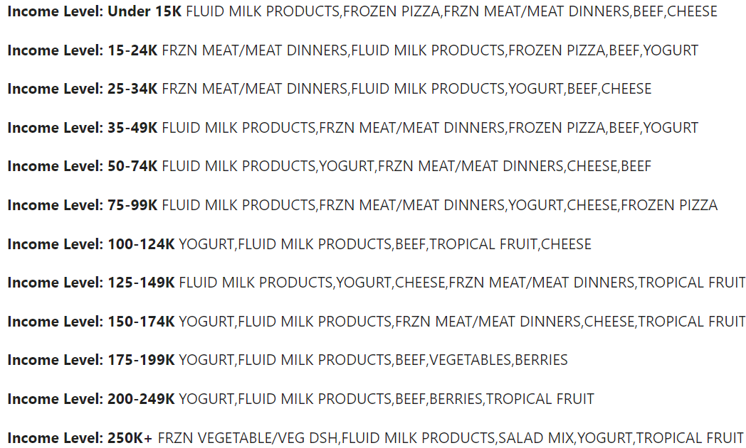
Top 5 product categories favoured by households in each income bracket after marketing campaigns
We can identify that the top bought products are mostly YOGURT, FLUID MILK PRODUCTS, BEEF, FRZN MEAT/MEAT DINNERS, CHEESE as they appear consistently across multiple income levels as top choices, indicating their popularity among customers across various income brackets.
Overall, when we compare the product categories before and after campaigns, we can observe that some product preferences like dairy and convenience foods are common across different income levels, there are also distinct choices that reflected mainly after campaigns which shows the campaigning and marketing impact on customer buying preferences.

Slide 8
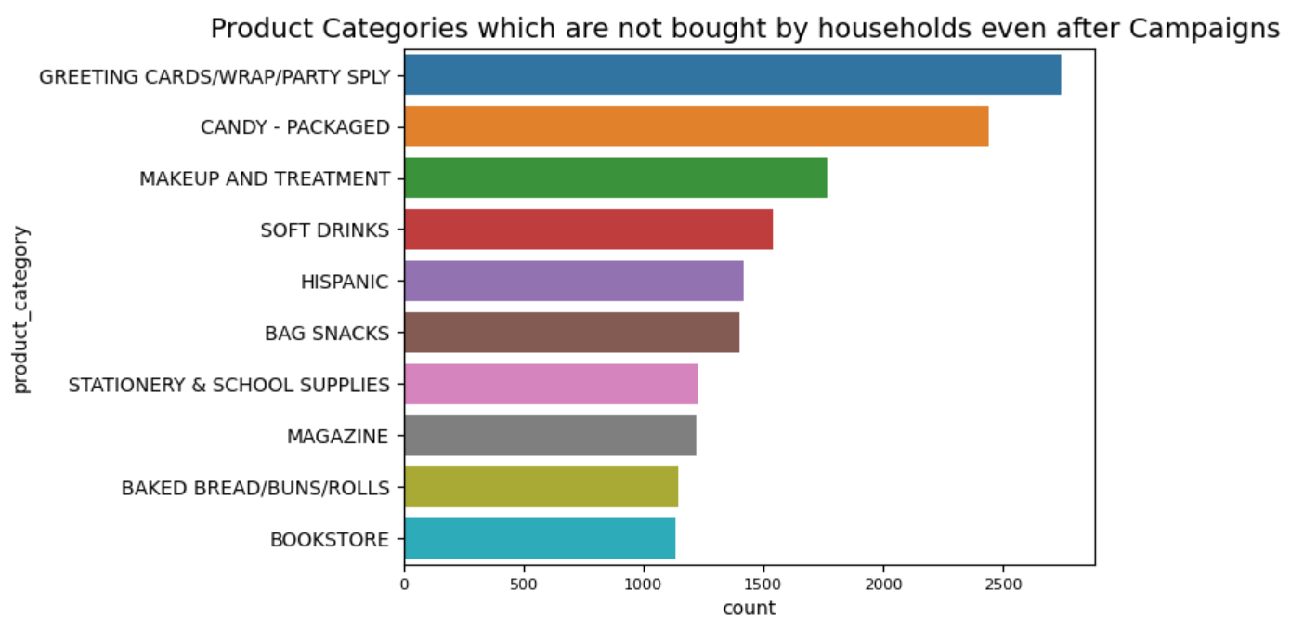
Product categories which are not bought by households even after campaigns
BOOKSTORE, BREAD,BUNS,MAGAZINES and STATIONERY are least bought by the households showing that they are least sensitive to campaigns. As there is no interest from the households to buy products related these product categories, we suggest the store management to invest less money in campaigning or marketing by taking minimal risk and issue more coupons or offers like '1+1 offer', 'most sold product with a least sold product as freebie' to sell the old stock of these product categories.

Slide 9
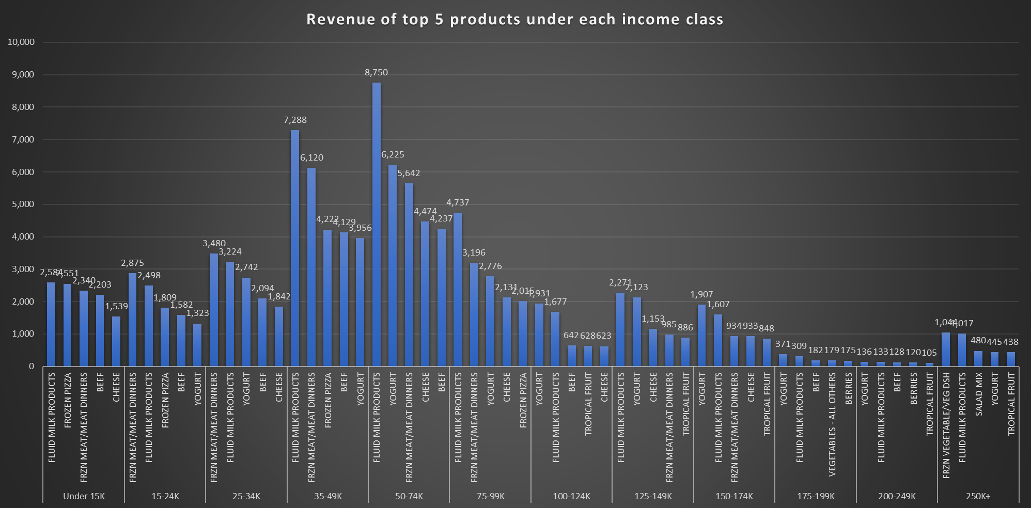

Slide 10
Product categories which are not bought by households even after campaigns
BOOKSTORE, BREAD,BUNS,MAGAZINES and STATIONERY are least bought by the households showing that they are least sensitive to campaigns. As there is no interest from the households to buy products related these product categories, we suggest the store management to invest less money in campaigning or marketing by taking minimal risk and issue more coupons or offers like '1+1 offer', 'most sold product with a least sold product as freebie' to sell the old stock of these product categories.

Slide 11
Summary:
Interesting Insights:
"BEEF" consistently generated the highest revenue for the store post-campaigns.
"YOGURT","FLUID MILK PRODUCTS","BEEF","FRZN MEAT/MEAT DINNERS" and "CHEESE" were top product choices across multiple income levels post-campaigns.
"FRZN VEGETABLE/VEG DSH" and "SALAD MIX" were unique preferences in the "250K+" income level post-campaigns.
"FROZEN PIZZA" was more popular among lower-income levels (Under 15K, 15-24K).
"VEGETABLES - ALL OTHERS" were preferred by the 175-199K income level.
"BERRIES" were favoured by higher-income levels (175-199K, 200-249K).
Preferences varied across income levels before and after campaigns, indicating the impact of marketing.

Slide 12
Limitations and Future Improvements:
The analysis is based on one year of historical data. Expanding the dataset to include data from the past 5 years would provide more recent and robust insights.
Due to technical constraints, we limited the analysis to the top 5 product categories. Expanding this to include more categories would offer a more comprehensive view for Foodelicious CEO's decision-making process.
When analysing the top 5 product categories before and after campaigns, we used the campaign start date as a reference point to prepare the data. However, this approach doesn't account for customers who regularly purchase daily necessities. A more nuanced analysis could consider this factor.
The line chart highlights spikes in revenue during May and August. Further investigation is needed to determine if these spikes are due to seasonal changes or external global factors affecting the business. This could be explored in greater detail.

Slide 13
Implications and Recommendations:
Focus on promoting "YOGURT","FLUID MILK PRODUCTS","BEEF","FRZN MEAT/MEAT DINNERS" and "CHEESE" as they are consistently popular.
Tailor marketing efforts to highlight unique purchasing patterns like "FRZN VEGETABLE/VEG DSH" and "SALAD MIX" for the "250K+" income bracket and promoting "FROZEN PIZZA" to lower-income levels.
For least preferred products use special coupons to sell out the old stock and come up with the strategies to increase the demand for these products taking minimal risk financially promoting offers like '1+1 offer', 'most sold product with a least sold product as freebie'.
Recognize that marketing campaigns can influence customer preferences and should be adapted accordingly.

