Slide 1



PROBABILITY AND STATISTICS SEMESTER PROJECT REVIEW 1
A statistical comparison of human written and AI-generated code across programming languages
AI
VS
A study of code length and comment characteristics.
By Akanksha Gupta (25BAI0033) and Bhargavi Panwar (25BDS0081)
Faculty Guide: Professor Juhi Baroi
Human
Notes:
(~15 s) Introduce the team and the title. This is Review 1: a preliminary study. We compare human-written and AI-generated code using Probability and Statistics methods. Focus so far: code length and comment characteristics.

Slide 2
Intro and problem statement
Background:
Generative AI tools such as ChatGPT, Claude, Gemini and such write programming code on request and AI assisted programming is spreading fast, including in coding heavy courses, and even in the job sector, with some companies replacing junior engineers with AI models.
OUR RESEARCH PROBLEM:
Are there statistically significant differences in code characteristics between human written and AI generated code and how do these differences vary?
Why all of this matters:
Understanding how AI generated code differs statistically from human-written code supports research on code provenance and responsible AI use.
Scope:
Measured: line count, character count, approximate comment lines
This project does not detect misconduct or prove authorship. It measures and compares code characteristics using statistical methods.
Languages analyzed: Java, Python, C, C++
Notes:
(~45 s) AI tools such as ChatGPT now write code on request, including in coding-heavy courses. We want to understand, statistically, how AI-generated code differs from human-written code in measurable ways. Be clear about scope: we are NOT detecting cheating or proving who wrote a program. Our research problem is on the right: are there statistically significant differences in measurable code characteristics between the two origins, and do they vary by language?

Slide 3
Objectives and research questions
Objectives
Research questions
To compare the line counts and the character counts of human written + AI generated code.
Do both groups show difference in the mean line count and character count?
1
RQ1
Compare approximate comment line counts.
Do their comment line characteristics differ?
2
RQ2
To investigate whether the origin (Human or AI written) of the code is associated with programming language.
Is the code origin associated with the programming language it’s written in?
3
RQ3
To apply descriptive statistics and inferential tests (hypothesis tests and confidence intervals) to our dataset.
Do the observed differences vary across the languages: Java, Python, C and C++?
4
RQ4
Notes:
(~45 s) Left: four objectives. Right: four research questions that map directly onto the statistical methods we use: t-tests for RQ1 and RQ2, chi-square test for RQ3, and language-wise comparison for RQ4. RQ4 is planned for the next review.

Slide 4
Literature review
sno | Authors and year: | Title: | Journal or conference: | What it does: | Relevance: | Limitation:
1 | Boukili, El Garouani & Riffi (2026) | A dataset for human-written and AI-generated code source classification | Data in Brief, 65, 112527 | It releases 10000 labelled samples where 5000 are human 5000 are from ChatGPT in java, python, C and C++, including XGBoost and LSTM classifiers | It is the main thing, the source of the dataset analysed in this project. | Human code (CodeNet) and AI code (ChatGPT) come from different collection places.
2 | Demirok, Kutlu & Mergen (2026) | MultiAIGCD: A comprehensive dataset for AI generated code detection covering multiple languages, models, prompts, and scenarios | Neural Computing and Applications, 38(16), 687 | Large dataset in python, java and go from six LLMs and three scenarios, it basically benchmarks detection models. | Detection performance varies by language, so that means each language should be analysed separately. | It’s a machine learning benchmark, not a statistical analysis of code measures.
3 | Gurioli, Gabbrielli & Zacchiroli (2025) | Is This You, LLM? Recognizing AI-written Programs with Multilingual Code Stylometry | IEEE SANER 2025 (arXiv:2412.14611) | Transformer based classifier for AI code stylometry across 10 languages, and it releases the H-AIRosettaMP dataset which holds 121247 snippets. | Shows that style differences between human and AI code can be studied across languages. | Focuses on classification here average accuracy 84.1%, not really hypothesis testing.
4 | Demirok & Kutlu (2024) | AIGCodeSet: A new annotated dataset for AI generated code detection | arXiv preprint (arXiv:2412.16594) | 2828 AI-generated and 4755 human-written python programs; AI code from CodeLlama, Codestral and Gemini 1.5 flash, baseline detectors. | AI code comes from many different LLMs, so our conclusions stay specific to our dataset. | python only, detection is the focus here.
5 | Li, Treude & Turel (2026) | Do comments and expertise still matter? An experiment on programmers' adoption of AI-generated JavaScript code | Journal of Systems and Software, 231, 112634 | It’s an experiment with 173 programmers: comments in AI generated code significantly increased its adoption, regardless of expertise. | Our motivation to studying code comments as a code characteristic. | Studies adoption behaviour, not exactly that if comment counts identify AI code.
Papers 1 to 4 build datasets and detectors, paper 5 had us look into comments. Our project is a focused statistical comparison. Paper 1 (a dataset for human written and Ai generated code source classification is the dataset we used for this project).
Notes:
(~60 s) Five papers. Paper 1 is our dataset paper. Papers 2 to 4 build datasets and detectors for AI-generated code across languages and generators, and show that results vary with language and generating model, which is why we compare languages separately. Paper 5 is an experiment showing comments influence whether programmers adopt AI code, which motivates our comment variable. None of them is a Probability and Statistics analysis of measurable code characteristics like ours, but we do not claim to be the first to study this area.

Slide 5




Motivation for this study
Why it this important
What the study does
AI code generators, they make it really easy to submit programming work without independent effort. Coding-intensive institutions need evidence-based understanding of how AI code differs from human code. Also, as it is being increasingly used in the workplace, character/number of lines can be used as a factor to analyze code efficiency
In this phase, our study compares human-written and AI generated code on line count, character count and approximate comment lines, using confidence intervals and hypothesis tests.
What it can be used for
What it does not do
Preliminary evidence for researchers and developers building code provenance and academic integrity tools, and a statistical baseline for later work.
It cannot prove a given program is AI written or that misconduct occurred. A human program can resemble AI code and the vice-versa.
Basically, earlier work built datasets and machine learning detectors. Our project is a focused statistical comparison that interprets effect sizes and uncertainty, language by language.
Notes:
(~45 s) Why it matters: AI makes it easy to submit code without doing the work, so institutions like ours need evidence-based understanding. What the study does: statistical comparison of simple measurable properties. Uses: preliminary evidence for people building detection or academic-integrity tools. Limits: we never claim to prove that any particular program is AI-written. Position: earlier work builds datasets and ML detectors; we interpret effect sizes and uncertainty language by language.

Slide 6
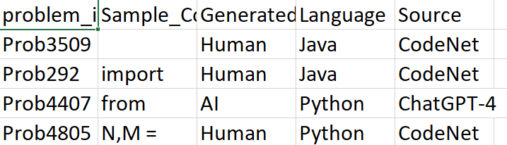
Dataset and variables
DATASET:
Variable | Meaning | Kind
Generated | AI or Human | Original
Language | Programming language | Original
Line_Count | Number of lines in a code sample | Derived
Character_Count | Number of characters | Derived
Comment_Line_Count | Approximate count of lines beginning with common comment markers | Derived
A dataset for human-written and AI-generated code source classification (Boukili et al., 2026)
SOURCE:
Mendeley Data
SAMPLE SIZE:
10000 code samples
Samples by origin and language (n)
Origin | C | C++ | Java | Python | Total
AI | 968 | 1221 | 1340 | 1471 | 5000
Human | 769 | 1419 | 1605 | 1207 | 5000
GROUPS:
5000 AI-generated and 5000 human-written (human: CodeNet; AI: ChatGPT)
LANGUAGES:
java, python, C and C++
DATA FIELDS (for this review):
Problem ID, source code, origin, language and source
Source: Dataset on Mendeley Data
Notes:
(~50 s) The dataset is from Boukili et al. 2026, published in Data in Brief and hosted on Mendeley Data. 10,000 samples, perfectly balanced between AI and human, across Java, Python, C and C++. Human code comes from the CodeNet repository; AI code was generated with ChatGPT. Each row is one program stored as text. Original columns: problem ID, source code, origin, language, source. We derived three numeric variables ourselves in R. Note the bottom-right table: the language mix is NOT the same in the two groups, which matters later.

Slide 7
Statistical methodology
1 Import the CSV
2 Inspect the data
3 Derive variables
4 Summarize and plot
5 Test hypotheses
6 Interpret
Method we used: | It’s purpose:
Mean, median, standard deviation | To summarize each code characteristic by origin
Boxplots and histogram | Used to show distributions, skew and outliers.
Welch's two-sample t-test | We used it to compare group means without assuming equal variances
95% confidence interval | Took as a plausible range for the difference in means
Chi-square test of independence | To test association between origin and language
Welch t-tests (line count, character count)
H₀: μ(AI) = μ(Human)
H₁: μ(AI) ≠ μ(Human)
Chi-square test (origin vs language)
H₀: origin and language are independent
H₁: origin and language are associated
Significance level α = 0.05 (95% confidence). We approximated the comment counts (lines starting with # or /* or //).
Notes:
(~70 s) Our workflow has six steps: import the CSV into R, inspect it, derive the numeric variables, summarize and plot, test hypotheses, then interpret. Methods table: mean/median/SD to summarize; boxplots and a histogram to see distributions and outliers; Welch's t-test to compare means without assuming equal variances (the groups clearly have different spreads); a 95% confidence interval for the size of the difference; chi-square for association between origin and language. Hypotheses are on the right. Significance level is 0.05. Comment counts are approximate.

Slide 8
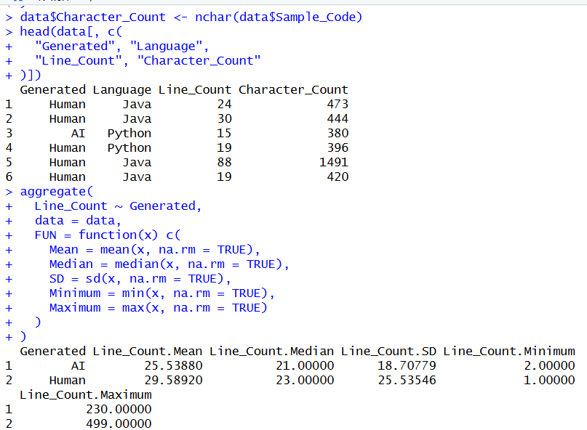
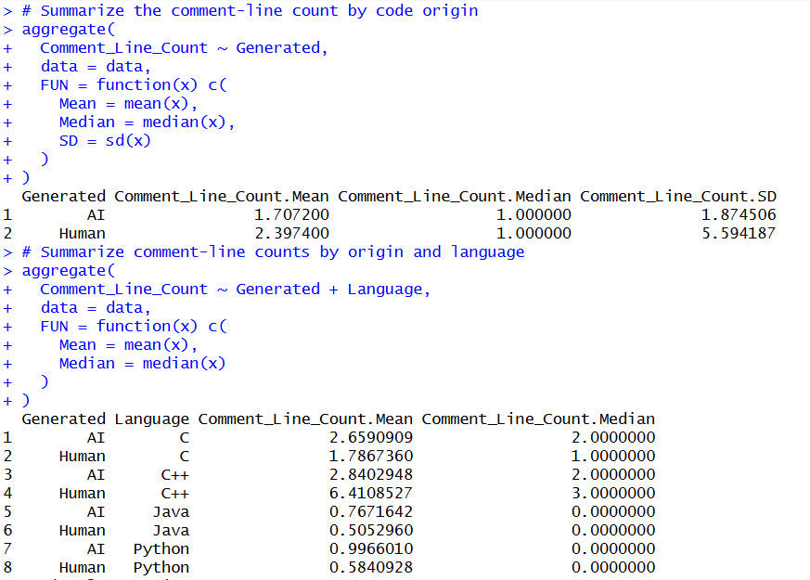
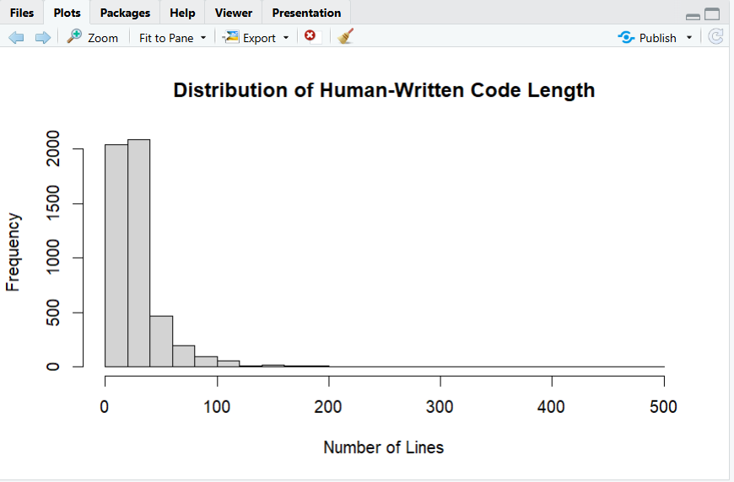
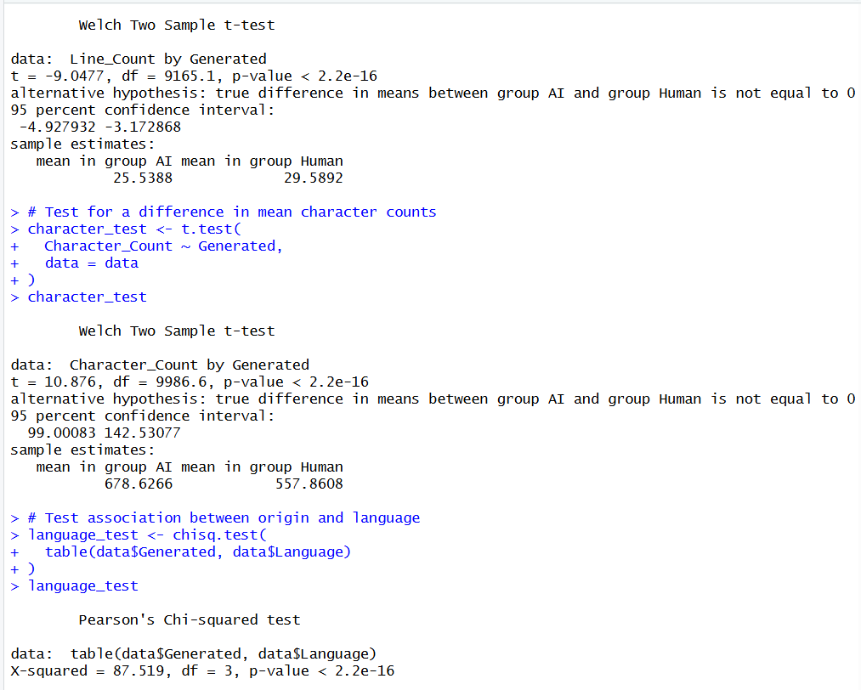
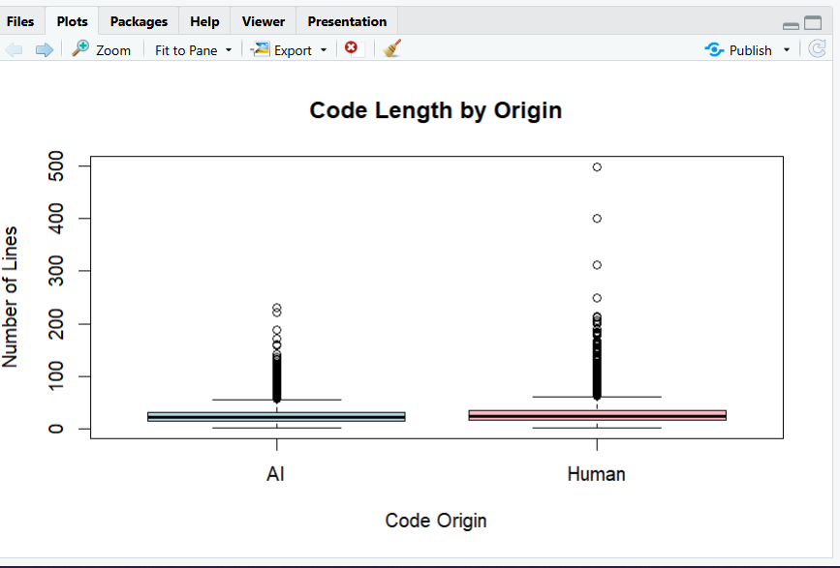
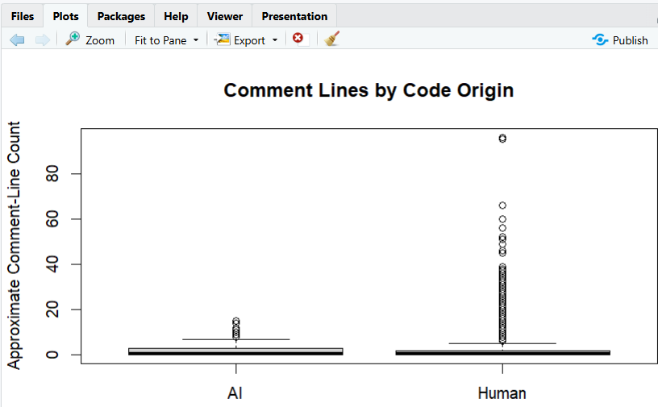
R code implementation
Notes:
(~30 s) PASTE YOUR CODE SCREENSHOT HERE (Insert > Picture). Walk through: read.csv to import; table() to check labels and languages; strsplit and nchar to create Line_Count and Character_Count; the grepl pattern for approximate comment lines; aggregate() for summaries; boxplot()/hist() for plots; t.test() and chisq.test() for the tests.

Slide 9
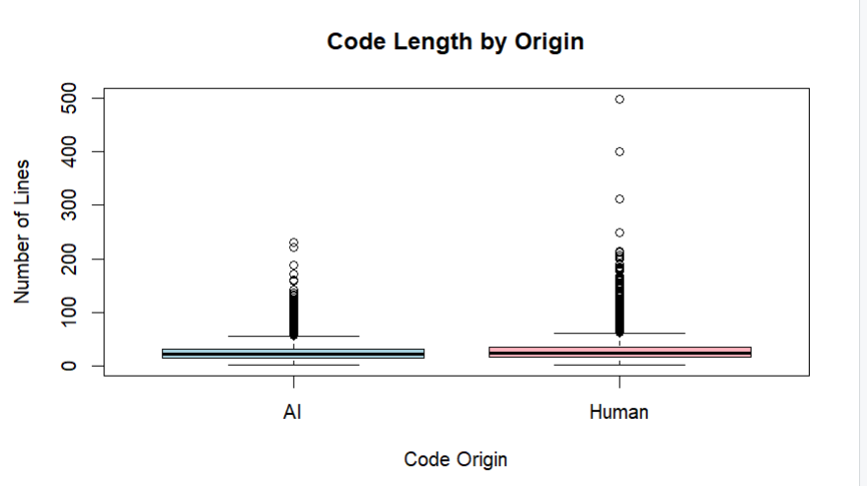
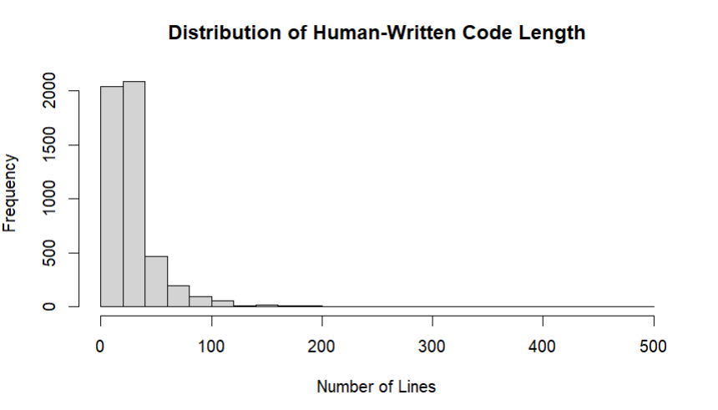
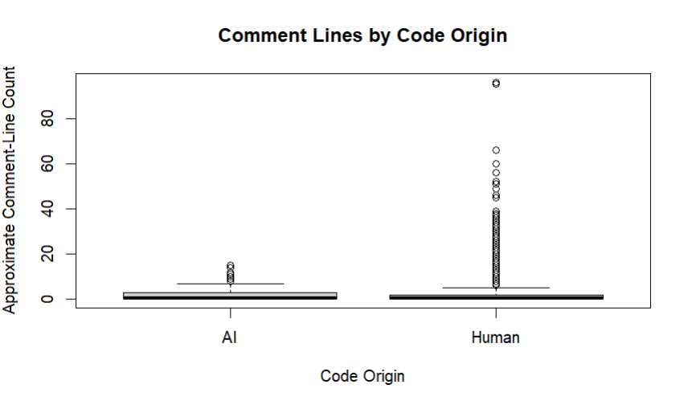
Preliminary descriptive results
Measure | AI mean | Human mean | AI median | Human median | AI SD | Human SD
Lines per sample | 25.54 | 29.59 | 21 | 23 | 18.71 | 25.54
Characters per sample | 678.63 | 557.86 | 527 | 417.5 | 545.73 | 564.46
Approx. comment lines | 1.71 | 2.40 | 1 | 1 | 1.87 | 5.59
Code length: medians are close yes, 21 vs 23 and both the groups have long right tails (basically more code lengths are shorter with a few high number).
Human code length is strongly right skewed means a few very long programs pull the mean up.
Human comment counts have a long tail we see maximum 96 vs 15 for AI.
By language, AI has the higher mean comment line count in C, java and python, human in C++ (6.41 vs 2.84). Also, # also matches C/C++ #include and #define lines, so C/C++ counts are inflated. These findings are descriptive, for this dataset only. In future, we may come up with a way to solve this issue.
Notes:
(~75 s) Top table: mean, median, SD by origin, straight from R. Lines: humans average about 4 more lines (29.59 vs 25.54) but medians are close (23 vs 21); human SD is larger (25.54 vs 18.71). Characters: the reverse, AI is higher (678.63 vs 557.86). Plots: all three are right-skewed with long tails of outliers, which is why we report medians next to means. Comments: overall human mean is higher (2.40 vs 1.71), but by language AI is higher in C, Java and Python and humans only in C++ (6.41 vs 2.84). CAUTION if asked: our comment measure counts lines starting with '#', and in C and C++ that also matches #include and #define lines, which inflates C/C++ counts (most of the human C++ figure). We checked: counting only // and /* comments in C/C++/Java and # in Python gives mean 0.76 for AI vs 0.53 for human, so the direction depends on the measure. We will refine this measure for Review 2. These are descriptive findings for this dataset only.

Slide 10
Hypothesis test results
Test | Estimate (AI /human) | 95% CI | Test statistic | p-val | decision
Mean line count (Welch t-test) | −4.05 lines | [−4.93, −3.17] | t = −9.05, df = 9165.1 | < 2.2 × 10⁻¹⁶ | Reject H₀
Mean character count (Welch t-test) | +120.77 characters | [99.00, 142.53] | t = 10.88, df = 9986.6 | < 2.2 × 10⁻¹⁶ | Reject H₀
Origin vs language (chi-square) | - | - | χ² = 87.52, df = 3 | < 2.2 × 10⁻¹⁶ | Reject H₀
Line count
Character count
Origin vs language
We see that human samples, average about 4 more lines than AI samples (29.59 vs 25.54)
Here, AI samples average about 121 more characters despite having more fewer lines. The cause (formatting, comments, structure maybe) is not yet tested yet.
The language mix differs by origin (python is 29% of AI samples vs 24% of human), so within language comparisons are needed. We will explore this in the next review 2.
p values are tiny partly because n = 10000. Effects are small (Cohen's d ≈ 0.18 and 0.22; Cramér's V ≈ 0.09). Independence by problem ID is not yet checked.
Notes:
(~75 s) Three tests, all at the 5% level. Line count: AI minus Human is -4.05 lines, 95% CI -4.93 to -3.17, Welch t = -9.05, p below 2.2e-16 (R's display floor). Character count: +120.77 characters, CI 99.00 to 142.53, t = 10.88. Chi-square: 87.52 on 3 df. All three reject the null. Interpretation: humans have more lines, AI has more characters, and the language mix differs between groups. A p-value is NOT the probability the null is true. With 10,000 samples tiny p-values are easy to get, so look at size: Cohen's d is about 0.18 for lines and 0.22 for characters, Cramer's V about 0.09, all small effects (computed as mean difference over pooled SD; V = sqrt(chi2 / n)). Results are preliminary until independence by problem ID is checked: 6,849 unique problem IDs across 10,000 samples.

Slide 11






Limitations
Balanced by design
Different sources
Unequal language mix
We only have about 5000 samples per group, so the data say nothing about how common AI code is in the real world.
Human code is from CodeNet, AI code from ChatGPT different models, differences may reflect collection, not authorship alone.
Origin and language are associated, so overall comparisons mix in language effects. We may explore this in later reviews (planned for review 2).
Possible dependence
Simple measures
Approximate comment count
6849 unique problem ids for 10000 samples. Also samples on the same problem may not be independent. We’ll investigate it too.
Counts of lines, characters and comments do not measure correctness, logic or quality.
Counts lines starting with #, // or /*. The # also matches C/C++ #include and #define lines and block and inline comments maybe missed.
Notes:
(~45 s) Be honest and brief. 1: the dataset is balanced by design, so it says nothing about how common AI code is. 2: human and AI samples come from different sources (CodeNet vs ChatGPT), so differences are not purely authorship. 3: language mix differs between groups, so overall comparisons blend language effects. 4: 6,849 unique problem IDs among 10,000 samples, so independence is not guaranteed. 5: we only measure size, not correctness or quality. 6: the comment measure is approximate; in particular # also matches #include and #define in C/C++. Statistical associations do not establish causation or prove authorship.

Slide 12
Work we completed and our next steps:
Completed for Review 1
Planned for Reviews 2 and 3
Dataset downloaded, imported in R and we checked it (10000 rows, 5 columns, no missing code, no duplicate rows)
Derived variables: line, character and approximate comment-line counts
Descriptive statistics and plots by code origin, all pasted
Welch t-tests, 95% confidence intervals and chi-square test
Literature review
We will repeat the comparisons within each of the four languages to investigate deeper
Test comment-line counts formally
Check independence (problem ids) and robustness to skew (Wilcoxon rank sum test)
Finalize interpretation, report and conclusions
Conclusion so far: measurable code characteristics differ between the two groups in this dataset, warranting further analysis by language and task.
Notes:
(~50 s) Left: what is done for Review 1, all backed by output we have actually run in R. Right: plan for Reviews 2 and 3: repeat everything within each language, test comment counts formally and fix the comment measure, check independence by problem ID and robustness to skew, then finalize. Close with the conclusion in the banner.

Slide 13
AI
Thank You!
Human
Dataset: Boukili, G., El Garouani, S., & Riffi, J. (2026). A dataset for human-written and AI-generated code source classification. Data in Brief, 65, 112527. https://doi.org/10.1016/j.dib.2026.112527
Notes:
(~10 s) Thank the panel and invite questions. Likely questions: why Welch's test (unequal variances); what a p-value means; why not just a classifier (this is a statistics project, not machine learning); what the comment measure misses (see limitations).

