Slide 1
PROBABILITY & STATISTICS FINAL REVIEW 3
A Statistical Comparison of
Human Written and AI Generated Code
C
low level language
C++
multi paradigm
Across C, C++, Java and Python
Java
object oriented
Code length
Normalized text density
Comment presence
Python
high level
Akanksha Gupta (25BAI0033)
Bhargavi Panwar (25BDS0081)
10000 code samples
5000 AI & 5000 human
Faculty Guide: Professor Juhi Baroi October 2026

Slide 2
What Review 3 adds after the earlier reviews:
In review 1–2, we established raw differences. In review 3 we ask a more specific question: what changes when we normalize and model the data?
01 Normalize code density
02 Split comment presence from volume
03 Model both factors together
04 Audit uncertainty
We ccorrected “characters per nonblank line” uses only characters on nonblank lines and excludes CR/LF line breaks.
This tests whether a sample has any detected comment separately from how many comment lines were counted.
Expanded regression and factorial ANOVA test language-by-origin interaction, not just separate averages.
We corrected Cliff’s delta, regression diagnostics, corrected density output and manual comment vvalidation sample.
Review 3’s contribution is a more interpretable style comparison, not just another round of the same mean tests.
02

Slide 3
Research question and objectives
Do measurable code characteristics differ by origin, and does the pattern depend on programming language (we use java, python, C and C++).
01
Size
02
Density
03
Comments
We compare line and character counts.
Compare characters per nonblank line.
Separate comment presence from comment volume.
04
Relationship
05
Interaction
Measure association and model character count.
Test language and origin effects, even their effects together (language-by-origin).
Scope of the project is to compare group level statistical patterns. This project does not classify individual snippets or measure code quality. But it can be used for further projects that do that.
03

Slide 4
SOURCE + SAMPLE
Dataset and operational measurements
10000
5000
5000
0
code samples
AI generated
Human written
missing code values
Source dataset: Boukili et al. (2026)
Balanced overall group
Balanced overall group
0 exact duplicate full rows
Language distribution (all samples)
Variables used:
C
1,737
Raw size
Normalized density
C++
2,640
Line count and stored character count.
Characters on nonblank lines and number of nonblank lines.
Java
2,945
Python
2,678
Comment presence
Comment volume
At least one detected comment line in each code snippet.
Approximate count per 100 nonblank lines.
Please note that the 50/50 origin split is a dataset design feature here not really a real world prevalence.
04

Slide 5
How all five PAS modules were integrated in this project:
MODULE 1
Random variables
Means, medians, SD, variance and dependence checks.
What varies across samples?
MODULE 2
Distributions
Histograms, outliers, skew and comment count overdispersion check.
What do the distributions look like?
MODULE 3
Hypothesis testing
Welch t-tests, confidence intervals, Holm correction, effect sizes, Wilcoxon and chi squared tests.
Are the found differences supported by evidence?
MODULE 4
Correlation & regression
Spearman ρ, log-linear regression and interaction comparisons.
How do size measures relate?
MODULE 5
Factorial ANOVA
Language, origin and language-by-origin on log transformed outcomes.
Does the pattern vary by language?
Please note that we applied the above as needed so not every syllabus topic or experimental design from each module is used, the listed ones are the ones we applied. Overall it’s loosely based on our probability and statistics theory syllabus.
05

Slide 6
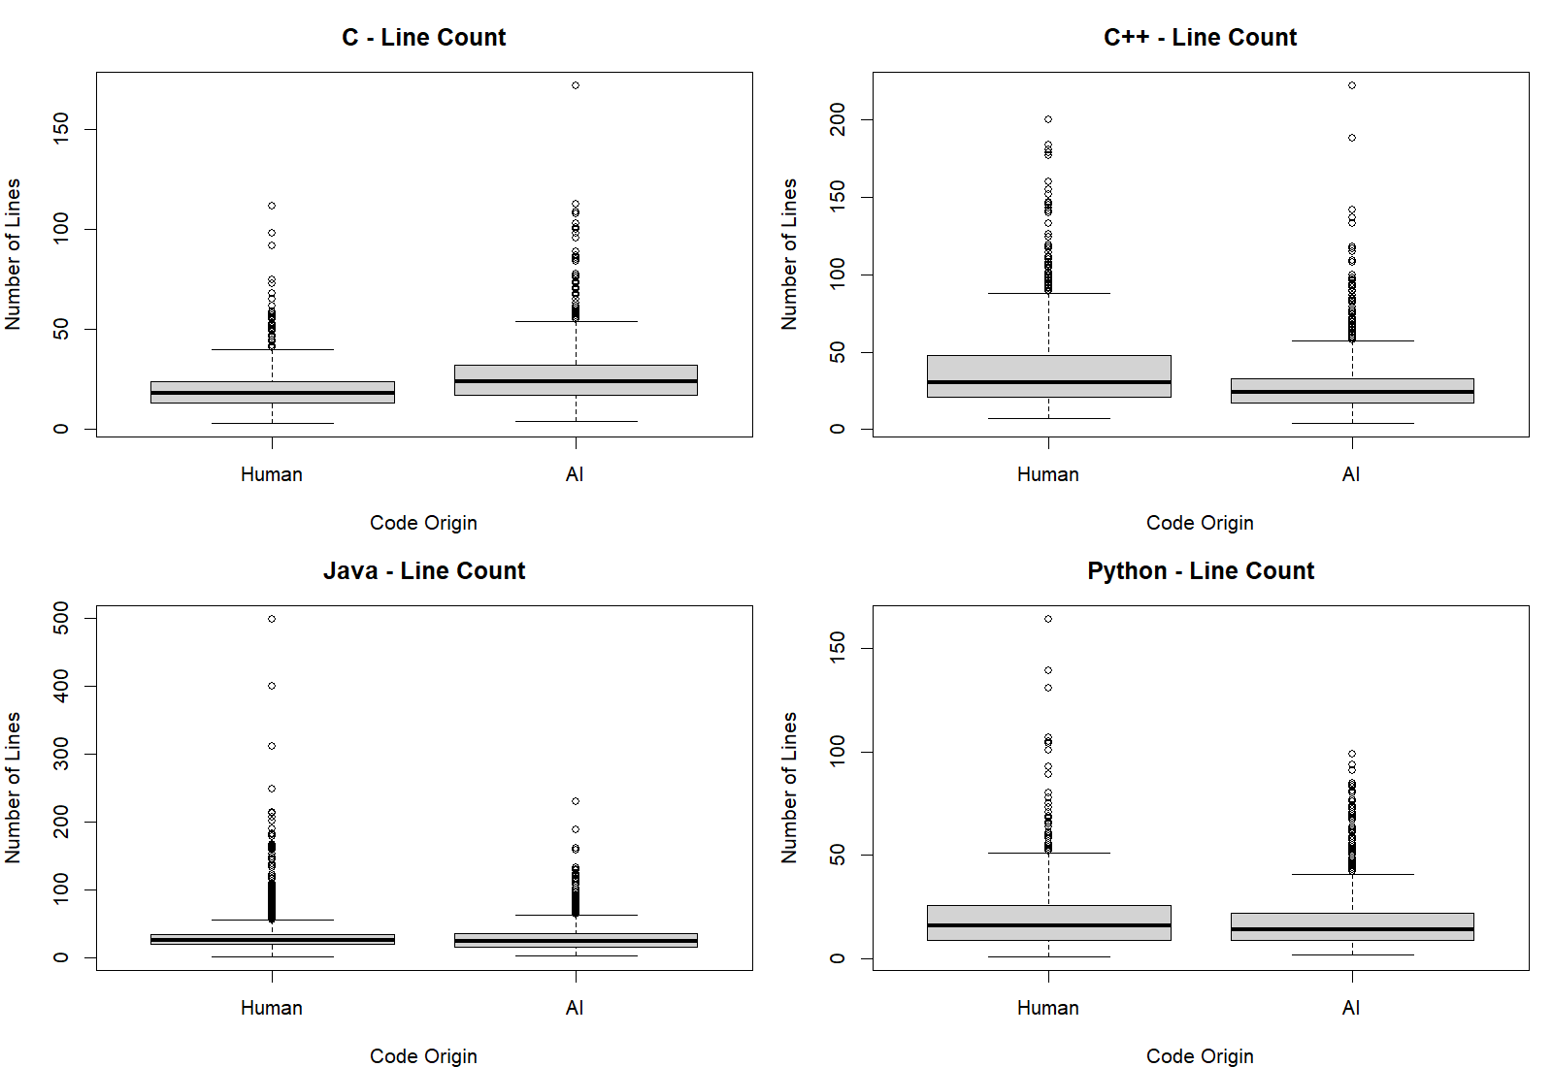
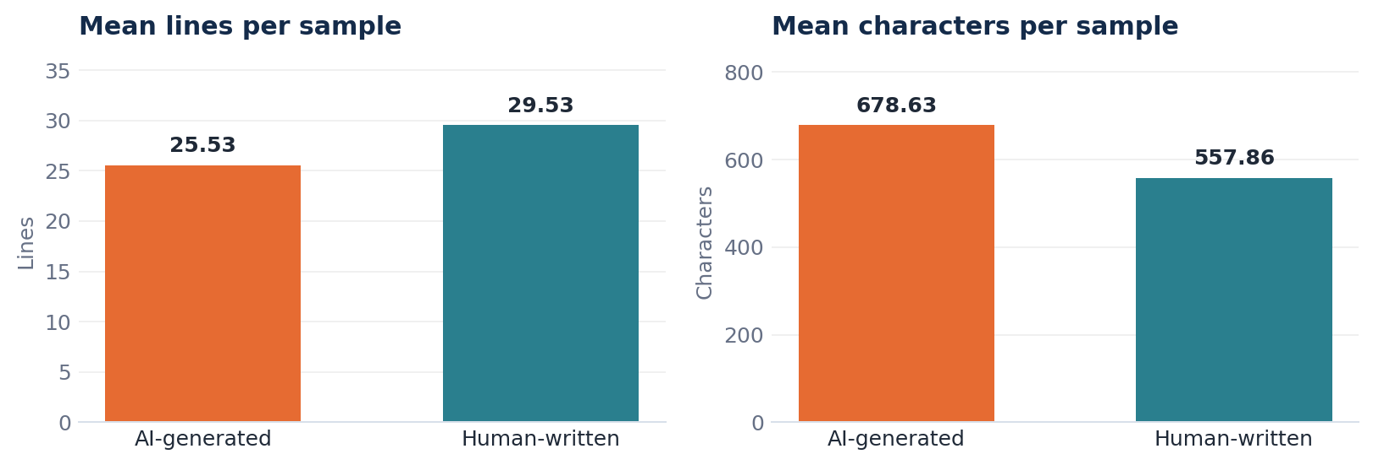
BASELINE RESULT (Explored in reviews 1 and 2)
HUMAN-WRITTEN
AI-GENERATED
Let us start with the raw measurements
Had +4.0 lines on average
+120.8 characters on average
We can see that size alone is incomplete, line count and character count do not move in the same way, and the direction changes by language. So we applied the same tests to languages separately also.
We also noticed that the distributions are strongly right-skewed, with long upper tails and outliers, so we also analysed them based on median and rank.
06

Slide 7
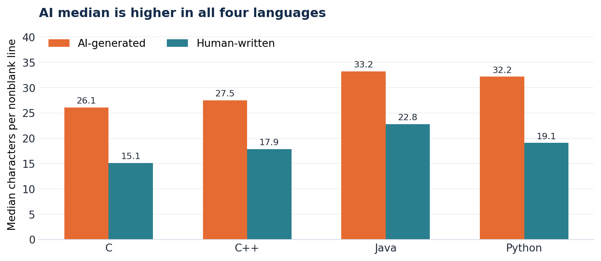
NORMALIZED MEASURE
Finding 1: AI samples have higher text density
MEDIAN DIFFERENCE
C
+11.0 chars/line
C++
+9.6 chars/line
Java
+10.4 chars/line
Python
+13.1 chars/line
Definition: characters on nonblank source lines ÷ nonblank lines, excludes CR/LF and blank-line whitespace, but retains indentation, trailing spaces and such on nonblank lines. R graphs on the next slide.
07

Slide 8
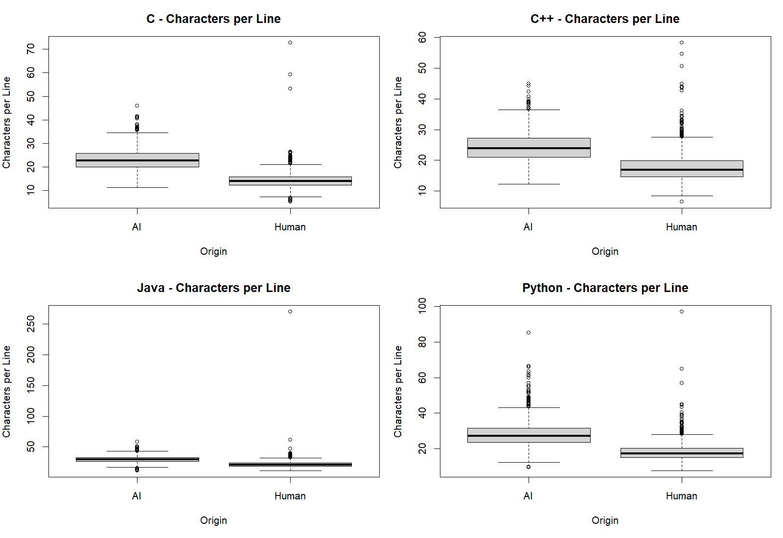
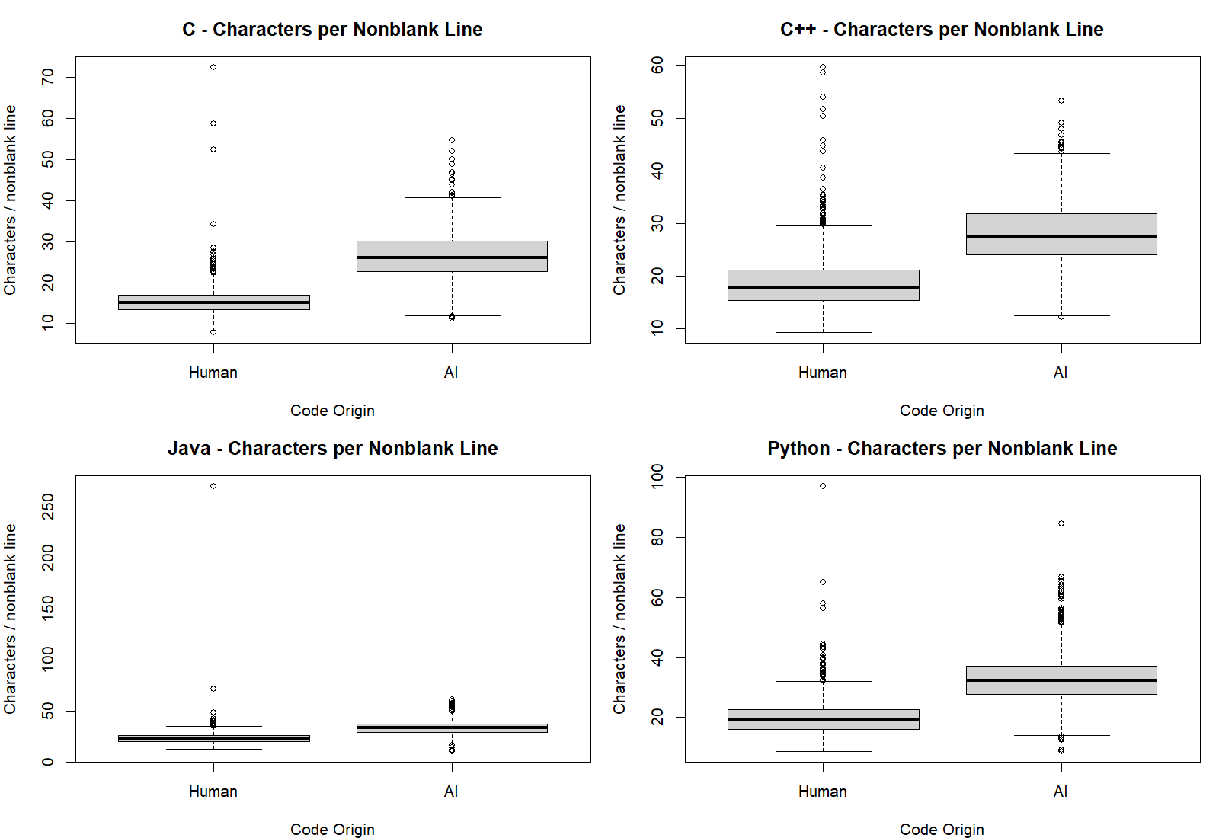
All 4 language comparisons remained significant after Holm correction, Cliff’s delta was 0.80–0.92 basically means large rank separation.

Slide 9
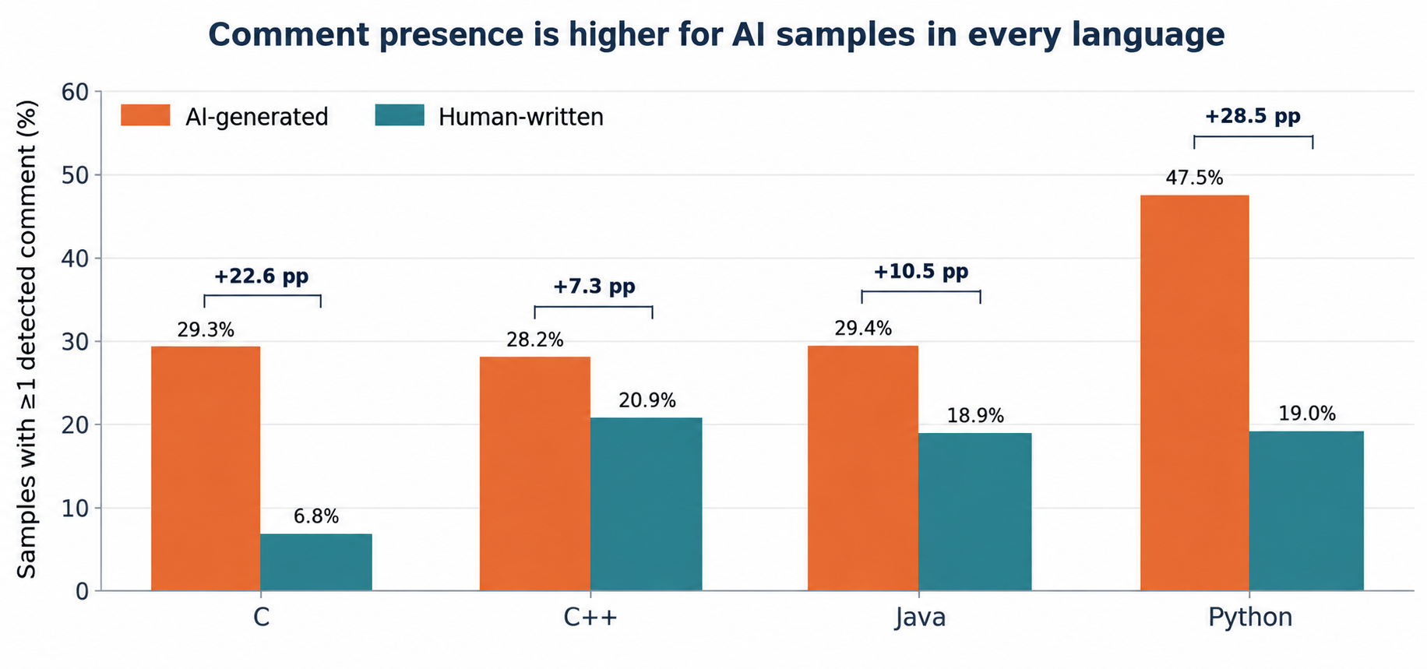
BINARY PRESENCE is NOT the same as COMMENT QUALITY
Finding 2: Comment presence differs by language
LARGEST GAPS WERE:
Python
+28.5
C
+22.6
Java
+10.5
C++
+7.3
All 4 proportion comparisons remained significant after Holm correction (95% CIs exclude 0). Please note that this measures detectable comment presence, not quality of the comment. But since the #include and such comments will be common for both measures, the percentage difference can be trusted.
To note: comment volume did not move uniformly. You can see that human C++ samples had a higher mean counted comment count, all groups had median count 0 though.
08

Slide 10
MODULE 3 ‘s INFERENCE
Finding 3: For mean comparisons, we found strong evidence, with one important exception:
Language | Measure | Mean (AI/Human) | 95% CI | Holm p (Welch) | Cliff’s Delta (rank)
C | Lines | +7.12 | [5.76, 8.47] | <2.2e−16 | +0.31
C | Characters | +359.60 | [322.46, 396.75] | <2.2e−16 | +0.69
C++ | Lines | -9.15 | [-10.89, -7.41] | <2.2e−16 | -0.25
C++ | Characters | +13.70 | [-29.71, 57.11] | 0.536 | +0.07
Java | Lines | -4.48 | [-6.40, -2.56] | 1.4e-05 | -0.11
Java | Characters | +149.15 | [100.95, 197.35] | 5.9e-09 | +0.25
Python | Lines | -1.77 | [-2.89, -0.65] | 0.004 | -0.09
Python | Characters | +143.78 | [116.71, 170.86] | <2.2e−16 | +0.27
Welch test: 7/8 were significant even after Holm correction. C++ character counts mean difference is not significant though (p = 0.536). It’s wilcoxon is significant but the rank effect is still small (Delta= +0.075).
09

Slide 11
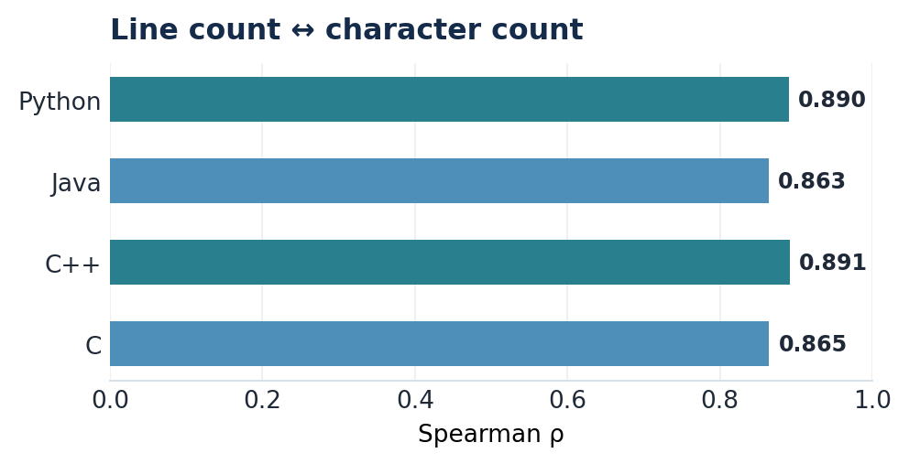
CORRELATION and REGRESSION
Finding 4: Size measures are strongly associated
OVERALL SPEARMAN CORRELATION:
NESTED REGRESSION COMPARISONS:
ρ = 0.882 AND p < 2.2×10⁻¹⁶
Language X origin
F(3, 9991) = 63.83
p = 7.08×10⁻⁴¹
Line slope X origin
F(1, 9990) = 10.07
p = 0.00151
Adding language specific origin differences substantially improved model fit, so we did that. The line count slope interaction was also a smaller but statistically significant, improvement.
Consistently strong positive association within each language (ρ ≈ 0.863–0.891).
Regression models log(1 + character count). We actually added this in case anyone uses this study , such as training a model. In that case if the input character count is 0, log (1+0) will handle that error. Please also note that diagnostics show heavy residual tails and possible non constant variance; results are exploratory, not a validated predictor.
10

Slide 12
FACTORIAL ANOVA ON LOG TRANSFORMED MEASURES
Finding 5: The origin pattern changes by language
Outcome: | Effect tested: | F statistic: | Partial η²: | Holm adjusted p:
Lines | Language | 532.1 | 0.138 | <2.2e−16
Lines | Origin | 47.9 | 0.005 | 4.6e-12
Lines | Language × origin | 69.6 | 0.020 | <2.2e−16
Characters | Language | 601.6 | 0.153 | <2.2e−16
Characters | Origin | 544.5 | 0.052 | <2.2e−16
Characters | Language × origin | 105.2 | 0.031 | <2.2e−16
Language effect:
Origin effect:
Interaction:
This is the largest effect for both line and character counts.
Small for line count (ηp² is about 0.005), larger for character count (about 0.052).
This is pretty significant for both outcomes: the origin associated pattern differs across languages.
11

Slide 13
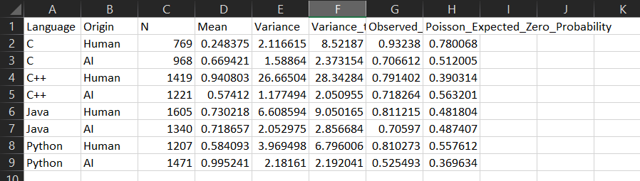
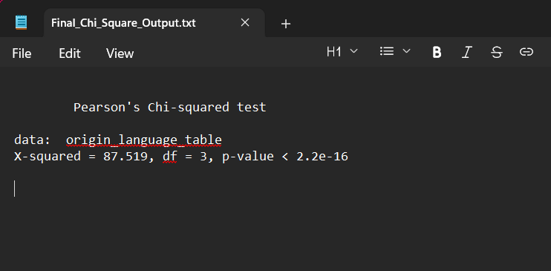
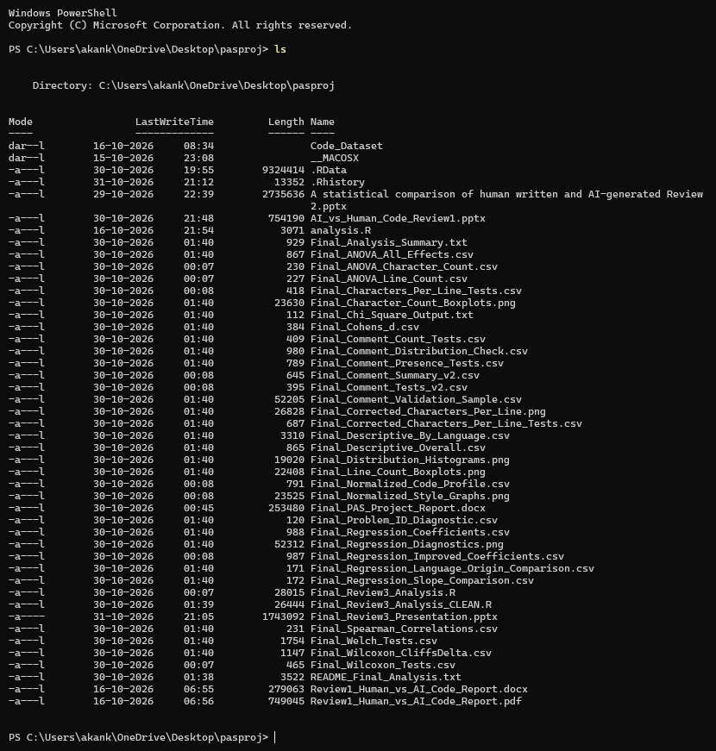
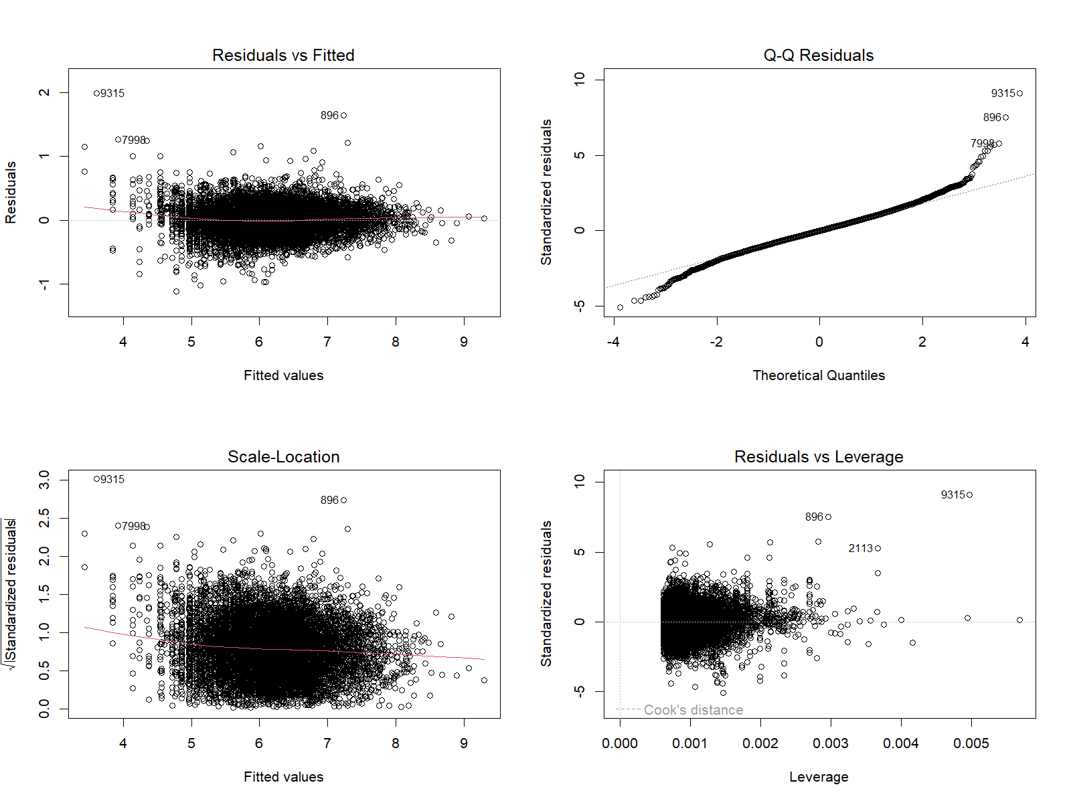
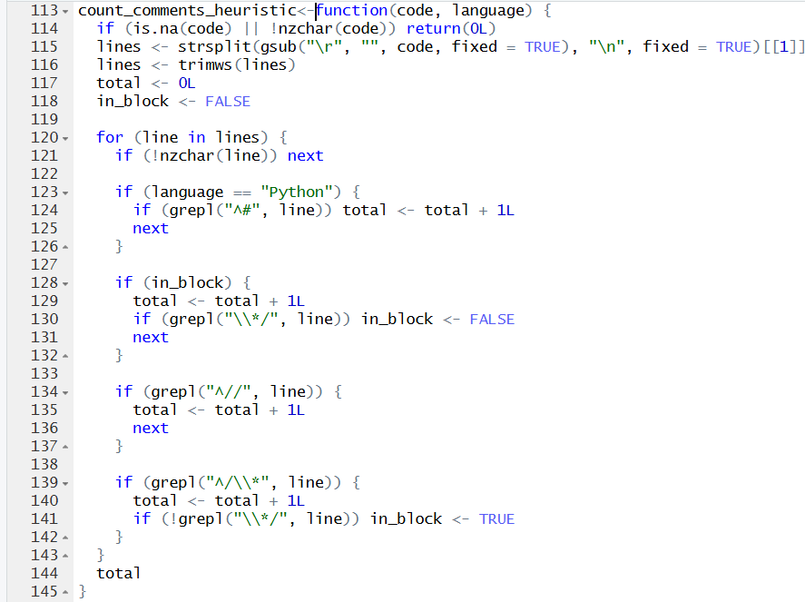
A peek at the code, graphs, outputs, tables and the project directory:

Slide 14
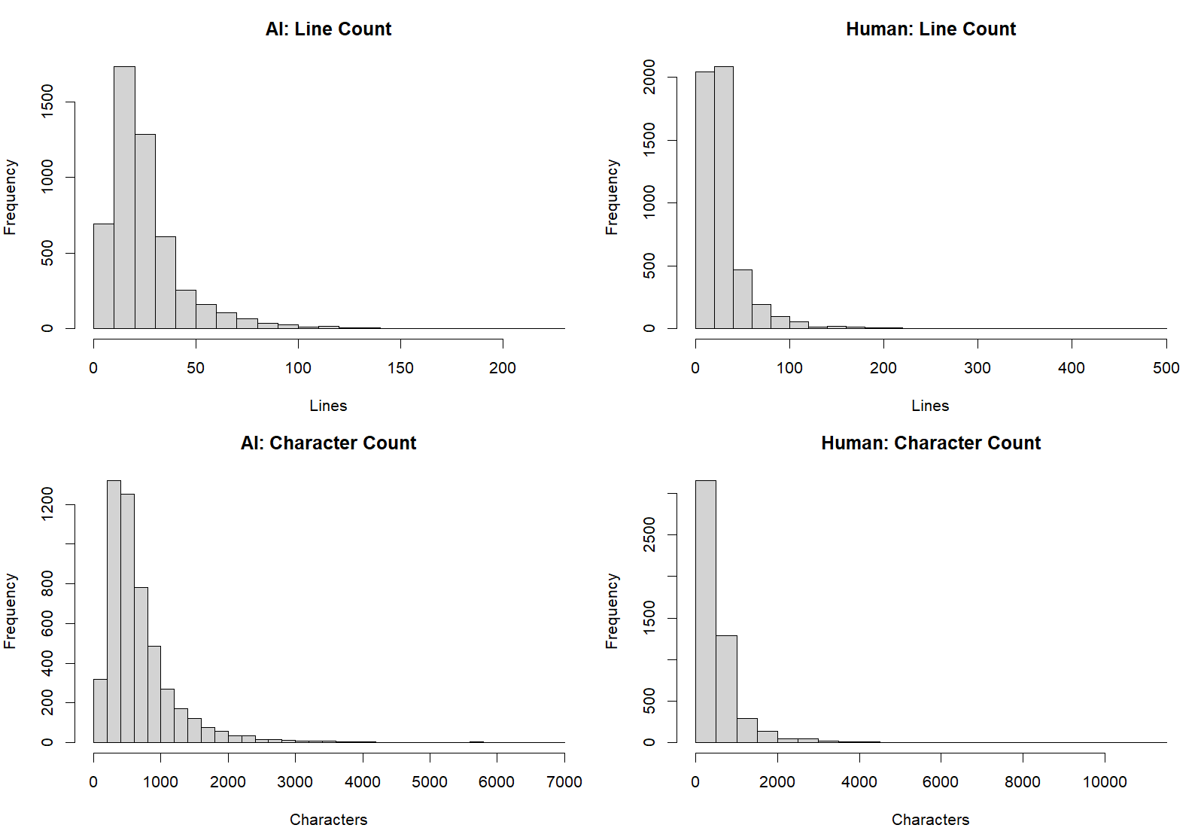
VALIDITY + ROBUSTNESS
Quality check: what our data can and can’t support
Different source pipelines
Human code came from a repository, AI code was generated. So source task differences may confound origin.
Heuristic comment counter
May miss inline comments or misread strings or block comments. If someone uses our study, do manually annotate the comments for accuracy.
Independence & prevalence
Only 3 problem IDs appeared in both origins, which is less but still full independence is not proven. A 50/50 split is not real-world prevalence.
Interpretation boundary
We make no claims about code quality, correctness, misconduct or individual authorship. This is not a validated detector, but rather a statistical study which can supplement those and further research. Our study shouldn’t be used to make total decisions.
12

Slide 15
FINAL REVIEW 3 | THE TAKEAWAY
It’s not just that AI code is longer, the pattern is more specific:
01
02
03
DENSITY
COMMENTS
LANGUAGE MATTERS
AI samples had higher median characters per nonblank line in all four languages.
AI samples were more likely to contain a detectable comment line in every language.
Raw length patterns vary by language, ANOVA found language by origin interactions.
26.1 vs 15.1 in C, 32.2 vs 19.1 in Python.
Largest gap: Python +28.5 percentage points.
C++ character count mean: has no Welch significance.
Our contribution is statistically interpretable, not an explicit detector.
13

Slide 16
SELECTED SOURCES
References and reproducibility
[1] Boukili, G., El Garouani, S., & Riffi, J. (2026). “A dataset for human-written and AI-generated code source classification.” Data in Brief, 65, 112527. https://doi.org/10.1016/j.dib.2026.112527
[2] Demirok, B., Kutlu, M., & Mergen, S. (2026). “MultiAIGCD: A comprehensive dataset for AI generated code detection covering multiple languages, models, prompts, and scenarios.” Neural Computing and Applications, 38, Article 687. https://doi.org/10.1007/s00521-026-12336-0
[3] Gurioli, A., Gabbrielli, M., & Zacchiroli, S. (2024). “Is This You, LLM? Recognizing AI-written Programs with Multilingual Code Stylometry.” arXiv:2412.14611. https://arxiv.org/abs/2412.14611
[4] Demirok, B., & Kutlu, M. (2024). “AIGCodeSet: A New Annotated Dataset for AI Generated Code Detection.” arXiv:2412.16594. https://arxiv.org/abs/2412.16594
Dataset access: https://data.mendeley.com/datasets/kjh95n54f8/1
Reproducibility: you can retain our clean R script, dataset description, output CSVs and plots with the final report.
14

Slide 17
Thank you!
We’re open to questions & discussion!
Email us at akankshagupta4344@gmail.com.
A statistical comparison of code characteristics across AI-generated and human-written samples.
Akanksha Gupta (Ideation, Module 1,4,5) & Bhargavi Panwar (Module 2&3), Probability & Statistics Semester Project

