Slide 1
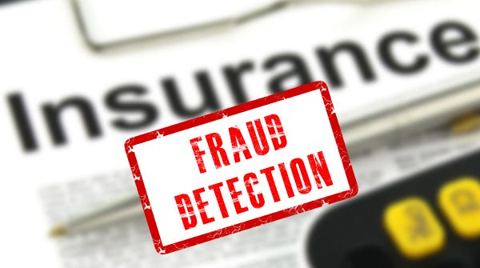

RISK ANALYTICS
Detecting Vehicle
Insurance Fraud
Finding the few fraudulent claims hidden among thousands , and the model that catches them.
15,420 claims
33 features
5 models tested
An end-to-end machine-learning investigation

Slide 2
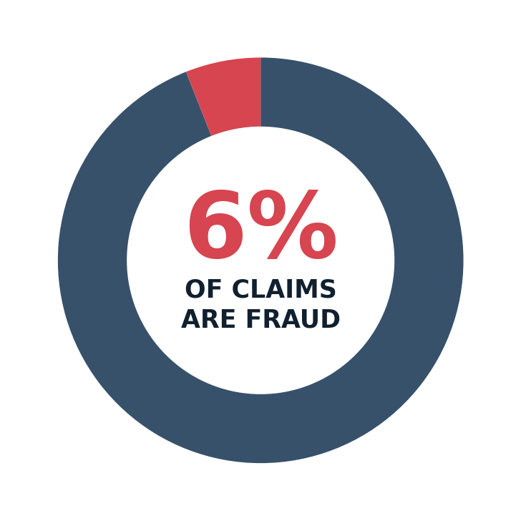
THE PROBLEM
Fraud is rare and that is exactly the problem.
THE CLASS IMBALANCE
The business question
How can we reliably flag fraudulent insurance claims before they are paid out?
Why it matters
Fraudulent claims drain insurer profit and push premiums higher for honest customers. But genuine fraud is buried inside a flood of legitimate claims , so the model must spot a needle in a haystack without crying wolf on everyone else.
Only ~1 in 16 claims is fraudulent , accuracy alone will reward a model that simply says "not fraud" every time.
Vehicle Insurance Fraud Detection
02

Slide 3






ROADMAP
How the investigation unfolds
01
02
03
The Problem
The Data
The Patterns
Rare fraud, high stakes
15,420 claims, 33 clues
What the data reveals
04
05
06
The Pipeline
The Models
The Verdict
Cleaning & balancing
Five contenders compared
Best model & actions
Vehicle Insurance Fraud Detection
03

Slide 4



OBJECTIVE
What a good fraud model has to do
Build & compare
Engineer & boost
Measure what matters
Train multiple predictive models to classify claims as fraud or legitimate.
Lift performance through careful preprocessing and feature engineering.
Evaluate with classification metrics , prioritising recall over raw accuracy.
Vehicle Insurance Fraud Detection
04

Slide 5




THE DATASET
15,420 claims, 33 clues
15,420
33
1
~6%
claim records
features per claim
binary target: fraud
are actually fraud
WHAT EACH CLAIM CARRIES
Behaviour & context: fault, accident area, witness & police report, address change
Vehicle & policy: make, vehicle category, price, age, base policy, policy type
Timing & demographics: month, day of week, age of policyholder, marital status, driver rating
Vehicle Insurance Fraud Detection
05

Slide 6
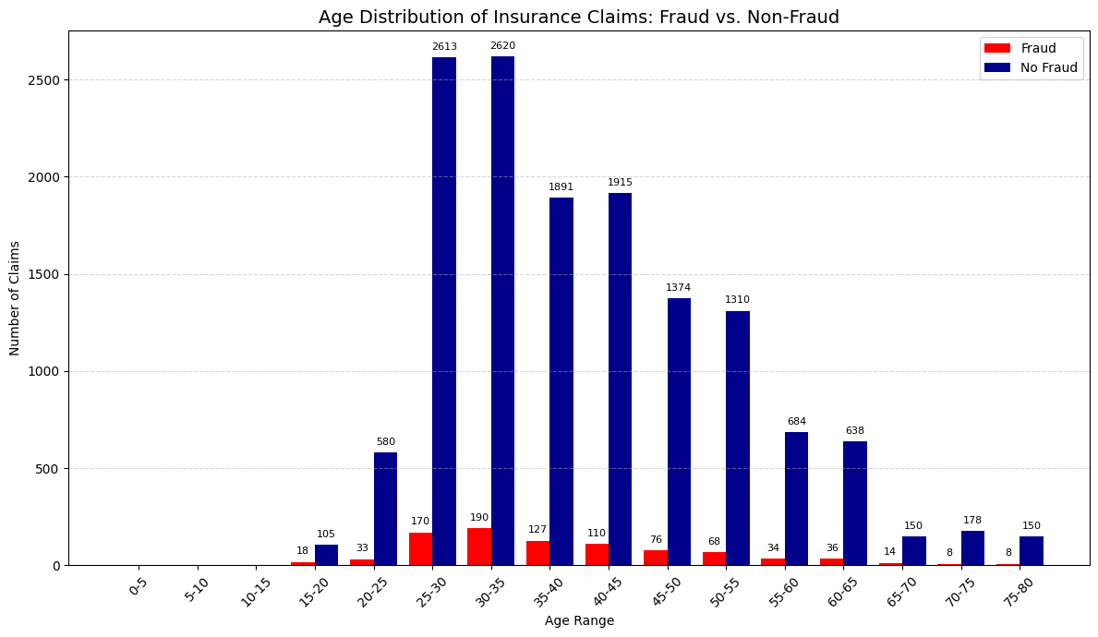


EXPLORATION
Letting the data tell its story
Before modelling, every feature was profiled on its own and against the fraud label , turning 33 raw columns into a shortlist of genuine warning signs.
AGE OF CLAIMS , FRAUD vs NOT FRAUD
Univariate
Distribution of each feature on its own , spotting skew, dominant categories and outliers.
Bivariate
Each feature crossed with the fraud label , surfacing categories where fraud over-indexes.
Fraudulent claims cluster in particular age bands rather than spreading evenly across all claimants.
Vehicle Insurance Fraud Detection
06

Slide 7
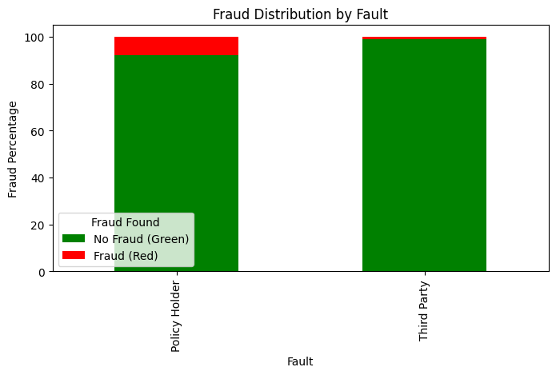
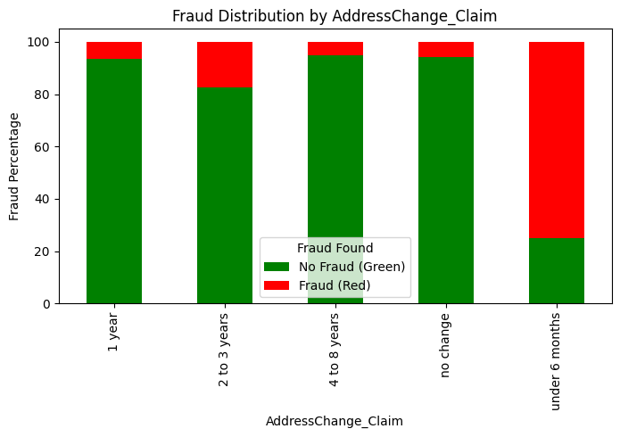
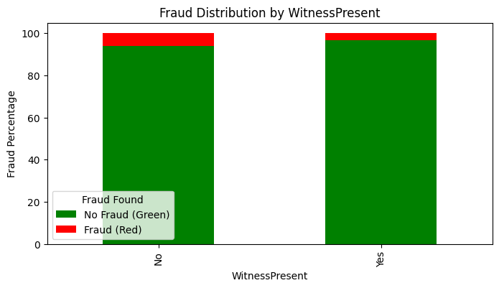

FINDING 1 · BEHAVIOURAL RED FLAGS
The biggest tells are about what's missing
FAULT
WITNESS PRESENT
RECENT ADDRESS CHANGE
What it tells us Claims where the policyholder is at fault, where no witness was present, and where the address changed recently all skew sharply toward fraud , absence of corroboration is the strongest signal in the data.
Vehicle Insurance Fraud Detection
07

Slide 8
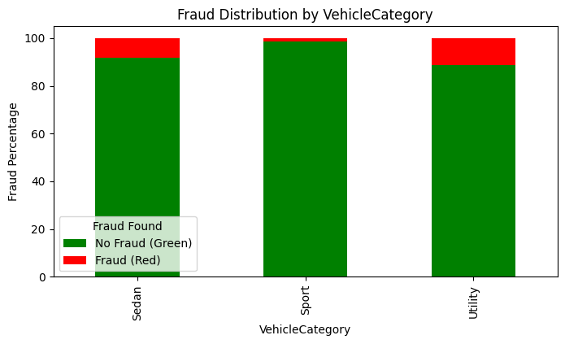
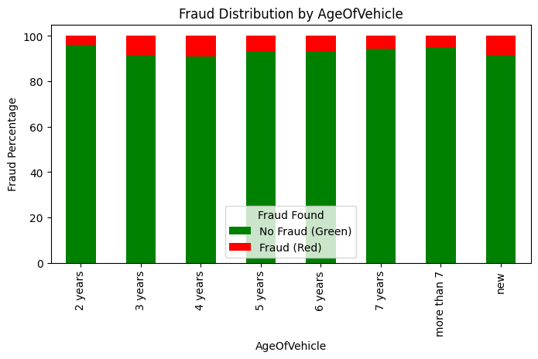
FINDING 2 · VEHICLE & POLICY
The vehicle itself carries a signal
VEHICLE CATEGORY
AGE OF VEHICLE
What it tells us Certain vehicle categories (such as utility vehicles) and particular vehicle ages show elevated fraud rates, making make-and-model context useful predictive fuel.
Vehicle Insurance Fraud Detection
08

Slide 9
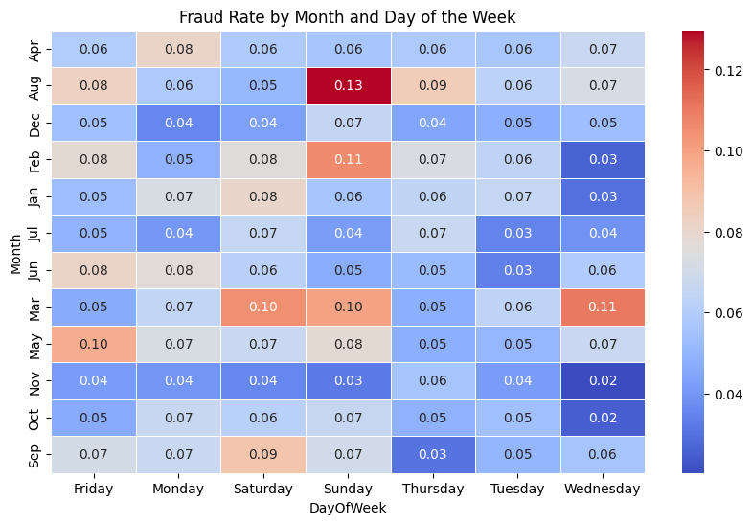
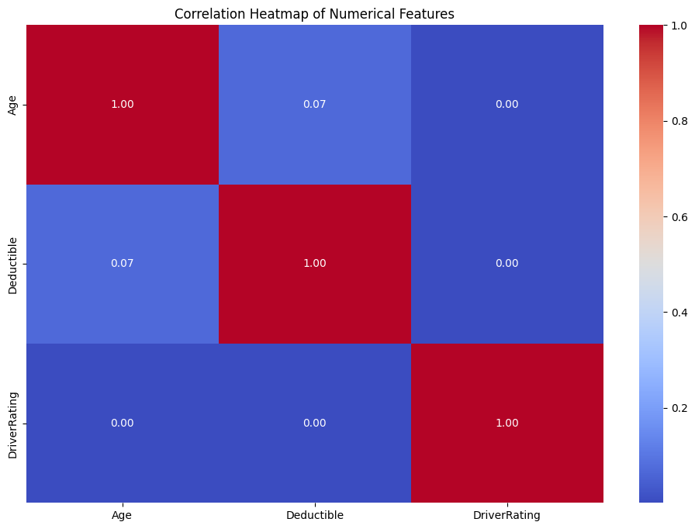
FINDING 3 · TIMING & INDEPENDENCE
Fraud has a calendar and no shortcuts
FRAUD RATE BY MONTH & WEEKDAY
CORRELATION OF NUMERIC FEATURES
What it tells us Fraud concentrates in specific month-and-weekday pockets, while numeric features stay weakly correlated , so there is no multicollinearity to remove and every feature earns its place.
Vehicle Insurance Fraud Detection
09

Slide 10







THE PIPELINE
From raw claims to model-ready data
1
2
3
4
Trim
Sort
Encode
Engineer
Drop redundant & high-cardinality columns (Make, PolicyNumber, raw dates).
Split features into numeric and categorical groups.
One-hot encode categories; convert booleans to 1/0.
Derive mapped temporal & grouped features for signal.
5
6
7
8
De-noise
Scale
Split
Balance
Remove extreme outliers with the IQR method.
Standardise numeric features to zero mean, unit variance.
80 / 20 train–test split, stratified to keep the 6% ratio.
Up-sample the fraud class , training set only.
No data leakage. Balancing happens after the split and only on the training set , the test set keeps its real-world 6% fraud rate, so every score reflects performance on truly unseen claims.
Vehicle Insurance Fraud Detection
10

Slide 11
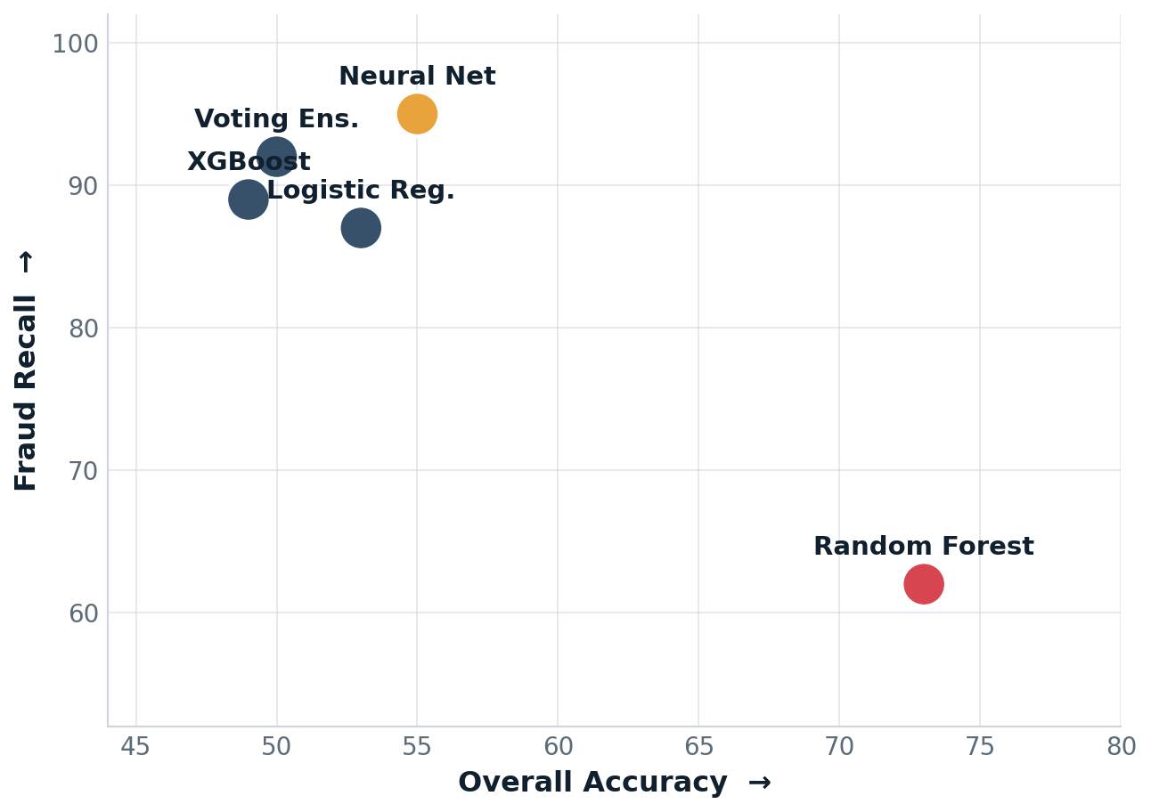


THE MODELS
Five models, one hard tradeoff
Because fraud is so rare, accuracy lies. A model can score 94% just by calling everything legitimate.
The real contest is between two metrics:
ACCURACY DOESN'T BUY RECALL
Recall
Of all real fraud, how much did we catch? Misses are expensive.
Precision
Of everything we flagged, how much was truly fraud? False alarms cost investigators.
Vehicle Insurance Fraud Detection
11

Slide 12
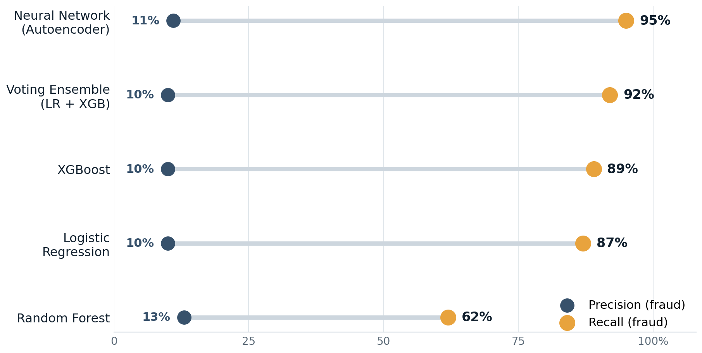
THE MODELS
How the five models stack up
METRICS (%)
FRAUD PRECISION → FRAUD RECALL
Model | Acc | Rec | F1
Neural Net | 55 | 95 | 20
Voting Ens. | 50 | 92 | 18
XGBoost | 49 | 89 | 17
Logistic Reg. | 53 | 87 | 18
Random Forest | 73 | 62 | 21
The pattern is clear. Every model reaches high recall except Random Forest, which trades recall for the best balance (F1) and far higher accuracy. Precision stays low across the board , the cost of catching rare fraud.
Vehicle Insurance Fraud Detection
12

Slide 13
THE VERDICT
Two models, two jobs
No single model wins outright , so pair them. One nets nearly all fraud up front; the other explains the final call.
FRONTLINE SCREEN
DECISIONING & AUDIT
Neural Network
Random Forest
95%
20%
11%
73%
21%
62%
Recall
F1
Precision
Accuracy
F1
Recall
Catches almost every fraudulent claim. Deploy as the first filter, then route flags to a human reviewer to manage false positives.
The most balanced, interpretable model. Use it for final decisions where explainability matters , audits, appeals and legal challenges.
Vehicle Insurance Fraud Detection
13

Slide 14



ACTION
Turning the model into a fraud strategy
Screen early with high recall
Monitor & retrain over time
Run the neural network upfront to catch fraud before any payout.
Refresh models regularly as fraud tactics evolve to avoid drift.
Decide with interpretable models
Codify the data's red flags
Use Random Forest where you must justify a decision in audits or court.
Hard-rule the strongest signals: no police report, recent address change, repeat claims.
Keep a human in the loop
Then keep improving
Route low-precision flags to investigators to filter out false alarms.
Tune thresholds, add fraud-focused features and explainability , see next slide.
Vehicle Insurance Fraud Detection
14

Slide 15


ROADMAP
Where this model goes next
Tune the threshold
Engineer fraud features
Segment fraud profiles
Set the cutoff by the business cost of a missed fraud vs a false alarm.
Claim-to-premium ratio, recent address change, prior-claim counts.
Model new vs long-time customers and low vs high-premium vehicles separately.
Score with anomalies
Retrain on fresh claims
Explain every flag
Use autoencoder reconstruction error to rank how abnormal a claim is.
Adapt continuously as fraud tactics shift over time.
Add SHAP / LIME so investigators can justify a decision.
Vehicle Insurance Fraud Detection
15

Slide 16
THE TAKEAWAY
Catching fraud is a recall game ,
and the data already holds the tells.
Behavioural red flags surface the fraud; a high-recall screen catches it; an interpretable model defends the decision. The result is a fraud pipeline that protects honest customers without overwhelming investigators.
95%
~6%
5
fraud recall, top model
real-world fraud rate held in test
models compared head-to-head
Thank you · Questions welcome

