Slide 1
IBM University Engagement Project Submission
“Exploring the Power of Agentic AI with IBM Orchestrate”

Slide 2
Project Title – PayGuard: Zero-PII Autonomous Fraud Risk Engine
Domain of Project – AI/ML
Student Name | Recent Passport Photo | Email ID | Mobile number [WhatsApp]
Akanksha Kuwar |  | akankshakuwar0508@gmail.com | 8888898605

Slide 3
Problem Statement -
Modern financial platforms struggle to balance fraud mitigation with user privacy. Online payment scams and credential-harvesting banking frauds are rapidly increasing day by day. Traditional fraud detection engines rely heavily on decrypting and parsing sensitive data like primary account numbers, identifiers, or personal data. This creates significant vulnerability risks during the pipeline transit layer.
Core Challenges:
Escalating Scams: Growth in sophisticated phishing, social engineering, and rapid account-draining operations.
Privacy Violations: Ingesting raw PII data risks compliance failures under strict global financial regulations.
High-Fidelity Attacks: Threat vectors like unverified hardware links or rapid velocity spikes bypass legacy checks.
System Friction: Rigid legacy fraud systems trigger excessive false positives, creating high customer friction.
Objectives:
Develop a Zero-PII Ingestion Pipeline that tokenizes and strips sensitive consumer credentials at the gateway layer.
Implement an orchestration engine using watsonx foundation models to analyze unidentifiable structural metadata in real time.
Deploy a deterministic threat-scoring matrix to trigger automated containment playbooks against surging digital payment anomalies.
.

Slide 4
Technology Used
IBM watsonx Orchestrate UI Console: The native development environment used to build and orchestrate the autonomous fraud risk engine.
Watsonx Foundation Models: The core AI orchestration engine driving multi-skill logical processing while shielding backend systems.
Retrieval-Augmented Generation (RAG) Layer: The embedded architecture component binding my uploaded compliance documentation directly to the assistant's runtime layer.
HTML5, CSS3, & JavaScript: Used to build the frontend interface landing page, the terminal UI telemetry module, and the floating chat application launcher widget.

Slide 5
Proposed Solution -
PayGuard is a privacy-first, autonomous fraud risk engine built natively within the IBM watsonx Orchestrate. It intercepts and aggregates non-identifiable payment metadata in real-time. By separating structural telemetry analysis from consumer identity, PayGuard provides a highly technical, zero-PII security verification layer to combat surging digital banking frauds and online scams.
How PayGuard Solves Consumer and Industry Problems:
Eliminates Identity Vulnerability (Zero-PII): Traditional engines decrypt sensitive records, risking data exposure during transit. PayGuard uses a dedicated ingestion pipeline to strip PANs, names, and OTPs. It evaluates security threats without holding data that hackers can exploit.
Neutralizes Surging Digital Scams: Sophisticated fraud (like late-night account drains, rapid velocity surges, or compromised QR codes) easily bypass legacy rules. PayGuard uses a sequential 3-skill prompt architecture to evaluate advanced biometric and timing telemetry instantly.
Reduces Financial Loss from Fatal Typos: Erroneous input faults (such as typing ₹45,000 instead of ₹450) cause immediate cash drains. PayGuard checks volume multipliers against historical wallet daily averages to flag and halt massive anomalies before final settlement.
Bypasses Infrastructure Friction: The solution requires no premium external infrastructure. It runs optimized logic steps directly through watsonx foundation models, delivering zero-cost security evaluation without high operational overhead

Slide 6
Orchestrate component Used -
The PayGuard architecture consists of four native components integrated are:
Orchestration & Intelligence Layer:
IBM watsonx Orchestrate: The central workspace hosting the agent's logic configuration and workspace settings.
watsonx Foundation Models: The core language model engine responsible for routing context and processing multi-skill logical workflows.
2. Knowledge Retrieval Layer:
Embedded RAG Layer: The reference component that links your uploaded compliance documentation directly to the assistant's runtime layer.
Ingested Knowledge Documents:
Document 1: PayPal Payment Fraud Risk Assessment.
Document 2: Secure Metadata Payment Flows & Tokenized Risk Architectures.
3. Pipeline Execution Framework: Sequential: Skill Pipeline Engine:
Skill 1: Risk Identification & Anomaly Check (Telemetry rule matching).
Skill 2: Quantitative Risk Scoring (Mathematical weight aggregation).
Skill 3: Enforcement & Strategic Mitigation Profile (Verdict output).
4. User Interface Layer
Frontend UI Dashboard: The administrative monitoring web screen styled via HTML5 and CSS3.
Telemetry Terminal Module: A JavaScript (ES6+) browser console layout that displays simulated security tracking events and active rules like Rule 101.
Floating Chat Widget Launcher: The interactive messaging window positioned in the bottom-right corner for live scenario entry.

Slide 7
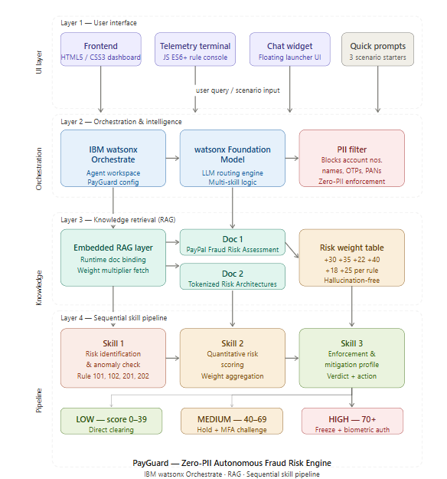
Architecture blueprint

Slide 8
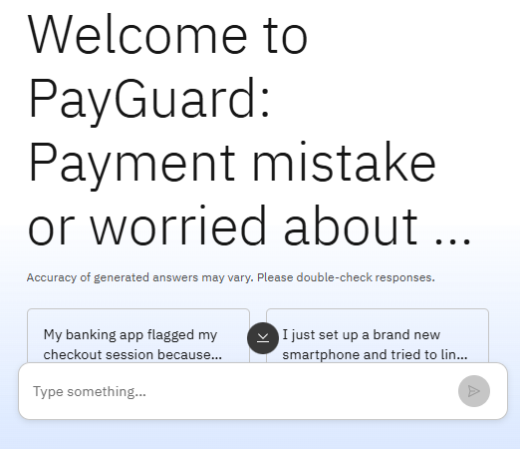
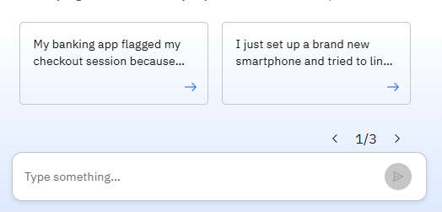
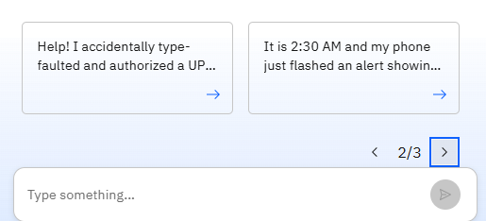
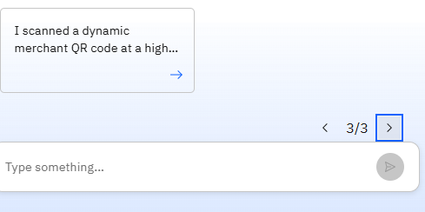
Screenshots:

Slide 9
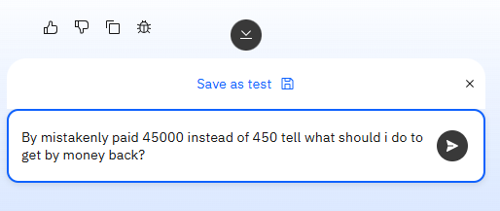
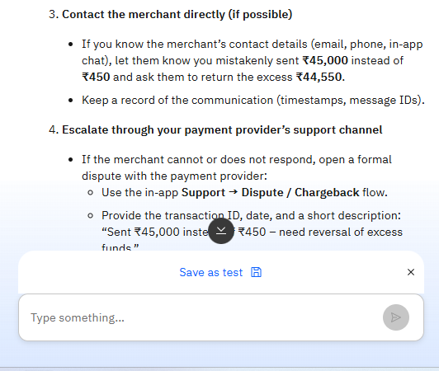
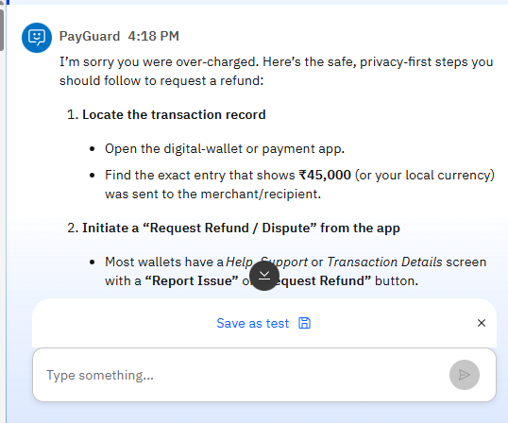
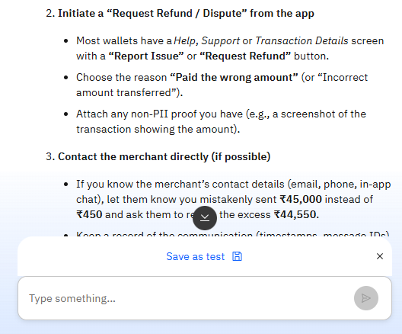
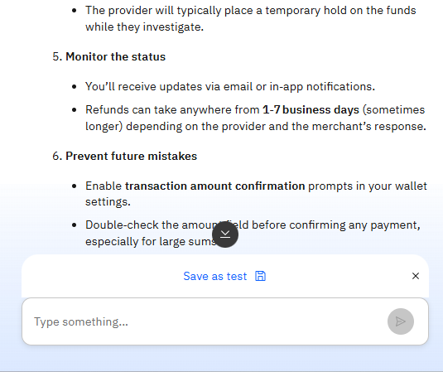
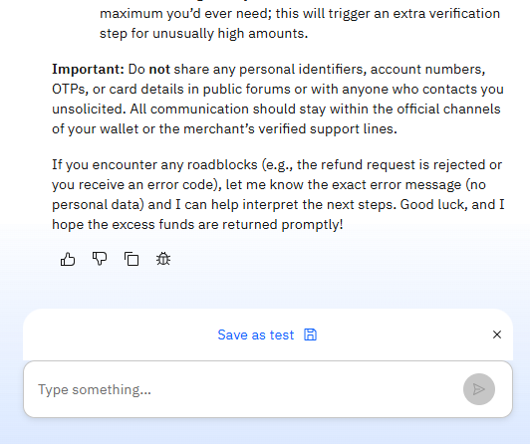

Slide 10
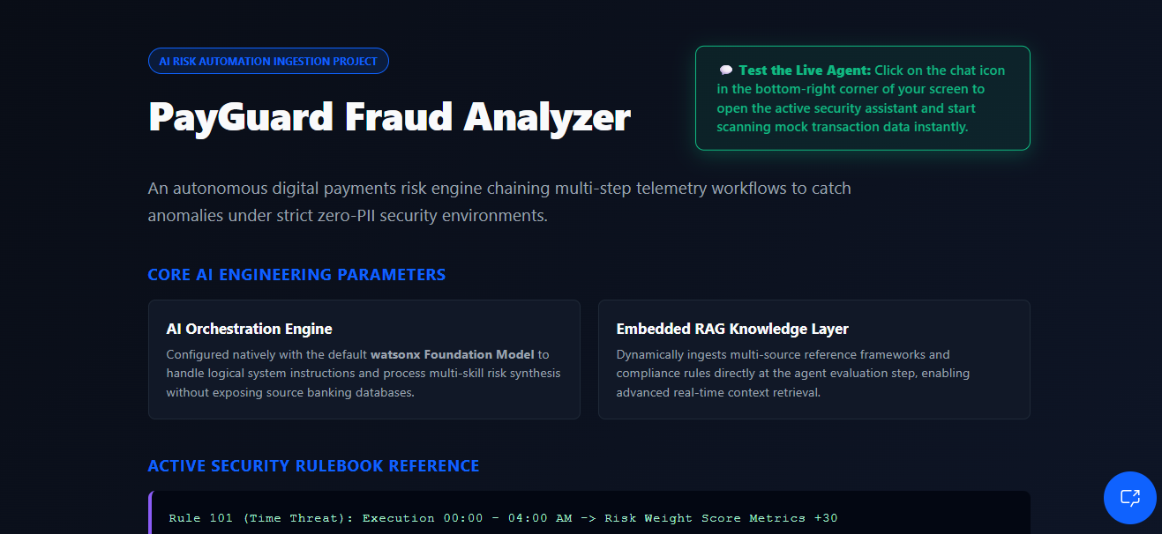
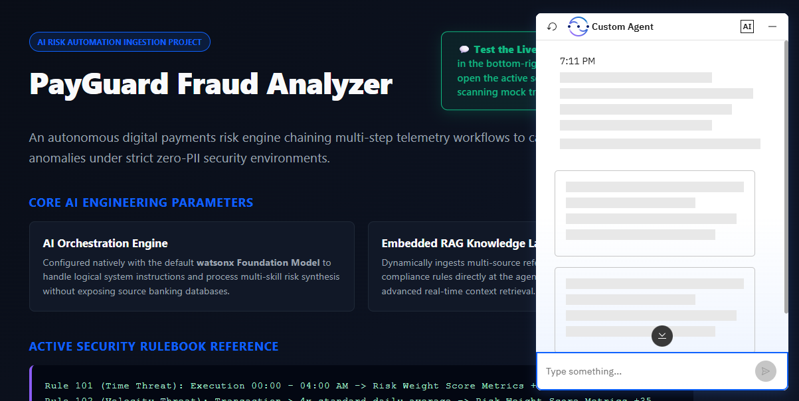
Frontend view of PayGuard after deployment:

Slide 11

Role of Agentic AI in the solution
Role of Agentic AI in PayGuard :
Agentic AI enables PayGuard to function as an intelligent, autonomous fraud risk engine rather than a simple rule-based chatbot. Using IBM watsonx Orchestrate and IBM watsonx Foundation Models, it coordinates a sequential pipeline of specialized skills to deliver real-time payment risk verdicts without human intervention. Each skill performs a distinct role Skill 1 detects anomalies and maps transaction metadata against threat rules (Rule 101: Time Threat, Rule 102: Velocity Threat), Skill 2 aggregates precise mathematical risk weights (+30, +35, +22, +40, +18, +25) sourced directly from the RAG knowledge layer, and Skill 3 translates the cumulative score into strict enforcement actions such as direct clearing, MFA challenges, or full biometric freezes. This multi-skill agentic approach ensures structured, hallucination-free decision-making by grounding every verdict in ingested compliance documentation rather than model guesswork. Agentic AI also brings context awareness to the system understanding transaction signals like unusual device profiles, late-night activity windows, geo-velocity anomalies, and clipboard-based input patterns to generate a risk profile tailored to each session. A critical agentic capability embedded in PayGuard is its absolute PII filter, which autonomously enforces data privacy by blocking any attempt to extract or retain account numbers, OTPs, cardholder names, or card PAN lines before they enter the pipeline. The skills communicate sequentially, with each layer's output feeding the next, enabling compounding intelligence across the detection, scoring, and enforcement cycle. Overall, Agentic AI makes PayGuard proactive, privacy-first, and verdict-driven acting like a smart digital payments investigator that autonomously protects users from fraud, transaction errors, and social engineering attacks in real time.

Slide 12
Novelty and Uniqueness
PayGuard stands out through several distinct architectural innovations designed specifically for modern digital transaction environments:
True Identity-Less Fraud Auditing (Zero-PII Isolation): Traditional fraud engines rely on gathering as much personal data as possible (names, card numbers, device locations) to verify trust. PayGuard flips this paradigm. It completely decouples risk estimation from identity by running a mandatory compliance scrubbing layer at inception. It proves that a transaction can be validated with high precision using pure, non-identifiable structural metadata vectors alone.
Linear 3-Skill Pipeline Architecture: Rather than processing risk in a single, unstructured pass, PayGuard forces watsonx foundation models into a strict, sequential three-stage tool execution loop (Identification ➔ Mathematical Scoring ➔ Enforcement Action). This enforces reliable, audit-ready operational tracing and eliminates the risk of logical jumps or data hallucinations during high-velocity evaluations.
Deterministic RAG-Driven Score Aggregation: Most AI fraud tools use predictive, probabilistic guessing to determine if a transaction is a scam. PayGuard introduces uniqueness by embedding a strict Retrieval-Augmented Generation (RAG) framework. The agent extracts hardcoded, exact corporate compliance threat multipliers (+30, +35, +22) directly from ingested policy manuals, combining deterministic rulebook accuracy with fluent semantic understanding.
Real-Time Telemetry and Biometric Behavior Profiling: PayGuard moves beyond simple account balance checks by integrating advanced, unidentifiable behavioral indicators:
Rule 202 (Behavioral Biometrics): Evaluates input cadence deviations and flags copy-pasted payment amounts. This intercepts automated background script hijacks without monitoring the user's personal files.
Velocity Surge Interception: Automatically calculates sudden multipliers against historical averages to instantly halt "fat-finger" typo crises before settlement occurs.

Slide 13
Git Hub Link
· Please create public github repository (Enable Add README button while creating repository) with format –
Please test and Paste the working Github URL –PayGuardGithubLink
Make sure you have Uploaded following three files into your github repository 1) app.json file , 2) yourproblemstatement.pdf file 3) your projectpresntation.pptx file 4)any other files
·
·
·

Slide 14
Future Scope
1. True RESTful API Gateway Integration:
Production Infrastructure: Transition from free-tier local browser simulations to an enterprise-grade API layer.
Live Protocol Codes: Emit operational network headers directly to banking ledger cores (HTTP 200, HTTP 403, HTTP 422).
Automated Webhooks: Deploy active webhook notification relays to trigger instant out-of-band biometric authentication prompts on user devices.
2. Advanced Multi-Agent Collaborative Networks:
Specialized Sub-Agents: Expand the single agent into a team of focused sub-agents via LangFlow.
Dedicated Task Routing: Assign separate sub-agents to handle incoming network metadata sanitization, rule weight calculations, and legal compliance log management independently.
Cross-Verification Loops: Implement secondary consensus validation layers among agents to minimize false positives prior to issuing transaction holds.
3. Native Database Integration & Real-Time Tracking:
Persistent Storage Layers: Replace temporary in-memory session arrays with persistent server-side storage architectures.
Dynamic Wallet Baselines: Compute historical daily averages dynamically on live transaction feeds rather than mocking transaction volumes.
Sub-Second Telemetry Audits: Track rapid velocity spikes and geo-velocity displacement bounds across true real-time multi-channel payment streams.
·
·
·

Slide 15


