Slide 1
FAKE NEWS CLASSIFIER PROJECT
SUBMITTED BY,
AKANKSHA PADHYE

Slide 2
INTRODUCTION:
Fake news is defined as a made-up story with an intention to deceive or to mislead. The rate of production of fake news has increased exponentially. In the past news obtained from newspaper, radio or TV were considered as the best and authentic source of information about the real world and ongoing situations but now everything has changed. In the run of popularity and ill mind set the media houses and social media are spreading fake news. It’s becoming harder and harder to say whether a piece of news is real or fabricated.
The effect of fake news can be seen everywhere. The fake news leads to communal disturbance, character assassination, mental trauma, sometimes it is used as a weapon to achieve some illicit plans etc. these are like wild fire which spread too quickly and difficult to control. Which creates difficulty in differentiating between fake news and authentic news.
Technologies such as Artificial Intelligence (AI) and Natural Language Processing (NLP) tools offer great promise for researchers to build systems which could automatically detect fake news. However, detecting fake news is a challenging task to accomplish as it requires models to summarize the news and compare it to the actual news in order to classify it as fake. Moreover, the task of comparing proposed news with the original news itself is a daunting task as it's highly subjective and opinionated.
The goal is to build a prototype to classify the news as fake or not fakes in order to bring awareness and reduce unwanted chaos.

Slide 3
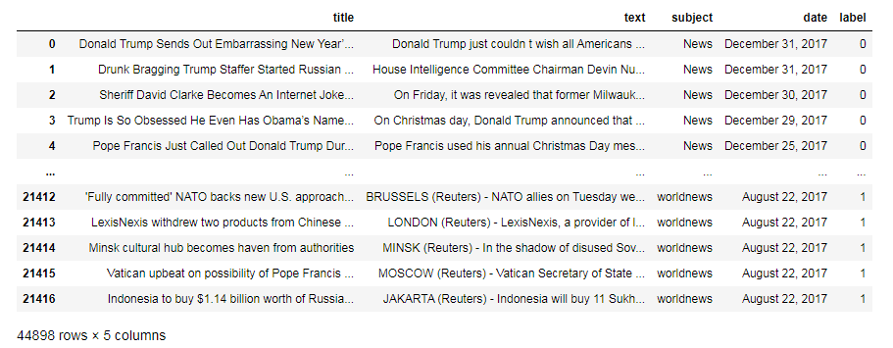
DATA SOURCES:
There are two datasets.
1st dataset consists of fake news with 23481 rows and 4 columns.
2nd dataset consist of true news with 21417 rows and 4 columns.
Using pandas in-build functions, we have merge both the datasets.
Label column is added to dataset which consist of two values, where 0 stands for fake news and 1 stands for true news.
All the columns except label column are having object datatype.

Slide 4
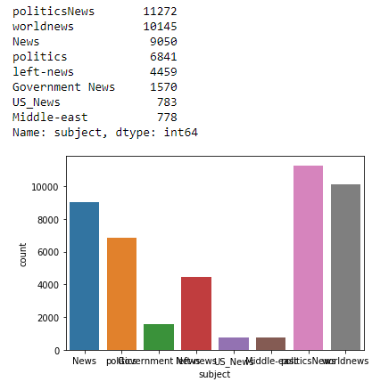
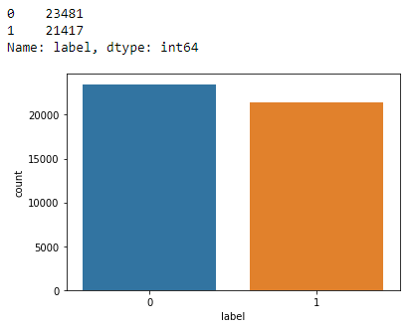
DATA VISUALIZATION:
Targeted variable has two values. 0 stands for fake news and 1 stands for true news. Fake news counts are 23481 which is more than true news with count 21417.
Maximum news subject is on politicsnews followed by worldnews and the least news is from subject USnews and middle-east.

Slide 5
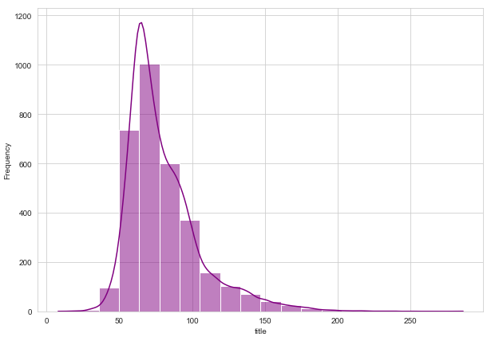
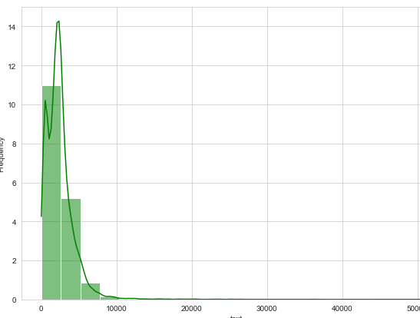
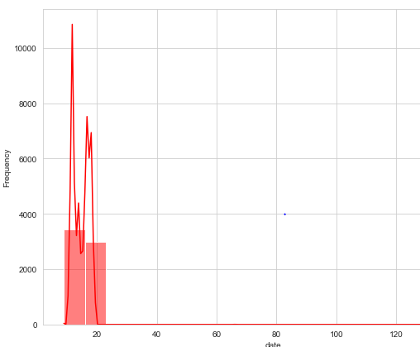
In title column majority comments are between 65-75, where maximum length is 1000
In text column maximum text is between 0-2000 and the maximum frequency is 11
In date column most of the date is between 5-10, where frequency is 3000

Slide 6
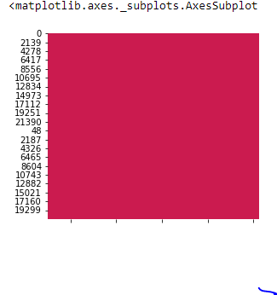
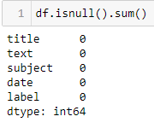
DATA PRE-PROCESSING:
Checking the missing values
Moving ahead, cleaning the dataset will remove errors which in turn will increase productivity and render highest quality information in decision making. Here, in this dataset, the null values are checked using isnull().sum(), which results in getting 2 features having null values in actual. The same has been visualized using heatmap.

Slide 7
Preprocessing using NLP
Data cleaning is the process of preparing data for analysis by removing or modifying data that is incorrect, incomplete, irrelevant, duplicated, or improperly formatted. This data is usually not necessary or helpful when it comes to analysing data because it may hinder the process or provide inaccurate results.
Before cleaning the data, a new column is created named ‘length_before_cleaning’ which shows the total length of the news respectively before cleaning the text.
The following steps were taken in order to clean the text:
Transform the text into lower case.
Replaced the email addresses with the text 'emailaddress'
Replaced the URLs with the text 'webaddress'
Removed the HTML tags
Removed the numbers
Removed extra newlines
Removed the punctuations
Removed the unwanted white spaces
Removed the remaining tokens that are not alphabetic
Removed the stop words
We also created new features for comparing the original length before cleaning and the new length after cleaning.

Slide 8
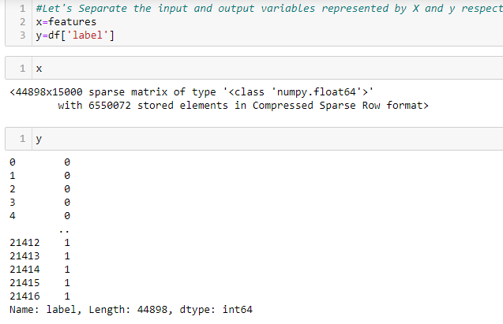
MODEL DEVELOPMENT AND EVALUATION:
Separating the features and targeted variables

Slide 9
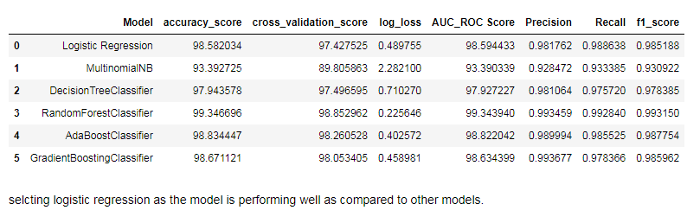
Splitting the train and test data
Training and testing the models minimize the effects of data discrepancies and better understand the characteristics of the model. The training data is used to make the machine recognize patterns in the data and the test data is used to see how well the machine can predict new answers based on its training. ‘X’ and ‘y’ were split for training and testing using train_test_split in a ratio of 70:30 respectively.
Building the model
After running the algorithms and according to the scores of performance metrics and other scores, we can see that Logistic Regression algorithm is performing well. Now, we will perform Hyperparameter Tuning to find out the best parameters and try to increase the scores.

Slide 10
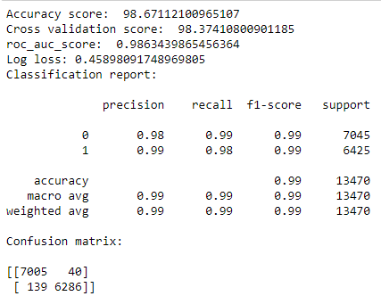
Hyperparameter Tuning
After tuning the model, we got the best score for logistic regression.

Slide 11
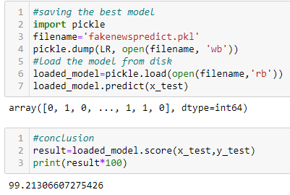
Finalizing the model
The final loaded model is having the accurarcy of 99% which is the best for any model.

Slide 12
CONCLUSION:
The finding of the study is that when the news’s are being published on a bogus name, the author names not available that news are end up being Fake.
We can understand this fake news’s are desperately being spread among the public to create a fake image of an individual, or to get profit out of it or to destroy the good deeds of the target person.

Slide 13
THANK YOU

