Slide 1
MALIGNANT COMMENTS CLASSIFIERS PROJECT
SUBMITTED BY,
AKANKSHA PADHYE

Slide 2
INTRODUCTION:
The proliferation of social media enables people to express their opinions widely online. However, at the same time, this has resulted in the emergence of conflict and hate, making online environments uninviting for users. Although researchers have found that hate is a problem across multiple platforms, there is a lack of models for online hate detection.
Online hate, described as abusive language, aggression, cyberbullying, hatefulness and many others has been identified as a major threat on online social media platforms.Social media platforms are the most prominent grounds for such toxic behavior.
There has been a remarkable increase in the cases of cyberbullying and trolls on various social media platforms. Many celebrities and influences are facing backlashes from people and have to come across hateful and offensive comments. This can take a toll on anyone and affect them mentally leading to depression, mental illness, self-hatred and suicidal thoughts.

Slide 3
Business Goal:
Our goal is to build a prototype of online hate and abuse comment classifier which can used to classify hate and offensive comments so that it can be controlled and restricted from spreading hatred and cyber bullying.
The purpose of the literature review is to:
Identify the foul words or foul statements that are being used.
Stop the people from using these foul languages in online public forum. To solve this problem.
we are now building a model using our machine language technique that identifies all the foul language and foul words, using which the online platforms like social media principally stops these mob using the foul language in an online community or even block them or block them from using this foul language. I have used 5 different Classification algorithms and shortlisted the best on basis on the metrics of performance and I have chosen one algorithm and build a model in that algorithm.

Slide 4
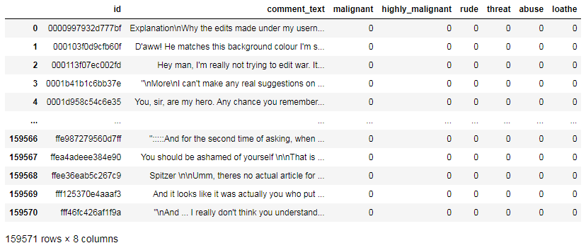
DATA SOURCES:
The data set contains the training set, which has approximately 1,59,571 samples and the test set which contains nearly 1,53,164 samples. All the data samples contain 8 fields which includes ‘Id’, ‘Comments’, ‘Malignant’, ‘Highly malignant’, ‘Rude’, ‘Threat’, ‘Abuse’ and ‘Loathe’.
The label can be either 0 or 1, where 0 denotes a NO while 1 denotes a YES. There are various comments which have multiple labels. The first attribute is a unique ID associated with each comment.

Slide 5
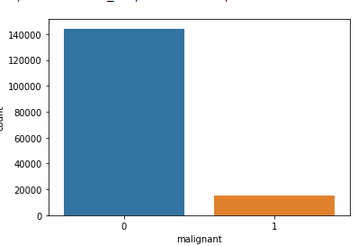
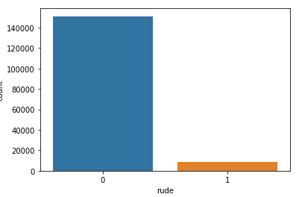
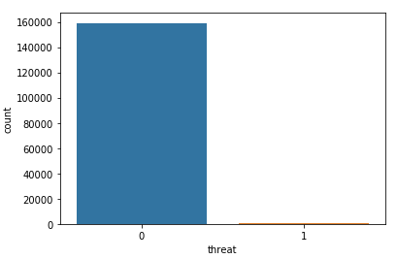
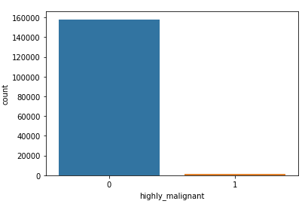
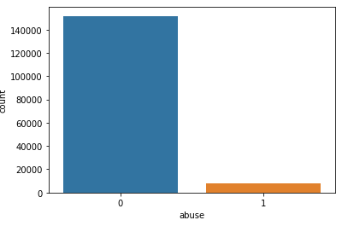
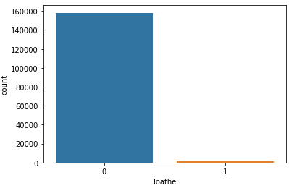
DATA VISUALIZATION:
There only mimimum number of columns in 'malignant', 'highly_malignant', 'rude', 'threat', 'abuse', 'loathe' and remaining all in 0

Slide 6
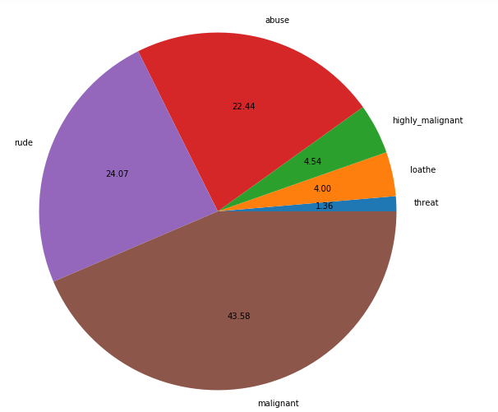
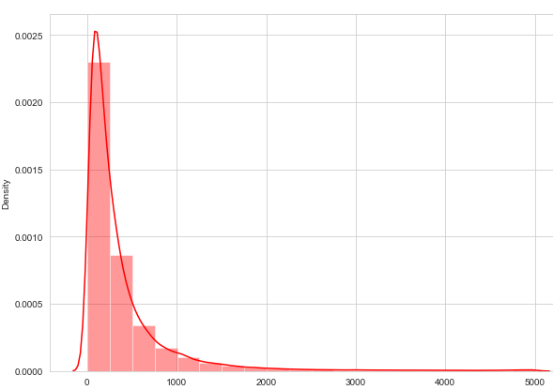
malignant and rude sentence are high classified and threat, loathe are least classified.
very few sentences are long but most of the sentences are small.

Slide 7
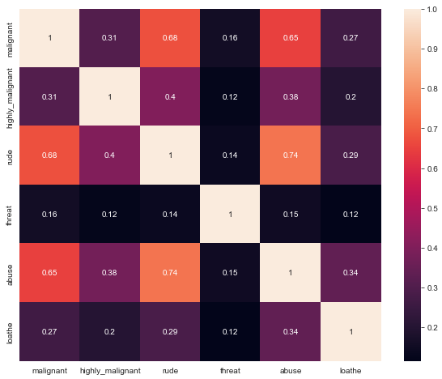
CORRELATION:
They more correlations in the variables, Abuse have more corelation with malignant and rude.
Rude has more postive corelation with malignant.
There are no negative corellations in the data.

Slide 8
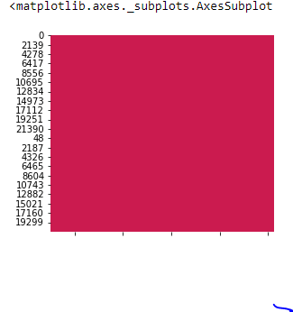
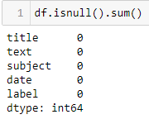
DATA PRE-PROCESSING:
Checking the missing values
Moving ahead, cleaning the dataset will remove errors which in turn will increase productivity and render highest quality information in decision making. Here, in this dataset, the null values are checked using isnull().sum(), which results in getting 2 features having null values in actual. The same has been visualized using heatmap.

Slide 9
Preprocessing using NLP
Data cleaning is the process of preparing data for analysis by removing or modifying data that is incorrect, incomplete, irrelevant, duplicated, or improperly formatted. This data is usually not necessary or helpful when it comes to analysing data because it may hinder the process or provide inaccurate results.
Before cleaning the data, a new column is created named ‘length_before_cleaning’ which shows the total length of the news respectively before cleaning the text.
The following steps were taken in order to clean the text:
Transform the text into lower case.
Replaced the email addresses with the text 'emailaddress'
Replaced the URLs with the text 'webaddress'
Removed the HTML tags
Removed the numbers
Removed extra newlines
Removed the punctuations
Removed the unwanted white spaces
Removed the remaining tokens that are not alphabetic
Removed the stop words
We also created new features for comparing the original length before cleaning and the new length after cleaning.

Slide 10

MODEL DEVELOPMENT AND EVALUATION:
Separating the features and targeted variables

Slide 11
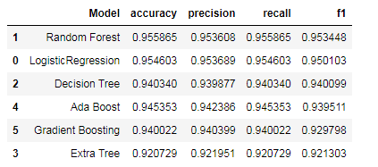
Splitting the train and test data
Training and testing the models minimize the effects of data discrepancies and better understand the characteristics of the model. The training data is used to make the machine recognize patterns in the data and the test data is used to see how well the machine can predict new answers based on its training. ‘X’ and ‘y’ were split for training and testing using train_test_split in a ratio of 70:30 respectively.
Building/Finalizing the model
After running the algorithms and according to the scores of performance metrics and other scores, we can see that Random Forest algorithm is performing well.

Slide 12
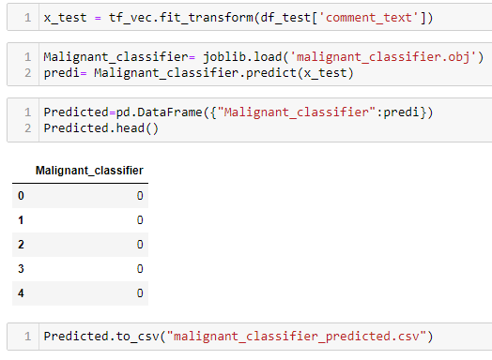
Further I have imported the test data and have done prediction on the same. After predicting using test data, we will store the results in a csv file

Slide 13
CONCLUSION:
The finding of the study is that only few users over online use unparliamentary language. And most of these sentences have more stop words, and are being long. As discussed before few motivated disrespectful crowds uses these foul languages in the online forum to bully the people around and to stop them from doing the things that they are suppose to do. Our Study helps the online forms and social media to induce a ban to profanity or usage of profanity over these forms.

Slide 14
THANK YOU

