Slide 1
Micro-Credit Defaulter Model
Submitted By
Akanksha Padhye

Slide 2
Review of Literature
This paper provides a systematic assessment of customer behavior and the trend of loan taken Vs loan paid back to the Microfinance Institution (MFI) in Indonesia bases on the above given factors. From our analysis and research done one can understand that depending on what factors customers are ending up on being a defaulter, using this study a Microfinance Institution (MFI) can predict that a customer can be a defaulter or not basis on which Microfinance Institution (MFI) can confer short-term loans.
Further our study helps the Micro finance institution to understand, analysis and predict the futuristic behavior of a customer that could help them in further speculation and improvement in selection of customers.

Slide 3
About Microfinance Institution
A Microfinance Institution (MFI) is an organization that offers financial services to low-income populations.
MFS becomes very useful when targeting especially the unbanked poor families living in remote areas with not much sources of income.
The Microfinance services (MFS) provided by MFI are Group Loans, Agricultural Loans, Individual Business Loans and so on.

Slide 4
Problem statement
Build a model using the best machine learning algorithm which can be used to predict in terms of a probability for each loan transaction, whether the customer will be paying back the loaned amount within 5 days of insurance of loan.
In this case, Label ‘1’ indicates that the loan has been paid i.e., Non- defaulter, while, Label ‘0’ indicates that the loan has not been paid i.e., defaulter.

Slide 5
EDA & Visualization

Slide 6
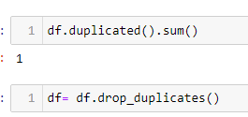
Deleting the duplicate records.
The first step of EDS started with cleansing the data with removing the duplicate records since duplicate records reduces the performance of the model.

Slide 7
Deleting the irreverent data and columns
Identified that ‘msisdn’ and ‘pcircle’ have unique values and same value respectively for all the columns, so I have dropped these two columns to make the data more predictable.

Slide 8
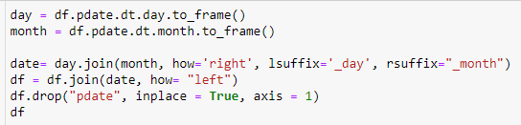
Splitting Date columns into machine Learning understandable format.
From the given data I have observed that data is taken from year 2016 and mostly of 06th, 07th, 08th months and I have split the ‘pdate’ columns into ‘pdate_day’ and ‘pdate_month’ to reduce the complexity and dropped ‘pdate’.

Slide 9
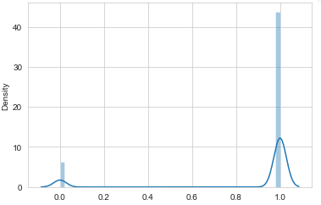
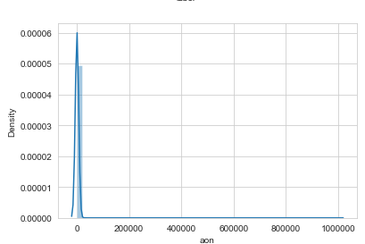
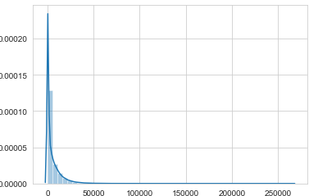
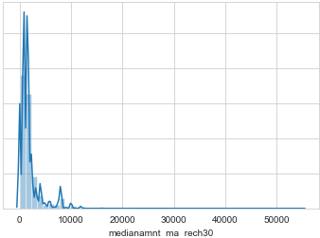
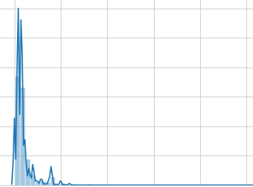
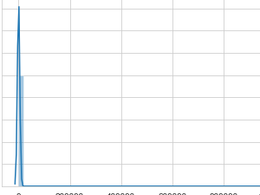
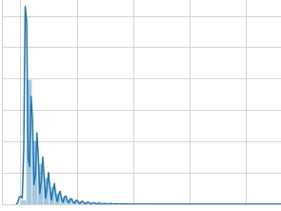
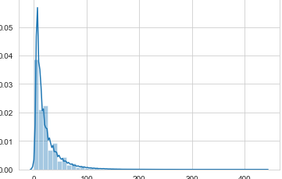
Removing Skewness and Outliers
The data is observed to have extreme positive skewness.
The sample of data is displayed we will correct the skewness by Power transformation method.

Slide 10

Removal of Skewness
The Pre-Processing of the data is completed with the skewness removal, data is completely ready for split and train with the model, before which I have tried in understanding the logic of output based on the input and also the from the data and insights that is derived from the data and also with the correlation of all the data, I have tried in getting pre-assumed insight ideas on which the output is defined. We are seeing about these pre-assumed ideas with the tools used in deriving these ideas are as follows.

Slide 11
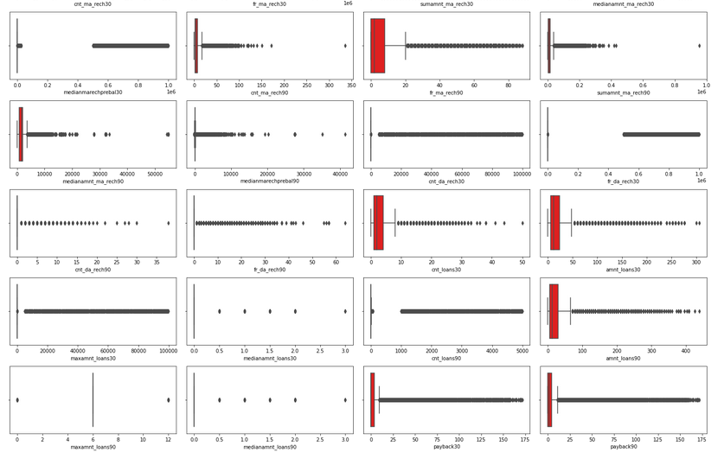
Outliers
Data seems to have too many outliers removal of outliers will deform the data and we will loose more data. So I have decided to work with outliers.

Slide 12
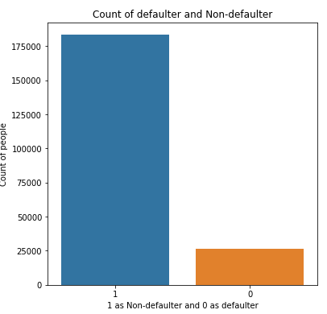
Data Visualizations
Observations:
We can see that 183431 people had paid their loan amount whereas 26162 people did not pay the amount.
Here the dataset is imbalanced. Label ‘1’ has approximately 87.5% records, while label ‘0’ has approximately 12.5% records.

Slide 13
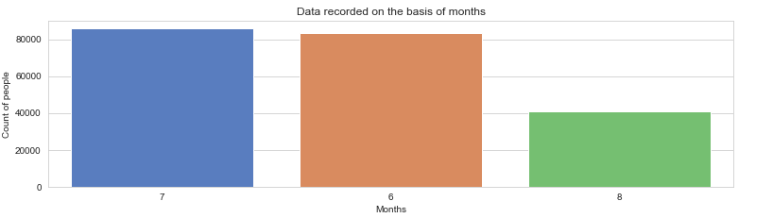
Data recorded on the basis of months
Maximum number of people records have been recorded in the month of July with a value of 85765 whereas least number of records have been recorded in the month of August with a value of 40674.
All the records are recorded in the months of June, July and August respectively.

Slide 14
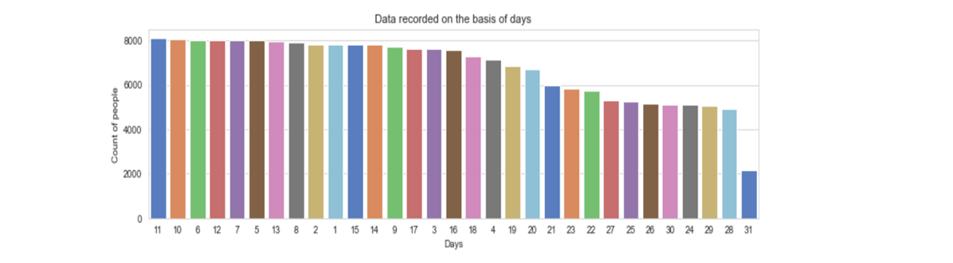
Data recorded on the basis of days
On 11th day, maximum number of people either took the loans or repaid the loan amount. The number of people is 8092.
On 31st day, minimum number of people either took the loans or repaid the loan amount. The number of people is 2178.

Slide 15
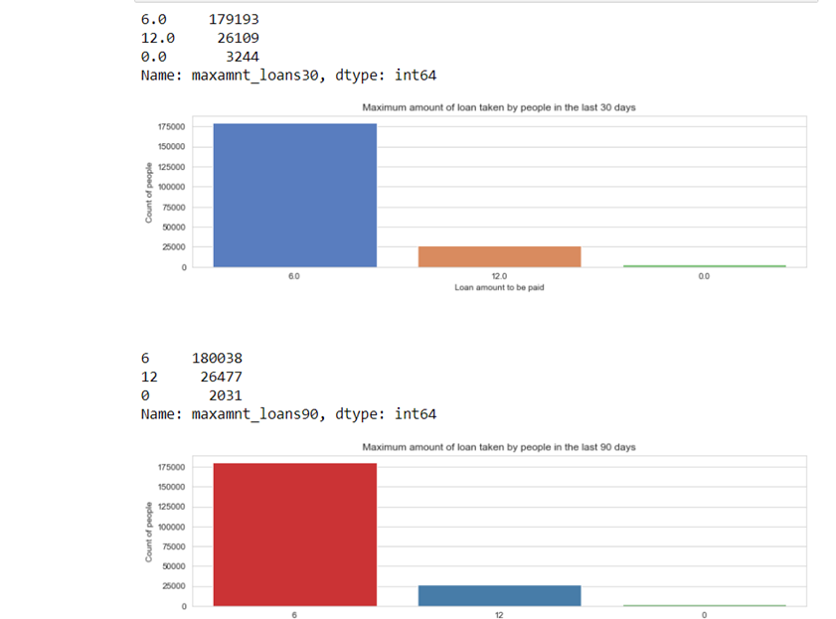
Maximum amount of loan taken by people in last 30 and 90 days
In 30 days, maximum number of people had taken 6Rs as the loan amount and the number of people is 179193 whereas the minimum number of people had not taken loan and their number is 3244.
In 90 days, maximum number of people had taken 6Rs as the loan amount and the number of people is 180038 whereas the minimum number of people had not taken loan and their number is 2031.
Maximum number of people had taken 12Rs as the loan amount within 90 days and their number is 26477 whereas for 30 days the number of people who had taken 12Rs is 26109 respectively.

Slide 16
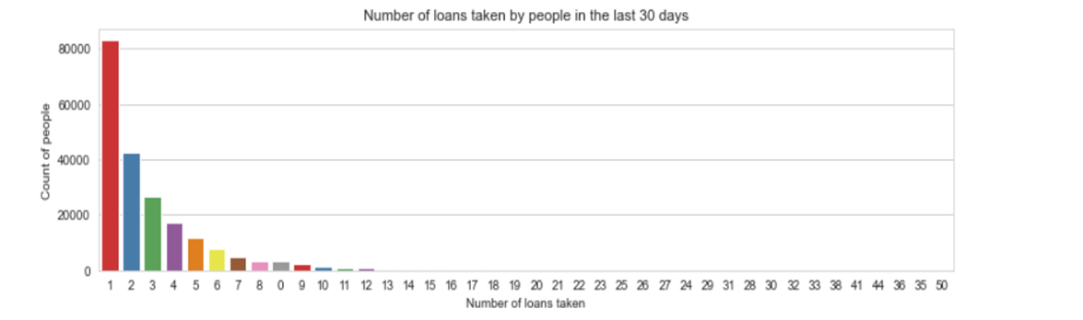
Number of loans taken by people in last 30 days
83028 is the maximum number of people who had taken loans and they had taken only once.
Single person had taken loans for 41, 50, 36 times etc.

Slide 17
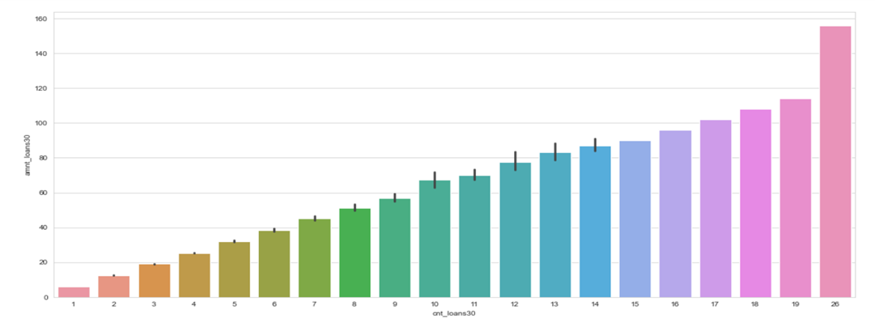
Number of loans taken by people in last 90 days VS Amount of loan taken by the people in last 90 days (considering only defaulters)
Maximum number of times the loan taken by the people is 26 and the amount is equivalent to 15.
Minimum number of times the loan taken by the people is 1 and the amount is equivalent to 6.

Slide 18
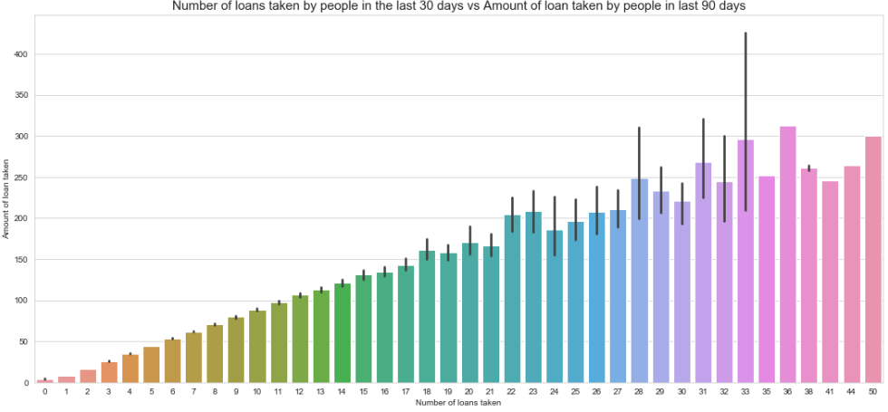
Number of loans taken by people in last 30 days VS Amount of loan taken by the people in last 90 days
Maximum number of loans taken by the people is 36 and the amount is equivalent to 320.
Minimum number of loans taken by the people is 0.

Slide 19
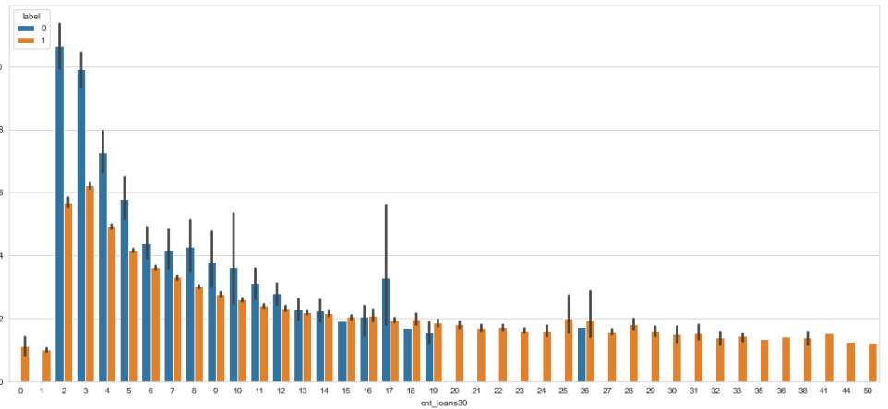
Maximum number of loans taken VS Amount paid within due dates by people or not on the basis of label
We can observe that the Average payback time over last 30 days is higher for people who had taken 2 times the loan and say that the users with a smaller number of loans taking are more than the defaulters.

Slide 20
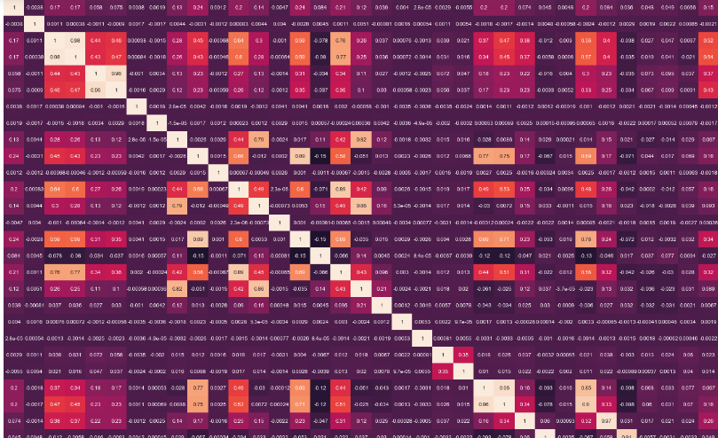
Correlation
"cnt_ma_rech30", "cnt_ma_rech90", "sumamnt_ma_rech90", "sumamnt_ma_rech30" have more corelation with the Target variable "label". Lets visualize the feature variable correlation with target variable seprately.
'daily_decr30', 'daily_decr90', 'rental30', 'rental90','last_rech_amt_ma','cnt_ma_rech30','sumamnt_ma_rech90', 'medianamnt_ma_rech90', 'cnt_loans30', 'amnt_loans30', 'amnt_loans90', 'maxamnt_loans90', payback30, payback90, pdate_day, pdate_month have more correlation with each other which is these variables are dependent on each other.

Slide 21
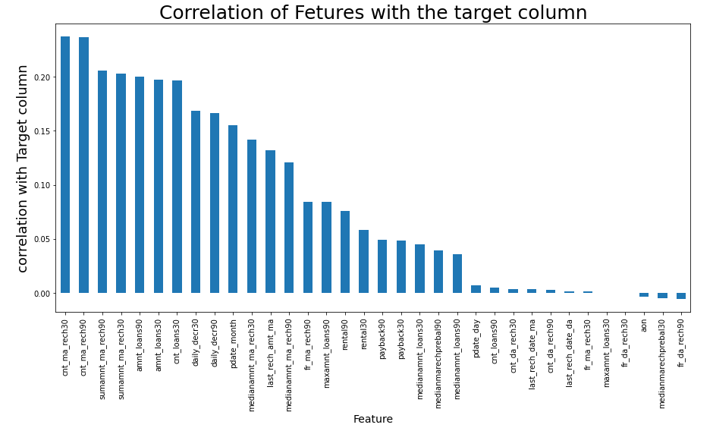
Correlation only with Target Variable
Key Observations:
From above we can observe that "cnt_ma_rech30", "cnt_ma_rech90", "sumamnt_ma_rech90", "sumamnt_ma_rech30" have more correlation with the Target variable "label".
We have more positive correlated variable than the negative correlated variable.

Slide 22
Splitting of data
The data is divided into two parts using component splitting.
In this experiment, data is split based on a ratio of 80:20 for the training set and the testing set.
The training set data is used in the logistic regression component for model training, while the testing set data is used in the prediction component.
We reduce the dimensions of the dataset to 10 features by using a technique known as Principal Component Analysis, as there are nearly 35 features present.

Slide 23
Testing of Identified Approaches (Algorithms)
We used the following algorithms mentioned below:
Logistic Regression
GaussianNB
Decision Tree Classifier
KNeighbors Classifier
Random Forest Classifier
Adaboost Classifier
Gradient Boosting Classifier

Slide 24
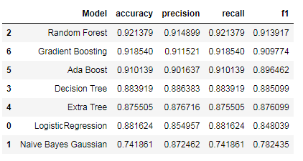
Model Dashboard
We have trained our model based on eight different Classification algorithm and have shortlisted the best algorithm with metrics as follows.

Slide 25
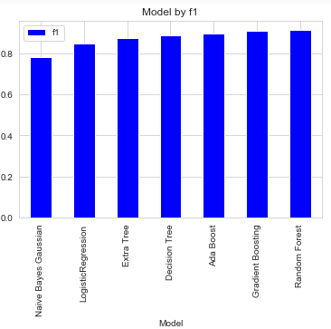
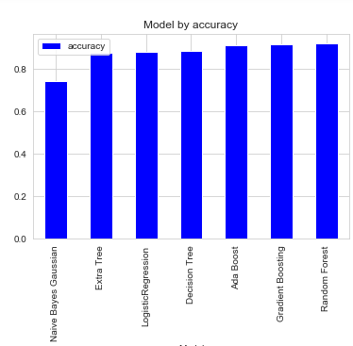
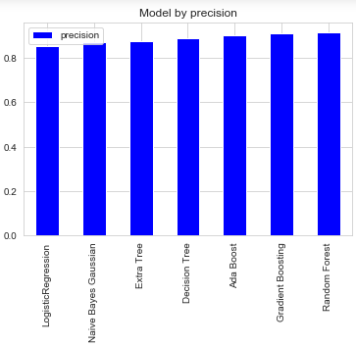
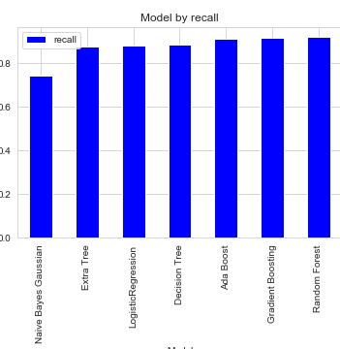
Model Dashboard
From above we see that Random Forest model have top the chart at F1-Score of 91.39% and accuracy of 92.13%. I have further hyper tuned the same model for better performance.

Slide 26
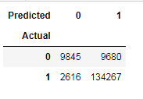
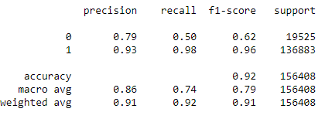
Finalized model Classification matrix of RandomForest
From above metrics we can understand how RandomForest model have performed and also overfitting in the model is very minimal since the model have accuracy of 92%.

Slide 27
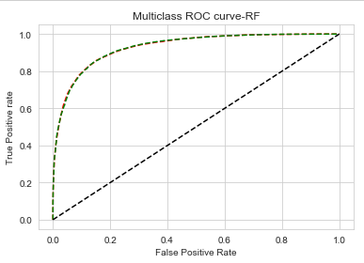
Finalized model ROC-AUC curve of RandomForest
From above metrics we can understand how RandomForest model have performed and also overfitting in the model is very minimal since the model have accuracy of 92%. We also saw the ROC-AUC curve which

Slide 28
Conclusion
Key Findings and Conclusions of the Study
From our above analysis we understand that which factors are responsible and using which a Microfinance Institution (MFI) can predict that a customer can be a defaulter or not a defaulter basis on which Microfinance Institution (MFI) can give a short-term loan and predictions that could help them in further investment and improvement in selection of customers.
Limitations of this work and Scope for Future Work
Limitations of the study arise from the use of a single dataset obtained from one company. However, the large number of loans and customers considered and generic applicability of credit scoring for mobile credit suggests that the variables and models investigated are relevant for other business applications. Further work may include the use of demographic information which could be obtained from mobile network operators and consideration of additional pay-as-you-go mobile products.

Slide 29
THANK YOU

