Slide 1
CAR PRICE PREDICTION PROJECT
SUBMITTED BY,
Akanksha Padhye

Slide 2
INTRODUCTION BUSINESS PROBLEM FRAMING
With the covid 19 impact in the market, we have seen lot of changes in the car market.
Now some cars are in demand hence making them costly and some are not in demand hence cheaper.
One of our clients works with small traders, who sell used cars.
With the change in market due to covid 19 impact, our client is facing problems with their previous car price valuation machine learning models.
So, they are looking for new machine learning models from new data. We have to make car price valuation model.

Slide 3
BUSINESS PROBLEM FRAMING
The Indian automotive sector was already struggling in FY20. before the Covid-19 crisis. It saw an overall degrowth of nearly 18 per cent. This situation was worsened by the onset of the Covid-19 pandemic and the ongoing lockdowns across India and the rest of the world. These two years (FY20 and FY21) are challenging times for the Indian automotive sector on account of slow economic growth, negative consumer sentiment, BS-VI transition, changes to the axle load norms, liquidity crunch, low-capacity utilisation and potential bankruptcies.
The return of daily life and manufacturing activity to near normalcy in China and South Korea, along with extended lockdown in India, gives hope for a U-shaped economic recovery. Our analysis indicates that the Indian automotive sector will start to see recovery in the third quarter of FY21. We expect the industry demand to be down 15-25 per cent in FY21. With such degrowth, OEMs, dealers and suppliers with strong cash reserves and better access to capital will be better positioned to sail through.
Auto sector has been under pressure due to a mix of demand and supply factors. However, there are also some positive outcomes.

Slide 4
ANALYTICAL PROBLEM FRAMING
We are building a model in Machine Learning to predict the actual value price of the prospective cars and decide whether to buy them or not. So, this model will help us to determine which variables are important to predict the price of variables & also how do these variables describe the price of the car. This will help to determine the price of cars with the available independent variables. They can accordingly manipulate the strategy of the firm and concentrate on areas that will yield high returns.
The different Mathematical/Analytical models that are used in this project are as below:
Linear Regression, Lasso, Ridge, Elastic Net, KNeighborsRegressor, Decision Tree Regressor, RandomForest Regressor, Adaboost Regressor, GradientBoostingRegressor.
First, use the train dataset and do the EDA process, fitting the best model and saving the model.
Then, use the test dataset, load the saved model and predict the values over the test data.

Slide 5


Slide 6
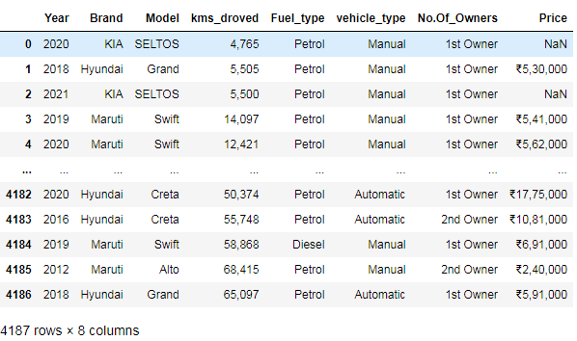
DATASET
Dataset has 4187 rows and 8 columns.
There are null values present in the dataset.
Dataset contains categorial and continuous data.
We have scrapped the data from cars24 website and made a dataframe.

Slide 7
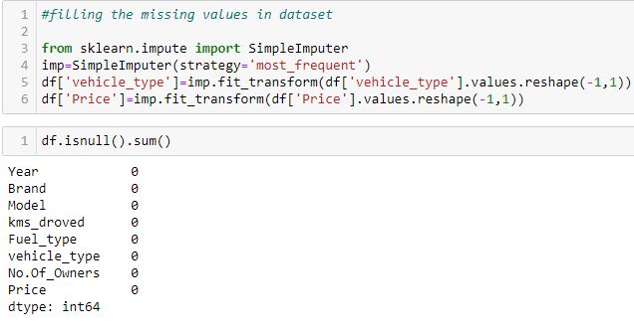
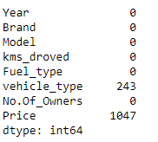
CHECKING THE NUMBER OF NULL VALUES & HANDELING THEM:

Slide 8
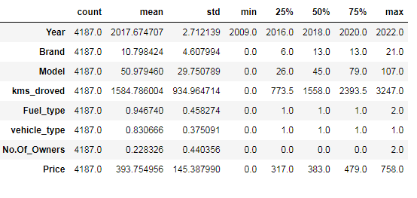
STATISTICAL SUMMARY
count is same for all the columns
For some columns mean is greater than 50% and for some columns mean is lesser than 50%
for all the columns there is a difference between max and 75%

Slide 9
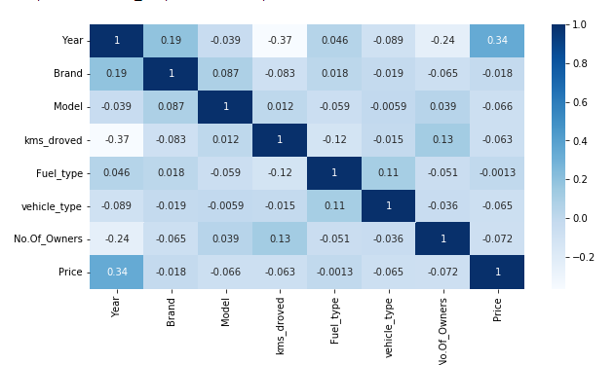
CORRELATION FACTOR
1. year is highly positively correlated with target varibale.
2. fuel_type is least correlated with target variable.
3. model and no.of owners is highly negatively correlation with target variable.

Slide 10
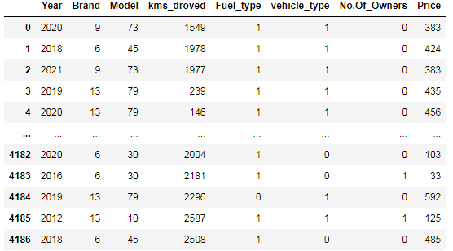
ENCODING NON-NUMERIC DATA USING LABEL ENCODER

Slide 11
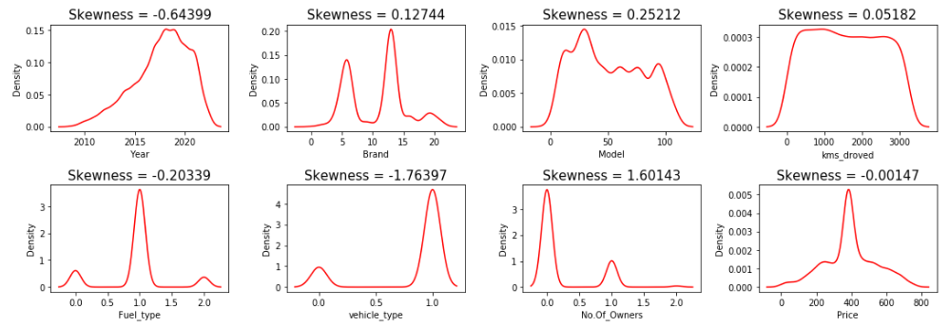
CHECKING SKEWNESS

Slide 12
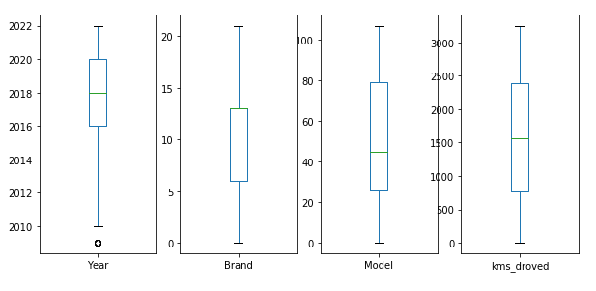
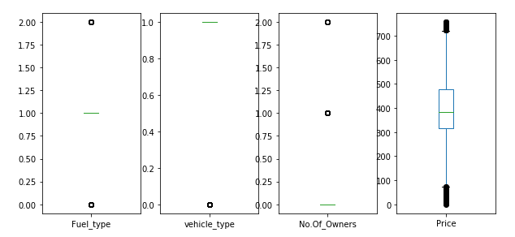
CHECKING OUTLIERS

Slide 13
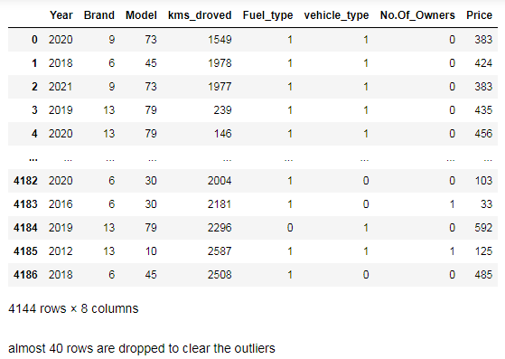
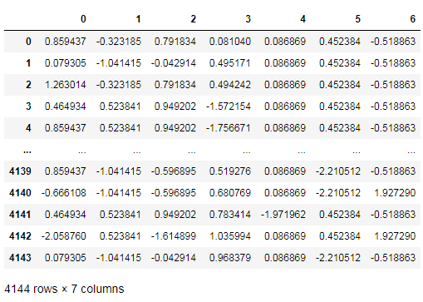
TREATING SKEWNESS & OUTLIERS

Slide 14
MODEL DEVELOPMENT
From the given dataset it can be concluded that it is a Regression problem as the output column “Price” has continuous output. So, for further analysis of the problem, we have to import or call out the Regression related libraries in Python work frame. The different libraries used for the problem solving are:
Sklearn
Sklearn.linear_model
Sklearn.ensemble
Sklearn.metrics
Sklearn.model_selection

Slide 15
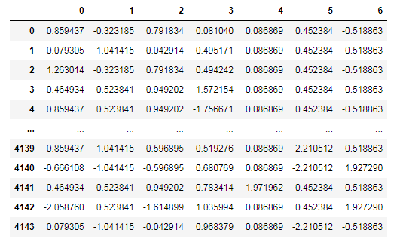
SCALING THE DATA USING STANDARD SCALER

Slide 16
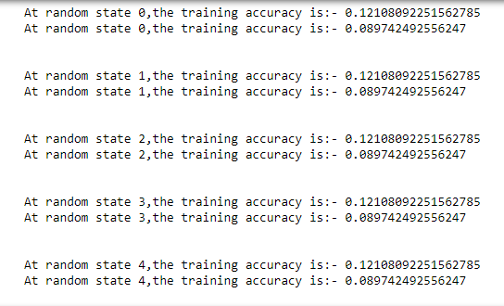
CHECKING THE RANDOM STATE
Selecting random state as 4. We are getting same values in all the random states.

Slide 17
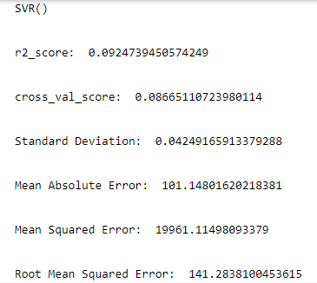
FINDING THE BEST MODEL
We are using LinearRegressor, Lasso, Ridge, ElasticNet, Support vector, Decision Tree and Kneighbors Regressor.
We are calculating r2 score, cross_val_score, std, mean_absolute error, mean_squared error, root_mean_squared error for each models.
Selected support vector regressor as its giving maximum accuracy as compared to other models.

Slide 18
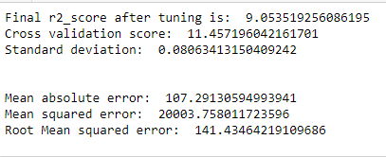
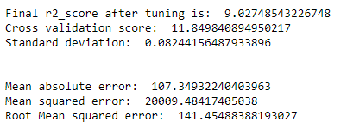
KEY METRICS FOR SUCCESS IN SOLVING PROBLEM UNDER CONSIDERATION
The key metrics used here were r2_score, cross_val_score, sd, MAE, MSE and RMSE. We tried to find out the best parameters and also to increase our scores by using Hyperparameter Tuning and we will be using GridSearchCV method.

Slide 19
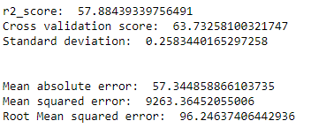
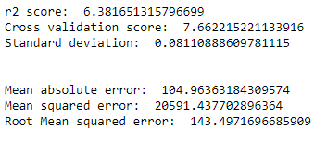
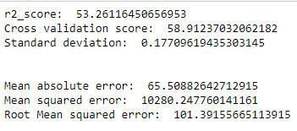
ENSEMBLING TECHNIQUES
RandomForest Regressor is giving 57% of r2 score which is maximum as compared to others.

Slide 20
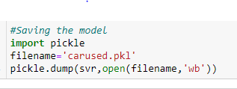
SAVING THE BEST MODEL
As svr is giving the best scores among other models, we are saving svr as our best model.

Slide 21
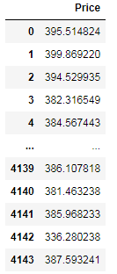
PREDICTING OVER TEST DATA

Slide 22
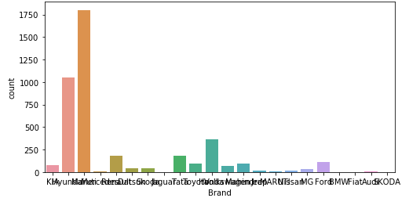
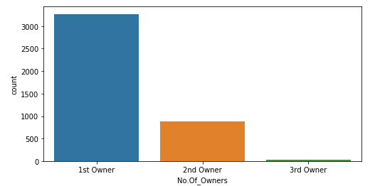
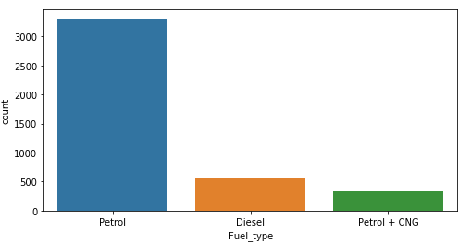
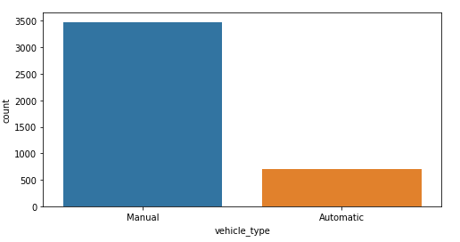
DATA VISUALIZATION PLOTTING GRAPHS FOR CATEGORICAL DATA

Slide 23
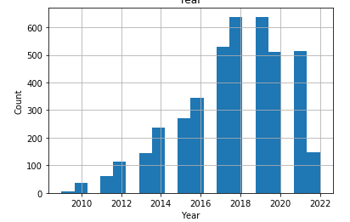
PLOTTING GRAPHS FOR CONTINUOUS DATA

Slide 24
OBSERVATIONS:
1. maximum cars to be selled are of year 2018 to 2020 of count almost 600 each.
2. 1st owner has the maximum count of 3268, then followed by 2nd owner count of 882 and 3rd owner count of 37.
3. maximum cars to be selled are manual with count of 3478 and rest all the 708 cars are automatic.
4. 3069 cars are petrol, 557 cars are diesel and rest 337 cars are petrol+cng.
5. maximum cars are of maruti, followed by hundai and least are SKODA and fiat.
6. alto, swift, baleno and grand models are maximum for selling.
7. Q, tiago, camry and carens models are very less for selling.

Slide 25
CONCLUSION:
The manufacturer like Land Rover, Benz, BMW cars are costliest used car in the market comparatively to other cars.
The low kilometres driven and also if the manufacturing year is lesser on these brands those card sells in much higher rates or closest to the buying new car rates.
The Diesel variant and Automatic shift variants are also costliest user car variants in the used car market.

Slide 26
THANK YOU

