Slide 1
HOUSE PRICE PREDICTION PROJECT
SUBMITTED BY,
Akanksha Padhye

Slide 2
INTRODUCTION BUSINESS PROBLEM FRAMING
Houses are one of the necessary needs of each and every person around the globe and therefore housing and real estate market is one of the markets which is one of the major contributors in the world’s economy. It is a very large market and there are various companies working in the domain.
Data science comes as a very important tool to solve problems in the domain to help the companies increase their overall revenue, profits, improving their marketing strategies and focusing on changing trends in house sales and purchases. Predictive modelling, Market mix modelling, recommendation systems are some of the machine learning techniques used for achieving the business goals for housing companies. Our problem is related to one such housing company.
We are required to model the price of houses with the available independent variables. This model will then be used by the management to understand how exactly the prices vary with the variables. They can accordingly manipulate the strategy of the firm and concentrate on areas that will yield high returns. Further, the model will be a good way for the management to understand the pricing dynamics of a new market.

Slide 3
BUSINESS PROBLEM FRAMING
A US-based housing company named Surprise Housing has decided to enter the Australian market. The company uses data analytics to purchase houses at a price below their actual values and flip them at a higher price. For the same purpose, the company has collected a data set from the sale of houses in Australia. The data is provided in the CSV file below.
The company is looking at prospective properties to buy houses to enter the market. You are required to build a model using Machine Learning in order to predict the actual value of the prospective properties and decide whether to invest in them or not. For this company wants to know:
• Which variables are important to predict the price of a variable?
• How do these variables describe the price of the house?

Slide 4
ANALYTICAL PROBLEM FRAMING
We are building a model in Machine Learning to predict the actual value of the prospective properties and decide whether to invest in them or not. So, this model will help us to determine which variables are important to predict the price of variables & also how do these variables describe the price of the house. This will help to determine the price of houses with the available independent variables. They can accordingly manipulate the strategy of the firm and concentrate on areas that will yield high returns.
The different Mathematical/Analytical models that are used in this project are as below:
Linear Regression, Lasso, Ridge, Elastic Net, KNeighborsRegressor, Decision Tree Regressor, RandomForest Regressor, Adaboost Regressor, GradientBoostingRegressor.
First, use the train dataset and do the EDA process, fitting the best model and saving the model.
Then, use the test dataset, load the saved model and predict the values over the test data.

Slide 5


Slide 6
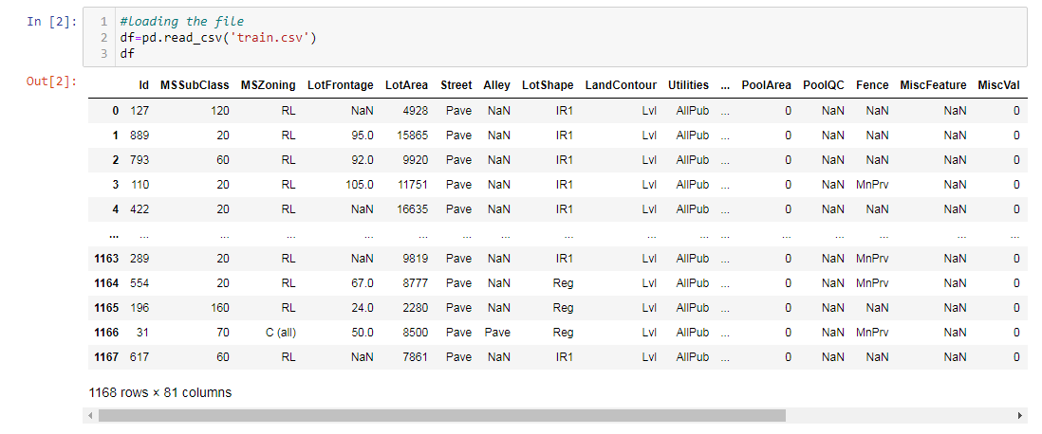
DATASET
Dataset has 1168 rows and 81 columns.
There are null values present in the dataset.
Dataset contains categorial and continuous data.

Slide 7
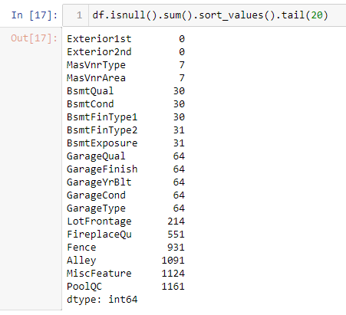
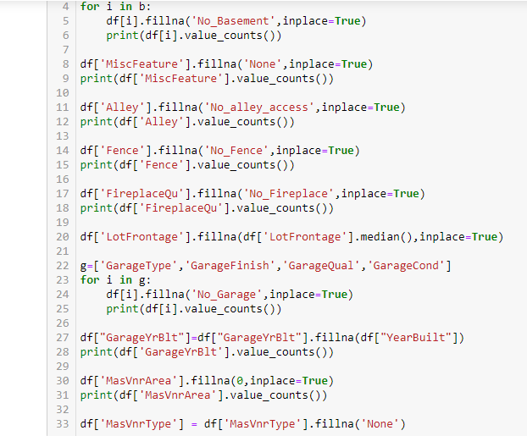
CHECKING THE NUMBER OF NULL VALUES & HANDELING THEM:

Slide 8
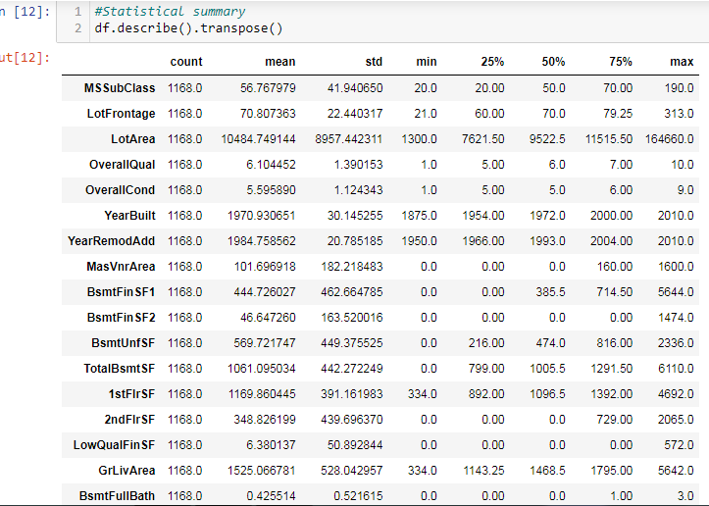
STATISTICAL SUMMARY
count is same for all the columns
For some columns mean is greater than 50% and for some columns mean is lesser than 50%
for all the columns there is a difference between max and 75%

Slide 9
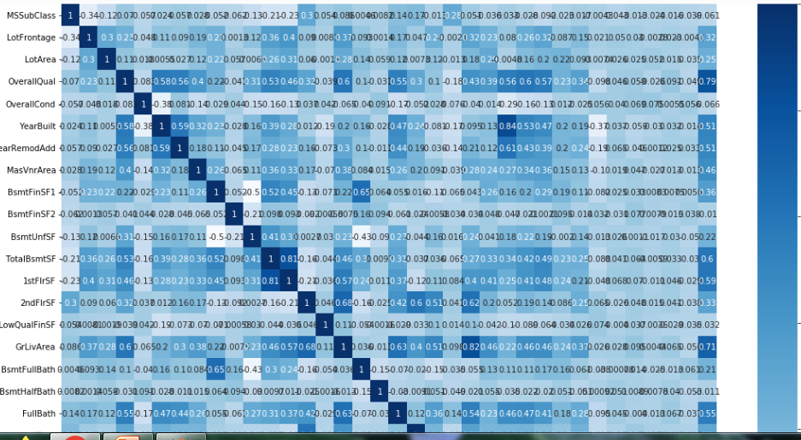
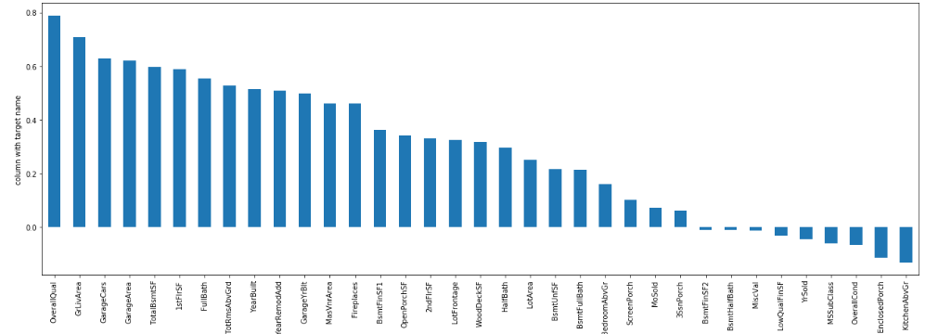
CORRELATION FACTOR
'OverallQual' & 'GrLivArea' are highly positively correlated with target column
'EnclosedPorch' & 'KitchenAbvGr' are highly negatively correlated with target column
'MSSubClass' ,'OverallCond' ,'OverallCond' ,'LowQualFinSF' ,'BsmtHalfBath' ,'YrSold', 'MiscVal', 'MoSold', '3SsnPorch' are least correlated with the target column

Slide 10
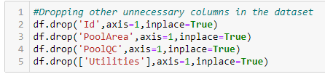
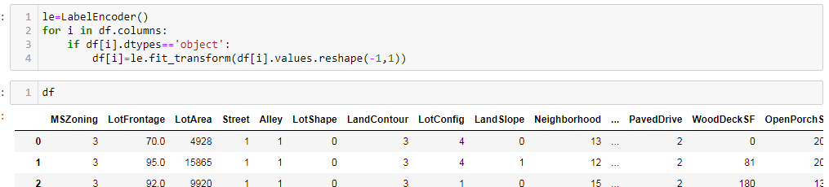
DROPPING UNNECESSARY COLUMNS AND ENCODING NON-NUMERIC DATA USING LABEL ENCODER

Slide 11
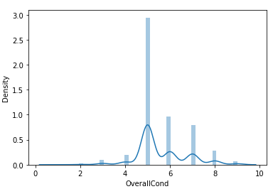
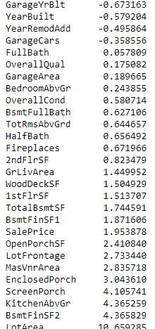
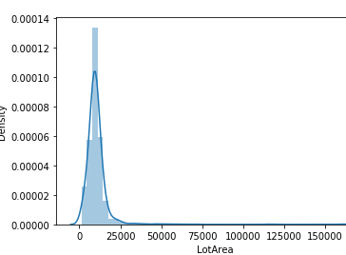
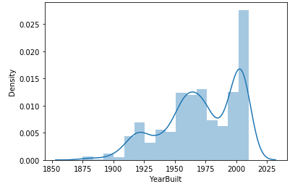
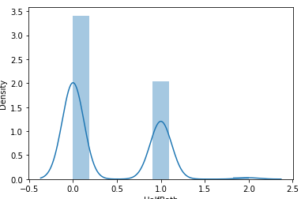
CHECKING SKEWNESS AND PLOTTING DIST PLOT

Slide 12
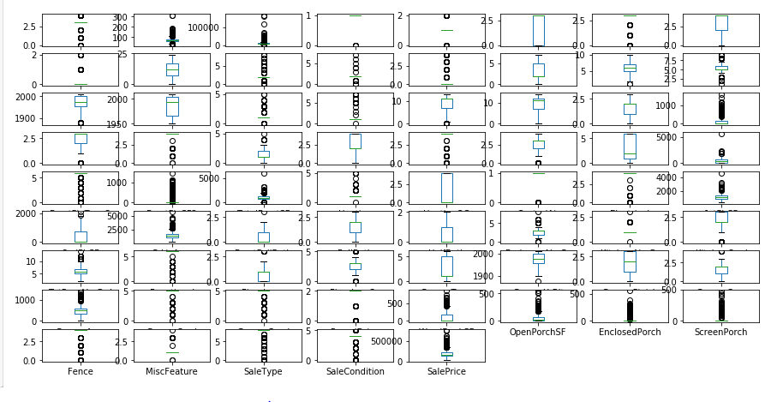
CHECKING OUTLIERS

Slide 13
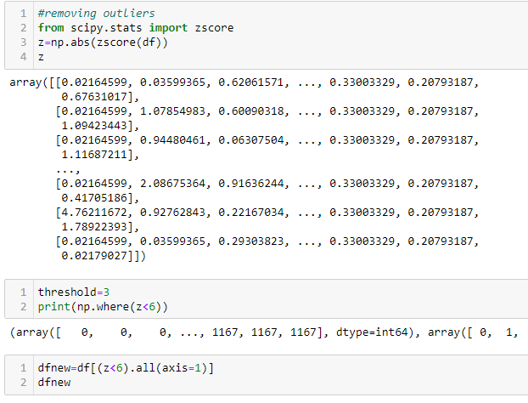
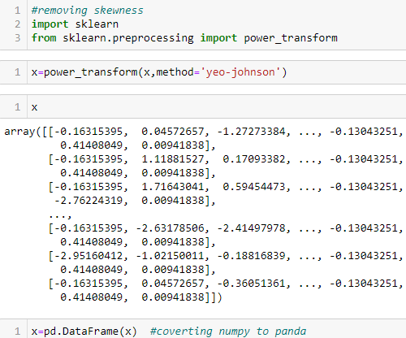
TREATING SKEWNESS & OUTLIERS

Slide 14
MODEL DEVELOPMENT
From the given dataset it can be concluded that it is a Regression problem as the output column “SalesPrice” has continuous output. So, for further analysis of the problem, we have to import or call out the Regression related libraries in Python work frame. The different libraries used for the problem solving are:
Sklearn
Sklearn.linear_model
Sklearn.ensemble
Sklearn.metrics
Sklearn.model_selection

Slide 15
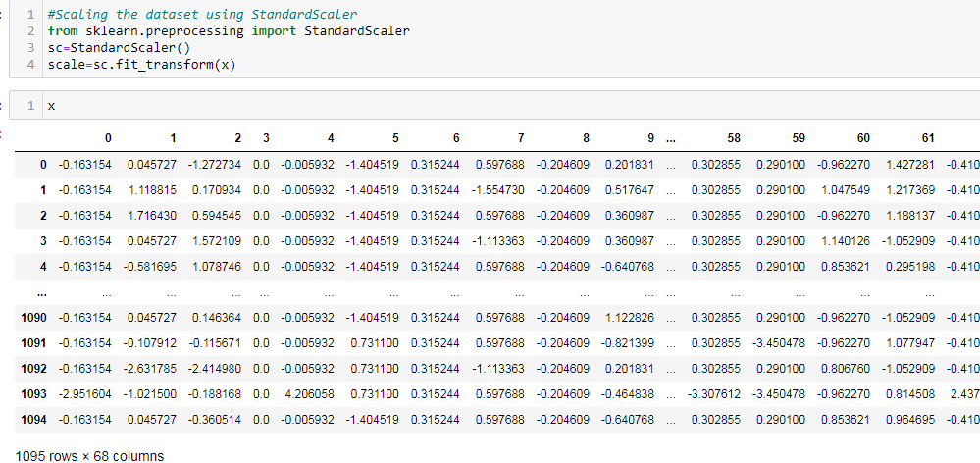
SCALING THE DATA USING STANDARD SCALER

Slide 16
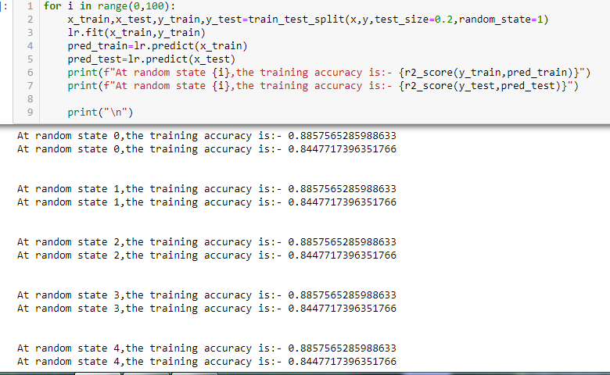
CHECKING THE RANDOM STATE
Selecting random state as 4. We are getting same values in all the random states.

Slide 17
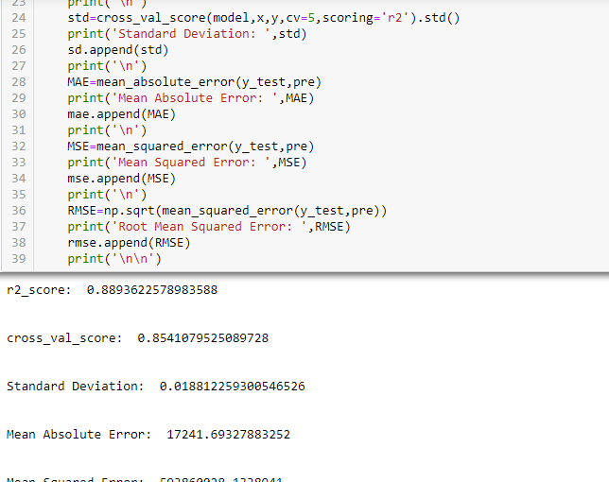
FINDING THE BEST MODEL
We are using LinearRegressor, Lasso, Ridge, ElasticNet, Support vector, Decision Tree and Kneighbors Regressor.
We are calculating r2 score, cross_val_score, std, mean_absolute error, mean_squared error, root_mean_squared error for each models.

Slide 18
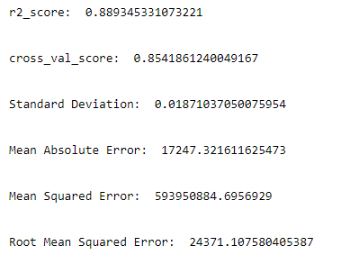
We can see that Ridge and Lasso Regression algorithms are performing well as compared to other models.

Slide 19
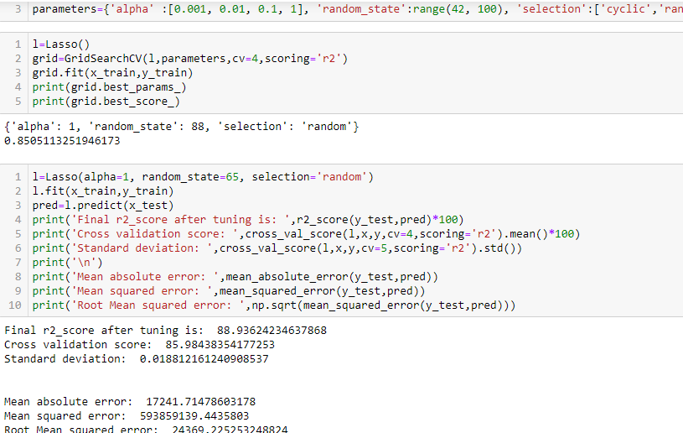
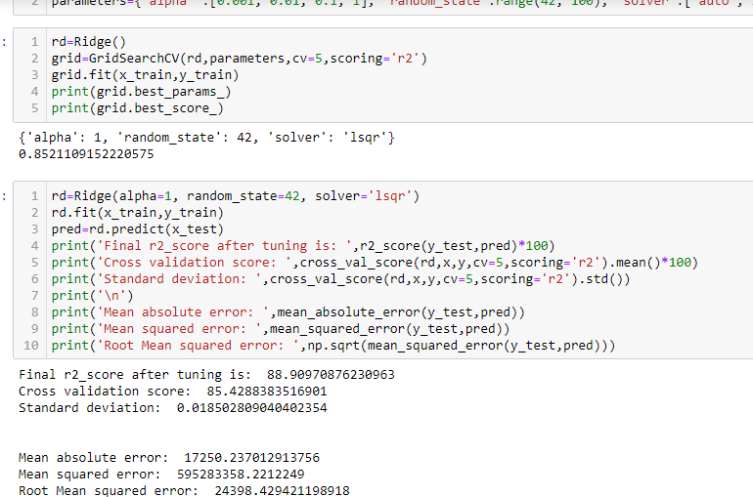
KEY METRICS FOR SUCCESS IN SOLVING PROBLEM UNDER CONSIDERATION
The key metrics used here were r2_score, cross_val_score, sd, MAE, MSE and RMSE. We tried to find out the best parameters and also to increase our scores by using Hyperparameter Tuning and we will be using GridSearchCV method.

Slide 20
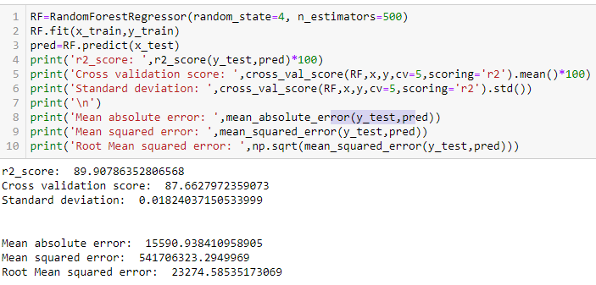
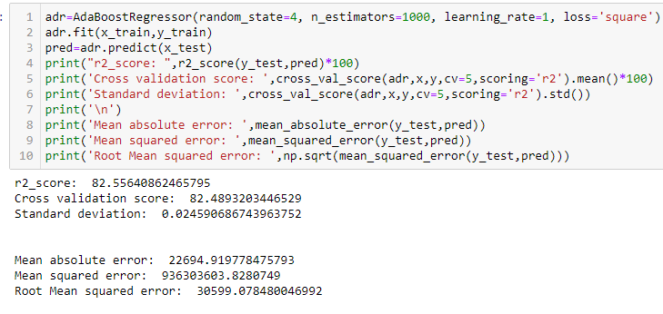
ENSEMBLING TECHNIQUES

Slide 21
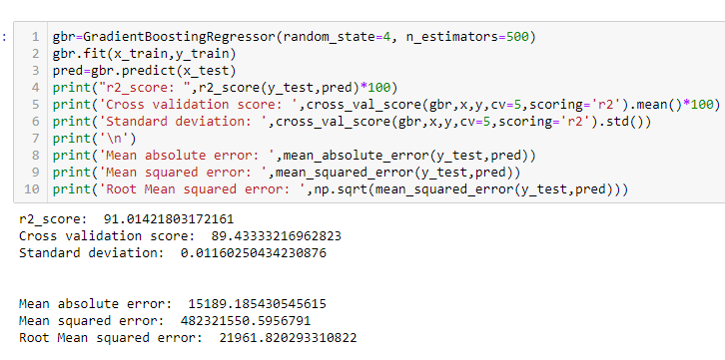
After applying Ensemble Techniques, we can see that GradientBoostingRegressor is the best performing algorithm among all other algorithms as it is giving a r2_score of 91.01 and cross validation score of 89.43

Slide 22
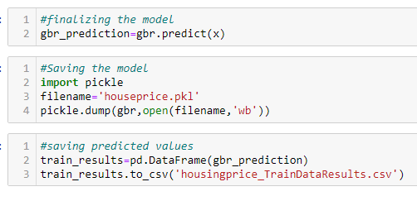
SAVING THE BEST MODEL

Slide 23
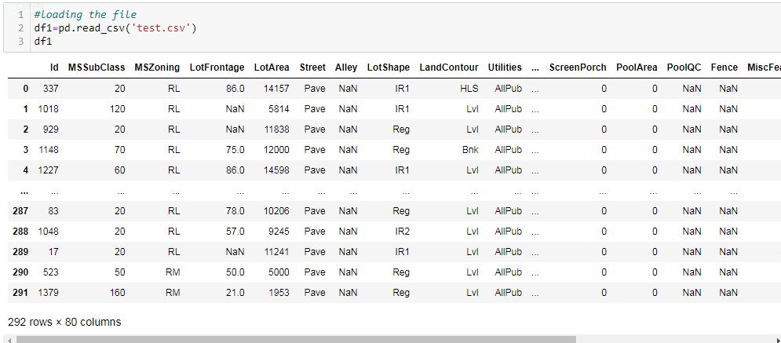
USING THE TEST DATASET
Here, we will be doing the same steps as we did for training dataset like handling missing data, dropping unnecessary columns, encoding non-categorical data, treating skewness, etc.
Then, we will scale the data according to the best model requirements

Slide 24
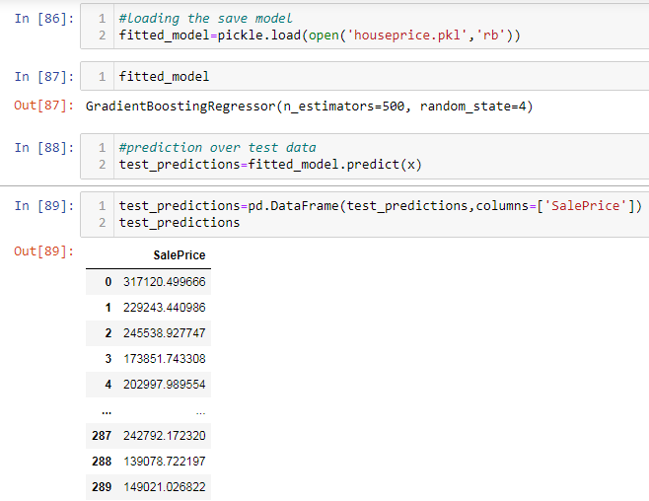
PREDICTING OVER TEST DATA

Slide 25
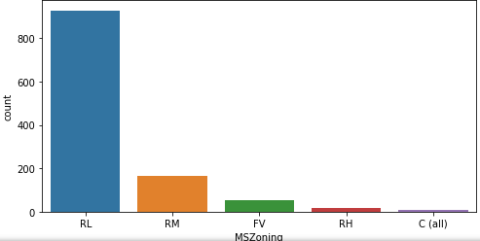
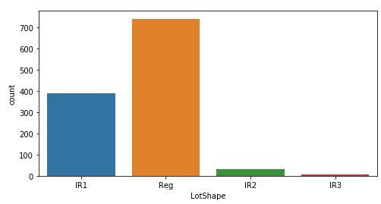
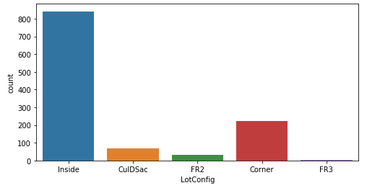
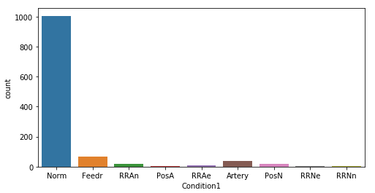
DATA VISUALIZATION PLOTTING GRAPHS FOR CATEGORICAL DATA

Slide 26
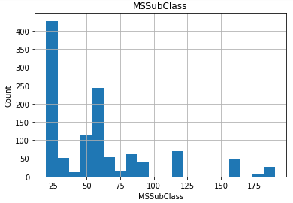
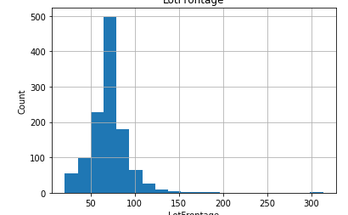
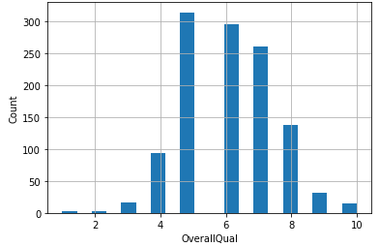
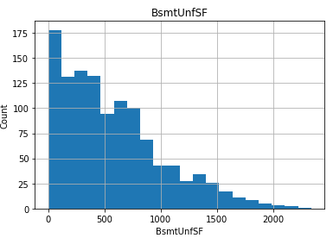
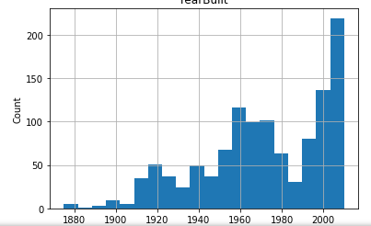
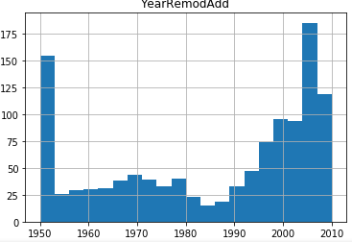
PLOTTING GRAPHS FOR CONTINUOUS DATA

Slide 27
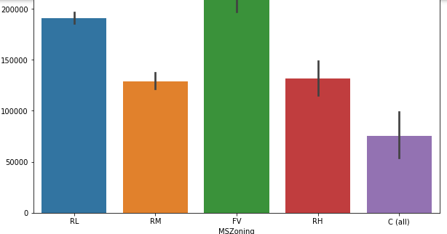
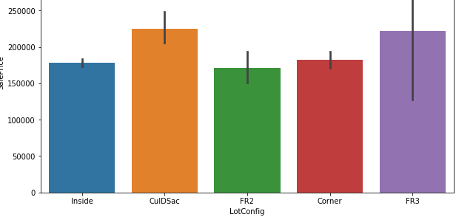
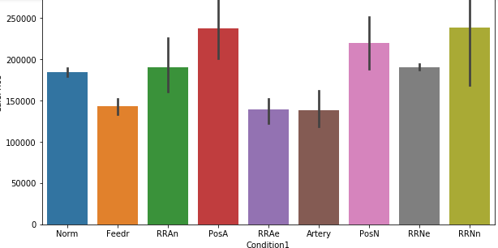
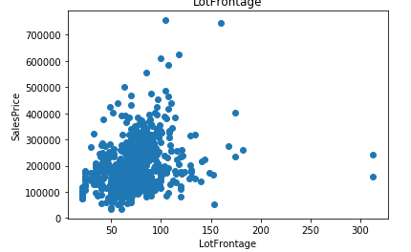
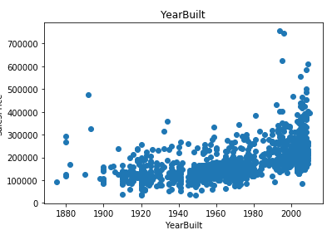
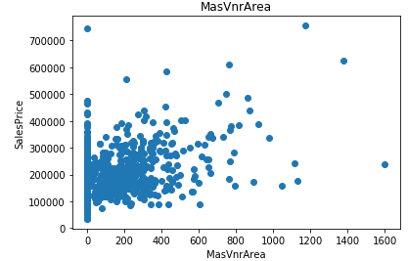
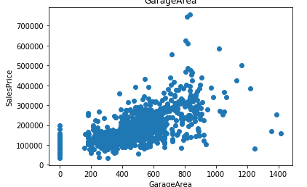
BIVARIATE ANALYSIS WITH SALESPRICE FOR CATEGORICAL & CONTINUOUS DATA

Slide 28
CONCLUSION
After getting an insight of this dataset, we were able to understand that the Housing prices are done on basis of different features.
First, we loaded the train dataset and did the EDA process and other pre-processing techniques like skewness check and removal, handling the outliers present, filling the missing data, visualizing the distribution of data, etc.
Then we did the model training, building the model and finding out the best model on the basis of different metrices scores we got like Mean Absolute Error, Mean squared Error, Root Mean Squared Error, etc.
We got Lasso Regressor as the best algorithm among all as it gave more r2_score and cross_val_score. Then for finding out the best parameter and improving the scores, we performed Hyperparameter Tuning.
As the scores were not increased, we also tried using Ensemble Techniques like RandomForestRegressor, AdaBoostRegressor and GradientBoostingRegressor algorithms for boosting up our scores. Finally, we concluded that GradientBoostingRegressor was the best performing algorithm, although there were more errors in it and it had less RMSE compared to other algorithms. It gave an r2_score of 91.01 and cross validation score of 89.43 which is the highest scores among all.
We saved the model in a pickle with a filename in order to use whenever we require.
We predicted the values obtained and saved it separately in a csv file.
Then we used the test dataset and performed all the pre-processing pipeline methods to it.

Slide 29
After treating skewness, we loaded the saved model that we obtained and did the predictions over the test data and then saving the predictions separately in a csv file.
From this project, we learnt that how to handle train and test data separately and how to predict the values from them. This will be useful while we are working in a real-time case study as we can get any new data from the client we work on and we can proceed our analysis by loading the best model we obtained and start working on the analysis of the new data we have.
The final result will be the predictions we get from the new data and saving it separately.
Overall, we can say that this dataset is good for predicting the Housing prices using regression analysis and GradientBoostingRegressor is the best working algorithm model we obtained.
We can improve the data by adding more features that are positively correlated with the target variable, having less outliers, normally distributed values, etc.

Slide 30
THANK YOU

