Slide 1
SPAM DETECTION PROJECT
SUBMITTED BY,
AKANKSHA PADHYE

Slide 2
INTRODUCTION:
Spam Detector is used to detect unwanted, malicious and virus infected texts and helps to separate them from the nonspam texts.
It uses a binary type of classification containing the labels such as ‘ham’ (nonspam) and spam.
Application of this can be seen in Google Mail (GMAIL) where it segregates the spam emails in order to prevent them from getting into the user’s inbox.

Slide 3
Business Goal:
The main goal of these two parts of article is to show how you could design a spam filtering system from scratch.
The purpose of the literature review is to:
In recent times, unwanted commercial bulk emails called spam has become a huge problem on the internet. The person sending the spam messages is referred to as the spammer. Such a person gathers email addresses from different websites, chatrooms, and viruses. Spam prevents the user from making full and good use of time, storage capacity and network bandwidth. Electronical Communication is the need of the day. For shopping for bread to hollering the Emergency Services there’s no second to communication.
Users who receive spam emails that they did not request find it very irritating. It is also resulted to untold financial loss to many users who have fallen victim of internet scams and other fraudulent practices of spammers who send emails pretending to be from reputable companies with the intention to persuade individuals to disclose sensitive personal information like passwords, Bank Verification Number (BVN) and credit card numbers.

Slide 4
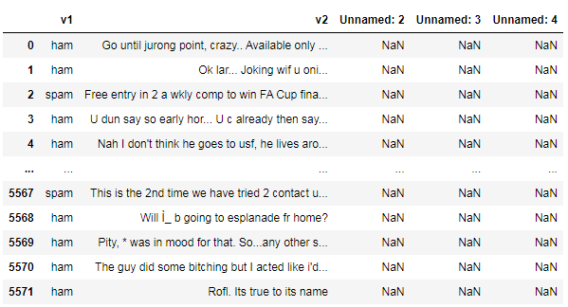
DATA SOURCES:
The dataset contains 5572 rows and 5 columns.
Columns unnamed 2,3,4 are unnecessary columns. Hence we have dropped them.
We have renamed the column v1 as target and v2 as sms.
Target column has 2 values i.e ham for non-spam sms and spam for spamed sms.

Slide 5
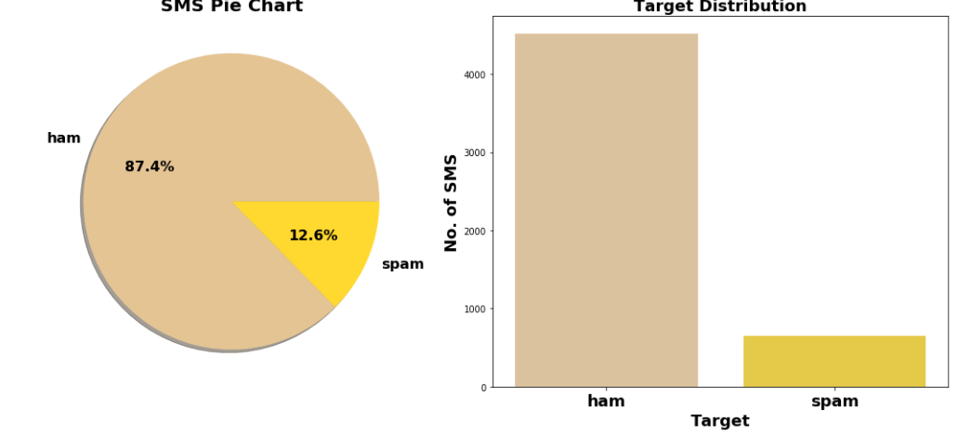
DATA VISUALIZATION:
There are around 87.4% sms ham and 12.6% sms spam. i.e HAM are 4516 and SPAM are 653 in counts.

Slide 6
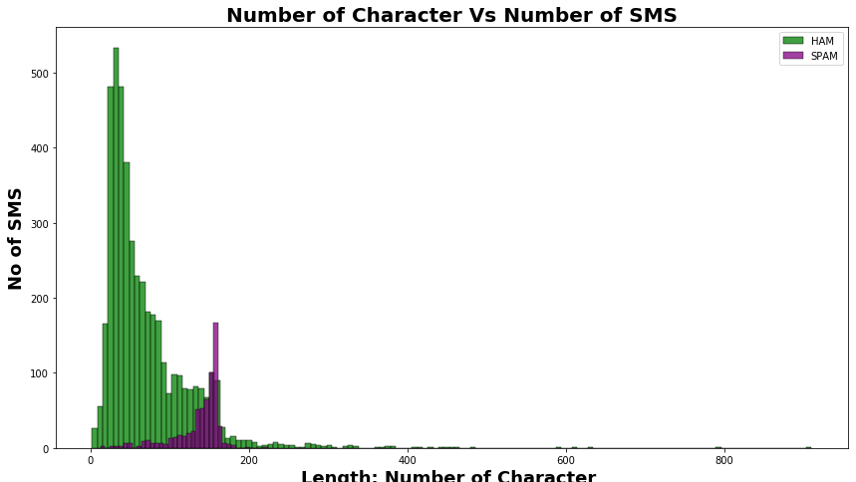
Number of character in Spam sms is comparetively much high than Non-Spam (ham) sms.
On average each ham sms contain 71 character, 17 words and 2 sentences

Slide 7
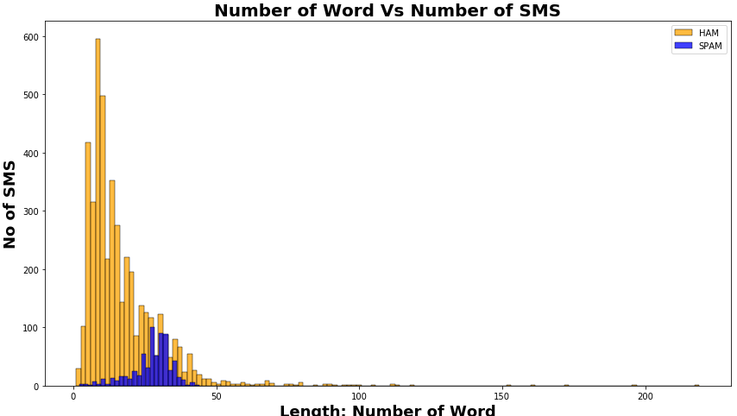
Number of Word in Spam sms is comparetively much high than Non-Spam (ham) sms.
On average each spam sms contain 138 character, 27 words and 3 sentences

Slide 8
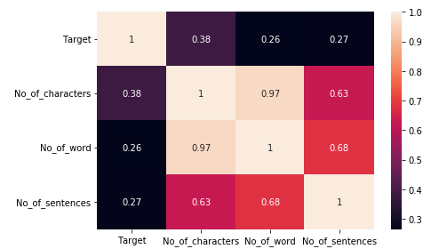
CORRELATION:
Target has 0.38 correlation with no. of characters which is maximum amongst the rest.
Target has 0.27 correlation with no. of sentences and 0.26 with no.of words

Slide 9
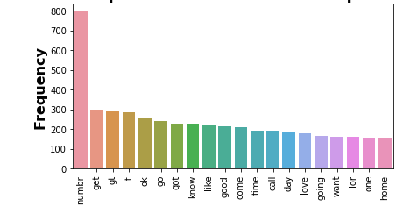
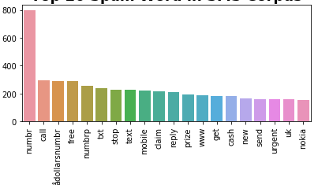
Top 20 Ham words in SMS corpus.
Top 20 Spam words in SMS corpus.

Slide 10
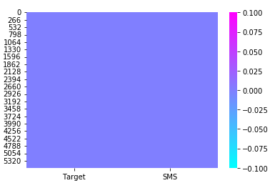

DATA PRE-PROCESSING:
The dataset contains no null values.
Dataset has the duplicates values which are 403 and we are dropping them.

Slide 11
Preprocessing using NLP
Data cleaning is the process of preparing data for analysis by removing or modifying data that is incorrect, incomplete, irrelevant, duplicated, or improperly formatted. This data is usually not necessary or helpful when it comes to analysing data because it may hinder the process or provide inaccurate results.
Before cleaning the data, a new columns are created named ‘no. of characters’, ‘no. of words’ and ‘no. of sentences’.
The following steps were taken in order to clean the text:
Transform the text into lower case.
Replaced the email addresses with the text 'email address'
Replaced the URLs with the text 'web address'
Removed the HTML tags
Removed the numbers
Removed extra newlines
Removed the punctuations
Removed the unwanted white spaces
Removed the remaining tokens that are not alphabetic
Removed the stop words

Slide 12
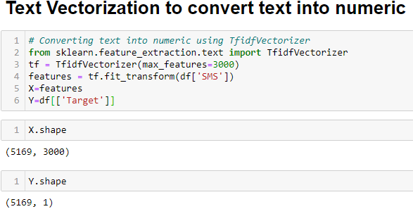
MODEL DEVELOPMENT AND EVALUATION:
Separating the features and targeted variables

Slide 13
Splitting the train and test data
Training and testing the models minimize the effects of data discrepancies and better understand the characteristics of the model. The training data is used to make the machine recognize patterns in the data and the test data is used to see how well the machine can predict new answers based on its training. ‘X’ and ‘y’ were split for training and testing using train_test_split in a ratio of 70:30 respectively.
Building/Finalizing the model
After performing logistic regression, multinomial NB, extra trees classifiers, random forest, adaboost classifier and bernoulli NB algorithms and doing cross validation for each model we selected multinomial NB as the best model because its giving the best accuracy as compare to other models.

Slide 14
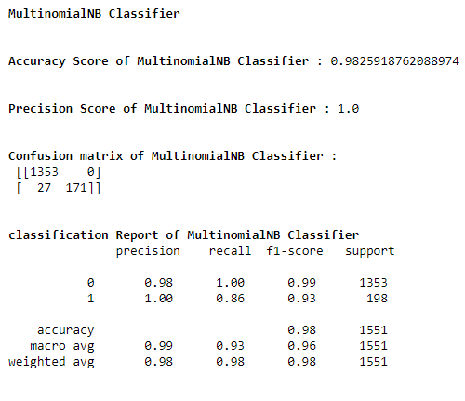
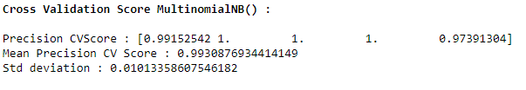
Further we imported the pickle library and the saved the best model in csv file.

Slide 15
CONCLUSION:
NLP gets hard are humans are not used to typing as proper grammar these years.
Sweet spot should be found between whether to pick stemming or lemmatization or both.
Naïve Bayes algorithms are quicker than rest of the algorithms.

Slide 16
THANK YOU

