Slide 1


PERSONAL PROJECT MANAGEMENT TOOL
Made By--
1139_AkankshaPatil
1047_RuchaDhamdhere

Slide 2

CONTENTS:
Introduction
Project Objective
Methodology
Diagrams
Screenshots
Future Scope

Slide 3
1. INTRODUCTION
Let’s start …

Slide 4
The tragedy in life doesn’t lie in not reaching your goal. The tragedy lies in having no goal to reach.”

Slide 5
INTRODUCTION:
Project management is the process of planning, scheduling, resource management, requirement analysis, designing and testing to achieve project goals and objectives. Without project management it is difficult to complete projects in given time. Therefore, project management is required to remove such barriers in project development and to achieve specific goals.
You can add different projects and assign them different status

Slide 6
2. PROJECT OBJECTIVE

Slide 7
Project Objective:
Existing system for a project is based on our traditional way keeping records and details on paper and registers. Access of these details and papers are not granted to common member in absence of the authority. It is hard to manage all the project system with pen and paper. It gets really hard to maintain the records and then keep track of past tasks. Hence this system is proposed to overcome the flaws of the existing system and giving power to the person so that he/she will be able to manage the project easily on personal level.

Slide 8
3. METHODOLOGY

Slide 9
REST API
Representational State Transfer API

Slide 10
RESTful API:
When a client request is made via a RESTful API, it transfers a representation of the state of the resource to the requester or endpoint. This information, or representation, is delivered in one of several formats via HTTP: JSON (Javascript Object Notation), HTML, XLT, Python, PHP, or plain text. JSON is the most generally popular file format to use because, despite its name, it’s language-agnostic, as well as readable by both humans and machines.

Slide 11
CRUD OPERATIONS
Create, Read, Update, Delete

Slide 12
CRUD Operations:
CREATE | This is a form view to create a new record in the database
READ | Reads the table records based on the primary key within the input parameter.
UPDATE | Updates the content of the table based on the specified primary key for a record.
DELETE | Deletes a specified row in the table.

Slide 13
CRUD and REST
In a REST environment, CRUD often corresponds to the HTTP methods POST, GET, PUT, and DELETE, respectively. These are the fundamental elements of a persistent storage system.
Throughout the rest of the article, we will recommend standards and response codes that are typically followed by developers when creating RESTful applications. Conventions may differ so feel free to experiment with different return values and codes as you become comfortable with the CRUD paradigm.
Imagine we are working with a system that is keeping track of meals and their corresponding prices for a restaurant. Let’s look at how we would implement CRUD operations.

Slide 14
4. DIAGRAMS

Slide 15
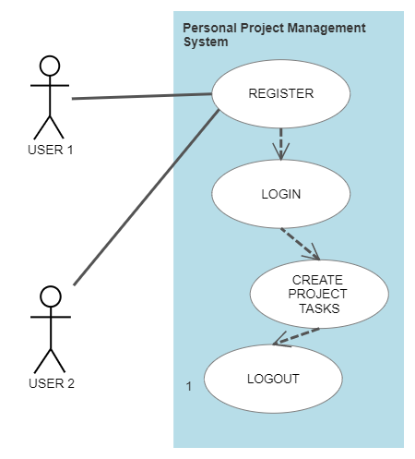
Use Case Diagram:
our office

Slide 16
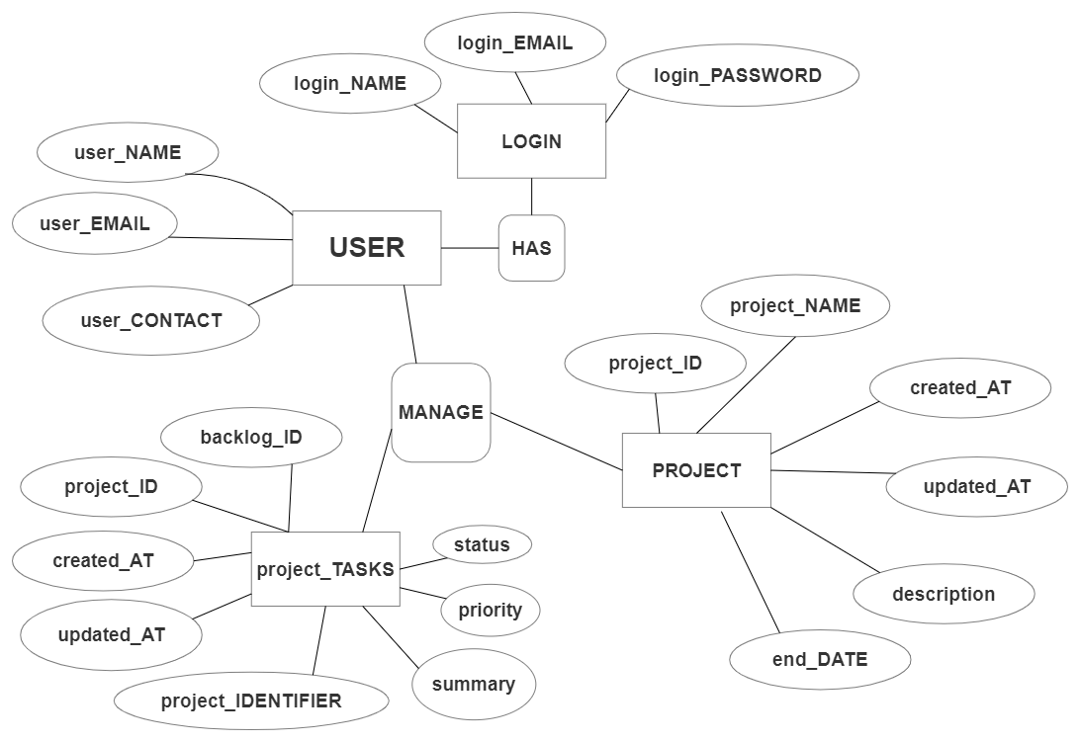
ER Diagram:
our office

Slide 17
5. SCREENSHOTS

Slide 18
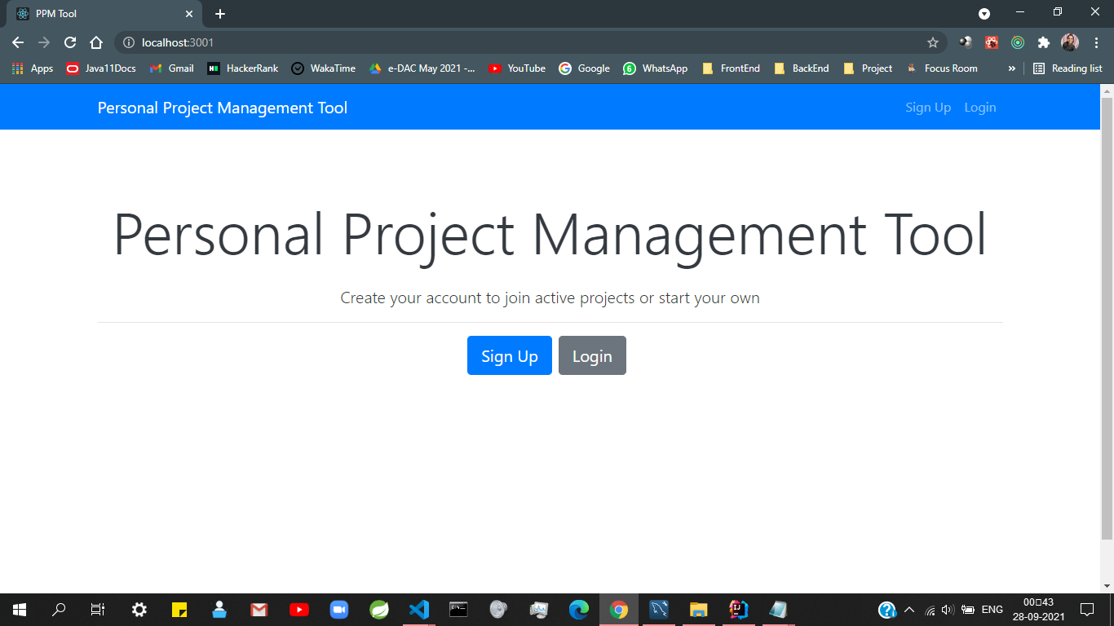
DASHBOARD

Slide 19
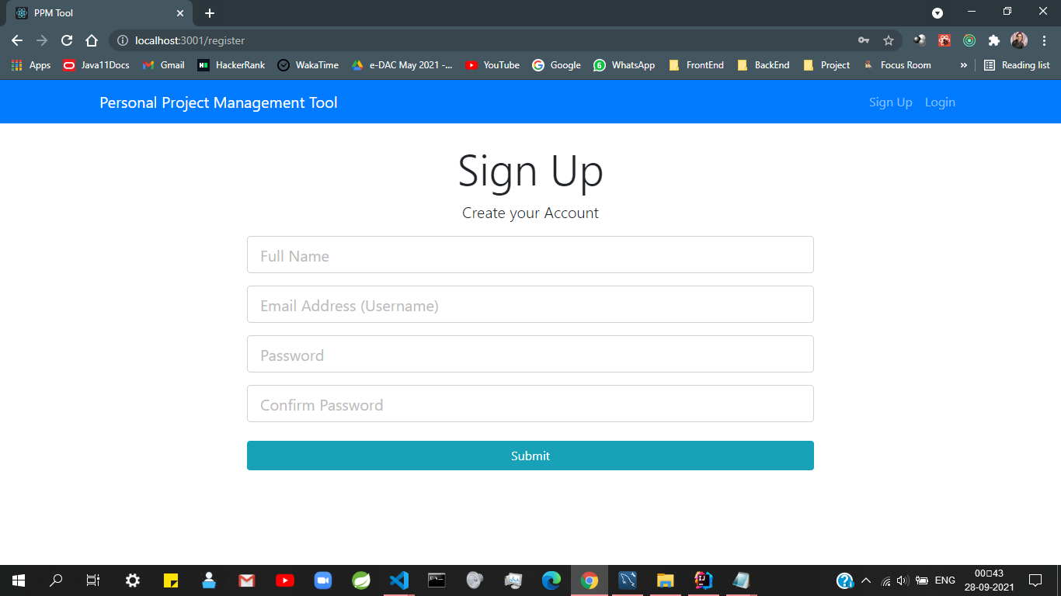
SIGN UP
PAGE

Slide 20
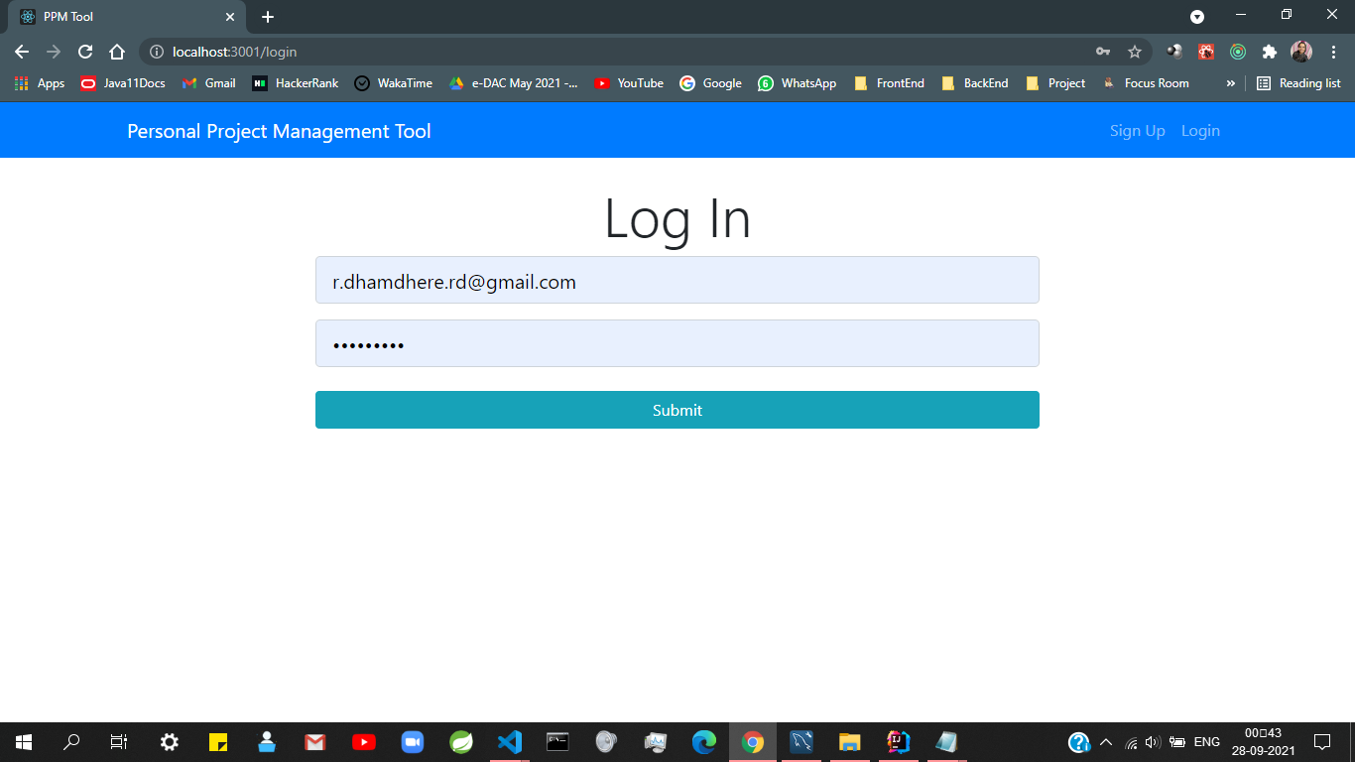
LOGIN
PAGE

Slide 21
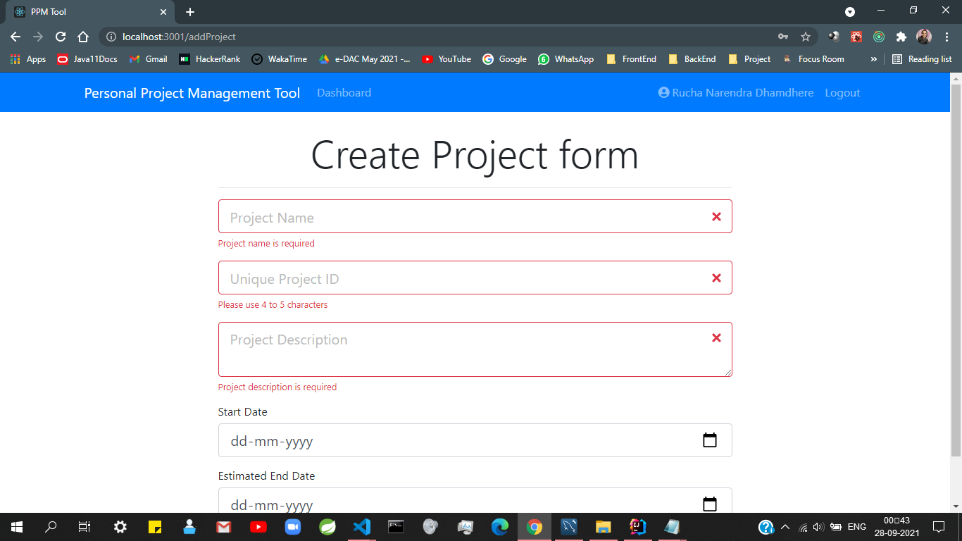
CREATE PROJECT
FORM

Slide 22
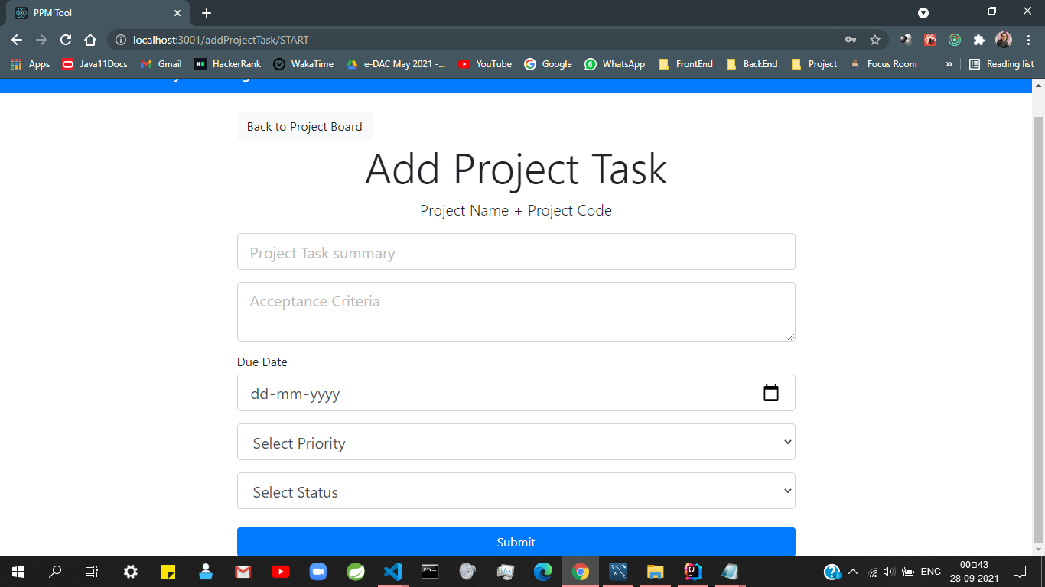
ADD TASK
FORM

Slide 23
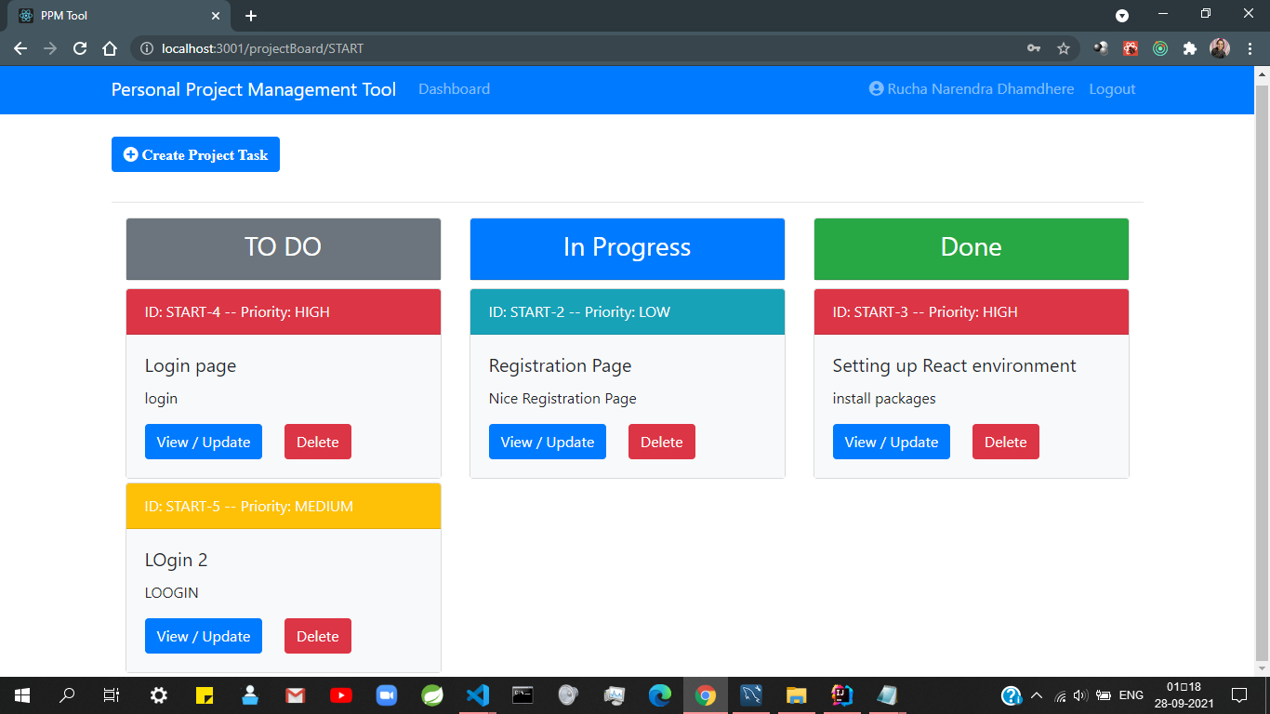
TASKS
BOARD

Slide 24
6. FUTURE SCOPE

Slide 25
Future Scope:
This project can be done on company level where employees of various fields can use this web app for different projects of the organization they are working for.
We can even add features like Emails, Alert messages, and Forgot
Password to this web application.

Slide 26
CREDITS
Project Guide: Kashinath Patil Sir
Mentor: Snehal Sapkal Ma’am
Made By--
1139_AkankshaPatil
1047_RuchaDhamdhere

Slide 27
THANKS!
Any questions?
You can find us at:
r.dhamdhere.rd@gmail.com
akankshapatil2015@gmail.com

