Slide 1
Artificial Intelligence
By Anna Fryling and Kayla Akombi

Slide 2
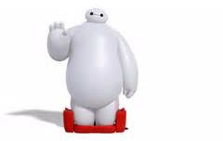
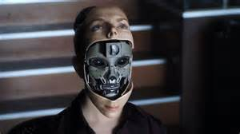
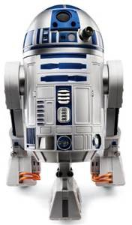
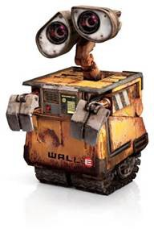
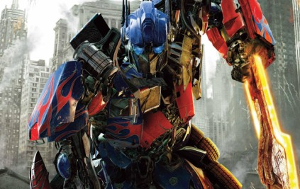
What is Artificial Intelligence?
Answer: The power of a machine to copy intelligent human behavior.
Right???

Slide 3
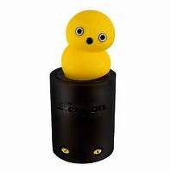
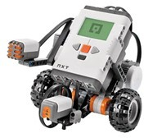
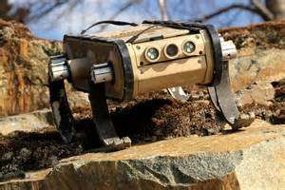
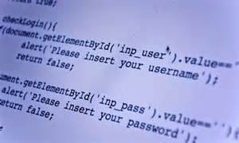
Robots at Artemis
Are they really intelligent?
A robot is only as smart as its initial program.
Answer: The power of a machine to copy and learn from intelligent human behavior.

Slide 4

Artificial Intelligence VS. Robot
AI
Robot
Programmed to think
Programmed to do
Social Interaction
Low level interaction
Learns
Only as smart as program

Slide 5
Artificial Intelligence Tests
Turing Test
Developed by Alan Turing
Involves an interpreter, a human, and a computer.
The computer and human have separate conversations with the interpreter.
If the interpreter can’t guess which is the computer or if the interpreter gets it wrong then the computer has
Artificial Intelligence.

Slide 6
Artificial Intelligence Tests
Imitation Game
Involves two tests
First test involves an interpreter, a male, and a female.
Female pretends to be male Interpreter tries to figure out who is who
Second test is similar to turing test Compares both tests

Slide 7
Artificial Intelligence Tests
Turing Test Imitation Game
Turing test the computer results to itself and not to humans
Imitation game compares the robots results to human results

Slide 8
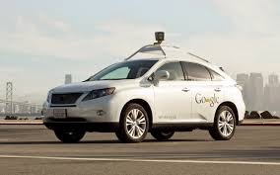

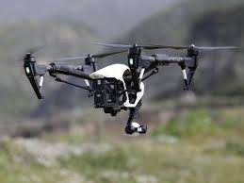
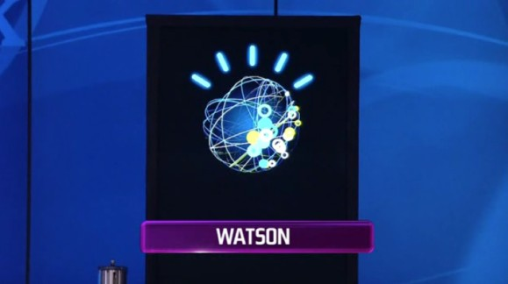
Examples
1.CleverBot
2.Autonomous Cars
3.Drones
4.Watson

Slide 9
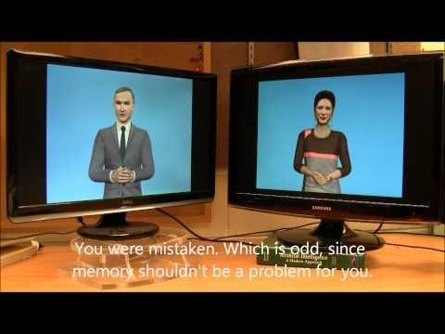
Problems
Although AI is advancing it can still be problematic.

Slide 10
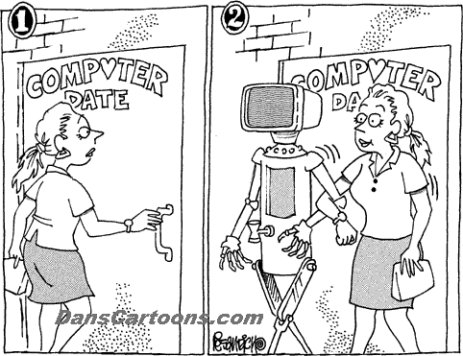
AI Controversies
Potential job takeover
Growing laziness Growing Cost
Priority Argument Robot Relationships?

Slide 11
Why it Matters
In the future AI is going to be everywhere.
It is important to know about it and understand it.
This is because we may be interacting with it on a day to day basis.
We learned at Artemis about the different robots that use AI We also learned when robots need AI and when they don’t.

Slide 12
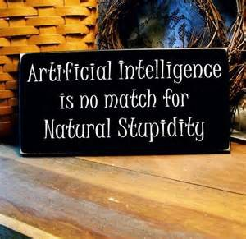
Thank You!!

