Slide 1
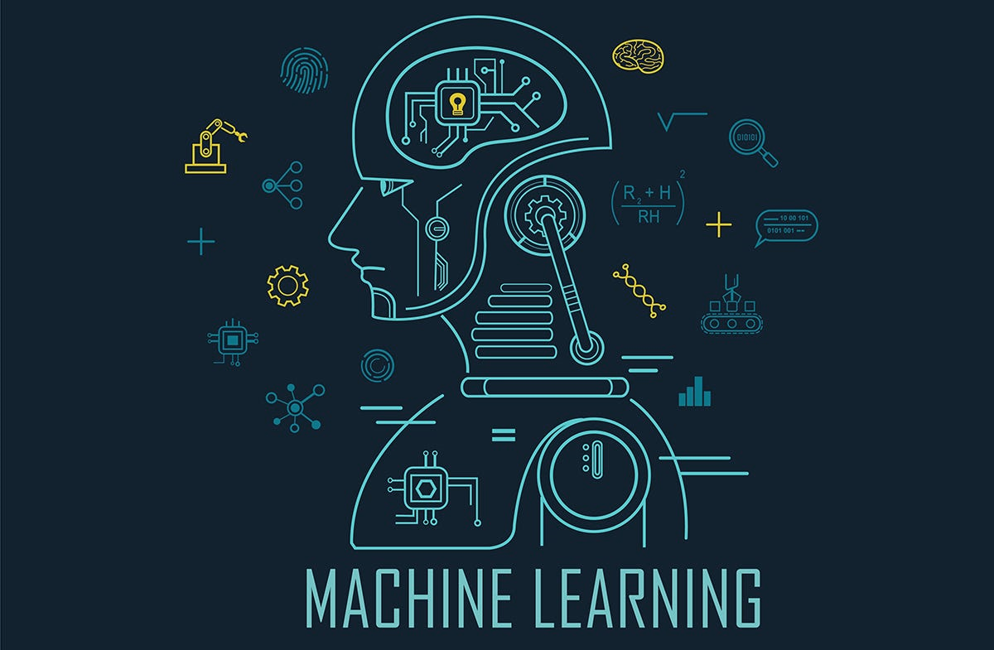
SALARY PREDICTION MODEL
A process of salary prediction with data science and machine learning.
This model is made by using SIMPLE LINEAR REGRESSION
Predictive models can help businesses plan and allocate resources effectively
THE PROJECT WILL BE PRESENTED IN THREE STAGES
Objective
Solutions
Business Impact

Slide 2
1. OBJECTIVE
INTRODUCTION
The dataset contains two parameters years of experience and salary of the employees of the company
It is seen that as the experience of the employee increases the salary also got some hike
But it is not the case with every employee ,few of the employee getting less salary even having good experience.
The size of the dataset is small it has 30 records only
The objective of the model
Objective of this MODEL is to predict the better accurate salary of the employee with
respect to their experience.

Slide 3
SOLUTION
Data processing
As the dataset was already cleaned therefor no other steps required to make
There were no missing values as well.
Model building
To make this model we used the different library named pandas, numpy, scikit learn.
For splitting the data-- train_test_split from scikitlearn library
For fitting the data -- linear regression from scikit learn library
For ploting the graph – seaborn library
after all this process model is ready

Slide 4
Model evaluation
For evaluating our model we used few metrics such as:
Mean squared error & its square root
R2_score value
Mean absolute error
visualization
The result we got
RMSE - 5970.3768
R2_score – 0.9440
After the evaluation done we can say that our model fitted the data very close to the regression line
Which means our model strength/performance is quite good as it gives 94% accuracy.

Slide 5
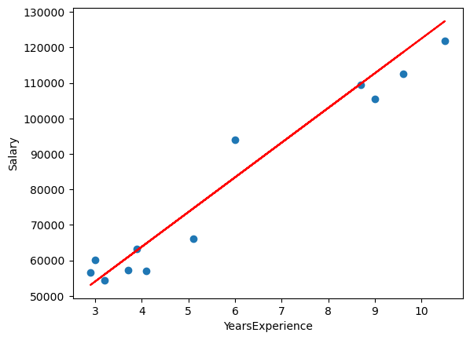
Visualization of regression line
As we can see here the regression line has find the best fit line for the predicted va;l the best fit line for the predicted value.

Slide 6
BUSINESS IMPACT
Informed Compensation Decisions:
The model assists in setting competitive and equitable salary packages for employees, helping the organization attract and retain top talent.
Budget Planning and Cost Control:
Salary prediction models aid in budget planning by forecasting labor costs more accurately. This results in better financial control and resource allocation.
Fairness and Equity:
The model helps identify pay disparities and gender or ethnicity-based pay gaps, promoting fairness and equity in compensation.
Performance Management:
Aligning salary with performance through predictive models motivates employees to excel in their roles, improving overall workforce performance.

Slide 7
Financial Stability:
Better cost control and optimized compensation result in financial stability and predictability for the organization.
Improved Organizational Performance:
A well-implemented salary prediction model can boost overall organizational performance by aligning employee compensation with business objectives.

