Slide 1
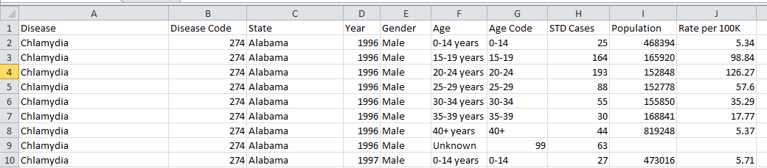
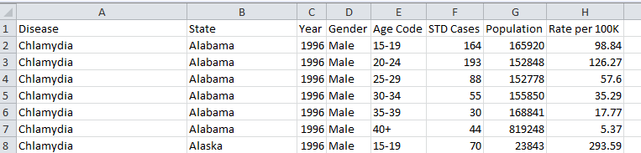
Dataset 1 and pre-processing
Dataset 1
Modified Dataset 1 (by dropping null values, redundant columns and records after 2008)
Dataset 1 describes the distribution of 3 types of STDs across different states, gender, age groups along with the population and rate of infection.
It is modified by dropping some redundant columns, some records and missing values to help create an effective visualisation.

Slide 2
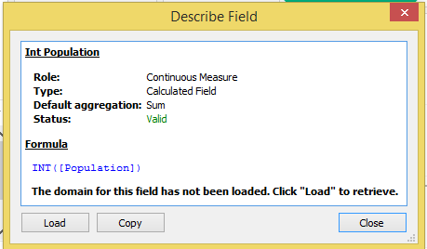
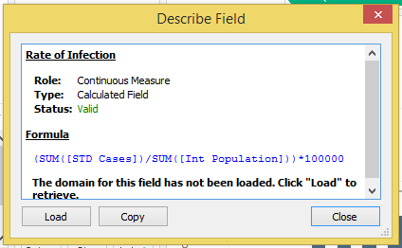
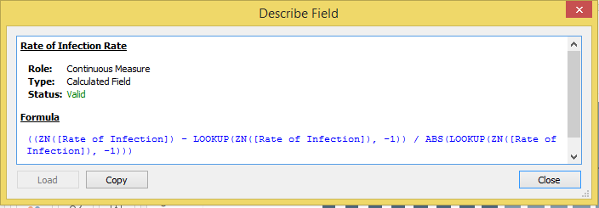
Additional Calculated fields
Three fields are additionally calculated as shown above in order to explore the hidden details in the data and
use them to plot graphs. Field names and their respective formulas used are shown in the boxes.

Slide 3
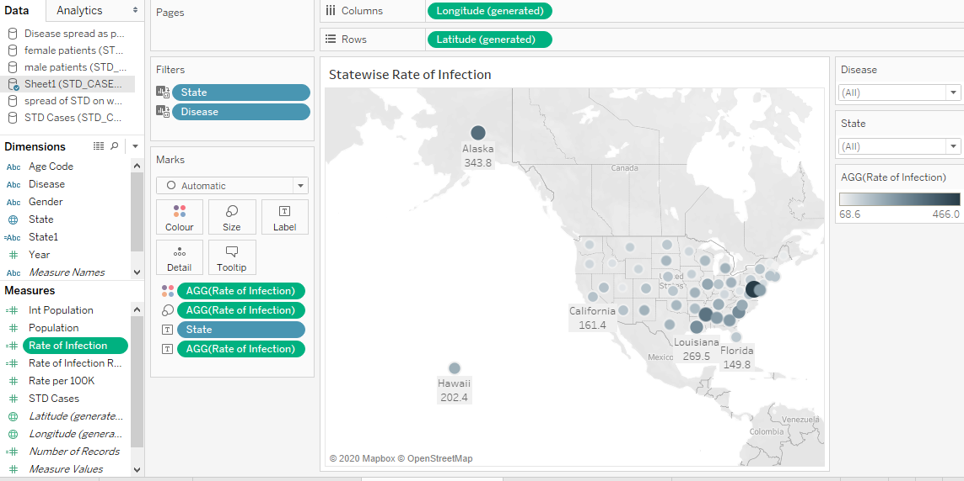
State wise Rate of Infection
This is the geographical representation of states and the Rates of infection associated with them. The calculated field of Rate of Infection is used here
along with the spatial mapping of the states. The shades and radial sizes of the circular marks vary with the values of Rate of Infection.
Higher the value, larger is the radial size and darker is the shade of the circle.

Slide 4
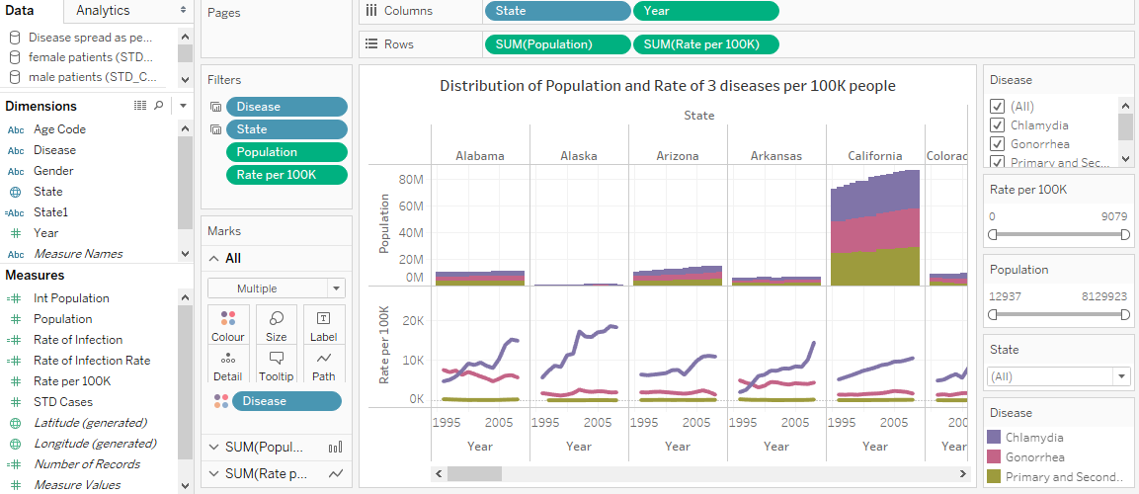
Distribution of Population and Rate of 3 diseases per 100K people
Stacked Bar plot shows the state wise and year wise populations belonging to each category of STD while the Line plot shows “Rate per 100K” info of the
infection for each state . The Line plots with different colours show the Rate per 100K for 3 different STDs for each state for all the years. These plots
can be used to compare the values of populations of and Rates among different states. The line plot also
depicts the trend in the rate for each individual disease over the years.

Slide 5
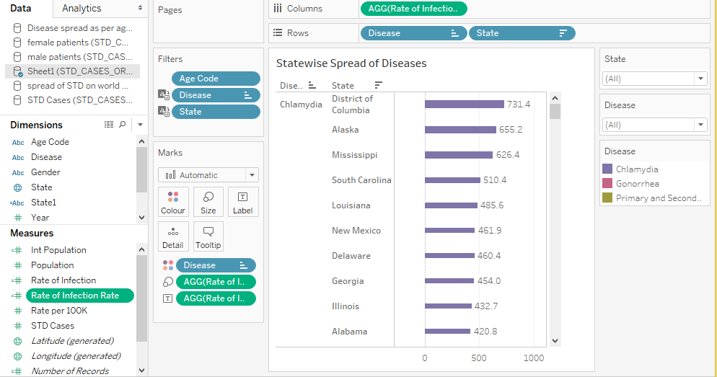
State wise Rate of Infection of Individual Diseases
Horizontal Bar plot represents rates of infection for different states and can be used to compare
state wise Rate of Infection for each of the 3 STD diseases.

Slide 6
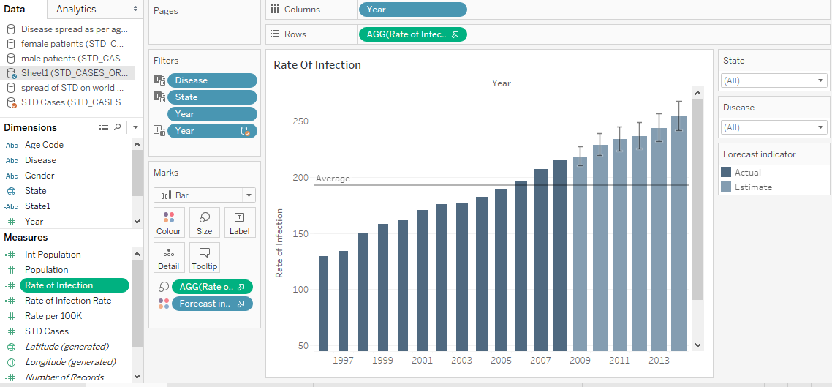
Rate Of Infection
Forecasted values
Bar plot here represents year wise representation of the calculated field “Infection Rate”. Attribute “Rate Of Infection” is plotted against the years.
An additional feature of forecasting future values is also implemented. The light coloured bars are the forecasted values.

Slide 7
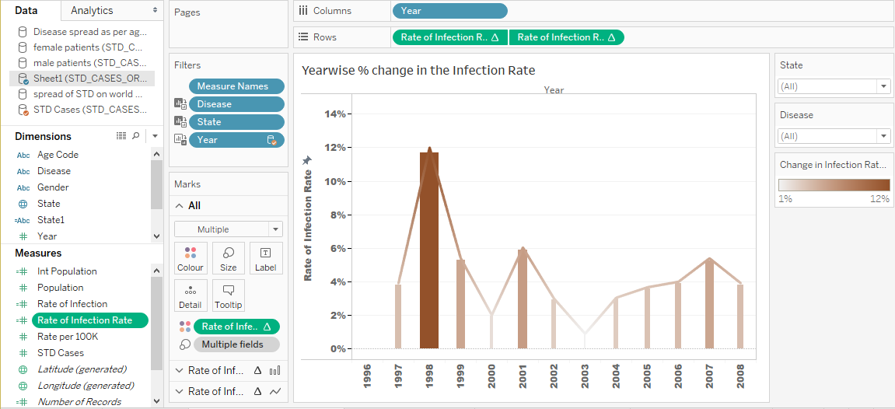
Year wise % change in the Infection Rate
Bar plot showing the % change in the Infection rate every between every 2 consecutive years. Darker shade represents higher value.
This plot gives an idea about the increase/decrease pattern of Infection Rate over the years.

Slide 8
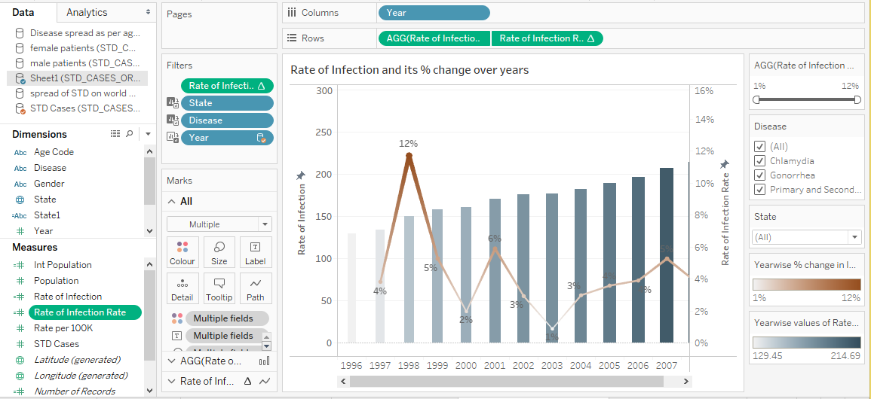
Rate of Infection and its % change over the years
A combined plot of “Rate of Infection” (Bar plot) and “Year wise % change in the Infection Rate”(Line plot). This combined plot gives
the pattern of infection rate over the years along with the exact values of increase and decrease in percentage.

Slide 9
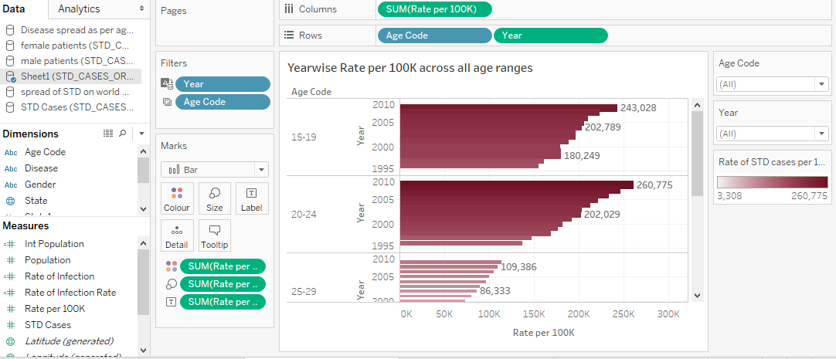
Year wise Rate per 100K across all age ranges
Horizontal bar graph showing “Rate per 100K” for each age group over the years. This plot helps us visualise
and compare the pattern and values of Rate of infection varying across all age groups.

Slide 10
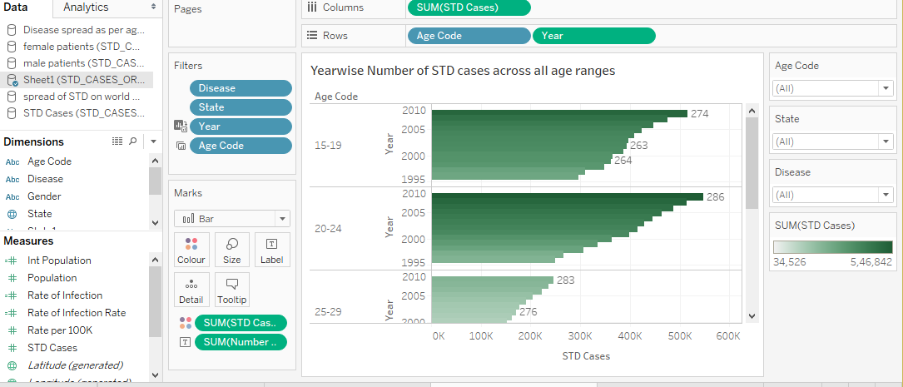
Year wise Number of STD cases across all age ranges
Another horizontal bar plot showing year wise number of ‘STD cases‘ for all age ranges. This plot helps
visualise the pattern of number of STD cases varying across all age groups over the years.

Slide 11
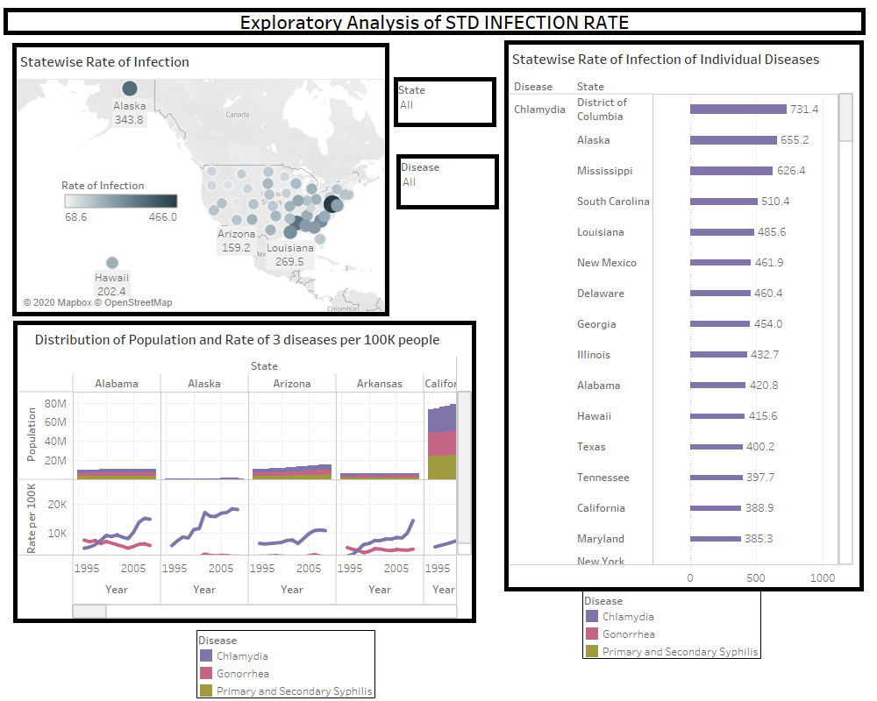
Dashboard 1 - Exploratory Analysis
The Dashboard 1 here is created using the first 3 plots. Since calculated fields are used to plot the graphs here which depict the
hidden information in the data, we name this visualisation as Exploratory Analysis.

Slide 12
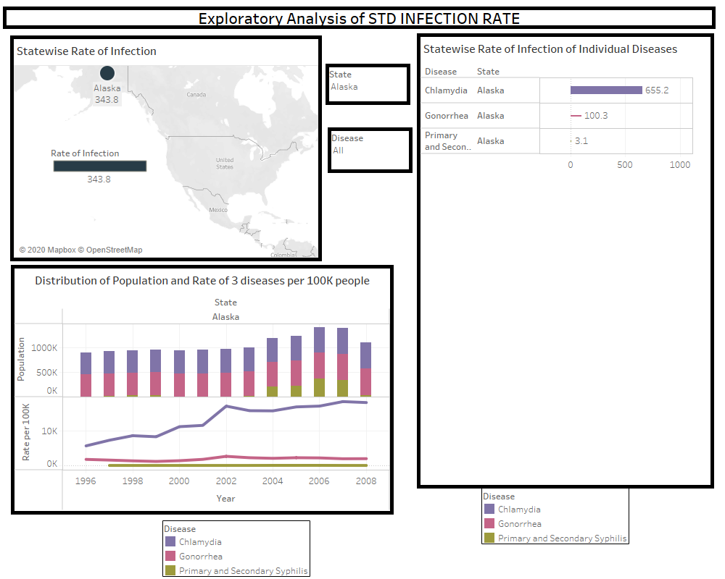
Dashboard 1 - Interactive feature
View of Dashboard when for eg. Alaska is selected from State filter
The above view of dashboard shows the interactive feature where the views in the dashboard change as per the values selected
from the State or Disease filter. Hence plots for any state along with the desired type of disease can be seen.

Slide 13
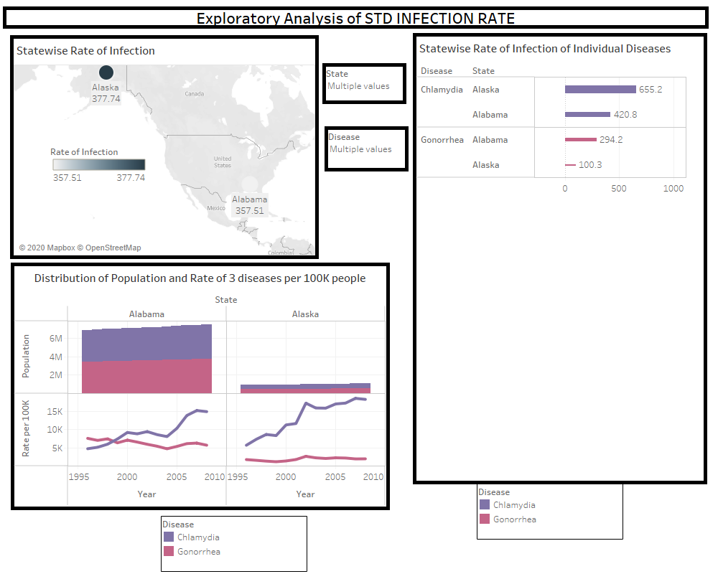
Dashboard 1 - Interactive feature
View of Dashboard when for eg. Alaska,Alabama is selected from State filter and 2 diseases are selected from Disease filter
The above view of dashboard shows the plots when 2 states and 2 diseases are selected from the respective filters. The number
of population of Alabama is more as compared to Alaska. Also we can see that rate of increase of chlamydia is
more as compared to Gonorrhoea in both the sates .

Slide 14
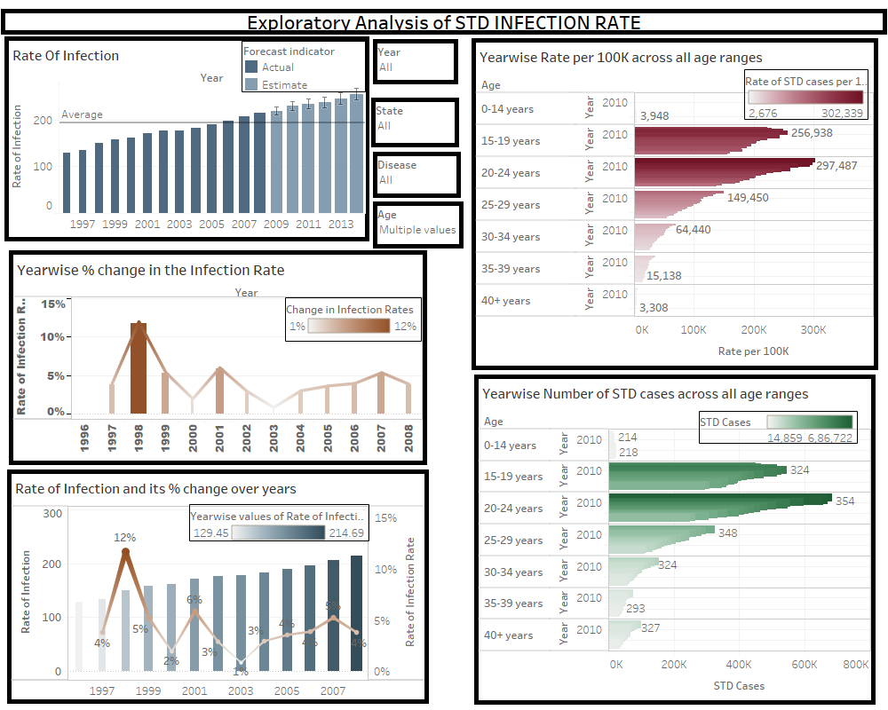
Dashboard 2 - Exploratory Analysis
The above view of the dashboard is created using the remaining 4 graphs. Calculated fields created by combining the columns
are used to plot the graphs. Hence we call this visualisation as exploratory analysis.

Slide 15
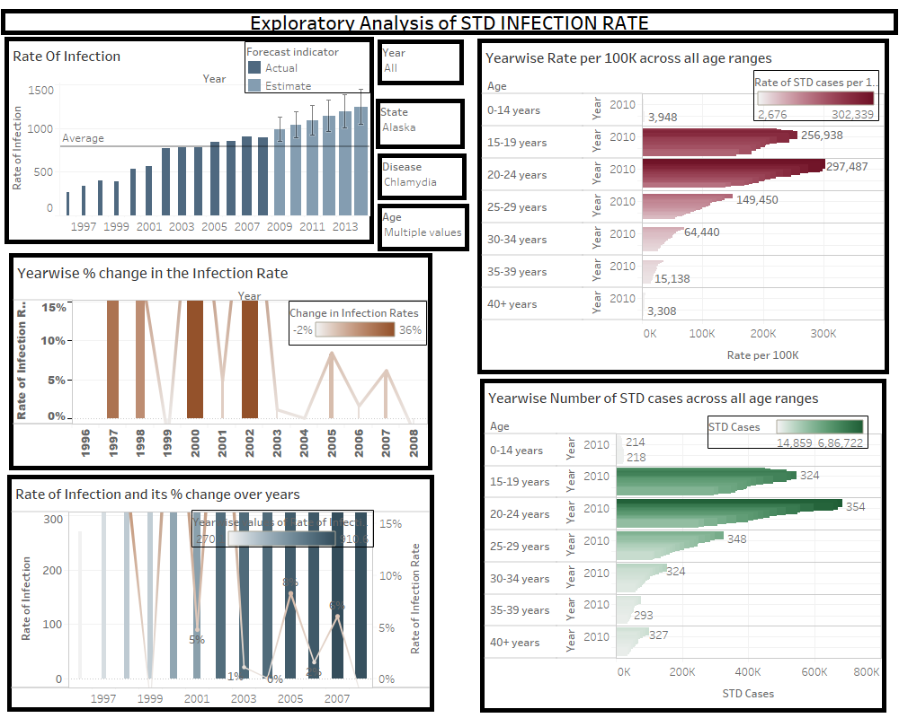
Dashboard 2 - Interactive feature
View of Dashboard when for eg. Alaska is selected from State filter and Chlamydia is selected from Disease filter
Above view of Dashboard 2 displays the interactive feature. All the views simultaneously change according to the values. selected in the filter.
Thus there is flexibility to choose different values of Year, State, Disease, Age from the dropdown filters.

Slide 16
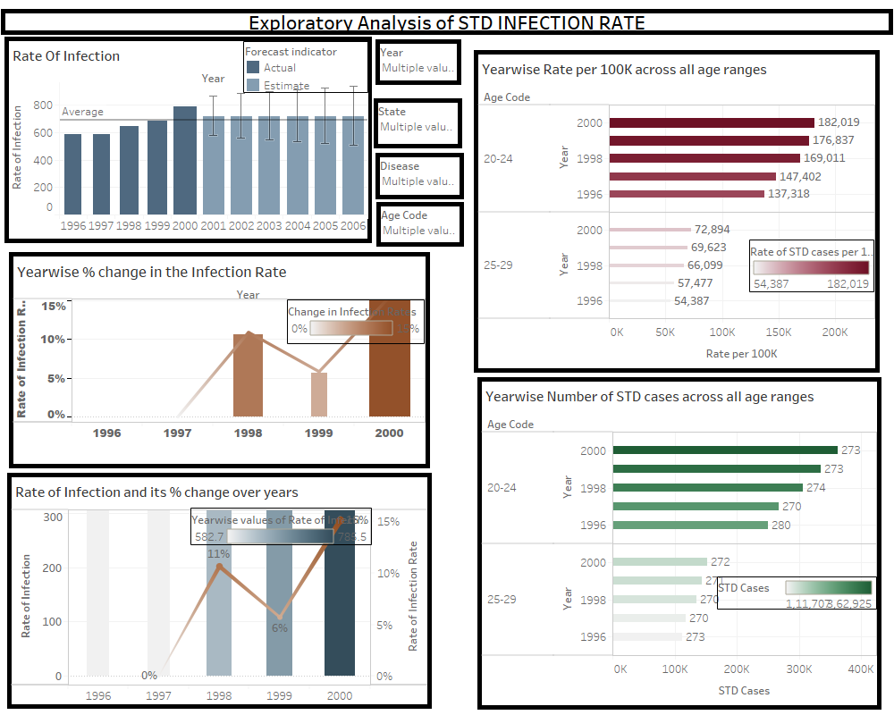
Dashboard 2 - Interactive feature
Above view of Dashboard 2 displays how all the plots change simultaneously when years, states, diseases and age codes are selected from respective
filters. Thus there is flexibility to choose different values of Year, State, Disease, Age from the dropdown filters.

Slide 17
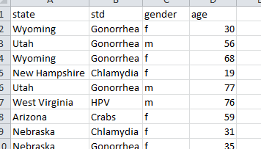
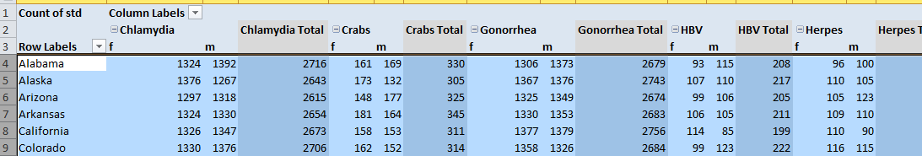
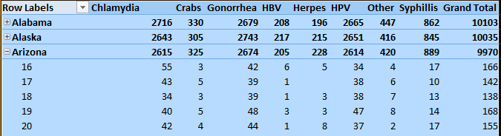
Dataset 2 and pre-processing
Dataset 2
Pivot
Table1
Pivot table2
This dataset depicts information about 6 categories of STDs across all states, genders and ages. The arrangement of given information was changed using
pivot tables. Male and female datasets were extracted from Pivot table1. And dataset of state/age wise counts of each type STD
diseases was extracted from Pivot table 2.

Slide 18
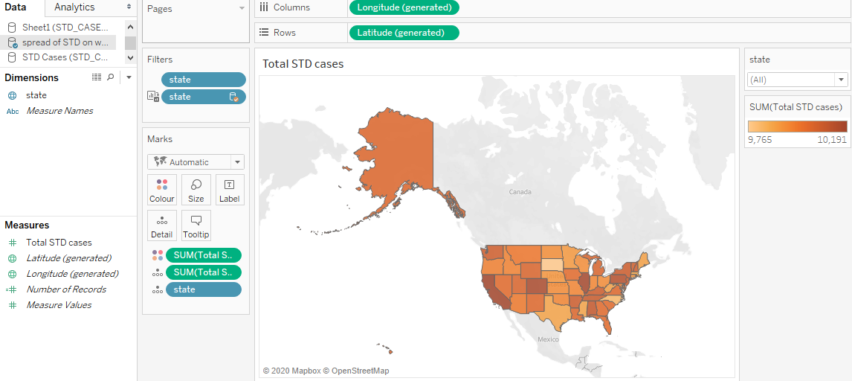
Total STD cases
Geographical data representation of Number of STD cases. The colour shades of states vary according to the Number
of STD cases. This plot helps analyse the spatially distributed values.

Slide 19
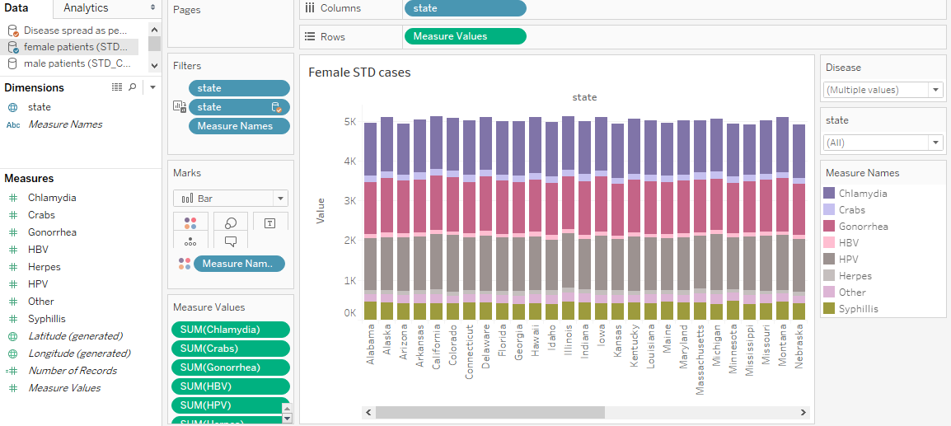
Female STD cases
Stacked Bar plot showing state wise representation of number of females affected by different types of STDs. Different colours are used to represent
different categories of STDs. Bars are separated by States and each bar is subdivided into 8 categories of STDs.

Slide 20

Male STD cases
Stacked bar plot showing state wise representation of number of males affected by different types of STDs. Different colours are used to
represent . different categories of STDs. Bars are separated by States and each bar is subdivided into 8 categories of STDs.

Slide 21
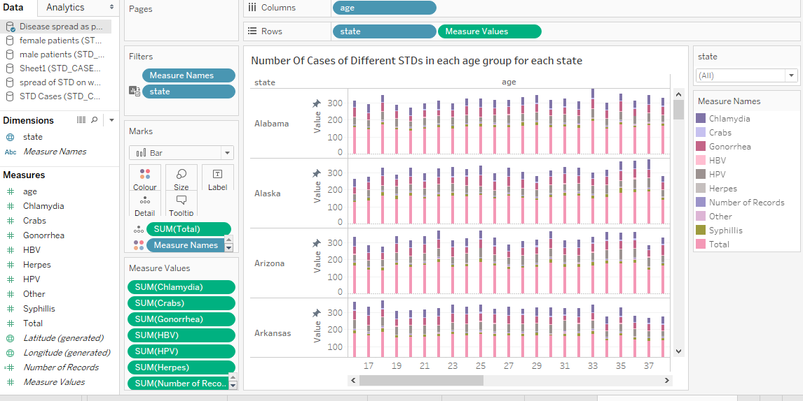
Number Of Cases of Different STDs in each age group for each state
Stacked bar plot showing state wise Number Of Cases of Different STDs in each age group. Different colours are used to represent different
categories of STDs. Bars are separated by Age and each bar is subdivided into 8 categories of STDs

Slide 22
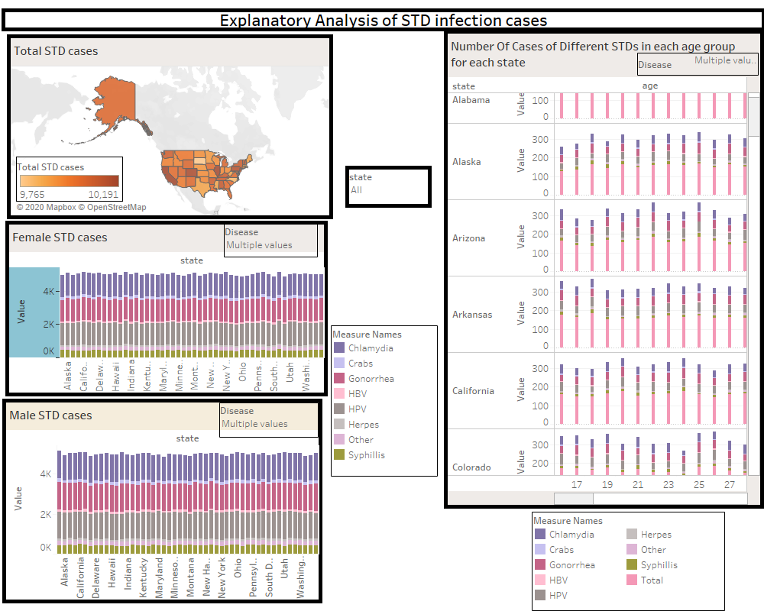
Dashboard 3 - Explanatory Analysis
The above dashboard is prepared using four plots of dataset 2. The plots show the given information in the original dataset. Only
that the datasets created for plotting these graphs are manipulated versions of original dataset using pivot tables. Hence
this visualisation is Explanatory Analysis.

Slide 23
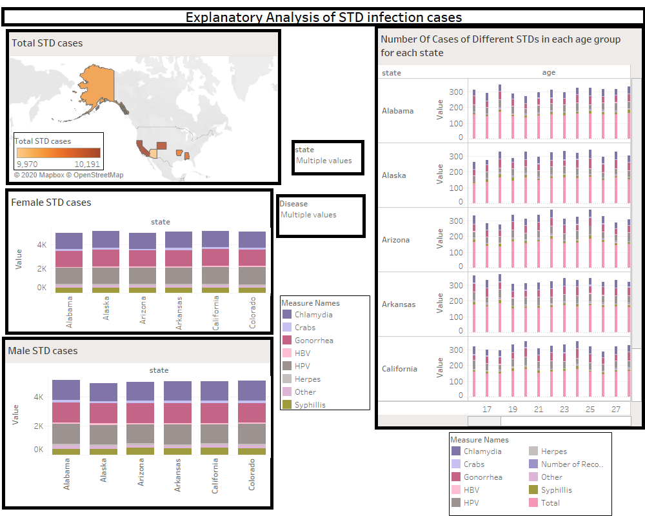
Dashboard 3 - Interactive feature
View of Dashboard when for eg. 5 states are selected from State filter
The above view of the dashboard shows the interactive feature which allows selection of States from the
dropdown filter. The views change accordingly to show the plots for only the selected sates.

Slide 24
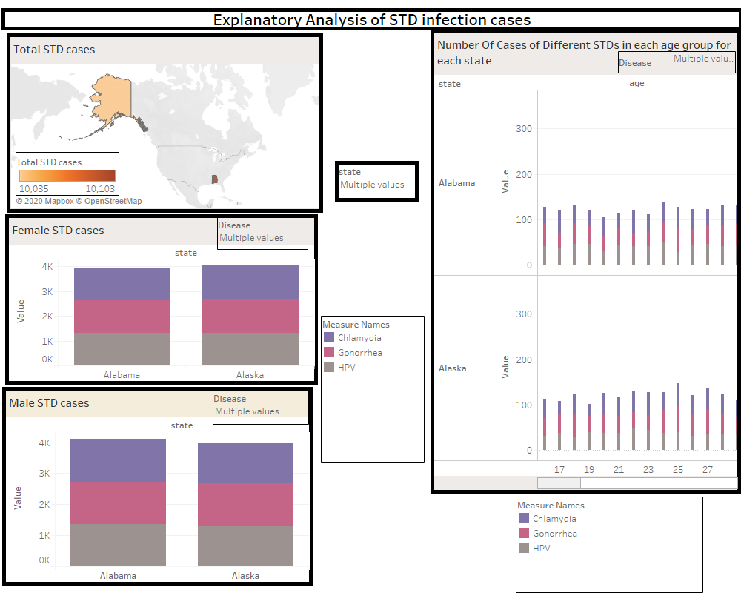
Dashboard 3 - Interactive feature
View of Dashboard when for eg. 2 states are selected from State filter and 3 diseases are selected from individual filters
The above view of the dashboard shows how the plots change simultaneously when states and diseases are selected from the dropdown filters.
This way it is easier to compare the plots for different diseases between any states .

Slide 25
Thank You!

