Slide 1
Comparison of Perceptron and Logistic Regression on a Dataset
Course name : ucs761 Deep learning
Name : abhishek kansal
Roll no : 1020303808
subgroup : 3c55

Slide 2
Regarding the Dataset Used
Two Input Features having uniform Distribution
Gaussian Noise
Std Deviation = 0 (i.e., 0.01 *a where a =0)
Out Put feature has Two Classes 0 and 1
Class Separated by Rotation of Degree 120.( i.e., 15*b where b=8)
Number of points per class = 40
Non-Trivial Due to Rotation

Slide 3
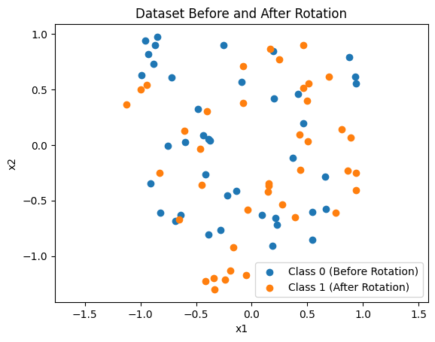
DATASET USED

Slide 4
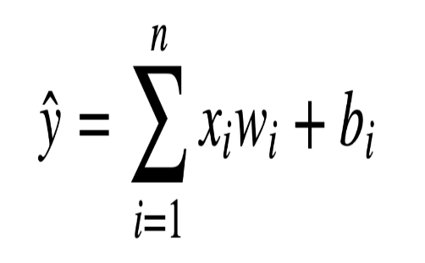
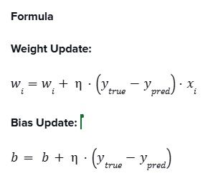
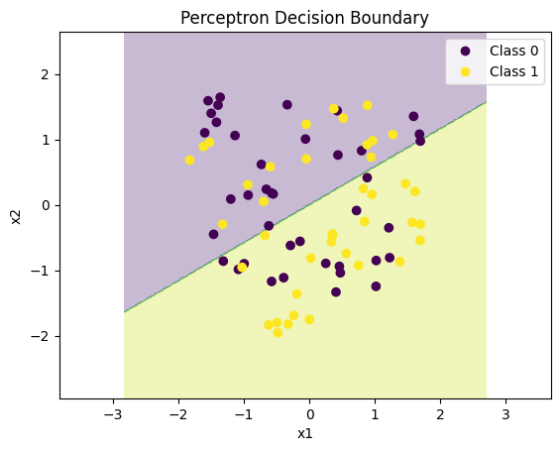
Perceptron Model
Learning Rate = 0.1
It is stable on scaled data
other values either learned too slowly or became unstable

Slide 5
Perceptron Behavior
Limitations :
Requires perfect linear separability
Accuracy saturation
Learning rate has limited effect on final accuracy
Converges
In our case, changing the learning rate affects convergence speed but not the final accuracy.

Slide 6
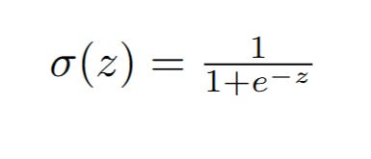
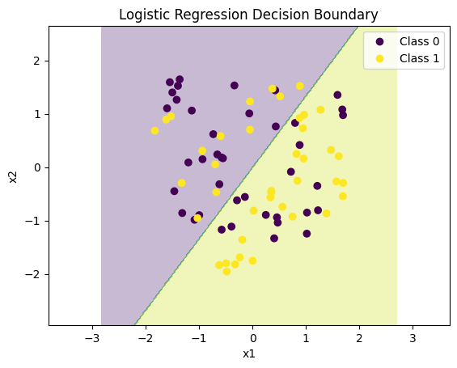
Logistic Regression
Logistic regression provides probabilistic outputs, unlike the perceptron which gives only hard class labels

Slide 7
Comparison And Insight
Case where Perceptron performs better
When the data is perfectly linearly separable and noise-free.
Case where Logistic Regression performs better
When the data has overlap or noise
In Our Case
Logistic Regression (60%) performs slightly better than the Perceptron(58.5%).
Our Insights
Both Perceptron and Logistic Regression are linear classifiers
Linear models are limited by data geometry, not by hyperparameter tuning
If the data is not perfectly separable, linear models hit a performance limit.
Our dataset is not perfectly linearly separable
Maximum achievable accuracy is thus capped by the dataset

Slide 8
Thanks

