Slide 1
Evaluation of 3D Geometric Representations for Autoencoder-Based Shape Reconstruction
A comparison of reconstruction accuracy, computational cost, and processing complexity
Presented by
Akansh Patel

Slide 2
Table of Content
Aim
Maize Dataset
Geometric Representation
PointNet++
DGCNN
3D CNN
Graph Convolution Network
DeepSDF
Recommendation

Slide 3
Aim
Compare different 3D geometric representations point clouds, voxel grids, meshes, and signed distance functions (SDFs) for autoencoder-based shape encoding.
Identify autoencoder architectures that provide the best trade-off between reconstruction accuracy, computational cost, and representation capacity.
Evaluate the robustness of the learned latent representations with respect to noise, geometric transformations, and bottleneck dimensionality.

Slide 4
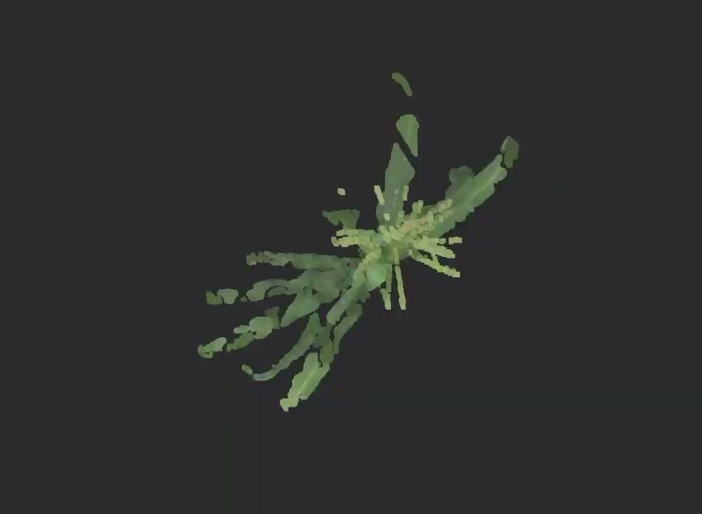
Maize Dataset
Maize Field 3D: dataset includes 1,045 high-quality point clouds of field-grown maize collected using a terrestrial laser scanner (TLS).
Each file contains 10,000 3D points (point cloud).
Geometry is complex, with fine details that must be preserved in reconstruction.
Capturing local geometry is crucial for accurate autoencoding.
fig 1: Maize point cloud data

Slide 5
Geometric Representations

Slide 6
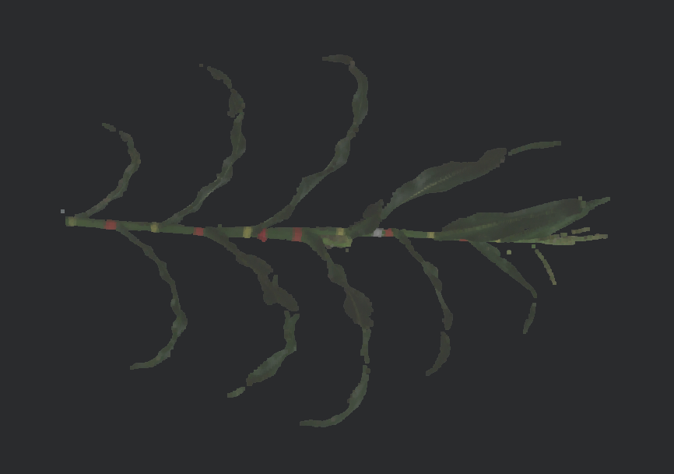
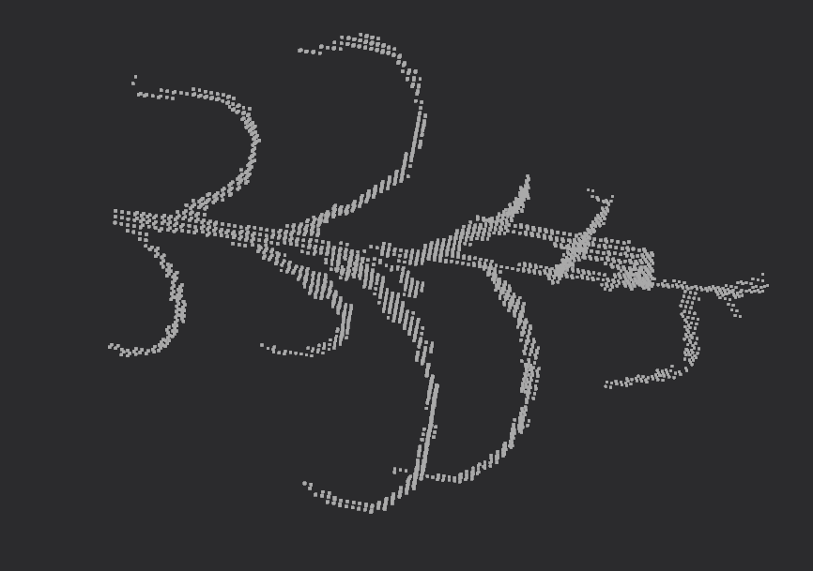
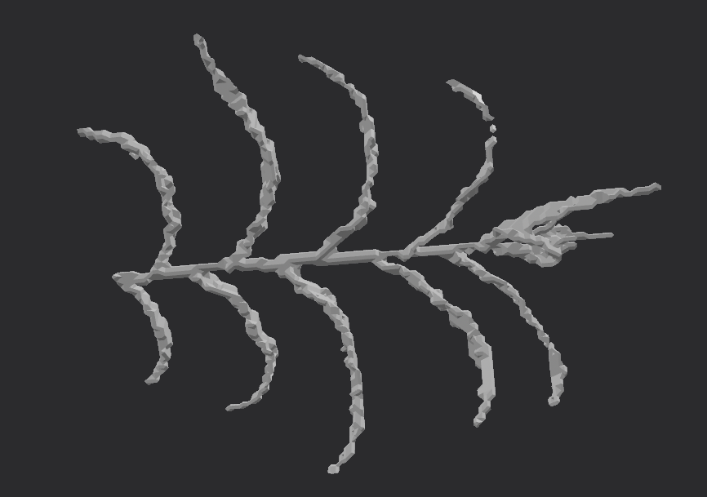
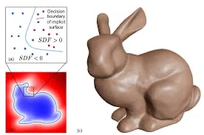
Geometric Representations
Point Cloud | Voxel | Triangular Mesh | Implicit (SDF)
The simplest representation: only points, no connectivity | A voxel is the three-dimensional equivalent of a pixel | A compact form representing surfaces | A mathematical function that represent surface as a zero level set
Best for scans / easy processing. | Best for segmentation / complex data | Best for compact representation | Best for reconstruction

Slide 7
Trade-offs in 3D Representations
Representations | Memory Scaling | Resolution - Memory Tradeoff | Topological Information | Processing Complexity
Point Cloud | Low (O(N)) | Linear increase with point count | Absent (no explicit connectivity) | Moderate (permutation-invariant operators)
Voxel | Very High (O(R³) | Cubic growth with spatial resolution | Implicit via regular lattice adjacency | Low (dense 3D convolutions)
Triangular Mesh | Moderate(V + F) | Adaptive refinement with localized resolution | Explicit surface connectivity (edges/faces) | High (graph and topology-aware operations)
Signed Distance Field(SDF) | O(θ) (network parameters) | Resolution-independent (continuous representation) | Implicit surface topology via zero level set | Moderate (function evaluation and sampling)

Slide 8
Deep Learning Architecture

Slide 9
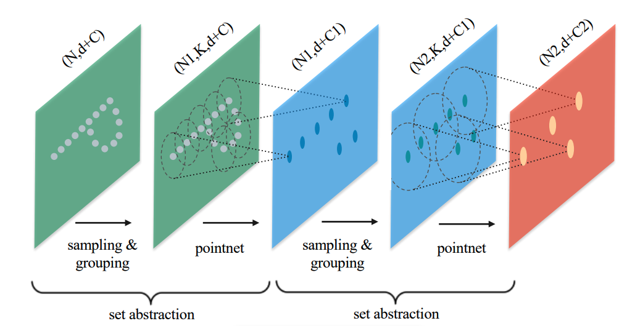
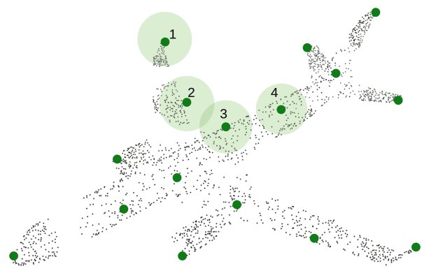
Pointnet++ (Multi Scale Grouping)
Key Components
Sampling Layer: (FPS).
Grouping Layer: Ball Query or K-Nearest Neighbors (KNN).
PointNet Layer: Learns features for each local neighborhood.
Multi-Scale Grouping (MSG): Hierarchically aggregates features from progressively larger local regions.
Hierarchical Point Set Feature Learning
Local Region
Model Training
Data Preparation: Downsampled each point cloud to 2048 points using Farthest Point Sampling and normalized coordinates; processed data saved for efficient training.
Decoder: Multi Layer Perceptron.
Training Implication: Without skip connections, the network may require longer training to accurately capture local details, because in the original PointNet++ segmentation task, skip connections preserve features across layers, and omitting them reduces gradient flow, making reconstruction of fine geometry harder.

Slide 10
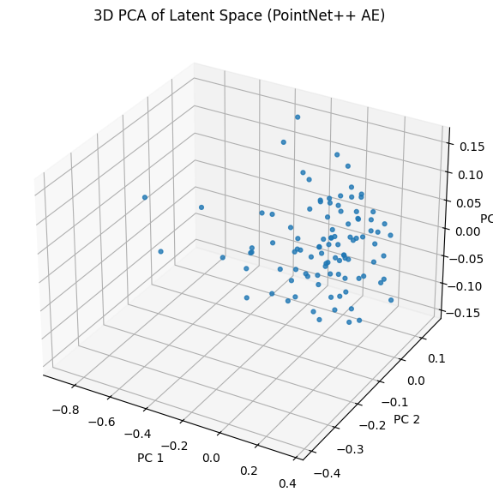
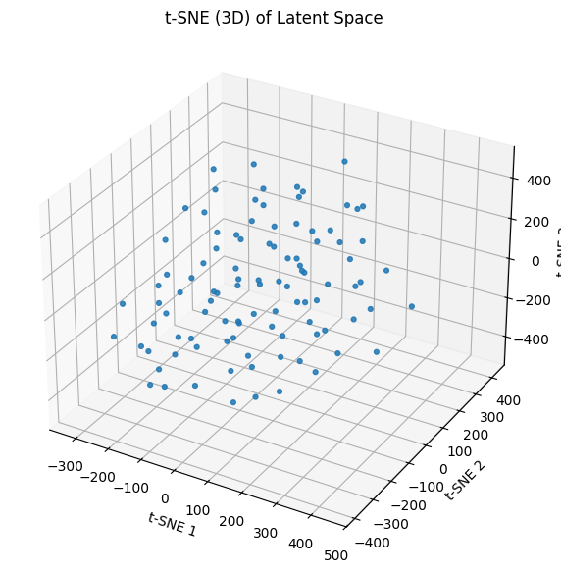
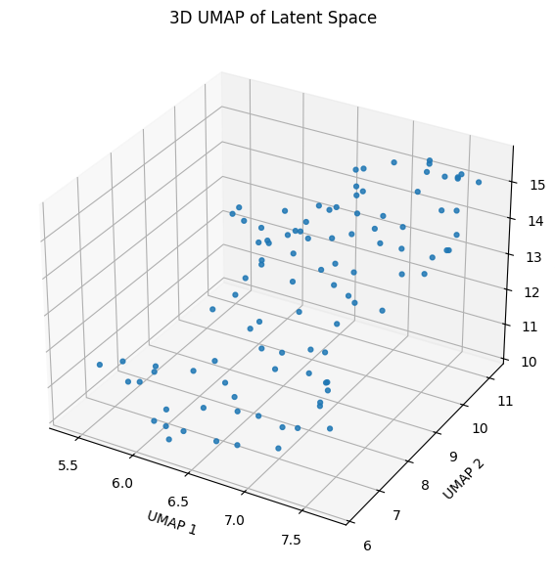
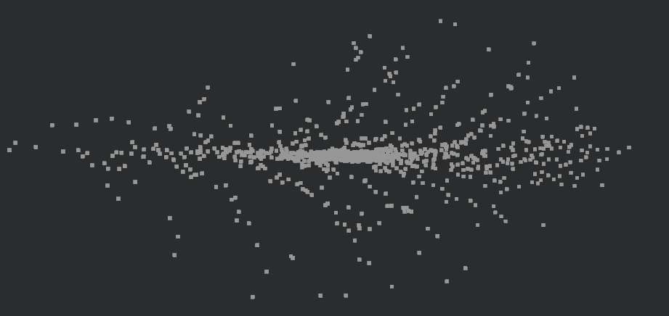
Pointnet++ : Outcomes
Architecture | Epoch | Loss | Training Time | Latent Dim | Limitations
Pointnet++ | 3270+ | 0.032 | 30hrs | 128 | Not transformation invariant. Requires 30+hrs of training to get near to the original geometry. Chamfer Loss calculation is itself computational heavy task.
Reconstructed Shape
latent Vector: PCA
latent Vector: t-SNE
latent Vector: t-SNE

Slide 11
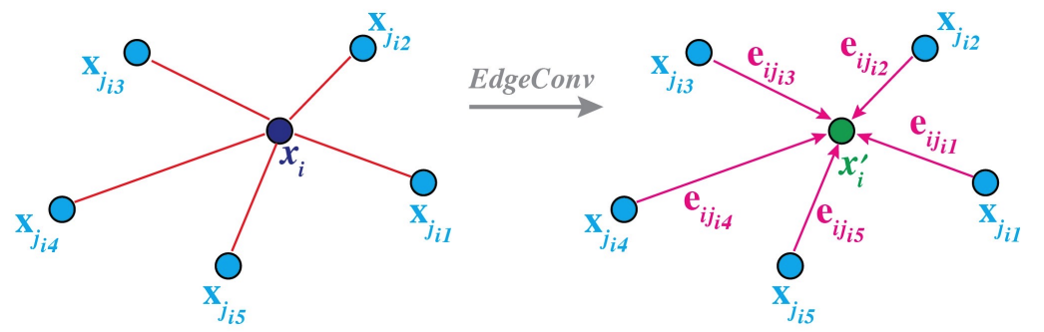
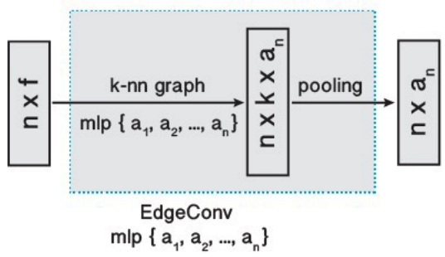
Dynamic Graph Convolution Neural Network
Key Components of DGCNN architecture
Model Training
Data Preparation: Each point cloud was downsampled to 2,048 points via Farthest Point Sampling (FPS) and normalized to a unit sphere to ensure uniform surface coverage and scale invariance.
Decoder: Multi layer perceptron.
Advantages:
  Permutation Invariance: Symmetric aggregation
  Local-Global Integration: Feature-space neighborhood modeling enables effective topological recovery and maintains semantic proximity in the latent space.

Slide 12
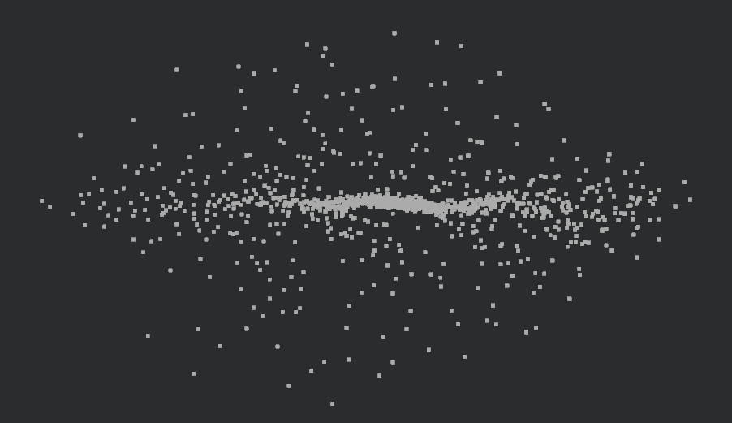
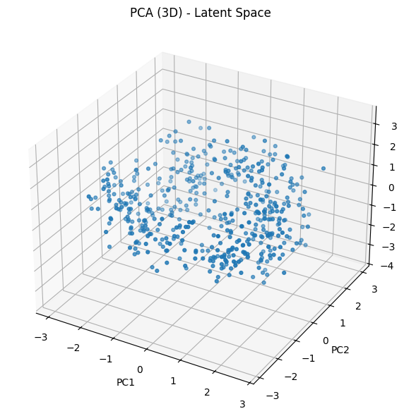
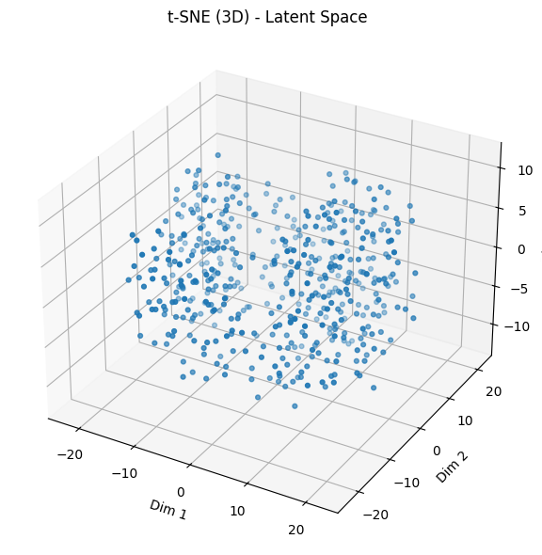
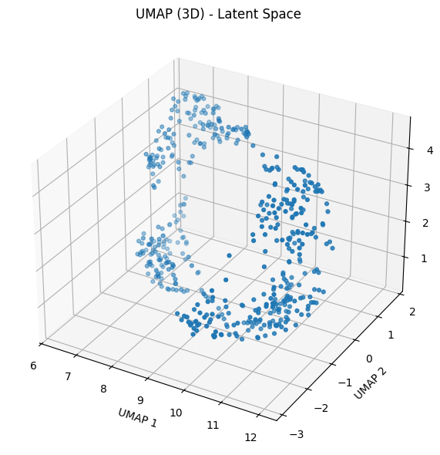
DGCNN : Outcomes
Architecture | Epoch | Loss | Training Time | Latent Dim | Limitations
DGCNN | 6000 | 0.0372 | 3.5hrs | 128 | Requires 10- 20hrs of training to get near to the original geometry.
Latent Vector of DGCNN:
Transformation Invariant
Even if the point are distance apart we ge semantic grouping.
Reconstructed Shape
latent Vector: PCA
latent Vector: t-SNE
latent Vector: UMap

Slide 13
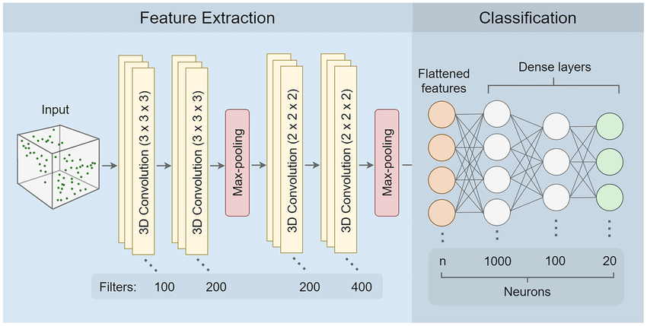
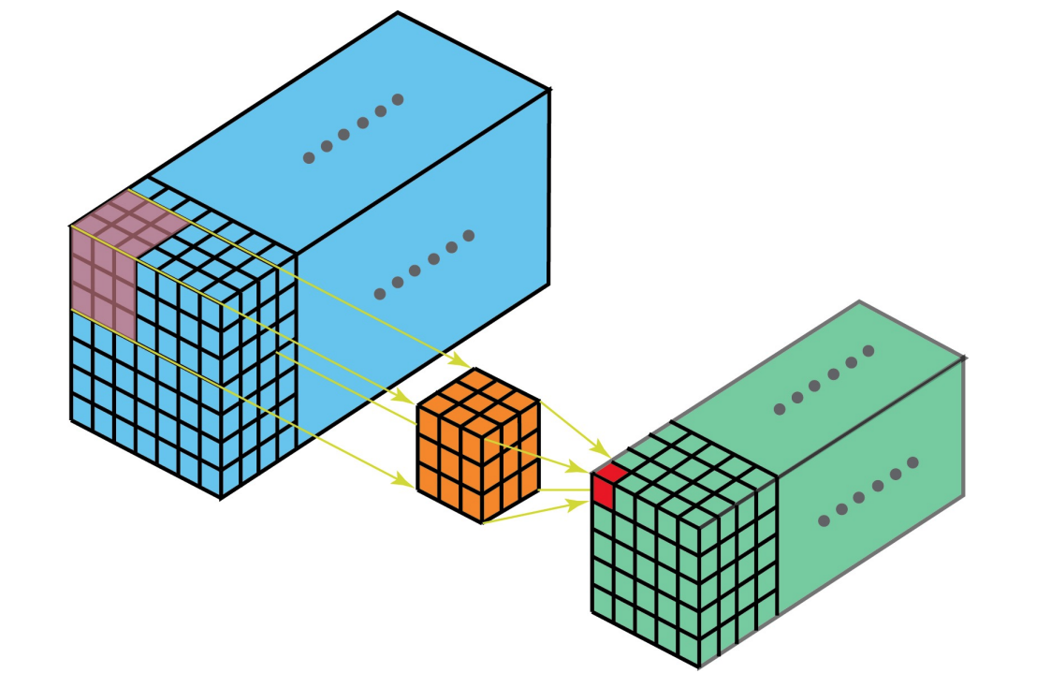
Voxel: 3D Convolution Neural Network
3D CNN architecture
3D Convolution Operation
Model Training
Data Preparation: The point cloud is normalized and discretized into a fixed-resolution 128×128×128 3D voxel occupancy grid for processing by a 3D CNN–based voxel autoencoder.
Convolution captures the local geometry.

Slide 14
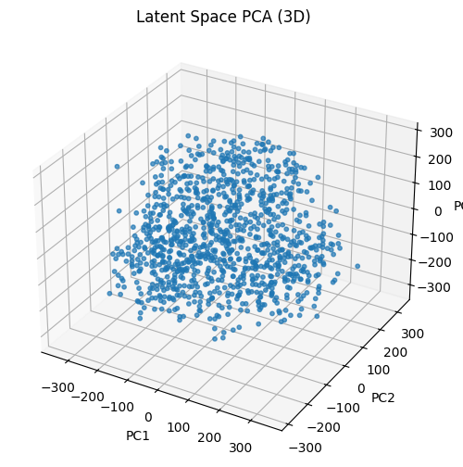
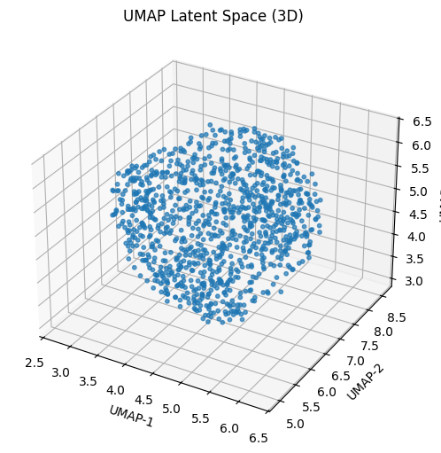
3D Convolution Neural Network
Architecture | Epoch | Loss | Training Time | Latent Dim | Limitations
3D CNN | 100 | 0.0012 | 30min | 128 | Noise: Moderately robust due to voxel averaging Geometric Transformations: Translation-invariant, but sensitive to rotation and scale. Bottleneck: Encodes global shape while sacrificing fine details due to resolution limits.
Reconstructed Shape
latent Vector: PCA
latent Vector: UMap

Slide 15
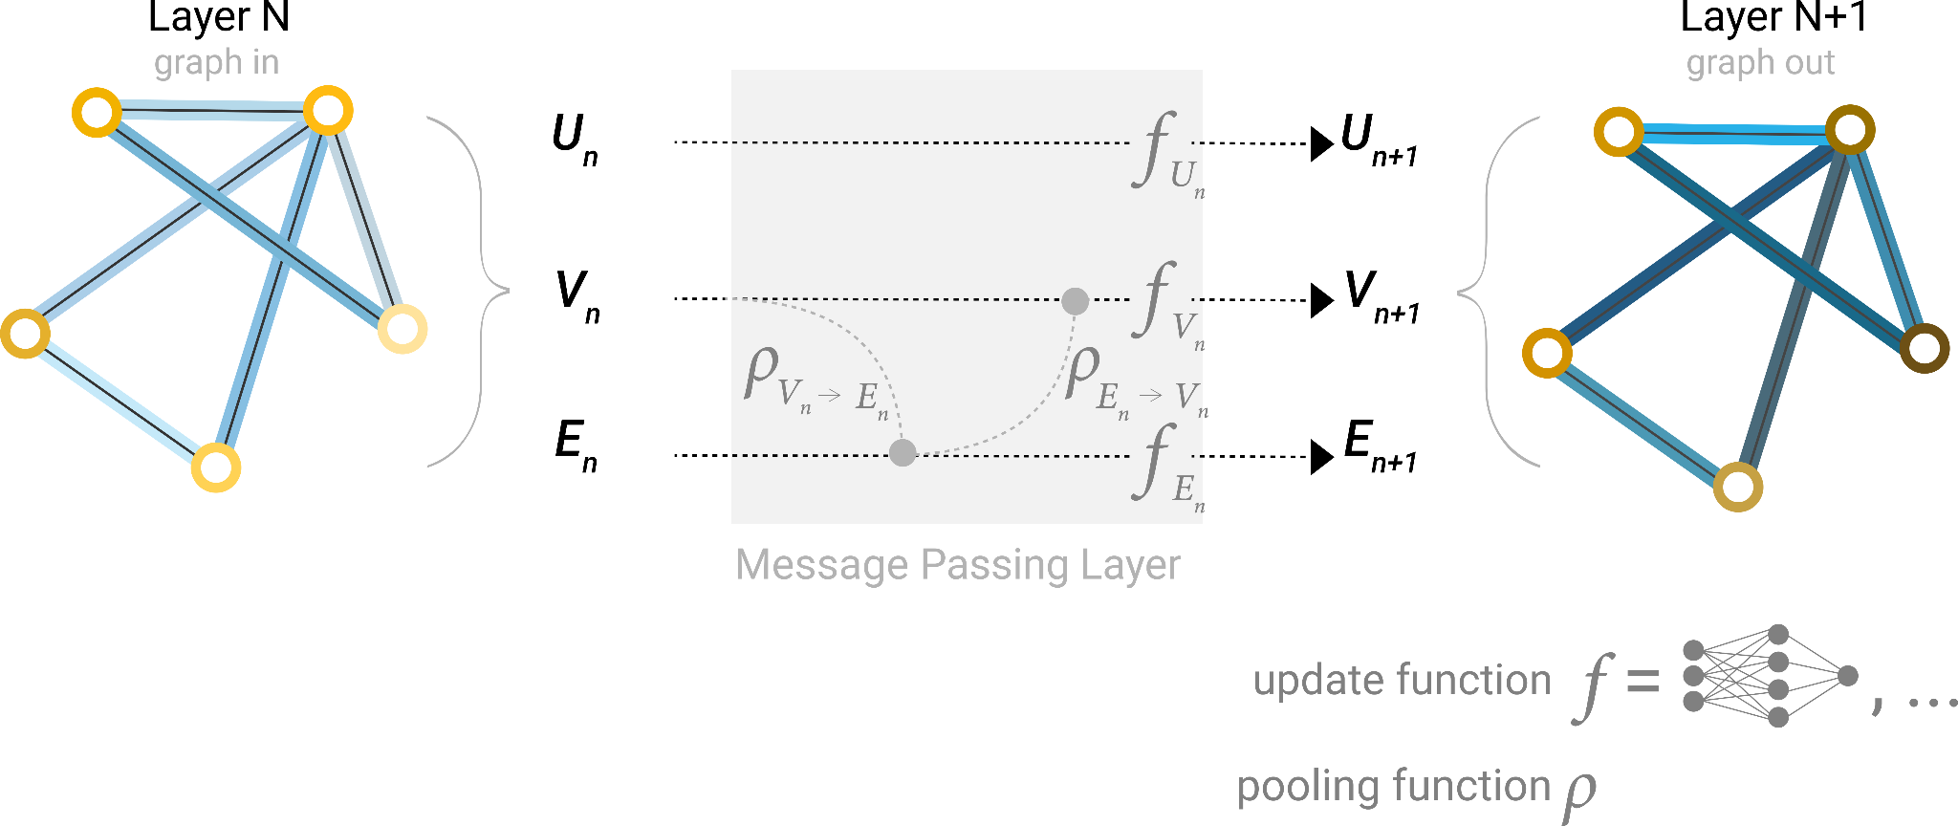
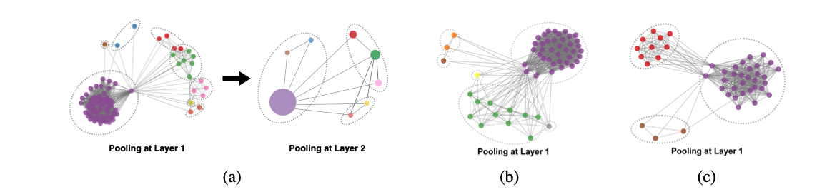
Graph Neural Network for Triangular Mesh
Processing Triangular Mesh Data
Edge Pooling
Key Idea
Mesh → Graph: Vertices as nodes, triangle edges as graph connections; node features = coordinates, normals, or curvature.
GNN Processing: Nodes aggregate neighbor information through message passing to learn local and global mesh structure.
Edge Pooling: Hierarchically merge connected nodes to reduce graph size while preserving geometry for latent representation.

Slide 16
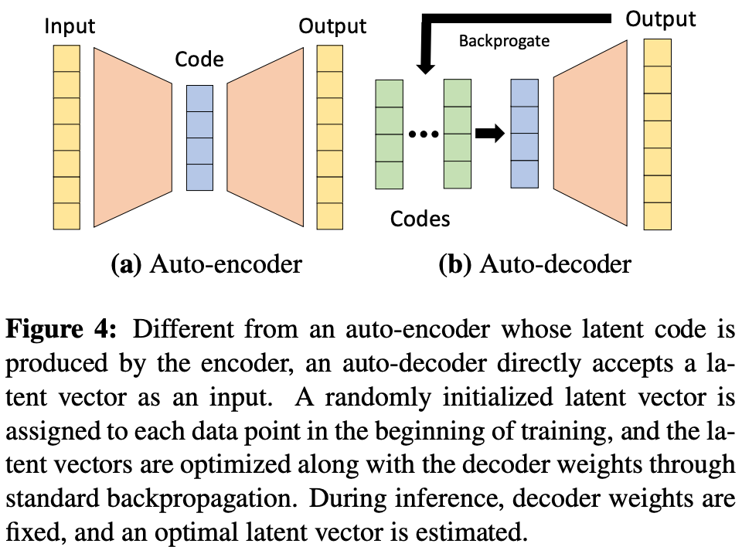
DeepSDF: Auto Decoder
Training:
Initialise random latent vector, combines with the 3D coordinates. Pass it do decoder
Compare predicted SDF with ground truth
Optimize the Network(decoder) weight and Latent Code z
Inference:
Fix decoder
Initialise test latent code.
Optimise the latent code with gradient descent.
Pass it to decoder and get the output
Model Training
Data Preparation: Each mesh is centered and scale-normalized, 5,000 points are sampled (80% near-surface, 20% uniform within ±0.1 padding), converted to signed distance values, and saved as DeepSDF training data.
Training Implication: Uses Skip connection.

Slide 17
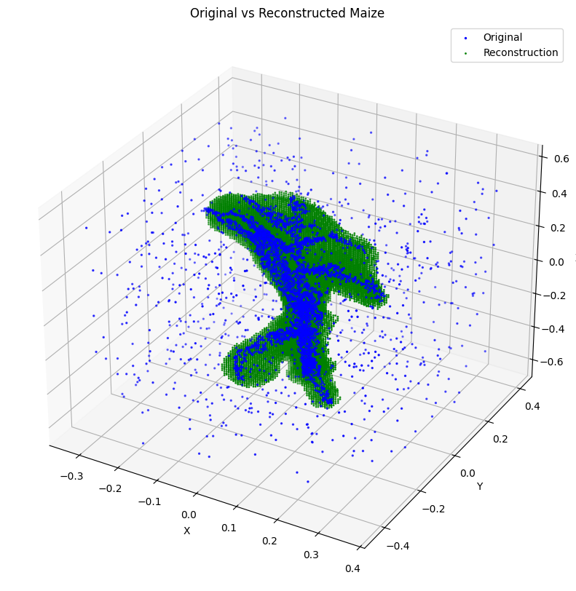
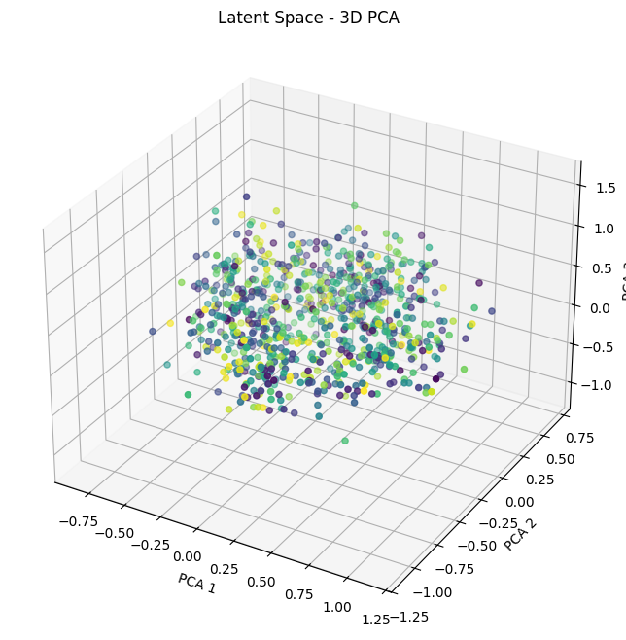
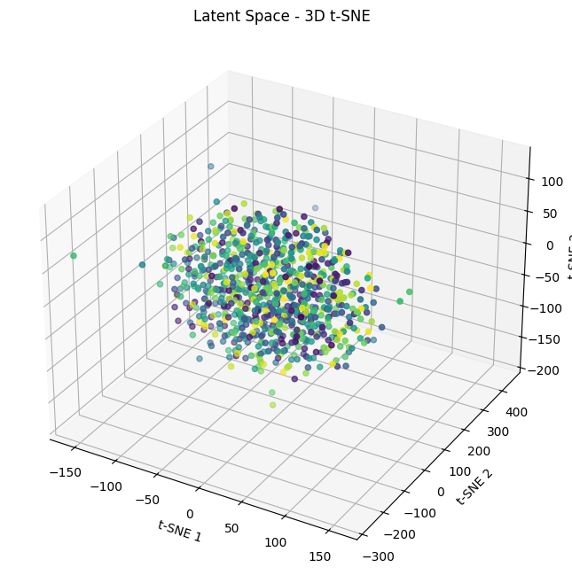
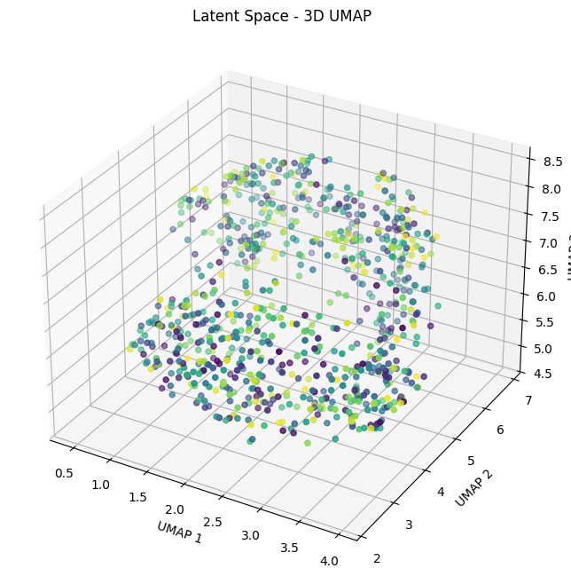
DeepSDF: Outcomes
Architecture | Epoch | Loss | Training Time | Latent Dim | Limitations
DeepSDF | 5000 | 0.0015 | 2.5hrs | 128 | Uses Skip connection
Reconstructed Shape
latent Vector: PCA
latent Vector: t-SNE
latent Vector: UMap

Slide 18
Summary

Slide 19
Model / Parameters | Latent Transformation Invariance | Reconstruction Accuracy | Noise Robusteness | Computational Power
Pointnet++ | Moderate | Moderate | Moderate | Low- Med (based on the geometry of input)
DGCNN | High | High | High | Med - High
3D CNN | Low | Med - High | Moderate | High
DeepSDF | High | Very High | Moderate | Moderate(based on the complexity of MLP)

Slide 20
Recommendation
Model | Best For | Key Points
DeepSDF | High Fidelity reconstruction. | Captures fine geometric detail with continuous SDF representation
DGCNN | Robust latent vector | Transformation invariant, reserves local geometry
Pointnet++ | Fast and memory efficient reconstruction | Scales well to large Point cloud data.
Voxel CNN | Low resolution and fast processing | Avoid large point cloud, coz of exponential rise in memory
Conclusion:
DGCNN: Provides robust, transformation-invariant latent representations through dynamic feature-space modeling.
DeepSDF: Excels at capturing and reconstructing fine, continuous surface details.
PointNet++: Offers high computational efficiency but demonstrates limited robustness to transformations.
Voxel-based CNNs: Remained constrained by memory-intensive O(N3) scaling and resolution limits.

