Slide 1

Energy Consumption Prediction
An overview of data preprocessing, visualization, and modeling.

Slide 2
Contents
Objective | A summary of the project goals and aim
Project Overview | Define the outline of the project
Milestone 1 | Details the initial steps, such as data collection, cleaning, and preprocessing.
Milestone 2 | Covers data visualization used to understand patterns and trends.
Milestone 3 | Covers encoding techniques
Milestone 4 | Focuses on tuning, optimizing, and finalizing model performance metrics.
Dataset Concusion | Summarizes insights drawn from the dataset analysis
Model Final Evaluation | Highlights the final model's performance and weakness based on key metrics
Final Insights | Presents the overarching conclusions,

Slide 3

Objective of the project:
The objective of the Energy Consumption Prediction project is likely to forecast future energy usage based on historical data and other relevant factors. This could involve analyzing past energy consumption patterns, identifying trends and seasonality, and using machine learning models to predict future energy demand. The goal might be to optimize energy production and distribution, reduce energy waste, and improve overall energy efficiency. The specific objectives could depend on the context of the project (e.g., predicting energy consumption for a building, a city, or a power grid).

Slide 4
The goal
Our Aim
The aim of the project is to forecast future energy usage based on historical data
Forecast future energy consumption using historical data and machine learning to optimize production, reduce waste, and improve efficiency.

Slide 5
Project Overview
This project forecasts future energy use. It analyzes historical consumption patterns, identifies trends, and employs machine learning to predict future demand. The goal is optimized energy production, waste reduction, and efficiency improvements.
01
02
Data Preparation
Data Visualization
03
04
Data Encoding
Machine Learning Models

Slide 6

01
Data Preparation

Slide 7
Dataset Characteristics
The "Household Power Consumption" dataset contains measurements of electric power consumption in a single household over a period of time. The data includes details recorded every minute from December 2006 to November 2010, The dataset consists of 2,075,259 entries across 9 attributes, incorporating both
numerical and categorical features.
Time Period: December 2006 - November 2010
Granularity: Data is recorded every minute
Exploratory Analysis:
Analysis | Definition | Observation
df.shape() | Returns a tuple representing the number of rows and columns in the dataset. | The dataset contains 2,075,259 rows and 9 columns, indicating sufficient data for analysis and modeling.
df.info() | Displays a concise summary of the Data Frame, including non-null counts and data types. | Data types, non-null counts, and memory usage of Data Frame columns. This consist of 8 object and 1 float values. Memory usage- 142.5+ MB

Slide 8
df.describe() | Provides statistical summary (mean, std, min, max, etc.) for numerical columns. | All numerical Columns like Global active and reactive Power and Global Intensity, Voltage, Sub metering 1,2,3 were analyzed. The Voltage remains stable 240.8V
df.describe (include=object) | Provides statistical summary for categorical columns (e.g., count, unique values, top category, frequency). | The dataset shows 2,075,259 entries, with some missing values in the Global active power and Voltage columns, indicated by the "?" symbol. The most frequent values for both Sub_metering_1 and Sub_metering_2 are 0, suggesting that appliances in these categories were often not in use.
df.nunique() | Displays unique values in all columns. | The highest unique values are in the Global active power 4186 then Voltage that have 2837 unique values
df.isnull().sum() | Counts the number of missing values for each column. | Except the Date and Time column Every columns have 25979 missing values

Slide 9
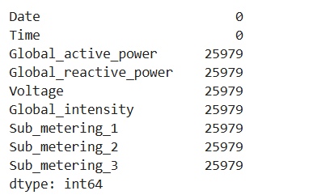
Handling Null Values
This dataset consists of 25979 missing values in Global active power and Global Reactive power, Voltage, Global Intensity, Sub metering 1,2 and 3 columns.

Slide 10
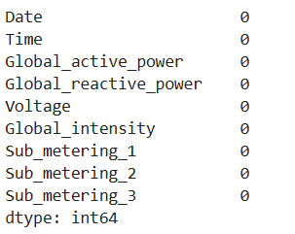
Handling Null Values
The missing values in the dataset are replaced with the mean of their respective columns.

Slide 11

02
Data Visualization

Slide 12
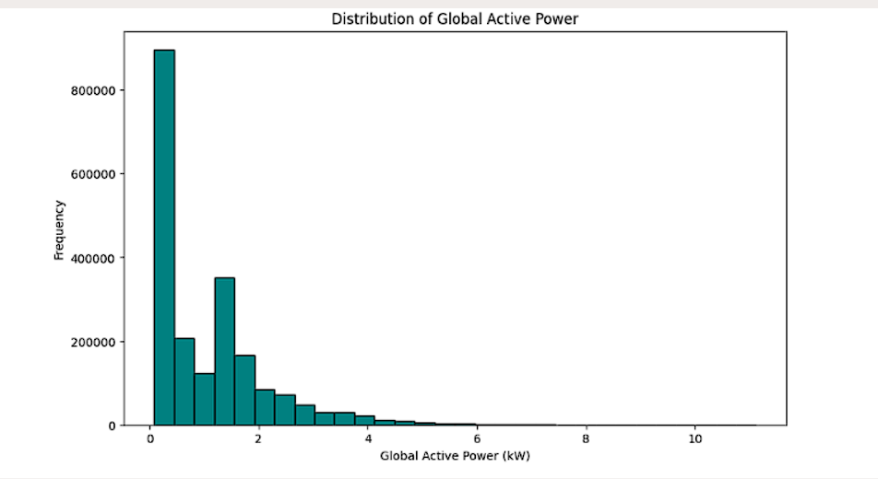
This part focuses on exploring the dataset visually to uncover meaningful patterns and relationships between variables. Through graphs and plots, we analyze trends and distributions, helping identify key insights related to stroke prediction.
Additionally, data encoding ensures that categorical variables are transformed into
a format suitable for machine learning models.
Visualization: Distribution of Global Active Power
Observation:
The histogram shows that most global active power values are low, with a right-skewed distribution. High power usage values are rare, indicating occasional peak demands.

Slide 13
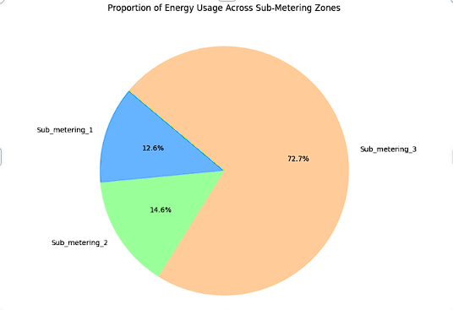
Proportion of energy usage across the three sub-metering zones by using pie chart
Visualization: proportion of energy usage across the three sub-metering zones (Sub_metering_1, Sub_metering_2, and Sub_metering_3)
Observation:
Sub_metering_3 typically has the largest share of energy usage, which may indicate a consistent load in that zone. Sub_metering_1 and Sub_metering_2 often consume less energy compared to Sub_metering_3, possibly because they serve devices or areas with lower or less frequent usage.

Slide 14
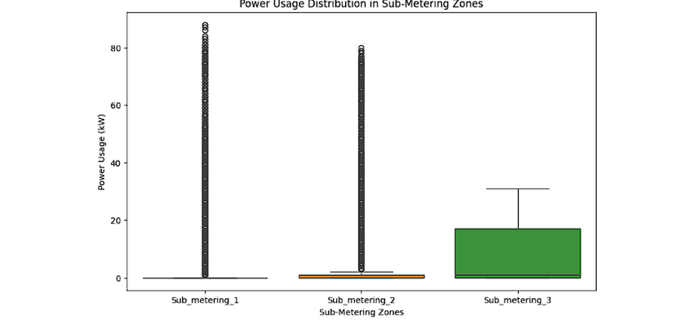
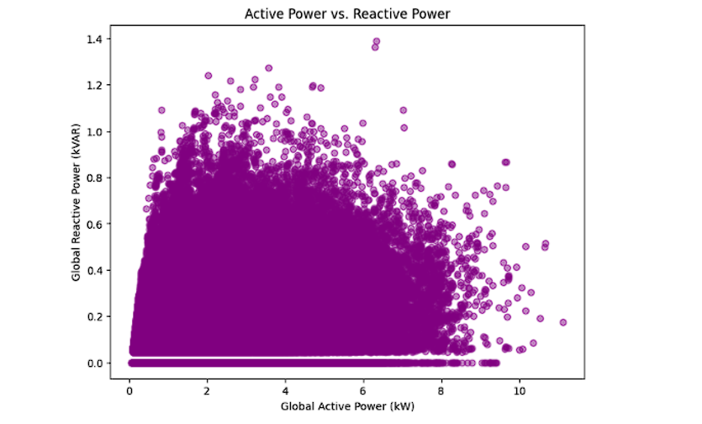
Box plot for different sub-metering zones
Visualization:
the distribution of power usage for different sub-metering zones
Observation:
This distribution pattern suggests that Sub_metering_3 might be used for devices or areas with more consistent power needs, while Sub_metering_1 and Sub_metering_2 might be associated with less frequently used or intermittent high-power equipment.
Scatter Plot of Active vs Reactive Power
Visualization:
correlation between active and reactive power consumption
Observation:
The scatter plot shows a positive correlation between global active power and global reactive power. As active power increases, reactive power generally increases as well, but with considerable spread, especially at higher active power levels.

Slide 15

04
Machine Learning Models

Slide 16
Linear Regression
Machine Learning (ML) models are algorithms that enable computers to learn patterns from data and make predictions or decisions without being explicitly programmed. Models used in this project are :
Ridge Regression
Lasso Regression

Slide 17
Preprocessing and Data Preparation for Regression Models
Handling Missing
Values
Feature Selection and Dropping Irrelevant Columns
Defining Features (X) and Target(Y)
Train-Test Split
Accuracy prediction

Slide 18
Model Performance Summary: RMSE and Accuracy
Model | Accuracy | RSME
Linear Regression | 99.84 | 0.04
Ridge Regression | 99.84 | 0.04
Lasso Regression | 95.21 | 0.23

Slide 19
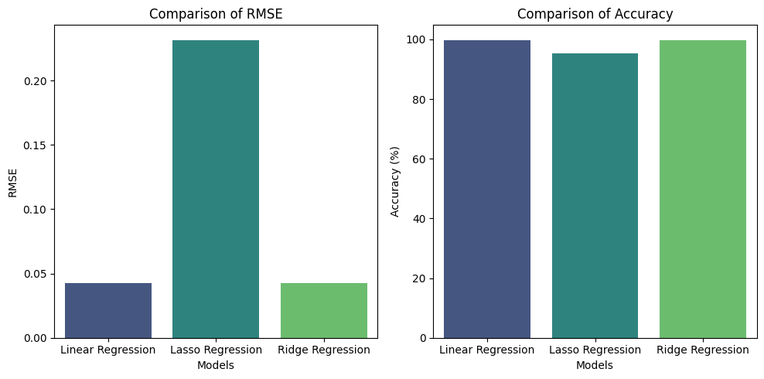
Visualizing Different Models
Key observations
RMSE Insights : Linear and Ridge Regression have low RMSE (0.04), indicating strong performance, while Lasso Regression's higher RMSE (0.23) suggests potential underfitting due to over-regularization.
Accuracy Insights : Linear and Ridge Regression achieve high accuracy (R² of 99.84%), showcasing their ability to capture data variance effectively. Lasso Regression has a lower accuracy (95.21%), likely due to excessive feature penalization.

Slide 20
Precision, Recall, F1 Score, and Accuracy

Slide 21

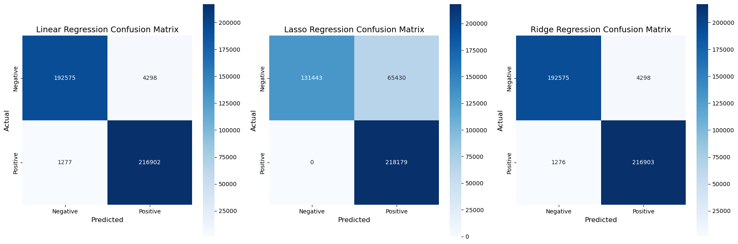


Precision (P): Measures how many predicted "high energy consumption" periods are correct.
P= TP/[TP+FP]
Recall (R):Measures how many actual "high energy consumption" periods are correctly identified.
R=TP/[TP+FN]
F1 Score: Harmonic mean of Precision and Recall, providing a balance between both.
F1 Score= 2*(P x R/P+R)
Accuracy: Overall correctness of the predictions.
Accuracy=(TP+TN)/(TP+TN+FP+FN)

Slide 22
Observations
Model | Precision | Recall | F1 Score | Accuracy
Linear Regression | 0.98 | 0.99 | 0.99 | 0.99
Ridge Regression | 0.98 | 0.99 | 0.99 | 0.99
Lasso Regression | 0.77 | 1.00 | 0.87 | 0.95
Linear Regression: Excellent performance with balanced precision, recall, F1 score, and accuracy, indicating a strong and reliable model.
Ridge Regression: Matches Linear Regression's performance, balancing regularization with data variance effectively.
Lasso Regression: Lower precision and F1 score suggest over-regularization, potentially leading to underfitting despite perfect recall.

Slide 23

04
Data and Model Analysis

Slide 24
Household Prediction Data:
The "Household Power Consumption" dataset contains measurements of electric power consumption in a single household over a period of time. The data includes details recorded every minute from December 2006 to November 2010.
Data Analysis
Data analysis is the process of examining, cleaning, and understanding data to find patterns, trends, or useful information.
It involves:
Checking the quality of the data (e.g., removing missing or incorrect values).
Exploring the data to understand its structure and relationships, like how variables are connected.
Summarizing the data using graphs, charts, or statistics to get insights.

Slide 25
Model Analysis
Model analysis involves evaluating how well a machine learning or statistical model performs. It helps ensure the model is accurate and reliable.
This process includes:
- Measuring performance using metrics like accuracy, precision, recall, or error rates.
- Testing the model on new or unseen data to check its ability to generalize.
- Comparing different models to choose the best one for a specific task.
ARIMA (AutoRegressive Integrated Moving Average) and Prophet are popular methods that can be used for data and model analysis, particularly in the context of time series forecasting.

Slide 26
ARIMA MODEL
ARIMA (Autoregressive Integrated Moving Average) is a popular time series forecasting model.
It combines three components:
1. Autoregression (AR):
Uses past values of the time series to predict future values.
2. Integration (I):
Process of subtracting consecutive values in the time series.
3. Moving Average (MA):
Considers past forecast errors to predict future values.
PROPHET MODEL
Prophet is an open-source forecasting tool developed by Facebook that uses advanced statistical models to predict future trends in time series data. It is particularly useful for data with strong seasonal patterns (like monthly sales or website traffic) and can handle missing data and outliers. Prophet is designed to be easy to use, allowing non-experts to quickly create reliable forecasts.

Slide 27
How Prophet Works :
Imagine you're forecasting website traffic.
Prophet will:
Identify the overall trend: Is the traffic generally increasing, decreasing, or staying stable? It might find that growth slows down after a certain point.
Model the weekly and yearly seasonality: Traffic might peak during weekdays and decline on weekends. There could be higher traffic during holidays.
Account for holiday effects: Black Friday, for example, might have a noticeable impact on traffic.
Combine all components: It combines the trend, seasonality, holidays, and any other regressors to generate a forecast. Since it is a Bayesian model, it considers different combinations of trend, seasonality, and holiday effects and their probable impacts, thus generating an overall probability distribution for the forecast.

Slide 28

05
Data Forecasting

Slide 29
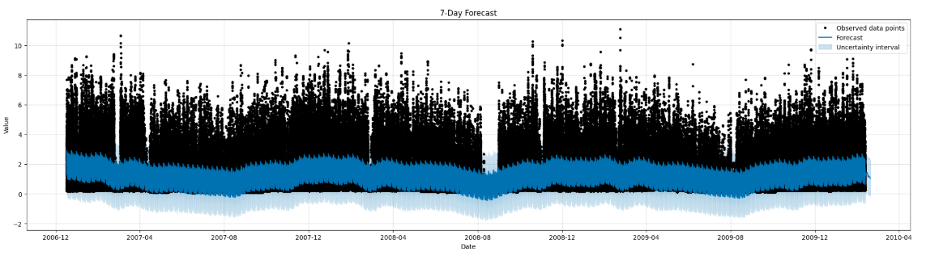
Data forecasting means predicting the future based on past information. It's like making an educated guess about what might happen next using data that has already been collected.
In Energy Consumption Prediction, data forecasting is used to predict how much energy people will use in the future. This helps energy companies plan better and make sure there is enough electricity or gas available when needed.

Slide 30
Overall trend: Observe if the forecast shows an increasing, decreasing, or stable trend in global active power over the next 7 days.
Peaks and troughs: Identify any significant peaks or dips in the predicted power usage.
Confidence intervals: Pay attention to the shaded areas around the forecast line. These represent confidence intervals, showing the range of uncertainty in the predictions. Wider intervals suggest lower confidence in the forecast.
Comparison to past data: (if available in the plot) Compare the forecast to the observed historical data to understand how the forecast deviates from past patterns.
External factors: Consider any known external events (holidays, weather patterns, etc.) that might affect energy consumption and compare them to the predictions.

Slide 31
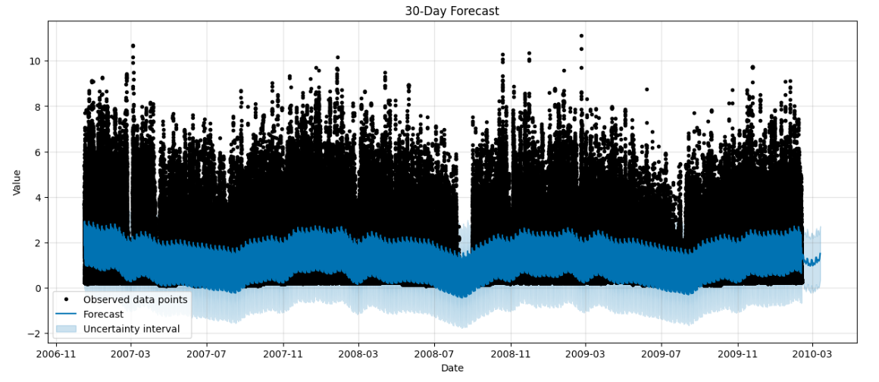
The predicted values (yhat) show a general increasing trend over the next 30 days, with some fluctuations.
The uncertainty intervals (yhat_lower and yhat_upper) appear to be relatively narrow, suggesting moderate confidence in the predictions, especially towards the end of the forecast period.
There is a potential peak in the predictions around the 15th day of the forecast, which could be further investigated.

Slide 32
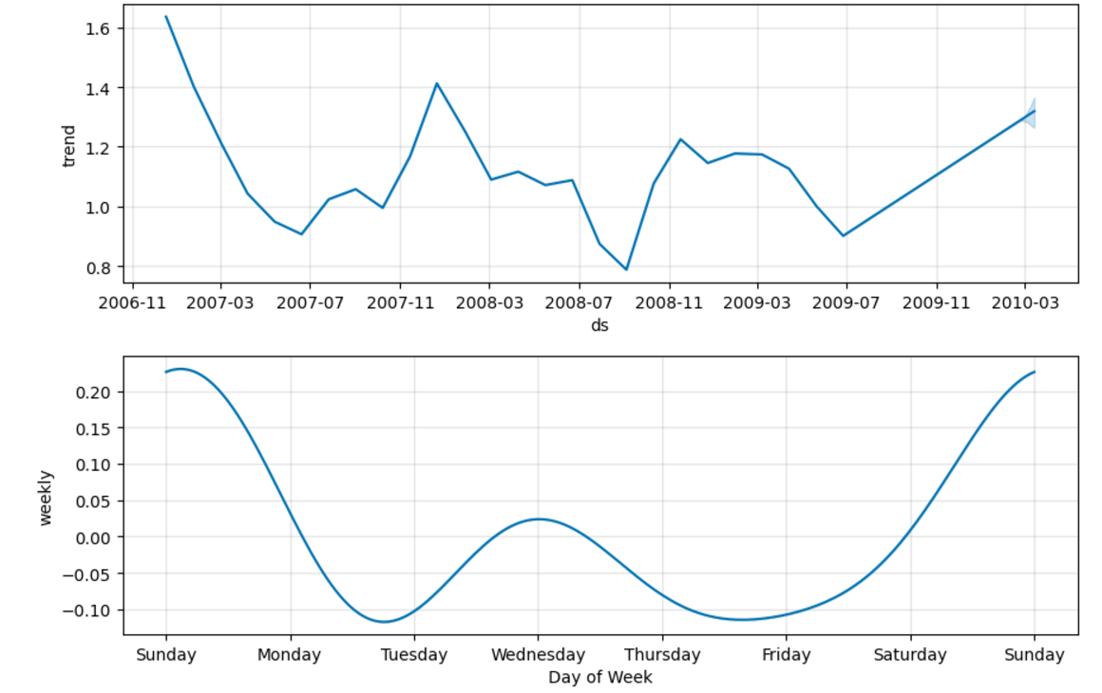

Slide 33
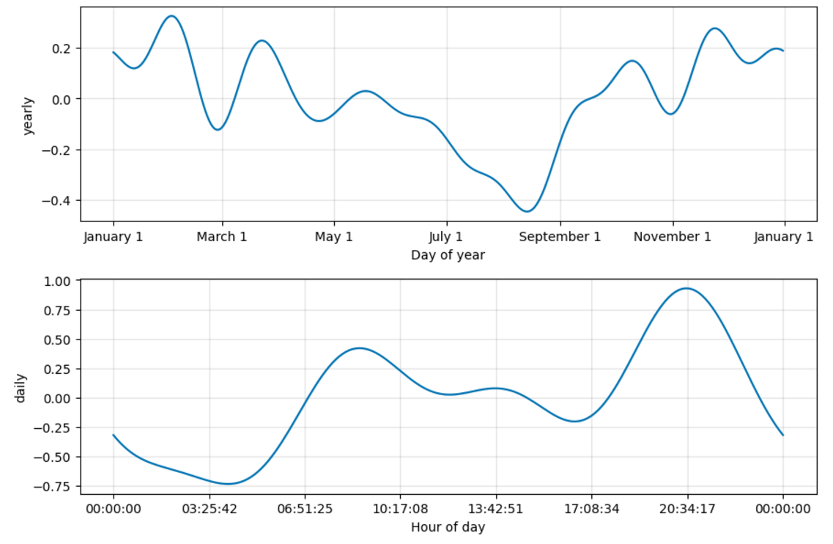

Slide 34
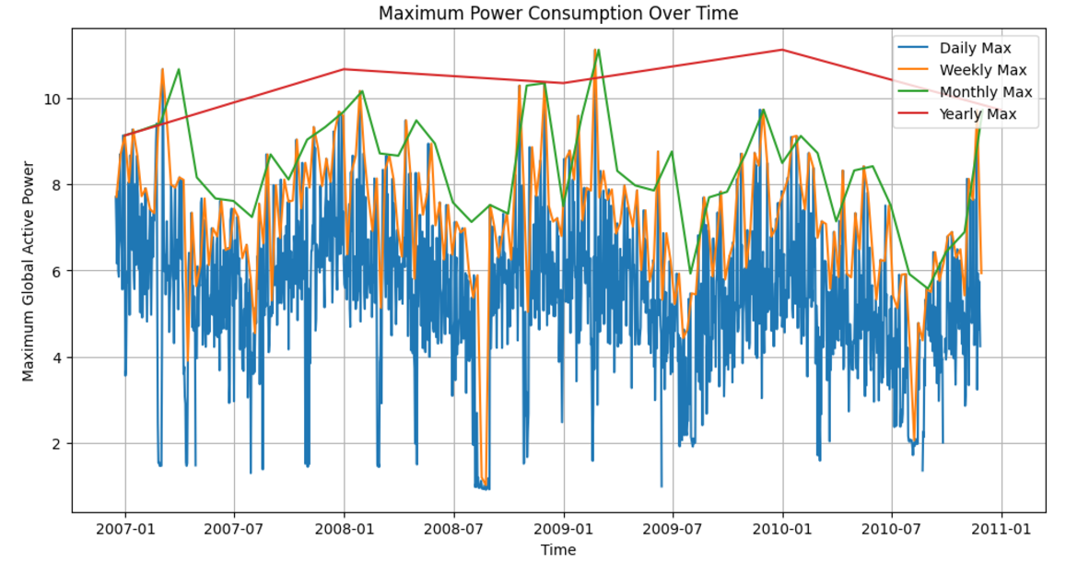

Slide 35
Daily Maximum Power Consumption
Observation: The maximum daily power consumption varies significantly, ranging from approximately 4.242 kW to 11.122 kW.
Time of Peak Consumption: Daily peaks are likely to occur during times of high household or industrial activity, such as:
Morning (6–9 AM): High power use for cooking, heating, or preparing for the day.
Evening (5–9 PM): Peak usage due to lighting, entertainment, and household chores.
Why? *These peaks align with human activity patterns, where demand increases during morning preparation and evening relaxation after work.
Weekly Maximum Power Consumption
Observation: Weekly peaks show significant variation, with some weeks reaching values as high as 9.724 kW.
Time of Peak Consumption:
Likely during weekdays (Monday-Friday) when industrial and commercial activity is at its peak.
Weekends may also show peaks depending on household activity patterns.
Why?
Weekly peaks often correlate with work schedules, industrial processes, and household routines.
Specific events (e.g., festivals or holiday preparations) may also drive consumption spikes in certain weeks.

Slide 36
Monthly Maximum Power Consumption
Observation: Monthly peaks show patterns tied to seasonal variations. For example:
The highest monthly consumption (10.670 kW) occurs in March 2007, and other high peaks occur in winter months like November or February. *Why? *Winter Months: Increased heating demands in colder months (November–February). *Summer Months: Possible spikes in regions requiring cooling (air conditioners, fans). *Seasonal Factors: Holidays, industrial cycles, and agricultural demands can also influence monthly consumption.
Yearly Maximum Power Consumption
Observation:
The highest annual peak (11.122 kW) occurs in 2009, with a declining trend in 2010.
Why 2009 Was the Highest?
Economic or industrial growth during 2009 may have driven higher consumption.
Specific events or seasonal extremes could have increased heating or cooling needs.
In 2010, the decline might be attributed to:
Increased energy efficiency measures.
Reduced industrial output or economic slowdowns.
Shifts to alternative energy sources or better power management.

Slide 37
Energy Prediction Streamlit App
Libraries & Initialization: Uses pandas, streamlit, and joblib. Encapsulates app logic in the EnergyConsumptionApp class with page configuration and resource loading.
Page & UI Styling: Configures Streamlit (wide layout, sidebar) and applies custom CSS for a polished interface.
Model Loading: Loads pre-trained Linear and Ridge Regression models along with feature names, handling errors gracefully.
User Inputs: Collects inputs for Voltage, Sub-metering, Date, and Time, Global Intensity and predicts Global Active Power.
Predictions & Results: Predicts energy consumption using Linear and Ridge models and displays results in a styled card.
Execution: Runs the app via a main() function, encapsulating all logic for easy execution.

Slide 38
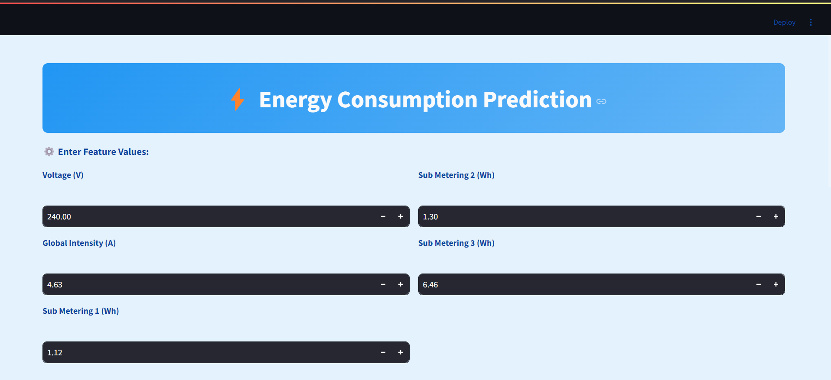
Screenshots of Streamlit App

Slide 39
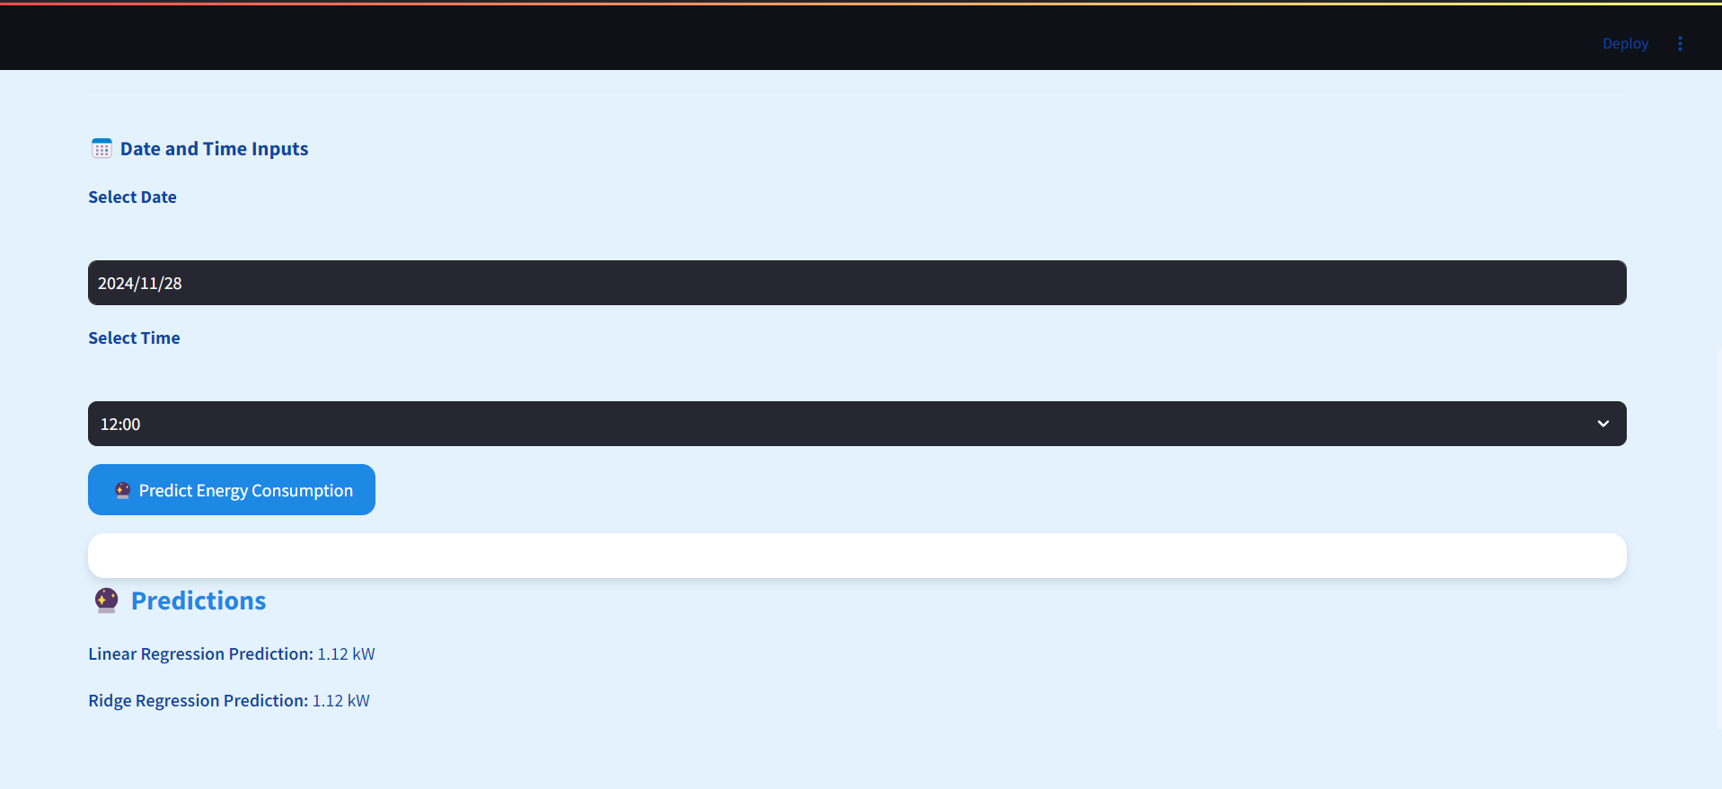
Screenshots of Streamlit App

Slide 40
Thanks!

