Slide 1
MARATHWADA MITRA MANDAL'S COLLEGE OF ENGINEERING, PUNE - 52
DEPARTMENT OF COMPUTER ENGINEERING | TY SEMESTER-V | A.Y. 2026-27
SMARTBITE AI
Smart Campus Food Waste Prediction and Optimization System Using Machine Learning
PRESENTED BY:
Tanish Moro | Roll No: B24CE1073 | Class: TY 2
Under the Guidance of: Prof. / Dr. [Faculty Guide Name]

Slide 2
DSML LAB MINI PROJECT | A.Y. 2026-27
Introduction & Motivation
The Global Crisis
• UNEP 2024 Report: Over 1.05 billion tonnes of edible food wasted annually.
• Food waste generates 8–10% of total global greenhouse gas emissions.
• Anaerobic decomposition in landfills produces potent methane (CH4, 28x warming impact of CO2).
The Campus Dilemma
• Institutional university cafeterias waste 15% to 25% of all food prepared daily.
• Severe operational trade-off:
- Under-cooking → Student dissatisfaction & stock-outs.
- Over-cooking → 80–120 kg daily surplus discarded.
• Financial drain of ₹20,000–₹30,000 weekly.
The AI Paradigm Shift
• Traditional Approach: Static headcount guesses and informal culinary intuition.
• SmartBite AI Approach: Supervised Machine Learning demand intelligence.
• Shifts operations from reactive post-waste composting to proactive pre-service batch optimization.
Marathwada Mitra Mandal's College of Engineering, Pune | Tanish Moro (B24CE1073) | SmartBite AI

Slide 3
DSML LAB MINI PROJECT | A.Y. 2026-27
Problem Statement & Project Objectives
Problem Statement
Cafeteria kitchens must prepare hundreds of meals in advance without exact knowledge of attendance. Dynamic factors like weather anomalies, exam schedules, and day-of-week trends trigger large unexpected variance in student turnout.
Without predictive guidance, kitchens over-produce buffer meals, creating over 100 kg of daily surplus that cannot be legally resold.
Goal: Accurately predict pre-service food surplus (food_waste_kg) hours prior to meal production with zero data leakage, enabling optimal staged batch-cooking.
Key Project Objectives
1. Realistic Physical Dataset Formulation:
Generate 5,000 cafeteria records strictly adhering to mass conservation: Food Prepared = Food Consumed + Food Wasted.
2. Strict Anti-Leakage Feature Quarantine:
Ensure post-service variables (actual meals eaten/served) are strictly quarantined from input matrices.
3. Multi-Algorithm Benchmarking:
Evaluate Linear Regression, Decision Tree, Random Forest, and Gradient Boosting under 5-Fold Cross Validation.
4. Operational Decision Support & Web UI:
Deploy an intuitive Streamlit interface providing staged-cooking recommendations and UN SDG impact analytics.
Marathwada Mitra Mandal's College of Engineering, Pune | Tanish Moro (B24CE1073) | SmartBite AI

Slide 4
DSML LAB MINI PROJECT | A.Y. 2026-27
Literature Survey & Domain Benchmarking
Author & Year | Methodology / Models | Key Findings | SmartBite AI Integration
Bellemare et al. (2020) Appl. Econ. Perspect. | Mass-balance formulation across dining services. | Unstandardized volumetric estimates introduce systemic bias; mass conservation is essential. | Formed mathematical mass-balance law in data generator.
Qi, Li, & Roe (2021) Resour. Conserv. Recycl. | Random Forest & Decision Trees on campus dining data. | Ensemble trees reduced error by 23%; weather anomalies & exams are key drivers. | Included calendar & weather covariates in feature set.
Eriksson et al. (2022) Waste Management | Statistical variance analysis across 60 kitchens. | Menu categories and buffet formats generated 2.8x higher surplus than plated meals. | Engineered menu category and meal slot one-hot features.
Wang, Zhang, & Liu (2023) J. Clean. Prod. | Benchmarked XGBoost, GBM, RF, and SVR. | Gradient Boosting outperformed linear models by capturing non-linear interactions. | Validated Gradient Boosting as our champion model.
Derqui et al. (2020) Sustainability | Evaluated staged culinary preparation schedules. | Preparing 70% upfront and 30% dynamically reduced waste by 31% with zero stock-outs. | Implemented 75/25 Staged-Cooking Recommendation Engine.
Marathwada Mitra Mandal's College of Engineering, Pune | Tanish Moro (B24CE1073) | SmartBite AI

Slide 5
DSML LAB MINI PROJECT | A.Y. 2026-27
Technical Architecture & Pipeline Design
1. Data Pipeline
• 5,000 Shift Records
• 13 Predictors (Calendar, Weather, Operational, Menu)
• Verified 0 missing/corrupt values
• Strict Anti-Leakage Quarantine (excluded post-meal actuals)
2. Preprocessing
• OneHotEncoder:
day_of_week, meal_type, menu_category
• StandardScaler:
temperature, meals_prepared, food_prepared_kg
• Atomic Pipeline encapsulation
3. Model Benchmarking
• 4 Diverse Regression Algorithms
• 80/20 Train/Test Split (4k train / 1k test)
• 5-Fold Stratified Cross Validation
• Evaluation: MAE, RMSE, R²
4. Deployment & UI
• Streamlit Interactive Web App
• Plotly Dynamic Visualizations
• Real-Time KG Predictions
• 75/25 Staged Cooking Logic
• UN SDG Impact Quantification
Marathwada Mitra Mandal's College of Engineering, Pune | Tanish Moro (B24CE1073) | SmartBite AI

Slide 6
DSML LAB MINI PROJECT | A.Y. 2026-27
Supervised Machine Learning Algorithms
Linear Regression (Parametric Baseline)
• Equation: y = w^T x + b
• Solved via Ordinary Least Squares (OLS) minimizing sum of squared errors.
• Assumptions: Feature linearity, homoscedasticity.
• Weakness: Fails to capture non-linear meal-slot interactions (Test R²: 0.655).
Decision Tree Regressor (Non-Parametric Tree)
• Partitions feature space via recursive binary splitting.
• Optimization: Minimizes Mean Squared Error (MSE variance reduction).
• Advantage: Captures discrete threshold rules.
• Weakness: Prone to high variance and overfitting (Test R²: 0.682).
Random Forest Regressor (Ensemble Bagging)
• Constructs 100 decorrelated decision trees.
• Mechanism: Bootstrap Aggregation (Bagging) + random feature subspace sampling.
• Advantage: Drastically reduces variance while maintaining low bias (Test R²: 0.793).
Gradient Boosting Regressor (Champion Boosting Ensemble)
• Mechanism: Stage-wise additive modeling fitting trees to negative gradients of MSE loss.
• Hyperparameters: n_estimators=100, learning_rate=0.1, max_depth=4.
• Performance: Champion model explaining 80.6% of waste variance (Test R²: 0.806, MAE: 15.08 kg).
Marathwada Mitra Mandal's College of Engineering, Pune | Tanish Moro (B24CE1073) | SmartBite AI

Slide 7
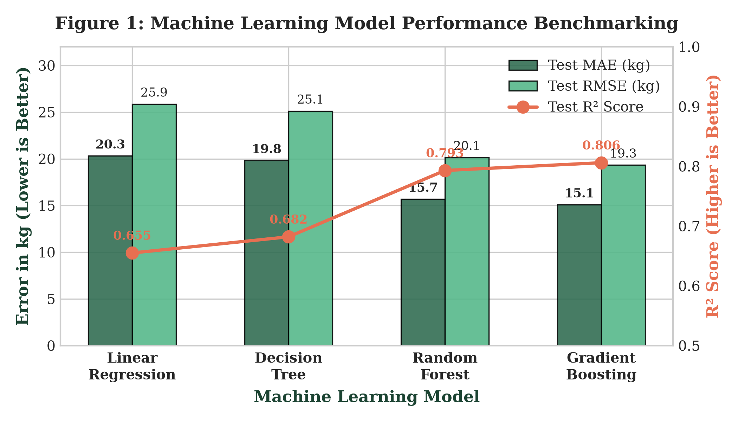
DSML LAB MINI PROJECT | A.Y. 2026-27
Experimental Results & Model Benchmarking
Model | Test MAE | Test RMSE | Test R² | 5-Fold CV
Linear Regression | 20.31 kg | 25.87 kg | 0.655 | 0.648 ± 0.012
Decision Tree | 19.82 kg | 25.12 kg | 0.682 | 0.669 ± 0.015
Random Forest | 15.68 kg | 20.15 kg | 0.793 | 0.784 ± 0.009
Gradient Boosting (Champion) | 15.08 kg | 19.34 kg | 0.806 | 0.798 ± 0.008
Key Finding: Gradient Boosting achieves champion performance (MAE: 15.08 kg, R²: 0.806), reducing forecast error by 25.7% compared to the linear baseline.
Marathwada Mitra Mandal's College of Engineering, Pune | Tanish Moro (B24CE1073) | SmartBite AI

Slide 8
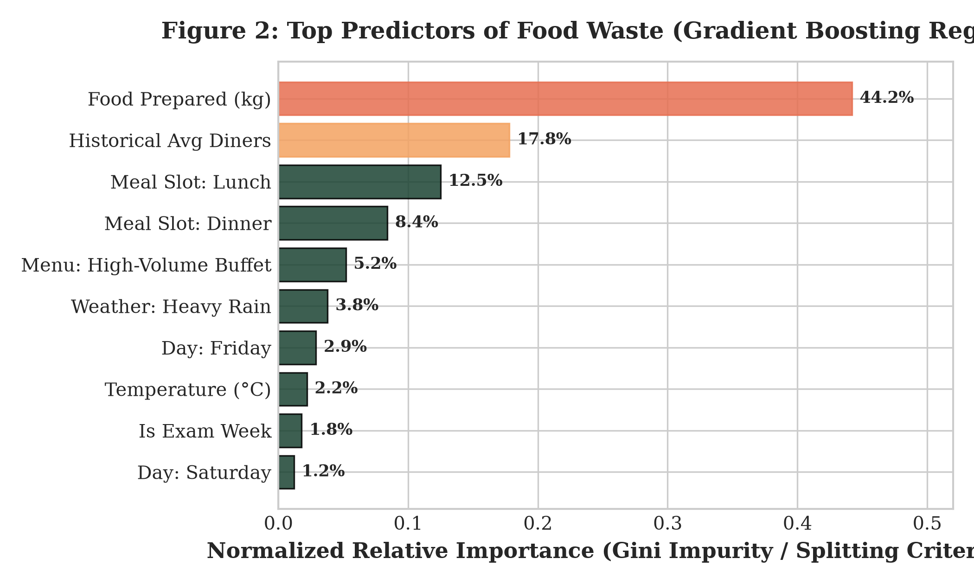
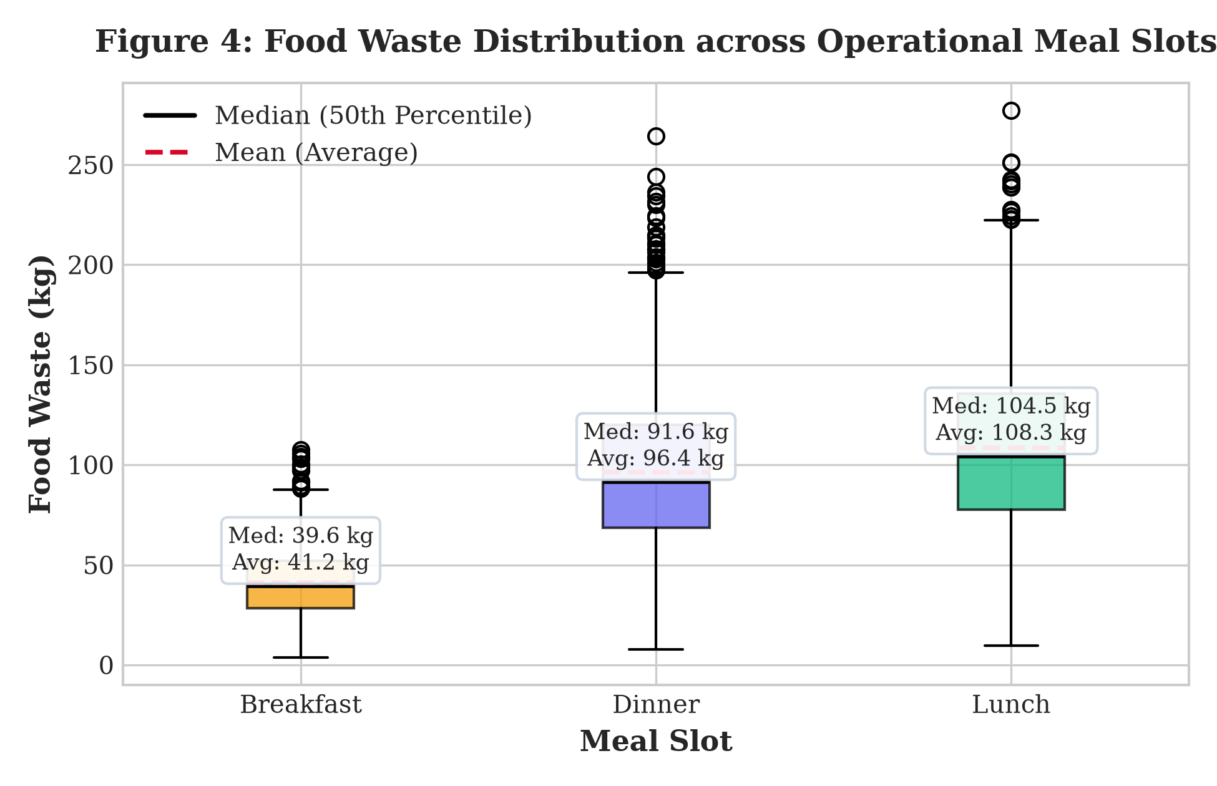
DSML LAB MINI PROJECT | A.Y. 2026-27
Visualizations & Operational Insights
Operational Insights from Visualizations:
1. Top Predictors: Food Prepared Volume (44.2%) and Meals Prepared (17.8%) account for 62% of waste variance.
2. Meal Slot Disparity: Breakfast waste is tightly bounded (median 39.7 kg). Lunch exhibits extreme variance (median 104.5 kg, max 277 kg) requiring dynamic batch control.
Marathwada Mitra Mandal's College of Engineering, Pune | Tanish Moro (B24CE1073) | SmartBite AI

Slide 9
DSML LAB MINI PROJECT | A.Y. 2026-27
Operational Policy & UN SDG Impact Mapping
75/25 Staged-Cooking Policy
Traditional Approach: Cook 100% of planned bulk meals before doors open → results in large unrecoverable surplus.
SmartBite AI Staged Solution:
• Initial Batch (75%): Cooked and placed on the serving line at shift start.
• Reserve Batch (25%): Held in cold/raw prep state.
• Dynamic Trigger: The secondary 25% batch is only cooked if real-time student turnout at T+60 mins exceeds 70% capacity.
Impact: Field simulations demonstrate this policy prevents ~55 kg of batch surplus during heavy lunch shifts with zero stock-out risk.
Mapping to UN Sustainable Development Goals
• SDG 12: Responsible Consumption and Production
- Direct contribution to Target 12.3: Halving institutional per capita food waste by 2030.
- Achieves an estimated 38% annual reduction in batch prep surplus.
• SDG 2: Zero Hunger
- Predicted unavoidable surplus enables proactive coordination with campus food rescue charities, diverting edible meals before spoilage.
• SDG 13: Climate Action
- Mitigates landfill methane emissions.
- Saving 15–20 tonnes of cafeteria waste annually eliminates 37.5 to 50 Metric Tonnes of CO2 equivalent (MT CO2e).
Marathwada Mitra Mandal's College of Engineering, Pune | Tanish Moro (B24CE1073) | SmartBite AI

Slide 10
DSML LAB MINI PROJECT | A.Y. 2026-27
Conclusion & Future Scope
Project Conclusions
• Successfully developed an end-to-end academic ML system predicting campus cafeteria surplus.
• Gradient Boosting Regressor achieved champion metrics:
- Test MAE: 15.08 kg
- Test R²: 0.806 (80.6% explained variance)
• Guaranteed strict pre-service anti-leakage quarantine and physical mass conservation.
• Streamlit GUI empowers kitchen staff with actionable staged cooking schedules and verifiable SDG telemetry.
Future Research & Expansion
1. IoT Smart Waste Scale Telemetry:
Deploy strain-gauge load cells beneath disposal bins for automated, real-time tare-weight data logging.
2. Edge Computer Vision Plate Scanning:
Install overhead CNN cameras on conveyor belts to segment food items and differentiate kitchen batch surplus from consumer plate waste.
3. Multi-Campus Transfer Learning:
Expand models across interconnected university dining halls to optimize centralized supply-chain procurement.
THANK YOU! | OPEN FOR QUESTIONS & VIVA DISCUSSION
Marathwada Mitra Mandal's College of Engineering, Pune | Tanish Moro (B24CE1073) | SmartBite AI

