Slide 1
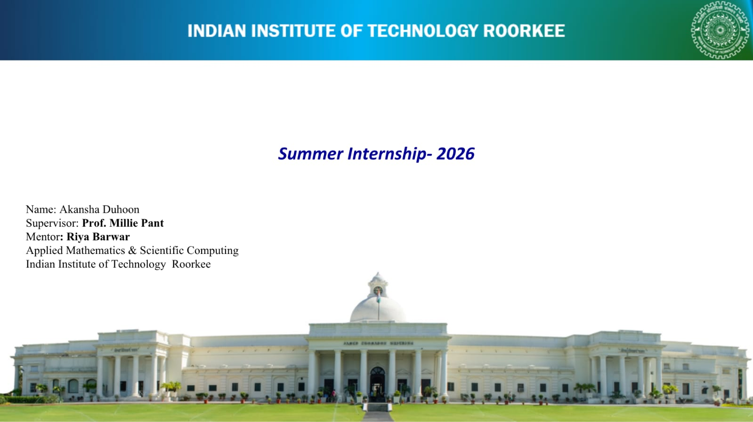
Machine Learning

Slide 2
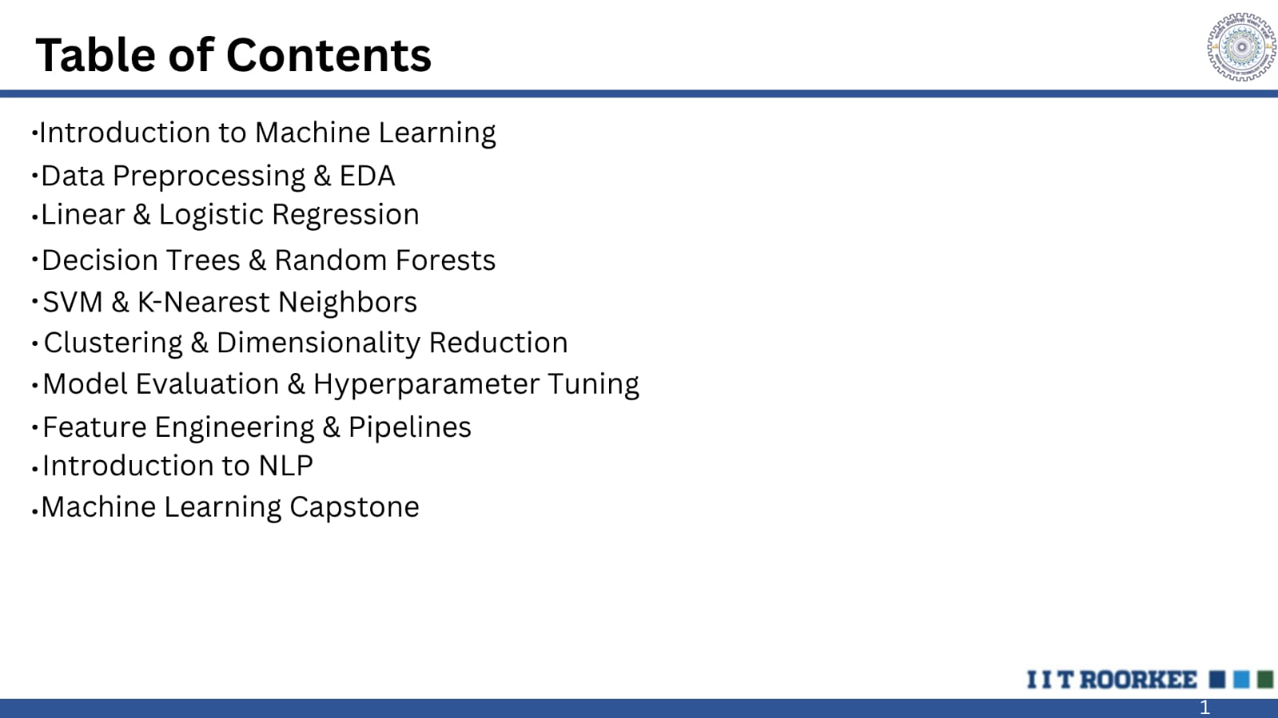

Slide 3
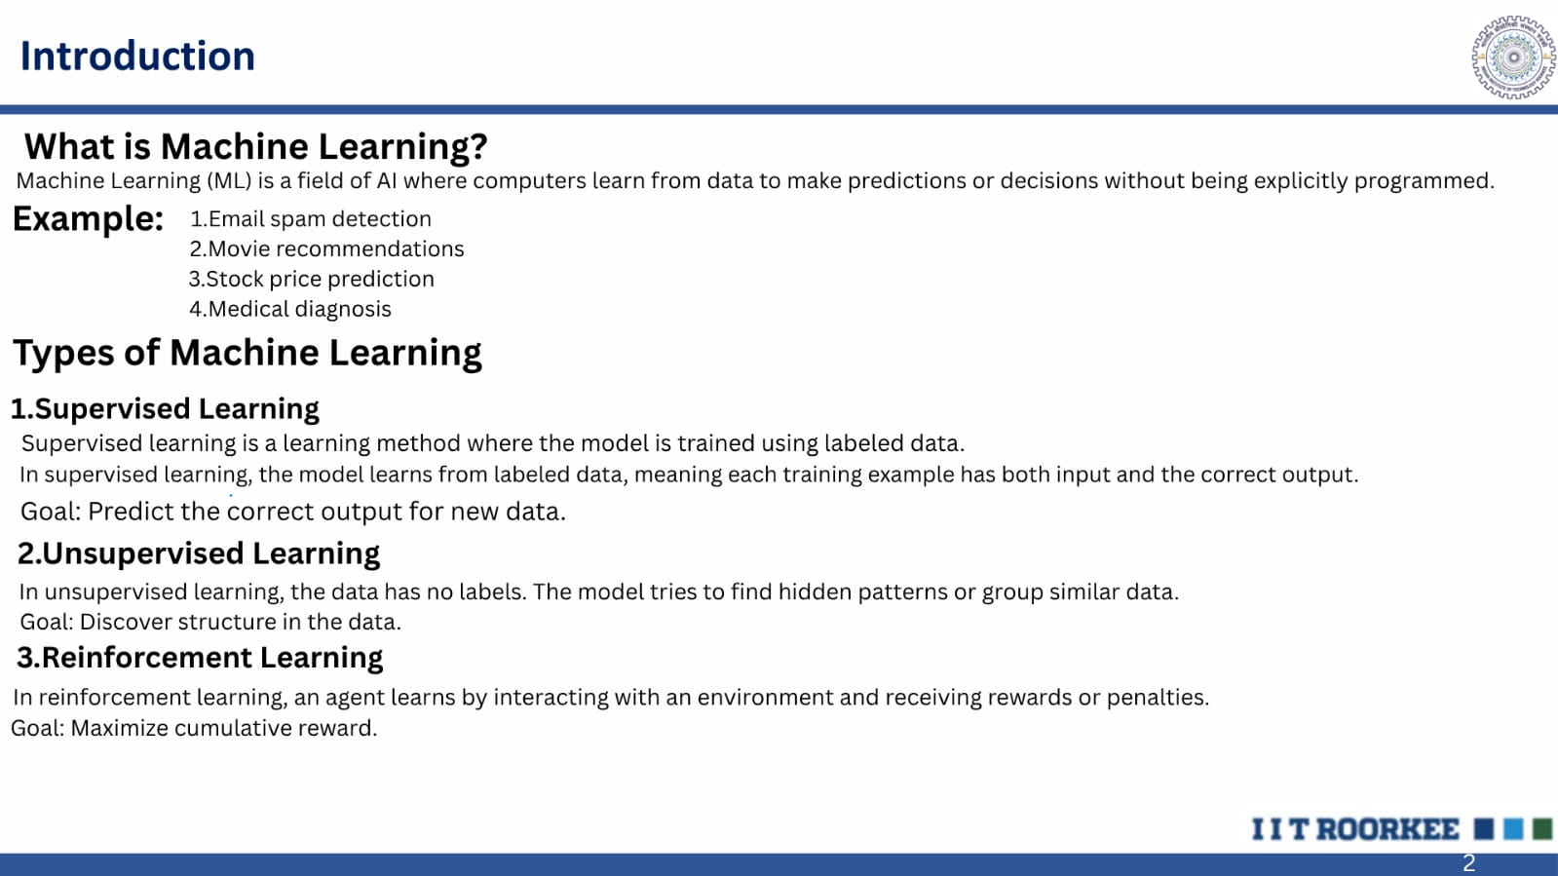

Slide 4
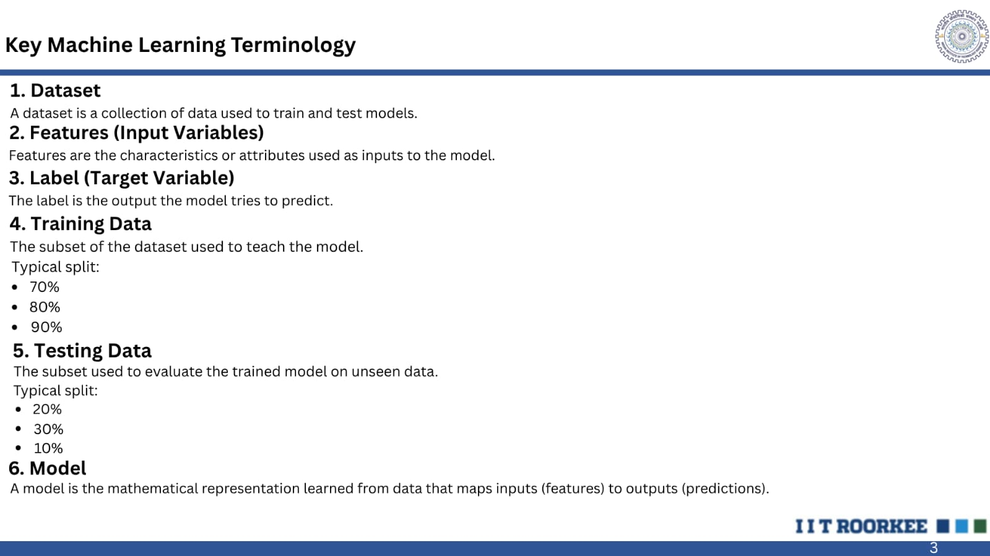

Slide 5
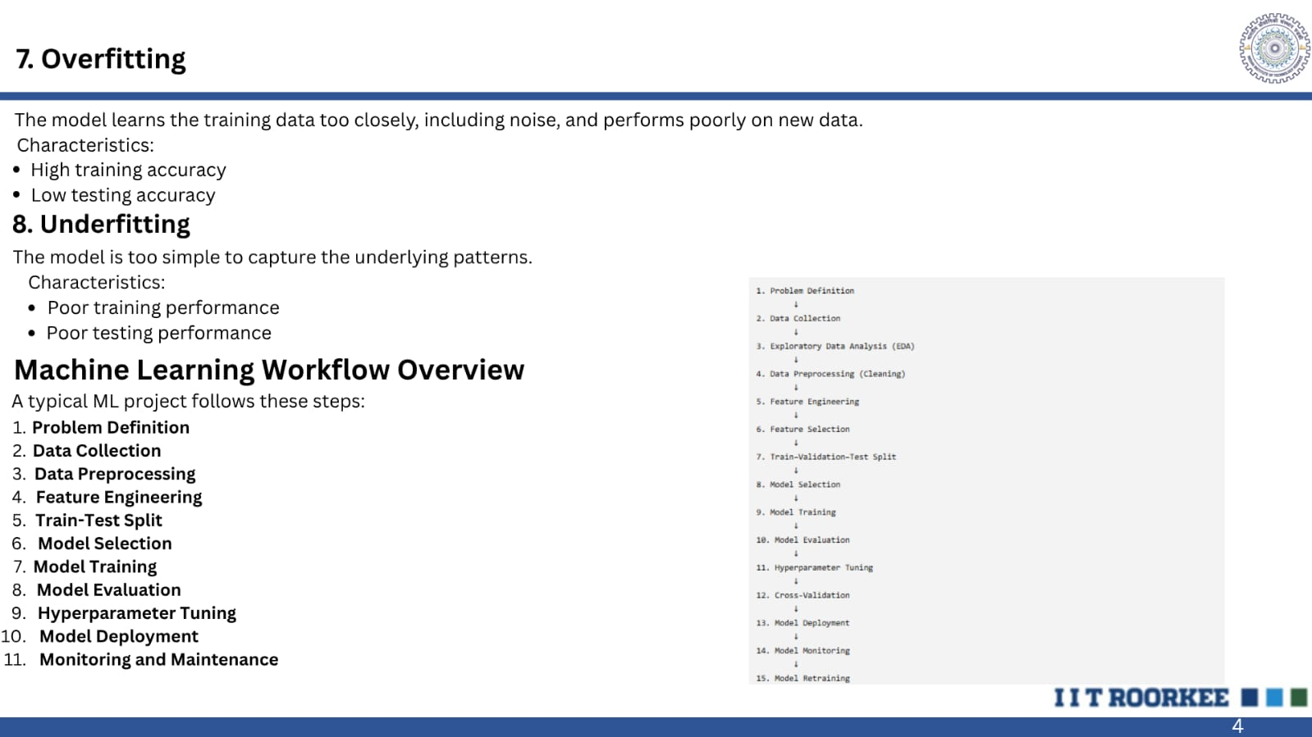

Slide 6
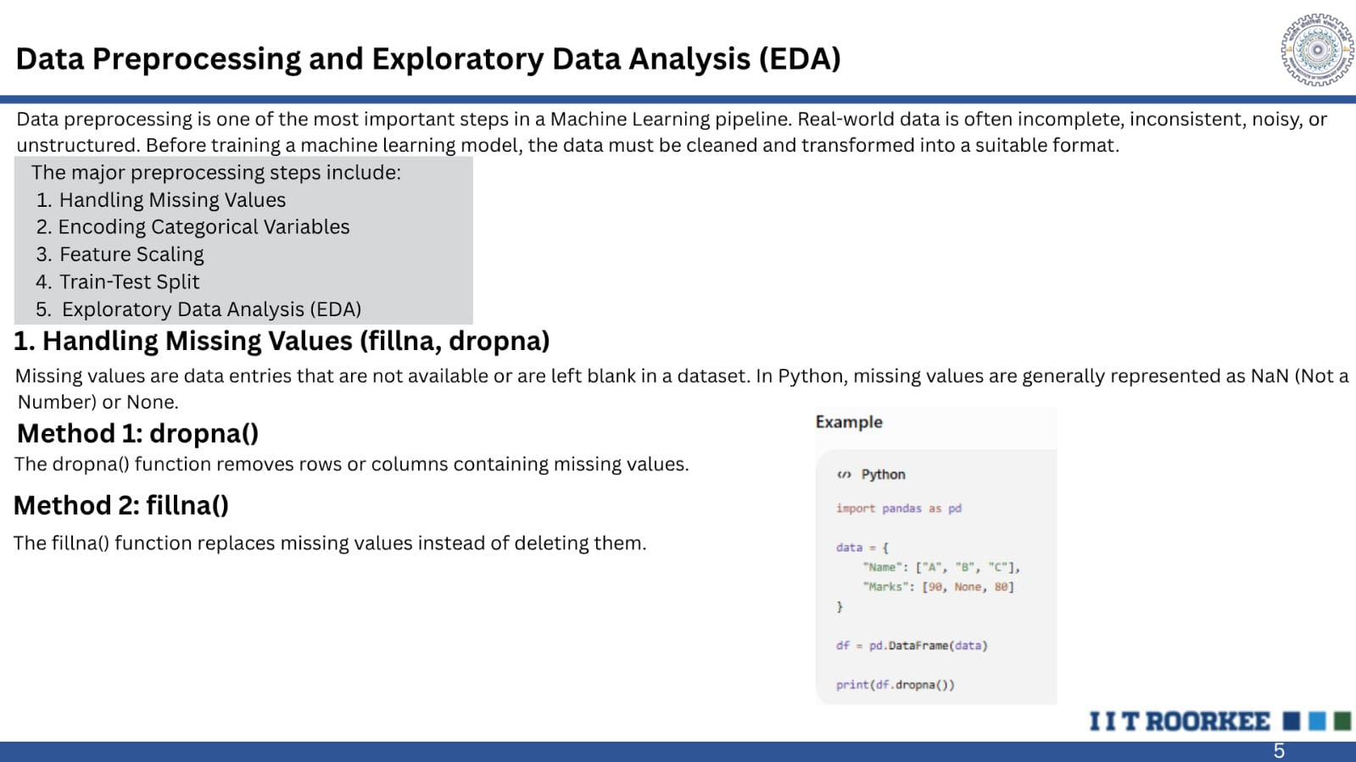

Slide 7
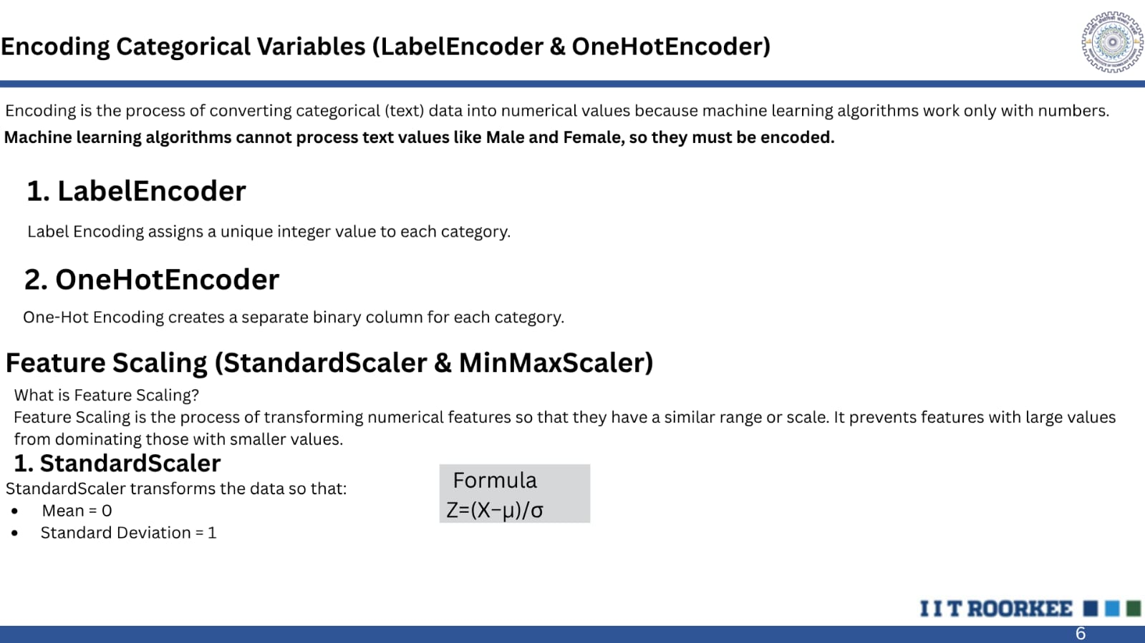

Slide 8
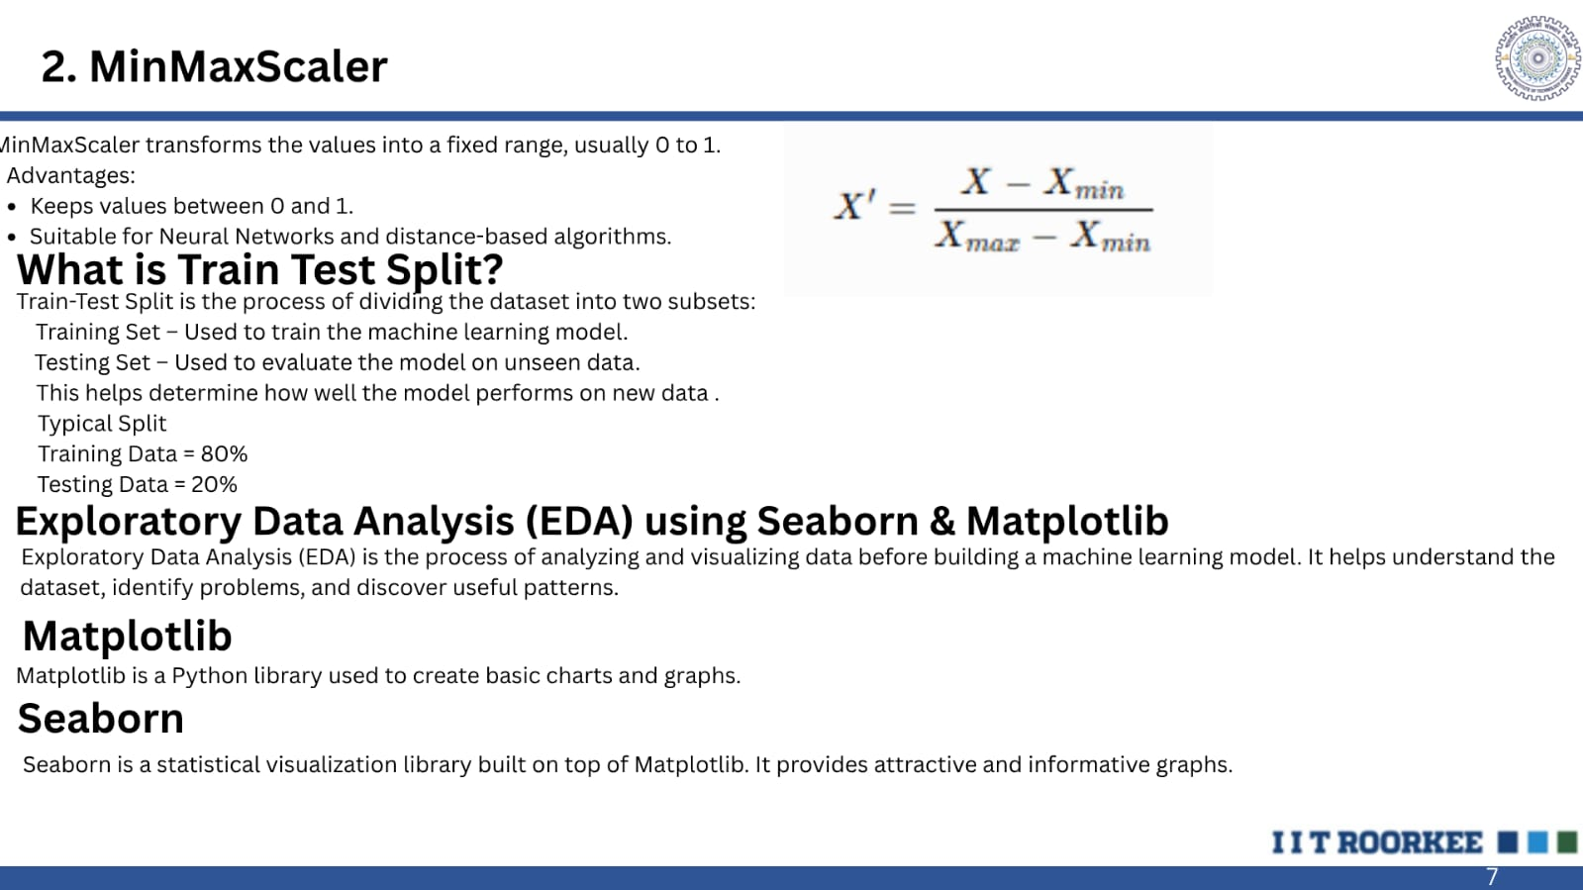

Slide 9
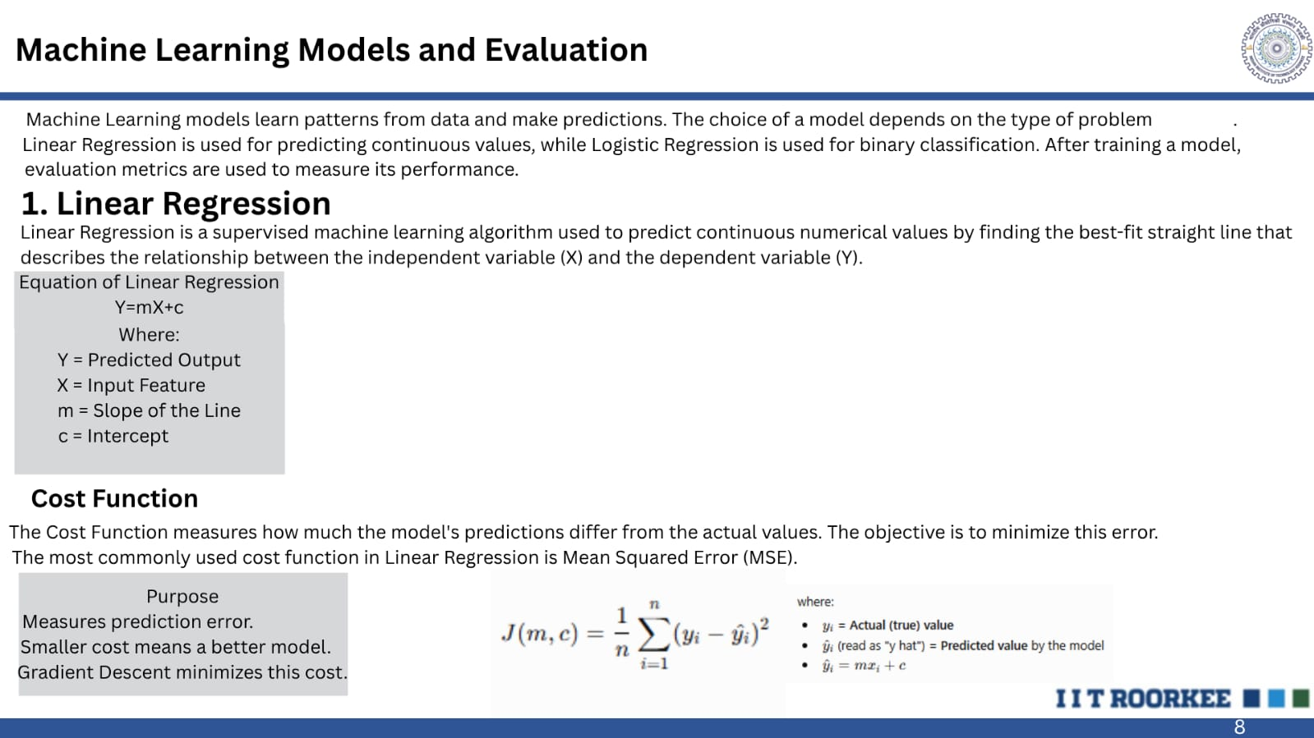

Slide 10
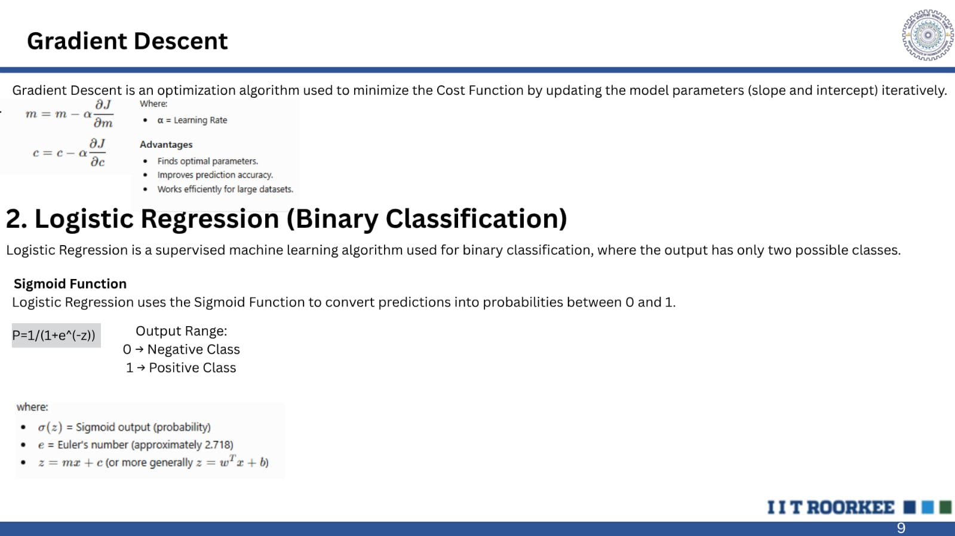

Slide 11
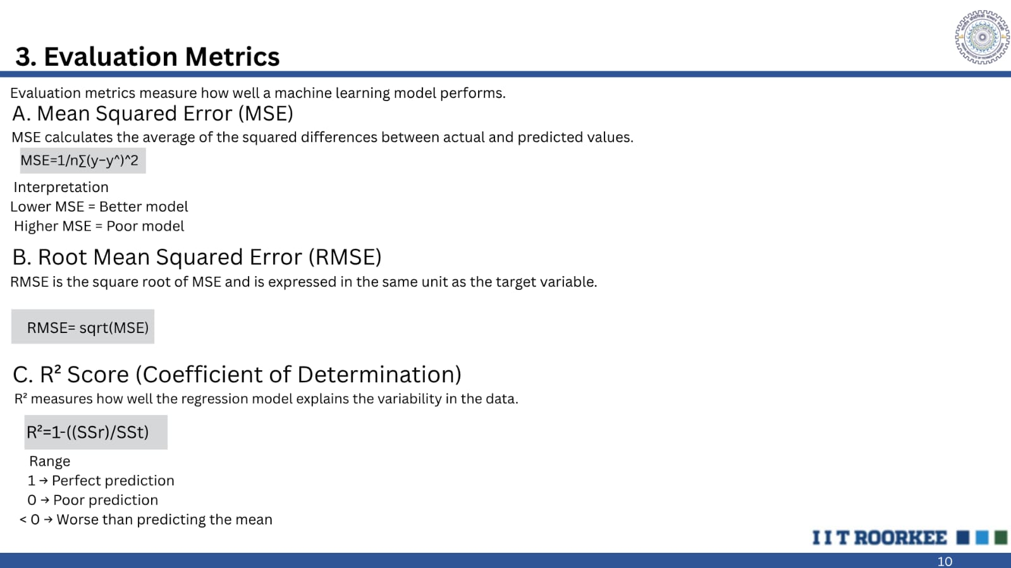

Slide 12
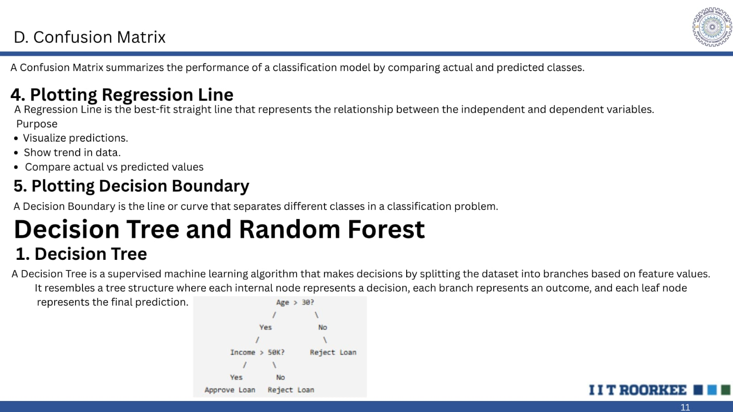

Slide 13
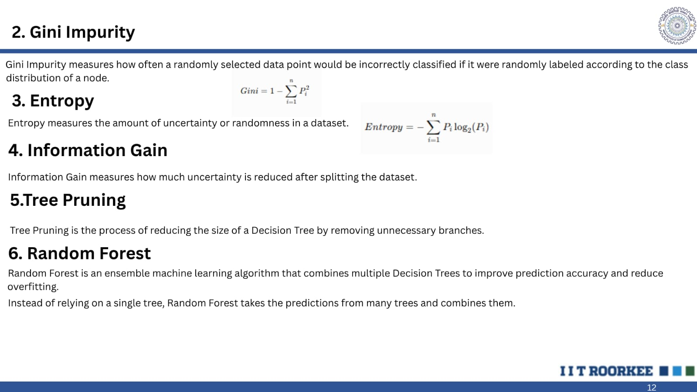

Slide 14
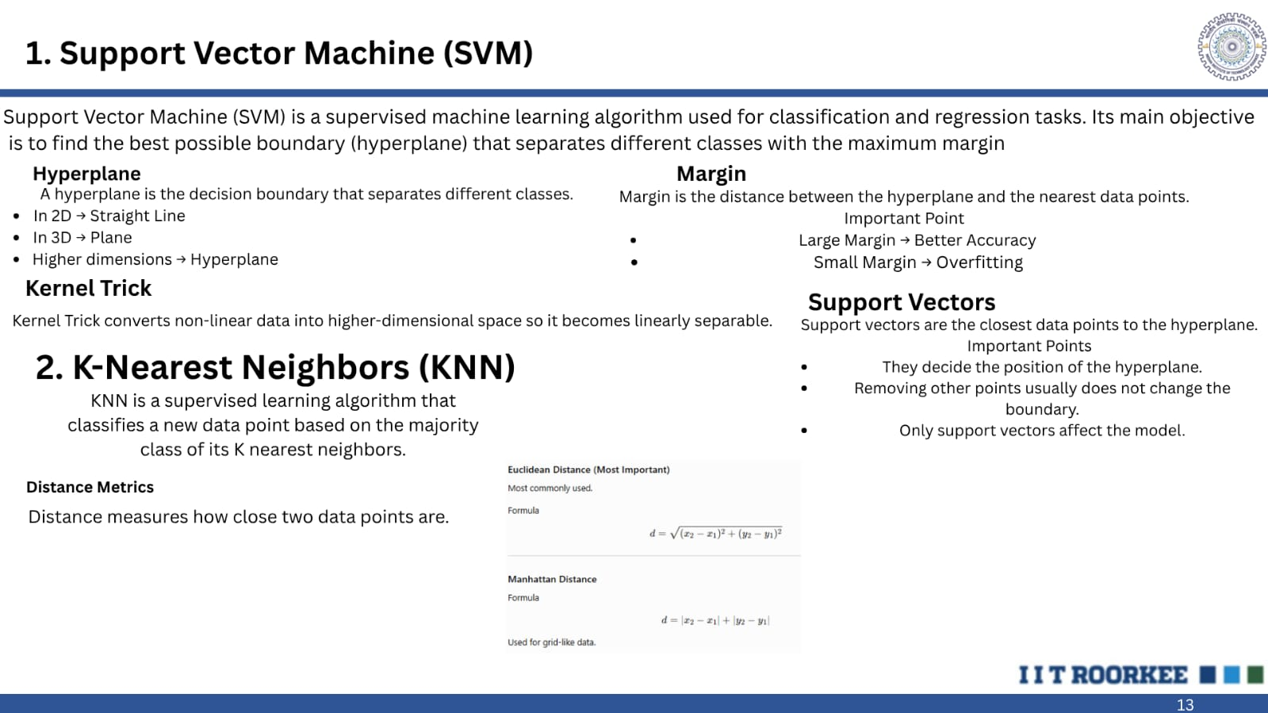

Slide 15
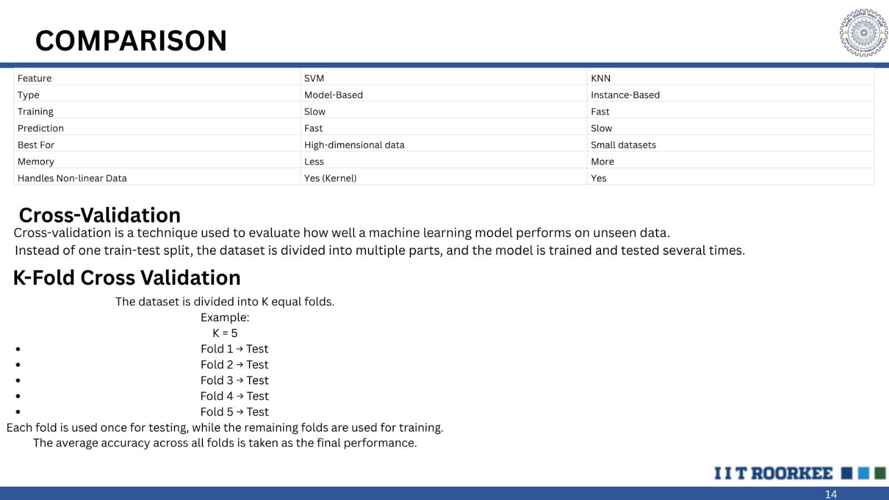

Slide 16
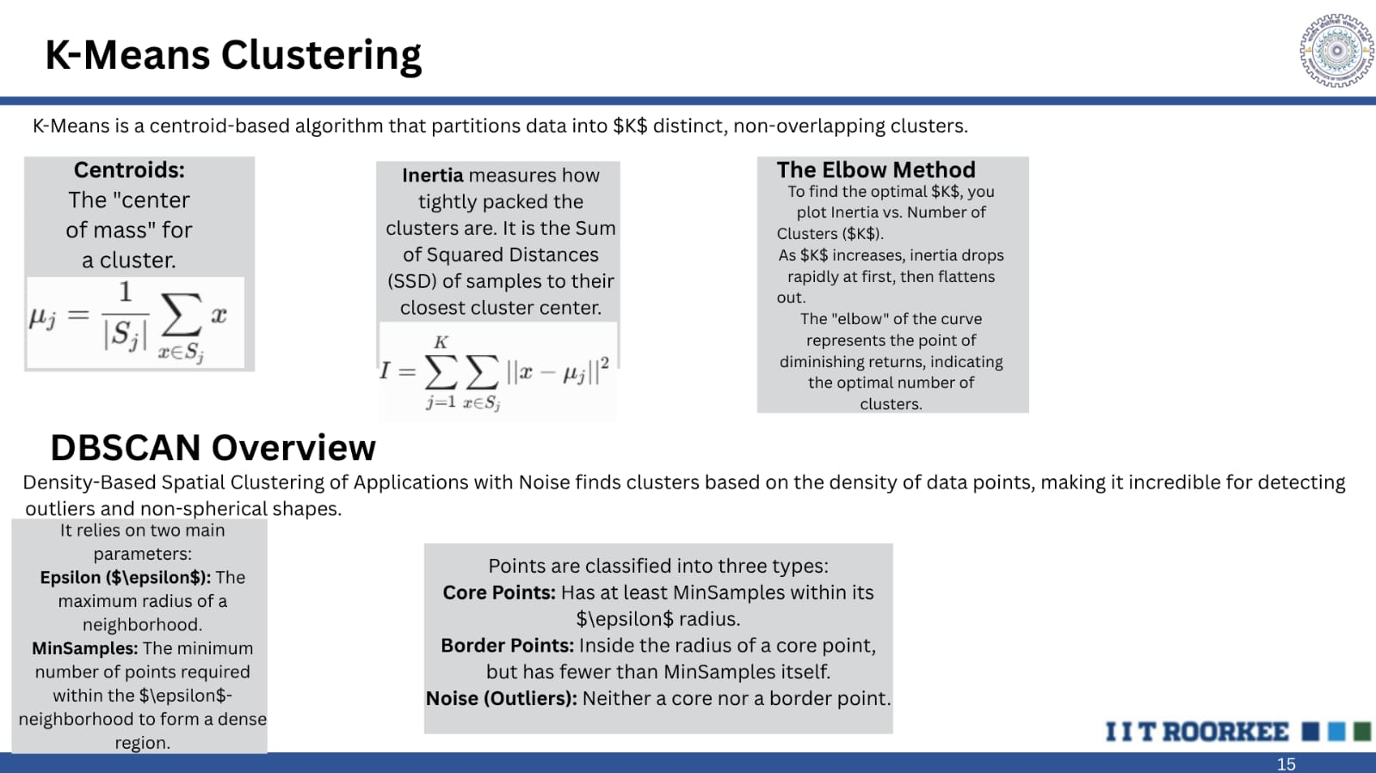

Slide 17
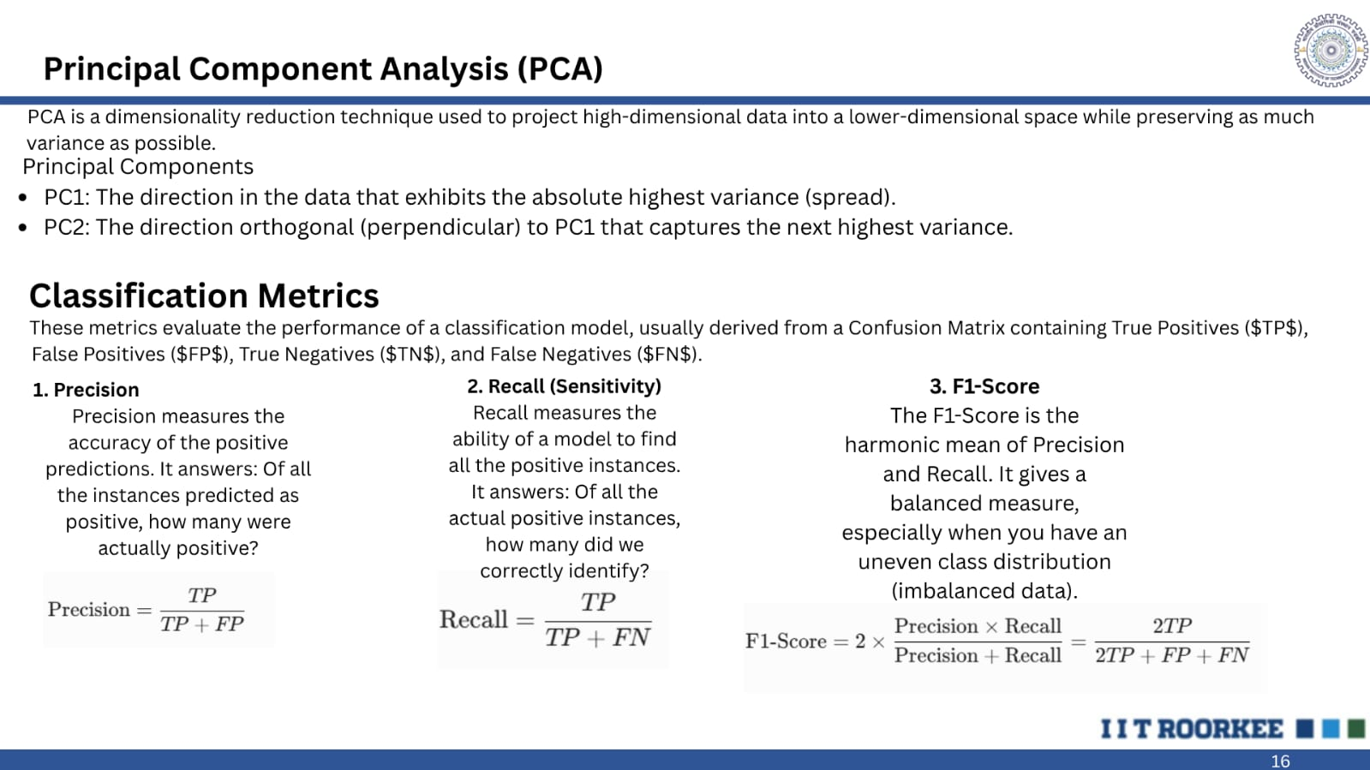

Slide 18
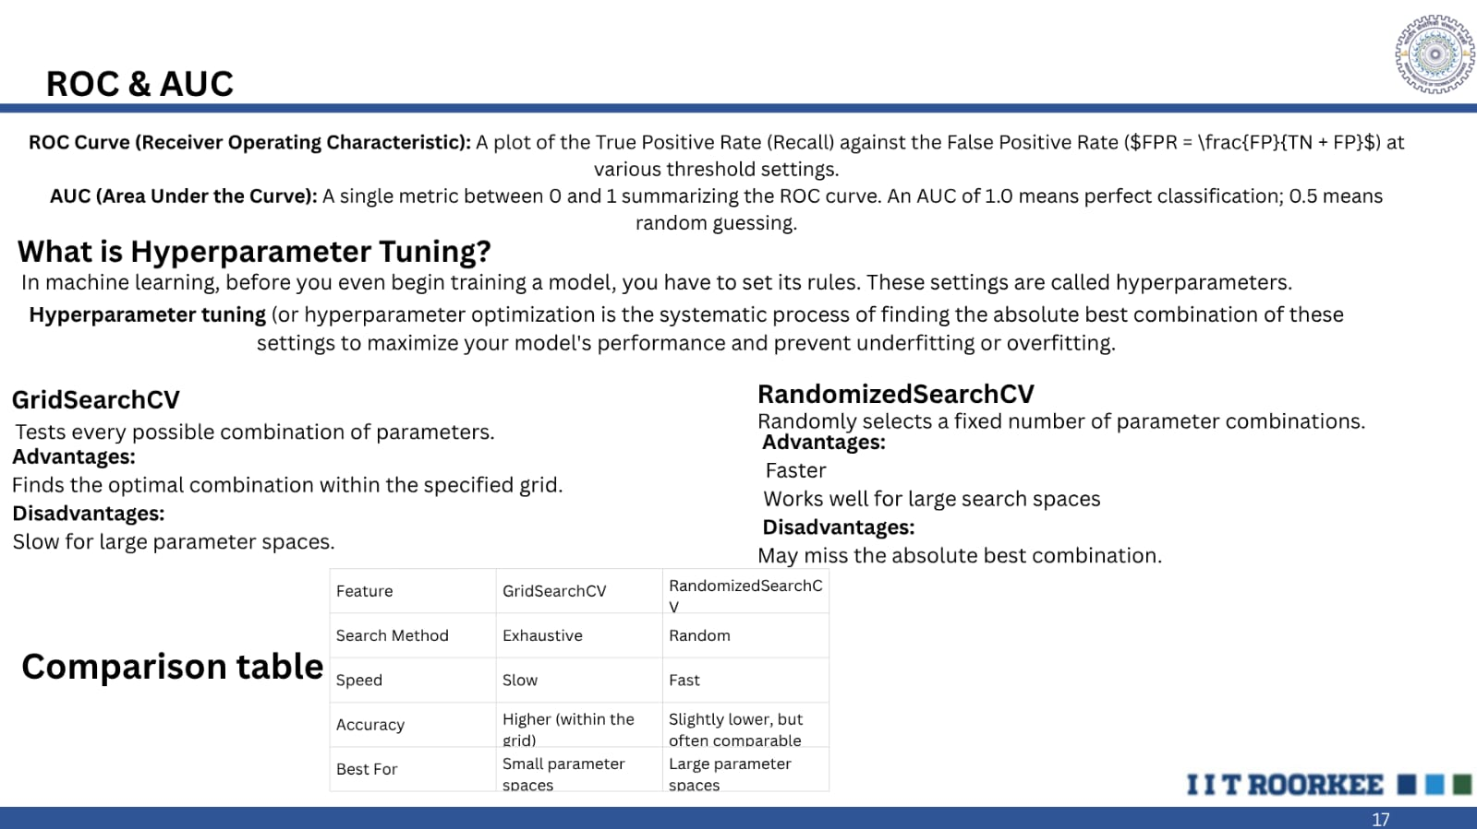

Slide 19
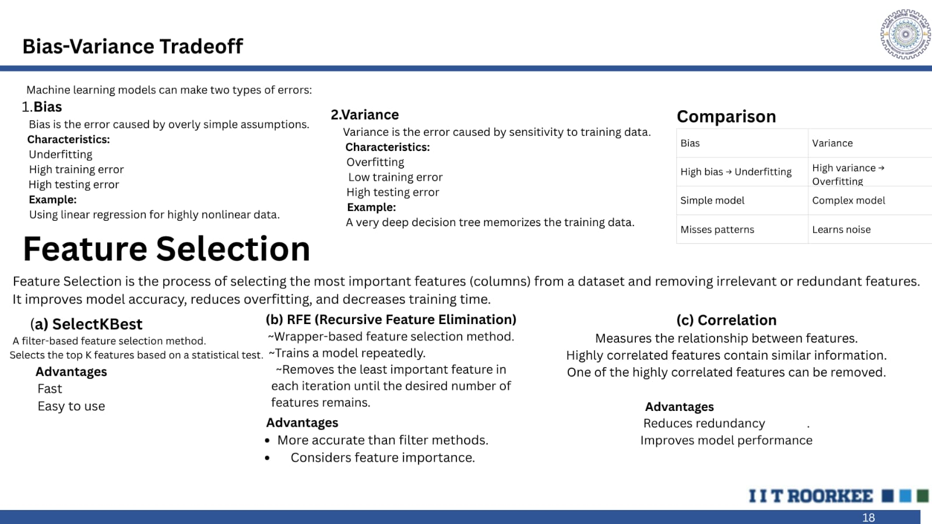

Slide 20
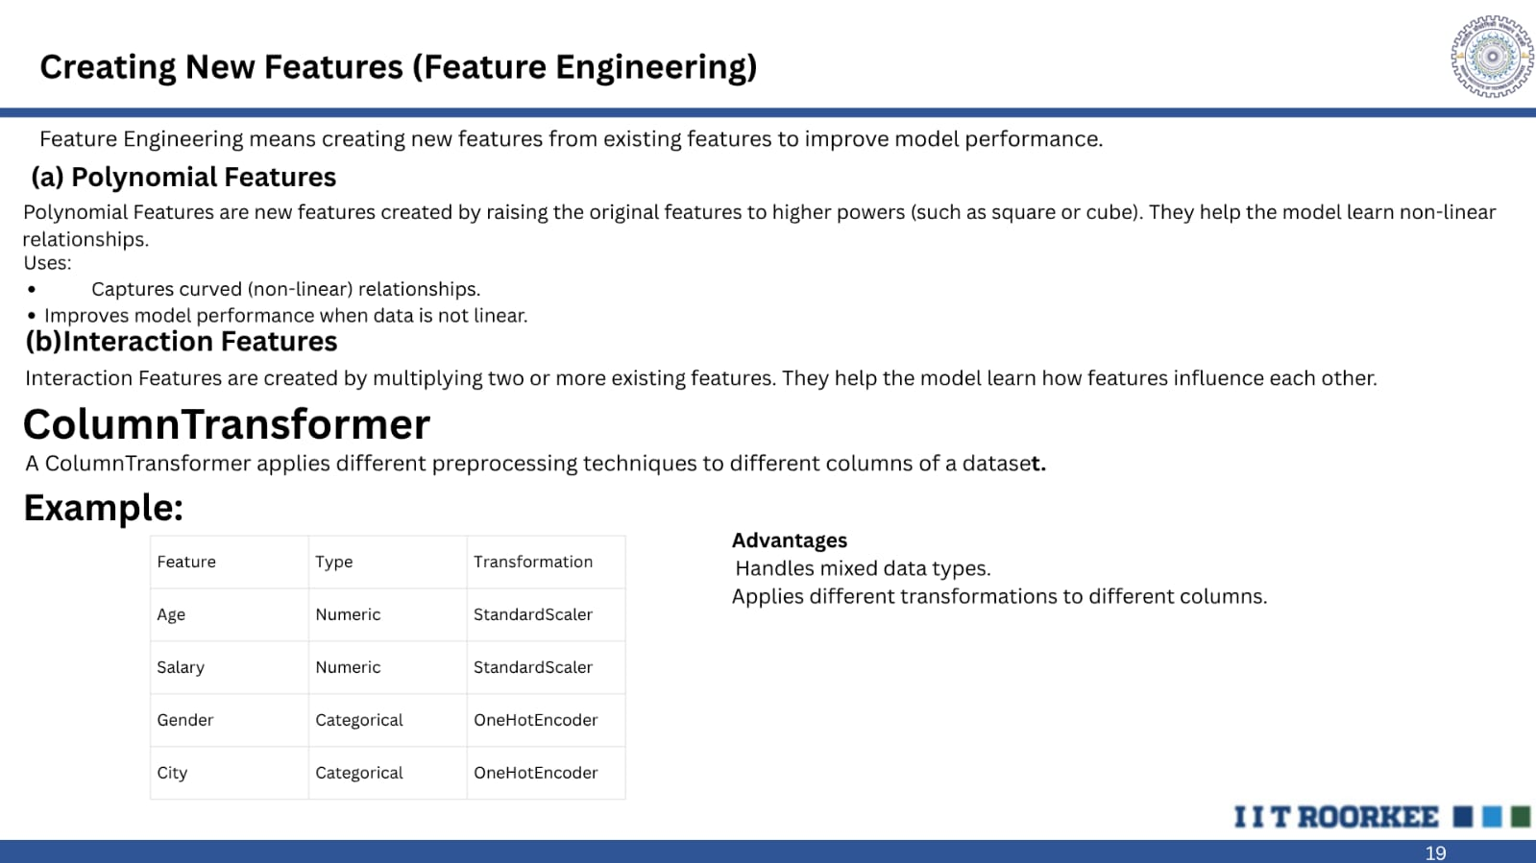

Slide 21
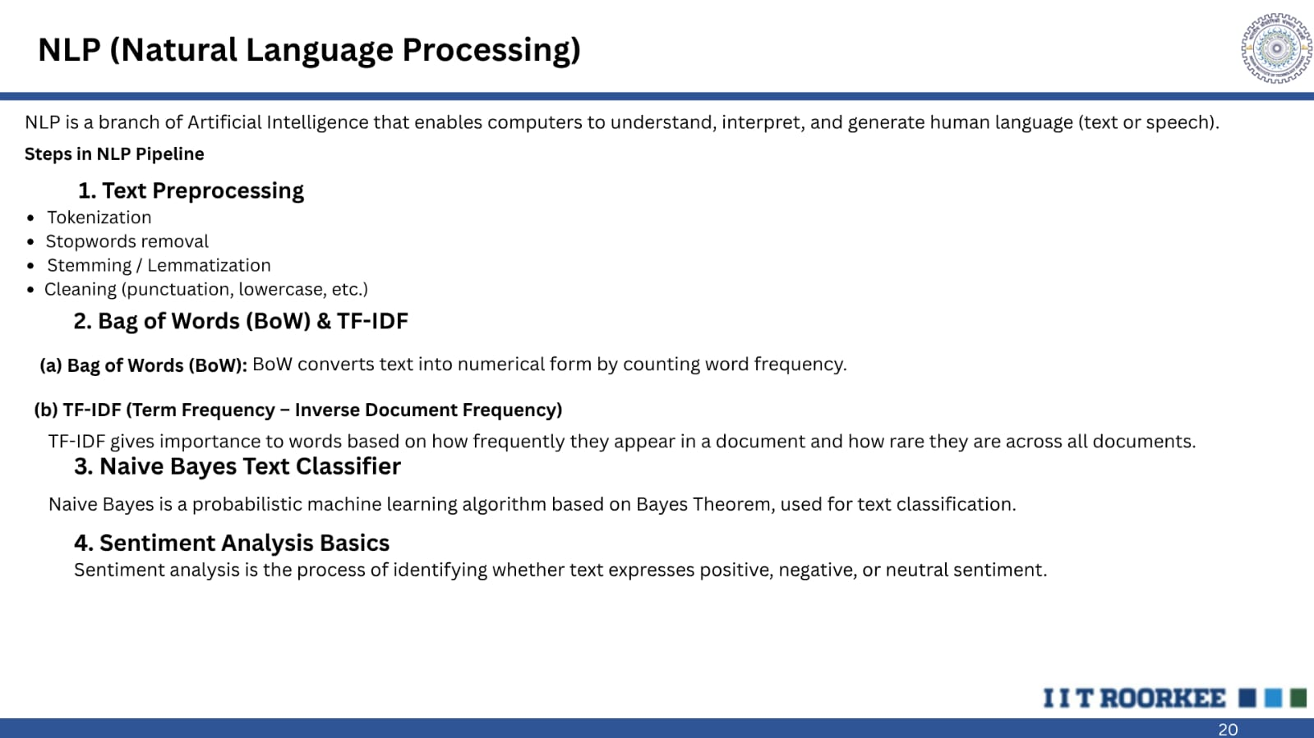

Slide 22

References
• Google ML Crash Course — https://developers.google.com/machine-learning/crash-course
• Scikit-learn Getting Started — https://scikit-learn.org/stable/getting_started.html
• Kaggle – Data Cleaning — https://www.kaggle.com/learn/data-cleaning
• StatQuest – Linear Regression — https://www.youtube.com/watch?v=nk2CQITm_eo
•
Scikit-learn Tree Docs — https://scikit-learn.org/stable/modules/tree.html
• Kaggle – NLP Getting Started — https://www.kaggle.com/competitions/nlp-getting-started

