Slide 1

Data Preprocessing In Machine Learning
Summer Internship- 2026
Name: Akansha Duhoon
Supervisor: Prof. Millie Pant
Mentor: Ms. Riya Applied Mathematics & Scientific Computing
Indian Institute of Technology Roorkee

Slide 2


Contents
Introduction
Need For Data Preprocessing
Handling Missing Values
Encoding
Feature Scaling
Handling Outliers
Application
References

Slide 3
Introduction
What is Data Preprocessing?
Data preprocessing is the process of transforming raw data into a clean and meaningful format before training a machine learning model.
Real-world data usually contains:
Missing values
Duplicate records
Different scales
Incorrect formats
Categorical values
Outliers
Noise
Example
Area | Bedrooms | Price
1500 | 3 | 50 Lakh
NaN | 2 | 35 Lakh
2000 | 4 | 70 Lakh
1800 | NaN | 60 Lakh
Problems:
Missing Area
Missing Bedrooms
We must preprocess the data before training.

Slide 4
IMPORTANCE OF DATA PREPROCESSING
Improves accuracy of machine learning models
Handles missing and inconsistent data
Reduces noise and redundancy
Converts raw data into usable format for algorithms
Enhances model performance and reliability
MACHINE LEARNING PIPELINE
Raw Data → Data Cleaning → Feature Engineering → Model Training → Prediction
Feature
Engineering
Raw Data
Data Cleaning
Model Training
Prediction
A machine learning pipeline makes the process automated, organized, reproducible, and efficient from raw data to final prediction.

Slide 5


COMMON ISSUES IN RAW DATA
Missing values
Categorical variables
Outliers
Different feature scales
Noisy and inconsistent data
Missing Values
When datasets have missing fields (represented as NaN or None), you generally have two choices: delete them or fill them.
dropna() (Deletion)
This approach removes entire rows or columns that contain missing data.
Use it when:
The missing values are very rare (e.g., less than 2% to 5% of your dataset).
You are missing the column you are trying to predict. You can't safely guess the answer!

Slide 6
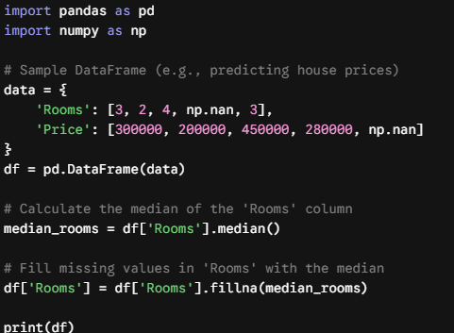
Fillna(Imputation)
Filling (also called imputation) means you replace the NaN values with a smart substitute.
Use it When
You have a smaller dataset and cannot afford to lose any rows.
The column has a clear statistical pattern.
Common Strategies:
Median: Best for numerical columns that have extreme outliers (e.g., Salary, House Prices).
Mean: Best for normally distributed numerical columns without wild outliers (e.g., Human Heights).
Use it when:
Mode (Most Frequent): Best for categorical text columns (e.g., City, Color).

Slide 7
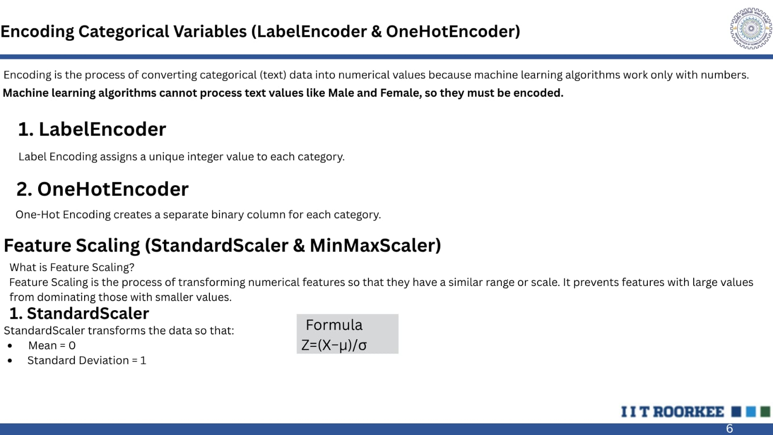
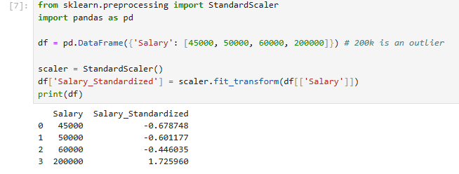

Slide 8
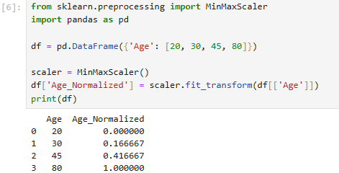

MinMaxScaler (Normalization)
Normalization shrinks and bounds your data so that every single value falls strictly within a specified range, almost always between 0 and 1.

Slide 9
Application
CustomerID | Age | City | Annual_Spend ($) | Membership_Tier | Churned? (Target)
101 | 25 | New York | 45000 | Bronze | No
102 | 47 | London | 85000 | Gold | Yes
103 | NaN | Paris | 62000 | Silver | No
104 | 31 | London | NaN | Bronze | Yes
105 | 22 | New York | 120000 | Gold | NaN
106 | 58 | NaN | 95000 | Silver | No
107 | 35 | Paris | 2100000 (Outlier!) | Gold | No
Here,this is the Dataset which contains missing values,categorical text etc.

Slide 10
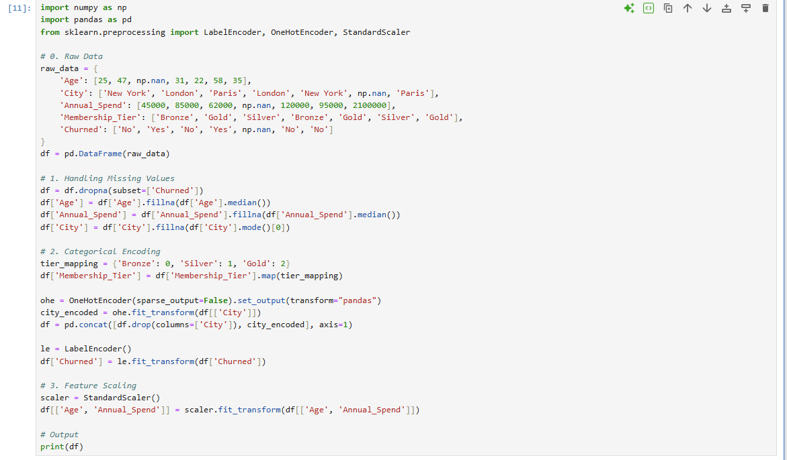
Application

Slide 11
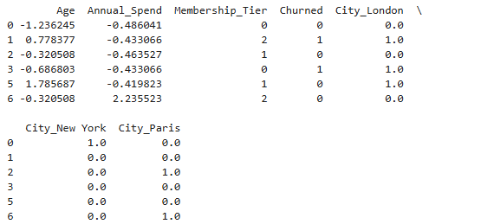
Output

Slide 12
References
• Kaggle – Data Cleaning — https://www.kaggle.com/learn/data-cleaning
• Scikit-Learn Official Guide: Data Preprocessing Documentation
• GeeksforGeeks: Data Preprocessing in Machine Learning using Python

