Slide 1
Sentiment Analysis of Amazon Reviews Using R

Slide 2
R - A Brief Introduction
R is a language for statistical computing and graphics.
It provides a wide variety of statistical (linear and nonlinear modelling, classical statistical tests, time-series analysis, classification, clustering, and much more.
It ranks 13 on the TIOBE index (Feb 2018).

Slide 3
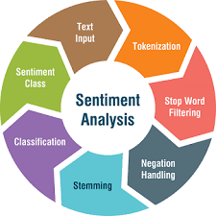
Problem Statement
P.S : Sentiment analysis of product reviews on Amazon. Analysis should categorise whether the user is happy, sad or neutral with his purchase.

Slide 4
Approach
Unigram.
Ngram.
Machine Learning.

Slide 5
Demo Flow
Scrape Product Reviews from a URL inputted in a UI.
Create Test Set by using Ratings as a metric.
Classify review into positive, negative or neutral using ngram.
Render actual vs expected results in the UI.
END.
START.

Slide 6
Key Takeaways
Learnt about R and Natural Language Processing.
Learnt about the Sentiment analysis process.
Tried different approaches to sentiment analysis.

