Slide 1
AI DELIVERY RISK ASSISTANT
Grounded delivery risk auditing — not another status summarizer.
Green on the outside. Red on the inside.
Project 3 | Akansha Verma

Slide 2
Why this problem stays invisible today
Why existing approaches miss it
The “watermelon” status report
1
Jira / Linear dashboards
Systems of record. Show what was entered — not whether it's still true, and never cross-reference against a transcript or postmortem.
Status:
GREEN
“On track — no blockers to flag.”
2
Generic LLM chat
A weekly status report says the project is on track.
Paste documents, get a summary. No structural guarantee against fabricating a claim or blending unrelated context.
A ticket export shows a critical dependency blocked for 9 days.
A standup transcript has an engineer saying they don't expect to hit the deadline.
3
Manual PM synthesis
All of that information already exists — nobody has connected it.
The actual status quo. Reading everything by hand, with no structural check for contradictions.

Slide 3
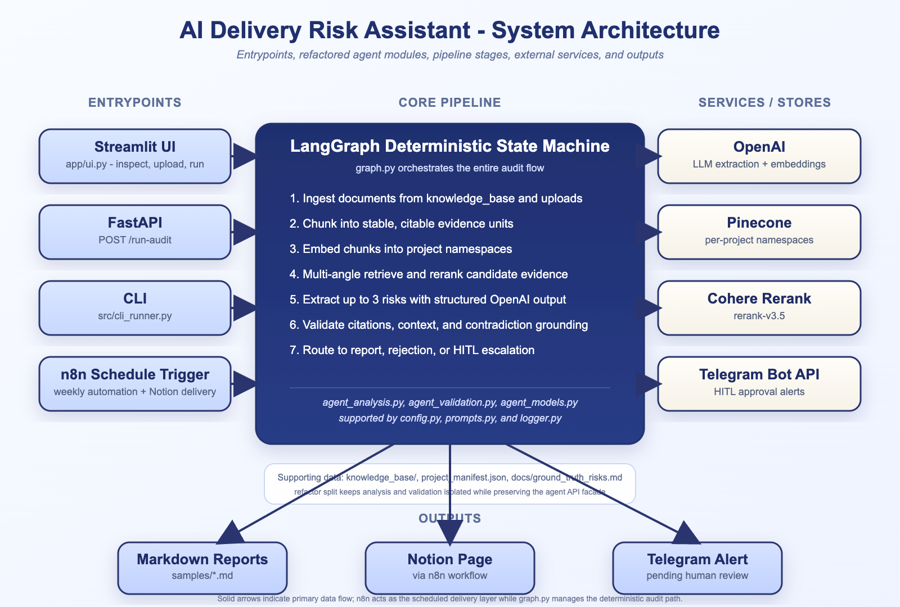
How: three non-negotiable design principles
1
Citation-or-reject grounding
2
Context-consistency guardrail
3
Deterministic escalation, human approval
Every risk traces to a real cited chunk, enforced in code. Unsupported claims are rejected before reporting.
Two individually-true facts from different projects can't be stitched into one risk. Cross-project contamination is rejected.
SEV-1 findings and status contradictions are never auto-published — a rule-based decision tree routes them to a human via Telegram.
System architecture

Slide 4
Evaluated against a planted ground-truth answer key
Not just “does it run” — does it surface the right risks, citing the right evidence.
Correctly triggered human escalation
Under-citation found, root-caused, fixed
Zero hallucinated risks
On the single hardest planted case — a contradiction requiring evidence from 4 separate documents.
Initially cited 2 of 4 sources. A prompt edit alone had no effect — evidence inspection proved the model had all 4 and chose not to cite them. Fixed with a deterministic ticket-ID guardrail; now cites 4, verified against a real re-run.
Across both negative controls: a resolved issue and a fabricated budget/vendor scenario — neither appeared.

Slide 5



Where this goes next
Sprint 1 — Pilot Validation
Sprint 2 — Slack & Jira Native
Sprint 3 — Portfolio Dashboard
1–2 engineering managers
Eng managers, tech leads, VP Eng
CTO, VP Delivery, Eng Ops Director
Buyer
Buyer
Buyer
Success metric
Success metric
Success metric
Manual synthesis time reduced; ≥1 risk caught early
40% weekly active usage; <5 min onboarding
3 paid pilot conversions; 25% less scope creep
Not “can AI summarize project information?”
It's: “How do we safely use AI to improve operational decisions —
without treating the AI itself as the source of truth?”
Thank you — questions welcome

