Slide 1

Seasonal Agriculture Performance Analysis
Student Name:-Akansha Dnyanoba Adhalkar
College Name:- Matsyodari Shikshan Sanstha's
College of Engineering and Technology, Jalna.
AICTE STU ID :- STU6a60e081616c91784733825

Slide 2

PROBLEM STATEMENT
Agricultural activities are influenced by seasonal variations in environmental conditions, farming practices, resource availability and market conditions. As a result, agricultural performance may differ from one season to another. However, raw agricultural data does not clearly explain how agricultural performance changes across seasons or what patterns can be observed in different seasonal conditions. The problem is to analyze the given agricultural dataset and investigate seasonal differences in agricultural performance by identifying meaningful patterns, trends, relationships and variations within the available data.

Slide 3
Project Description
Analyzed a dataset containing 4,000 agricultural records and 28 variables.
Studied agricultural performance across different crops, seasons and farming conditions.
Cleaned the dataset by handling missing values and duplicate records.
Performed statistical and descriptive analysis of important variables.
Used univariate, bivariate and multivariate analysis to identify patterns.
Analyzed relationships between environmental factors and crop yield.
Compared yield, production and profit across different seasons.
Analyzed water efficiency for different irrigation methods.
Compared the average yield of different crops.
Used graphs and correlation analysis to present findings clearly.
Identified important agricultural patterns and unusual outcomes.
Provided data-driven recommendations for better seasonal planning and resource utilization

Slide 4

WHO ARE THE END USERS?
Farmers – for better crop and seasonal planning.
Agricultural Planners – for analyzing crop performance and resource usage.
Government Agricultural Departments – for data-driven agricultural planning.
Agricultural Researchers – for studying seasonal and crop-wise patterns.
Farming Organizations – for improving resource utilization and profitability.

Slide 5

Technology Used
Python – Main programming language
Google Colab – Development and analysis platform
Pandas – Data cleaning and analysis
NumPy – Numerical operations
Matplotlib – Data visualization
Seaborn – Statistical graphs and visualizations
CSV Dataset – Source of agricultural data

Slide 6
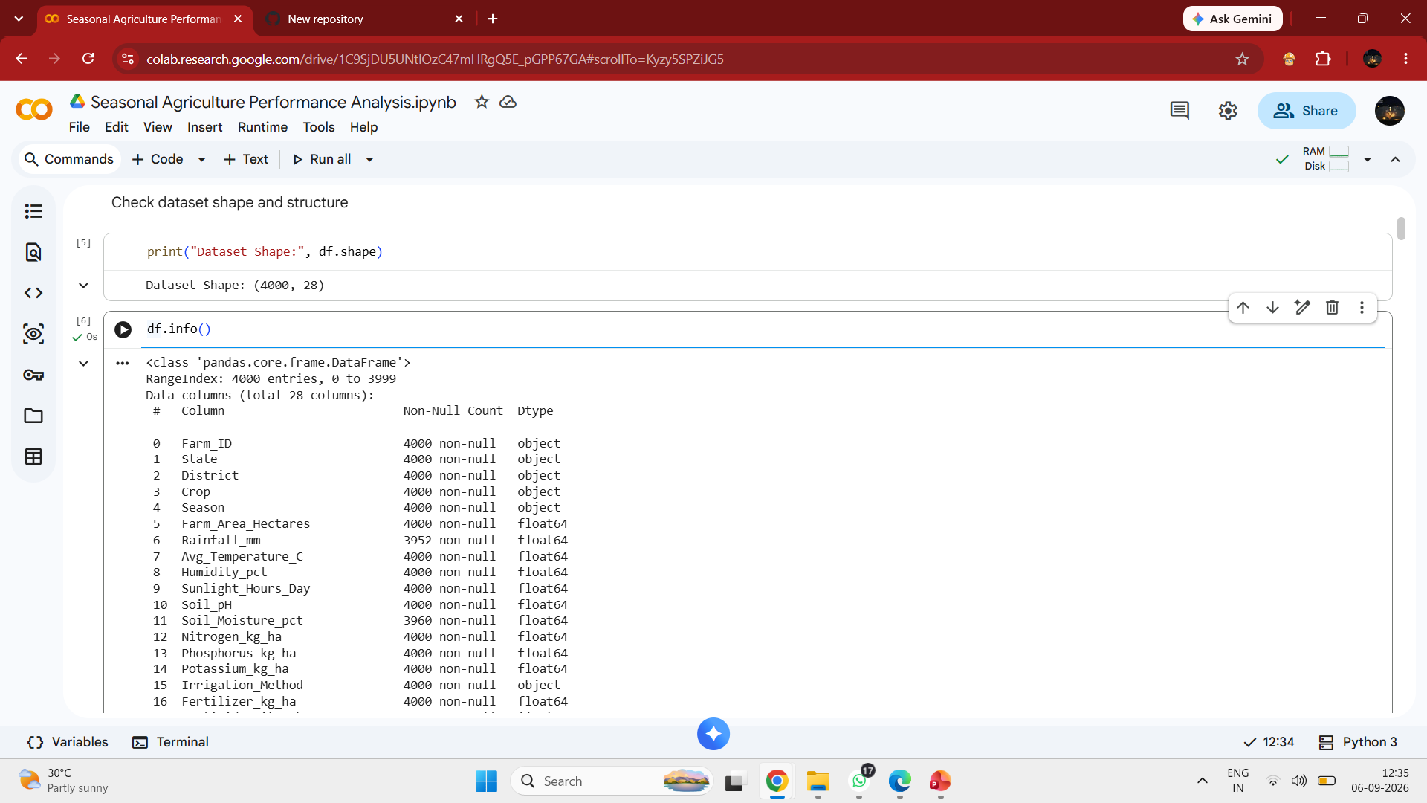
RESULTS
Dataset Overview
Screenshot showing df.shape / df.info()
Shows 4,000 records and 28 columns

Slide 7
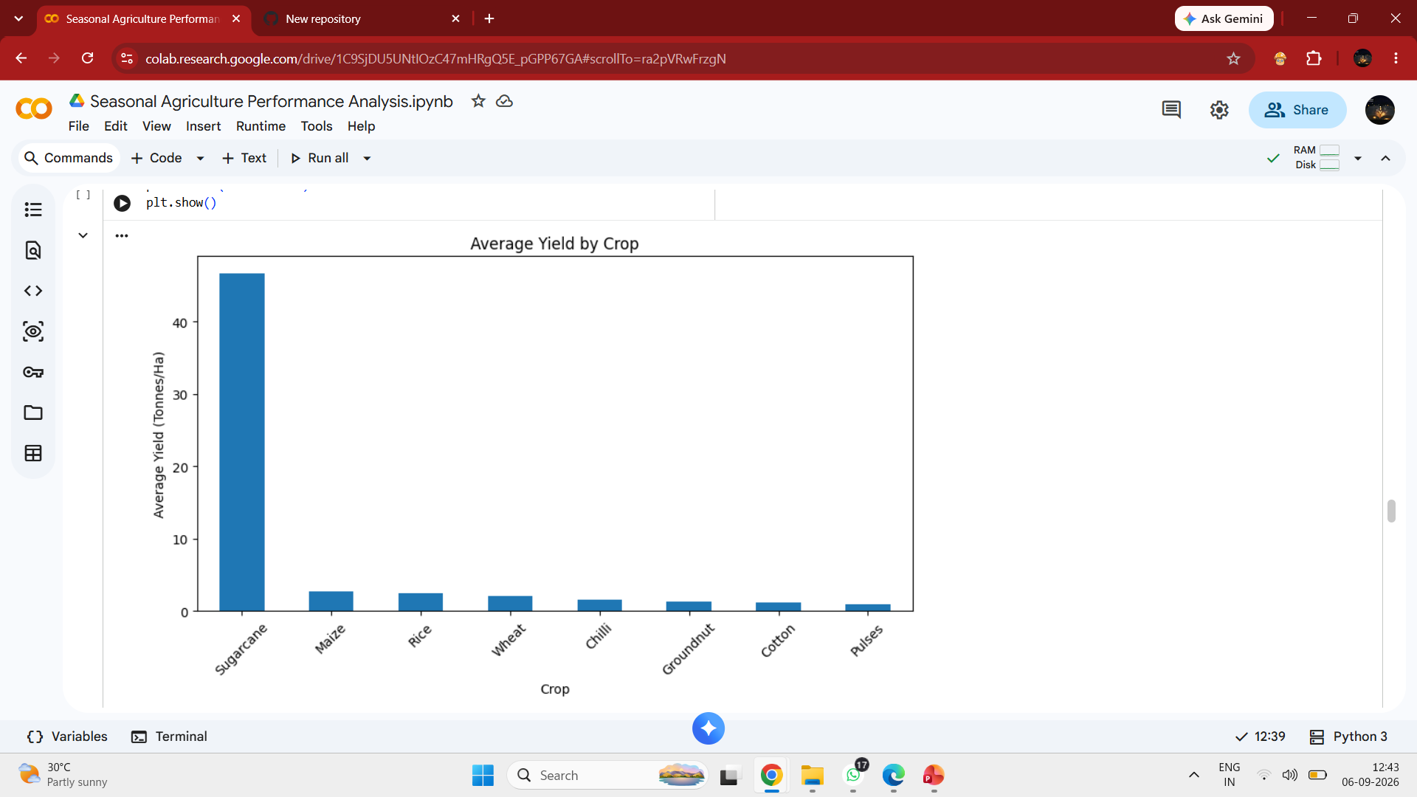
RESULTS
Average Yield by Crop
Screenshot of your Average Yield by Crop bar graph.
Shows Sugarcane as the highest-yielding crop.

Slide 8
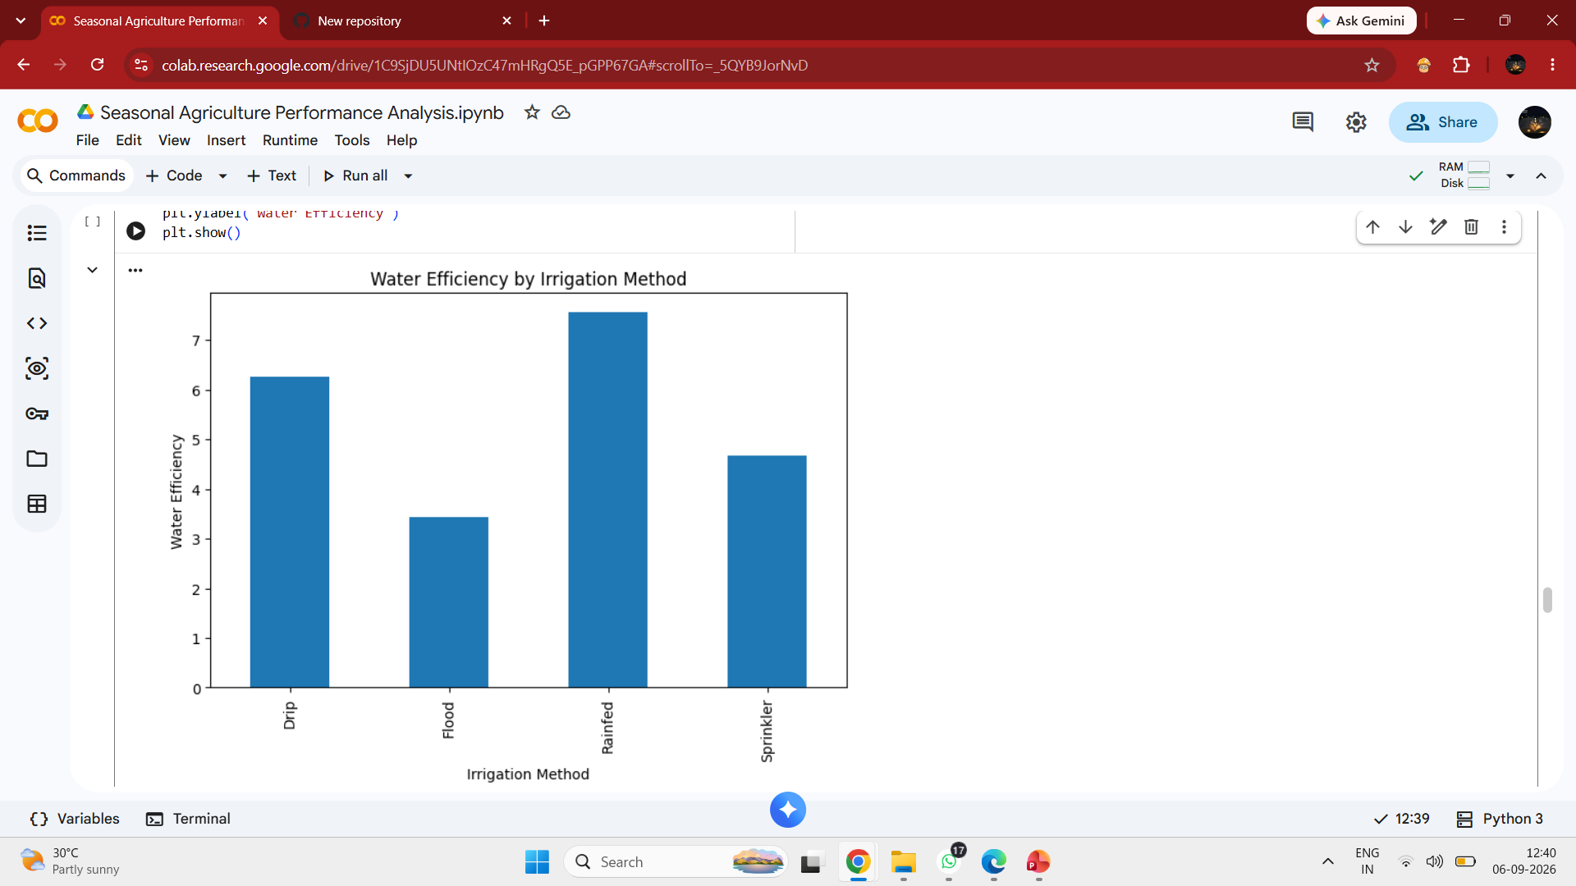
RESULTS
Water Efficiency by Irrigation Method
Screenshot of the Water Efficiency by Irrigation Method graph.
Shows Rainfed with the highest average water efficiency.

Slide 9
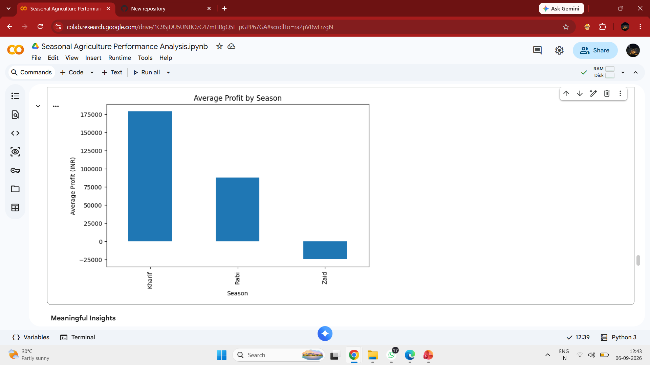
RESULTS
Average Profit by Season
Screenshot of the Average Profit by Season graph.
Shows Kharif with the highest average profit and Zaid with negative average profit.

Slide 10
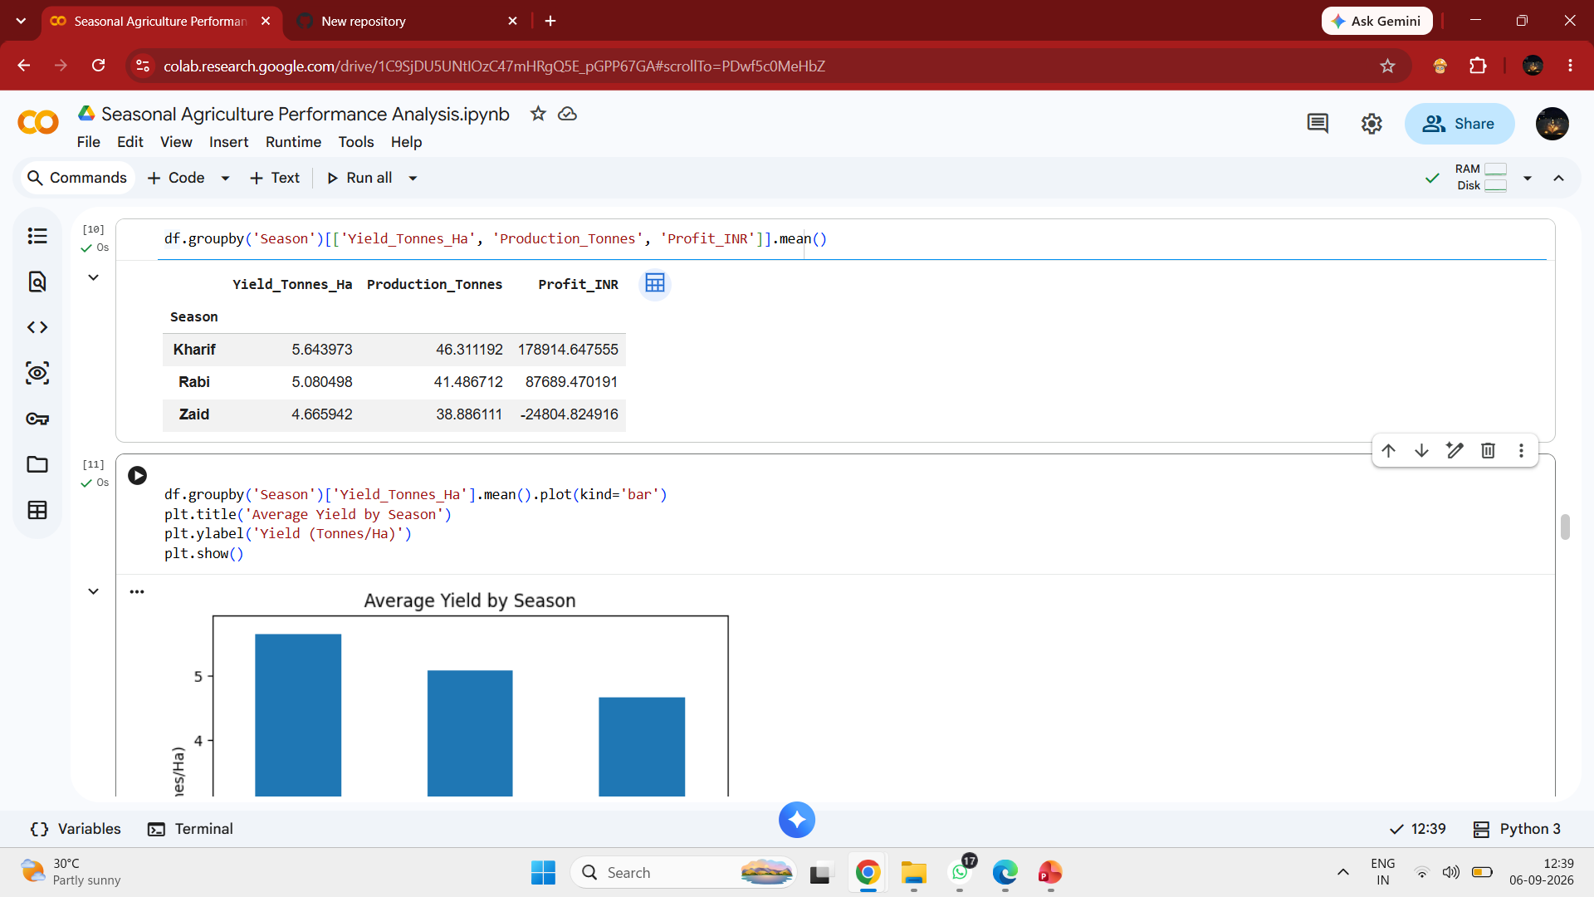
RESULTS
Average Yield by Season
Screenshot of the Average Yield by Season graph.
Shows Kharif, Rabi and Zaid comparison.

Slide 11
Future scope
Predict crop yield using Machine Learning techniques.
Include real-time weather data for better analysis.
Add real-time market prices to improve profit estimation.
Develop a crop recommendation system based on farming conditions.
Build an interactive dashboard for farmers and agricultural planners.
Extend the analysis with larger and multi-year datasets.
Add regional-level analysis to provide more specific recommendations.

Slide 12
GitHub Link
🌐 https://github.com/akanshaadhalkar-a11y/Seasonal-Agriculture-Performance-Analysis

Slide 13
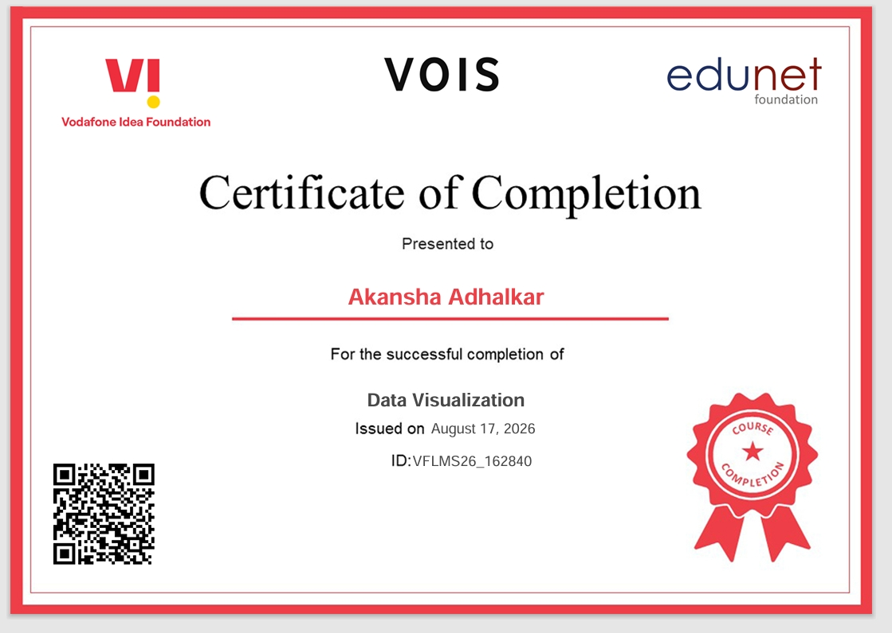
VOIS Course completion certificate - Course name- Data Visualization

Slide 14
Thank you
.
.

