Slide 1

Amazon E-Commerce Performance Analysis
Business Insights & Recommendations using Power BI
Akansha Godge
21 sept 2026

Slide 2
Introduction
E-commerce data shows how products sell, where revenue comes from and how customers experience delivery.
This project uses the supplied Amazon E-Commerce dataset to examine sales performance, customer loyalty, ratings and returns.
Power BI dashboards bring these findings together to support stock planning, targeted customer rewards and service improvements.

Slide 3

Problem Statement
Identify the products, regions and customer tiers that contribute most to revenue.
Evaluate customer ratings, delivery time and returns to identify service priorities.
Use the findings to recommend customer rewards and targeted sales strategies.

Slide 4


Data Overview
Dataset: Amazon E-Commerce (Orders & Customers)
Size: ~1,000+ records across multiple tables
Tables & Key Fields:
Orders → OrderID, Date, Status, Sale Price
Customers → CustomerID, Location, Purchase History
Preprocessing: Cleaned duplicates, fixed missing values, standardized dates & prices

Slide 5
Tools & Analysis Focus
Tools Used
SQL – Data extraction, transformation, table joins.
Excel – Quick exploration & validation checks.
Power BI – Dashboards, DAX calculations, visuals.
Analysis Focus
Cleaned and prepared data
Analyzed patterns (sales, returns, customer behavior)
Built interactive dashboard to derive insights

Slide 6
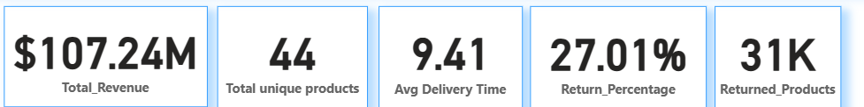
Key Performance Indicators (KPIs)
Total revenue is $107.24M across 44 unique products.
Average delivery time is 9.41 days. Compare this with the delivery target before assessing performance.
The dashboard reports a 27.01% return rate and 31K returned products. Investigate return reasons before choosing corrective actions.

Slide 7
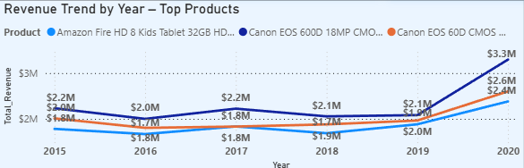
Revenue Trend of Selected Top Products
Insights:
All three displayed products generated more revenue in 2020 than in 2019.
Canon EOS 600D leads the displayed products in 2020 at about $3.3M, followed by the Fire HD 8 Kids Tablet at $2.6M.
Business implication: Review demand and stock availability for these leading products.

Slide 8
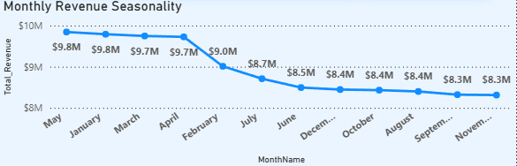
Monthly Revenue Comparison
Insights:
May and January have the highest displayed revenue at about $9.8M each. June is lower at about $8.5M.
September and November have the lowest displayed revenue at about $8.3M each.
Business implication: Plan stock for stronger months and test promotions in weaker months.

Slide 9
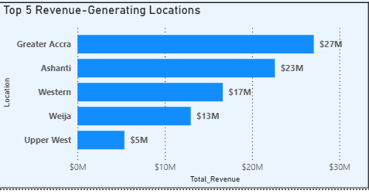
Top Revenue-Generating Locations
Insights:
Greater Accra leads at about $27M, followed by Ashanti at $23M.
Upper West contributes about $5M, the lowest among the five locations shown.
Business implication: Protect service capacity in leading regions and investigate demand in lower-revenue regions.

Slide 10
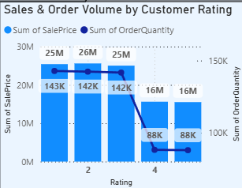
Revenue and Quantity by Customer Rating
Insights:
Ratings 1, 2 and 3 contribute about $25M, $26M and $25M. Ratings 4 and 5 contribute about $16M each.
Each rating 4–5 group has about 88K units, compared with 142K–143K for ratings 1–3.
Business implication: Compare group sizes and purchases per customer before designing rating-based offers.

Slide 11
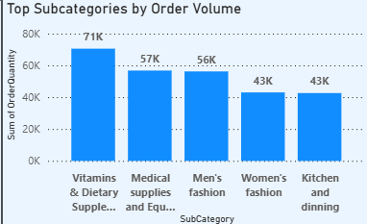
Top Subcategories by Order Quantity
Insights:
Vitamins & Dietary Supplements lead with about 71K units, followed by Medical Supplies at 57K.
Men’s Fashion contributes 56K units. Women’s Fashion and Kitchen & Dining contribute about 43K each.
Business implication: Prioritize stock availability for the subcategories with the highest quantity sold.

Slide 12
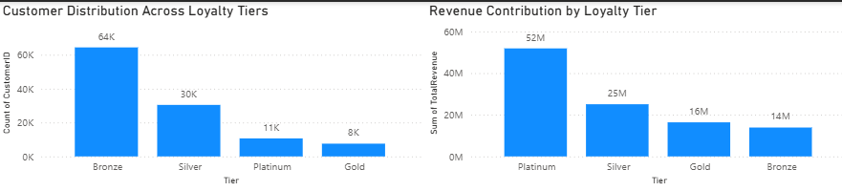
Customer Distribution and Loyalty Revenue
Insights:
Bronze and Silver have the largest displayed CustomerID counts at about 64K and 30K.
Platinum contributes the highest revenue at about $52M, despite a smaller displayed count of 11K.
Business implication: Test targeted Platinum rewards. Confirm distinct customer counts before comparing value per customer.

Slide 13
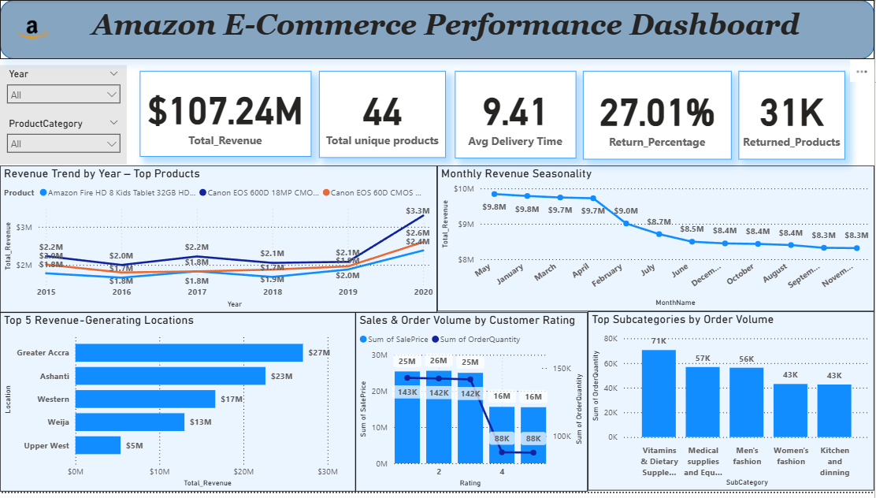
Dashboard Overview
Interactive dashboard tracking revenue trends, seasonal patterns, regional performance, product categories, and return rates

Slide 14
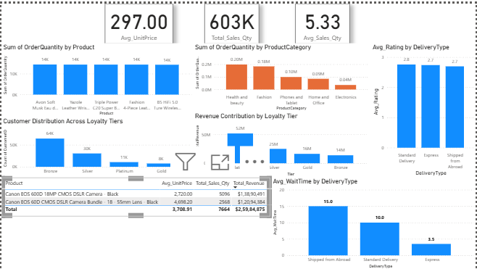
Product and Customer Dashboard

Slide 15
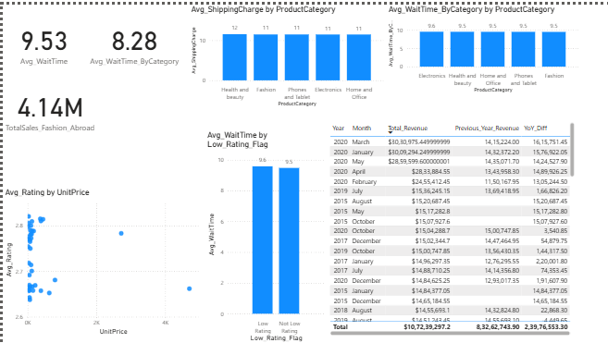
Delivery and Revenue Dashboard

Slide 16

Conclusion
The selected top products show higher revenue in 2020. Canon EOS 600D leads their 2020 comparison.
Greater Accra and Ashanti lead the locations shown. Vitamins & Dietary Supplements lead subcategory quantity.
Platinum contributes the highest loyalty-tier revenue. May and January lead the monthly revenue comparison.
The reported 27.01% return rate warrants investigation into products and return reasons.

Slide 17

Recommendations
Customer retention: Test targeted rewards for Platinum customers and track repeat purchases.
Stock planning: Use the monthly revenue comparison and leading subcategories to guide inventory planning.
Regional strategy: Maintain service capacity in Greater Accra and Ashanti. Investigate lower-revenue regions before expanding.
Returns: Identify high-return products and return reasons before changing product listings or service processes.
Delivery: Compare wait times with service targets and monitor customer ratings by delivery type.

Slide 18


