Slide 1
Non-Personalized Car Recommender System
Group:
Mark Pit
Toan Quach
Hiep Nguyen
Instructor: Prof. Shafqat Ali Shad
21. Oct 2015

Slide 2
Agenda
Overview
Architecture
Apriori Algorithm
Recommendation Criteria
Tools & Technologies
Limitations
Demo

Slide 3
Overview
The domain is non-personalized, which means it gets data from other users to form a recommendation. This is done through the detection and storage of user clicks and searches and transforming it into a set of frequently accessed items using a data mining algorithm called Apriori.
Datasets are scraped or crawled from data sources and pre-processed before importing to the HDFS using Hive. Data is then retrieved by the application through JDBC.

Slide 4
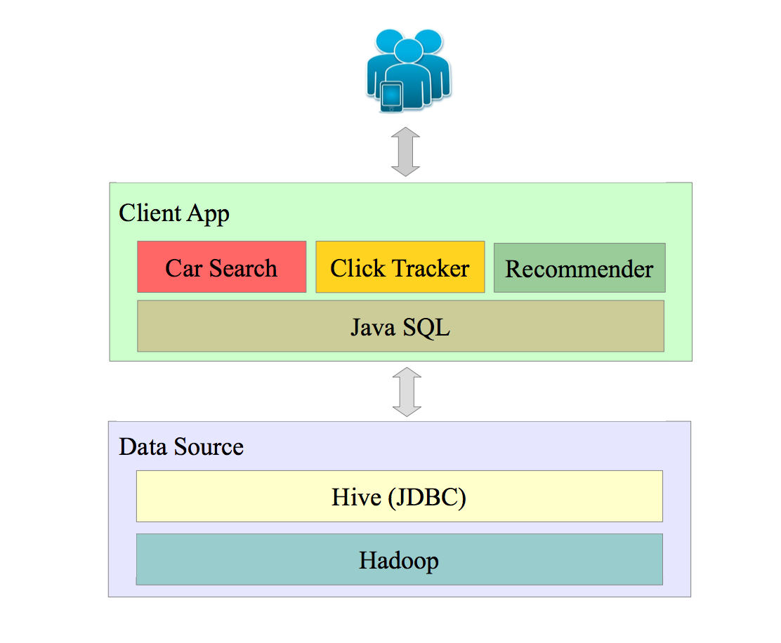
Architecture

Slide 5
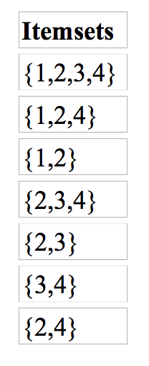
Apriori Algorithm I
Apriori is an algorithm for frequent item set mining and association rule learning over transactional databases. It proceeds by identifying the frequent individual items in the database and extending them to larger and larger item sets as long as those item sets appear sufficiently often in the database.
The frequent item sets determined by Apriori can be used to determine association rules which highlight general trends in the database.
Example
Assume a large set of car ID's taken from the database including the target user's clicks and search history:

Slide 6
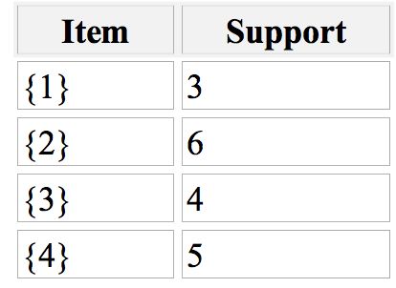
Apriori Algorithm II
We will use Apriori to determine the frequent item sets of this database. To do so, we will say that an item set is frequent if it appears in at least 3 transactions of the database: the value 3 is the support threshold.
The first step of Apriori is to count up the number of occurrences, called the support, of each member item separately, by scanning the database a first time. We obtain the following result
All the itemsets of size 1 have a support of at least 3, so they are all frequent.

Slide 7
Recommendation Criteria
Users need to login to view recommendations
New users will initially have no recommendations
If users have search & click history:
If user car searches does not have similar data with other users, the recommendation is based on his own search & click history sorted according to frequency
If user car searches have similar data with other users:
Retrieve all associated data and use Apriori to order based on the frequent Car ID given a minimum support.

Slide 8
Tools & Technologies
Java
CSS
JQuery
Spring MVC
Hadoop
Hive
Git / GitHub
Facebook API
Eclipse
Edmunds Car Ratings API

Slide 9
Limitations
Didn’t use the Spark & Pig in the project
Need to enhance the recommendation system based on rating, reviews, ….
The performance is little bit slow because of the connection to HDFS via Hive DDL, DML (e.g group by, insert statements…)
Transaction handling is limited

Slide 10
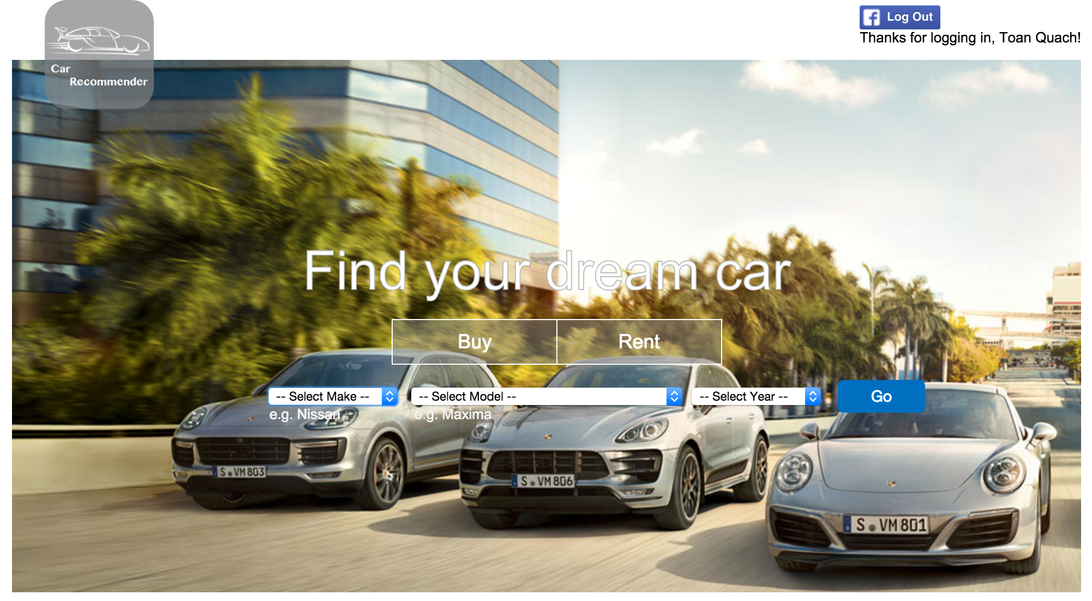
Live Demo

Slide 11
Thank You!

