Slide 1
Ideatory MakeMyTrip Challenge
Submitted by
Name: Akansha Kumar
Ideatory username:akansha

Slide 2
Problem Definition
Problem:- User clickstream data and information about a group of hotels is provided.
Objective:- Segment users into a given set of classes. The classes are,
Backpackers
Family
Couple
Supervised learning –
Set of training features and target are provided
A test set with features data is provided
Objective:- Predict the target values for the test data

Slide 3
Standard Approach
Steps:-
Data extraction:- From csv (transfer data from csv to pandas dataframe in python)
Data mining:- Perform joins to combine data from multiple dataframes into a single dataframe. (join method in pandas)
Data manipulation:- Convert discrete non-numeric data and boolean data to integers. Develop an initial set of features
Break data into test data and training data for test cross-validation
Perform PCA and FA to determine influential features. This step decides the model features.
Choose classifiers –
Try multiple classifiers and determine the F1 score for test cross validation
For each classifier implement GridSearchCV and randomserachCV to obtain an optimum set of parameters
Implement the classifier on the supplied test data and generate the test target csv for submission.

Slide 4
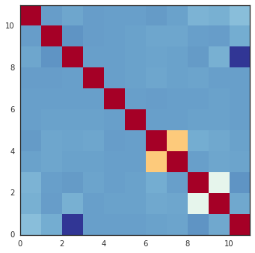
Initial Features
Age
Gender (Male-1, Female-0)
Number of Rooms
Seen price
isClicked (True-1, False-0)
isBooked (True-1, False-0)
Star Rating
Trip Adviser Rating
Stay period (Difference between Check out date and Check in date)
Travel Gap (Difference between booking date and Check in date)
***Correlation plot – top right corner

Slide 5
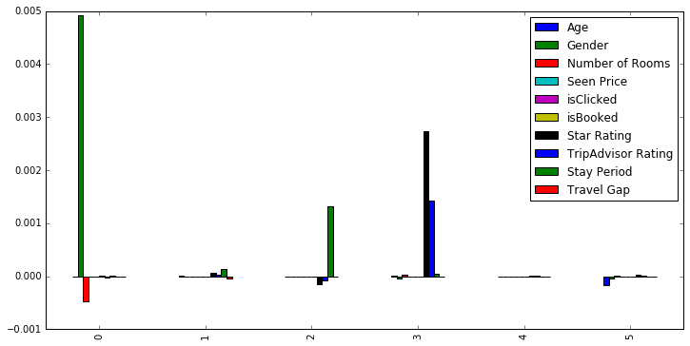
Feature Extraction
Understand the influence of the features on the target
Correlation plot
Principal components (sklearn.decomposition.PCA)
Independent components – bottom right corner (sklearn.decomposition.FastICA)
Factors (sklearn.decomposition.FactorAnalysis)
Selected Features
Age
Star Rating
Seen price

Slide 6
Cross-validation for model validation
Prediction accuracy
Standard approach of breaking the training data into test (test_cv) and training data (cv_train) for cross-validation.
Use train_cv to build the regression model, and test it against test_cv.
The score ranges from 0-1.0 where 1.0 is the best fit.
sklearn.cross_validation_train_test_split – Split training data into random test and train data.
Test size – 40000 (1/3rd of the total data)
Use this validation approach to all the classifier and keep track of the scores and choose the one that has the best score.

Slide 7
Classifier Methods
I have tried the following methods (all these methods are available in sklearn package in python),
Decision Tree Classifier
Gaussian Naïve Bayes
Support vector Machines
Random Forest Classifier
Logistic Regression
SGD Regressor
K Nearest Neighbors Classifier
Bernoulli Naïve Bayes
Linear Discriminate Analysis
Quadratic Discriminate Analysis
Ada Booster Classifier

Slide 8
Parameter Optimization
All the methods described in the previous slide have hyper parameters.
Parameters have a strong influence on the regression model hence affect the predictions.
Cross-validation is a standard method to determine an optimum value for the hyper parameters
Each parameter set is implemented in the model and a score is determined. Score ranges from 0 to 1.0.
Methods:-
Grid based (GridSearchCV in sklearn) :- Performs a grid based on all the permutations of the parameter space (inputted by the user) and performs a search
Random based (RandomizedSearchCV in sklearn) :- Randomly searches for the best parameter set

Slide 9
Implementation of a classifier
Standard steps:-
Create an instance of the classifier
Fit the training data
Predict the test results

Slide 10
Future Work
Predictive methods are always not complete. There is a significant scope for future work,
Try several other methods
Implement a learning based hyper parameter optimization
There is still room for model search
Search for other features not given in the data
More visualization
Implement heuristic methods for optimization

Slide 11
Tools
Jupyter ipython notebook
mysql
python:-
pandas
sklearn
scipy
numpy
matplotlib

