Slide 1



-INCORPORATING DATA ANALYTICS IN CLAIMS MANAGEMENT
Akshata Kanumuri, Dikshya Mohanty, Lei Huang, Muralidharan Singaravel

Slide 2
Overview
Key Takeaways
Data Wrangling & Merging
Data Visualization
Modelling Techniques
Final Model
What is Workers Compensation?
Major Issues in Dataset
Key Visualization Insights
New Variables and
Analytical Models
Initial Hypotheses
Findings From MLR
Notes:
Workers’ compensation provides cash and medical benefits to workers who are injured or become ill in the course of their employment and provides benefits to the survivors of workers killed on the job.
Key issues which we noticed in the files are missing values for various fields like Average Weekly Wage, Claimant Age at DOI, Date service began, Date service ended. Some of the missing values were replaced with mean and the values which could not be replaced, the fields were dropped in the final aggregated data.
In data visualization, by running various tableau reports on different claims dimensions and measures, we could see some interesting insights like the number of claims in the last quarter across all the years is less compared to the other quarters, lower back is the most frequently
injured body part which also resulted in the most number of fatalities
Few initial hypotheses which we identified are i) The young workers (age <24) are at a greater risk for injury at work. ii) The insurance company states that more 70 percent of its claims are settled within 180 days of filing the claim.
We added the following derived variables - Time To Process, Day Of Incident, Age Group and No Of Days Away which we felt will be helpful in building the predictive models
From MLR, we identified that given Average weekly wage, No of days the worker was away after the injury, time to process a claim and count of transaction of per claim, we can predict the non-indemnity claim amount for a lower back injury resulting from strain or sprain.

Slide 3
Recommendations
Key Takeaways
Data Wrangling & Merging
Data Visualization
Modelling Techniques
Final Model
Understanding the Many Factors Affecting Claims
Tackling Missing Data
Identifying the Critical Claims
Moving to electronic claims
Notes:
Understanding the Many Factors Affecting Claims: There is a tremendous amount of data that are being generated constantly and it is important to understand the factors affecting the claim. From the MLR model we saw that one can predict the claim amount using Average weekly wage, No of days the worker was away after the injury, Time to Process and Count of Transactions per Claim that will allow for more responsive service, faster and more effective claims settlement which will in turn improve the claims management.
Tackling Missing Data: For any effective predictive model building, the data has to be reasonably accurate and complete that is, essentially free of missing values. It can either be handled at the data collection stage by training the data entry personnel to enter all the fields that are identified as mandatory/critical (example employee average weekly wage, employee return to work date which were identified as significant predictors) or at the data wrangling stage by replacing with Mean/Median/Mode like we did for above mentioned variables.
Identifying the Critical Claims: When the insurance claims process offers customers consistent service across multiple delivery channels, the company and the customer benefit. For faster claims processing, it is essential to identify the critical claims either based on the claims amount or the employee/employer information or injury type or processing time. Once the claim is identified as critical, it can be processed faster. Submitting an insurance claims means the customer is dealing with something stressful that has happened. When the insurance claims process relieves some of this stress by faster and accurate claims processing, customers are likely to become more loyal.
Moving to electronic claims: E-claims are more accurate and offer faster processing than paper submission, submitting claims electronically reduces mistakes that are caused when paper claims are converted to an electronic format like invalid worker’s age in this dataset and some of the information about the employer/employee can be pre-populated like Average weekly wage which had close to 63% missing values.

Slide 4
Data Wrangling and Data Merging
Key Takeaways
Data Wrangling & Merging
Data Visualization
Modelling Techniques
Final Model
Two files Transactions_Part1.csv and Transactions_Part2.csv are appended
-Match all the column names and data type
Missing values removed for
-PayType -PayCateogry
-ServiceFromDate -ServiceToDate
Appended transaction and claims data are merged with ClaimIdentifier as the key
Notes:
Two files Transactions_Part1.csv and Transactions_Part2.csv are appended and we need to make sure that all the column names and data type matches.
The following Data Wrangling are done in Transaction Data:
Missing values in the following columns are removed
PayType
PayCateogry
ServiceFromDate
ServiceToDate
Then appended transaction and claims data are merged with ClaimIdentifier as the key for merging

Slide 5
Data Wrangling and Data Merging
Key Takeaways
Data Wrangling & Merging
Data Visualization
Modelling Techniques
Final Model
The following Data Wrangling are done in Claim Data:
AverageWeeklyWage has 84924 missing values, which is 63% of the total records, so we replaced the null values with mean.
ClaimantAge_at_DOI has 45078 missing values, which is 34% of the total records, so we l replaced the null values with mean. Further analyzing the column we saw that there are close to 300 records with invalid workers’ age ( age <14) which were removed.
IncidentDescription has 18 missing values, so we removed all the records with missing IncidentDescription.

Slide 6
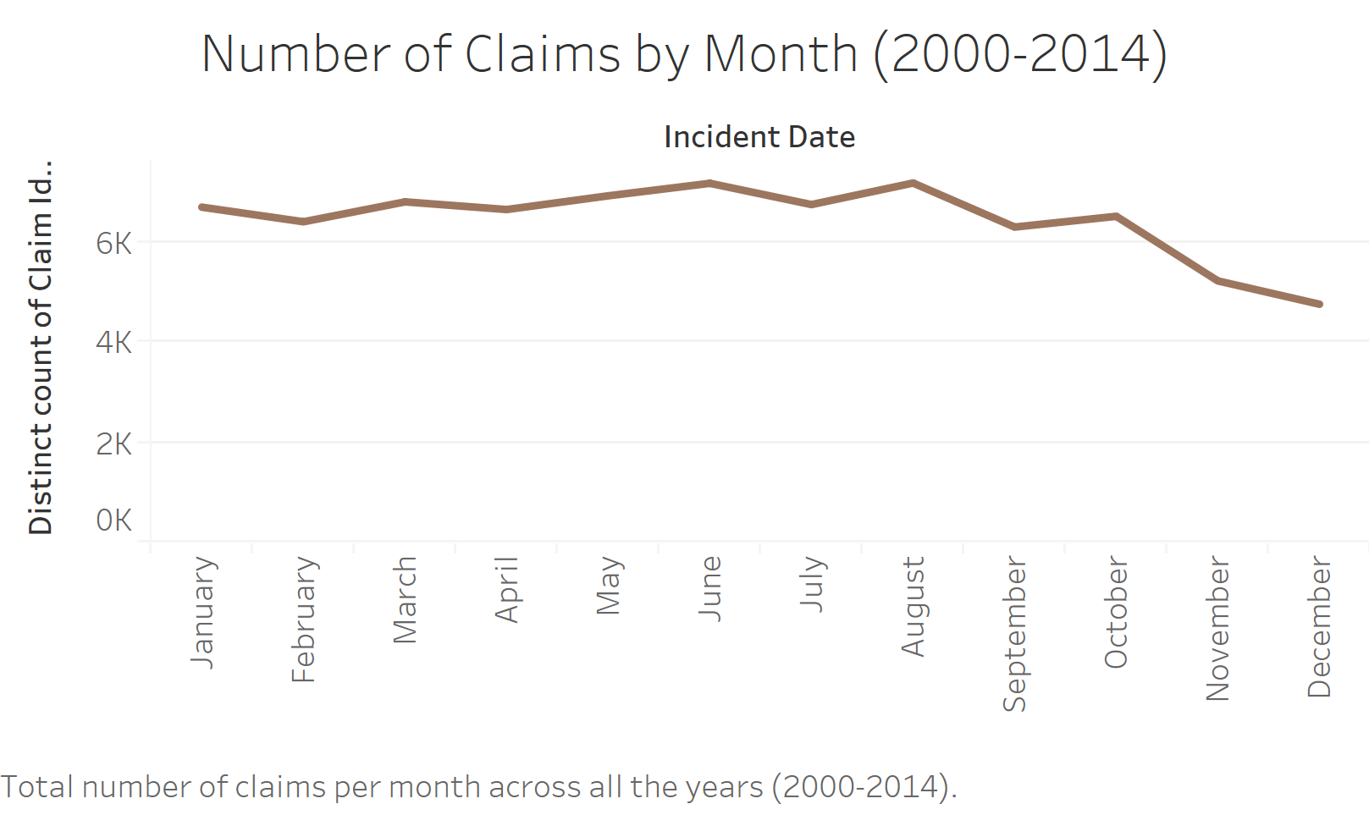
Key Takeaways
Data Wrangling & Merging
Data Visualization
Modelling Techniques
Final Model
Notes:
Number of Claims by Month (Years 2000 to 2014): Also, we can see that the number of claims in Q4 across all the years is less compared to the other quarters, the reason may be less number of working days or holiday season. The Insurer can work on reduced staffing capacity in the last quarter as the number of claims are comparatively less than Q1, Q2 and Q3.

Slide 7
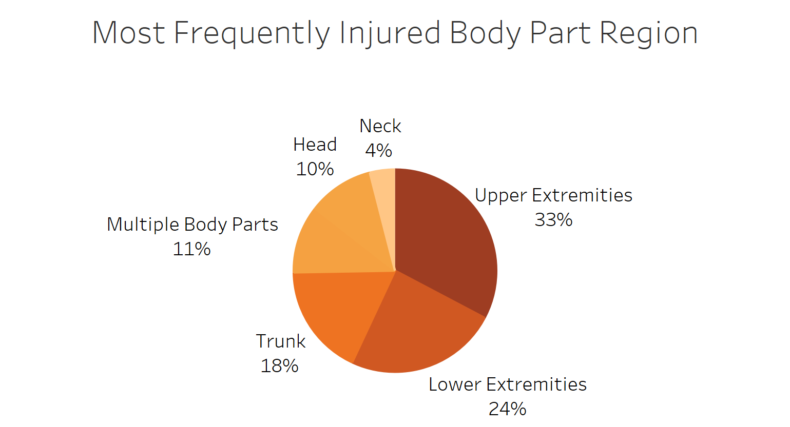
Key Takeaways
Data Wrangling & Merging
Data Visualization
Modelling Techniques
Final Model
Notes:
Upper Extremities is most frequently injured body part in all the claims.

Slide 8
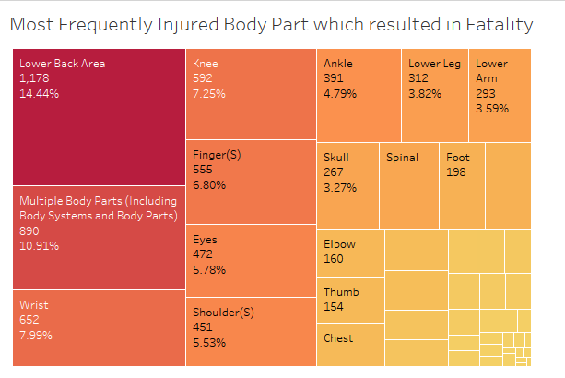
Key Takeaways
Data Wrangling & Merging
Data Visualization
Modelling Techniques
Final Model
Notes:
An employer has legal obligations to provide safe and healthy workplaces for employees, so to reduce the risk of back pain in the workplace the employer should provide information, training and supervision on safe ways to work or provide special programs like provide occupational physiotherapists which can prevent long-term back pain and be highly cost-effective

Slide 9
Initial Hypotheses
Key Takeaways
Data Wrangling & Merging
Data Visualization
Modelling Techniques
Final Model
i) The young workers (age <24) are at a greater risk for injury at work.
ii) If an employee is out of work for more than six months, they have less than a 50% chance of ever returning to work in any capacity
iii) The non-indemnity claim amount is dependent on the Worker’s wage and no. of days the worker was away.
iv) The most common workplace injury is Sprains and Strains.

Slide 10
Added New Derived Variables
Key Takeaways
Data Wrangling & Merging
Data Visualization
Modelling Techniques
Final Model
TimeToProcess
Difference between ClaimantClosedDate and ClaimantOpenedDate
DayOfIncident
Day of the week when the incident occurred
AgeGroup
<18, 19 - 24, 25 - 54, 55 - 64, >65
NoOfDaysAway
Difference between ReturnToWorkDate and IncidentDate.
Critical_Class
Binary dependent variable to classify claims as critical or non-critical

Slide 11
Decision Tree Model
Key Takeaways
Data Wrangling & Merging
Data Visualization
Modelling Techniques
Final Model
Dependent Variable
Results can be Used to
180DaysAway :
worker away from work for > 180 days
Measure efficacy of treatments
Evaluate providers’ ‘performance’ and cost utilization
Identifying which provider would be more effective
Independent Variable
Age Group
Gender
BodyPartRegion
InjuryNature
Notes:
Measure efficacy of treatments through the number of lost work days for each case, and identify treatments that correspond to speedier resolution.
Evaluate providers’ ‘performance’ and cost utilization across the patient populations they treat in a fair, risk-adjusted way.
Identifying which provider would be more effective at treating a specific injured worker, given the age, gender, and diagnoses.

Slide 12
Association Rule Mining
Key Takeaways
Data Wrangling & Merging
Data Visualization
Modelling Techniques
Final Model
Input
Output
Benefit
BodyPart
DayofIncident
InjuryNature
IncidentDescription
Pattern of circumstances related to the injuries
Implement safety program.
Minimize future incidents leading to the same claim
Notes:
In Workers Compensations insurance, understanding the cause of injury is crucial for preventing repeat injuries. Association Rule analysis can be used to reduce both claim frequency and severity. This technique enables Insurers. Employee and Employers to understand the pattern of circumstances related to the injuries.
Lower Back injury is the most common type of injury in the claims data set. So, the input to this model can be BodyPart, DayofIncident, InjuryNature, IncidentDescription, Shift and TypeofWork (we do not currently have this in the dataset).
The Output from this model:
Can help the safety manager understand the circumstances (what/where/when) associated with the back injuries and company would benefit from implementing safety programs to prevent lower back injuries.
Gain interesting and useful insights about the circumstances surrounding the claims and these insights can be used to minimize future incidents leading to such claims

Slide 13
Multiple Linear regression
Key Takeaways
Data Wrangling & Merging
Data Visualization
Modelling Techniques
Final Model
Dependent Variable
Initial Hypothesis Tested
Other Paid (Excluding indemnity)
The non-indemnity claim amount is dependent on the Worker’s wage and no. of days the worker was away.
Independent Variable
AverageWeeklyWage
NoOfDayAway
TimeToProcess
CntTransPerClaim

Slide 14
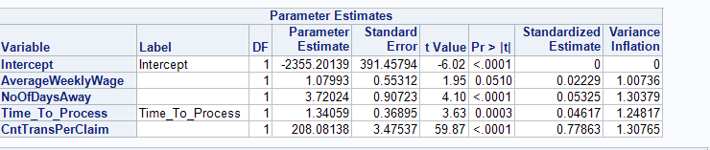
Multiple Linear Regression Equation
Key Takeaways
Data Wrangling & Merging
Data Visualization
Modelling Techniques
Final Model
Claim Amount = -2355.201 + 1.080* AverageWeeklyWage + 3.720*NoOfDayAway + 1.341 * TimeToProcess + 208.08* CntTransPerClaim
Notes:
From the above model results, we can say that the MLR model is statistically significant for non-indemnity claim amount of less than $25000.00 (after we remove the outliers) with the predictors variables of AverageWeeklyWage, NoOfDayAway, TimeToProcess and CntTransPerClaim.

Slide 15
Interpreting Linear regression Equation
Key Takeaways
Data Wrangling & Merging
Data Visualization
Modelling Techniques
Final Model
i) All the coefficients are positive which represents positive relationship between dependent and independent variables.
ii) The higher the worker’s wage the higher will be the medical claim costs.
iii) The more number of days the worker is absent because of injury, the more will be the medical claim costs.
iv) Higher medical claims needs more time to process .
iv) The higher the count of transactions per claim the higher will be the medical claim costs.

Slide 16
Limitation of Linear regression
Key Takeaways
Data Wrangling & Merging
Data Visualization
Modelling Techniques
Final Model
i) Before fitting the model, each of the independent variable is to be evaluated for MultiCollinearity.
ii) One of the key assumptions is that there is linear relationship between dependent and independent variables, and normal distribution of residuals.
iii) There are many independent categorical variables in this dataset which has to be first transformed and create dummy variables for each.
iv) Linear Regression is sensitive to Outliers, so we need to first identify and remove outliers

Slide 17
Key Takeaways
Data Wrangling & Merging
Data Visualization
Modelling Techniques
Final Model
MLR Results can be Used to
Successfully identify and predict medical cost drivers within Workers’ Compensation claims (i.e., specific diagnoses that result in costlier claims).
Settle claims early and more effectively.
Use to more accurately set reserves for an individual claim.

Slide 18
Thank You!

