Slide 1
R/C AIRCRAFT DESIGN & BUILD MANUAL
From mission to
maiden flight
A practical, calculation-backed guide to sizing, stability, airfoils, structures, propulsion, radio setup, and safe flight testing.
CG
VOLUME 1
Conventional fixed-wing sport and trainer aircraft
Designed for builders who want to understand why the airplane works—not just copy dimensions.
FIRST EDITION • DESIGN, BUILD, TEST, IMPROVE
1

Slide 2
START HERE
What this manual is—and what it is not
Use it to make sound first-pass decisions, then verify them with testing and experienced help.
THIS MANUAL HELPS YOU
IT DOES NOT REPLACE
• Turn a mission and target mass into a wing size.
• Size conventional tails using tail-volume coefficients.
• Choose useful starting proportions for control surfaces.
• Build straight, stiff, light structures with reliable linkages.
• Plan a cautious maiden flight and improve the design from evidence.
• Local flying-field rules, insurance, or legal requirements.
• Manufacturer limits for batteries, motors, ESCs, servos, and radios.
• An experienced pilot for the maiden of an unproven design.
• Structural analysis for very fast, very large, turbine, or competition aircraft.
THE DESIGN ENVELOPE
The numerical starting points in this volume target ordinary subsonic, conventional-tail, propeller-driven R/C aircraft—especially trainers and sport models. Swept wings, canards, flying wings, biplanes, ducted fans, turbines, and giant scale models need extra analysis.
Safety rule: remove the propeller whenever you are setting up the radio, reversing channels, adjusting endpoints, or working near the power system.
!
HOW TO READ IT
Green = recommended habit. Orange = design choice. Red = failure or safety risk. Equations are followed by plain-language meaning and worked examples.
2

Slide 3
START HERE
The manual map
The front end takes you from requirements through the first flight; the airfoil guide is one chapter in the larger system.
01
Design the system
Mission, forces, controls, wing, tail, CG
02
Understand airfoils
Shape, vocabulary, families, equations
03
Build the structure
Materials, spars, alignment, hinges
04
Choose the systems
Power, propeller, battery, radio, servos
05
Test and improve
Preflight, maiden, trim, diagnosis, repair
!
The process is a loop, not a straight line: changing weight changes wing area, power, structure, CG, and often the tail.
3

Slide 4
DESIGN THE SYSTEM
The design loop: change one thing, update the rest
A model airplane is a connected system. Every major choice affects several other choices.
1
MISSION
What must it do?
7
TEST
2
MASS
Measure, trim, learn
measured results update the budget
What will it weigh?
YOUR AIRPLANE
6
STRUCTURE
3
WING
Strength, stiffness, accuracy
Area, span, chord
5
POWER
4
TAIL + CG
Thrust, energy, cooling
Stability and authority
!
Freeze the mission first. Otherwise the design grows heavier, faster, and more complicated every time a new feature is added.
4

Slide 5
DESIGN THE SYSTEM
Write the mission before drawing the airplane
Clear requirements prevent the design from becoming a random collection of appealing features.
FLIGHT TASK
OPERATING SPACE
• Trainer, sport, glider, aerobatic, scale, STOL, payload, endurance, or speed?
• Choose one primary mission and at most two secondary goals.
• Field size, surface, wind, noise limits, transport box, launch method, landing method.
• A small field often demands low wing loading more than high top speed.
TARGETS
NON-NEGOTIABLES
• All-up mass, stall speed, flight time, climb rate, wingspan limit, construction time, and budget.
• Use numbers where possible, not words such as “light” or “fast.”
• Radio failsafe, battery access, cooling, removable wing, landing gear, camera, tow hook, or float mount.
• Each requirement has mass and drag costs.
5

Slide 6
DESIGN THE SYSTEM
Four forces—and the moments they create
An airplane moves because forces act at locations. A force away from the CG also creates a turning moment.
Lift
CG
Thrust
Drag
Weight
FORCES
MOMENTS
• Lift acts roughly perpendicular to the relative wind.
• Weight acts through the CG.
• Thrust and drag act roughly along the flight path.
• Pitch turns nose up/down.
• Roll rotates wingtip to wingtip.
• Yaw swings the nose left/right.
TRIMMED FLIGHT
Steady flight requires both force balance and moment balance. Lift can equal weight while the airplane still pitches uncontrollably if the moments do not balance about the CG.
!
A tail is not merely a small rear wing. It supplies leverage that balances and damps pitching and yawing motion.
Reference basis: NASA Glenn Beginner’s Guide to Aeronautics—forces, lift, drag, and moments.
6

Slide 7
DESIGN THE SYSTEM
Pitch, roll, and yaw—and the surfaces that control them
The pilot commands rotations. The airplane’s stability decides what happens after the command.
ROLL
PITCH
YAW
front view
side view
top view
rotates around the
nose-to-tail axis
nose tips up / down around
the wingtip-to-wingtip axis
nose swings left / right
around the vertical axis
Each view looks straight down the rotation axis (the colored dot) — the motion happens in the plane of the page.
AXIS
MAIN CONTROL
PILOT SEES
STABILIZER
Pitch
Elevator
Nose up or down
Horizontal tail
Roll
Ailerons
Bank left or right
Main wing tips
Yaw
Rudder
Nose left or right
Vertical tail
A normal turn is a three-axis event: ailerons bank, elevator maintains the curved flight path, and rudder prevents the airplane from skidding or slipping badly.
!
Reference basis: NASA aircraft axes and control surfaces.
7

Slide 8
DESIGN THE SYSTEM
Banked turns raise the stall speed
The wing must make more lift in a turn because only part of the lift vector points upward.
LOAD FACTOR
45° bank
n = 1 / cos φ
L cos φ
must equal W
L
φ is bank angle. At 60°, the wing supports about twice the aircraft weight.
L sin φ
turns you
TURNING STALL SPEED
Vₛ,turn = Vₛ √n
W
The stall speed increases with the square root of load factor.
BANK
LOAD FACTOR n
STALL-SPEED MULTIPLIER
0°
1.00
1.00 ×
30°
1.15
1.07 ×
45°
1.41
1.19 ×
60°
2.00
1.41 ×
Practical lesson: do not make steep, slow turns near the ground. Add speed before banking, and keep the turn coordinated.
!
?
YOUR TURN
At what bank angle does stall speed rise by 25%? Work backwards: n = 1.25² = 1.5625 → cos φ = 1/1.5625 = 0.64 → φ ≈ 50°.
Equations follow standard level-turn mechanics; use as an idealized estimate.
8

Slide 9
DESIGN THE SYSTEM
Control surfaces: useful starting proportions
Authority comes from area, lever arm, deflection, airspeed, stiffness, and clean airflow—not area alone.
AILERONS
ELEVATOR
RUDDER
SURFACE
CHORD
SPAN / HEIGHT
MAIN JOB
Aileron
18–22% of wing chord
Outer 40–50% of each half-wing
Roll
Elevator
25–35% of tail chord
About 80–95% of tail span
Pitch
Rudder
30–40% of fin chord
Most of fin height
Yaw
Flap
20–30% of wing chord
Inner 40–60% of each half-wing
Lift/drag
These are conventional-trainer starting points, not laws. A fast model needs less deflection; a slow 3D model may use much larger surfaces.
!
9

Slide 10
DESIGN THE SYSTEM
Control throw, rates, expo, and differential
Start modestly. Excess control is harder to manage than slightly too little control.
SETTING
TRAINER START
WHAT IT CHANGES
COMMON MISTAKE
Aileron throw
10–15° each way
Roll rate
Huge travel causes snap-like response
Elevator throw
10–15° each way
Pitch rate / flare
Too much makes CG problems feel worse
Rudder throw
20–25° each way
Yaw / ground steering
Binding at full travel
Flap throw
15–25° takeoff; 30–45° landing
Lift and drag
Deploying too fast without elevator mix
Dual rates
Low for maiden; high available
Maximum travel
Maiden on high rates accidentally
Expo
About 15–30% as a start
Softness near center
Using expo to hide linkage slop
Aileron differential
1.5:1 to 2:1 up/down
Reduces adverse yaw
Equal travel on draggy wings
!
Measure throws at the widest part of the surface. Confirm the radio’s expo sign: different brands define positive and negative differently.
10

Slide 11
DESIGN THE SYSTEM
Servo and linkage geometry
A rigid, slop-free linkage makes a modest servo work better than a powerful servo connected badly.
inner servo hole = more force, less travel
surface swings through this arc
outer hole = bigger swing
inner hole
SERVO
control horn near hinge line
MECHANICAL ADVANTAGE
GOOD INSTALLATION
• Move the pushrod inward on the servo horn for more force and less surface travel.
• Move it outward on the control horn for more force and less travel.
• Keep the control-horn hole close to the hinge line to avoid changing geometry badly.
• Servo arm near 90° to the pushrod at neutral.
• No flexing pushrod, loose clevis, or soft mount.
• No binding at full travel; servo does not buzz continuously.
• Retainers fitted to clevises and wire bends.
Flutter risk rises quickly with speed. Stiff surfaces, tight hinges, short rigid linkages, and adequate servo torque are structural safety items—not cosmetic details.
!
Use the servo manufacturer’s torque and voltage limits; verify under expected aerodynamic load.
11

Slide 12
DESIGN THE SYSTEM
How large does the wing need to be?
Start with all-up mass and desired low-speed behavior. Span comes later.
1. Estimate all-up flying mass—including battery, wiring, covering, fasteners, and glue.
2. Choose a target wing loading appropriate to size and mission.
3. Calculate wing area from mass ÷ wing loading.
4. Choose aspect ratio; calculate span and average chord.
5. Check stall speed with an estimated Cₗmax.
6. Revisit structure, power, and mass. Repeat until the numbers agree.
span b
chord c
AREA FROM WING LOADING
SPAN FROM ASPECT RATIO
S = m ÷ wing loading
b = √(AR × S)
In model units: area in dm² = mass in grams ÷ target g/dm².
After choosing AR, span follows. Average chord is S ÷ b.
Do not select wingspan because it “looks right.” Two aircraft with the same span can have very different areas, loading, stall speeds, and handling.
!
YOUR TURN
?
A 2000 g version of your design keeps the same 45 g/dm² loading. Find S and the span at AR 6.5. (S = 44.4 dm² → b = √(6.5 × 0.444) ≈ 1.70 m. Weight grew 33% but span only grew 16% — can you see why in the equations?)
Reference basis: standard wing-loading, aspect-ratio, and lift relationships.
12

Slide 13
DESIGN THE SYSTEM
Wing loading: mass carried by each unit of wing area
Lower loading usually means slower flight and gentler landings; higher loading means more speed and energy.
MODEL-BUILDER FORM
SOLVE FOR AREA
Wing loading = mass / area
S = mass / target loading
Common metric unit: g/dm². Use all-up mass, not bare airframe mass.
This is the fastest first-pass way to size a trainer wing.
SLOW / FLOATY
TRAINER / SPORT
FAST / HEAVY
≈ 25–40
≈ 40–60
60+
g/dm², size dependent
g/dm², size dependent
g/dm²; not a universal boundary
WHY SIZE MATTERS
Simple wing loading does not scale perfectly. Small models operate at lower Reynolds numbers and often need proportionally lighter loading to feel as forgiving as a larger model. Use comparable successful aircraft of similar size as a reality check.
Keep a mass budget. Reserve roughly 10–15% for items you forgot. Weight added late forces faster flight, stronger structure, and often a larger power system.
!
Ranges are broad hobby starting points, not category standards. Compare with proven models of similar scale.
13

Slide 14
DESIGN THE SYSTEM
Stall speed: the speed where the wing runs out of usable lift
The equation links weight, area, air density, and maximum lift coefficient.
STALL-SPEED ESTIMATE
Vₛ = √[ 2 W / (ρ S Cₗmax) ]
W is weight in newtons, ρ is air density, S is wing area, and Cₗmax is the wing’s maximum lift coefficient.
WEIGHT W
AREA S
More weight raises stall speed. Doubling weight raises Vₛ by √2, not by 2.
More wing area lowers stall speed. It also adds structure and drag.
CₗMAX
SPEED MARGIN
Airfoil, roughness, Reynolds number, flap setting, planform, and stall pattern all affect it.
A practical approach is often around 1.3 Vₛ in calm air, then adjusted for gusts and pilot skill.
Cₗmax is usually the least certain input. Treat the result as an estimate and validate with conservative flight testing at safe altitude.
!
Reference basis: NASA Glenn lift equation. The stall expression follows from setting lift equal to weight at Cₗmax.
14

Slide 15
DESIGN THE SYSTEM
Span, chord, and aspect ratio
Wing area sets the basic lift requirement; aspect ratio decides how that area is distributed.
span b
chord c
ASPECT RATIO
RECTANGULAR WING
AR = b² / S
S = b × c
Long, narrow wings have high AR. Short, broad wings have low AR.
For a rectangle, average chord is simply area divided by span.
HIGHER AR
LOWER AR
• Lower induced drag for a given lift.
• Efficient gliding.
• Longer spar and greater bending challenge.
• Compact and often agile.
• More induced drag.
• Usually easier to make stiff.
Reference basis: NASA Glenn aspect-ratio definition and finite-wing behavior.
15

Slide 16
DESIGN THE SYSTEM
Planform, taper, and sweep
The outline of the wing affects stall progression, structure, efficiency, and control placement.
RECTANGULAR
MILD TAPER
span b
span b
chord c
chord c
Easy to build; friendly stall; excellent first design.
Less tip area and drag; keep taper modest for a trainer.
STRONG TAPER
SWEPT
chord shrinks toward the tip — leading and trailing edges both angle in, no sweep
chord stays the same — the whole panel angles back from the centerline
sweep angle Λ
large root chord
small tip chord
Can tip-stall abruptly without washout or airfoil changes.
Moves aerodynamic center and complicates CG/MAC reasoning.
For a first scratch-built trainer, rectangular or mild taper is the lowest-risk planform choice.
16

Slide 17
DESIGN THE SYSTEM
Dihedral, washout, incidence, and decalage
These angles change how the airplane returns to level, stalls, and trims.
DIHEDRAL — tips rise (front view)
WASHOUT — tip twisted nose-down
dihedral angle
root — higher angle
tip — lower angle
Tips sit HIGHER than the root. In a sideslip, the low wing meets the air at a higher angle, lifts more, and rolls the plane level.
The root reaches stall angle first while the tip — and its aileron — is still flying. A stall becomes a gentle nod, not a snap roll.
INCIDENCE — how the wing is mounted
DECALAGE — wing minus tail incidence
incidence angle
wing chord +3°
tail chord +1°
A construction angle set in the jig: the wing chord sits a few degrees nose-up relative to the fuselage datum. It never changes in flight — angle of attack does.
decalage = 2°
The difference between the two incidences. It sets how hard the tail must push to hold the wing at its working angle — i.e., the elevator trim.
INCIDENCE
DECALAGE
The fixed angle of a wing or tail relative to a fuselage reference line. It is a construction setting, not the same as angle of attack in flight.
The angular difference between the wing and horizontal tail reference lines. It influences the elevator position required for trim.
TRAINER START
BUILD RISK
• Rudder/elevator-only: noticeable dihedral.
• Aileron trainer: moderate dihedral.
• Washout: often about 1–2° at each tip.
• Both panels must match.
• Accidental twist is not washout.
• Covering can pull a straight wing out of shape.
YOUR TURN
?
You measure the left wingtip at +1.4° washout and the right tip at +0.6°. Is that washout, warp, or both? Which wing drops first near the stall — and what does the plane do next?
Starting angles depend on configuration. Measure both sides with the same datum and jig.
17

Slide 18
DESIGN THE SYSTEM
Tail anatomy: stabilizers and control surfaces
The complete tail assembly is the empennage. Fixed surfaces stabilize; moving surfaces command.
VERTICAL STABILIZER
CG
RUDDER
HORIZONTAL STABILIZER
tail moment arm l
ELEVATOR
PART
WHY IT EXISTS
CONTROL / CONSEQUENCE
Horizontal stabilizer
Pitch stability and damping
Elevator
Vertical stabilizer / fin
Yaw stability and damping
Rudder
Tail moment arm
Leverage behind the CG
Allows smaller tail for same volume
A stabilizer’s effectiveness depends on area, shape, lever arm, airflow, and aircraft CG.
18

Slide 19
DESIGN THE SYSTEM
Horizontal-tail volume: area × leverage for pitch stability
A small tail far behind the CG can be as effective as a larger tail mounted close.
CG
SH: TAIL + ELEVATOR
tail moment arm l
Pitch leverage = horizontal-tail area × distance behind CG
HORIZONTAL TAIL VOLUME
SOLVE FOR TAIL AREA
Vₕ = Sₕ lₕ / (S c̄)
Sₕ = Vₕ S c̄ / lₕ
Sₕ = horizontal-tail area, lₕ = CG-to-tail arm, S = wing area, c̄ = mean aerodynamic chord.
Choose Vₕ, then calculate area. A longer fuselage reduces required tail area.
BROAD RANGE
TRAINER START
EXAMPLE
0.30–0.60
0.50–0.60
640 cm²
conventional aircraft
forgiving first pass
1.5 kg trainer below
!
Compare the result with successful aircraft of similar configuration. Volume coefficients are screening tools, not proof of stability.
Reference basis: MIT Unified Engineering preliminary aircraft design rules.
19

Slide 20
DESIGN THE SYSTEM
Vertical-tail volume: area × leverage for yaw stability
The fin resists unwanted yaw and damps side-to-side motion; the rudder commands yaw.
CG
SV: FIN + RUDDER
tail moment arm l
Yaw leverage = vertical-tail area × distance behind CG
VERTICAL TAIL VOLUME
SOLVE FOR FIN AREA
Vᵥ = Sᵥ lᵥ / (S b)
Sᵥ = Vᵥ S b / lᵥ
Sᵥ = fin-plus-rudder area, lᵥ = CG-to-fin arm, S = wing area, b = wing span.
More side area ahead of the CG—large canopy, floats, nose—may require more fin behind the CG.
BROAD RANGE
TRAINER START
EXAMPLE
0.02–0.05
0.035–0.05
300 cm²
conventional aircraft
good yaw damping
1.5 kg trainer below
!
An undersized fin can produce weak directional stability and Dutch-roll-like wandering. A very large fin can make crosswind handling and structure harder.
Reference basis: MIT Unified Engineering preliminary aircraft design rules.
20

Slide 21
DESIGN THE SYSTEM
Center of gravity, neutral point, and static margin
CG position can turn a well-built airplane from calm to uncontrollable.
CG
NP
static margin = SM × c̄
25% c̄
mean chord c̄
CG ahead of NP = stable. Spacing exaggerated for clarity; 25% c̄ is a common quick-start CG for unswept trainers.
STATIC MARGIN
MAIDEN TARGET
SM = (x_{NP} − x_{CG}) / c̄
≈ 10–15%
Positive static margin means the CG is ahead of the neutral point.
conservative conventional design
CG TOO FAR FORWARD
CG TOO FAR AFT
• Very stable but nose-heavy.
• Needs more elevator; weak flare.
• Higher trim drag and landing speed.
• Pitch-sensitive and hard to trim.
• May oscillate or pitch up.
• Can become unrecoverably unstable.
YOUR TURN
?
c̄ = 226 mm and you balance the model 12 mm ahead of the neutral point. What is the static margin, and is it enough for a maiden? (12 / 226 ≈ 5% — too little; move the CG forward.)
Reference basis: MIT Unified Engineering. “25% chord” is only a rough shortcut for some unswept conventional wings.
21

Slide 22
DESIGN THE SYSTEM
Stability and control authority are different
A stable aircraft returns toward trimmed flight; an authoritative control can move it strongly. You need both in the right amounts.
STATIC STABILITY
DAMPING
• Initial tendency after a disturbance.
• Positive pitch stability means a nose-up disturbance creates a restoring tendency.
• How quickly oscillations die out.
• Tails, fuselage, wing, and speed all contribute.
CONTROL AUTHORITY
TRIM
• Ability to create roll, pitch, or yaw moment.
• Depends on surface size, lever arm, deflection, dynamic pressure, and stiffness.
• A steady control position where moments balance.
• A plane can be stable yet badly trimmed—or controllable yet unstable.
Design check: verify both natural stability and enough control for takeoff, flare, recovery, and crosswind correction.
22

Slide 23
WORKED TRAINER
Step 1: build a realistic mass budget
The example is a 1.5 kg electric trainer designed for calm-to-moderate field flying.
ITEM
BUDGET
NOTE
Airframe structure
480 g
Wing, fuselage, tail, landing gear
Motor + prop + mount
180 g
Approx. 220 W class
ESC + wiring
55 g
With cooling margin
Battery
185 g
3S 2200 mAh example
Receiver + 4 servos
115 g
Includes leads and hardware
Covering / finish
85 g
Often underestimated
Fasteners / glue / misc.
100 g
Hinges, horns, wheels, connectors
Design reserve
300 g
20% early-design reserve
TARGET ALL-UP MASS
1500 g
The number used for sizing
At each design review, replace estimates with measured masses. If the total grows, recalculate wing loading, stall speed, power, and CG.
!
23

Slide 24
WORKED TRAINER
Step 2: size the wing
Target: forgiving 1.5 kg trainer with approximately 45 g/dm² wing loading and AR 6.5.
MASS
TARGET LOADING
ASPECT RATIO
1500 g
45 g/dm²
6.5
all-up
trainer target
moderate
AREA
SPAN
AVG. CHORD
S = 1500 / 45 = 33.3 dm²
b = √(6.5 × 0.333) = 1.47 m
c = 0.333 / 1.47 = 0.226 m
33.3 dm² = 0.333 m².
Choose about 1470 mm.
A rectangular wing uses about 226 mm chord.
BUILD DECISION
• Use a rectangular or mildly tapered planform for predictable construction and stall behavior.
• Estimated Cₗmax = 1.1 gives Vₛ ≈ 8.1 m/s (29 km/h); a calm-air approach near 1.3 Vₛ is about 10.5 m/s.
• Keep the surface smooth and the leading edge accurate; low-Reynolds-number performance is sensitive to roughness and shape errors.
YOUR TURN
?
Rerun this whole page for a 2 kg sport model: 60 g/dm², AR 7, Cₗmax 1.0. Find S, b, c, and Vₛ. (Answers: S = 33.3 dm², b ≈ 1.53 m, c ≈ 218 mm, Vₛ ≈ 9.8 m/s — same wing area as the trainer, yet it stalls 1.7 m/s faster. Why?)
Lift and stall estimate based on the NASA Glenn lift equation; Cₗmax remains an assumption to validate.
24

Slide 25
WORKED TRAINER
Step 3: size the tail and controls
Use a 650 mm tail arm, Vₕ = 0.55, Vᵥ = 0.04, and the wing dimensions from the previous page.
WING AREA
WING SPAN
MEAN CHORD
TAIL ARM
0.333 m²
1.47 m
0.226 m
0.65 m
S
b
c̄
l
H-TAIL
V-TAIL
Sₕ ≈ 0.064 m²
Sᵥ ≈ 0.030 m²
About 640 cm²; for example, 470 × 135 mm average.
About 300 cm²; for example, 240 mm high × 125 mm average chord.
BUILD DECISION
• Elevator: about 30% of horizontal-tail chord—roughly 40 mm—and most of the tail span.
• Rudder: about 35–40% of fin chord and most of the fin height.
• Ailerons: about 45 mm chord, roughly 330–370 mm span each, with 1.5:1 to 2:1 up/down differential.
• Begin with conservative CG and modest throws; move aft or increase travel only after evidence from safe flights.
Tail-volume starting ranges: MIT Unified Engineering preliminary design rules.
25

Slide 26
WORKED TRAINER
Step 4: power system and maiden configuration
The objective is a confident climb—not unlimited vertical performance.
POWER TARGET
REQUIRED INPUT
BATTERY EXAMPLE
130–160 W/kg
195–240 W
3S 2200 mAh
trainer range
for 1.5 kg
use correct C rating
POWER
ROUGH ENDURANCE
1.5 kg × 150 W/kg ≈ 225 W
0.8 × 2.2 Ah / 12 A × 60 ≈ 8.8 min
Choose motor, propeller, and ESC as a tested combination.
Actual current changes continuously; use a timer and telemetry if available.
BUILD DECISION
• ESC: at least about 30 A for a measured 20–25 A setup, with adequate cooling and BEC capacity.
• Maiden CG: conservative 10–15% static margin; confirm the physical balance with the flight battery installed.
• Low rates: aileron/elevator 10–15°, rudder 20–25°. Confirm correct directions from behind the airplane.
• Have an experienced pilot perform or assist with the first flight; climb to height before trimming or testing stall behavior.
Power-to-weight values are broad hobby starting points. Measure actual current and power with a wattmeter.
26

Slide 27
WORKED TRAINER
Step 5: the finished trainer — dimensioned three-view
The numbers from steps 1–4 turned into geometry you can build from. All dimensions in millimetres.
TOP VIEW — scale 1 : 300
propeller disc
span 1470
CG — 25% chord = 56 mm aft of LE
chord 226
aileron 45 × ~350
tail arm 650
elevator 40 mm deep, full span
tail span 470
SIDE VIEW — fin 240 tall, 125 chord
FRONT VIEW — dihedral ≈ 3° per panel
240
tips ride ≈ 40 mm above the roots
?
YOUR TURN
Redraw this three-view at 1:5 on paper, adding the rudder outline (35–40% of fin chord). Does the finished aircraft fit your building board and your car?
Geometry from steps 1–4: 1500 g, 33.3 dm², AR 6.5, Vₕ = 0.55, Vᵥ = 0.04, tail arm 650 mm. Scales differ per view.
27

Slide 28
R/C DESIGN & BUILD MANUAL
02
Understand airfoils
The wing section shapes the pressure field, lift range, drag, stall behavior, construction method, and usable speed range.
Think → calculate → build straight → test carefully → improve one change at a time.
28

Slide 29
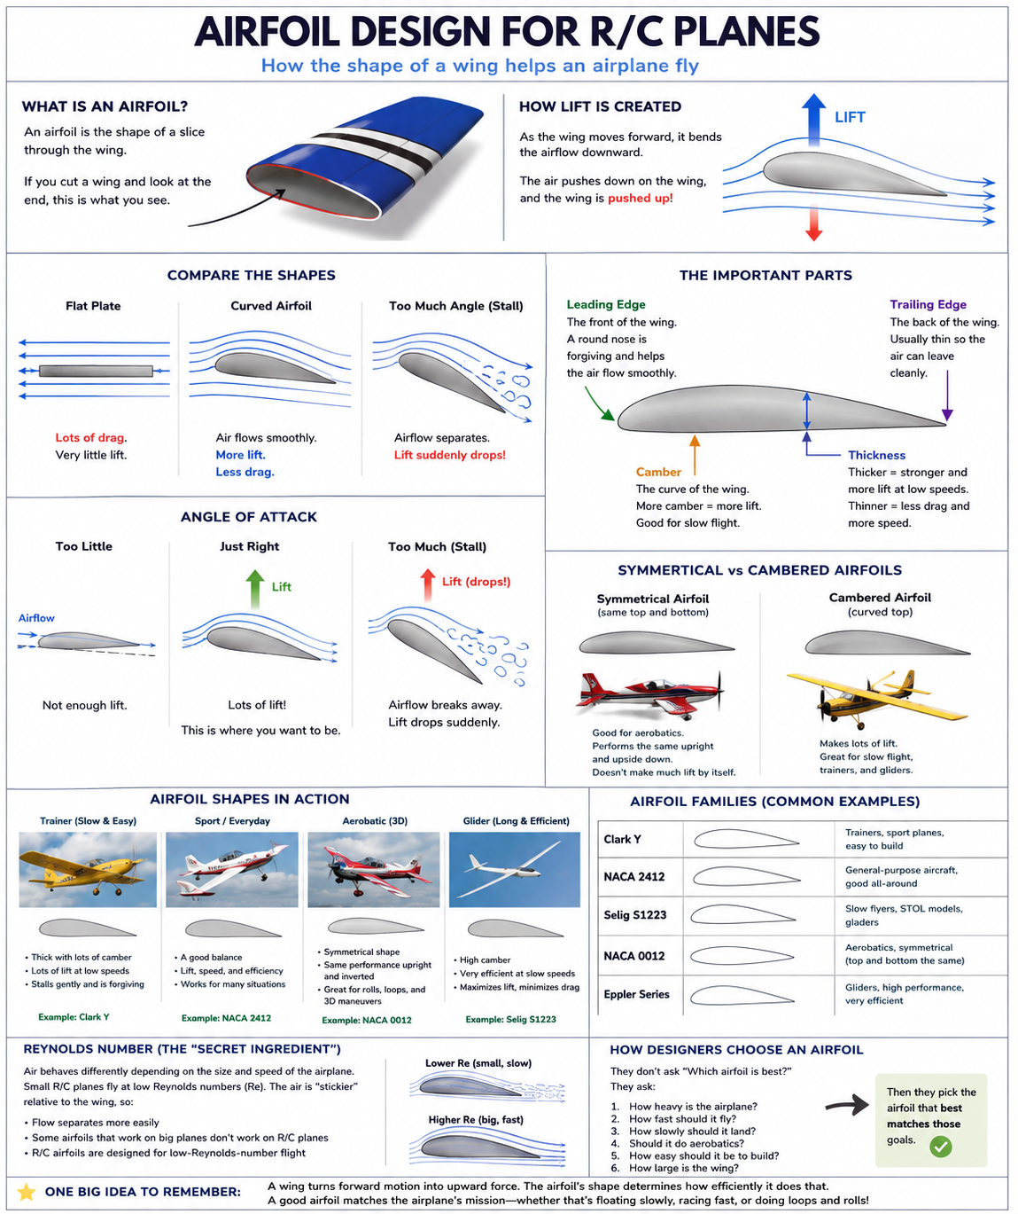
UNDERSTAND AIRFOILS
How designers choose an airfoil
Nobody asks “which airfoil is best?” — they ask which airfoil fits the mission, the mass, and the Reynolds number.
THE QUESTIONS DESIGNERS ASK
AIRFOIL ROLES AT A GLANCE
1
How heavy is the airplane?
Clark Y
Sets the lift the wing must make.
trainers; easy flat-bottom build
2
How fast should it cruise?
Sets the working Cₗ and drag priorities.
NACA 2412
sport all-rounder
3
How slowly must it land?
Sets the Cₗmax you need.
S1223
Will it fly inverted or do aerobatics?
slow flight, heavy lifting
4
Pushes toward symmetric sections.
NACA 0012
5
How easy must it be to build?
aerobatics, tails and fins
Flat bottoms and gentle curves are friendlier.
How small is the wing chord?
E387
6
Sets Reynolds number — small chords need low-Re sections.
gliders, efficient cruise
Details: next five pages. Full vocabulary: reference pages 40–44.
One big idea: the wing pushes air down, so the air pushes the wing up (Newton’s third law). The airfoil decides how efficiently that trade happens, over what speed range, and how gently it fails at the stall. Choose it after mission, mass, and wing loading are known — never before.
!
HOW TO READ THE NEXT FIVE PAGES
Each page gives one family: its geometry (thickness, camber, and where they peak), what it is best at, why it flies the way it does, what to watch while building, and rough R/C tendencies scored 0–5. The scores are habits, not test data — wing loading and Reynolds number can overturn them.
29

Slide 30
AIRFOIL FAMILY 1 OF 5
Clark Y: the friendly builder’s airfoil
A classic cambered section with a nearly straight aft lower surface
chord line
MAX THICKNESS
MAX CAMBER
PERSONALITY
11.7%
3.4%
steady
near 28% chord
near 42% chord
forgiving, not especially fast
WHY IT FLIES THIS WAY
BEST FOR
1
Moderate camber makes useful lift at a small angle of attack, so the airplane does not need to fly nose-high all the time.
High-wing trainers
Relaxed sport and scale models
Medium-to-slow electric aircraft
2
The rounded leading edge and fairly thick nose give the airflow room to stay attached as the angle increases.
BUILD NOTES
3
Its lower surface is close to straight over much of the rear half, which simplifies rib alignment during construction.
Keep the leading edge smooth and truly rounded.
Use the plan’s jigging or washout; avoid accidental wing twist.
Leave enough spar depth near the thickest part.
CONSTRUCTION PICTURE
WATCH-OUTS
Not equally good inverted.
Can become draggy when pushed fast.
A thick airfoil cannot rescue excessive wing loading.
A nearly straight aft lower surface makes alignment on a building board easier.
ROUGH R/C TENDENCIES (0–5)
Slow lift
Speed
Inverted
Not test data; wing loading and Reynolds number matter.
30
Geometry: UIUC Airfoil Coordinates Database (clarky.dat). Descriptions are practical R/C tendencies, not a substitute for wind-tunnel or XFOIL data at your model’s Reynolds number.

Slide 31
AIRFOIL FAMILY 2 OF 5
NACA 2412: the balanced all-rounder
A four-digit airfoil with moderate camber and useful structural thickness
chord line
MAX THICKNESS
MAX CAMBER
CAMBER LOCATION
12.0%
2.0%
40%
the “12” in its name
the first digit tells you this
the second digit tells you this
WHY IT FLIES THIS WAY
BEST FOR
1
Two percent camber gives more upright lift than a symmetric section without creating an extreme undercambered shape.
General sport models
Scale aircraft
Moderate aerobatics
2
Twelve percent thickness leaves useful room for a spar, servos, and a strong leading edge.
BUILD NOTES
3
It is a compromise: reasonably efficient, reasonably gentle, and capable of sport flying without specializing in one job.
The lower surface is curved, so use rib feet, tabs, or a jig.
Measure the 40% camber location from the leading edge.
Do not blunt the trailing edge more than the plan requires.
CRACK THE FOUR-DIGIT CODE
WATCH-OUTS
2
4
12
Upright and inverted trim will differ.
Full-size data may not match a small model’s Reynolds number.
2% maximum camber
camber peak at 40% chord
12% maximum thickness
Surface waves can erase a theoretical advantage.
ROUGH R/C TENDENCIES (0–5)
Slow lift
Speed
Inverted
Not test data; wing loading and Reynolds number matter.
31
Geometry: UIUC Airfoil Coordinates Database (naca2412.dat). Descriptions are practical R/C tendencies, not a substitute for wind-tunnel or XFOIL data at your model’s Reynolds number.

Slide 32
AIRFOIL FAMILY 3 OF 5
Selig S1223: high lift at low model speeds
A strongly cambered, low-Reynolds-number section for slow flight and heavy lifting
MAX THICKNESS
MAX CAMBER
PERSONALITY
12.1%
8.7%
high lift
forward, near 20% chord
far more than the other examples
slow, powerful, draggy when fast
WHY IT FLIES THIS WAY
BEST FOR
1
Very strong camber bends the airflow downward aggressively, allowing a large lift coefficient at low Reynolds numbers.
Slow flyers and STOL models
Payload or lift demonstrations
Models with short takeoff goals
2
The concave lower surface helps the section’s low-speed job but makes the rib and covering shape harder to preserve.
BUILD NOTES
3
High camber usually brings a stronger nose-down pitching moment, so the tail and center of gravity must be designed to balance it.
Cut the undercamber accurately; a flat shortcut changes the airfoil.
Support film covering so it does not bridge across the curve.
Make the thin trailing edge stiff enough to stay straight.
HIGH LIFT COMES WITH A TRIM COST
WATCH-OUTS
large lift
High drag at speed.
Poor inverted performance.
High lift does not mean stall-proof.
nose-down pitching moment
ROUGH R/C TENDENCIES (0–5)
The tail and center of gravity must balance that moment.
Slow lift
Speed
Inverted
Not test data; wing loading and Reynolds number matter.
32
Geometry: UIUC Airfoil Coordinates Database (s1223.dat). Descriptions are practical R/C tendencies, not a substitute for wind-tunnel or XFOIL data at your model’s Reynolds number.

Slide 33
AIRFOIL FAMILY 4 OF 5
NACA 0012: the same shape top and bottom
A 12%-thick symmetric section for aerobatics, tails, and predictable reversed flight
MAX THICKNESS
MAX CAMBER
ZERO-ANGLE LIFT
12.0%
0%
about 0
the “12” in its name
the two leading zeros
for an ideal 2-D section
WHY IT FLIES THIS WAY
BEST FOR
1
With no camber, the ideal section produces nearly zero lift at zero angle of attack.
Aerobatic and pattern models
Horizontal tails and fins
Aircraft that fly inverted often
2
A positive angle gives positive lift; the same negative angle gives nearly the same lift in the opposite direction.
BUILD NOTES
3
The 12% thickness provides useful spar depth without favoring upright flight over inverted flight.
There is no flat bottom, so use jig tabs or a split-shell method.
Mirror the ribs carefully; tiny asymmetry creates unwanted trim.
Keep the leading edge radius equal on both sides.
UPRIGHT AND INVERTED
WATCH-OUTS
lift
It still needs angle of attack to support weight.
Symmetric does not automatically mean low drag.
High wing loading still raises stall speed.
Same profile; reverse the angle of attack and the lift reverses.
lift relative to airplane
ROUGH R/C TENDENCIES (0–5)
Slow lift
Speed
Inverted
Not test data; wing loading and Reynolds number matter.
33
Geometry: UIUC Airfoil Coordinates Database (n0012.dat). Descriptions are practical R/C tendencies, not a substitute for wind-tunnel or XFOIL data at your model’s Reynolds number.

Slide 34
AIRFOIL FAMILY 5 OF 5
Eppler airfoils: a toolbox, not one shape
E387 is a low-Re example; other Eppler numbers were designed for very different missions
E387 THICKNESS
E387 CAMBER
FAMILY RANGE
9.1%
3.8%
very wide
near 31% chord
near 41% chord
glider, high lift, aerobatic, and more
WHY IT FLIES THIS WAY
BEST FOR
1
“Eppler” is a design family, not a single airfoil. The number after the name is essential.
E387: gliders and efficient models
E423: specialized high lift
E472: aerobatic applications
2
E387 is relatively thin with moderate camber and is listed as a low-Reynolds-number profile, which suits efficient light models.
BUILD NOTES
3
E423 is deeply cambered for high lift, while E472 is symmetric for aerobatics - proof that the family name alone predicts very little.
Choose the exact Eppler number for the mission.
Accurate ribs and a smooth surface matter more on efficient sections.
Match the airfoil to the model’s expected Reynolds number.
ONE NAME, VERY DIFFERENT JOBS
WATCH-OUTS
Do not specify only “Eppler.”
Roughness and dents can spoil low-drag behavior.
A profile tested at the wrong Reynolds number can mislead.
Always specify the number - “Eppler” by itself is incomplete.
ROUGH R/C TENDENCIES (0–5)
E387 slow eff.
E387 speed
Build ease
Not test data; wing loading and Reynolds number matter.
34
Geometry: UIUC Airfoil Coordinates Database (e387.dat). Descriptions are practical R/C tendencies, not a substitute for wind-tunnel or XFOIL data at your model’s Reynolds number.

Slide 35
R/C DESIGN EQUATIONS
The equations that connect shape to flight
Enough math to design intelligently — without pretending the model is simpler than it is
Core idea: in level flight L ≈ W. Speed appears squared, so small speed changes matter a lot. C_{L} and C_{D} change with angle of attack, airfoil, Reynolds number, and surface finish.
DYNAMIC PRESSURE
LIFT
DRAG
q = ½ ρ V²
L = q S C_{L}
D = q S C_{D}
q is the air’s “push strength.” ρ is air density and V is speed.
S is wing area. C_{L} packages the effects of shape and angle of attack.
C_{D} is the drag coefficient. It rises when the wing is rough, badly shaped, or near stall.
Double speed → four times q.
Level flight needs L about equal to weight.
More lift usually costs some drag.
STALL SPEED
REYNOLDS NUMBER
WING GEOMETRY
V_{stall} = √(2W / ρSC_{Lmax})
Re = ρ V c / μ
AR = b² / S and W/S
W is weight and C_{Lmax} is the largest lift coefficient before stall.
c is chord and μ is air viscosity. Re tells you how “sticky” the airflow acts.
AR is aspect ratio; b is span. W/S is wing loading.
Lighter + larger wing + higher C_{Lmax} = slower stall.
Small, slow R/C wings usually have low Re.
Long wings reduce induced drag; low wing loading helps slow flight.
WORKED EXAMPLE: A 1.5 KG SPORT MODEL
Given: wing area S = 0.35 m², average chord c = 0.25 m, span b = 1.40 m, speed V = 12 m/s, C_{L} = 0.60, C_{Lmax} = 1.20. Use ρ = 1.225 kg/m³ and μ = 1.81 × 10⁻⁵ Pa·s.
1. Weight
W = mg = 1.5 × 9.81 = 14.7 N
b = 1.40 m
2. Air push
q = ½ × 1.225 × 12² = 88 Pa
3. Lift
L = 88 × 0.35 × 0.60 = 18.5 N
4. Stall speed
V_{stall} ≈ 7.6 m/s = 27 km/h
5. Reynolds number
Re ≈ 2.0 × 10⁵
S = 0.35 m²
6. Aspect ratio
AR = 1.40² / 0.35 = 5.6
18.5 N of lift is greater than 14.7 N of weight, so at that speed and C_{L} the model would climb - or it could lower its angle of attack.
Equations and definitions: NASA Glenn Research Center, Beginners Guide to Aeronautics (lift equation, drag equation, Reynolds number). Example uses sea-level standard density and is an estimate, not a flight-test result.
35

Slide 36
R/C DESIGN EQUATIONS
Where the equations come from
Nothing on the previous page is memorized magic — each result is a few lines of algebra away from L = W.
STALL SPEED, DERIVED
LOAD FACTOR IN A BANK, DERIVED
1
Level flight: L = W
1
Bank angle φ tilts the lift
The wing exactly supports the weight — the starting point for everything.
Lift stays perpendicular to the wings, so it leans with them.
2
W = ½ ρ V² S C_{L}
2
Vertical part: L cos φ
Substitute the lift equation for L.
Only this component fights gravity (see page 8).
3
Slowest flight → C_{L} = C_{Lmax}
3
Steady height: L cos φ = W
Flying slower means more lift coefficient; the most you can ask for is Cₗmax.
Not climbing, not sinking — vertical forces balance.
4
V², isolated: V² = 2W / (ρ S C_{Lmax})
4
n ≡ L / W = 1 / cos φ
Multiply both sides by 2, divide by ρ S Cₗmax.
Define load factor n as lift over weight; divide step 3 by W cos φ.
5
Take the square root
5
V_{stall} ∝ √L → multiply by √n
Speed must be positive — done.
Stall speed scales with the square root of the lift demanded.
V_{stall} = √( 2W / ρ S C_{Lmax} )
V_{s,turn} = V_{s} √n = V_{s} / √(cos φ)
!
When you can re-derive a formula, you own it: you know exactly which assumptions it hides (steady flight, constant density, rigid wing) and when it stops being true.
YOUR TURN
?
Derive the general level-flight speed for any Cₗ (not just Cₗmax). Then compute the worked trainer’s speed at Cₗ = 0.4 with W = 14.7 N, S = 0.333 m². Check: you should get ≈ 13.4 m/s.
Both derivations assume steady, unaccelerated flight at sea-level density.
36

Slide 37
R/C DESIGN EQUATIONS
Induced drag: the price of making lift
The one equation missing from most beginner guides — and the reason gliders have long, skinny wings.
THE EQUATION
READ IT LIKE AN ENGINEER
C_{D,i} = C_{L}² / ( π · AR · e )
• Cₗ is squared: fly twice the lift coefficient, pay four times the induced drag.
• AR is in the denominator: longer wings pay less for the same lift.
• It has nothing to do with surface finish — this drag exists because lift exists.
e is the span-efficiency factor: 1.0 for a perfect elliptical lift distribution, typically 0.7–0.85 for straight R/C wings. Everything else you already know.
WHERE IT COMES FROM
WORKED NUMBERS — YOUR TRAINER
AR = 6.5, e ≈ 0.8, so π·AR·e ≈ 16.3
Cruise, Cₗ = 0.60:
C_{D,i} = 0.36 / 16.3 ≈ 0.022
Slow pass, Cₗ = 1.10:
C_{D,i} = 1.21 / 16.3 ≈ 0.074 — 3.4× more
Slow flight is draggy flight: throttle up before you slow down.
low pressure above
leaks around the tips
Air spills around each tip → trailing vortices → the wing flies in its own downwash → the lift vector tilts back. That backward tilt is induced drag.
Every gram costs twice: more weight → more Cₗ needed at the same speed → more induced drag → more power → bigger battery → more weight. This is why the mass budget on the worked-trainer pages matters so much.
!
YOUR TURN
?
Halve the aspect ratio to 3.25 (same area). What happens to C_{D,i} at Cₗ = 0.6? Now explain why an albatross — which soars for hours without flapping — has AR ≈ 15.
C_{D,i} = Cₗ²/(π·AR·e): standard finite-wing result (Prandtl lifting-line theory); see NASA Glenn induced-drag pages.
37

Slide 38
R/C DESIGN EQUATIONS
The lift curve: what Cₗ actually does
One graph ties together angle of attack, Cₗmax, and the stall — read it once and pages 14, 33, and 41 snap into place.
Cₗ
Cₗmax = 1.2
1.0
linear region:
≈ 0.08 Cₗ per degree
0.5
cruise trim
stall: flow separates,
lift falls, drag soars
critical angle ≈ 13°
cambered wing: zero lift
at −4°, real lift at 0°
5°
10°
15°
20°
angle of attack α
READ IT LIKE THIS
WHY IT MATTERS
CAMBER SHIFTS IT
More angle → more lift, click for click, until the boundary layer gives up. The curve is honest: nothing warns you at 12.9°.
The elevator commands α, so it commands Cₗ. A stall is exceeding the critical angle — possible at any airspeed, upright or inverted (page 41).
A symmetric section (NACA 0012) passes through the origin. Camber slides the whole line left — free lift at zero angle, at the cost of a nose-down pitching moment.
YOUR TURN
?
Sketch the NACA 0012 curve on top of this one (same slope, through the origin, Cₗmax ≈ 1.0 at model Reynolds numbers). Where do the two wings trim differently? Which stalls first at the same α?
Illustrative curve for a cambered trainer section near Re ≈ 2×10⁵; slope and Cₗmax vary with section and Reynolds number.
38

Slide 39
R/C DESIGN EQUATIONS
Reynolds number: why small models feel different air
Re appears on half the pages of this manual — here is the number line that makes it concrete.
THE DEFINITION
SEA-LEVEL SHORTCUT
Re = ρ V c / μ
Re ≈ 68 000 × V × c
Speed × chord × density, against viscosity: how much the air behaves like a crowd in motion versus honey.
V in m/s, c in metres. The trainer at 12 m/s with 0.226 m chord: Re ≈ 68 000 × 12 × 0.226 ≈ 1.8×10⁵.
WHERE R/C AIRCRAFT LIVE ON THE Re SCALE
laminar-separation trouble zone
indoor / micro models
foam park flyers
YOUR 1.5 kg TRAINER — cruise dot ≈ 1.8×10⁵
giant scale
full-scale light aircraft
10⁴
10⁵
10⁶
10⁷
BELOW ~10⁵, THINGS GET WEIRD
WHAT TO DO ABOUT IT
The boundary layer stays laminar, separates early, and may not reattach: Cₗmax drops, drag rises, and stalls sharpen. Full-size airfoil data quietly stops being true.
• Prefer sections designed for low Re (E387, S1223 class) and data from UIUC low-speed tests.
• Keep the leading edge accurate and the skin smooth.
• Remember the tips: smaller chord = lower Re = they misbehave first.
YOUR TURN
?
Compute Re at the trainer’s wing in a slow landing: V = 6 m/s, c = 0.226 m. Is it inside the trouble zone? (Re ≈ 92 000 — marginal, which is why landings expose bad wings.)
Re = ρVc/μ with sea-level ρ/μ ≈ 68 000 s/m². Band edges are indicative, not sharp physical boundaries.
39

Slide 40
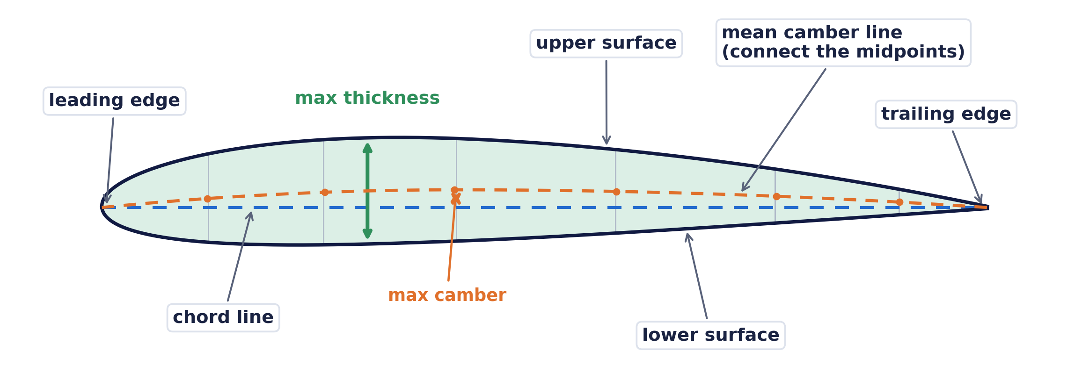
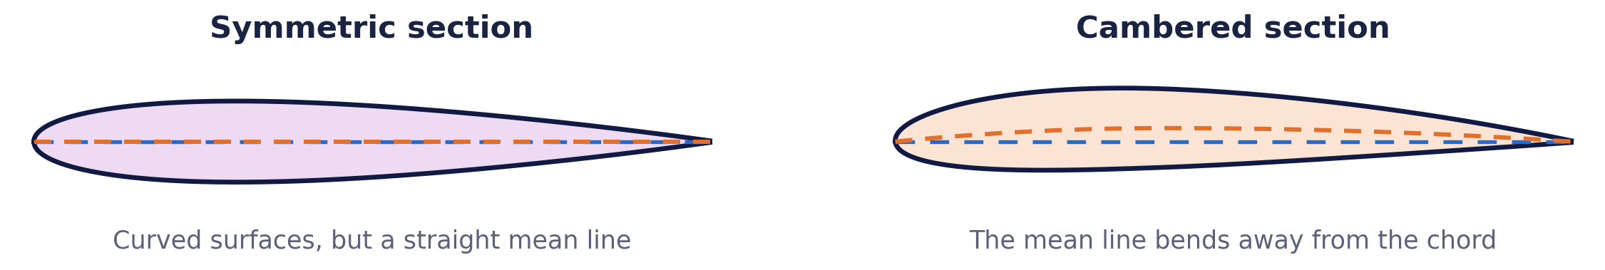
REFERENCE — AIRFOIL VOCABULARY 1 OF 5
Airfoil anatomy: camber, thickness, and chord
Camber, thickness, chord, and surfaces describe different parts of the same cross-section
At each chord position, the orange dot is halfway between the upper and lower surfaces. Connecting those dots makes the mean camber line.
CAMBER
THICKNESS
CHORD
The curve of the mean camber line - not the curve of the top or bottom by itself. Because the mean line is built from midpoints, camber depends on both surfaces. Max camber is usually written as a percentage of chord.
The distance between the upper and lower surfaces. Maximum thickness tells you the thickest part of the section, often as a percentage of chord. A thick airfoil can leave more room for a strong spar.
The straight line from the leading edge to the trailing edge. Chord length is written c. Locations such as "40% chord" are measured back from the leading edge along this line.
CURVED DOES NOT AUTOMATICALLY MEAN CAMBERED
THE IMPORTANT TEST
Ask what the mean camber line does. - Straight mean line: zero camber, even when both surfaces are curved. - Bent mean line: cambered airfoil. - The largest gap between the mean line and chord is the maximum camber. This is why a symmetric NACA 0012 has curved surfaces but 0% camber.
Standard aerodynamic terminology; generic diagrams are simplified and not to scale.
40

Slide 41
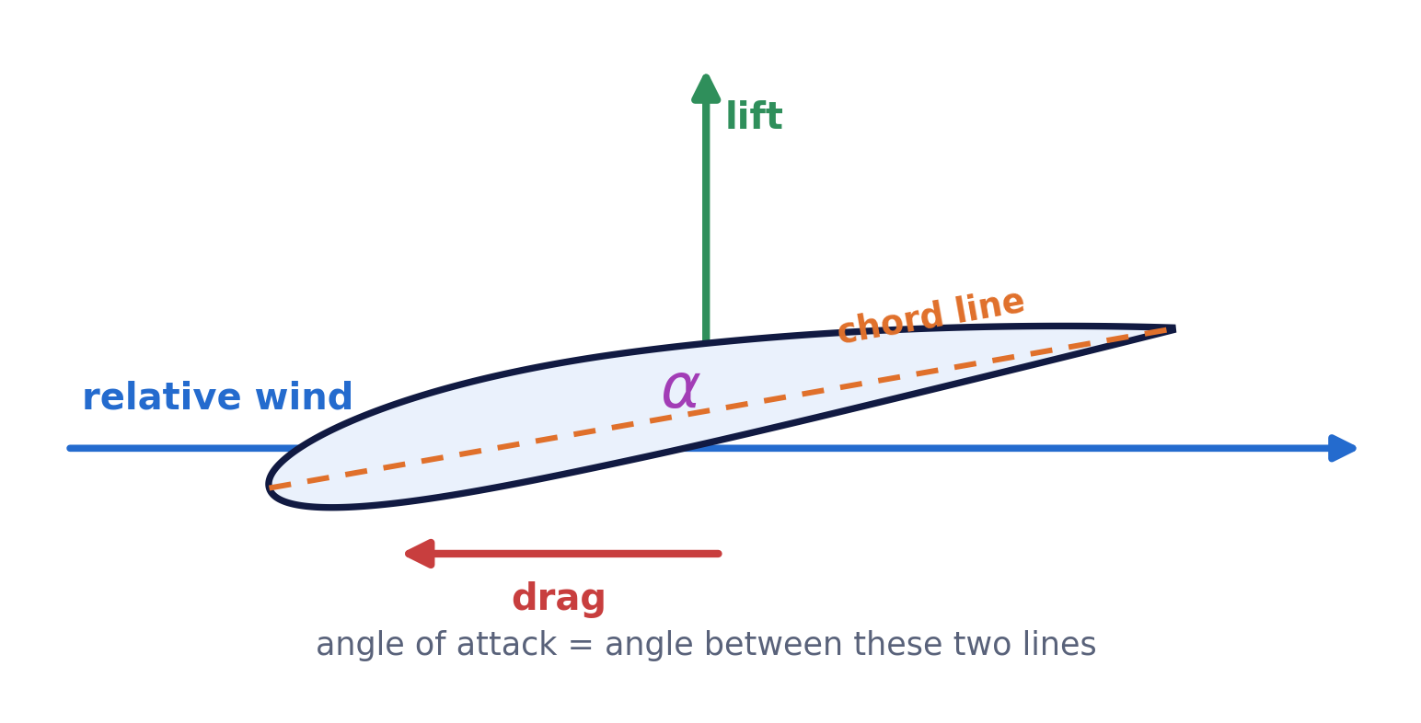
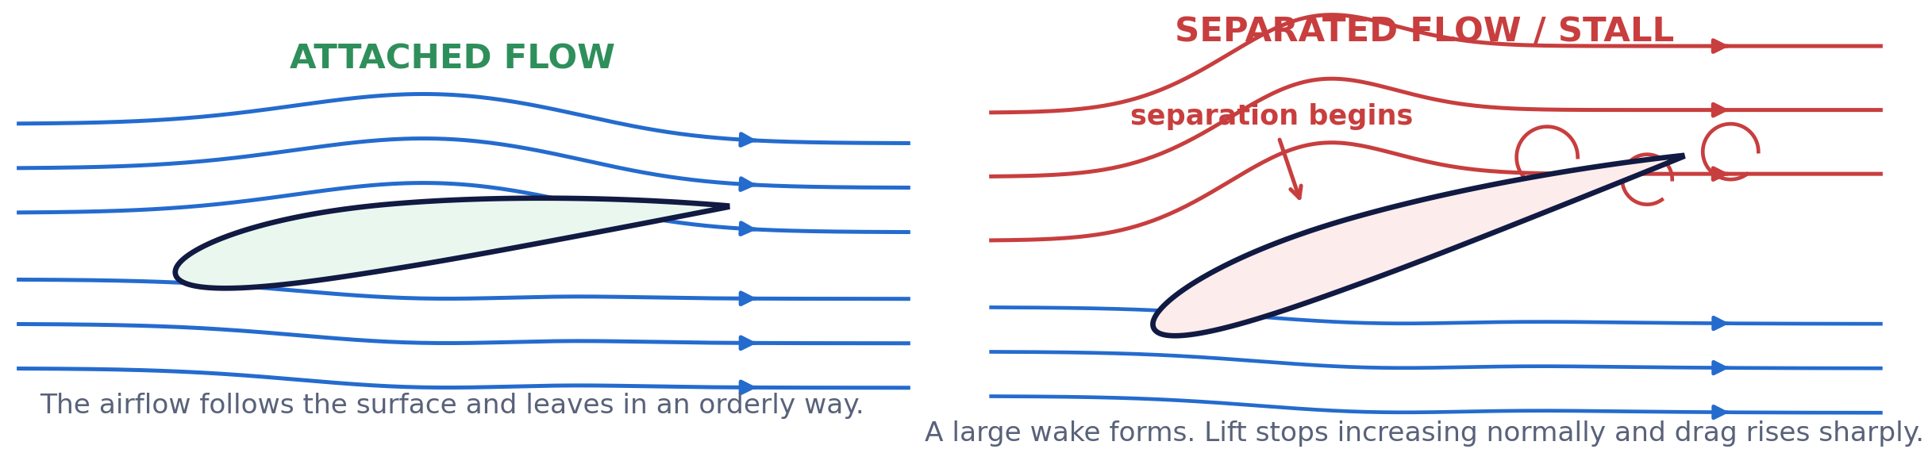
REFERENCE — AIRFOIL VOCABULARY 2 OF 5
Angle of attack, airflow, lift, drag, and stall
These words describe the wing relative to the air - not just relative to the ground or horizon
FOUR LINES AND ANGLES TO KEEP SEPARATE
W
Relative wind
The airflow direction the wing feels. It points opposite the aircraft's path through the air.
c
Chord line
A line fixed in the wing from leading edge to trailing edge.
α
Angle of attack
drag
The angle between the chord line and relative wind. It changes during flight.
P
Pitch attitude
Lift is perpendicular to the relative wind. Drag points along it — downstream.
The nose angle relative to the horizon. It is not automatically the same as angle of attack.
ATTACHED FLOW VERSUS SEPARATED FLOW
BOUNDARY LAYER
SEPARATION
STALL
A very thin layer of air next to the surface. Skin friction slows it down. Even though the main airflow is fast, the air touching the wing has nearly zero speed relative to the surface.
When the boundary layer no longer has enough energy to follow the surface, it peels away. The separated region creates a larger wake, more drag, and less predictable lift.
A stall happens when the wing exceeds its critical angle of attack and large-scale separation develops. It can happen at any airspeed. Low speed matters because holding the airplane up then requires more angle of attack.
Lift and drag directions are defined relative to the airflow; diagrams show the ideas rather than exact flow fields.
41

Slide 42
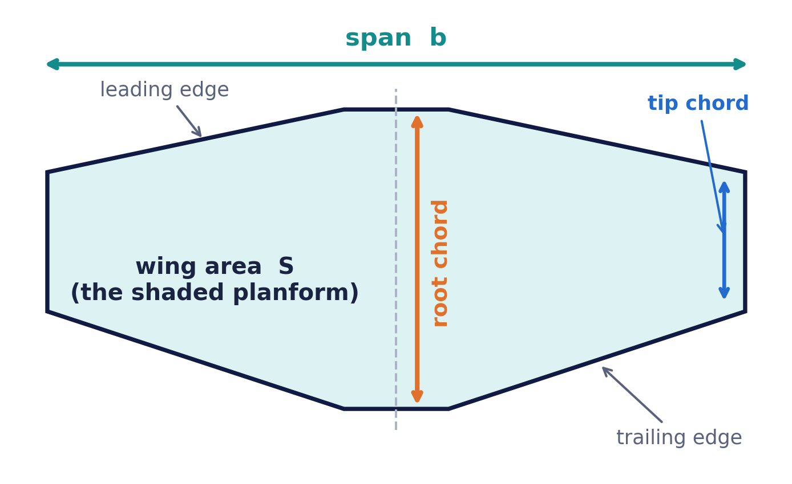
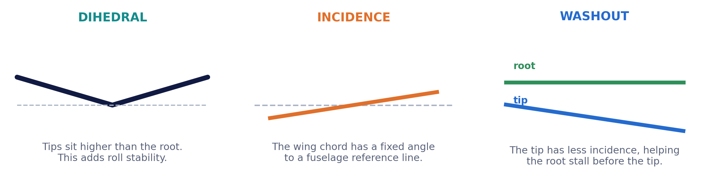
REFERENCE — AIRFOIL VOCABULARY 3 OF 5
Wing geometry: span, area, loading, and twist
An airfoil is one slice; the complete wing adds planform shape, spanwise angles, and structural limits
Planform means the outline seen from above. Wing area S is the area inside that outline.
SPAN, CHORD, AND AREA
ASPECT RATIO AR
WING LOADING W/S
Span b is tip-to-tip distance. Chord c is leading-edge to trailing-edge distance. On a tapered wing the chord changes, so designers may use a representative mean aerodynamic chord. Wing area S is the planform area.
AR = b²/S. A long, narrow wing has a higher aspect ratio than a short, wide wing of the same area. Higher AR usually reduces induced drag, but it also increases bending loads and may need a stronger spar.
Weight divided by wing area. Lower wing loading usually means slower takeoff, landing, and stall speeds. Higher loading often feels faster and more solid in wind, but demands more speed and stronger structure.
ANGLES BUILT INTO THE COMPLETE WING
Incidence is fixed by construction. Angle of attack changes in flight. Washout is an intentional change in incidence from root to tip.
Standard wing-geometry definitions; unusual planforms can require more specialized area and chord conventions.
42

Slide 43
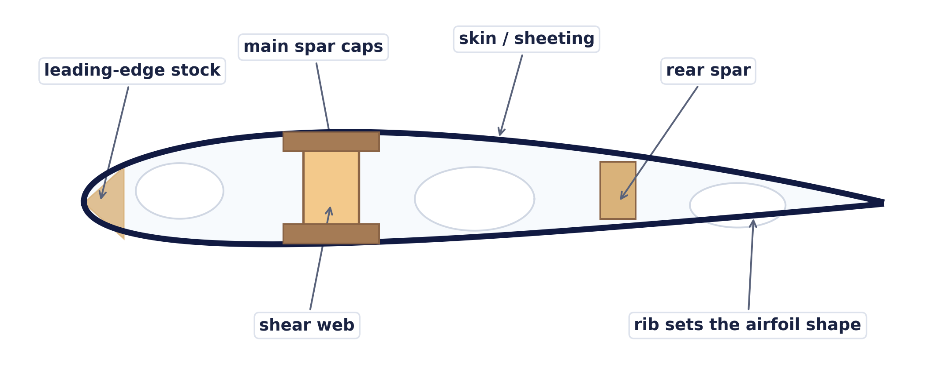
REFERENCE — AIRFOIL VOCABULARY 4 OF 5
Built-up wing terms: what the parts do
A good airfoil drawing only becomes a good wing when the structure holds that shape accurately
This is a conventional balsa-style cutaway. Foam, composite, and printed wings use different parts but must carry the same loads.
RIB, SPAR, AND SHEAR WEB
SKIN, SHEETING, AND SURFACE FINISH
A rib is the cross-section frame that sets the airfoil shape. The spar is the main spanwise beam that resists bending. Spar caps carry most of the tension and compression; the shear web joins them and resists sliding forces.
The skin creates the smooth outer surface. Sheeting can also form a torsion-resistant box with the spar. Dents, wrinkles, open gaps, and a blunt trailing edge disturb the boundary layer - especially on small, low-Reynolds-number models.
JIG, BUILDING BOARD, AND TWIST
CENTER OF GRAVITY AND PITCHING MOMENT
A jig or flat building board holds parts while glue cures. Twist means the local wing angle changes along the span. Planned washout is useful; accidental twist can make one wing stall first and cause a sudden roll.
The center of gravity (CG) is the balance point of the complete aircraft. Its location strongly affects stability. Pitching moment is the airfoil's tendency to rotate nose-up or nose-down; cambered sections often have a nose-down tendency that the tail must balance.
Construction methods vary; the load paths and alignment ideas apply to most R/C wings.
43

Slide 44
REFERENCE — AIRFOIL VOCABULARY 5 OF 5
Equation symbol key: how to read the math page
A symbol is just a short name. The units tell you what kind of quantity it represents
Coefficient means a unitless score that packages the effects of shape and conditions. Subscript max means the largest value reached before the stated limit.
FORCES AND MOTION
AIR AND PRESSURE
L
Lift [N]
ρ
rho: density [kg/m³]
Force perpendicular to the relative wind.
How much air mass is packed into a volume.
D
Drag [N]
μ
mu: viscosity [Pa s]
Force parallel and opposite to the relative wind.
How strongly the air resists layers sliding past each other.
W
Weight [N]
q
Dynamic pressure [Pa]
Gravity force. W = mass x 9.81 near Earth.
q = 1/2 rho V². A measure of the airflow's push strength.
V
Airspeed [m/s]
α
alpha: angle of attack [deg]
Speed through the air, not necessarily ground speed.
The angle between chord line and relative wind.
WING GEOMETRY
COEFFICIENTS AND RESULTS
S
Wing area [m²]
CL
Lift coefficient, C_{L}
Planform area of the complete wing.
How strongly the wing makes lift at this angle and condition.
b
Span [m]
CD
Drag coefficient, C_{D}
Tip-to-tip distance.
How strongly the aircraft makes aerodynamic drag.
c
Chord [m]
CLmax
Maximum lift coefficient, C_{Lmax}
Leading-edge to trailing-edge distance.
The greatest C_{L} reached before lift begins to fall near stall.
AR
Aspect ratio [none]
Re
Reynolds number [none]
AR = b²/S. A shape ratio, so it has no units.
Compares motion effects with viscous or "sticky" effects.
HOW THE MAIN EQUATIONS CONNECT
FORCE
SCALING
STALL SPEED
L = q S C_{L} D = q S C_{D}
Re = rho V c / mu AR = b²/S
V_{stall} = sqrt(2W / rho S C_{Lmax})
Air push x area x coefficient
Size, speed, air, and planform
More weight raises it; more area lowers it
Symbols match the equation page. SI units are shown; model-aircraft practice may also use g/dm², oz/ft², mph, or km/h.
44

Slide 45
R/C DESIGN & BUILD MANUAL
03
Build the structure
The aerodynamic design only exists in the air if the finished model is straight, stiff enough, light enough, and reliably connected.
Think → calculate → build straight → test carefully → improve one change at a time.
45

Slide 46
BUILD THE STRUCTURE
Choose a construction method that matches the mission
The “best” material is the one that meets stiffness, mass, repair, cost, and accuracy needs.
BALSA / PLYWOOD
FOAMBOARD / DEPRON
• Light, stiff, repairable, and precise.
• Excellent for built-up wings and box fuselages.
• Requires grain awareness, jigs, and finishing.
• Fast and inexpensive prototypes.
• Folded skins can form strong box structures.
• Paper and hot glue can add surprising mass.
EPP / EPO / MOLDED FOAM
3D PRINT / COMPOSITE / HYBRID
• Tough and practical for trainers.
• Adhesive compatibility matters.
• Local reinforcement is needed at mounts and hinges.
• Can create complex, repeatable shapes.
• Printed shells can be heavy or brittle.
• Composites are efficient but require process control and safety gear.
Prototype the hardest joint first: wing joiner, landing-gear plate, motor mount, removable wing, or control hinge. A weak joint can erase the advantage of strong material.
!
46

Slide 47
BUILD THE STRUCTURE
Adhesives: match the glue to the load and material
Glue is part of the structure. More glue is often heavier—not stronger.
ADHESIVE
GOOD USE
ADVANTAGE
WATCH OUT
Thin CA
Tight balsa joints
Fast, light wicking bond
Brittle; fumes; bonds skin instantly
Medium / thick CA
Small gaps, field repairs
Fast and convenient
Use foam-safe type where required
Aliphatic / PVA
Wood-to-wood joints
Sandable, tough, low odor
Needs clamping and cure time
Epoxy
Motor mounts, joiners, mixed materials
Gap filling; strong when joint is designed well
Heavy; mixing accuracy; sensitization risk
Hot glue
Foamboard prototypes
Fast; fills gaps
Heavy; softens with heat; bulky fillets
Contact / foam adhesive
Foam skins and large areas
Flexible; spreads load
Ventilation; compatibility; cure time
Design the joint so parts fit and loads flow through overlapping material, doublers, tabs, or gussets. Glue should transfer load—not bridge a badly fitting gap by itself.
!
Follow adhesive safety data, ventilation requirements, cure times, and foam compatibility instructions.
47

Slide 48
BUILD THE STRUCTURE
Wing structure: bending, shear, and torsion
A wing must resist bending upward and twisting under aerodynamic and control loads.
CROSS-SECTION THROUGH THE WING (one rib bay)
spar caps carry bending
skin sets the shape
rib holds it all in the airfoil shape
D-box skin resists twist
shear web joins the caps
lightening hole: keeps the rib light where stresses are low
ROUGH ROOT MOMENT
LOAD PATH
M_{root} ≈ n W b / 8
• Upper and lower spar caps carry most bending tension/compression.
• Shear web keeps the caps working together.
• Closed leading-edge skin or D-box resists twist.
Idealized uniformly loaded straight wing. n is load factor, W weight, b span.
CRITICAL LOCATIONS
DESIGN HABIT
• Wing root and joiner.
• Landing-gear attachment.
• Servo and control-surface cutouts.
• Avoid abrupt stiffness changes.
• Reinforce load entry points.
• Test a spare joint to failure.
YOUR TURN
?
Your 1.5 kg trainer pulls a 60° banked turn (n = 2). Estimate the root moment: Mᵣₒₒₜ ≈ 2 × 14.7 N × 1.47 m / 8 ≈ 5.4 N·m — like holding a 1 kg water bottle half a metre from your wrist. Would a bare 6 mm balsa spar take it?
The root-moment expression is a first-order check, not a complete structural analysis or gust-load model.
48

Slide 49
BUILD THE STRUCTURE
A repeatable wing-building sequence
Accuracy is easiest when the wing is built over a flat datum and checked before every irreversible step.
1
PREPARE
Full-size plan, protected flat board, matched ribs, straight spars, labeled left/right parts.
2
PIN THE DATUM
Lower spar or lower skin fixed straight; root and tip blocks establish incidence and washout.
3
BUILD THE SKELETON
Ribs square to the board; add spars, web, leading edge, trailing edge, servo mounts.
4
LOCK IN TORSION
Add D-box, top skin, or folded skin while the panel is still held in the jig.
5
JOIN PANELS
Set dihedral with a gauge; reinforce joiner and root; verify both incidences match.
6
FIT CONTROLS
Cut free surfaces, bevel, hinge, install horns, route leads, and check full travel.
7
FINISH AND RECHECK
Cover symmetrically; remove any warp with heat and measurement—not guesswork.
!
Do not “build the warp out later.” The covering stage can correct small errors, not a fundamentally crooked structure.
49

Slide 50
BUILD THE STRUCTURE
Fuselage and tail: make the reference geometry real
A straight fuselage and square tail reduce trim drag and prevent mysterious handling problems.
SIDE — every angle from ONE datum
TOP — diagonals must match
REAR — fin vertical
wing incidence vs datum
tail incidence vs datum
plumb / square reference
datum
formers square to the datum
A
B
Draw the datum on the plan and on the board. Wing and tail incidences are measured from it — never from each other, never by eye.
A = B, or the tail is skewed
90° to the tailplane
Tape from each wingtip to the opposite stab tip before the glue cures.
Sight it from the front AND the rear — twist hides from one side.
FUSELAGE BOX
TAIL MOUNTING
• Use a straight centerline and square formers.
• Add doublers where wing, gear, battery, and motor loads enter.
• Provide cooling inlet and a larger exit path.
• Horizontal tail square to centerline and at intended incidence.
• Fin vertical when viewed from front and rear.
• Use temporary strings or diagonal measurements before gluing.
ACCESS
CRASHWORTHINESS
• Battery removable without disturbing controls.
• Receiver and linkages inspectable.
• Wing fasteners reachable.
• Let inexpensive parts fail before expensive ones.
• Avoid battery contact with sharp structure.
• Secure canopy and hatch.
Measure from a common datum. “Looks straight” is not a measurement.
50

Slide 51
BUILD THE STRUCTURE
Hinges, horns, and pushrods
The control system must move freely with almost no looseness and remain secure under vibration.
inner servo hole = more force, less travel
surface swings through this arc
outer hole = bigger swing
inner hole
SERVO
control horn near hinge line
HINGE LINE
CONTROL HORN
• Straight and aligned.
• Small gap.
• Enough bevel for travel.
• Every hinge bonded on both sides.
• Load spread into solid structure.
• Hole close to hinge line.
• No soft foam crushing beneath it.
PUSHROD
BENCH TEST
• Short, straight, and supported.
• No buckling under push load.
• Thread lock only where appropriate.
• Full travel without binding.
• Surface returns to exact neutral.
• No buzz, flex, or lost motion.
Control-system failures are single-point failures. Use positive retainers and inspect before every session.
51

Slide 52
BUILD THE STRUCTURE
Alignment, covering, and finish
A glossy finish cannot compensate for mismatched angles or a warped wing.
BEFORE COVERING
DURING COVERING
Wing panels match in incidence and washout.
Shrink opposite sides in stages.
Horizontal tail is square to the fuselage centerline.
Support the panel on a flat jig.
Fin is vertical.
Recheck twist while the material is still warm.
Control surfaces straight; hinge gaps consistent.
Keep heat away from foam and plastic parts.
AFTER COVERING
FINISHING DISCIPLINE
Measure root and tip angles again.
Paint and filler have real mass.
Check the wing join and fasteners.
Keep the tail especially light.
Verify all controls move freely.
Balance the spinner and propeller.
Open cooling paths and servo hatches.
Mark the CG points permanently under the wing.
52

Slide 53
BUILD THE STRUCTURE
Weight distribution and component placement
The lightest airplane is not enough; mass must also be located where the design can balance without dead ballast.
TAIL SERVOS?
MOTOR + ESC
CG
RECEIVER
BATTERY SLIDES
PLACEMENT ORDER
AVOID DEAD BALLAST
• Fix immovable masses first: motor, landing gear, servos.
• Create a useful battery adjustment range.
• Keep receiver and antennas away from high-current wiring.
• Move battery, servos, or equipment before adding lead.
• A heavy tail requires a much larger nose correction.
• Long tail pushrods may be lighter than tail-mounted servos.
MOMENT BALANCE
INSTALLATION RULE
Σ(m × distance) = 0
• Secure the battery for all flight loads.
• Protect it from sharp edges.
• Keep access simple enough that it is always installed correctly.
Measure distances from the desired CG. Nose moments balance tail moments.
Balance the complete flight-ready aircraft with the actual propeller, battery, hatch, and landing gear installed.
53

Slide 54
R/C DESIGN & BUILD MANUAL
04
Choose the systems
The power system, propeller, battery, radio, servos, and wiring must work as one tested combination—with thermal and electrical margin.
Think → calculate → build straight → test carefully → improve one change at a time.
54

Slide 55
CHOOSE THE SYSTEMS
Power, thrust, and propeller basics
Power tells you how quickly work can be done. Thrust is the force that accelerates the airplane.
BATTERY
ESC
MOTOR
PROP
Voltage sets potential speed. Current creates torque. The propeller turns power into thrust.
TRAINER
SPORT
HIGH PERFORMANCE
100–150 W/kg
150–220 W/kg
220–350+ W/kg
broad starting range
broad starting range
mission dependent
PROPELLER DIAMETER
PROPELLER PITCH
• More disk area; usually more static thrust.
• Raises motor torque and current.
• Needs ground and fuselage clearance.
• Higher pitch tends toward higher pitch speed.
• Can overload the motor.
• Prop efficiency depends on aircraft speed and operating point.
Never choose the propeller from diameter and pitch alone. Use motor/prop/battery test data and verify voltage, current, power, temperature, and RPM with the actual installation.
!
Power-to-mass bands are broad hobby starting points. The manufacturer’s tested combinations take priority.
55

Slide 56
CHOOSE THE SYSTEMS
Motor Kv, battery, ESC, and BEC
The labels describe different limits. No single number tells you whether the system is safe.
MOTOR KV
BATTERY
Kv is approximately no-load RPM per volt. It is not a power rating. Propeller load, winding resistance, voltage, cooling, and current limit determine usable output.
Cell count sets nominal voltage. Capacity sets stored charge. C rating claims current capability, but voltage sag, connector quality, age, and temperature also matter.
ESC
BEC / RECEIVER POWER
Must tolerate measured current, battery voltage, switching load, and temperature. Provide cooling and margin. Program brake and timing only when the motor/prop combination requires it.
The BEC powers receiver and servos. Confirm voltage compatibility and current capacity—especially with many digital servos or high-voltage servos.
ELECTRICAL POWER
IDEAL NO-LOAD RPM
P = V × I
RPM ≈ Kv × V
A 3S pack near 11.1 V delivering 20 A supplies about 222 W before losses.
Loaded RPM is lower. This estimate does not approve a propeller.
LiPo safety: use the correct charger mode and cell count, inspect for damage or swelling, charge in a suitable fire-resistant location, never short the pack, and follow the battery manufacturer’s storage and disposal instructions.
!
Always follow component manufacturer limits and local safety guidance.
56

Slide 57
CHOOSE THE SYSTEMS
Worked propulsion choice for the 1.5 kg trainer
Select a tested combination, then verify it with a wattmeter and temperature checks.
TARGET POWER
NOMINAL VOLTAGE
IDEAL CURRENT
≈ 225 W
11.1 V
≈ 20.3 A
150 W/kg × 1.5 kg
3S LiPo
225 W ÷ 11.1 V
≈ 20.3 A
3S LiPo
+
wattmeter
ESC
ground test
30 A · BEC 5 V
MOTOR
10×6 prop
11.1 V · 2200 mAh
−
outrunner
swap any two
to reverse
BEC: 5 V + signal
RECEIVER
to servos
Thick lines: the high-current loop (battery → ESC → motor). Thin lines: the BEC control side. Measure at the battery lead during the ground test.
CANDIDATE SYSTEM
GROUND TEST
• 3S 2200 mAh LiPo.
• Outrunner and propeller combination documented around 220–240 W.
• ESC rated at least 30 A with an adequate BEC.
• Connector and wiring sized for measured current.
• Restrain aircraft safely; stay outside propeller arc.
• Measure current and power at full throttle briefly.
• Check motor, ESC, battery, and connectors for heat.
• Repeat with cowling installed to verify cooling.
Do not “prop up” until the current reaches the ESC label. Current limits are maximums, not performance targets. Leave thermal and operating margin.
!
57

Slide 58
CHOOSE THE SYSTEMS
Radio, servo, and wiring architecture
A clean installation makes failures less likely and troubleshooting much faster.
motor
antennas at 90°, clear of ESC and motor wires
swap any two motor wires to reverse
RECEIVER
L AILERON
1 AIL
Y-lead
3S LiPo
ESC 30 A
2 ELE
R AILERON
11.1 V
BEC 5 V
throttle lead:
signal + BEC 5 V
3 THR
XT60
4 RUD
ELEVATOR
bind / batt spare
RUDDER
HIGH-CURRENT SIDE — thick, short, compact
SIGNAL SIDE — keep clear of power wires
extensions clipped or taped — never loose
One plug does double duty: the throttle lead carries the ESC signal out and BEC power in — it is the receiver’s only power source. Check its polarity twice.
SERVO SELECTION
RECEIVER INSTALLATION
• Enough torque at the actual supply voltage.
• Speed appropriate to aircraft.
• Metal gears are not automatically better.
• Mount rigidly; isolate vibration where specified.
• Antennas oriented as manufacturer specifies.
• Away from motor wires, ESC, carbon shielding, and metal.
• Secure against vibration but do not crush.
• Easy bind and status access.
FAILSAFE
WIRE MANAGEMENT
• Set throttle to safe/off position.
• Choose sensible control positions.
• Test by switching transmitter off only according to radio instructions.
• Strain relief at connectors.
• No rubbing on sharp edges.
• Servo extensions positively retained.
• High-current loops kept compact.
Follow the radio manufacturer’s installation, range-test, antenna, failsafe, and power-supply instructions.
58

Slide 59
R/C DESIGN & BUILD MANUAL
05
Test, fly, and improve
A maiden flight is a controlled experiment. The goal is not to prove the airplane perfect—it is to collect safe evidence.
Think → calculate → build straight → test carefully → improve one change at a time.
59

Slide 60
TEST, FLY & IMPROVE
Preflight inspection: airframe, controls, power, and radio
Use a written sequence. Memory is weakest when excitement is highest.
AIRFRAME
CONTROLS
Wing and tail secure.
Correct direction viewed from behind.
No cracks, loose covering, or warps.
Full movement; no binding or buzz.
Propeller undamaged and correctly fitted.
Neutral positions match marks.
Landing gear and wheels secure.
Hinges, horns, clevises, and retainers secure.
POWER
RADIO / RANGE
Correct battery and charge state.
Correct model memory.
Pack restrained; hatch latched.
Low rates selected.
Cooling path clear.
Failsafe verified.
Throttle cut works; prop area clear.
Range test completed as the radio manufacturer specifies.
!
Same order every time: airframe → controls → power → radio. Anything that fails gets fixed before flying — not watched during it.
Follow local field rules and the radio, battery, motor, and propeller manufacturer instructions.
60

Slide 61
TEST, FLY & IMPROVE
The maiden-flight plan
Decide what will happen before takeoff—including the abort plan.
1
CONDITIONS
Large familiar field, mild steady wind, good light, charged batteries, experienced helper.
2
GROUND CHECK
CG, directions, range, power, taxi/hand-launch plan, timer, and emergency throttle cut.
3
TAKEOFF
Use a firm smooth launch or straight takeoff. Do not climb at an extreme angle.
4
CLIMB TO HEIGHT
Reach a safe altitude before trimming, slowing, or making aggressive turns.
5
TRIM LIGHTLY
Correct one axis at a time. If large trim is needed, land and inspect instead of masking a problem.
6
BASIC CHECKS
Gentle turns, power-off glide, control response, and temperature. No low-altitude stall test.
7
LAND EARLY
Use a wide pattern and extra speed. Save advanced testing for later flights.
!
Abort if the airplane is badly out of trim, controls feel wrong, power is weak, or the structure sounds or behaves abnormally.
61

Slide 62
TEST, FLY & IMPROVE
Trim and tune in a safe order
Do not change CG, incidences, control travel, and mixes all at once. You will not know what fixed—or caused—the behavior.
1. MECHANICAL ZERO
2. CG FIRST
Straight surfaces, centered servo arms, equal link lengths. Use transmitter trim only for small flight corrections.
Confirm balance and pitch behavior before adding mixes. Move aft only in small steps after stable flights.
3. THROWS + EXPO
4. AILERON DIFFERENTIAL
Set maximum rate for required maneuvers; use expo to shape center feel, not hide slop.
Adjust to reduce adverse yaw. Observe coordinated turns at safe height.
5. POWER EFFECTS
6. FLAPS / SPECIAL MODES
Correct thrust-line or mixing only after checking CG, alignment, and control neutral.
Add elevator compensation gradually at altitude; use slow deployment.
!
Keep a flight log: configuration, battery, wind, CG, throws, trim clicks, temperatures, flight time, observations, and next single change.
62

Slide 63
TEST, FLY & IMPROVE
Troubleshooting by symptom
Land first. Then separate aerodynamic, mechanical, electrical, and pilot-input causes.
SYMPTOM
POSSIBLE CAUSES
TEST
LIKELY ACTION
Pitches up with throttle
CG aft; thrust line; wing incidence; flexible tail
Check CG/alignment; static run; inspect flex
Correct cause; avoid large mix first
Needs much up elevator
CG forward; tail incidence; heavy model
Verify balance and neutral; glide behavior
Move mass / correct geometry carefully
Rolls one way hands-off
Wing warp; lateral balance; aileron neutral
Measure both panels; support at centerline
Remove warp; balance; reset linkage
Wanders in yaw
Small fin; linkage slop; aft CG; turbulence
Inspect rudder; compare tail volume
Repair linkage; CG forward; larger fin if proven
Tip drops near stall
Taper/warp; tip incidence; aileron input
Measure washout; inspect surface roughness
Correct twist; reduce taper effect; fly faster
Servo chatters / buzzes
Binding; overload; poor power; RF/noise
Disconnect linkage; load-test BEC
Fix geometry; power system; replace damaged servo
Short flight time
High current; damaged pack; drag; overprop
Wattmeter; capacity; temperatures
Use correct prop; reduce drag; replace pack
Never keep flying an aircraft that needs large unexplained trim, shows flutter, overheats, or has intermittent controls.
63

Slide 64
WORKSHEET
One-page preliminary design worksheet
Print this page or duplicate it in the PowerPoint. Fill every box before cutting material.
MISSION + FIELD
MASS BUDGET
Primary mission: ________________________ Field / launch / landing limits: ______________________________
Target all-up mass: ______ g Measured estimate: ______ g Reserve: ______ %
one primary mission; numbers, not adjectives
keep a 10–15% reserve for what you forgot
WING
STALL + SPEED
Target loading: ______ g/dm² Area S: ______ dm² AR: ______ Span b: ______ mm Mean chord c̄: ______ mm
Assumed Cₗmax: ______ Estimated Vₛ: ______ m/s Approach target: ______ m/s
S = m ÷ loading · b = √(AR·S) · c = S ÷ b
Vₛ = √( 2W / ρSCₗmax ) · approach ≈ 1.3 Vₛ
HORIZONTAL TAIL
VERTICAL TAIL
Vₕ: ______ Tail arm lₕ: ______ mm Area Sₕ: ______ cm² Elevator chord: ______ mm
Vᵥ: ______ Tail arm lᵥ: ______ mm Area Sᵥ: ______ cm² Rudder chord: ______ mm
Sₕ = Vₕ S c̄ / lₕ · start Vₕ ≈ 0.50–0.60
Sᵥ = Vᵥ S b / lᵥ · start Vᵥ ≈ 0.035–0.05
CG + CONTROLS
POWER + RADIO
CG datum: __________________ Maiden CG: ______ mm / ______ % MAC Ail: ___° Elev: ___° Rud: ___°
Battery: ______S ______mAh Prop: ______ Measured A/W: ______ / ______ ESC/BEC: ______ Receiver/servos: __________________
maiden at 10–15% static margin, low rates
trainer ≈ 130–160 W/kg; verify with a wattmeter
AS BUILT — measured all-up mass: ________ g · measured CG: ________ mm aft of LE · date / builder: ______________
Keep the completed worksheet with the build log and update it with measured finished values.
64

Slide 65
CHECKLIST
Build-stage gates
Do not advance because the calendar says so. Advance when the evidence says the stage is complete.
DESIGN FREEZE
STRUCTURE
Mission written down
Load paths identified
One primary mission with numbers — target mass, stall speed, field size. Not adjectives.
You can point at the drawing and say how wing lift reaches the fuselage and where landing loads go.
Wing and tail sized
Jigs and datums prepared
Area, span, chord, and both tail volumes on the worksheet, sanity-checked against a proven model of similar size.
Flat board, incidence blocks, and matched rib sets ready before any glue is opened.
CG range and datum defined
Access designed in
You know where the CG must sit, what you measure it from, and how the battery moves to trim it.
Battery, servos, receiver, and cooling openings planned now — not carved out of finished structure later.
Power system chosen from data
Materials compatibility checked
Motor, prop, ESC, and battery picked as a tested combination — not mixed from guesses.
Adhesives tried on scrap of the actual wood or foam; hardware sized to the loads it carries.
BEFORE COVERING
READY TO MAIDEN
Incidence and washout measured
Power verified
Both panels read the same numbers from the same datum — written down, not eyeballed.
Full-throttle current, watts, and temperatures measured with a wattmeter — cowling installed.
Tail square, fin vertical
Battery, failsafe, range test
Diagonal measurements match left and right; the fin is checked from the front and the rear.
Pack restrained for crash loads; failsafe closes the throttle; range test done per the radio manual.
Linkages cycle freely
Controls confirmed
Full travel with no slop, no binding, and no servo buzz at the extremes.
Correct directions checked from behind the plane, low rates selected, trims centered.
Mass and CG updated
Maiden plan agreed
Estimates replaced with weighed numbers — and the balance plan still works with them.
Written flight plan and abort criteria, helper briefed, conditions chosen — before driving to the field.
65

Slide 66
REFERENCES & ROADMAP
Sources, validation, and the road ahead
Use authoritative sources, successful comparable models, measured test data, and disciplined flight notes together.
CORE REFERENCES
VERIFY WITH
• NASA Glenn — Beginner’s Guide to Aeronautics — lift, drag, forces, controls, interactive sims.
www1.grc.nasa.gov/beginners-guide-to-aeronautics
• MIT OpenCourseWare — Unified Engineering (16.01) — preliminary design and stability rules.
ocw.mit.edu/courses/16-01-unified-engineering…
• UIUC Airfoil Coordinates Database — published geometry, low-Re test data.
m-selig.ae.illinois.edu/ads/coord_database.html
• Academy of Model Aeronautics — safety code, education, technical library.
modelaircraft.org
• Component manufacturer data sheets and tested motor/prop combinations.
• Local regulations, club rules, insurance requirements, and field procedures.
• A proven aircraft of similar size, configuration, Reynolds number, and mission.
• Measured mass, current, power, temperature, CG, geometry, and flight behavior.
PLANNED DEEP-DIVE VOLUMES
BUILDER’S EVIDENCE PACK
• Detailed aerodynamic analysis and XFOIL workflow.
• Advanced structures and composite techniques.
• Electric propulsion and propeller matching.
• Gliders, flying wings, biplanes, and unusual configurations.
• 3D-printed fixed wings: LW-PLA structures, print orientation, spar integration.
• CFD modelling: from XFLR5 panel methods to full Navier–Stokes — and when each is worth the effort.
• Design worksheet and mass budget.
• Dimensioned drawings and datums.
• Photos of critical joints and wiring.
• Ground-test results and maiden-flight log.
The strongest design habit is intellectual honesty: label assumptions, measure finished values, record failures, and update the model instead of defending the original guess.
!
ONE SENTENCE TO REMEMBER
Size for the mission, balance conservatively, build straight and stiff, test at safe altitude, and change only one major variable at a time.
Links verified July 2026. Always follow current manufacturer and regulatory guidance.
66

