Slide 1
Thermal Modelling of the Human Skin
In the era of 5G mobile telecommunication networks

Slide 2
Content
Bio-heat transfer equation (BHTE)
Pseudo spectral time domain (PSTD)
Solution of the 1-D (tissue depth) BHTE via the PSTD
Solution of the 2-D (tissue surface) BHTE via the PSTD
Reduced order modelling (ROM)
1-D (depth) and 2-D (surface) BHTE ROM
Assessing the incident power density (IPD) numerically
Heating factor on the surface of the tissue

Slide 3
Bio-heat transfer equation

Slide 4
Pseudo spectral time domain

Slide 5
Solution of the 1-D (tissue depth) BHTE

Slide 6
Solution of the 2-D (tissue surface) BHTE

Slide 7
Reduced order modelling
Singular value decomposition (SVD) algorithm applied to the solution of the partial differential equation (PDE)
Captures the low-rank dynamics of the system, from which the system itself can be fully recovered
Reduced order models (ROMs) leverage POD modes for projecting PDE dynamics to low-rank subspaces where the simulations of the governing model can be readily evaluated
Dimensionality reduction
The generation of n degree, high-dimensional system – large number of degrees of freedom
Optimal basis elements – representing the system with a set of modes of rank r (where r << n) via the POD that are optimal for representing the given system

Slide 8
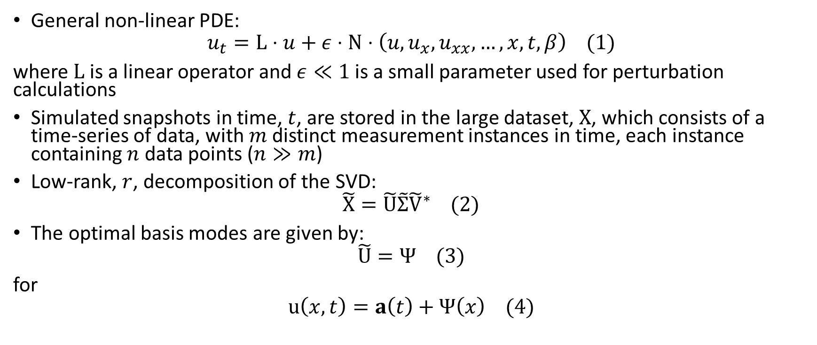
POD Expansion
General non-linear PDE:
$$u_{t}=L⋅u+ε⋅N⋅\left(u,u_{x},u_{xx},…,x,t,β\right) (1)$$
where $L$ is a linear operator and $ε≪1$ is a small parameter used for perturbation calculations
Simulated snapshots in time, $t$, are stored in the large dataset, $X$, which consists of a time-series of data, with $m$ distinct measurement instances in time, each instance containing $n$ data points ($n≫m$)
Low-rank, $r$, decomposition of the SVD:
$$\tilde{X}=\tilde{U}\tilde{Σ}{\tilde{V}}^{∗} (2)$$
The optimal basis modes are given by:
$$\tilde{U}=Ψ (3)$$
for
$$u\left(x, t\right)=a\left(t\right)+Ψ\left(x\right) (4)$$

Slide 9
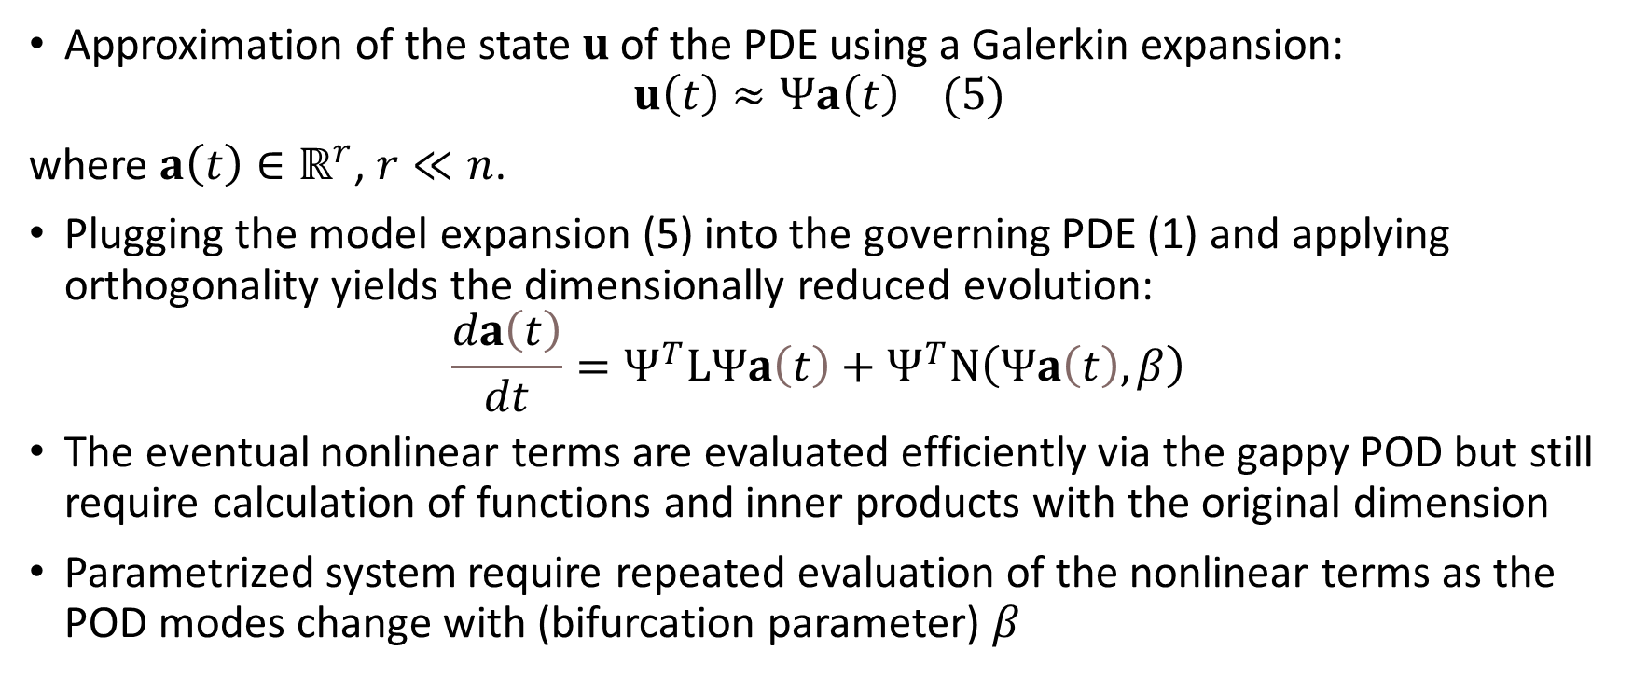
Galerkin projection onto POD Modes
Approximation of the state $u$ of the PDE using a Galerkin expansion:
$$u\left(t\right)≈Ψa\left(t\right) (5)$$
where $a\left(t\right)∈ℝ^{r}$, $r≪n$.
Plugging the model expansion (5) into the governing PDE (1) and applying orthogonality yields the dimensionally reduced evolution:
The eventual nonlinear terms are evaluated efficiently via the gappy POD but still require calculation of functions and inner products with the original dimension
Parametrized system require repeated evaluation of the nonlinear terms as the POD modes change with (bifurcation parameter) $β$

