Slide 1



Doctoral Qualifying Exam
Averaging Schemes for Assessment of Incident and Absorbed Power Density on
Skin Surface
Candidate: Ante Kapetanović
Supervisor: prof. Dragan Poljak, PhD
January 26th, 2023

Slide 2
Table of Contents
General Introduction in Human Exposure to EMFs
Exposure Assessment and Dosimetry in Era of 5G
State of Research
  Tissue Models and Control Surfaces
  Power Density Averaging Schemes
Conclusion and Future Work
Doctoral Qualifying Exam Averaging schemes for Assessment of Incident and Absorbed Power Density on Skin Surface

Slide 3
1. General Introduction in
Human Exposure to EMFs
Doctoral Qualifying Exam Averaging schemes for Assessment of Incident and Absorbed Power Density on Skin Surface

Slide 4
EM Radiation
is created due to periodic changes of
electric and/or magnetic fields
Periodicity → frequency
Non-ionizing vs. ionizing radiation
  Single photon energy up to vs. above 10 eV
EM waves in lossy medium transfer kinetic energy
to surrounding bounded atoms/molecules of material → “vibrations” → temperature rise
  Wavelength of the incident field ~ dominant dimension of material
  Biological tissue ~ microwave up to low-energy UV spectrum
Doctoral Qualifying Exam Averaging schemes for Assessment of Incident and Absorbed Power Density on Skin Surface

Slide 5
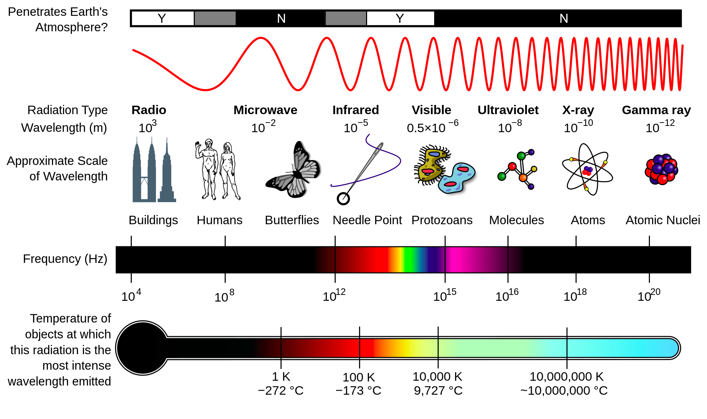
Doctoral Qualifying Exam Averaging schemes for Assessment of Incident and Absorbed Power Density on Skin Surface

Slide 6
Non-Ionizing EM Radiation Effects on Biological Tissue
are any change (physical, chemical, or mechanical) induced in tissue
Feedback repair mechanism
  Preservation of homeostasis within threshold limits
Limits exceeded → adverse health effects
Non-thermal vs. thermal effects
  Frequency dependent with transition at ~100 kHZ
Non-thermal effects at RF → no scientific consensus
Doctoral Qualifying Exam Averaging schemes for Assessment of Incident and Absorbed Power Density on Skin Surface

Slide 7
Summary of Non-Ionizing Radiation Effects on Biological Tissue
exposure to | static H-fields | LF | RF | IR | visible light | low-energy UV
frequency [Hz] | 0 | 1 up to 100 k | 100 k up to 300 G | 300 G up to ~400 T | ~400 T up to 790 T | > 790 T
interaction effects | induced fields & currents | stimulation of excitable cells | →← | tissue heating
Doctoral Qualifying Exam Averaging schemes for Assessment of Incident and Absorbed Power Density on Skin Surface

Slide 8
Assessment Basis for Heating Effects
Interaction between induced E-fields and polar molecules within tissue → kinetic energy
Increased kinetic energy → frequent interaction of polar molecules and charged particles → thermal energy
Heating effects depend on the distribution of EM power within exposed tissue
  Steady state conditions vs. brief exposure
  Local vs. whole-body exposure
  Tissue type-1 vs. type-2
Doctoral Qualifying Exam Averaging schemes for Assessment of Incident and Absorbed Power Density on Skin Surface

Slide 9
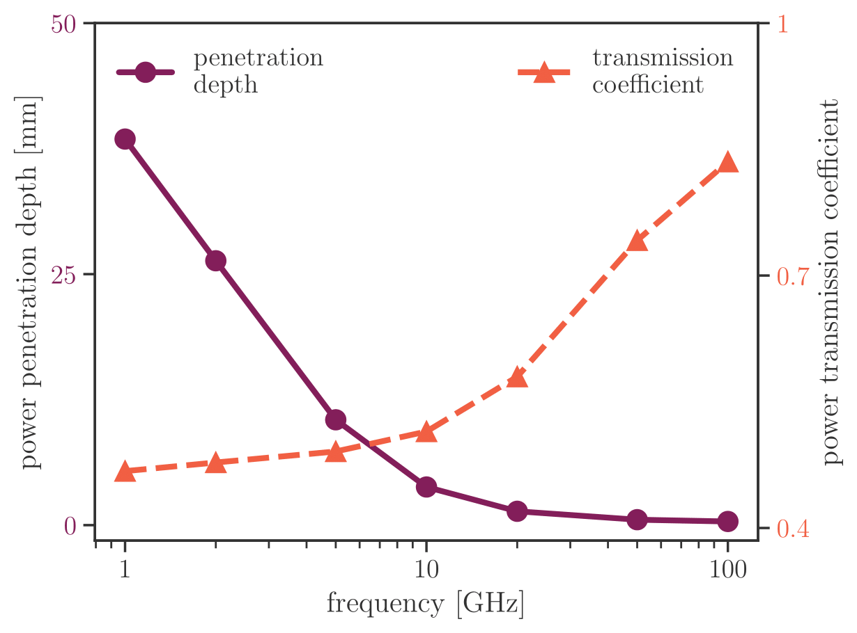
Power transmission and penetration depth into dry skin
Homogeneous block of tissue with dielectric properties of dry skin.
Doctoral Qualifying Exam Averaging schemes for Assessment of Incident and Absorbed Power Density on Skin Surface

Slide 10
Limiting Exposure to Artificial EMFs
Widespread use of wireless RF consumer electronics
International bodies prescribe exposure limits within guidelines (ICNIRP) or standard (IEEE C95.1)
  Occupational vs. general public
Protection against adverse health effects – respecting the frequency and exposure scenario dependent limits
  Derived upon published literature
  Applied reduction factors
Threshold values → BRs → RLs
Doctoral Qualifying Exam Averaging schemes for Assessment of Incident and Absorbed Power Density on Skin Surface

Slide 11
(Very) Brief Historical Overview
1960s – Tri-service program, first set of C95.1.x
1970s – large number of wireless devices operate in close proximity of human body → public distrust → many controversies
1970/80s – termographic studies, comprehensive environmental studies → RF dosimetry handbook¹
1990s – IRPA → INIRC → ICNRIP
2020s – new C95.1 standard² and ICNIRP guidelines³
¹ Durney et al. Brooks Air Force Base, TX: USAF School of Aerospace Medicine, AFSC, 1986
² IEEE Std C95.1-2019:1–312, 2019
³ ICNIRP, Health Physics 118:483–524, 2020
Doctoral Qualifying Exam Averaging schemes for Assessment of Incident and Absorbed Power Density on Skin Surface

Slide 12
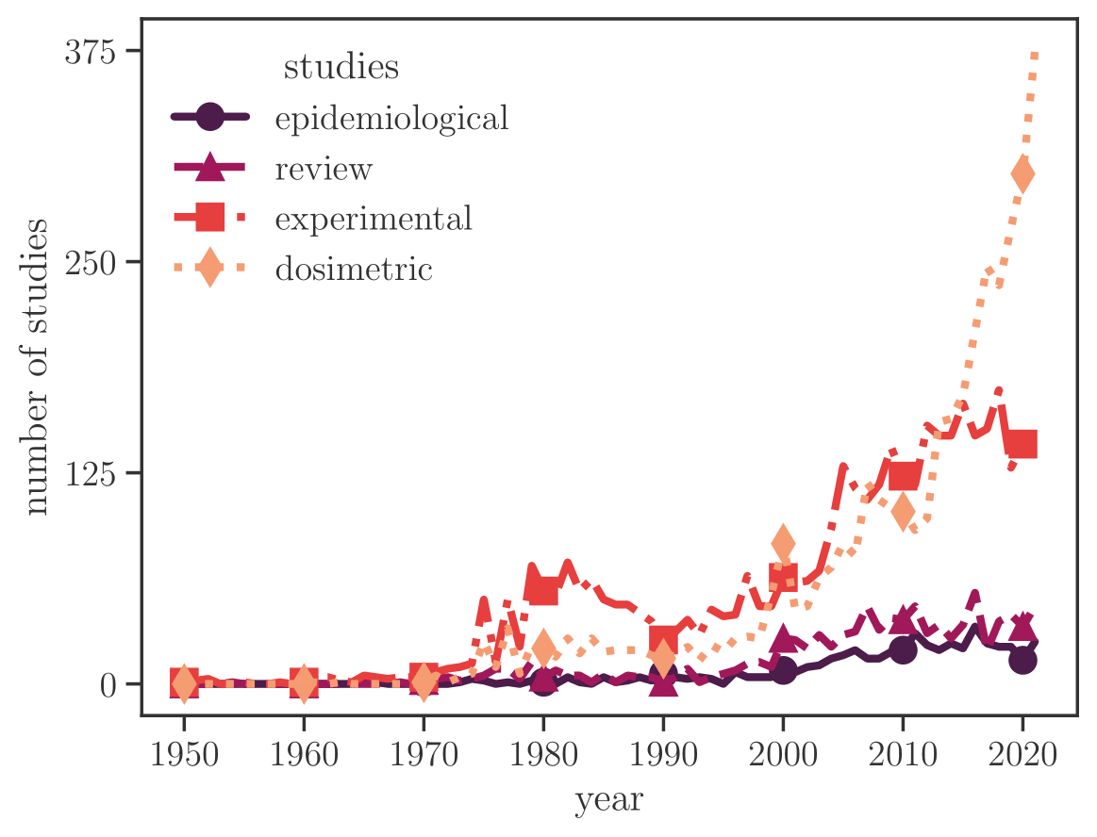
Evolution of research related to bioeffects of RF fields
(50s to date)
Compiled from the database of publications at http://emf-portal.org.
Doctoral Qualifying Exam Averaging schemes for Assessment of Incident and Absorbed Power Density on Skin Surface

Slide 13
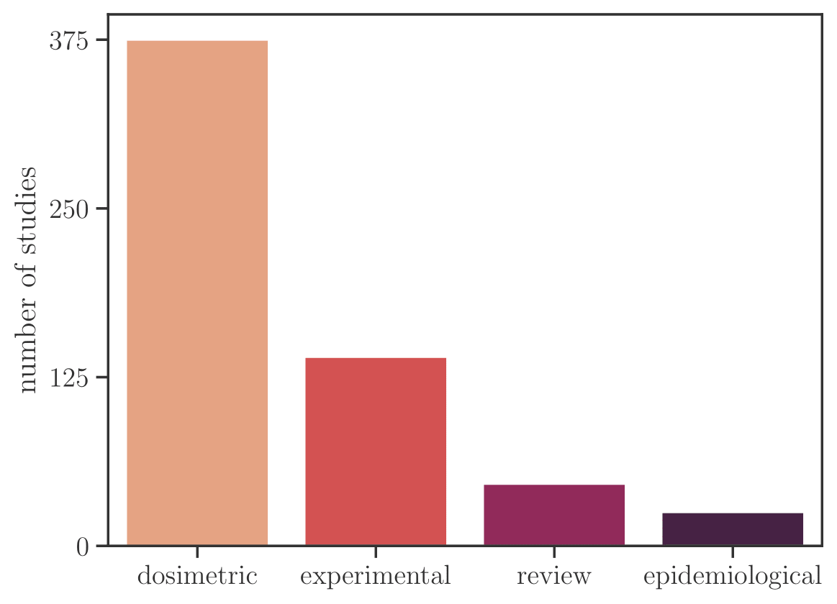
2021 studies related to bioeffects of RF fields
Compiled from the database of publications at http://emf-portal.org.
Doctoral Qualifying Exam Averaging schemes for Assessment of Incident and Absorbed Power Density on Skin Surface

Slide 14
Dosimetric Quantities in Terms of BRs
are derived from the levels of RF EMFs that correspond to (operational) adverse health effects
are frequency dependent dosimetric quantities at the appropriate spatio-temporal scale of exposure, e.g.:
  Whole-body exposure (over 30 min): SAR = 4 W/kg ~ 1 °C
    Reduction factors of 10 for workers and 50 for general public
  Local exposure up to 6 GHz (over 6 min): 10-g or 1-g SAR
  Local exposure above 6 GHz (over 6 min): 4-cm² or 1-cm² APD
    Reduction factor of 2 for workers and 10 for general public
RLs provide more practical means of demonstrating compliance by estimating IPD in free space
Doctoral Qualifying Exam Averaging schemes for Assessment of Incident and Absorbed Power Density on Skin Surface

Slide 15
2. Exposure Assessment and Dosimetry in
Era of 5G
Doctoral Qualifying Exam Averaging schemes for Assessment of Incident and Absorbed Power Density on Skin Surface

Slide 16
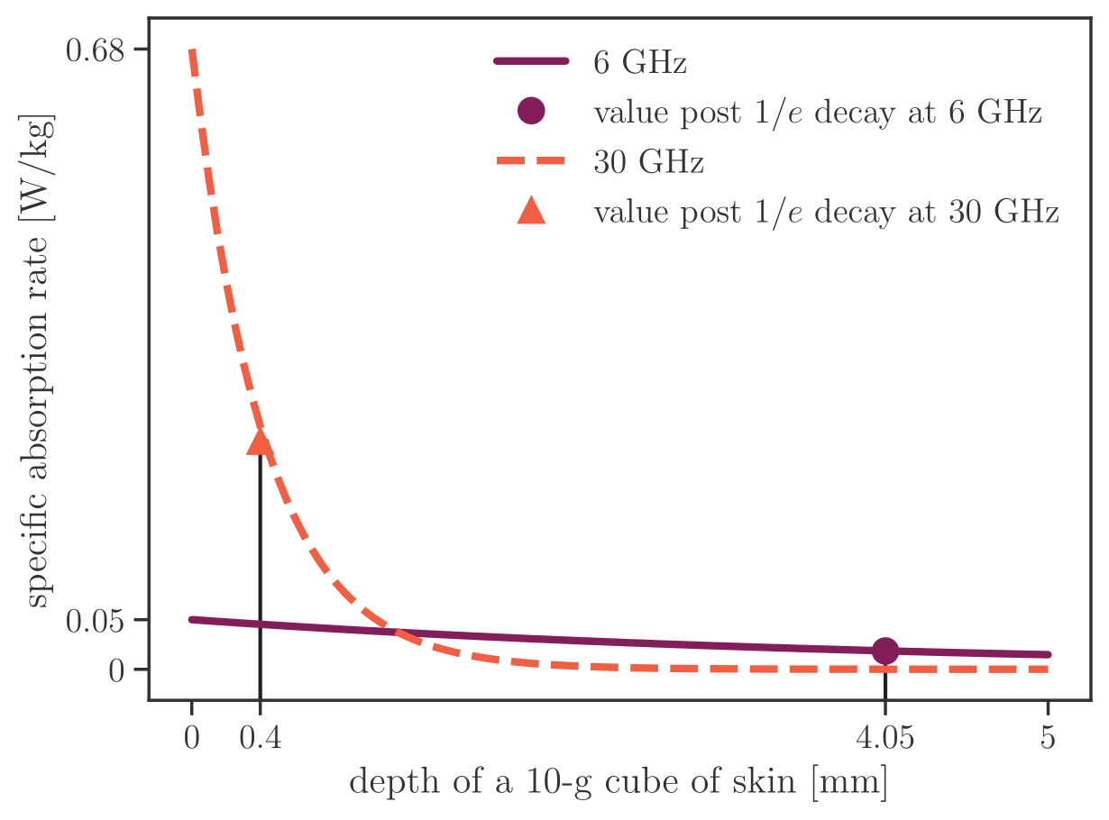
~ 90% EM power is dissipated in the uppermost skin layer above 6 GHz
Homogeneous block of tissue with dielectric properties of skin
exposed to a plane wave of 100 mW/cm².
Doctoral Qualifying Exam Averaging schemes for Assessment of Incident and Absorbed Power Density on Skin Surface

Slide 17
Definition of the Spatially Averaged APD
Derived from the Poynting vector
A – frequency-dependent averaging area
E, H* – peak values of the electric and complex-conjugate magnetic fields
n – unit normal vector on A
dA – integral element of A
Doctoral Qualifying Exam Averaging schemes for Assessment of Incident and Absorbed Power Density on Skin Surface

Slide 18
Definition of the Spatially Averaged APD via Volume-Averaged SAR
Tissue surface is positioned at z = 0
zmax should be sufficiently larger than the EM penetration depth
ρ – tissue density in kg/m³
SAR is defined as
σ – tissue conductivity in S/m
Doctoral Qualifying Exam Averaging schemes for Assessment of Incident and Absorbed Power Density on Skin Surface

Slide 19
Practical Considerations for
Power Density Spatial Averaging
[2, 6] GHz → peak value of the incident PD
> 6 GHz → averaging across 4 cm² square
evaluation plane^{4, 5}
> 30 GHz → averaging across 1 cm² area in addition to 4 cm² to account for narrow beams
at high frequencies⁶
⁴ Hashimoto et al. Phys. Med. Biol. 62(8):3124–3138, 2017
⁵ Funahashi et al. IEICE Trans Electronics 8:644-646, 2018
⁶ Foster et al. Health Physics 111(6):528-541
Doctoral Qualifying Exam Averaging schemes for Assessment of Incident and Absorbed Power Density on Skin Surface

Slide 20
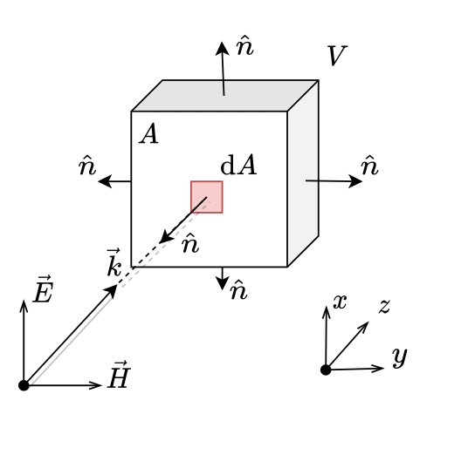
Sab, 1 and Sab, 2 are equivalent
provided that the surface surrounding a given volume of the tissue is closed and no active sources are present in this volume of interest
Mathematical details are omitted for your – you are welcome ,
but can be found in
Doctoral Qualification Paper in
Chapter 3.3.2.
Doctoral Qualifying Exam Averaging schemes for Assessment of Incident and Absorbed Power Density on Skin Surface

Slide 21
Mathematical Defintion of the IPD
Modulus of the time-averaged power density vector
Assuming that the separation distance is
⪎ λ/2π,
spatially averaged IPD is
a valid proxy for
local max. temp. rise⁷
⁷ IEEE Std 2889-2021:1–152, 2021
Doctoral Qualifying Exam Averaging schemes for Assessment of Incident and Absorbed Power Density on Skin Surface

Slide 22
3. State of Research
3.1. Tissue Models and Control Surface
Doctoral Qualifying Exam Averaging schemes for Assessment of Incident and Absorbed Power Density on Skin Surface

Slide 23
Tissue-Equivalent Model Configuration
1- or 3-/4-layer block tissue model⁸ > 6 GHz
Anatomy of skin
horny layer | clear layer | granular layer | prickle cell layer | basal cell layer | papillary layer | reticular layer
epidermis |  |  |  |  | dermis
Hypodermis – low heat transfer → thermal barrier
Muscle
Dielectric properties ← 5-term Cole-Cole model⁹
⁸ Ziskin et al. Bioelectromagnetics 39(3):173-189, 2018
⁹ Gabriel. TR-1996–0037, US Air Force, 1996
Doctoral Qualifying Exam Averaging schemes for Assessment of Incident and Absorbed Power Density on Skin Surface

Slide 24
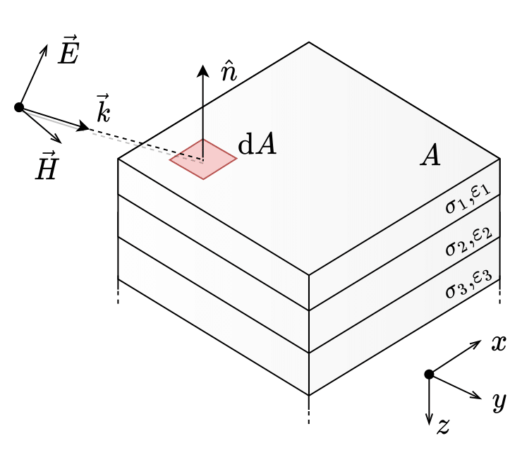
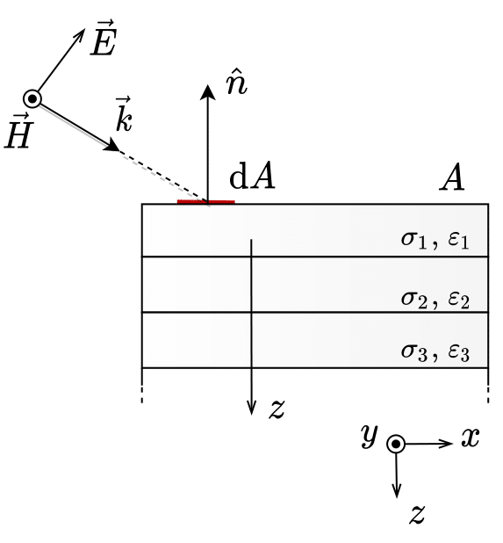
Control Surface during Spatial Averaging on the Multi-Layer Tissue-Equivalent Block Model
Doctoral Qualifying Exam Averaging schemes for Assessment of Incident and Absorbed Power Density on Skin Surface

Slide 25
3. State of Research
3.2. Power Density Averaging Schemes
Doctoral Qualifying Exam Averaging schemes for Assessment of Incident and Absorbed Power Density on Skin Surface

Slide 26
Prior to IEEE C95.1 and ICNIRP 2020...
ICNIRP 1998¹⁰
  Whole-body exposure above 10 GHz in the far-field zone → the IPD spatially averaged on 20 cm² planar control surface
  Local exposure → the spatially-averaged IPD over the most exposed region of 1 cm²
IEEE C95.1-1999¹¹
  Spatial averaging – the root-mean-square of the power density over an area equivalent to the vertical cross-section of the human body (projected) at a distance of no less than 20 cm
¹⁰ ICNIRP, Health Physics 74 (4):494-522, 1998
¹¹ IEEE Std C95.1-1999:1–83, 1999
Doctoral Qualifying Exam Averaging schemes for Assessment of Incident and Absorbed Power Density on Skin Surface

Slide 27
State of the Art
Transition frequency of 6 GHz
  Anderson et al 2010¹², McIntosh and Anderson 2010¹³
Harmonization of control surfaces between standards
  Colombi et al 2015¹⁴, Thors et al 2016¹⁵, Xu et al 2018¹⁶
Square averaging surface of 2 x 2 and 1 x 1 cm²
  Hashimoto et al 2017⁴
Spatially averaged transmitted power density
  Funahashi et al 2018¹⁷
¹² Anderson et al. Bioelectromagnetics 31(6):454–466, 2010
¹³ McIntosh and Anderson, Bioelectromagnetics 31(6):467–478, 2010
¹⁴ Colombi et al. IEEE Antennas Wirel. Propag. Lett. 14:1247–1249, 2015
¹⁵ Thors et al. IEEE Access 4:7469–7478, 2016
¹⁶ Xu et al. IEEE Access 6:830–838, 2018
¹⁷ Funahashi et al. IEEE Access 6:77665-77674, 2018
Doctoral Qualifying Exam Averaging schemes for Assessment of Incident and Absorbed Power Density on Skin Surface

Slide 28
Going beyond the State of the Art
Non-planar body parts, e.g., fingers¹⁸, ears¹⁹, with the curvature radius ~ wavelength of the incident EMF
→ underestimation of the area-averaged qauntities
Non-planar tissue models currently discussed within IEEE ICES TC95 SC6 WG7
  Canonical shapes, e.g., sphere & cylinder
  Anatomical models
¹⁸ Li et al. IEEE Trans. Microw. Theory Tech. 60(7):2267–2276, 2012
¹⁹ Sacco et al. IEEE J. Electromagn. RF Microw. Med. 6(3):413–419, 2022
Doctoral Qualifying Exam Averaging schemes for Assessment of Incident and Absorbed Power Density on Skin Surface

Slide 29
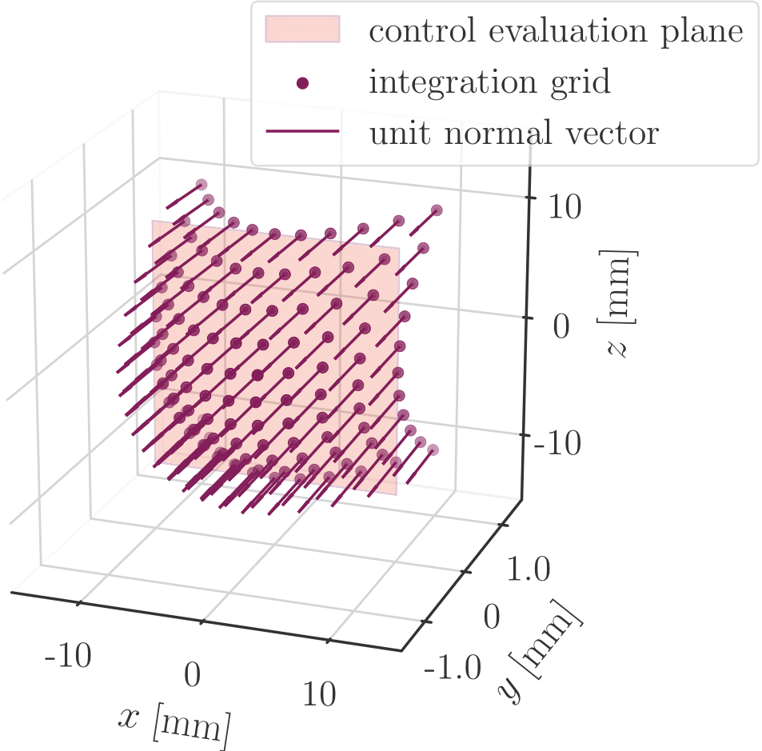
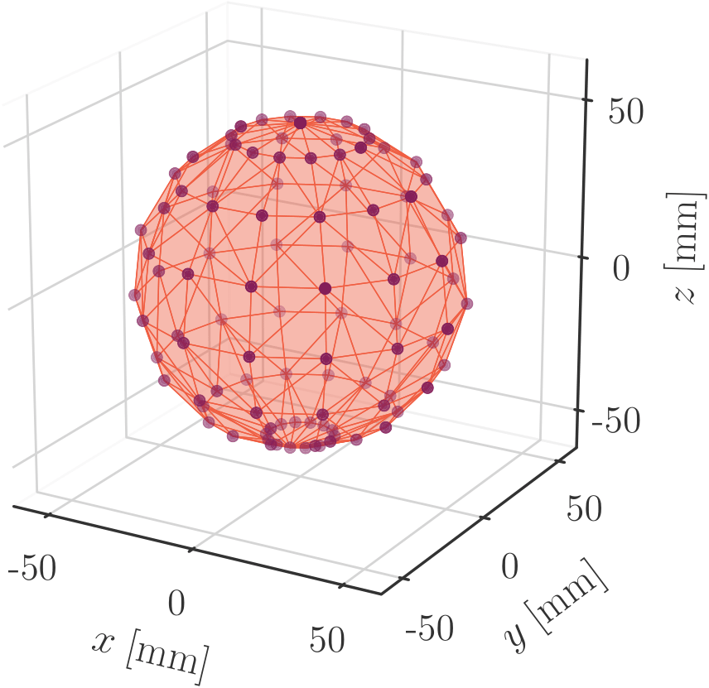
Spherical Model with Radius Set to 5 cm^{20, 21}
²⁰ Kapetanovic and Poljak. IEEE Trans. Electromagn. Compat. 64(5): 1296–1303, 2022
²¹ Kapetanovic et al. In proceedings SoftCOM 2023
Doctoral Qualifying Exam Averaging schemes for Assessment of Incident and Absorbed Power Density on Skin Surface

Slide 30
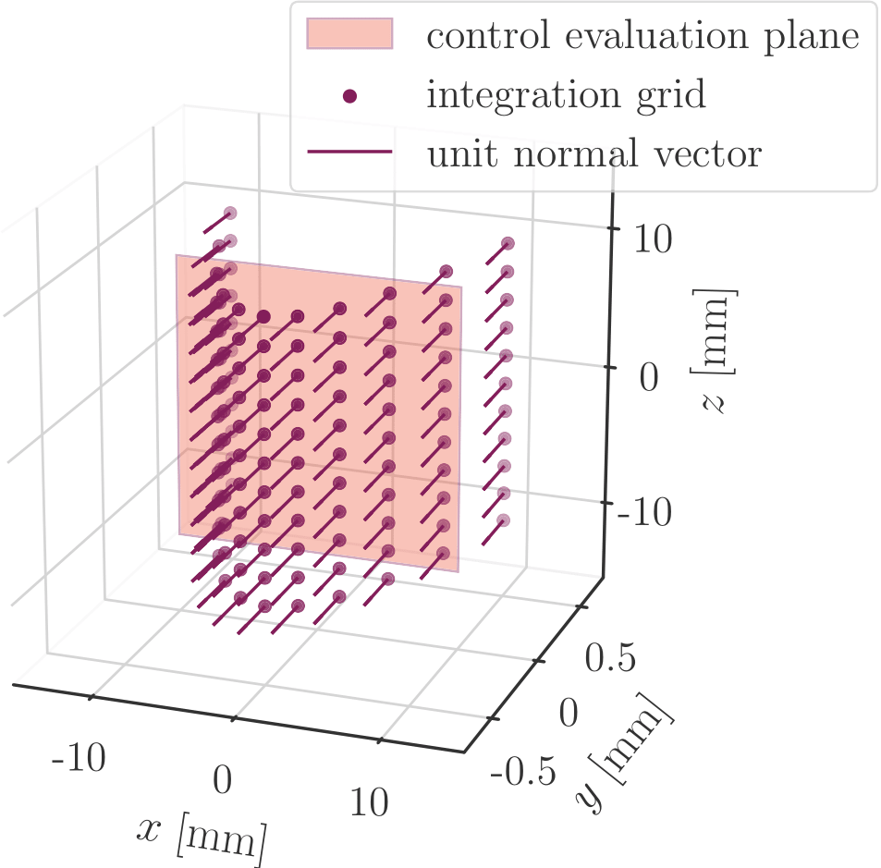
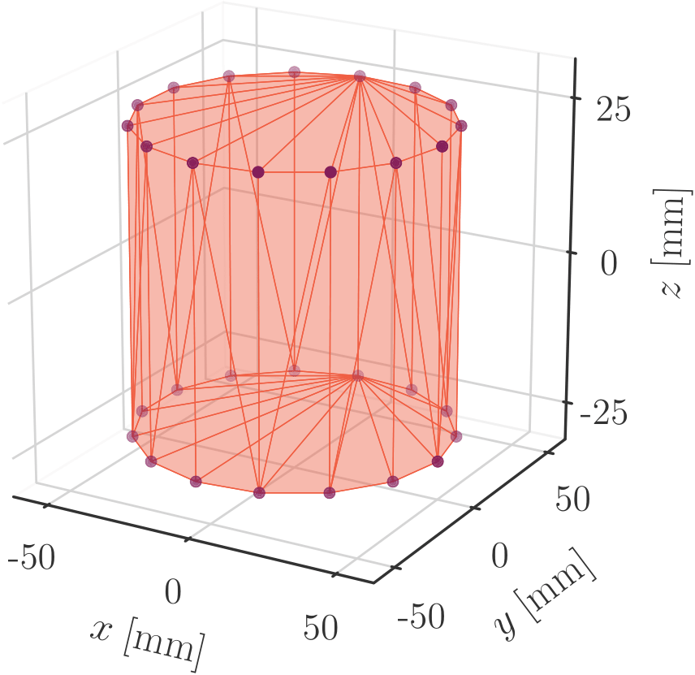
Cylindrical Model With Radius Set to 5 cm²²
²² Kapetanovic and Poljak. To appear in Radiat. Prot. Dosimetry, 2023
Doctoral Qualifying Exam Averaging schemes for Assessment of Incident and Absorbed Power Density on Skin Surface

Slide 31
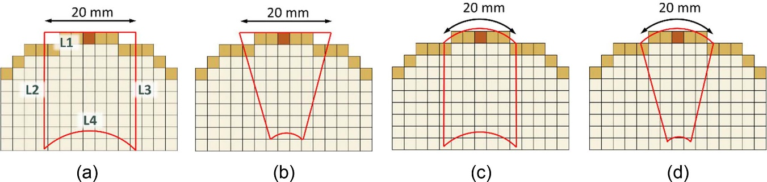
Reference Averaging Surface for
Non-planar models²³
(a) and (b) L1 - parallel to the grid axis to match the standard evaluation plane
(a) and (b) L1 - bent along the surface to match the curvature of skin
Side bounds - parallel to the grid axis in (a) and (c)
Side bounds - parallel to the internal E-field gradients at the surface in (b) and (d)
L4 - defined as the contour where the E-field is at 1/1000 of max value in the volume
²³ Diao and Hirata. 55(22):224001, 2020
Doctoral Qualifying Exam Averaging schemes for Assessment of Incident and Absorbed Power Density on Skin Surface

Slide 32
4. Conclusion and Future Work
Doctoral Qualifying Exam Averaging schemes for Assessment of Incident and Absorbed Power Density on Skin Surface

Slide 33
Summary
Recent updates of international exposure limits are motivated with the deployment of 5G worldwide
Steady-state local exposure above 6 GHz – APD/IPD
Valid proxies for temperature rise on flat surfaces
Curvature of local body parts is pronounced → compromised accuracy & compliance assessment
Future work
  Analytical spatial averaging on non-planar surfaces (ICES TC96 SC6 WG7)
  Numerical & data-driven techniques for surface integration across conformal surfaces of anatomical tissue models
Doctoral Qualifying Exam Averaging schemes for Assessment of Incident and Absorbed Power Density on Skin Surface

Slide 34
Thank You for Your Attention
Q&A
Doctoral Qualifying Exam Averaging schemes for Assessment of Incident and Absorbed Power Density on Skin Surface

Slide 35
Abbreviations in Order of Appearance
EMF – electromagnetic field
5G – fifth generation
EM – electromagnetic
UV – ultraviolet (radiation)
RF – radio-frequency
LF – low-frequency
IR – infrared (radiation)
ICNIRP – Internation commission on non-ionizing radiation protection
IEEE – Institute of Electrical and Electronics Engineers
BR/DRL – basic restriction or dosimetric reference limit
RL/ERL – refernce level or exposure reference level
IRPA - International Radiation Protection Association
INRC – International Non-Ionizing Radiation Committee
SAR – specific absorption rate
APD – absorbed power density
IPD – incident power density
Doctoral Qualifying Exam Averaging schemes for Assessment of Incident and Absorbed Power Density on Skin Surface

