Slide 1



Kvalifikacijski doktorski ispit
Tehnike prostornog usrednjavanja za određivanje upadne i apsorbirane gustoće snage na površini kože
Ante Lojić Kapetanović
alojic00@fesb.hr
http://adria.fesb.hr/~alojic00/
Preznetacija za obranu Kvalifikacijskog doktorskog ispita, 20.1.2023.

Slide 2
Sadržaj
Tba
Tba
...
Kvalifikacijski doktorski ispit Tehnike prostornog usrednjavanja za određivanje upadne i apsorbirane gustoće snage na površini kože

Slide 3
EM izloženost [6 – 300] GHz
Neionizirajuće zračenje – fotoni RF EM spektra ne prenose kinetičku energiju dovoljnu za ionizaciju (>10 ev)
Interakcija s tkivom – zagrijavanje (fotoni prenose kinetičku energiju na atomi koji za posljedicu pojačano titraju oko centra mase)
Čitava energija u rasponu od 6 do 300 GHz je distribuirana u <8 mm od površine kože
Internacionalne smjernice¹ i standardi² definiraju prostorno usrednjenu gustoću EM snage apsorbirane na površini (APD) kao proxy temperaturnog porasta
¹ International Commission on Non-Ionizing Radiation Protection (ICNIRP). Guidelines for limiting exposure to electromagnetic fields (100 kHz to 300 GHz). Health Physics 118:483–524, 2020
² IEEE. IEEE standard for safety levels with respect to human exposure to electric, magnetic, and electromagnetic fields, 0 Hz to 300 GHz. IEEE Std C95.1-2019:1–312, 2019
Kvalifikacijski doktorski ispit Tehnike prostornog usrednjavanja za određivanje upadne i apsorbirane gustoće snage na površini kože

Slide 4
We are going to cover
The Why – why we want to assess exposure levels of a human head to Microsoft HoloLens2
The What – what is the actual novelty of our approach and what does it offer
The How – techniques that underly our method; computational results and some nice plots
The Yeah But So What – what are the improvements compared to already existing methods and approaches
The contents of this presentation are the sole responsibility of the University of Split, Faculty of Electrical Engineering, Mechanical Engineering and Naval Architecture (FESB) and do not necessary reflect the views of the European Union.

Slide 5
Transitioning towards 5G
Stable 4G wireless technology → active deployment of 5G
Recently updated exposure limits^{1, 2} up to 300 GHz define basic restrictions to ensure no hazardous biological effects (superficial overheating) from EMF interaction with human body will occur
Absorbed or epithelial power density (PD) deposited over a control skin surface
Incident PD – practical means of demonstrating compliance with exposure limits by means of reference levels
¹ ICNIRP (2020), Guidelines for limiting exposure to electromagnetic fields (100 kHz to 300 GHz). Health Physics, vol. 118, pp. 483–524
² IEEE Std C95.1-2019 (2019), IEEE standard for safety levels with respect to human exposure to electric, magnetic, and electromagnetic fields, 0 Hz to 300 GHz
The contents of this presentation are the sole responsibility of the University of Split, Faculty of Electrical Engineering, Mechanical Engineering and Naval Architecture (FESB) and do not necessary reflect the views of the European Union.

Slide 6
Practical PD considerations for defining reference levels
f = [2, 6] GHz → peak value of the incident PD
f > 6 GHz → averaging across 4 cm² square
evaluation plane^{3, 4}
f > 30 GHz → averaging across 1 cm² area in addition to 4 cm² to account for narrow beams at high frequencies⁴
³ Funahashi et al. (2018), Averaging area of incident power density for human exposure from patch antenna arrays. IEICE Transactions on Electronics, vol. 8, pp. 644-646
⁴ Foster et al. (2016), Thermal response of human skin to microwave energy: a critical review. Health Physics, vol. 111, no. 6, pp. 528-541
The contents of this presentation are the sole responsibility of the University of Split, Faculty of Electrical Engineering, Mechanical Engineering and Naval Architecture (FESB) and do not necessary reflect the views of the European Union.

Slide 7
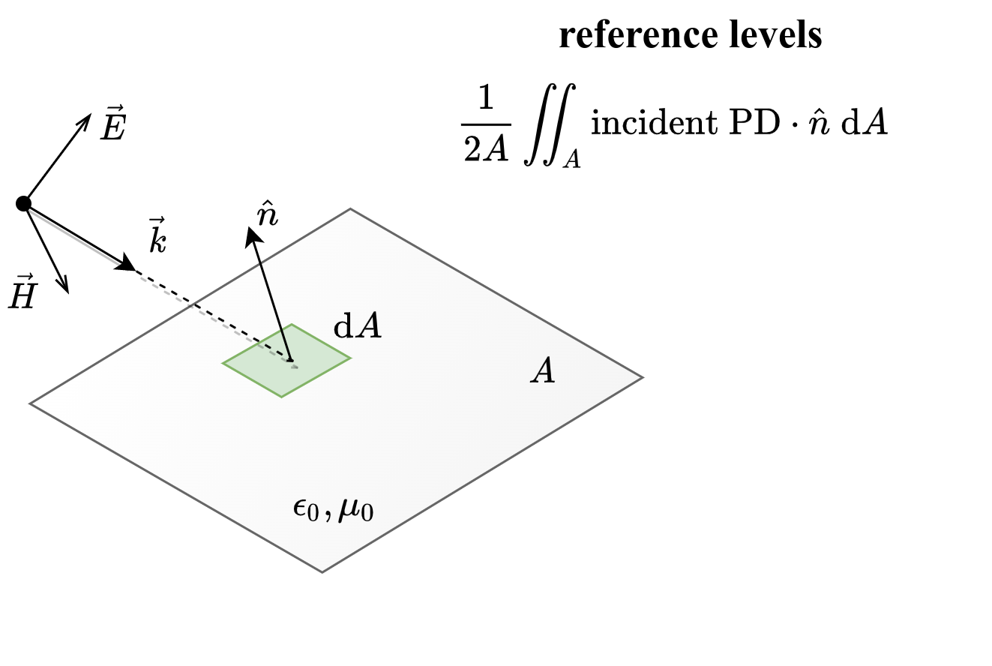
Spatial averaging above 6 GHz on a planar interface of area A
The contents of this presentation are the sole responsibility of the University of Split, Faculty of Electrical Engineering, Mechanical Engineering and Naval Architecture (FESB) and do not necessary reflect the views of the European Union.

Slide 8
Mathematical identity of the area-averaged incident PD, sPD, derived from the Poynting vector
A – frequency-dependent averaging area
E, H* – peak values of the electric and complex-conjugate magnetic incident fields (free space)
n – unit normal vector on A
dA – integral element of A
The contents of this presentation are the sole responsibility of the University of Split, Faculty of Electrical Engineering, Mechanical Engineering and Naval Architecture (FESB) and do not necessary reflect the views of the European Union.

Slide 9
Going beyond the spatial averaging SotA
SotA – planar single- or multilayer block tissue-equivalent models⁵
Averaging over control evaluation plane → poor estimation if nonplanar geometrical features are pronounced⁶, e.g., eyes, fingers, ears, etc.
Our study investigates:
  1. how to consider nonplanar features of exposed body parts in assessment of reference levels;
  2. how the level of curvature affects sPD.
⁵ Li et al. (2021), Intercomparison of calculated incident power density and temperature rise for exposure from different antennas at 10–90 GHz. IEEE Access, vol. 9, pp. 151654-151666
⁶ Sacco et al. (2022),Exposure Levels Induced in Curved Body Parts at mmWaves. IEEE J. Electromagn. RF Microw. Med. Biol., vol. 6, pp. 413-419
The contents of this presentation are the sole responsibility of the University of Split, Faculty of Electrical Engineering, Mechanical Engineering and Naval Architecture (FESB) and do not necessary reflect the views of the European Union.

Slide 10
APD (i)
Prostorno usrednjena gustoća EM snage apsorbirane na površini je definirana kao osnovno ograničenje ili dozimetrijski referentni level za ograničavanje izloženosti EM poljima [6 – 300] GHz
[6 – 30] GHz → usrednjavanje na kvadratnoj kontrolnoj plohi³ površine A = 4 cm²
(30 – 300] GHz → A = 1 cm² (fokusirani snop zračenja⁴) vrijednost ne smije prekoračiti 2x vrijednost APD-a na 4 cm²
E i H su vršne vrijednosti električnog i konjugiranog magnetskog polja, n je normalni vektor po površini, dA je integralna varijabla.
³ Y. Hashimoto et al. On the averaging area for incident power density for human exposure limits at frequencies over 6 GHz. Physics in Medicine and Biology 62(8):3124–3138, 2017
⁴ Foster, K. Thermal modeling for the next generation of radiofrequency exposure limits: commentary. Health Phys 113:41-53, 2017

Slide 11
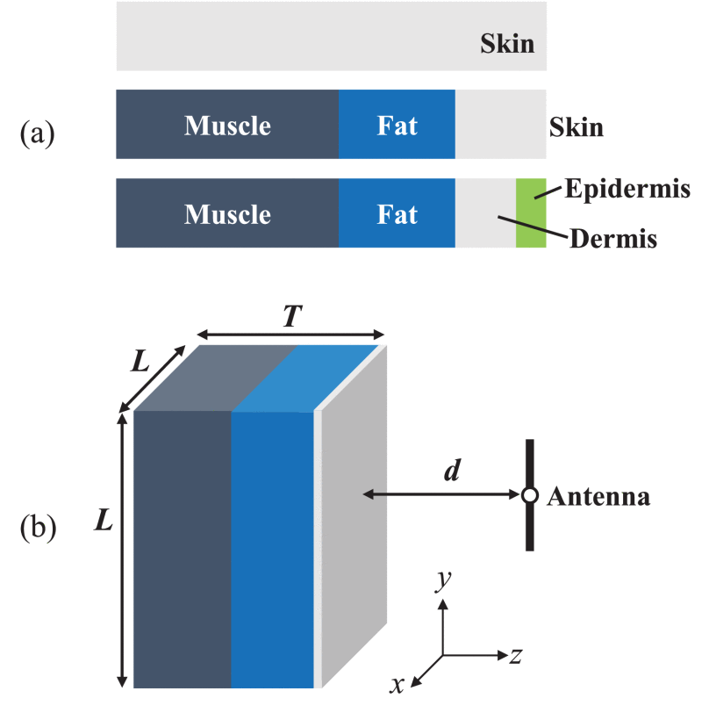
APD (ii)
Slika 2 iz komparativne studije⁵ utjecaja različitih faktora (antena, geometrija problema, frekvencija, ...) na updanu gustoću EM snage (IPD)
IPD se koristi za korelaciju temperaturnog rasta u stvarnim mjerenjima – određivanje APD-a otežano
aproksimacija slobodnog prostora
⁵ K. Li et al. Intercomparison of calculated incident power density and temperature rise for exposure from different antennas at 10–90 GHz. IEEE Access 9:151654-151666, 2021

Slide 12
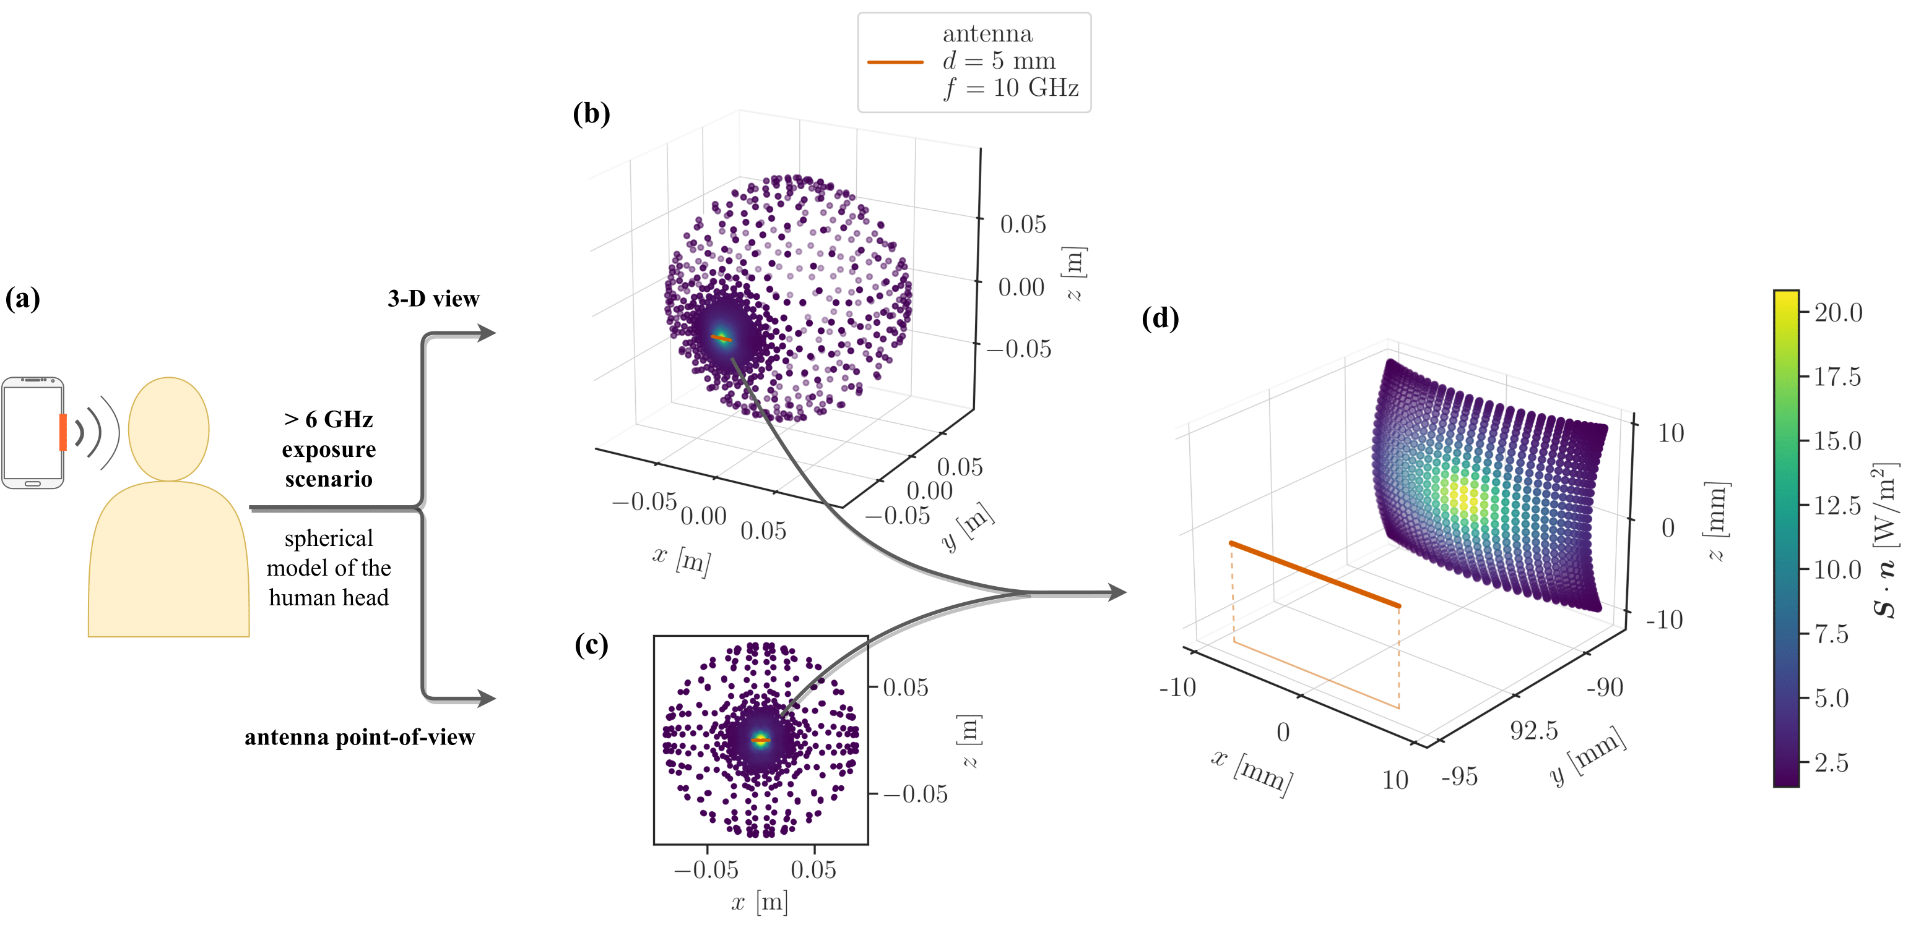
Sferni model ljudske glave⁶ (i)
⁶ A. Lojić Kapetanović & D. Poljak. Assessment of incident power density on spherical head model up to 100 GHz. IEEE Transactions in Electromagnetic Compatibility, accepted for publishing 2022

Slide 13
Sferni model ljudske glave⁶ (ii)
Distribucija normala po kotrolnoj površini sfernog model.
Slika 3 iz rada6 u panelu (a) prikazuje odnos međusobnog položaja sferne I triju planarnih kontrolnih površina za proračun prostorno usrednjenog IPD-a.
Panel (b) odgovara približenom prikazu panela (a).
⁶ A. Lojić Kapetanović & D. Poljak. Assessment of incident power density on spherical head model up to 100 GHz. IEEE Transactions in Electromagnetic Compatibility, accepted for publishing 2022

Slide 14
Sferni model ljudske glave⁶ (iii)
Slika 5 iz rada⁶ prikazuje % razliku između IPD-a usrednjenog na sfernoj i 3 planarne kontrolne površine kao funkcija udaljenosti od antene na značajnim frekvencijama.
⁶ A. Lojić Kapetanović & D. Poljak. Assessment of incident power density on spherical head model up to 100 GHz. IEEE Transactions in Electromagnetic Compatibility, accepted for publishing 2022

Slide 15
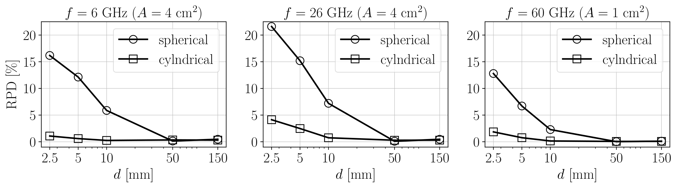
Cilindrični model ljudske glave⁶ (i)
Slika 6 iz rada⁷ prikazuje % razliku između IPD-a usrednjenog na sfernoj/cilindričnoj I standardnom planarnom kontrolnom površinom.
Prilikom proračuna korišten je in-house model dipolne antene pri čemu je distribucija struje dobivena korištenjem hibridne tehnike rubnih elemenata i strojnog učenja.
⁷ A. Lojić Kapetanović & D. Poljak. Machine learning-assisted antenna modelling for realistic assessment of human exposure reference levels above 6 GHz, submitted to Radiation Protection Dosimetry

Slide 16
EM model of the human head and practical exposure scenarios
Spherical model of the human head:
  1. the average adult male head
  2. 5-year-old child head model
Spherical model of the small body parts on the human head, e.g., eyes.
Source model: a half-wavelength dipole operating at 2.4, 5, and 10 GHz at a distance, d
The contents of this presentation are the sole responsibility of the University of Split, Faculty of Electrical Engineering, Mechanical Engineering and Naval Architecture (FESB) and do not necessary reflect the views of the European Union.

Slide 17
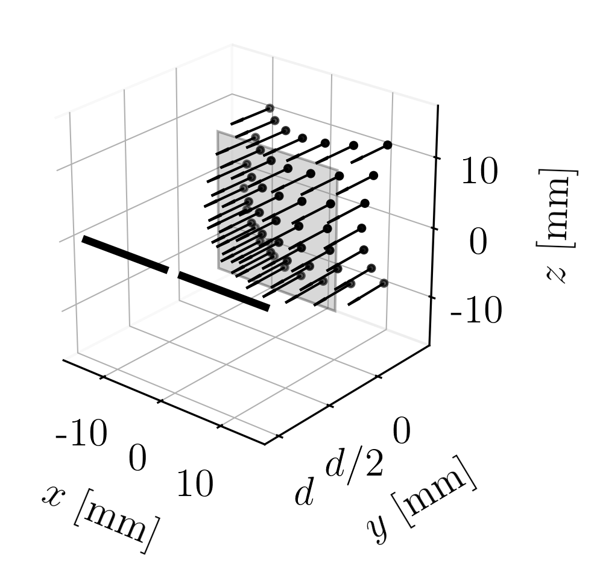
Effects of curvature is reflected on sPD trough distribution of n
distribution of n
on a spherical surface
ISO 80000-2:2019
spherical coords.
Parameterized spherical surface for averaging
dipole
Unit vecor field normal to v
The contents of this presentation are the sole responsibility of the University of Split, Faculty of Electrical Engineering, Mechanical Engineering and Naval Architecture (FESB) and do not necessary reflect the views of the European Union.

Slide 18
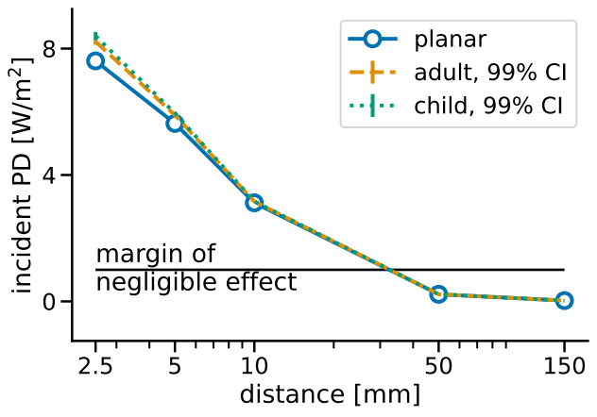
By increasing d, sPD decreases monotonically on both adult and child spherical head models
f = 10 GHz
The contents of this presentation are the sole responsibility of the University of Split, Faculty of Electrical Engineering, Mechanical Engineering and Naval Architecture (FESB) and do not necessary reflect the views of the European Union.

Slide 19
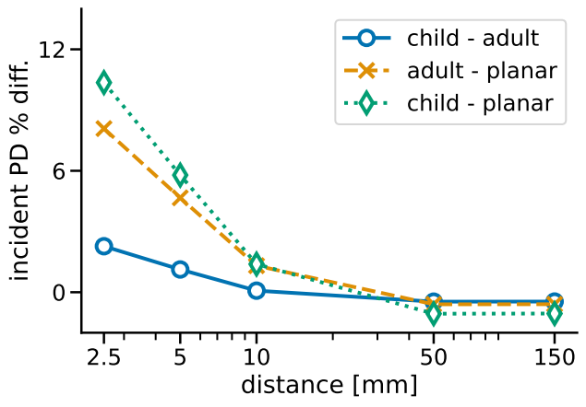
Relative difference in sPD of ~10% can be found between child head model and planar interface in the radiative near field
f = 10 GHz
The contents of this presentation are the sole responsibility of the University of Split, Faculty of Electrical Engineering, Mechanical Engineering and Naval Architecture (FESB) and do not necessary reflect the views of the European Union.

Slide 20
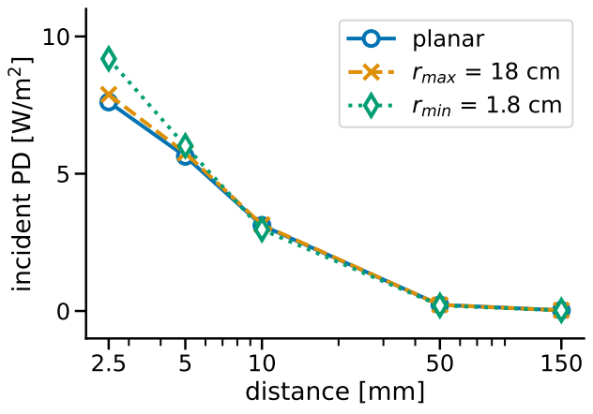
Smallest considered spherical model results in strong discrepancies in sPD compared to both large spherical model and planar interface
f = 10 GHz
The contents of this presentation are the sole responsibility of the University of Split, Faculty of Electrical Engineering, Mechanical Engineering and Naval Architecture (FESB) and do not necessary reflect the views of the European Union.

Slide 21
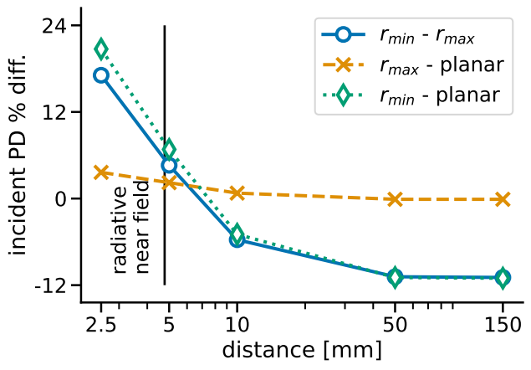
sPD is substantially larger (up to 24 %) for the small spherical model compared to the planar interface and the corresponding spherical model with tenfold radius*
* this efffect is reversed at d ≥ 10 mm where sPD is up to 12% less on small spherical model compared to the planar interface
f = 10 GHz
*
The contents of this presentation are the sole responsibility of the University of Split, Faculty of Electrical Engineering, Mechanical Engineering and Naval Architecture (FESB) and do not necessary reflect the views of the European Union.

Slide 22
Concluding remarks and summary
Stochastic-deterministic analysis of the EM exposure of the spherical model of the human head (child & adult) to the MS HoloLens2 is presented
No significant variability in sPD in the range of ±3 std. from the expected radius of the human head is found
Child head model yields larger sPD (up to 12%) compared to the adult head and planar interface
Small spherical body parts (e.g., eyeballs of r = 1.8 cm) result in significantly larger values of sPD (up to 24%) compared to planar interfaces in the radiative near field region
Curvature is an important factor to consider in the future version of international EM exposure limits
The contents of this presentation are the sole responsibility of the University of Split, Faculty of Electrical Engineering, Mechanical Engineering and Naval Architecture (FESB) and do not necessary reflect the views of the European Union.

Slide 23
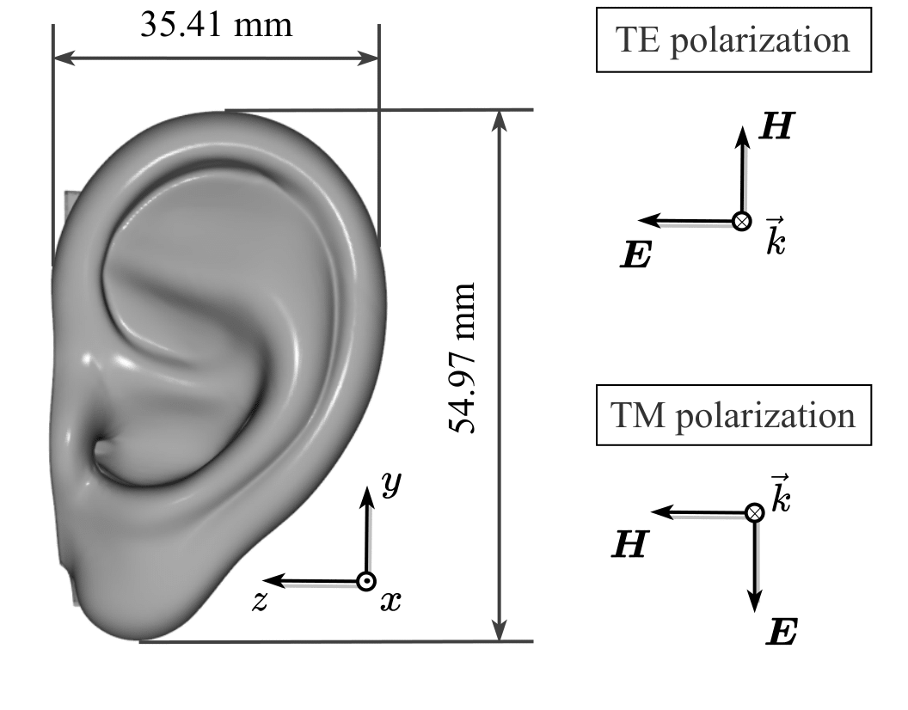
Realistični EM model ljudskog uha (i)
Prosječno uho odrasle osobe⁸
ε_{r} = 7.98 + j 10.90 (suha koža, 60 GHz)
Tetraedarska diskretizacija (elemenent = λ/8 → ukupno 15M elemenata)
TE i TM polarizacija upadnog ravnog vala x-orjentacija (60 GHz)
⁸ C. Sforza et al. Age- and sex-related changes in the normal human ear. Forensic Science International 187(1):110.e1–110.e7, 2009

Slide 24
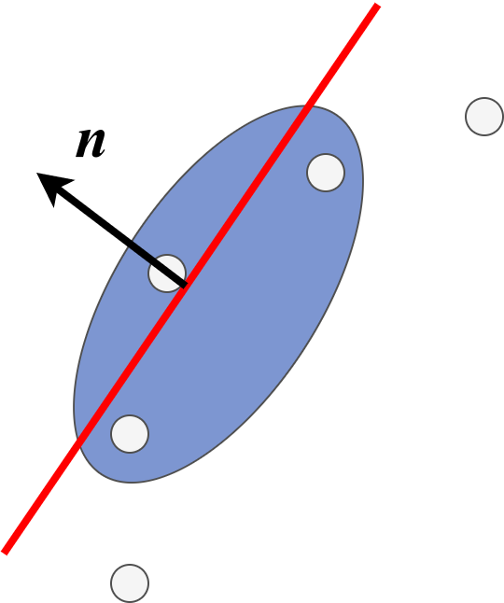
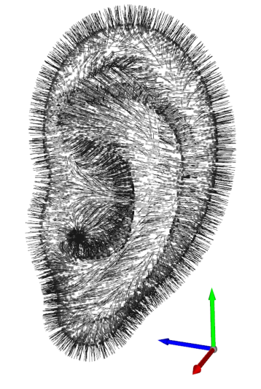
Realistični EM model ljudskog uha (ii)
Metoda⁹ predstavljena na BioEM 2022 konferenciji – vektor normale na površini uha (3-D oblak točaka):
  3-D lokalni oblak točaka u susjedstvu promatrane točke
  Hiperravnina lokalnog oblaka fitana koristeći PCA regresiju¹⁰
  n je definiran kao eigenvektor s najmanjom pripadnom eigenvrijednosti
  Orjentacija normalnog vektora
y
y
z
z
x
x
⁹ A. Lojić Kapetanović et al. Novel procedure for spatial averaging of absorbed power density on realistic body
models at millimeter waves, BioEM 2022
¹⁰ H. Hoppe et al. Surface reconstruction from unorganized points. ACM Special Interest Group on Computer Graphics 26(2):71–78, 1992

Slide 25
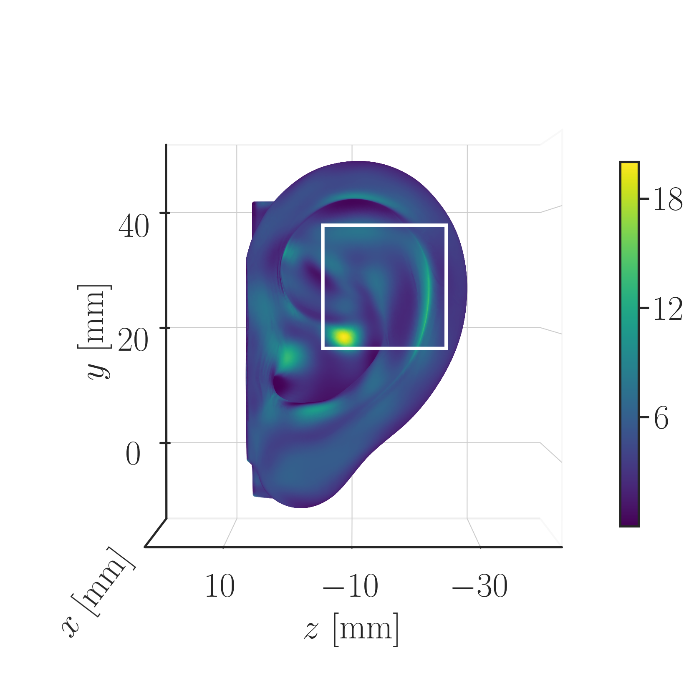
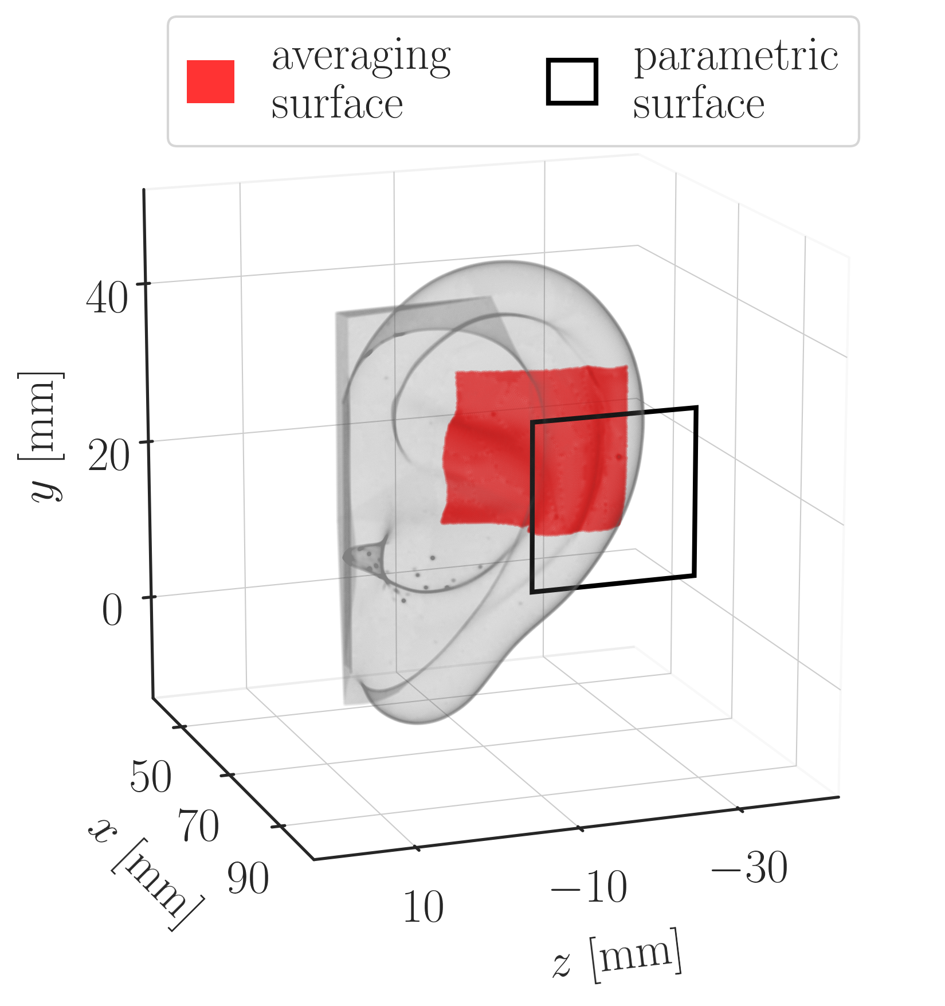
Realistični EM model ljudskog uha (iii)
Površina za usrednjavanje > površina parametrizirane 2-D plohe = 4 cm²

Slide 26
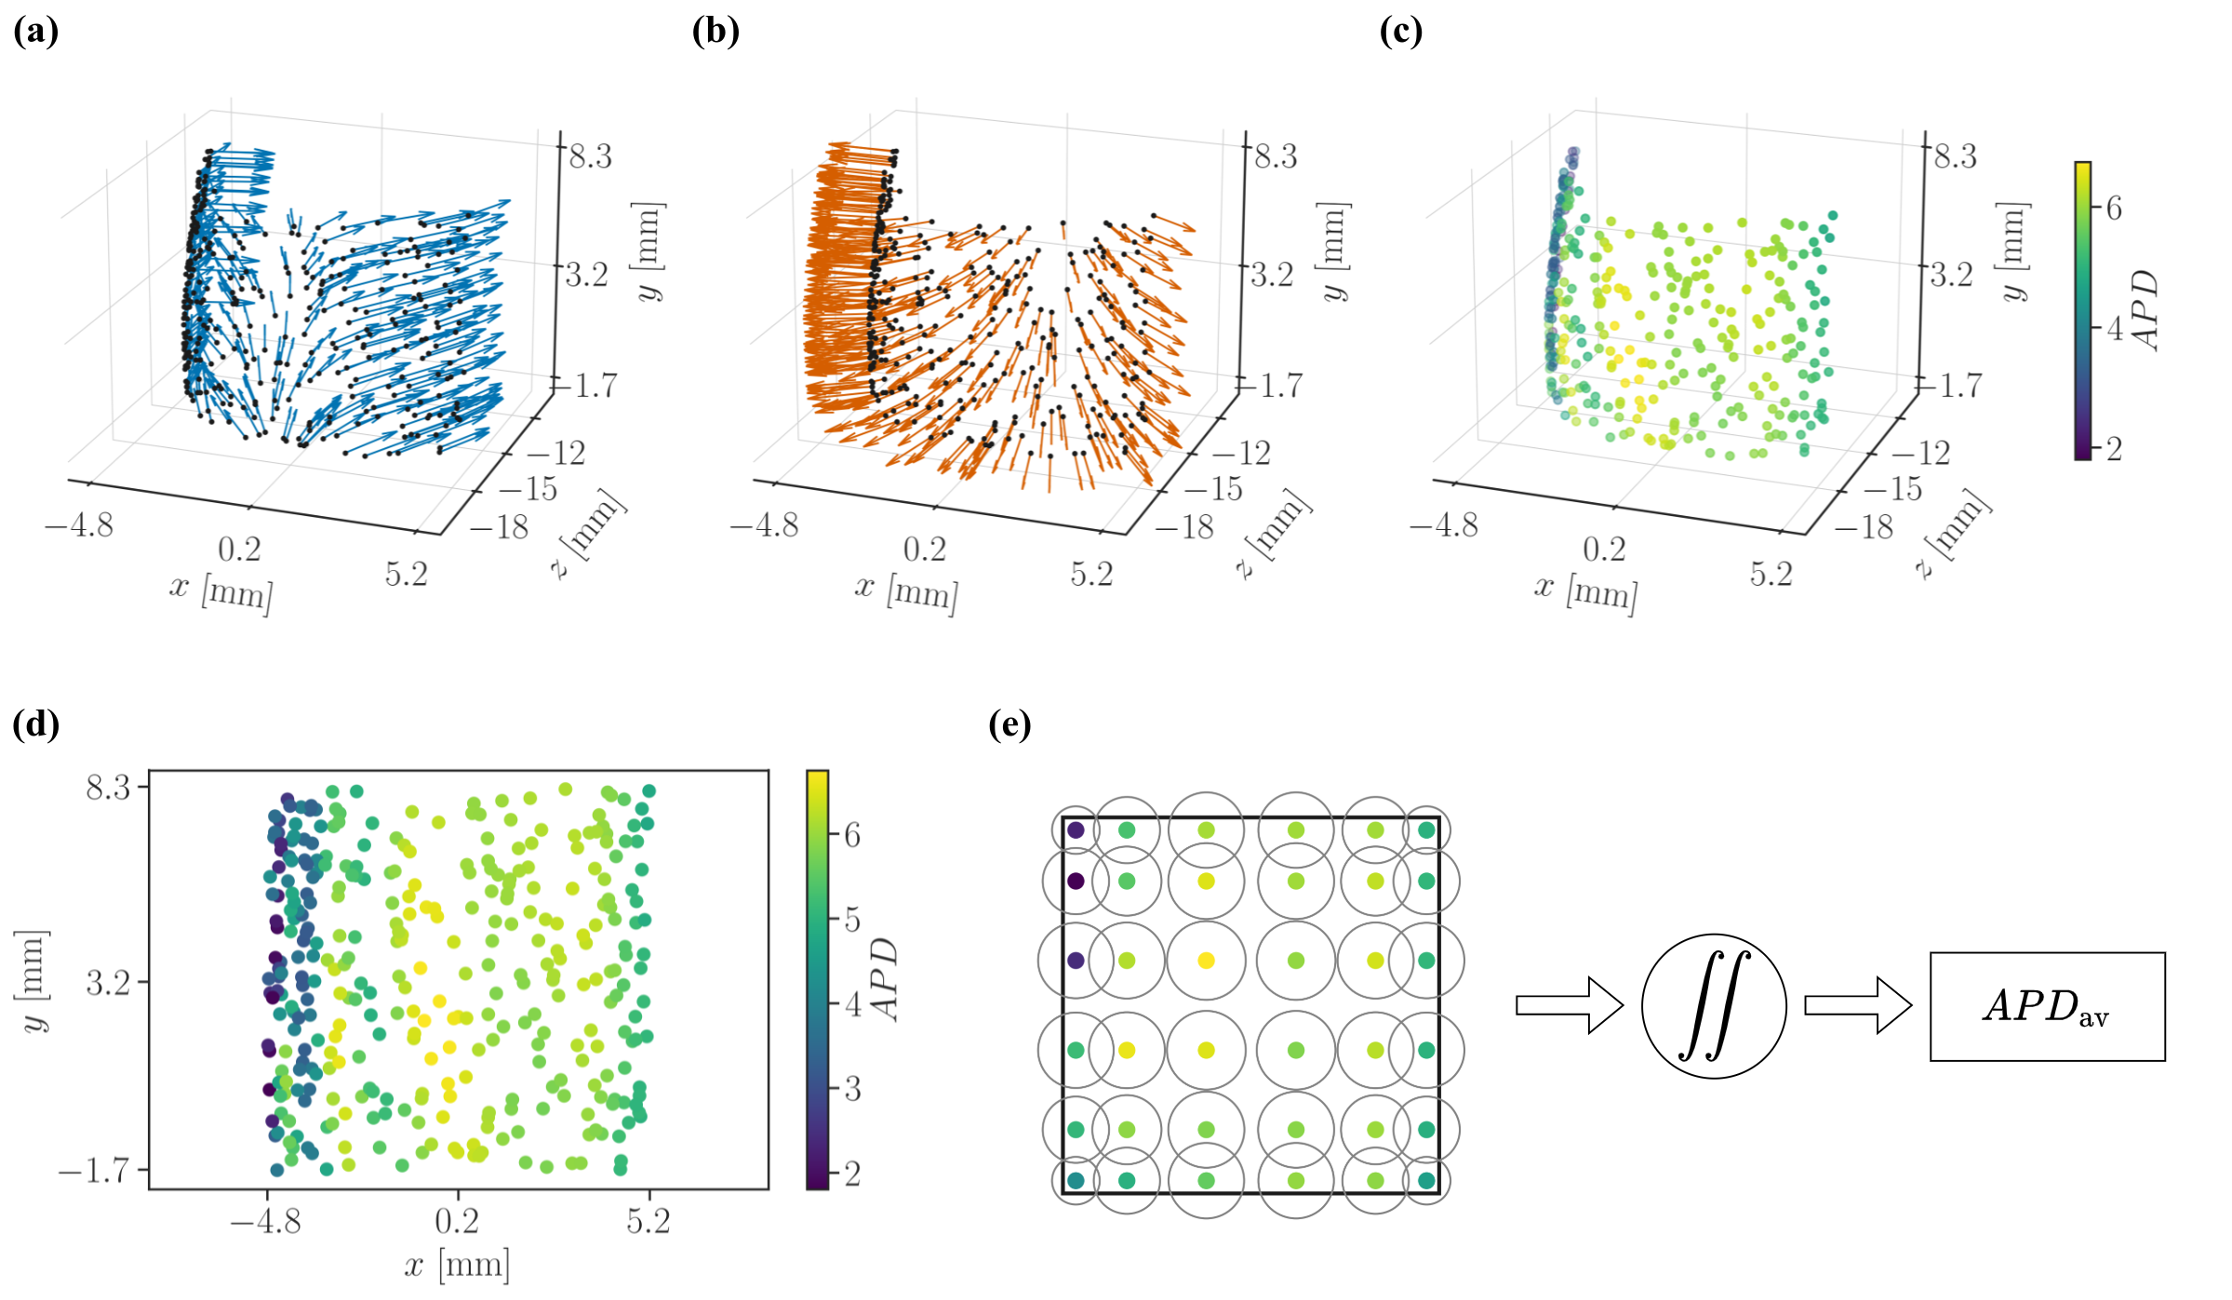
Realistični EM model ljudskog uha (iv)
distribucija APD (c) = skalarni produkt updane snage (a) i normalnog vektora po površini (b)
2-D parametrizacija distribucije APD u 3-D prostoru (c) → distribucija točaka za numeričku integraciju (d)

Slide 27
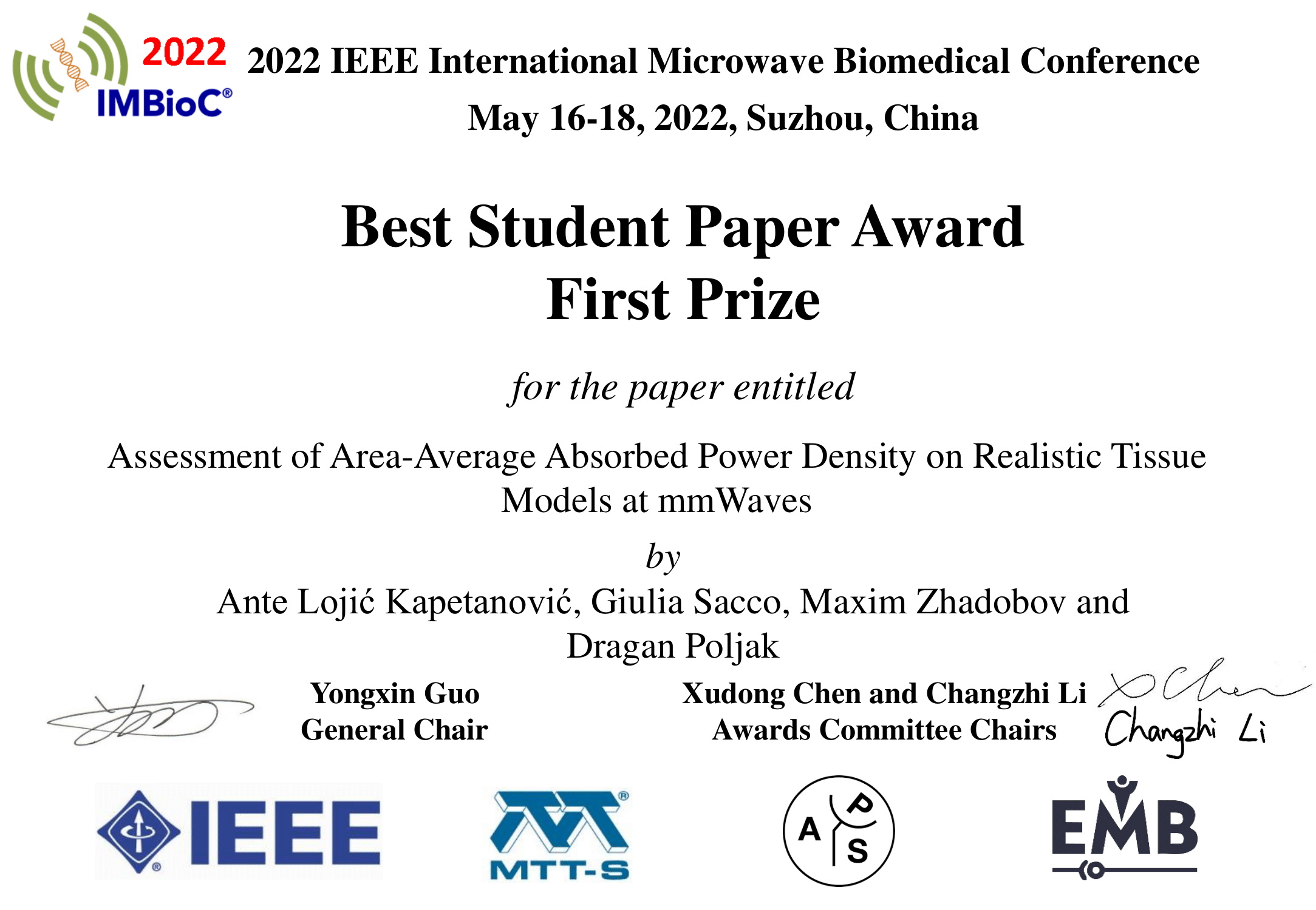
Realistični EM model ljudskog uha (v)
Metoda predstavljena u radu A. Lojić Kapetanović et al. Assessment of area-average absorbed power density on realistic tissue models at mmWaves, IMBioC 2022
U procesu pisanje ekstenzije IMBioC 2022 rada za objavu posebnog izdanja česopisa IEEE Journal of Electromagnetics, RF and Microwaves in Medicine and Biology.

Slide 28
Zaključak
5G tehnologija koristi frekvencije mikro (3 do 30 GHz) i milimetarskih valova (30 do 300 GHz) - nedostatak eksperimentalnih i epidemioloških studija koje ispituju dugoročeni efekt izloženosti milimetarskim valovima¹¹
Znanstvno potkrijepljeni (nepovoljni) efekt interakcije milimetarskih valova i tkiva → zagrijavanje površine
Smjernice i standardi izvode (konzervativne) vrijednosti dozimetrijskih veličina → zagrijavanje ograničeno na maks. 1°C
Točnost računalne dozimetrijske analize – iznimno velika važnost
Trenutni i budući rad u okviru IEEE TC95 SC6 EMF Dosimetry Modeling → WG7 for average schemes and assessment methods of epithelial/absorbed power density
¹¹ K. Karipidis et al. 5G mobile networks and health—a state-of-the-science review of the research into low-level RF fields above 6 GHz, Jorunal of Exposure Science & Environmental Epidemiology 31:585-605, 2021

Slide 29
Hvala na pozornosti.
alojic00@fesb.hr
http://adria.fesb.hr/~alojic00/
Kvalifikacijski doktorski ispit Tehnike prostornog usrednjavanja za određivanje upadne i apsorbirane gustoće snage na površini kože

