Slide 1
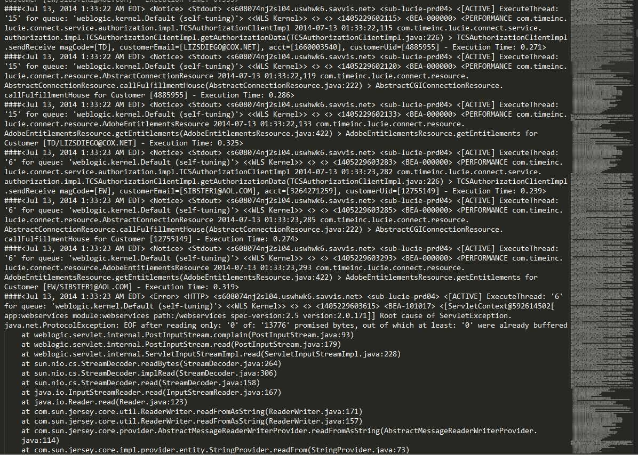
Lumberjack: The Kick-A** Log Parser
Objective: Build a log parsing tool to aggregate and parse LUCIE and SUBS3 server logs
Stakeholders:
LUCIE and SUBS3 team members
Implementation Process:
Agile approach
POC
Set weekly goals
Technologies used
Anshul Kapoor
Notes:
Internal tool
Reduce error detection time
Quicker turnarounds to customer inquires
Iteratively build the software
End-to-end process first
Front-end functionality added latter on

Slide 2
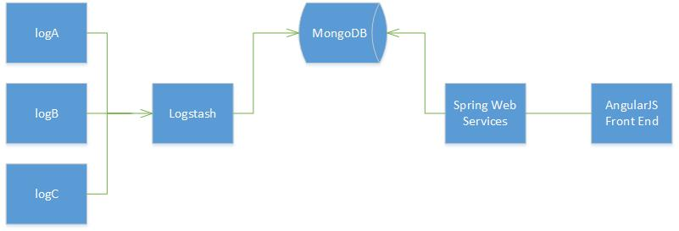
Lumberjack: The Kick-A** Log Parser
Software Design
Challenges
Environment setup
Logstash file parser
Anshul Kapoor
Notes:
Setup linux vm instead

Slide 3
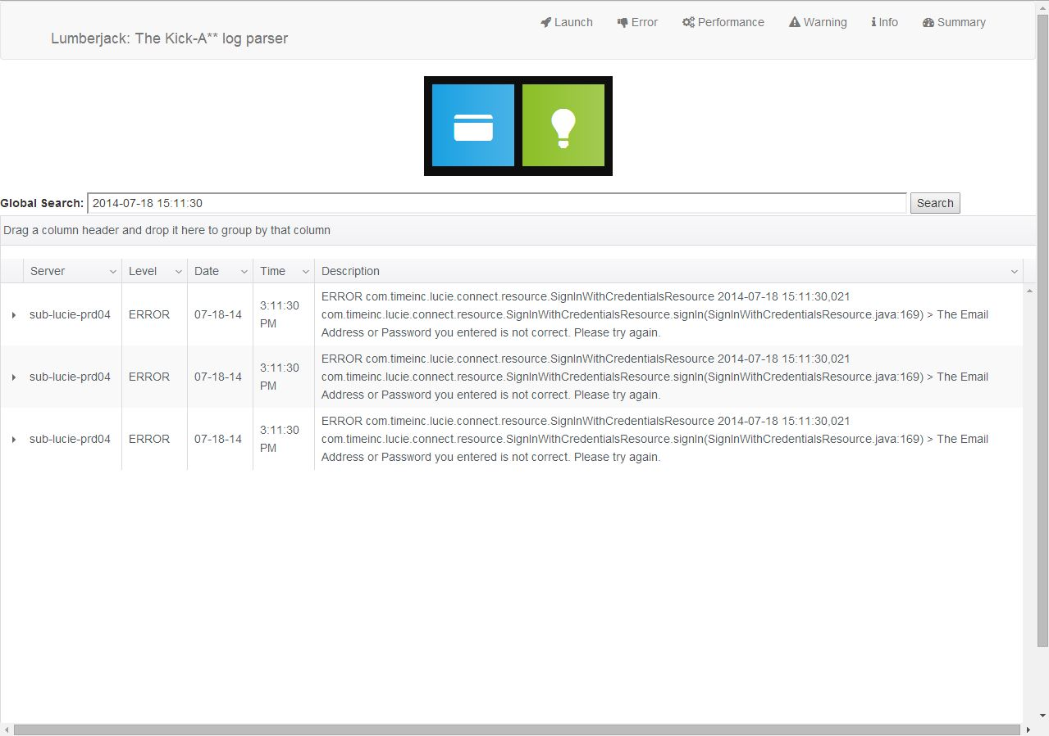
Lumberjack: The Kick-A** Log Parser
Result:

Slide 4
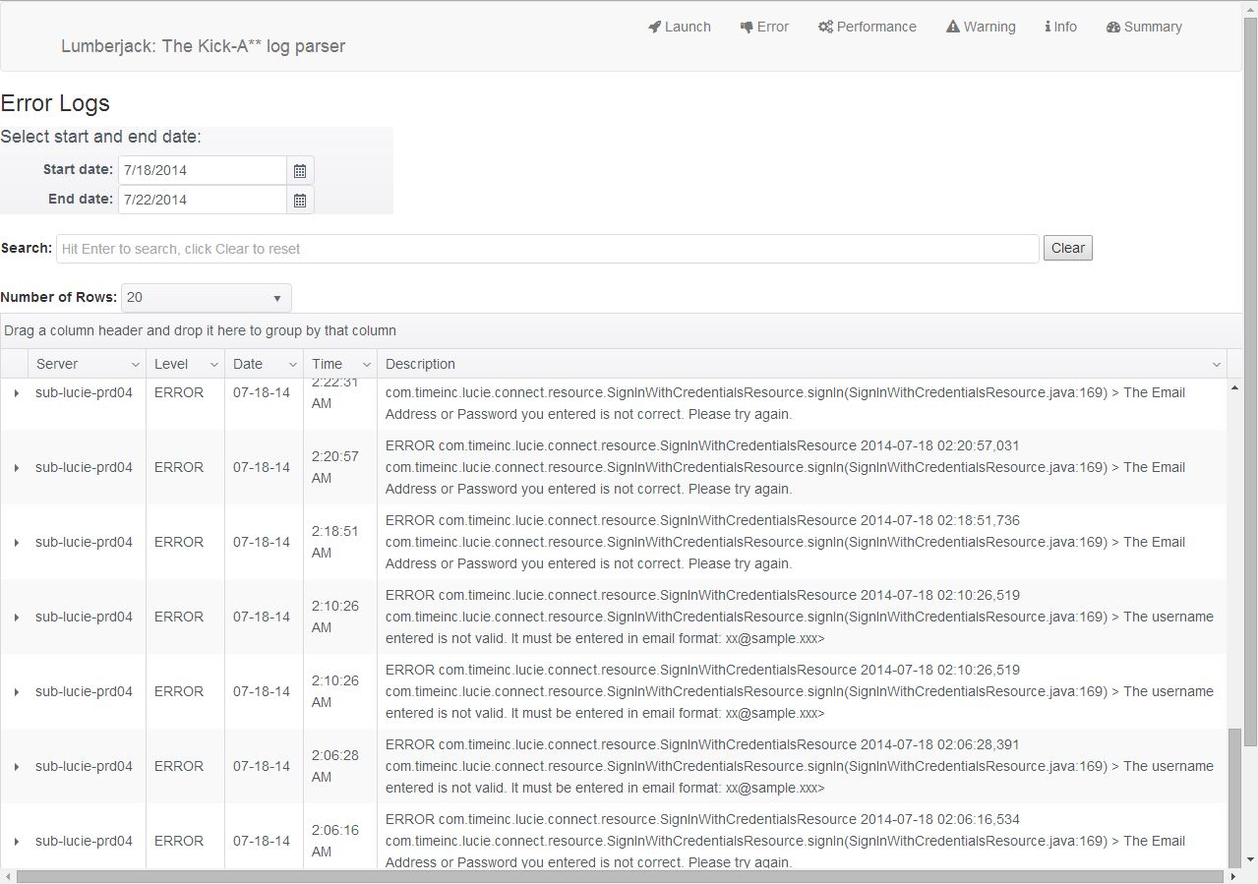
Lumberjack: The Kick-A** Log Parser
Result:

Slide 5
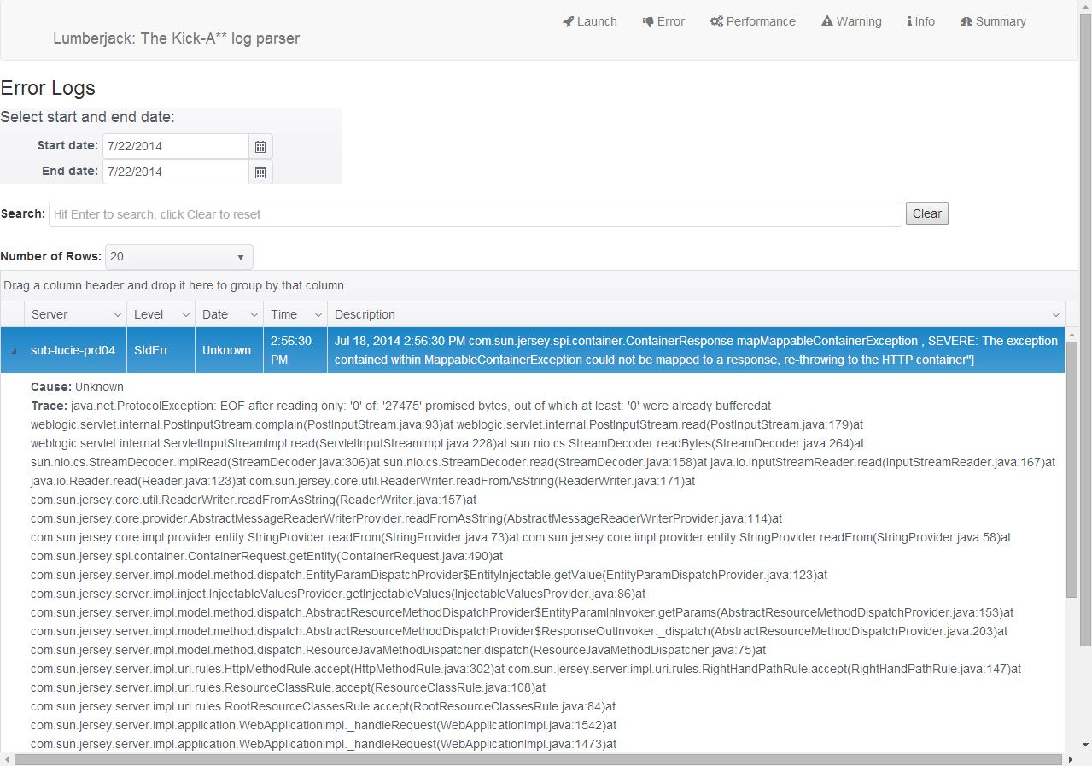
Lumberjack: The Kick-A** Log Parser
Learning Outcomes:
New technologies
Time Inc. work environment
Anshul Kapoor
Notes:
Reduce error detection time
Quicker turnarounds to customer inquires
Find bugs in current logs
Able to detect logs
Learn new technologies, both front and back end

