Slide 1


WORK IT, WRAP IT, FIX IT, FOLD IT
Graham Hutton and Neil Sculthorpe

Slide 2
This Talk
Worker/wrapper is a simple but powerful method for optimizing recursive programs;
Previously, we developed theories for fix and fold, but with different correctness conditions;
We combine and extend the two approaches to give a generalised worker/wrapper theory.

Slide 3
Worker / Wrapper
A technique for changing the type of a recursive program to improve its performance:
wrapper
program
worker

Slide 4
Fixed Points
Our original formalisation was based on the use of explicit fixed points. For example:
ones = 1 : ones
can be rewritten as:
ones = fix f
f xs = 1 : xs
fix f = f (fix f)

Slide 5
The Problem
Suppose we wish to change the type of a recursive
program that is defined using fix.
A
B
Type of the original program, fix f.
Type of the desired worker, fix g.

Slide 6
Assumptions
We assume conversion functions
rep
A
B
abs
such that:
A can be faithfully represented by B.
abs . rep = id_{A}

Slide 7
Let’s Calculate!
fix f
=
fix (id_{A} . f)
=
Rolling rule.
fix (abs . rep . f)
=
abs (fix (rep . f . abs))
=
abs (fix g)

Slide 8
Summary
We have derived the following factorisation:
fix f
=
abs
fix g
Recursive program of type A.
Wrapper of type B → A.
Recursive worker of type B.

Slide 9
Final Step
We simplify the worker
fix g
=
fix (rep . f. abs)
to eliminate the overhead of repeatedly converting
between the two types, by fusing together
and
rep
abs

Slide 10
The Worker / Wrapper Recipe
Express the original program using fix;
Choose the new type for the program;
Define appropriate conversion functions;
Apply the worker/wrapper transformation;
Simplify the resulting definitions.

Slide 11
Generalising
The technique also works for weaker assumptions:
abs . rep = id_{A}
From the ‘fix’ paper.
abs . rep . f = f
fix (abs . rep . f) = fix f

Slide 12
… and for other conditions relating f and g:
g = rep . f . abs
From the ‘fold’ paper.
rep . f = g . rep
abs . g = f . abs
Necessary and sufficient.
fix g = rep (fix f)
fix g = fix (rep . f . abs)

Slide 13
Generalised Recipe
If the worker is already given, we aim to verify that one of the conditions is satisfied;
Otherwise, our aim is to construct the worker, using one of the conditions as a specification;
Similar assumptions and conditions also give a generalised worker/wrapper theory for fold.

Slide 14
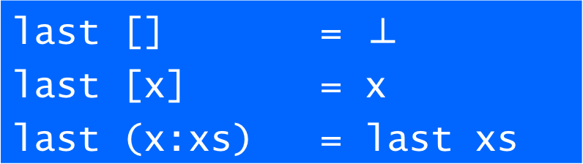
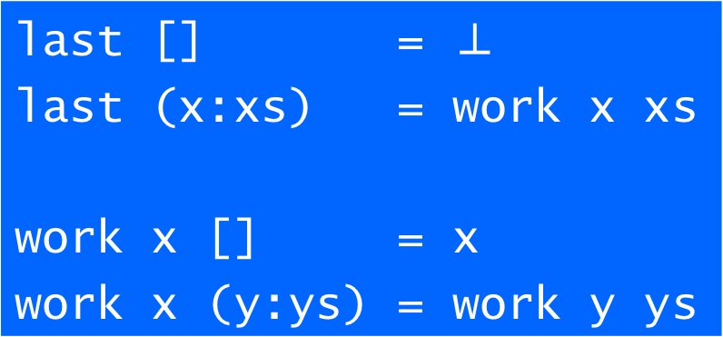
Example

Slide 15
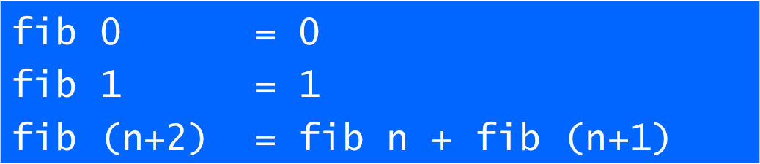
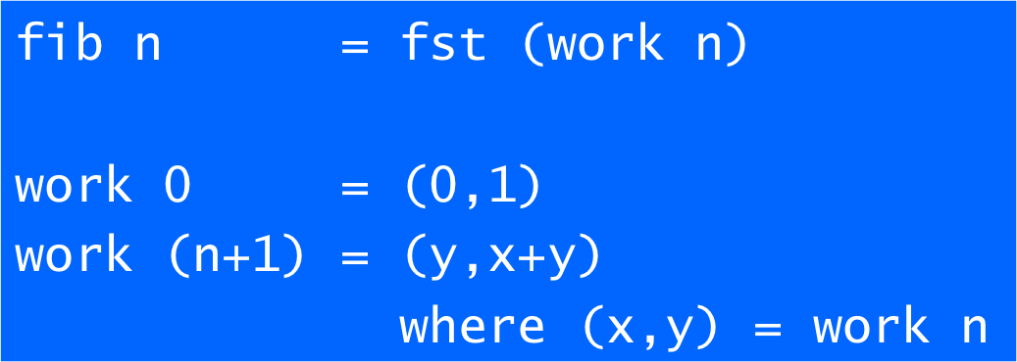
Example

Slide 16
Summary
Generalised technique for changing the type of a program to improve its performance;
Captures a wide variety of program optimization techniques in a single unified framework;
The paper also presents a range of new results concerning strictness side conditions.

Slide 17
Further Work
Other recursion patterns;
Time and space analysis;
Computational effects;
Implementing the technique.

