Slide 1
Chemistry Studio:
An Intelligent Tutoring System
(Natural Language Component)
Ankit Kumar (Y8088)
Abhishek Kar (Y8021)
Mentors:
Dr. Sumit Gulwani (MSR, Redmond)
Dr. Ashish Tiwari (SRI Intl.)
Dr. Amey Karkare (IIT Kanpur)

Slide 2
Introduction
Aim to build an intelligent tutoring system targeted at the domain of Periodic Table (Chemistry)
Targeted at solving problems by emulating thought processes/lines of reasoning employed by students
Much more than a problem solver – aid learning by generating hints and intelligent problems
Notes:
Motivation – Internship at MSR Redmond – Sumit Gulwani – Geometry Construction System
Different from static lookup systems
Why periodic table –
simplicity and structured nature of the domain guided by facts and inference mechanisms.
Compulsory subject for students of grade 9 to 12.
Next slide – System Overview

Slide 3
System Overview
System divided into two components –
Natural Language Component
  Translate natural language input to an intermediate logical representation
  Paraphrasing of hints and problems generated
Problem Solving Component
  Solve problems, generate hints and new problems of graded difficulty
  More info: Problem Solving team
Notes:
Explain paraphrasing.
Next slide - Logic on next slide

Slide 4
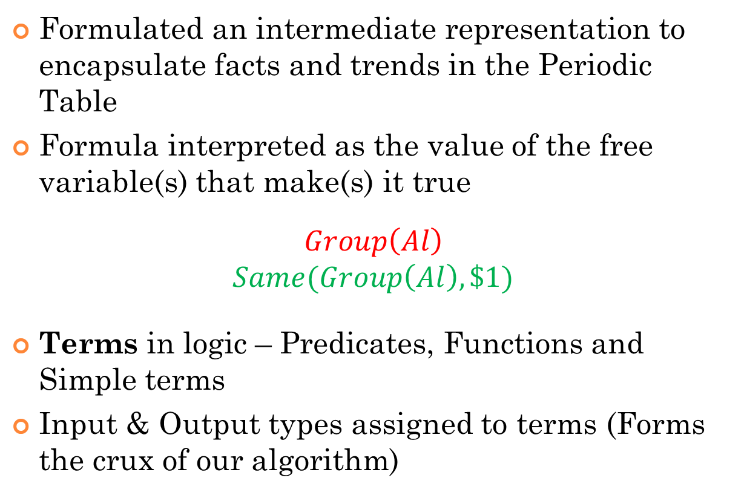
Intermediate Logical Representation
Formulated an intermediate representation to encapsulate facts and trends in the Periodic Table
Formula interpreted as the value of the free variable(s) that make(s) it true
$$Group\left(Al\right)$$
$$Same(Group\left(Al\right),\$1)$$
Terms in logic – Predicates, Functions and Simple terms
Input & Output types assigned to terms (Forms the crux of our algorithm)
Notes:
Domain knowledge
Explain interpretation of formula.
Examples of
Predicates – And, Same, Halogen, Alkali Metal
Functions – Atomic Number, Group, Period
Simple terms – Ca, Li, 5, $1, Stays_same

Slide 5
Natural Language Component
Input Problem
Tokens
Parser Tier 2
Domain information
Parser Tier 1
Terms in logic
Lexer
Option Parsing
Full logical representation
Notes:
Schematic of the entire process with top level desriptions

Slide 6
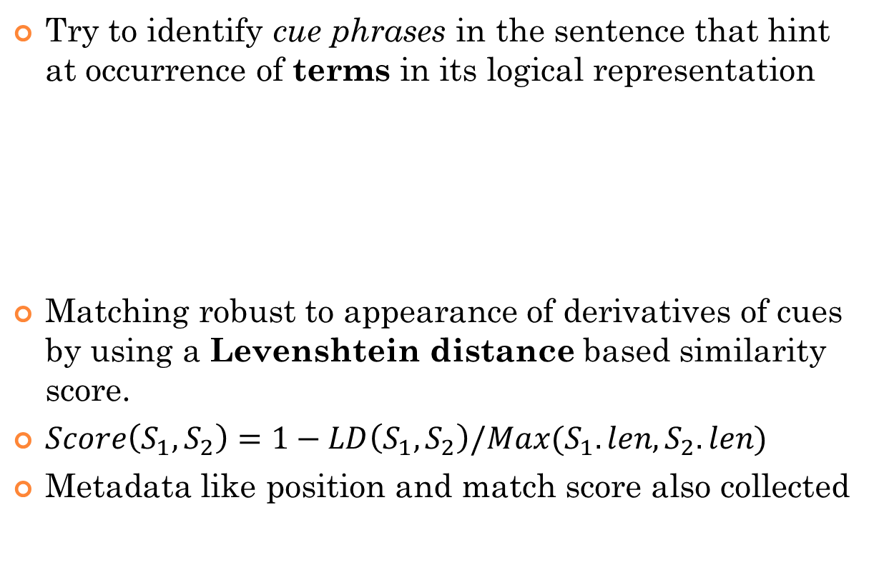
Lexer
Try to identify cue phrases in the sentence that hint at occurrence of terms in its logical representation
Matching robust to appearance of derivatives of cues by using a Levenshtein distance based similarity score.
$Score\left(S_{1},S_{2}\right)=1−LD\left(S_{1},S_{2}\right)/Max(S_{1}.len,S_{2}.len)$
Metadata like position and match score also collected
Cue Phrases | Logic Terms
Ionisation Energy | IE()
Greatest | Max()
Actinide | RareEarthElement()
Notes:
Also collected metadata. Give intuition. Don’t go in detail for the algo. Ask if anybody wants to. Lexer and parser interface
Focus on

Slide 7
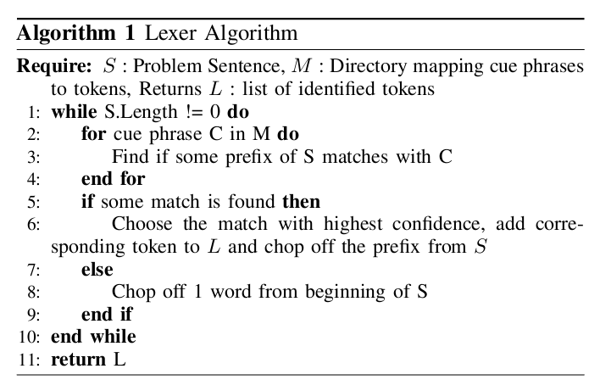
Lexer Algorithm

Slide 8
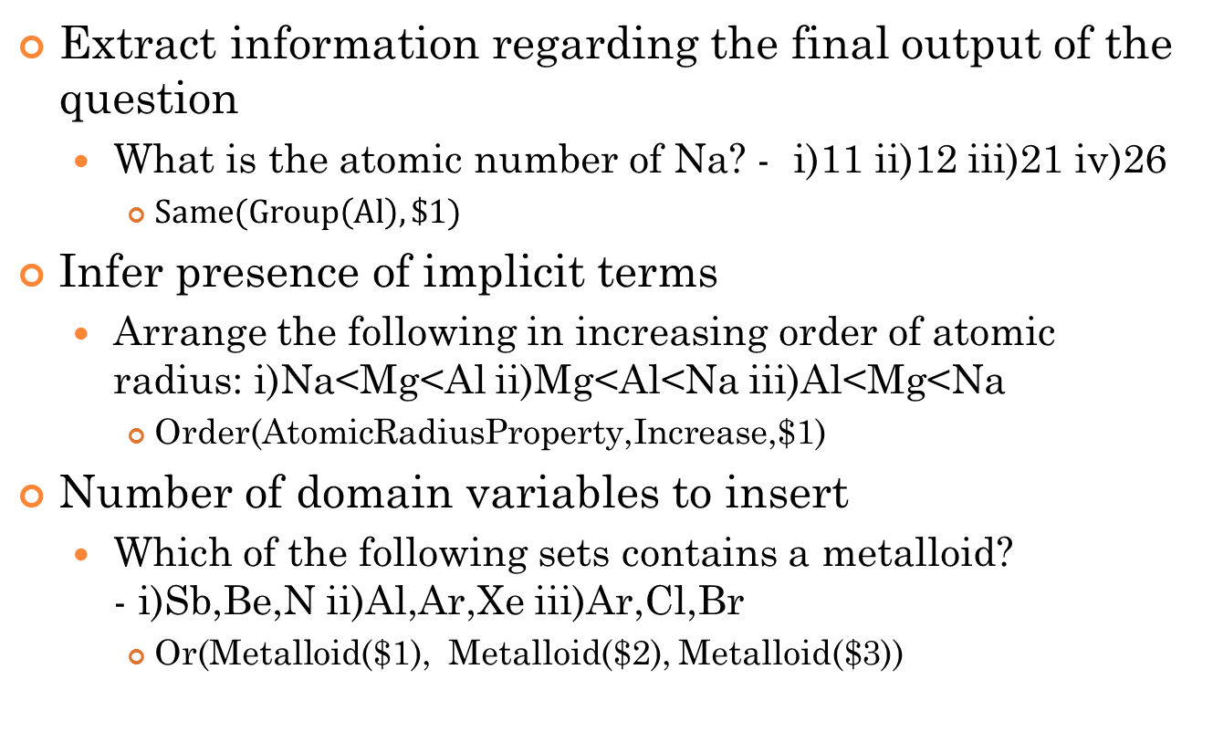
Option Parsing
Extract information regarding the final output of the question
  What is the atomic number of Na? - i)11 ii)12 iii)21 iv)26
    $Same(Group\left(Al\right),\$1)$
Infer presence of implicit terms
  Arrange the following in increasing order of atomic radius: i)Na<Mg<Al ii)Mg<Al<Na iii)Al<Mg<Na
    Order(AtomicRadiusProperty,Increase,$1)
Number of domain variables to insert
  Which of the following sets contains a metalloid?
  - i)Sb,Be,N ii)Al,Ar,Xe iii)Ar,Cl,Br
    Or(Metalloid($1), Metalloid($2), Metalloid($3))
Notes:
Define domain variables

Slide 9
Parser
Intermediate representation viewed as a tree whose preorder traversal generates the representation
Arranges identified terms into a type-consistent representation tree
Two possible approaches
  Bottom-up
  Top-down
    Provides better control
Same
Group
Group
$1
Li
Notes:
Bottom up top down basic explanation

Slide 10
Parser-Contd.
Take terms identified by lexer and create tokens with holes
Two types of tokens:
  Simple token - One ‘non-hole’ node
  Compound token – Multiple ‘non-hole’ nodes
Parser to fill these holes with other subtrees in a type safe manner such that the final tree generated has no holes.
Two tiered organization
Same
Same
Group
Hole
Hole
Hole
Hole

Slide 11
Parser – Tier i
Exploits local structure of input to construct compound tokens from simple tokens
Prevent construction of extraneous formulae
  Which element is in group 3 and period 2?
    And(Same(Group($1) , 3), Same(Period($1), 2))
    And(Same(Period($1) , 3), Same(Group($1), 2))
Associate numbers with numeric predicates based on proximity
Associate equality predicate with a numeric function based on proximity
Identify certain terms which generally occur coupled with other terms
Notes:
Same(Group(),Group())
Same(Group(), num)
Trend(Down, Property, increase)

Slide 12
Parser – Tier ii
As a top down approach, algorithm is a recursive one with a decision made at every execution step
Fill left most hole in every execution step and branch a decision path
Implement a ranking scheme to disambiguate multiple generated trees
4 cases at every execution step
  no holes, but unused tokens left
  no holes, all tokens used
  holes with unused tokens
  holes with all tokens used

Slide 13
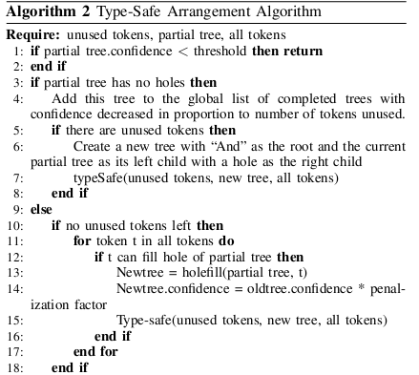
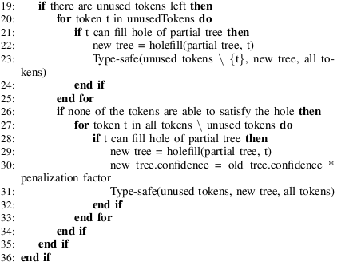
Algorithm

Slide 14
An Example - Lexer
Which element in group 2 has the maximum metallic property?– i)Be ii)Mg iii)Ca iv)Sr
metallic character?
Which element in Group 2 has the maximum metallic character?
Group 2 has the maximum metallic character?
2 has the maximum metallic character?
maximum metallic character?
Group
2
Max
MetallicProperty

Slide 15
Parser – Tier 1
Group
2
Max
MetallicProperty
Same
$1
Max
Hole
Hole
Group
2
MetallicProperty
Hole

Slide 16
Parsing Tier 2
Max
Max
$1
Same
Hole
Hole
Group
2
MetallicProperty
MetallicProperty
Same
Hole
Group
2
$1

Slide 17
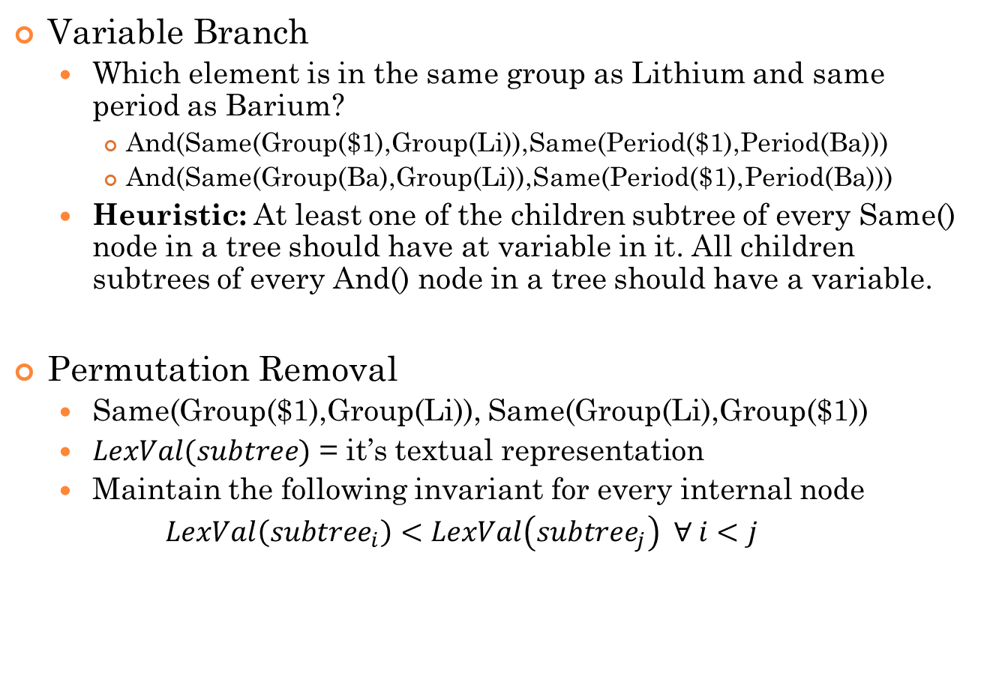
Special Techniques
Variable Branch
  Which element is in the same group as Lithium and same period as Barium?
    And(Same(Group($1),Group(Li)),Same(Period($1),Period(Ba)))
    And(Same(Group(Ba),Group(Li)),Same(Period($1),Period(Ba)))
  Heuristic: At least one of the children subtree of every Same() node in a tree should have at variable in it. All children subtrees of every And() node in a tree should have a variable.
Permutation Removal
  Same(Group($1),Group(Li)), Same(Group(Li),Group($1))
  $LexVal(subtree)$ = it’s textual representation
  Maintain the following invariant for every internal node
  $LexVal\left({subtree}_{i}\right)<LexVal\left({subtree}_{j}\right) ∀ i<j$

Slide 18
DEMO

Slide 19
Questions

Slide 20
Further Work
Challenges for lexer
  At, In
  s, p
Forall queries
Assertion based questions
Paraphrasing

Slide 21
Thank You

