Slide 1
SIMULATION OF AN INVENTORY SYSTEM
We shall now see how simulation can be used to compare alternative ordering policies for an inventory system.
Problem Statement:
A company that sells a single product which is important enough to its customers would like to decide how many items it should have in inventory for each of the next n months (n is a fixed input parameter).
The times between demands are IID exponential random variables with a mean of 0.1 month.

Slide 2
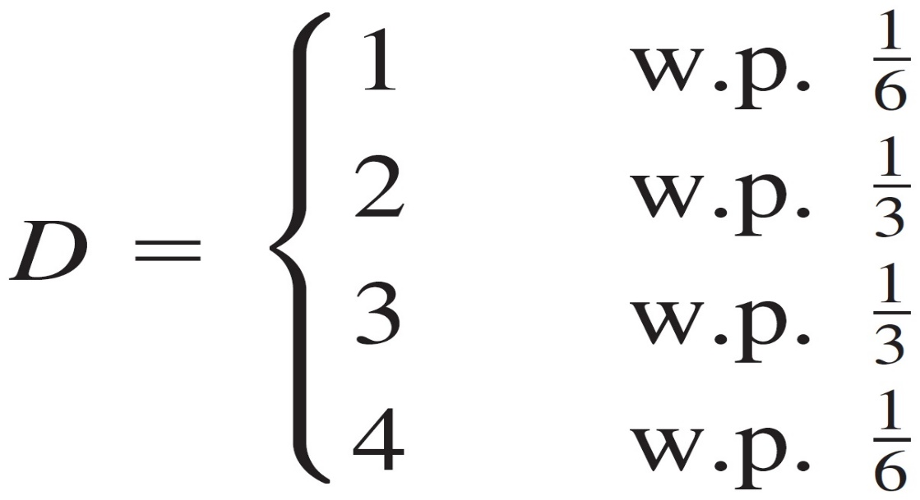
SIMULATION OF AN INVENTORY SYSTEM
Problem Statement:
The sizes of the demands, D, are IID random variables (independent of when the demands occur), with

Slide 3
SIMULATION OF AN INVENTORY SYSTEM
Problem Statement:
At the beginning of each month, the company reviews the inventory level and decides how many items to order from its supplier.
If the company orders Z items, it incurs a cost of K+iZ, where K = $32 is the setup cost and i = $3 is the incremental cost per item ordered (If Z = 0, no cost is incurred).
When an order is placed, the time required for it to arrive (called the delivery lag or lead time) is a random variable that is distributed uniformly between 0.5 and 1 month.

Slide 4
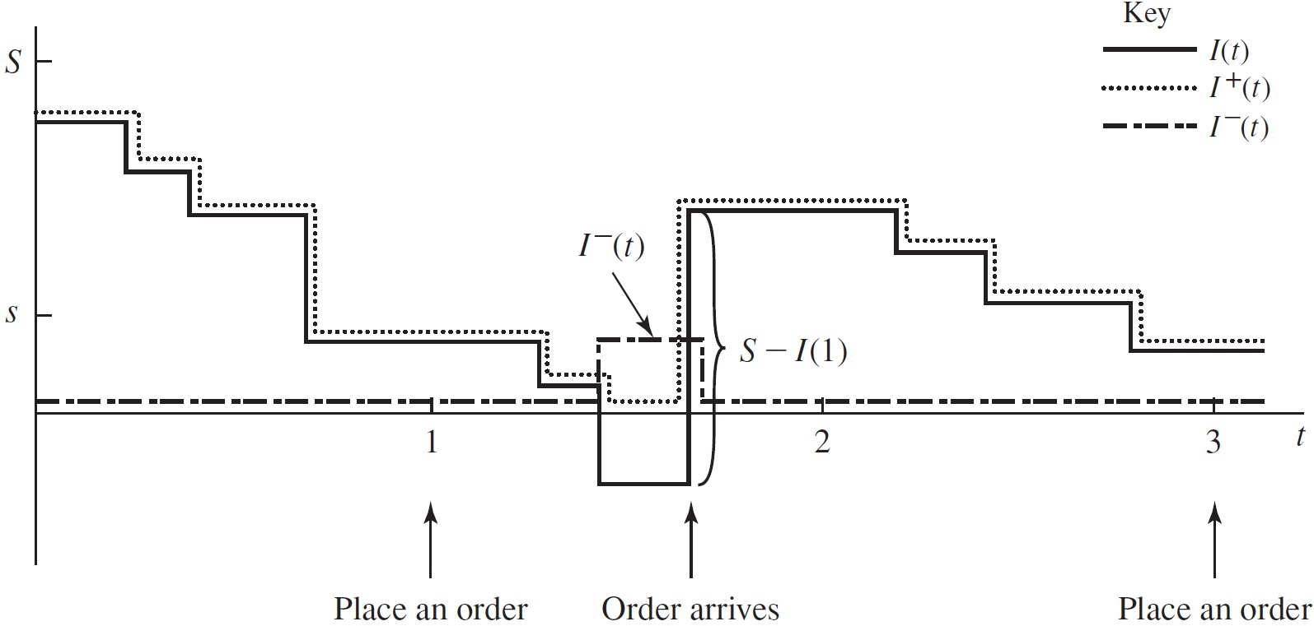
SIMULATION OF AN INVENTORY SYSTEM

Slide 5
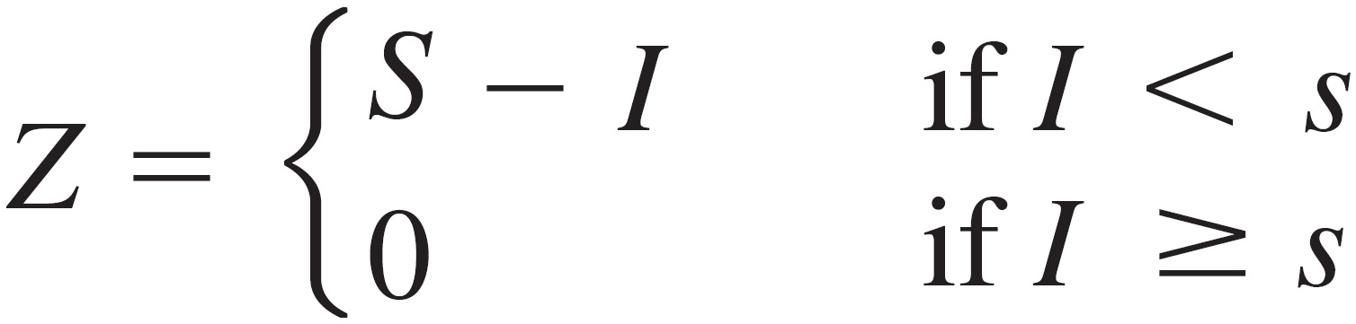
SIMULATION OF AN INVENTORY SYSTEM
The company uses a stationary (s, S) policy to decide how much to order, i.e.,
where I is the inventory level at the beginning of the month

Slide 6
SIMULATION OF AN INVENTORY SYSTEM
When a demand occurs, it is satisfied immediately if the inventory level is at least as large as the demand.
If the demand exceeds the inventory level, the excess of demand over supply is backlogged and satisfied by future deliveries (In this case, the new inventory level is equal to the old inventory level minus the demand size, resulting in a negative inventory level).
When an order arrives, it is first used to eliminate as much of the backlog (if any) as possible; the remainder of the order (if any) is added to the inventory.

Slide 7
SIMULATION OF AN INVENTORY SYSTEM
So far, we have discussed only one type of cost incurred by the inventory system, the ordering cost.
However, most real inventory systems also have two additional types of costs, holding and shortage costs, which we discuss after introducing some additional notation.
Let I(t) be the inventory level at time t [note that I(t) could be positive, negative, or zero]
Let I⁺(t) = max{I(t), 0} be the number of items physically on hand in the inventory at time t [note that I⁺(t) >= 0}]; and let I⁻(t) = max{-I(t), 0} be the backlog at time t [I⁻(t) >= 0 as well].
A possible realization of I(t), I⁺(t), and I⁻(t) is shown in the next figure. The time points at which I(t) decreases are the ones at which demands occur.

Slide 8
SIMULATION OF AN INVENTORY SYSTEM

Slide 9
SIMULATION OF AN INVENTORY SYSTEM
For our model, we shall assume that the company incurs a holding cost of h = $1 per item per month held in (positive) inventory.
The holding cost includes such costs as warehouse rental, insurance, taxes, and maintenance, as well as the opportunity cost of having capital tied up in inventory rather than invested elsewhere.
We have ignored in our formulation the fact that some holding costs are still incurred when I⁺(t) = 0.
However, since our goal is to compare ordering policies, ignoring this factor, which after all is independent of the policy used, will not affect our assessment of which policy is best.

Slide 10
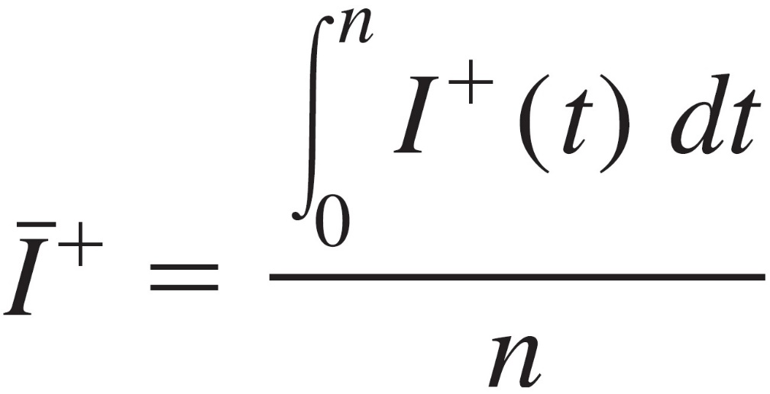
SIMULATION OF AN INVENTORY SYSTEM
Now, since I⁺(t) is the number of items held in inventory at time t, the time-average (per month) number of items held in inventory for the n-month period is:
which is akin to the definition of the time-average number of customers in queue given previously. Thus, the average holding cost per month is hĪ⁺.

Slide 11
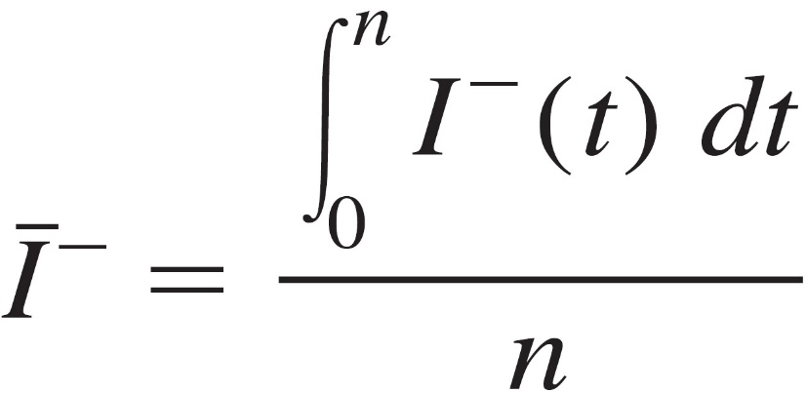
SIMULATION OF AN INVENTORY SYSTEM
Similarly, suppose that the company incurs a backlog cost of π = $5 per item per month in backlog; this accounts for the cost of extra record keeping when a backlog exists, as well as loss of customers’ goodwill. The time-average number of items in backlog is:
so the average backlog cost per month is πĪ⁻.

Slide 12
SIMULATION OF AN INVENTORY SYSTEM
Assume that the initial inventory level is I(0) = 60 and that no order is outstanding.
We simulate the inventory system for n = 120 months and use the average total cost per month (which is the sum of the average ordering cost per month, the average holding cost per month, and the average shortage cost per month) to compare the following nine inventory policies:

Slide 13
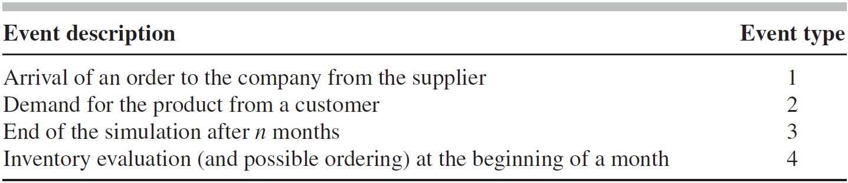
Program Organization and Logic
Our model of the inventory system uses the following types of events:
We have chosen to make the end of the simulation event type 3 rather than type 4, since at time 120 both “end-simulation” and “inventory-evaluation” events will eventually be scheduled and we would like to execute the former event first at this time (Since the simulation is over at time 120, there is no sense in evaluating the inventory and possibly ordering, incurring an ordering cost for an order that will never arrive).

Slide 14
Program Organization and Logic
The execution of event type 3 before event type 4 is guaranteed because the timing routine gives preference to the lowest-numbered event if two or more events are scheduled to occur at the same time.
In general, a simulation model should be designed to process events in an appropriate order when time ties occur.
An event graph appears in the next Figure.

Slide 15
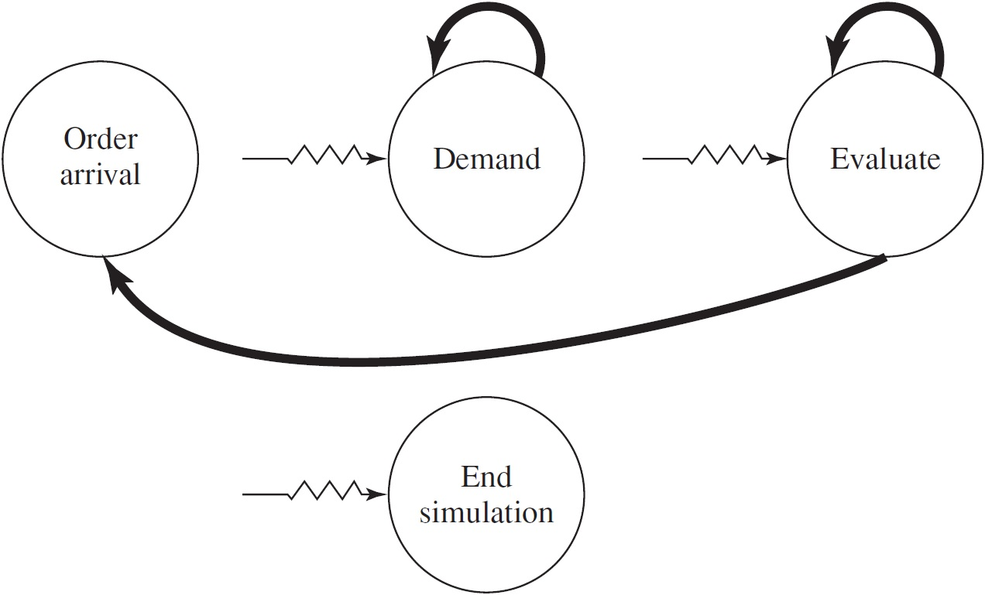
Program Organization and Logic

Slide 16
Program Organization and Logic
There are three types of random variates needed to simulate this system. The interdemand times are distributed exponentially.
The demand-size random variate D must be discrete, as described above, and can be generated as follows.
First divide the unit interval into the contiguous subintervals C1 = [0, 1/6], C2 = [1/6, 1/2], C3 = [1/2, 5/6] and C4 = [5/6, 1], and obtain a U(0, 1) random variate U from the random-number generator.

Slide 17
Program Organization and Logic
If U falls in C1, return D = 1; if U falls in C2, return D = 2; and so on.
Since the width of C1 is 1/6 - 0 = 1/6, and since U is uniformly distributed over [0, 1], the probability that U falls in C1 (and thus that we return D = 1) is 1/6; this agrees with the desired probability that D = 1.
Similarly, we return D = 2 if U falls in C2, having probability equal to the width of C2, 1/2 – 1/6 = 1/3, as desired; and so on for the other intervals.
The subprogram to generate the demand sizes uses this principle and takes as input the cutoff points defining the above subintervals, which are the cumulative probabilities of the distribution of D.

Slide 18
Program Organization and Logic
We now describe the logic for event types 1, 2, and 4, which actually involve state changes.
The order-arrival event is flowcharted in the next figure, and must make the changes necessary when an order (which was previously placed) arrives from the supplier.
The inventory level is increased by the amount of the order, and the order-arrival event must be eliminated from consideration.
A flowchart for the demand event is also given in the next figure, and processes the changes necessary to represent a demand’s occurrence.

Slide 19
Program Organization and Logic
First, the demand size is generated, and the inventory is decremented by this amount.
Finally, the time of the next demand is scheduled into the event list. Note that this is the place where the inventory level might become negative.

Slide 20
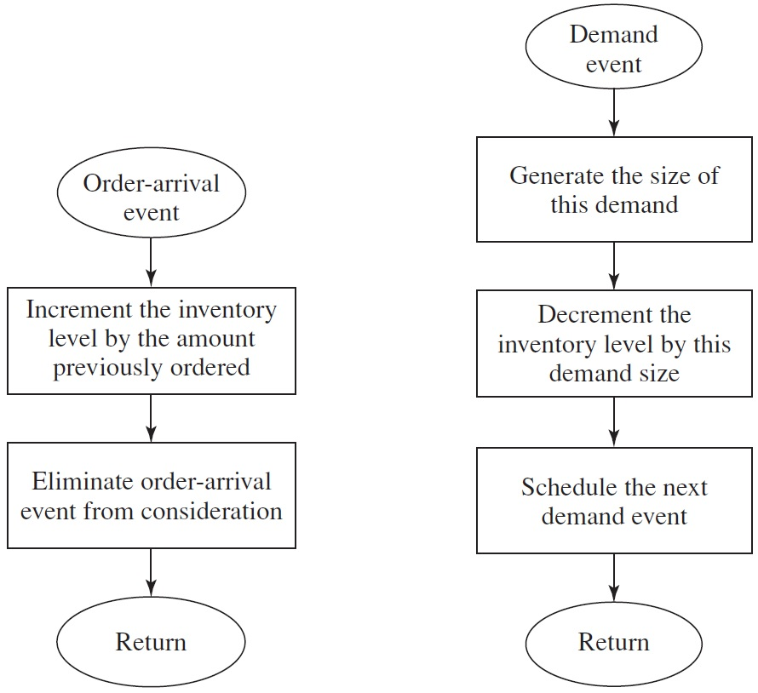
Program Organization and Logic

Slide 21
Program Organization and Logic
The inventory-evaluation event, which takes place at the beginning of each month, is flowcharted in the next figure.
If the inventory level I(t) at the time of the evaluation is at least s, then no order is placed, and nothing is done except to schedule the next evaluation into the event list.
On the other hand, if I(t) < s, we want to place an order for S - I(t) items.
This is done by storing the amount of the order [S - I(t)] until the order arrives, and scheduling its arrival time.
In this case as well, we want to schedule the next inventory-evaluation event.

Slide 22
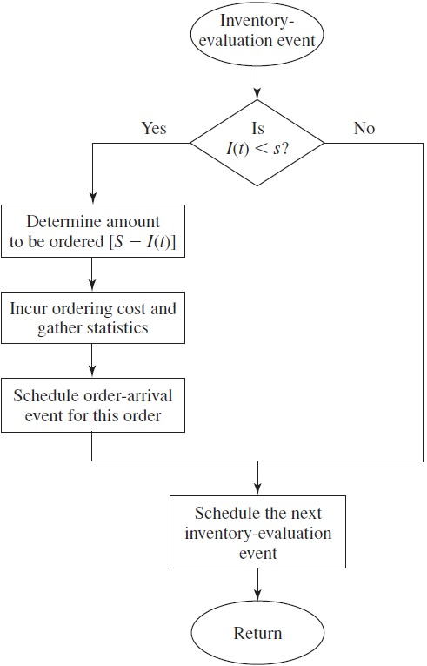

Slide 23
Program Organization and Logic
It is convenient to write a separate nonevent routine to update the continuous-time statistical accumulators which is flowcharted in the next figure.
The principal issue is whether we need to update the area under I⁻(t) or I⁺(t) (or neither).
If the inventory level since the last event has been negative, then we have been in backlog, so the area under I⁻(t) only should be updated. On the other hand, if the inventory level has been positive, we need only update the area under I⁺(t).
If the inventory level has been zero (a possibility), then neither update is needed.
The code for this routine also brings the variable for the time of the last event up to the present time. This routine will be invoked from the main program just after returning from the timing routine, regardless of the event type or whether the inventory level is actually changing at this point.
This provides a simple (if not the most computationally efficient) way of updating integrals for continuous-time statistics.

Slide 24
