Slide 1
DeepSea Exercise
Tf - serving

Slide 2
Task Goal
Replacement of models’ load and interference service.
Use of tf-serving.
Model load from s3 bucket.
Reference python app for tf-serving call.
Fully dockerized.

Slide 3




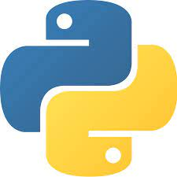
Docker Compose Implementation
minio_storage
Minio as s3 bucket
docker-compose.yml
tf-serving
tf-serving
tf-client
Python application

Slide 4
Solution
3 docker containers created by Docker Compose (minio_storage, tf-serving, tf-client)
One additional container has been used (createbuckets) for initial minio configuration (bucket creation).
Model used -> Half Plus Two toy model by TensorFlow Serving repo.
Model downloaded and copied in the minio_storage container.
Python script (request_prediction.py) is copied in the tf-client container.
Python application runs in tf-client container:
Executed by using the command:
docker exec –it <container_id> python /scripts/request_prediction.py
Keyboard input asked by user (comma separated floats or integers).
requests python library is used.
Prediction is returned in json format.
Response handling by the script.
exit stops the application.

