Slide 1
Texas HMDA LOAN
Loan Approval :
Random forest vs decision tree models vs Logistic Regression models

Slide 2
About the dataset
The Home Mortgage Disclosure Act (HMDA) requires many financial institutions to maintain, report, and publicly disclose loan information about mortgages. HMDA was originally enacted by Congress in 1975.
These public data are important because:
1. They help show whether lenders are serving the housing needs of their communities
2. They give public officials information that helps them make decisions and policies.
3. They shed light on lending patterns that could be discriminatory.
https://cfpb.github.io/api/hmda/fields.html

Slide 3
About the dataset…
Data from https://www.consumerfinance.gov/data-research/hmda/explore
Used Texas 2017 dataset.
What kind of information you can find in the public HMDA data:
1. Information about the loan itself
- whether the application was approved or denied,
- loan amount,
- The type of loan, (whether it is a “VA” or “FHA” loan).
- If the loan is for buying a home, refinancing an existing mortgage, or
for home improvements.

Slide 4
About the dataset…
2. Demographic information on applicants’ race, ethnicity, and sex which helps prevent discriminatory lending.
3. Data about the lender like the name of the lender and which agency regulates them.
4. Information about the property itself like the type of property and whether the owner intends to live there.

Slide 5
About the dataset…
It’s important to note that the data do not include direct identifying information, like names or Social Security numbers.
Instead of disclosing the address, lenders disclose the census tract, which is the part of a community where the property is located. Census tracts vary in size, but on average about 4,000 people live in a census tract. This provides enough information about the location to be useful, but still provides protections for individual privacy.

Slide 6
Task at hand
Ran a random forest classifier model to predict if loans were approved or not.
Data set has 1,048,575 rows and 47 columns. I ended up dropping a lot of the categorical variables and only left a few that describe the loan applicant’s ethnicity and gender.
This will help me in calculating some summaries about the loan approval rate.

Slide 7

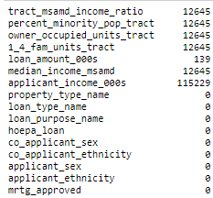
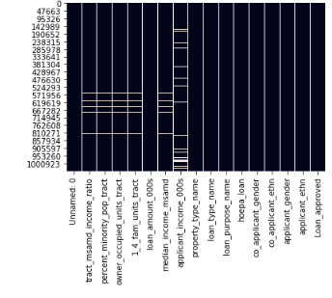
Missing values

Slide 8
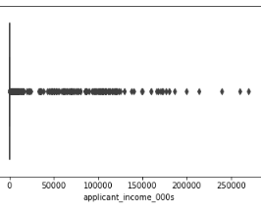
Data exploration
On the right is a box plot of the ‘applicant_income’ column.
This column has the highest percentage of missing data and must be imputed.
There are a lot of outliers in this column and therefore, imputing the mean would introduce bias. Therefore, I will impute the median instead.

Slide 9
Prepare the dataset.
After imputation, on to one-hot-encoding.
Trained the model and made predictions.
My model only has an RF-score of 0.596

Slide 10
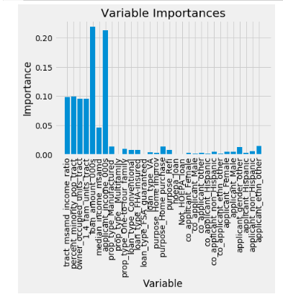
Variable importance
Loan amount and applicant income are the most important variables in our dataset.

Slide 11
Model / algorithm | accuracy score
Random Forest | 0.5942115783691406
Random Forest 5-fold cross validation | 0.6673579801589049
Random forest 10-fold cross validation n =40 | 0.6676033970673318
Random forest 10-fold cross validation n =100 | 0.6678640676267712
Logistic regression | 0.639819643451491
Decision Tree classifier | 0.6163744824771206
n

Slide 12
What went wrong …..
My model performance was less than fulfilling and these are the possible reasons.
1. According to the variable importance calculation, ‘applicant income 000s’ is 1 of the top 2 important variables in our model. It was missing about 11% of its data points. I imputed using the median instead of the mean to reduce bias due to the many outliers present in that column. Perhaps even that was not sufficient for imputation and maybe a more sophisticated method of imputation was necessary.
Poor data collection techniques- so many levels for each categorical variable. E.g. Target variable (loan_approved) had 6 possible options/ levels which I compressed into just 2 i.e. approved (1)or not approved (0).

Slide 13
What went wrong…..
This data set was collected for purposes of city planning for housing needs in the community and to check for discrimination. Therefore the variables in the dataset are geared towards that.
01
However, I was using it to predict whose loan will be approved and which will not. Perhaps, there are more important variable that go into predicting loan approvals for the banks and other financial institutions.
02
Using the dataset for the wrong purpose- need credit history, other loans extended to applicant, education levels which could help approximate the income.
03

Slide 14
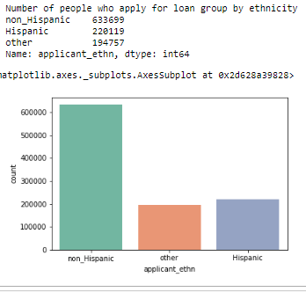
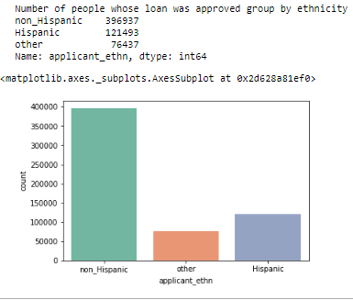
What can I learn from this dataset?
We can evaluate the distribution of loan applications vs approval within the different demographic groups.
1. Most of the loan applications came from non-Hispanic applicants. Also, most of the approved loans are for non-Hispanic applicants.

Slide 15
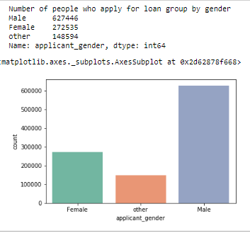
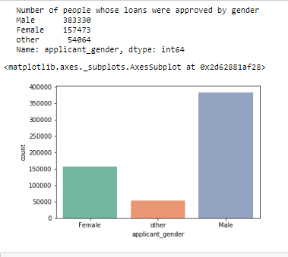
Loan grouped by gender
1. Most of the loan applicants were males.
2. Most of the approved loans are for male applicants

Slide 16
References:
1. https://www.kaggle.com/cgump3rt/investigate-missing-values 2. https://www.kaggle.com/chaseos/understanding-id-and-timestamp3. 3. https://github.com/ResidentMario/missingno 4. https://towardsdatascience.com/ways-to-detect-and-remove-the-outliers-404d16608dba 5. https://towardsdatascience.com/how-to-handle-missing-data-8646b18db0d4 6. https://www.kaggle.com/gpreda/credit-card-fraud-detection-with-rf-auc-0-93 7. http://dataaspirant.com/2017/06/26/random-forest-classifier-python-scikit-learn/ 8.https://chrisalbon.com/machine_learning/trees_and_forests/feature_selection_using_random_forest/ 9. https://towardsdatascience.com/random-forest-in-python-24d0893d51c0

