Slide 1
UTH CAS LAB SUMMER INTERNSHIP ROUNDUP
Karasmanoglou apostolos, mentor: Stavros simoglou

Slide 2
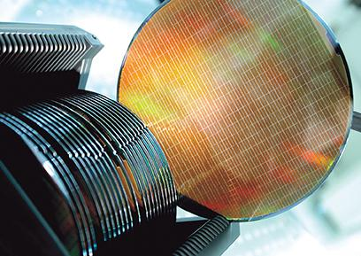
Introduction
Freshly-made transistor quantities (width, channel length, conductance, etc) may vary largely across a single silicon wafer
Largely non-deterministic factors
Evaluation of these parameters yields statistical results we can use to extrapolate information
Focus on timing analysis properties
Here we will use simulation to generate a dataset => Monte Carlo Method!

Slide 3
Requirements
Monte Carlo generated dataset
Abstraction: raw input data representing component timing delays
An assumption about the “shape” of the distribution is made
E.g assumed normal, lognormal, etc…
Research of the statistical properties of distributions
Implement efficient methods for fitting PDF’s on Monte Carlo generated datasets
Implement methods for circuit timing analysis

Slide 4
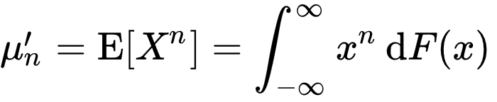
Part 1: Researching moments/cumulants
Moments are statistical quantities that carry vital information about distributions
First 4 moments are Mean, Variance, Skewness and Kurtosis
Each measure a different analytical property of a distribution
For our purposes we can define any distribution using the first 3 central moments

Slide 5
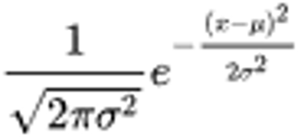
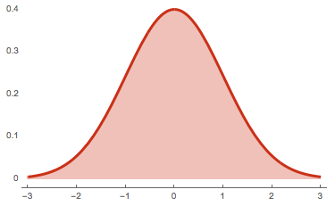

Normal distribution
Mean = Mode = Median = μ
Variance = $σ^{2}$
Skewness = 0
Kurtosis = 3
Standard case for a symmetrical distribution. Very important due to its role in the central limit theorem it is a highly idealized case…Real world distributions.May approach normal distributions but they often contain considerable skewness and kurtosis

Slide 6
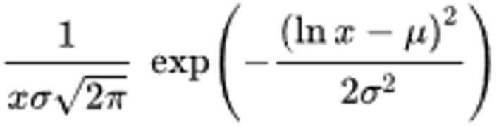
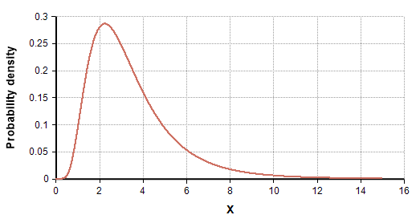

Log-normal distribution
Mean = $exp⁡(μ+\frac{σ^{2}}{2})$
Median = $\exp\left(μ\right)$
Mode = $\exp\left(μ −σ^{2}\right)$
Variance =
Skewness = ${(e}^{σ^{2}}$+ 2)$\sqrt{e^{σ^{2}} −1}$
Kurtosis = $\exp\left(4σ^{2}\right)+ 2exp\left(3σ^{2}\right)+\exp\left(2σ^{2}\right) −6$
Small changes in percentage by various factors in natural phenomena become additive on a log scale which induces the distribution of their log to be by approximation normal. This is why the log-normal pops up in several natural models.

Slide 7
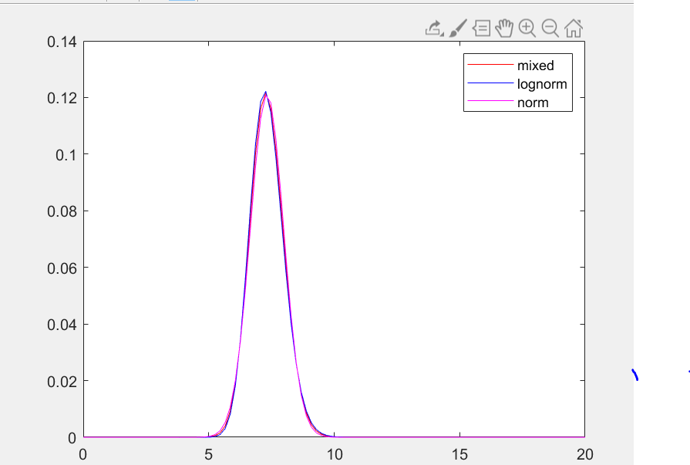

For our purposes we focus on normal and lognormal distributions
Use normal distributions for low skewness data
Use lognormal distributions for high skewness data
Mix normal and lognormal! => We define a third kind of distribution by using a weighted mean of the two distributions
$f\left(x\right)=$ ${αf}_{LN}\left(x;μ_{LN},σ_{LN}\right)+(1 −α)f_{N}(x;μ_{N},σ_{N})$
Parameter α estimated based on data specifics

Slide 8







Cumulants : an alternative to moments
Similar definition as moments
Very important property of moments(μ) / cumulants(κ)
Suppose X,Y are two independent random variables. The n-th cumulant of X + Y is : $κ_{X+Y }^{(n)}=κ_{Χ }^{(n)}+κ_{Y }^{(n)}$
This follows for the first 3 moments of the distribution
Since we can define most distributions using the first 3 moments, this becomes very important in manipulating distributions
$μ_{1}′$ = $κ_{1}$
$κ_{1}$ = $μ_{1}′$
$μ_{2}$ = $κ_{2}$
$κ_{2}$ = $μ_{2}$
$μ_{3}$ = $κ_{3}$
$κ_{3}$ = $μ_{3}$

Slide 9
Part 2: The moment match method
Efficient method for fitting distributions on datasets
Any dataset is described by a set of moments that can be directly derived from the samples
Since all our distributions are defined by their first 3 moments
A) Assume the type of the distribution (Norm, Lognorm)
B) compute the moments of the data
C) Fit distribution on data

Slide 10

Fitting normal/lognormal distributions on data requires only the mean and variance of the dataset to derive a distribution
Fitting a mixed distribution requires extraction of the third central moment of the dataset to set “a” parameter
Specifically, if μ, σ and $μ_{3}$ the mean, variance and 3rd central moment of the dataset, a is estimated to be
a = $\frac{μ_{3}}{{\left(e^{{σ_{LN}}^{2}}−1\right)}^{2}{[e^{{{2μ_{LN}+σ}_{LN}}^{2}}]}^{\frac{3}{2}}(e^{{σ_{LN}}^{2}}+2)}$

Slide 11




Application in SSTA: The addition problem
$$T_{1}$$
$$T_{2}$$
$$T_{n}$$
…
$$T_{path}$$
$$T_{path}=T_{1}+T_{2}+ …+T_{n}$$
Computing the total path delay as a random variable requires computation of the distribution of a long sum of random variables

Slide 12

As stated before:
Supposing X,Y are two independent random variables, for n = 1,2,3 the n-th central moment of of X + Y is : $μ_{X+Y }^{(n)}=μ_{Χ }^{(n)}+μ_{Y }^{(n)}$
How do you compute the distribution of random variable Z = X + Y
Solution 1: Use convolution according to probability theory theorem for sums of independent random variables. => Costly
Solution 2: Assume distribution type (mixed/lognorm/norm) and use moment matching based on the newly computed moments
Similarly we can define methods for computing differences between random variables

Slide 13



Application in SSTA: The max problem
Computing the maximum delay between two paths “joining” at a two input buffer is essential for computing the total delay as a random variable
$$T_{1}$$
$$T_{3}$$
$$T_{2}$$
$$T_{tot}=T_{3}+max⁡\{T_{1},T_{2}\}$$

Slide 14
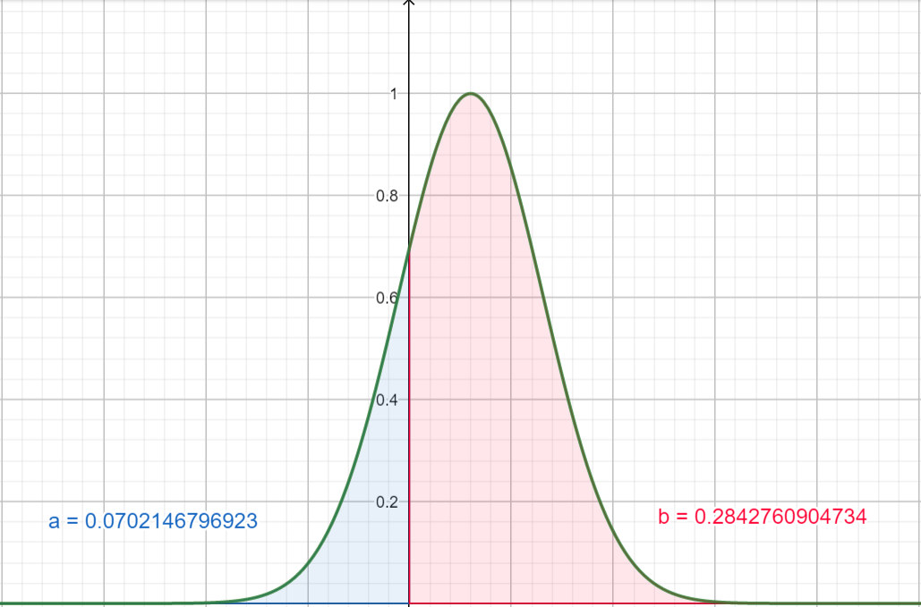

Solution 1: Worst case analysis
max{X,Y} should select the random variable that is more likely to exhibit larger values
Not a bad estimate when X,Y distributions are far apart from each other
Calculate the difference Z = X – Y variable and compute the likelihoods $P\left(Z<0\right), P(Z>0)$ to tell whether X > Y is more likely than X < Y or otherwise…
Computation involves integration (a bit complex)

Slide 15
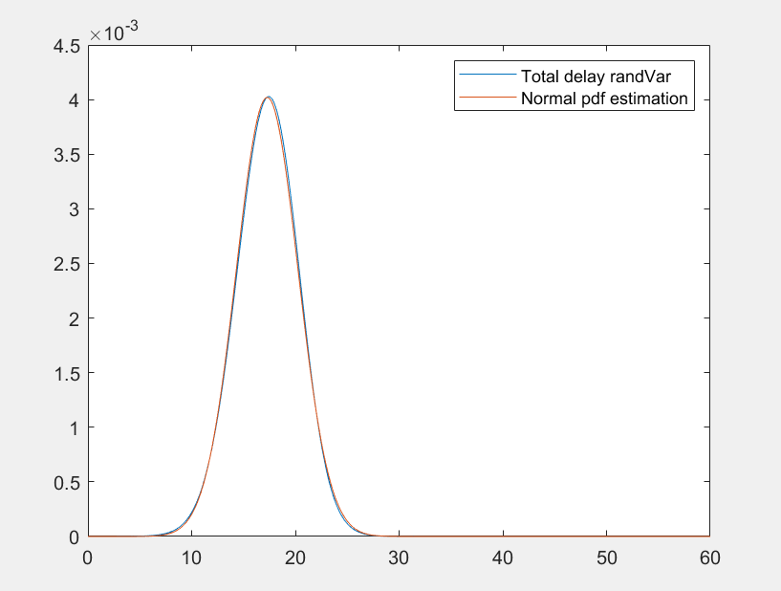

Solution 2: Moment Match again !
First, we use the analytical formula for the p.d.f of Z = max{X,Y}
$f_{z}\left(z\right)=$ ${ f}_{x}\left(z\right){ F}_{y}\left(z\right)+$ ${ f}_{y}\left(z\right){ F}_{x}\left(z\right)$
No specific type of distribution
Secondly, we compute the moments of the estimated distribution
Assuming the shape of our distribution mixed/logn/norm we can use moment matching to obtain an approximation of the initial p.d.f
That way we can enforce a specific type of distribution !
Different assumptions of distributions shape yield different results
Differentiate mixmax/lognmax/normmax methods

Slide 16
Thoughts on the moment matching method
As we can see, moment matching is an extremely versatile method
If our assumptions are valid, having a set of moments we can instantly obtain any distribution in closed form
Other applications of moment matching used in this project were pdf decimation and in the transformation of random variables from one type to the other
Generalized method implemented on mmfit matlab script

Slide 17
Part 3: Implementing an API
An abstract environment for working with random variables, optimized for SSTA analysis
Object-Oriented Design : Divide different types of random variables into classes inheriting randVar superclass
Use of the varBox object to automate data analysis : Different instances of the varBox class result in different types of analysis on the data

Slide 18
Random variable Class architecture
randVar Class
lognVar Class
normVar Class
mixVar Class

Slide 19
randVar superclass contains all basic methods for random variable analysis. normVar, lognVar and mixVar are subclasses
normVar,lognVar and mixVar classes are more optimal in terms of performance and accuracy
Different variable types model different data cases
normVar class fits best in low skewness datasets approximating a normal distribution
lognVar class fits best in high skewness datasets approximating a lognormal distribution
mixVar class makes the best of every other case inbetween

Slide 20
Transformation between random variables
randVar
X
X_logn = lognVar(X)
X_norm = normVar(X)
X_mix = mixVar(X)
X_logn = lognVar(X_mix)
X_norm = normVar(X_mix)
mixVar
X_mix
lognVar
X_logn
normVar
X_norm

Slide 21
varBox class
Directly obtain analysis from a dataset
Different sets of properties yield a different analysis
Experiment “control panel”
Allows us to organize and evaluate data analysis
Most important parameters :
lognorm/norm tolerance (?)
Plot accuracy
Analysis type (worst/ max)
varBox
(norm_tol, logn_tol, acc, analysis_type, …)
Data
Result

Slide 22
Afterthoughts
Lots of room for improvement:
Testing + optimizing matlab tools
Considering correlated random variables
Creating abstraction for encoding buffer circuits and automating analysis
Generating and testing examples under different experimental assumptions

